Slide 1
LeNet-1 Convolutional Neural Network acceleration in CUDA
Computer Engineering master degree, Politecnico di Torino, GPU programming course.

Slide 2
Project objectives
Write CPU version and obtain serial benchmarks
Implement a first Naïve version on GPU
Apply optimisations and compare results
Analyze a computationally intensive algorithm

Slide 3
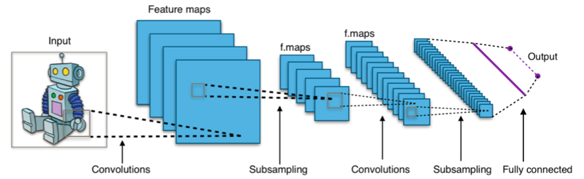
CNNs in a nutshell
CNNs are a class of Deep Learning algorithms widely used for image classification.
A CNN is a list of layers that transform the input data into an output prediction (classification)
Layers can be of 3 types: Convolutional layer, Non-linear layer and Pooling layer. These are the building-blocks of any CNN

Slide 4
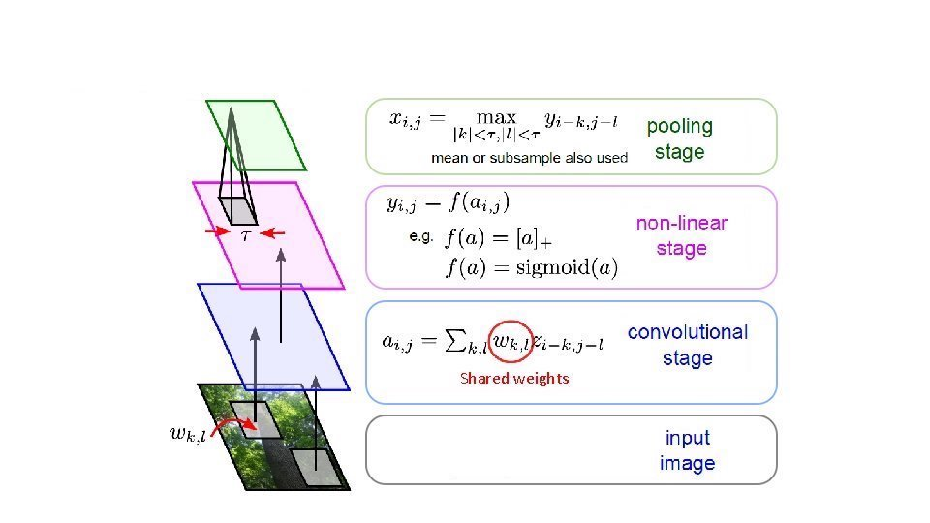
Building-block of a CNN

Slide 5
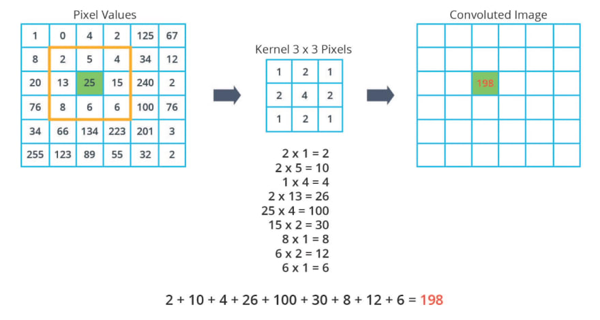
Convolutional Stage

Slide 6
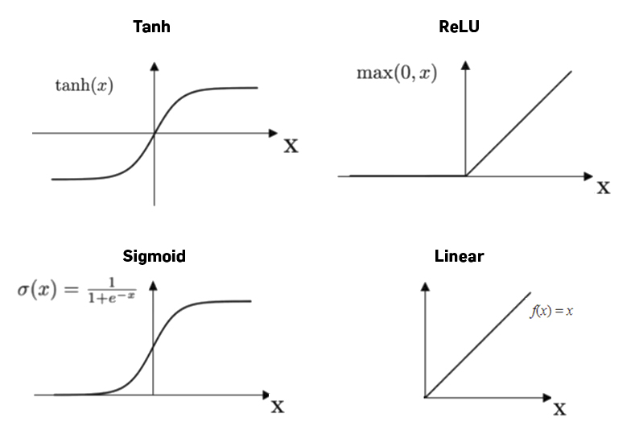
Activation functions in the Non-linear layer

Slide 7
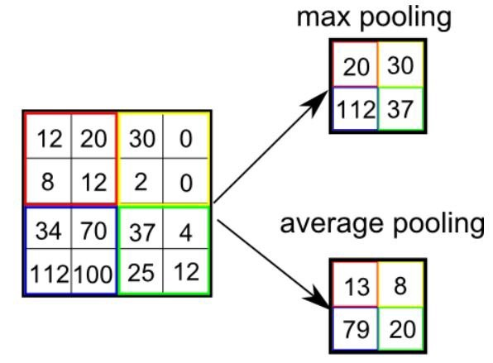
Pooling or Subsampling layer

Slide 8
Repeating the mathematical steps presented in the building block for each neuron (pixel) in each feature maps in the network is a computationally intensive task.
On the CPU the neurons are processed in series
On the GPU all neurons in a given layer can be processed in parallel by independent threads!

Slide 9
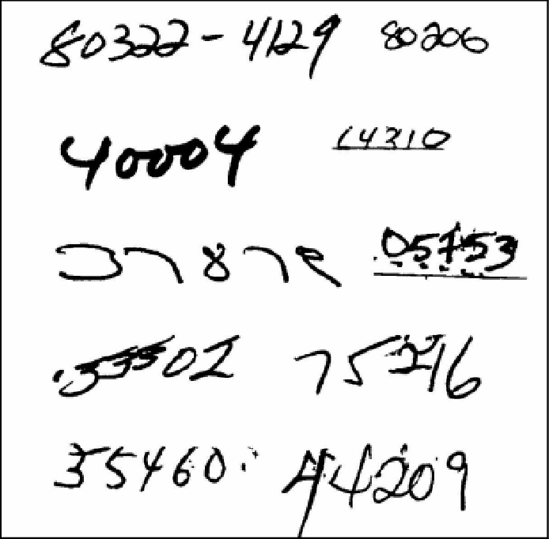
The LeNet-1 CNN, a pioneering work in Deep Learning
LeNet-1 is one of the earliest Convolutional Neural Network, proposed in 1998 by Yann LeCun.
Attempt to classify and recognise ZIP code images

Slide 10
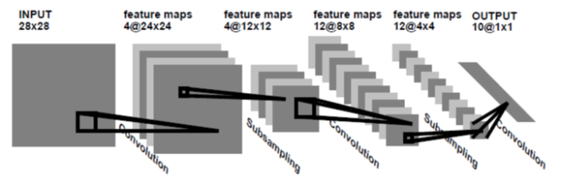
LeNet-1 CNN

Slide 11
CPU serial version benchmarks
Random images and random weights have been used for the benchmarks
The CPU computes each neuron value in series, so 1 single thread doing all the job.
Sampled execution profile shows an average around 700 us for each forward propagation

Slide 12
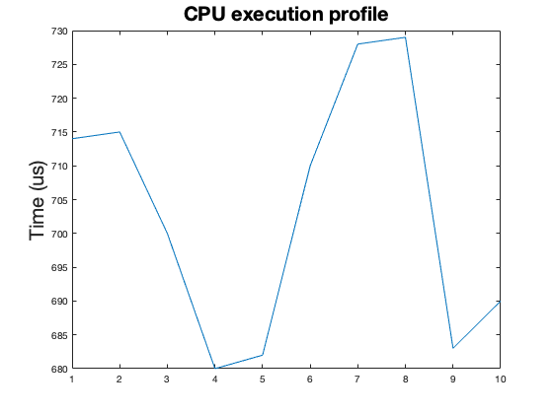
CPU performances sampled from 10 runs of the algorithm on different images and weights

Slide 13
GPU versions
Filters and features in Global Memory
Constant filters moved in Constant Memory
All features in Shared Memory, all filters in Constant Memory
Running multiple networks with blocks concurrency

Slide 14
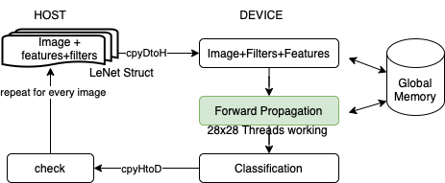
1)
All features and filters are moved and filled in global memory
1 block with 28x28 threads running the CNN
Heavy usage of global memory is the bottleneck!

Slide 15
1)
Load and store efficiency is low because of strided access from convolutions and poolings
Load efficiency: 49.17%
Store efficiency: 76.15%
Load transactions: 124610
Store transactions: 632
API overhead between host and device

Slide 16
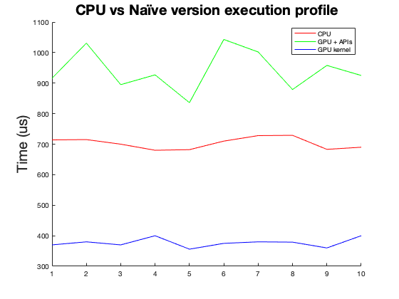
1)
The GPU executes faster but the data exchange between host and device leads to bad performances

Slide 17
2)
After a CNN is trained, all filters are constant!
Device’s contant memory is big enough to contain all filters.
Overall better usage of memory and less global load requests.
Load transactions: 12000+ → 64610
Load efficiency: 49% → 60%

Slide 18
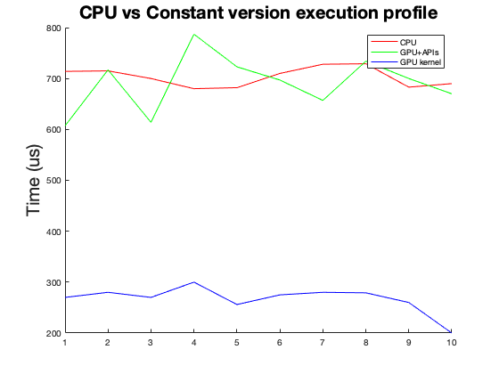
2)
GPU performances getting better

Slide 19
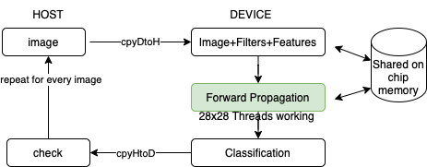
3)
All features can be allocated and computed in Shared Memory
The kernel just needs the image
Global memory usage is negligible because the image and the classification are the only one moved off-chip

Slide 20
3)
All 28x28 threads can load the image in a coalesced way!
Load efficiency: 60% → 100%
Load transactions: 64000+ → 394
Store transactions: 632 → 2
API overhead between host and device higly reduced

Slide 21
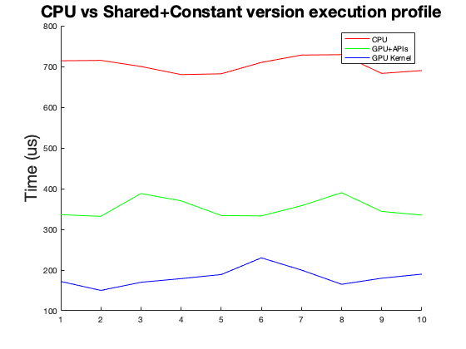
3)
GPU can now run the forward propagation almost 2x faster than the CPU

Slide 22
Blocks concurrency
Previous implementations make use of a single block
It is possible to run the algorithm on different images in parallel on the gpu because each block can work on his own allocated shared memory!
So now is possoble to run N instances of the CNN on N different images with N concurrent blocks!

Slide 23
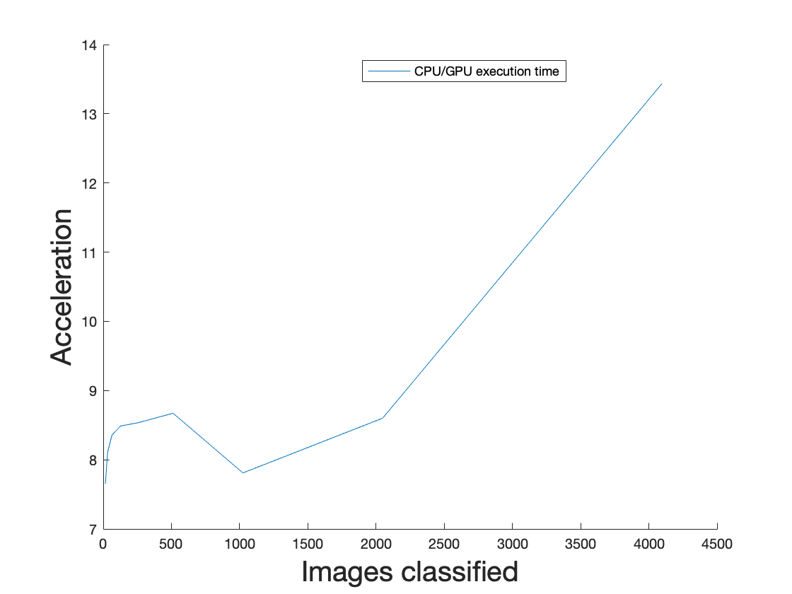
GPU acceleration can move further now

