Slide 1

MC2101: A RISC-V-based Microcontroller for Security Assessment and Training
Author: Luca DALMASSO
Advisor: Paolo Ernesto PRINETTO
Co-Advisor: Gianluca ROASCIO
Notes:
design of MC2101:
work realized under the supervision of P. and R.

Slide 2

License & Disclaimer
License Information
Disclaimer
This presentation is licensed under the Creative Commons BY-NC License
To view a copy of the license, visit:
http://creativecommons.org/licenses/by-nc/3.0/legalcode
We disclaim any warranties or representations as to the accuracy or completeness of this material.
Materials are provided “as is” without warranty of any kind, either express or implied, including without limitation, warranties of merchantability, fitness for a particular purpose, and non-infringement.
Under no circumstances shall we be liable for any loss, damage, liability or expense incurred or suffered which is claimed to have resulted from use of this material.

Slide 3
Outline
Introduction
MC2101 Microcontroller
Architecture
Peripherals
Experimental Results
Conclusions
Notes:
introduction on the context in which the present work is involved
purposes of this thesis work
overview of the main components and functionalities the designed platform can provide
In the experimental results are discussed and reported the resources used by this platform once synthesized on FPGA
Conclusions

Slide 4
Introduction
Embedded systems are massively used as edge devices in:
Safety-critical applications
Cars, Aircrafts, Trains, Medical equipment, …
Business-critical missions
Industrial automation, telecommunications, …
Key benefits:
Real-time reliable
Low manufacturing cost
Low power consumption
Require minimal human intervention on the field
Notes:
They play crucial role in functioning of cars, aircraft, trains, medical equipment
Real time reliable
engineered to solve very specific tasks with no or little delay
guaranteeing at the same time low power consumption and low manufacturing cost

Slide 5
Introduction
Such devices must be secure and reliable
Problem:
Built-in device security is minimal
Research Solution:
Software-based techniques
Can be easily tested outside the operating environment with a proper software toolchain
Hardware-based solutions
Require a CPU architecture description to be physically tested
Most famous architectures are licensed (Intel, ARM) and not accessible to research
Production of new silicon (e.g., ASIC) is unaffordable
Notes:
safety/business-critical missions require secure and reliable devices
The problem : Being cheap and low power imply being constrained in terms resources and performances (few KB of Memory, Few MHz CORE that are not enough to support robust HW and OS)
CONSEQUENCE: build in device security is minimal
SOLUTIONS
software: protect the system at app level
hardware: protect the system at hard level
Hardware solutions require real hardware to be tested and evaluated --> because most popular architecture in use (x86, ARM) are licenced and not accessible, research and academia need an open architecture

Slide 6
Introduction
To evaluate both HW/SW security solutions
Open-source design
customizable starting from the core itself
Open-source ISA
Simple
Supported by popular software toolchain, e.g., GNU GCC
RISC-V ISA
Synthesizable on FPGA
Notes:
To evaluate HW/SW solutions: research community needs an architecture that UNLIKE Intel or ARM is fully accessible
Among all the known open source designs, the most complete is the RISC-V ISA

Slide 7
Introduction
Simple
Small standard base (47 instructions)
Modular ISA
Additions via optional extensions
Designed for Extensibility
Stable
Base is frozen
Today's open-source standard in embedded systems design
Notes:
47 instructions are enough to build a minimalistic RISC-V machine

Slide 8
Introduction
Purpose of the thesis work: design MC2101, a modular, extensible and synthesizable embedded system to be used as a reliable platform for:
Integrate and evaluate security solutions for embedded/IoT domain
Run real applications
Teaching microcontrollers architecture
Security training activities for students and professionals
E.g., Capture-the-Flag challenges

Slide 9
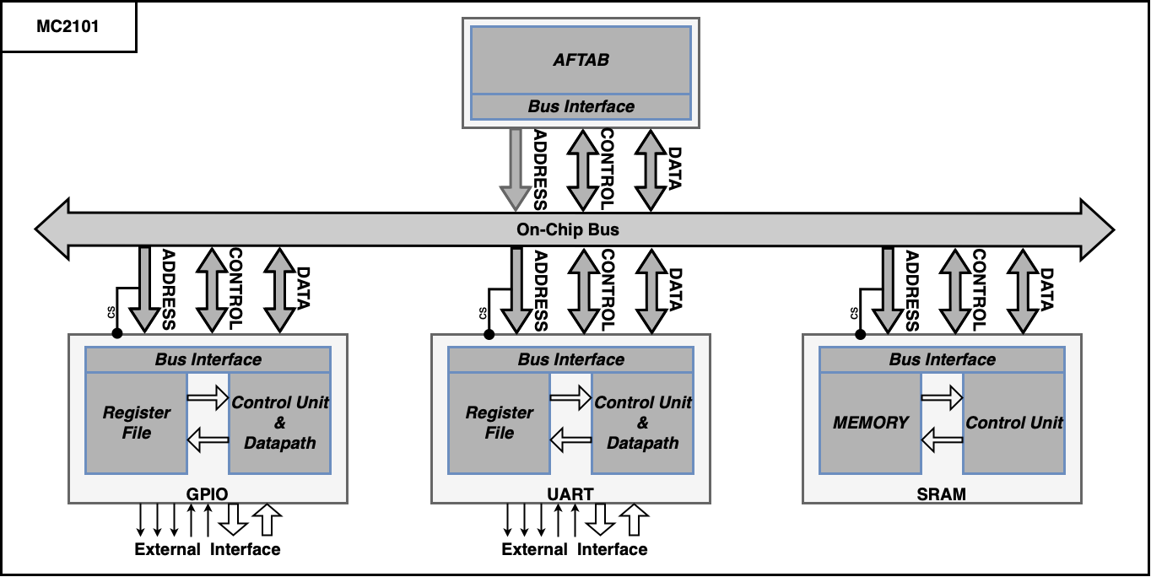
MC2101 Architecture: overview
The microcontroller includes:
A 32-bit RISC-V processor: AFTAB
Designed at PoliTO and developed by University of Tehran
Sequential core
RV32IM Subset RISC-V ISA
Integer base + Multiplication and Division Extension
Subset of privilege extension for interrupts and exceptions
Master of the BUS
Access peripherals and RAM in memory mapped mode.

Slide 10
MC2101 Architecture: overview
Single BUS interconnecting the processor with memory and peripherals
Supports multi-cycle R/W operations
Control signals for interrupts
Control signals for transfer response
Minimal set of peripherals designed to provide all necessary I/O functions
GPIO, UART

Slide 11
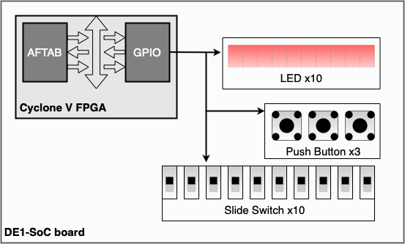
MC2101 Architecture: GPIO
General Purpose Input Output (GPIO) peripheral
Present in every microcontroller
Designed to manage incoming and outcoming digital signals
Controlling physical pins
Bit-banging operations
The logic and the software library designed allow to:
configure pins direction
read/write pins logic state
enable interrupt on each input pin
configure interrupt triggering behavior
Notes:
present in every microcontroller because it can be used for a diverse variety of applications.
physical pins --> in FPGAs can be mapped to a lot of components like BUTTONs, LEDs, SWITCHEs

Slide 12
MC2101 Architecture: UART
The UART module designed for MC2101 provides a receiver-transmitter pair
Configurable with different speeds
Supporting different data widths
Parity codifications
Information status for different error conditions:
Overrun Error, Frame Error, Break Interrupt
Prioritized interrupts
Buffered communications
Two dedicated hardware FIFO’s
Notes:
error conditions and parity allow to monitor the integrity of a communication
buffered communications for optimizing interrupts triggering and transmissions

Slide 13
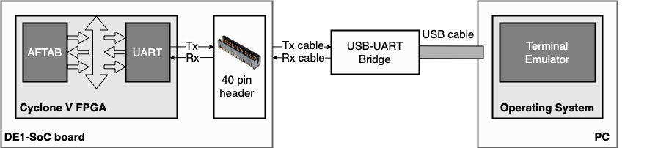
MC2101 Architecture: UART
Communication channel between PC and the microcontroller synthesized on FPGA
Uart Tx and Rx are bridged to USB
Through a PC terminal, it is possible to send/receive characters
Software libraries integrate scanf & printf functions
Notes:
the software also include string manipulation functions togheter with the printf and scanf.

Slide 14
Experimental Results
Synthesized on Cyclone-V FPGA using Quartus 21.1 software
Very small percentage of available resources is used
Great deal of freedom for future developments
Resource Name | Used Amount | Total Amount | Percentage Used
ALM | 2628 | 32070 | 8%
FF | 3443 | 64140 | 5%
PIN | 36 | 457 | 8%
M10K Memory Bits | 131072 | 4065280 | 3%
M10K Blocks | 16 | 397 | 4%

Slide 15
Conclusions
Creation of a fully synthesizable design
Architecture and software libraries allow MC2101 to be used on a development board
Tests demonstrated the ability of the system to perform all the functions setup
Included software toolchain allows to automate synthesis processes, RTL simulations, and compilation of custom applications
Notes:
software toolchain based on CMake and Make tools, ModelSim and Quartus commands that together allow the automation

Slide 16
Thanks for your attention!

