Slide 1
自我介紹
(nizima Live)

Slide 2
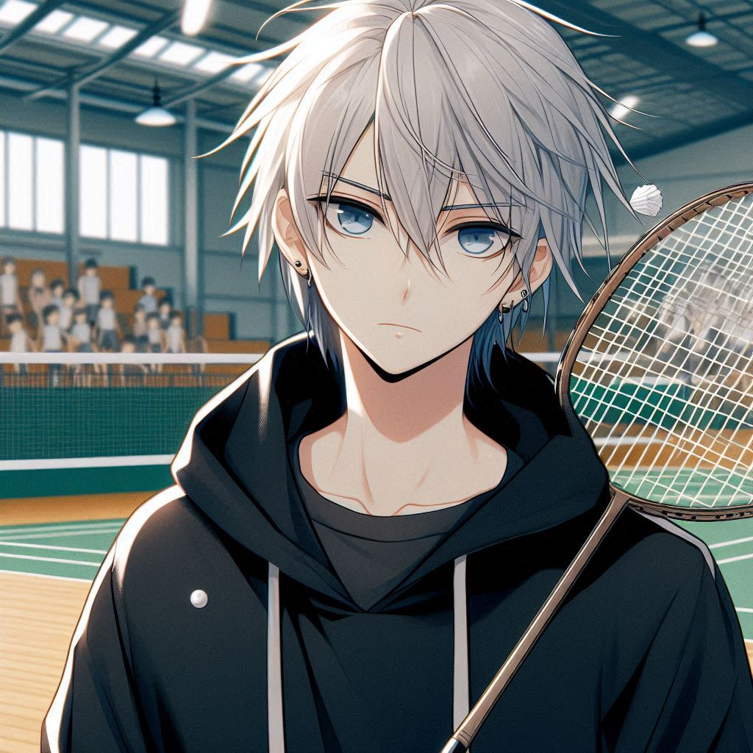
1. 目標
Notes:
日本動漫風格的男高中生，身材高大、苗條的男性角色，膚色偏白，有著中長髮不超過肩膀並且尖的銀色頭髮沒有黑色陰影，眉毛為銀色，不露出耳朵，穿著全黑色連帽衫和藍眼睛，站在羽球場背景中，手上有羽毛球拍。
我是個男高中生，從小熱愛羽毛球，夢想是成為全國高中生羽毛球單打比賽冠軍。這個夢想驅使我每天不斷努力，無論再累也不輕言放棄。

Slide 3
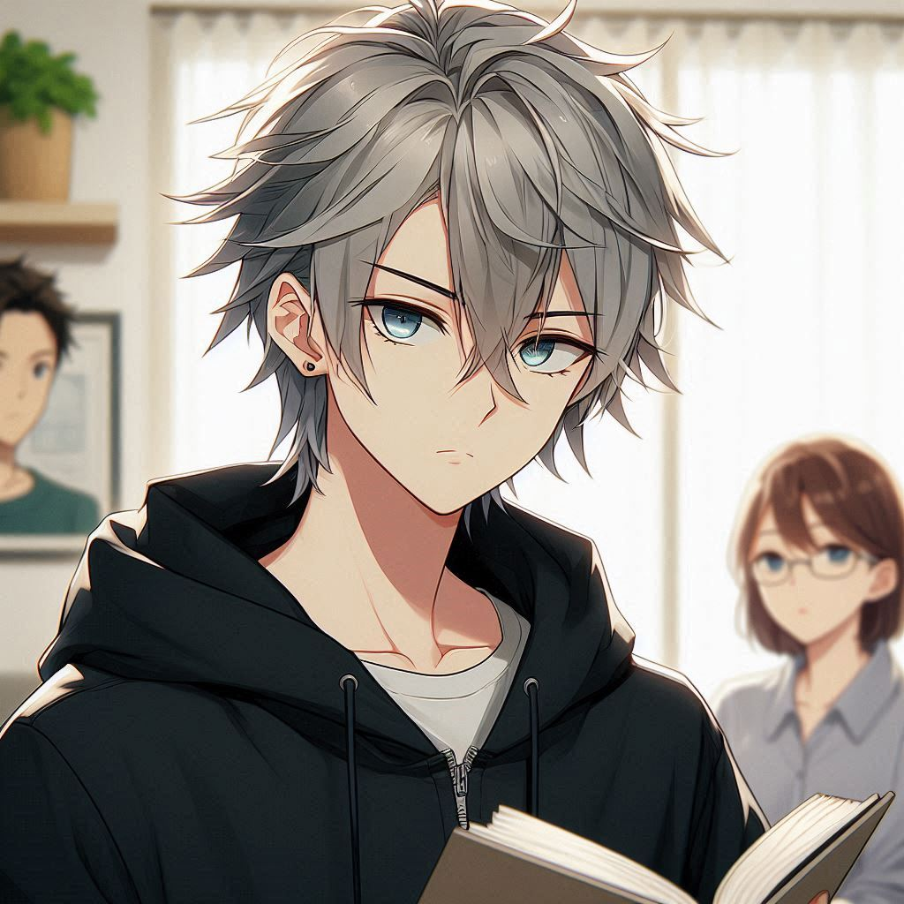
2. 阻礙
Notes:
Japanese anime style male high school student, tall and slim male character with fair skin color, has medium-length hair that doesn't go beyond his shoulders and spiky silver hair with no black shading, silver eyebrows that don't show his ears, wears an all-black hoodie and blue eyes, Reading a book in the room, with her parents nearby looking unhappy
其實家裡並不太支持我全心投入羽毛球，他們認為學業才是未來的保障，希望我把重心放在課業上。學業壓力確實不小，但羽毛球也已經成為我生活中不可或缺的一部分。

Slide 4
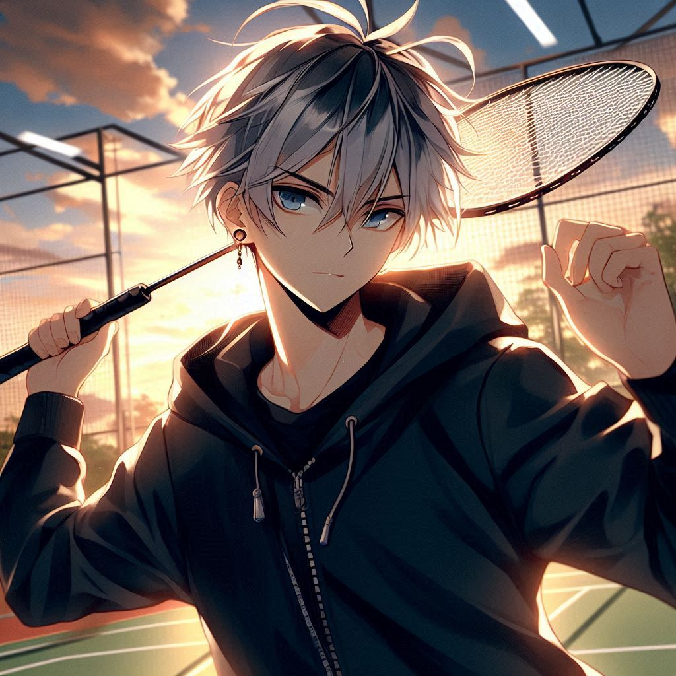
3. 努力
Notes:
In the background of a badminton court, the sky is getting late and the sun is setting, a Japanese anime style male high school student, tall and slim male character with fair skin color, with medium length hair not exceeding the shoulders and spiky silver hair without black shadows, with silver eyebrows, not showing his ears, wearing an all black hoodie and blue eyes, standing in the background of a badminton court with a badminton racket in his hand making a swinging motion.
每天放學後，我都會抓緊時間，趁著夕陽尚未落下，去體育館或戶外場地練習揮拍。即使疲憊不堪，我也會提醒自己，再多練習一分鐘，就離我的目標更近一步。

Slide 5
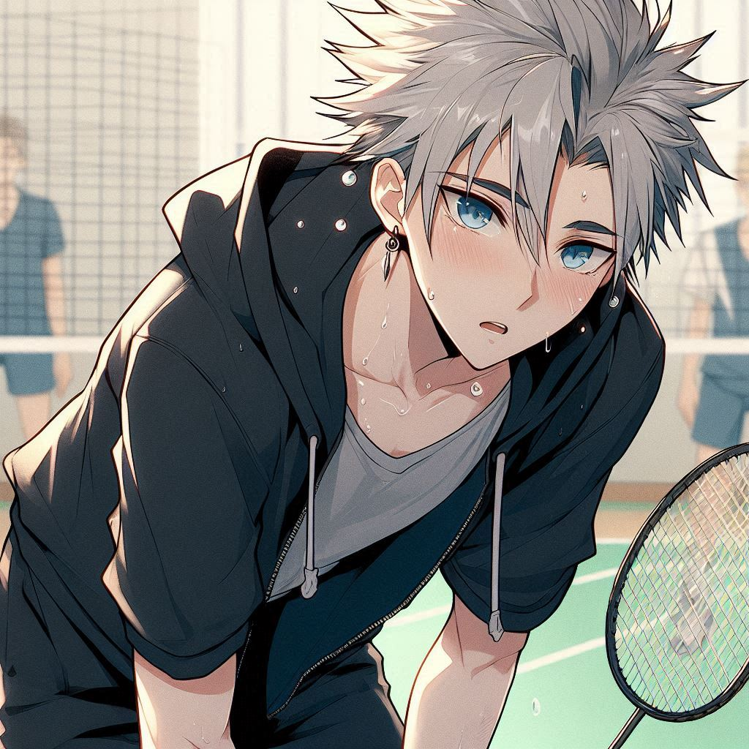
4. 結果
Notes:
The venue is a badminton court, to participate in the match with the opponent in the sparring, the character sweats like rain, very tired bending down, Japanese anime style male high school students, tall, slim male characters, pale, with medium-length hair not exceeding the shoulders and pointed silver hair without black shadow, eyebrows are silver, does not reveal the ears, wearing an all-black hoodie and blue eyes, the hand has a badminton racket.
有一次，我參加了一場重要比賽，但因為狀態不好，輸掉了關鍵場次，心情一度跌落谷底。這次失敗讓我重新審視自己的技術，並深刻反思不足之處。

Slide 6
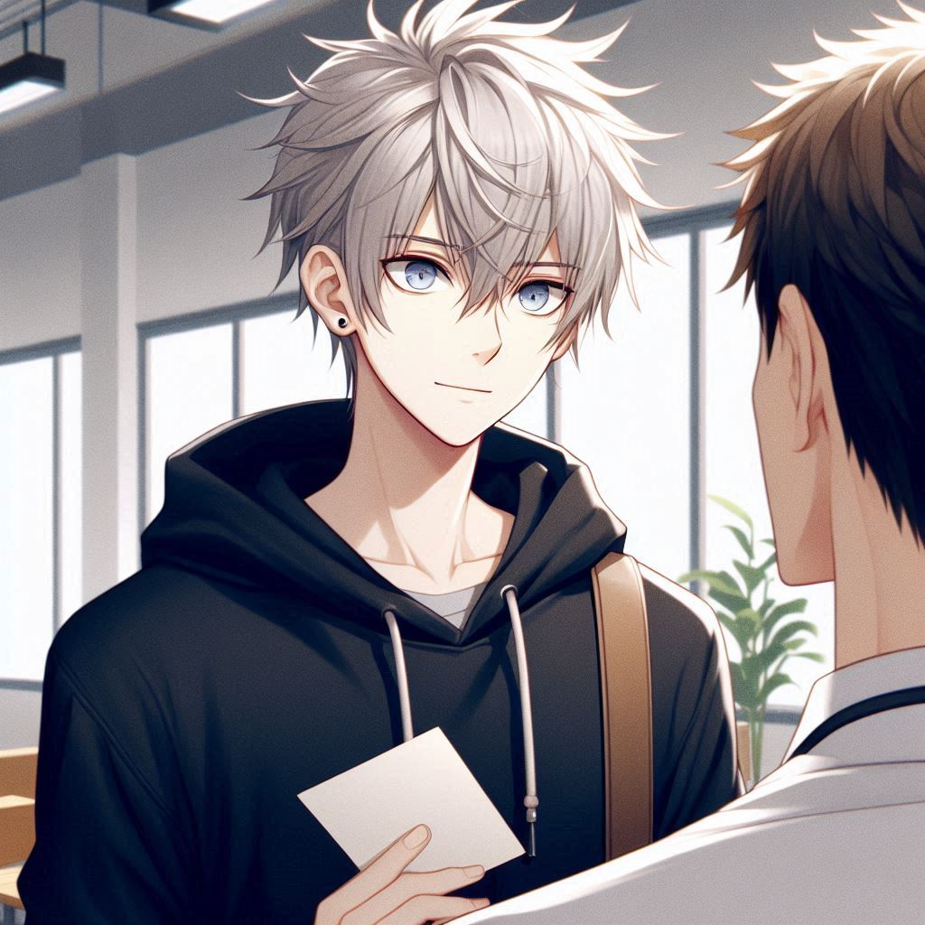
5. 意外
Notes:
The scene is in the gym of the gym teacher, the gym teacher gives me the invitation to the school team. Japanese anime style male high school student, tall, slim male character, pale skin color, has medium-length hair that does not exceed the shoulders and spiky silver hair with no black shadow, silver eyebrows that do not show the ears, wears an all-black hoodie and blue eyes!
後來，體育老師發現了我的潛力，邀請我加入羽毛球校隊，並推薦我參加本地比賽，讓我有更多實戰機會。

Slide 7
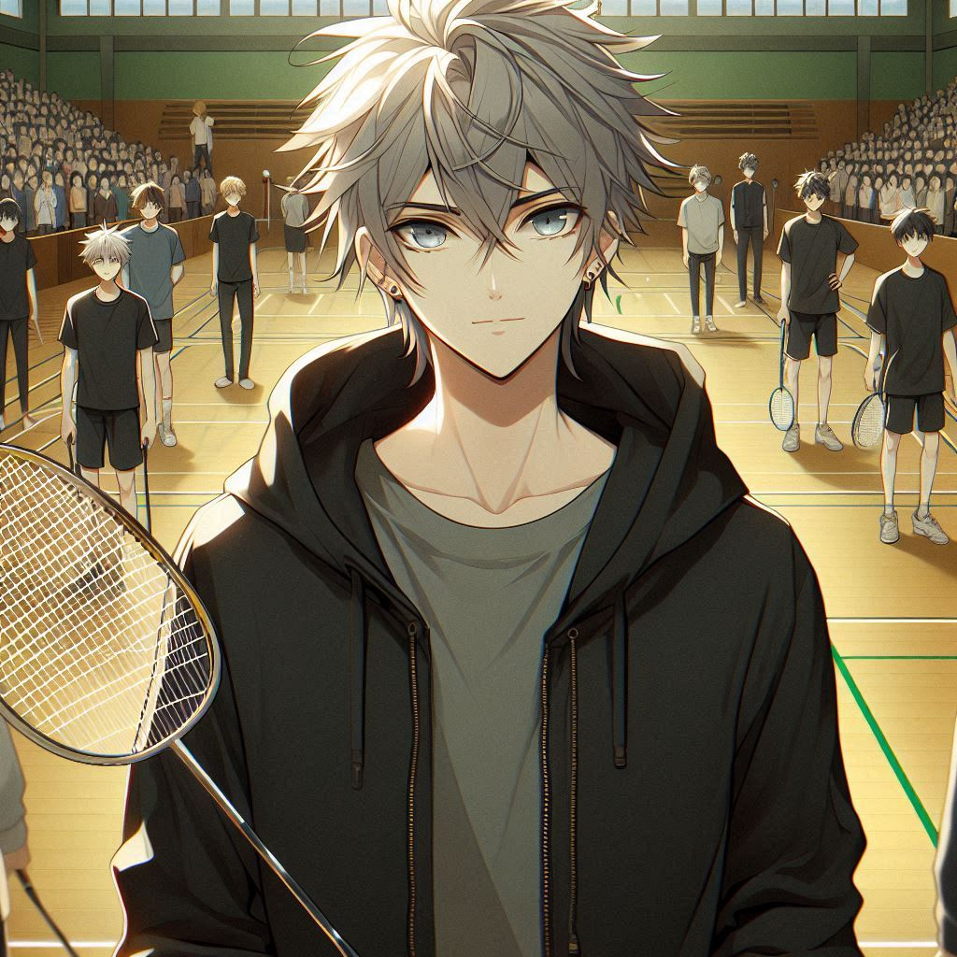
6. 轉彎
Notes:
Scene in a badminton tournament where a high school student wins the badminton championship, and a badminton tournament court with many players. This Japanese anime style high school boy is a tall, slim male character with pale skin, medium-length, shoulder-length, spiky silver hair with no black shading, silver eyebrows that do not show his ears, an all-black hoodie, and blue eyes, standing in the background of a badminton court, with a badminton racket in his hand.
我漸漸明白，追求夢想不只是為了贏得比賽的榮耀，更是享受這個過程中的成長。

Slide 8
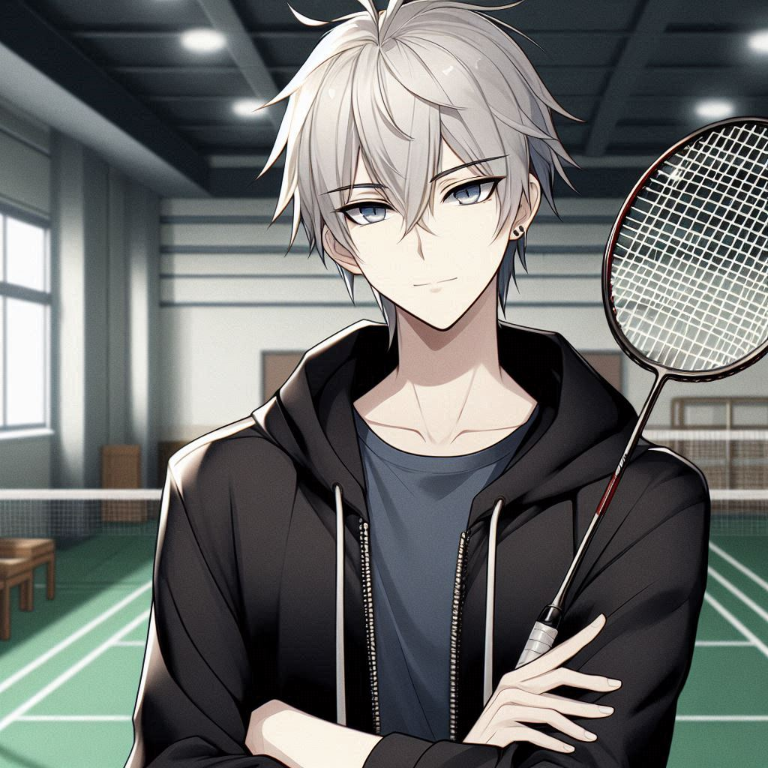
7. 結局
Notes:
日本動漫風格的男高中生，身材高大、苗條的男性角色，膚色偏白，有著中長髮不超過肩膀並且尖的銀色頭髮沒有黑色陰影，眉毛為銀色，不露出耳朵，穿著全黑色連帽衫和藍眼睛，站在羽球場背景中，手上有羽毛球拍。
這一路上的每次挫折與小小的成功，都讓我更加堅定，無論結果如何，我會繼續追逐我的羽毛球夢。

