Slide 1
MICROPROCESSOR-BASED SYSTEM SIMULATION AND DEBUGGING FUNCTION IMPLEMENTATION
Docenti del corso:
William FORNACIARI
Davide ZONI
Angela BOVOLENTA
Juan Esteban NINO
Luca CASCIANO
Milano, marzo 2021

Slide 2
MAIN GOALS
2
WORKING SYSTEM
Cortex-M3 IP core
Memory and AXI interconnect
DEBUGGER
Low level analysis of signals exchanged between memory and microprocessor in a specific portion of code.
Luca Casciano
Notes:
Juan
45s

Slide 3
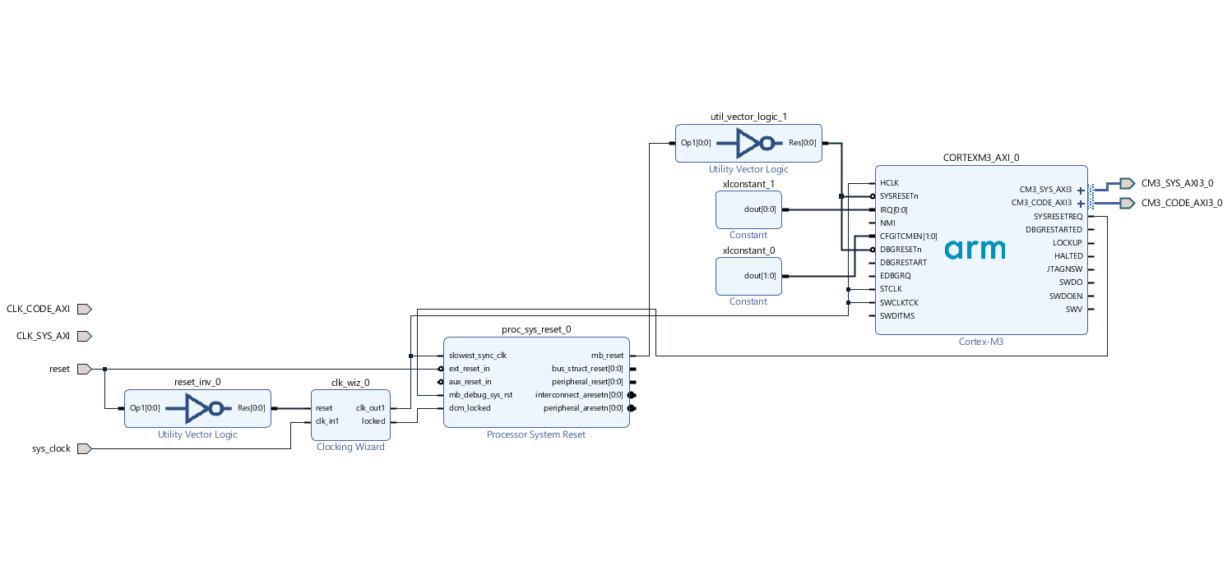
BLOCK DESIGN
3
Luca Casciano
Notes:
Juan
45s

Slide 4
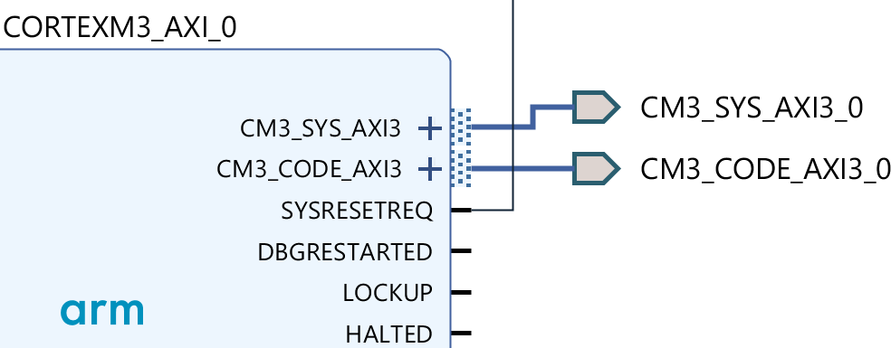
BUS ARCHITECTURE and AXI INTERCONNECT
4
CODE BUS
Used to fetch instructions from the flash memory
SYSTEM BUS
Used to exchange data with ram and peripherals
Luca Casciano
Notes:
Juan
45s

Slide 5
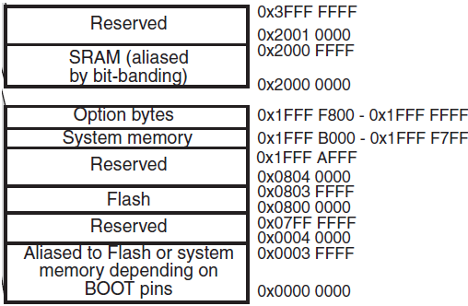
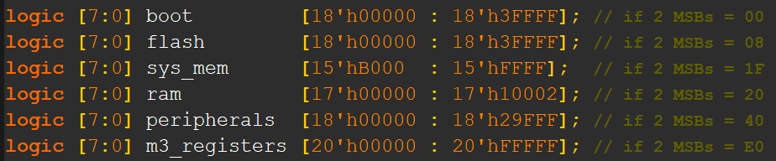
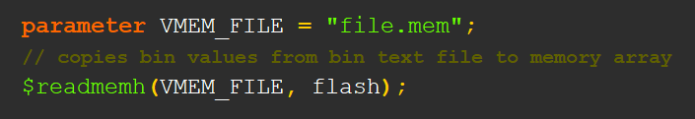
MEMORY ADDRESS SPACE
5
MSB : memory selection
LSB : memory address
Portion of a memory address space of a 32-bit microcontroller architecture
Flash memory population
Luca Casciano

Slide 6
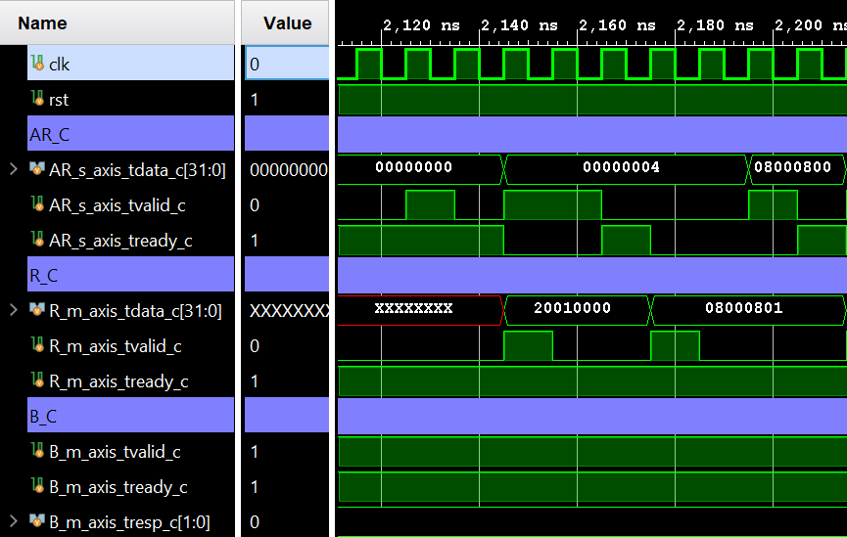
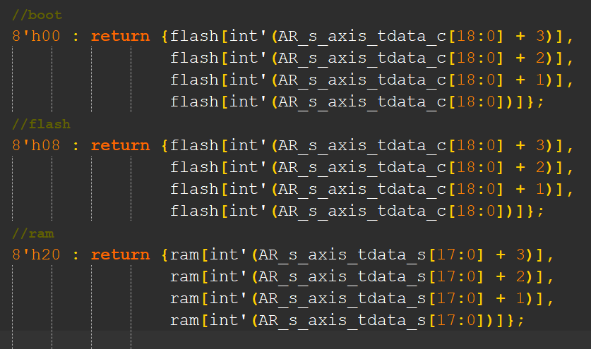
READ OPERATION
6
Function implementation
Instruction and data request
The memory provides data from the specific address requested by the processor
Luca Casciano

Slide 7
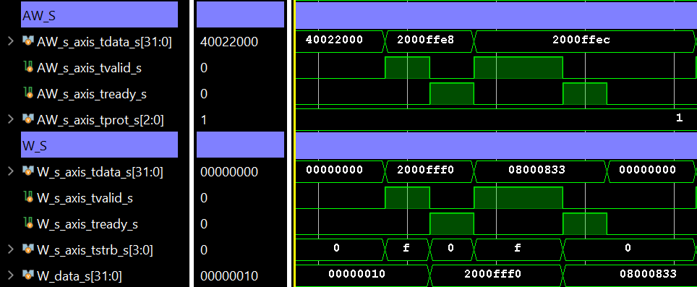
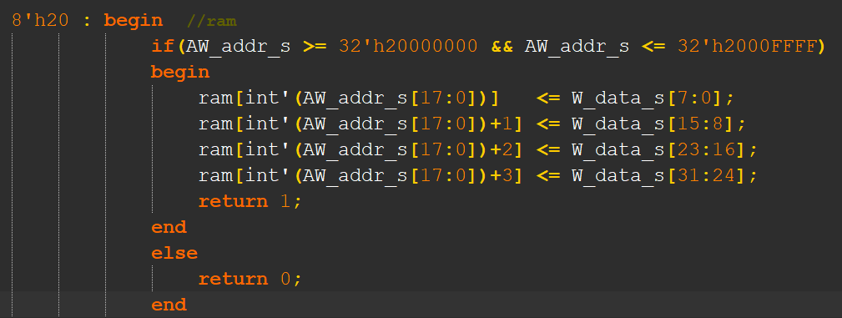
WRITE OPERATION
7
Function implementation
Simulation waveform
Luca Casciano

Slide 8
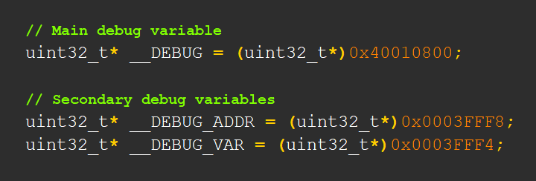
DEBUGGER
8
MAIN IDEA
One or more debug variables used to define a temporal execution window of a specific portion of code
Luca Casciano

Slide 9
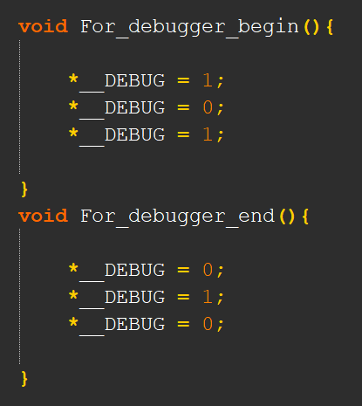
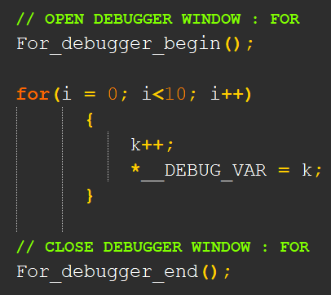
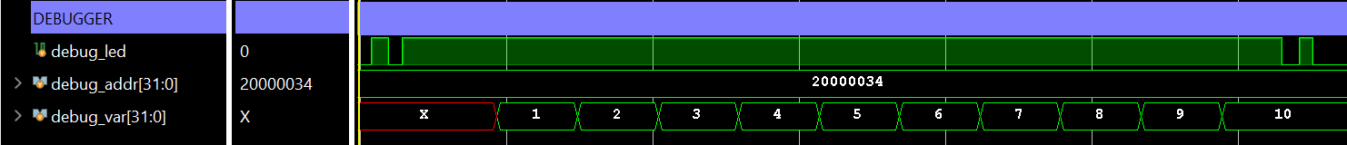
C - CODE
9
Debugger function implementantion and signal waveform
Luca Casciano

Slide 10
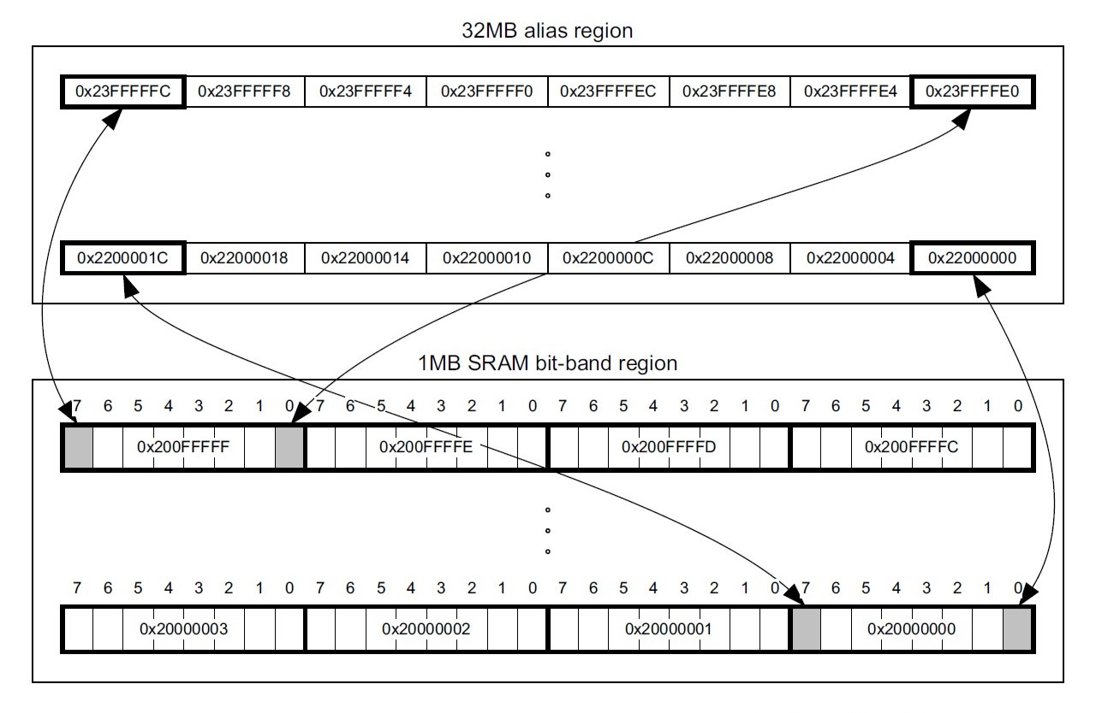
BIT-BANDING
10
SRAM is divided into two regions: bit-band region and alias region
Bits in bit-band region are modified writing in the alias region
Luca Casciano

Slide 11
PROS and CONS
11
PROS
Easy way to inspect signals exchanged between processor and memory during the execution of a portion of code
The programmer is free to implement his own debugging protocol
No need of a physical debugger like ILA, since high performance is not necessary. We can also save silicon area
CONS
It does not provide a lot of information
The programmer should independently choose the addresses for debug variables
Luca Casciano

Slide 12
FUTURE DEVELOPMENTS
12
1) Implementation of the algorithm used to handle the bit-banding technique, to find the right address of a variable
2) Emulation of peripherals to create a complete microcontroller system
Luca Casciano

Slide 13

13
Grazie per l’attenzione
Luca Casciano

