Slide 1
Computer Vision Course
Luca Ponti
Computer Engineering for Robotics
Accademic year 2024/2025

Slide 2
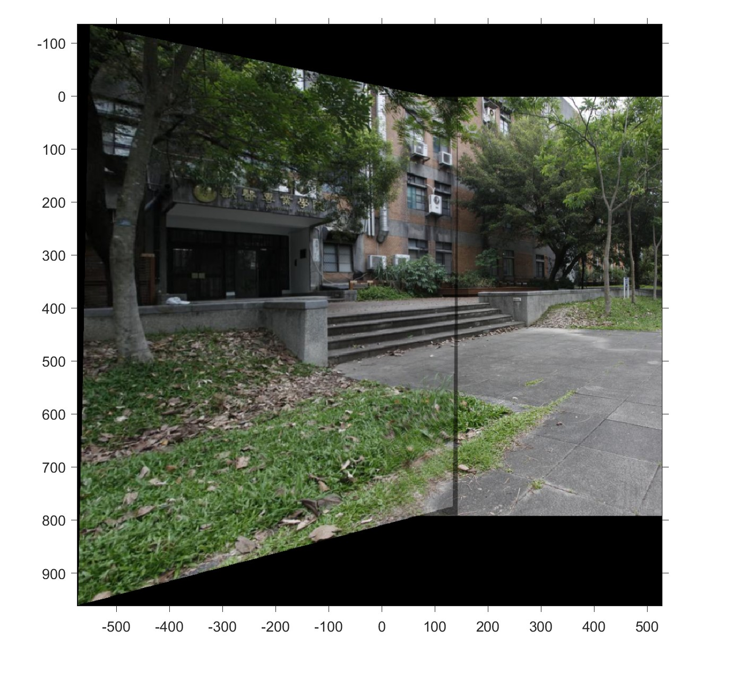
Image stitching (1)
Absolute difference between normalized matrices, the first computed with the build-in function of MATLAB, the second one computed step by step with the SVD.
0.0000 0.0003 0.1993
0.0002 0.0028 0.0892
0.0000 0.0000 0
There is also the symbolic version to understand step by step every single computation.

Slide 3
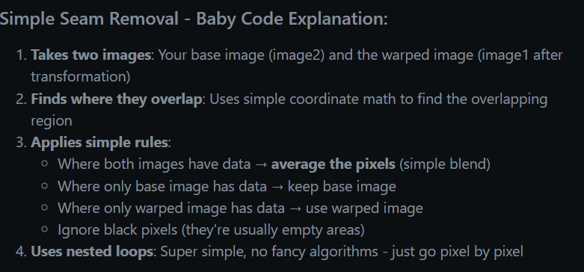
Seams remove

Slide 4
blending solution that follows the weighted blending approach
Proper Coordinate System Handling: Creates a unified output coordinate system that can contain both images after warping.
Distance-Based Weighted Blending: Implements the formula I_blend = (w1*I1 + w2*I2)/(w1 + w2) where:
w1 and w2 are distance-based weights that create smooth transitions
In overlap regions, weights are calculated based on distance from image borders
This eliminates visible seams and creates natural-looking blends
Mask Creation: Creates binary masks to identify valid pixels in each image.
Multi-Channel Support: Works with color images by processing each channel separately.
Comprehensive Visualization: Shows:
Individual warped images
Weight maps for debugging
Final blended panorama
Weight visualization to see how blending occurs
How it Works:
Output Space Creation: Determines the bounding box that contains both the warped first image and the second image.
Image Placement: Places both images in this unified coordinate system.
Weight Calculation: Creates smooth weight transitions using distance transforms, so pixels closer to image centers have higher weights.
Blending: Applies the weighted average formula channel by channel.
The result should be a seamless panoramic image without visible seams, just like shown in your reference image. The blending weights ensure smooth transitions in overlap regions while preserving image quality in non-overlapping areas.

