Slide 1

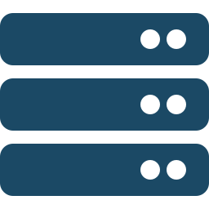

NeoBank — Project Digital Leap
High Level Design — Progress Checkpoint
Legacy
Target
IBM Mainframe running COBOL
No mobile or web channels
No open banking integration
Mobile + web for customers
Real-time fraud detection + AI advisor
Open Banking APIs for fintech partners
Luca Agrippino · 24 March 2026
Notes:
Good evening, everyone.
NeoBank's Project Digital Leap is about modernising a traditional bank.
On the left: a legacy IBM Mainframe running COBOL.
This is the system of record for all financial data but has no digital channels for customers.
On the right: the target: a mobile and web platform supporting up to one million users, with real-time fraud detection, an AI financial advisor, Open Banking APIs, five nines uptime, and full GDPR compliance.
The critical constraint: the Mainframe cannot be replaced.
It must remain the system of record.
Every architectural decision starts from this tension.
So that is the challenge.
Before we can design anything, we need to understand who actually uses this system, and what do they need to do?

Slide 2
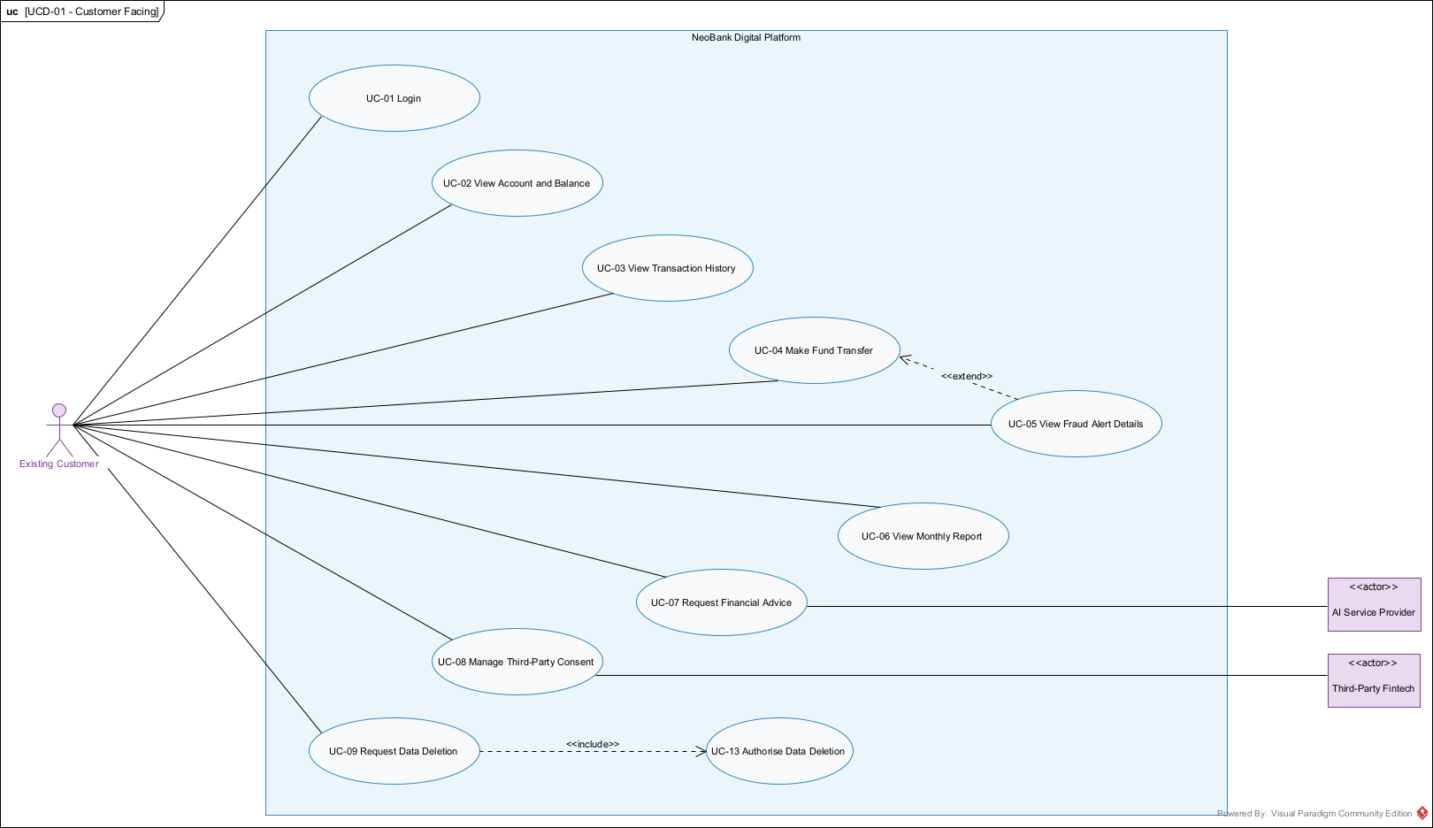
Who uses the system?
Use case analysis · UDC-01 Customer Facing
Key use cases
UC-04
Fund Transfer
UC-05
Fraud Alert Details
UC-01
Login + Authentication
UC-07
AI Financial Advice
UC-09
GDPR Data Deletion
→ We'll zoom into UC-04 later
Notes:
This is the customer-facing use case diagram.
There are also two other diagrams for Open Banking and Internal Operations, but this one drives the main architecture.
The existing customer can login, view balances, make fund transfers, request financial advice, and request GDPR data deletion.
Notice User Case-04 Make Fund Transfer extends to User Case-05 View Fraud Alert Details.
This means that when the system detects fraud, the customer needs to see why their transfer was blocked.
I've highlighted the key use cases on the right and we'll zoom into User Case-04 as a full sequence diagram in a few slides.
But where do all these services actually run?
Not everything can live in the same place...

Slide 3
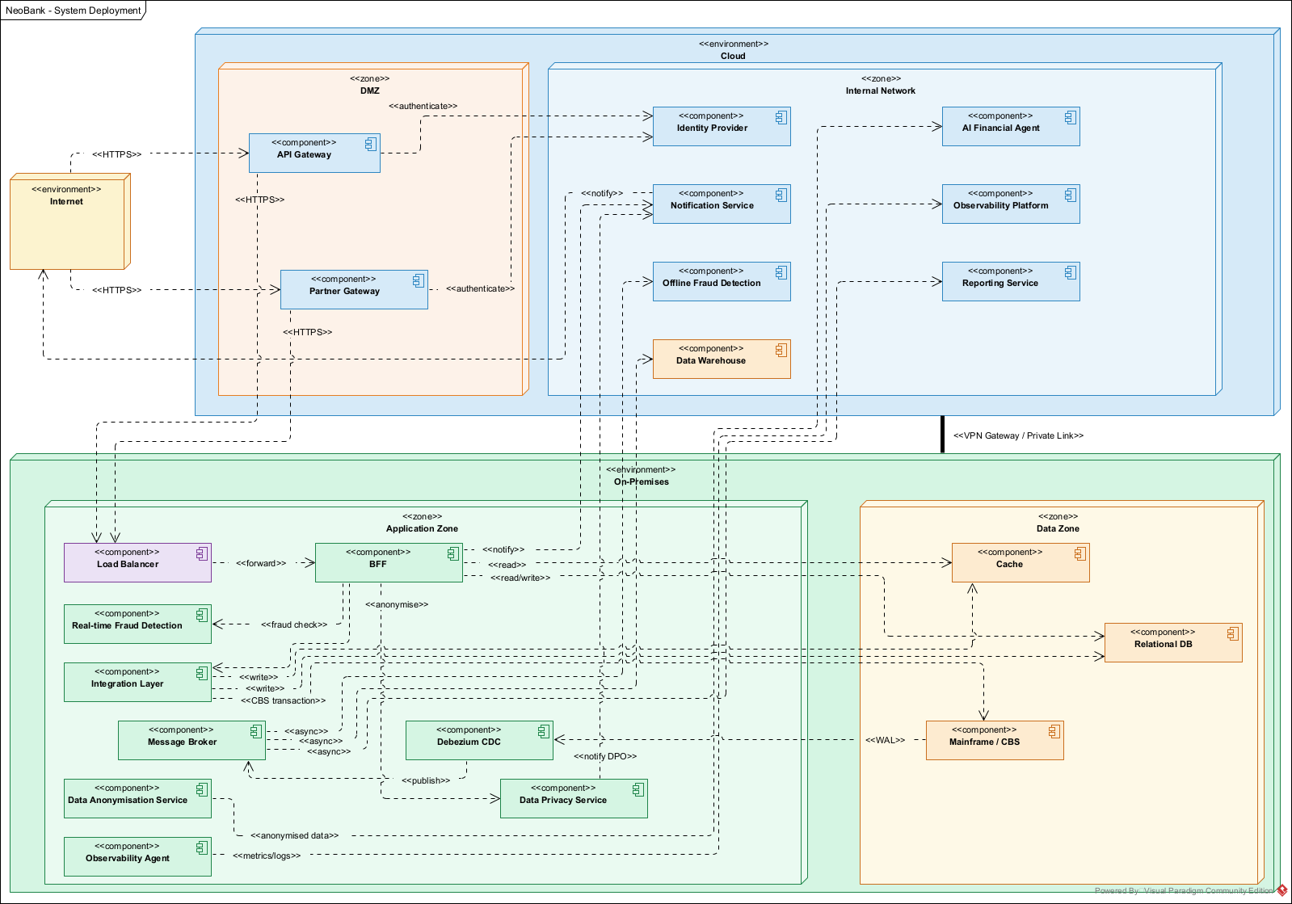
Where do things run?
Deployment topology · Hybrid cloud + on-premises
Notes:
Now we see where everything physically runs.
At the top: the cloud environment, with a demilitarized zone containing the API Gateway and Partner Gateway; these are the entry points for customers and fintechs.
The cloud internal network hosts the Identity Provider, AI Financial Agent, Notification Service, and Observability Platform.
At the bottom: the on-premises environment.
This is where the Backend For Frontend, Fraud Detection, Integration Layer, Message Broker, and all data stores live, including the Mainframe.
The two environments are connected via a VPN or Private Link.
Notice the data flow: metrics and logs go up to the cloud observability.
But financial data stays on-premises.
Only anonymised data crosses the boundary to the AI agent.
This is a regulatory decision, not a technical preference.
Now let's look inside these environments, what components are actually there?

Slide 4
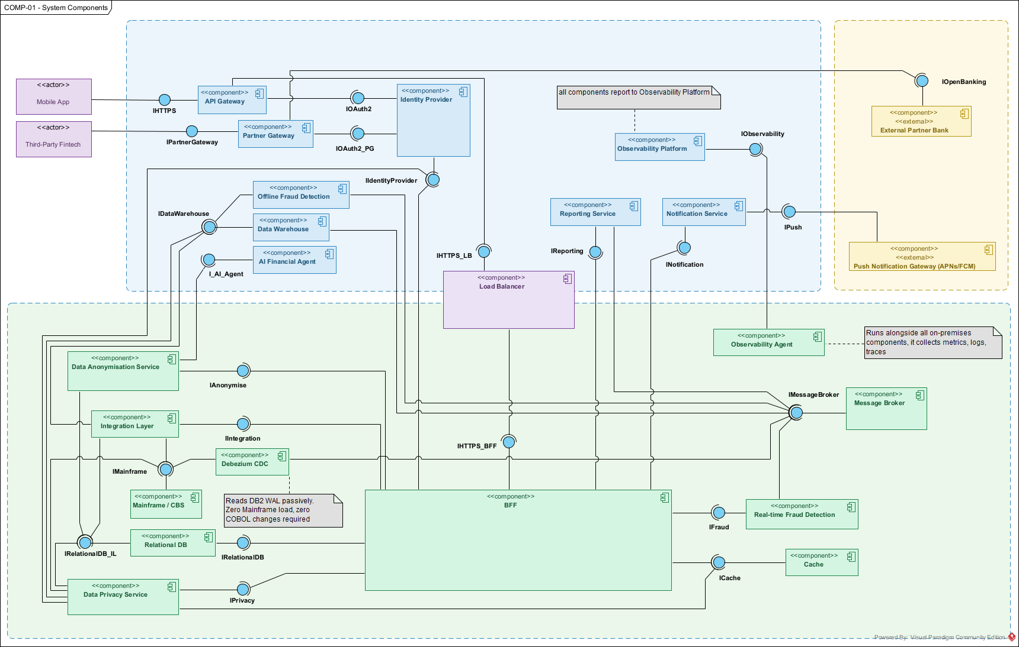
What are the building blocks?
System components · COMP-01
Notes:
This is the full system component diagram.
I don't try to explain every box but I’ll trace the main path: A request enters from the left, into the Mobile App or Third-Party Fintech.
It hits the API Gateway or Partner Gateway, gets authenticated by the Identity Provider, then flows through the Load Balancer to the BFF on-premises.
The BFF is the orchestrator, I mean it talks to the Cache for reads, the Fraud Detection Engine for transfers, the Integration Layer for Mainframe writes, and the Message Broker for asynchronous events.
You saw these same zones in the deployment diagram and now you see what lives inside them.
But why did I choose these particular components?
There are three key architectural decisions driving this design...

Slide 5
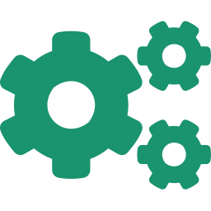
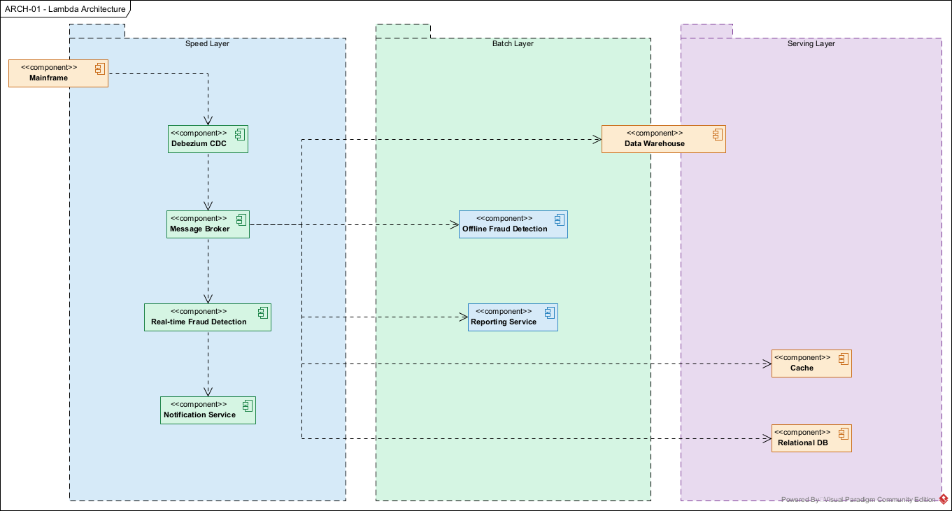
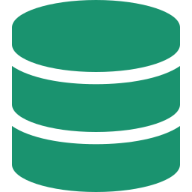


Why these components?
Key architectural decisions · ARCH-01 Lambda Architecture
Hybrid deployment
Because GDPR and banking regulation prohibit financial data in the cloud. Only stateless AI services cross the boundary.
CDC via Debezium
Because we have only 5 COBOL developers. Passive WAL reading means zero Mainframe changes, zero load.
BFF + CQRS
Because the Mainframe cannot handle 1M concurrent reads. Separate read/write paths protect the CBS at scale.
The Lambda Architecture (right) shows how CDC feeds three layers: Speed (real-time fraud, notifications), Batch (offline fraud, reporting), and Serving (cache, DB for reads).
Notes:
This is the most important slide where I defending these decisions.
Three top-level choices, each starting with BECAUSE, let’s see why!
First: hybrid deployment.
I chose this BECAUSE General Data Protection Regulation (GDPR) and banking regulations require that financial transaction data and Personal Identification Information stay within the geographic region on infrastructure the bank controls.
Only the AI Financial Agent crosses the boundary, and it receives only anonymized data.
The Data Anonymisation Service sits on-prem and strips PII before anything leaves.
Why not full cloud?
Because the regulatory re-certification alone would exceed the 12-month MVP timeline.
Second: CDC with Debezium.
I chose this BECAUSE we only have five COBOL developers and they are needed for maintaining the existing CBS.
Any approach that requires Mainframe code changes, like building REST APIs on the Mainframe, would create a bottleneck.
Debezium reads the DB2 transaction log passively.
Zero COBOL changes.
Zero additional load.
The alternative was polling or batch Extract, Transform and Load, but those introduce latency that breaks the near-real-time requirement.
Third: Backend for Frontend with Command Query Responsibility Segregation.
I chose this BECAUSE the Mainframe was designed for branch banking, maybe with hundreds of concurrent users.
Routing one million digital users directly to it would destabilise the existing operations.
By separating reads from writes, we serve all read traffic from the modern cache and database and the Mainframe only handles validated write transactions.
The Lambda Architecture on the right shows how Change Data Capture feeds into this: Speed Layer for real-time, Batch Layer for analytics, Serving Layer for reads.
Now let me prove these decisions hold together...

Slide 6
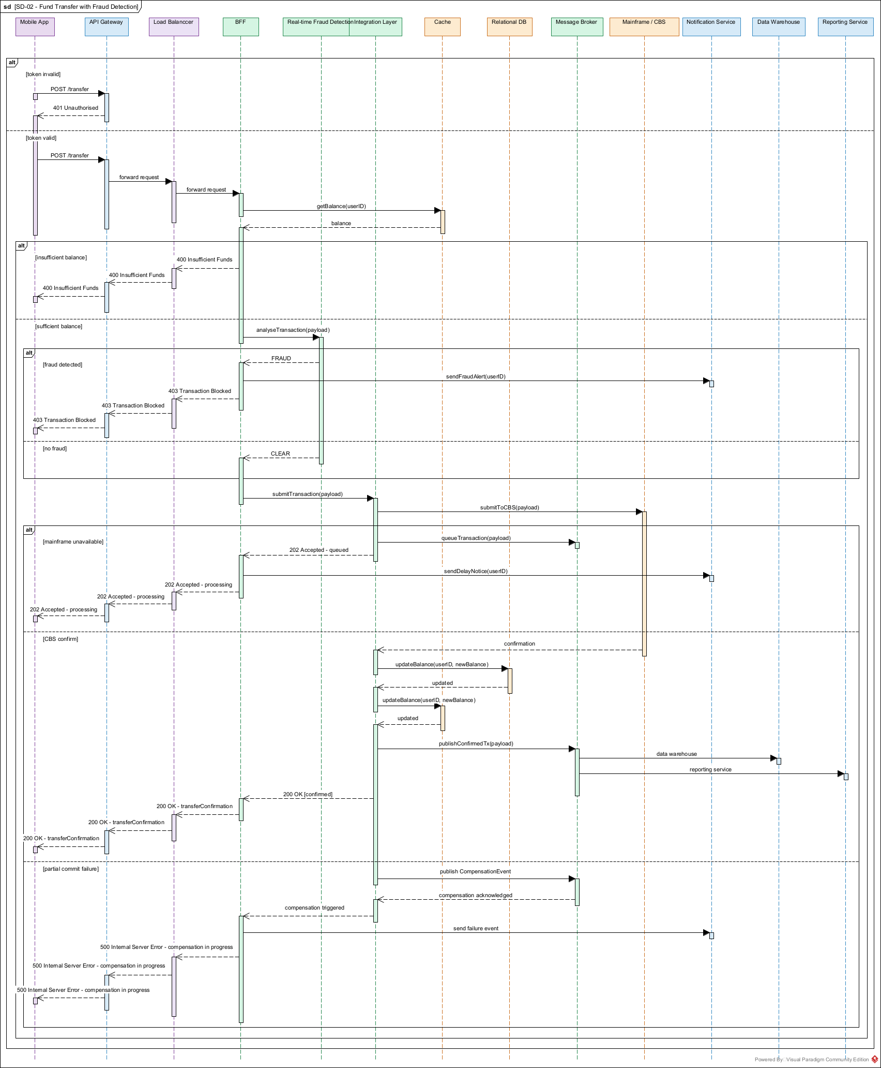
How does a fund transfer work?
Sequence diagram · SD-02 Fund Transfer with Fraud Detection
Notes:
This is Sequence Diagram for the User Case 04, and it is where five of my architectural decisions are tested together.
Step one: the user sends POST /transfer.
Step two: The API Gateway validates the token , invalid means 401 immediately.
If valid, the BFF calls the Real-time Fraud Detection Engine.
Why real-time AND offline?
Because they solve different problems: real-time needs low latency for blocking transfers, offline needs more data and processing time for pattern analysis.
Different trade-offs, different components.
[Point at the first alt fragment — fraud detected]
Two outcomes: FRAUD → 403, transaction blocked, notification sent.
[Point at the second branch — no fraud, then mainframe interaction]
CLEAR → proceed to the Integration Layer, which talks to the Mainframe.
But what if the Mainframe is down?
[Point at the mainframe unavailable alt fragment]
This is where the Saga pattern comes in.
We cannot do distributed transactions across the Mainframe and modern services.
So instead, we queue the transaction in the Message Broker and return 202 Accepted.
The customer gets a delay notification.
When the Mainframe comes back, the transaction processes.
[Point at the partial commit failure section at the bottom]
If there is a partial commit failure, we trigger a compensation event, this is the Saga's rollback mechanism.
This one diagram touches authentication, fraud detection, mainframe resilience, event-driven architecture, and error compensation.
Every pattern from the previous slide is working here.
But every design has trade-offs. Let me be transparent about the tensions I had to resolve...

Slide 7
What did we accept?
Requirement tensions and architectural responses
99.999% uptime vs. Mainframe as single point of failure
Millisecond latency vs. Mainframe under load
Queue transactions during unavailability.
Circuit breakers prevent cascade failures.
Automatic retry with idempotency.
Reads served from cache via CDC sync.
Mainframe reserved for writes only.
CQRS decouples the two paths.
Scale to 1M users vs. Mainframe throughput
Zero data loss vs. minimise costs
Integration Layer shapes and throttles traffic.
Digital layer absorbs all read operations.
Only validated writes forwarded to CBS.
Full sync replication for financial data.
Async cheaper storage for non-critical data.
Selective redundancy, not blanket.
Every tension involves the Mainframe. Every resolution follows the same principle: decouple, buffer, and protect the CBS. The Integration Layer is the architectural fulcrum.
Notes:
Four tension cards, each showing a conflict and its resolution.
The pattern is deliberate; every conflict involves the Mainframe.
Notice how each resolution traces back to the decisions from slide 5: CDC feeds the cache for fast reads, CQRS separates the paths, the Integration Layer queues and shapes traffic.
Every resolution follows the same principle: decouple, buffer, protect.
The Integration Layer is the fulcrum.
It absorbs traffic, shapes requests, queues transactions during unavailability, and prevents cascade failures.
Without this component, none of the other decisions hold together.

Slide 8
Thank you
Notes:
That’s all!
Thank you for your time.

