Slide 1
Next Gen Shiny Application for Regulatory Submissions
Jayashree VedANAYAGAM,

Slide 2
Agenda
INTRODUCTION
APPLICATION DETAILS
ANALYSIS INPUTS
ANALYSIS DISPLAY
DATA EXPLORER
INFERENCIAL STATISTICS
eSUB DOCUMENTATION
ADDITIONAL DETAILS
FUTURE ENHANCEMENTS
VALIDATION
AUTDIT TRIAL AND TRACKING
CONCLUTION

Slide 3
Introduction
Innovative methods are explored to make regulatory submission process faster, efficient and with quality. One such method is shiny application and dashboard. It is user-friendly, reproducible and scalable.
Understanding Standards & Guidelines
R Packages and R shiny application
CDISC Standards
SDTM IG
ADAM IG
TAUG
Analysis Results Standards
FDA Conformance Guideline and ISS, ISC Guidelines for CTD
EMA ICH Guidelines on CTD
R is widely used and open source software for Data Science, vast package library
Tidyverse, ggplot2, Haven – Data processing
Rmarkdown, Kniter, Kable – Report rendering
Survival, Hmisc, Epitool – Statistics
Application in R
Shiny – R, CSS, HTML
Shinydashboard, shinycssloaders
plotly

Slide 4
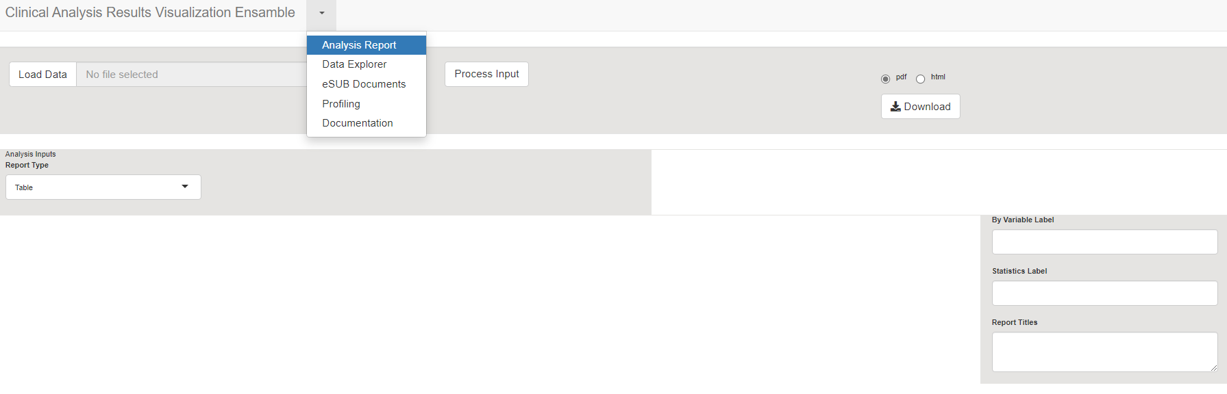
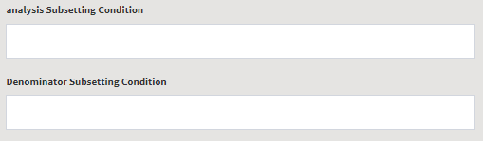
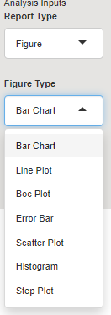
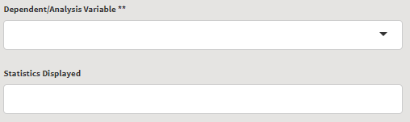
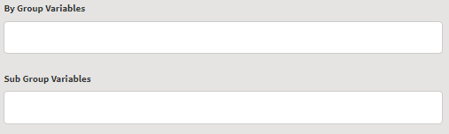
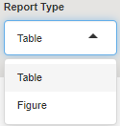
Application DETIALS
ANALYSIS INPUTS
Variable Identification & Subset
Grouping variables: row variable and column variables (discrete vars).
Treatment variable identifier (per CDISC ADaM IG) topmost column variable.
Data subset : population subset, analysis subset and BigN/Denominator subset.
Dependent variable : identified into discrete or continuous analysis and appropriate analysis statistics
Type of report is simply whether it is table or figure.

Slide 5
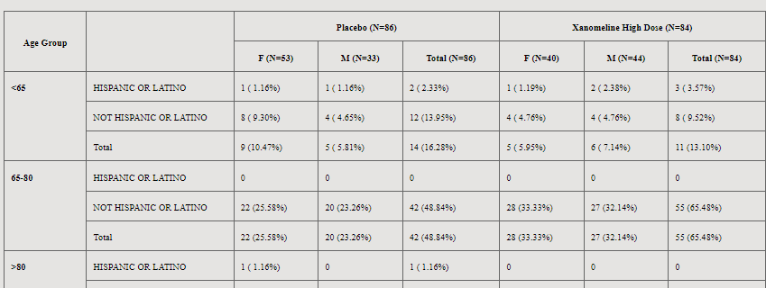


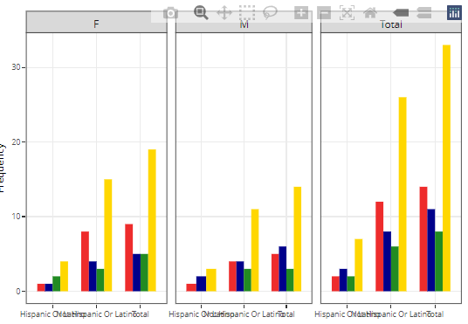
Application DETIALS
ANALYSIS DISPLAY
viewing results – Table/ Figure
customizing title/footnote
saving the report. (3 formats pdf, html and docs)
Grouping vars for figures : column variable becomes faceting and row variable is value filter.
Default title footnote is generated based in the variable label attributes that come along with data
Reactable or datatables for listings

Slide 6
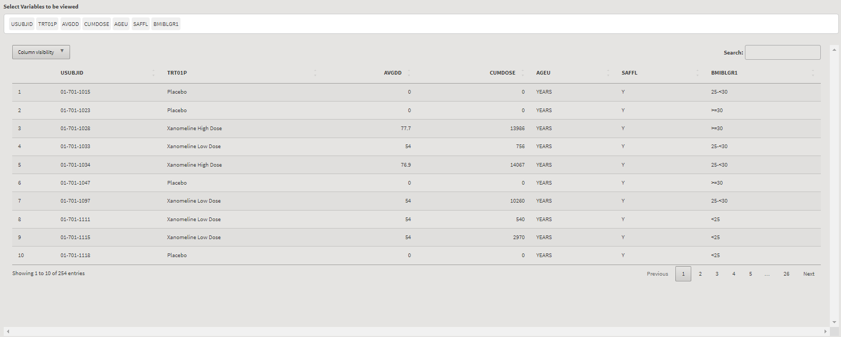
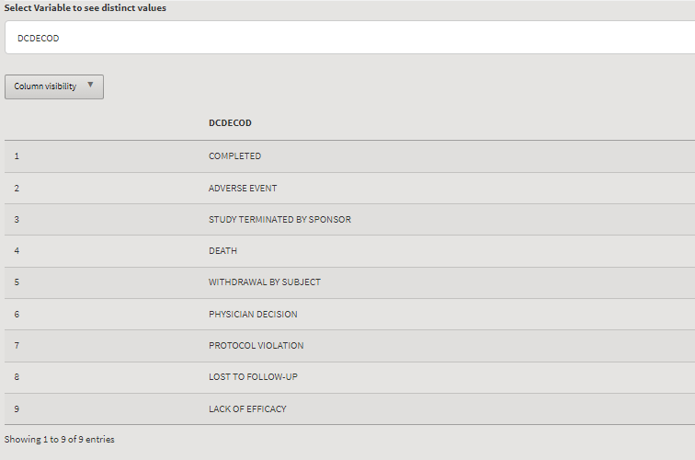
Application DETIALS
DATA EXPLORER
This is to enable doing basic data check
Understand available variables and values.
Generating simple listings.
Viewing selected variable as data table and applying subset
Variable attribute, distinct values and check for missing can also be done.
Additional features : minimalistic statistics planned to be included

Slide 7
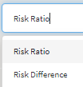
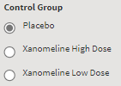

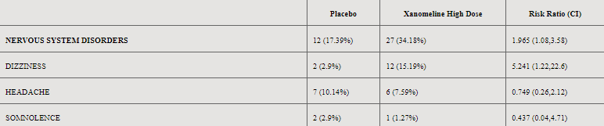
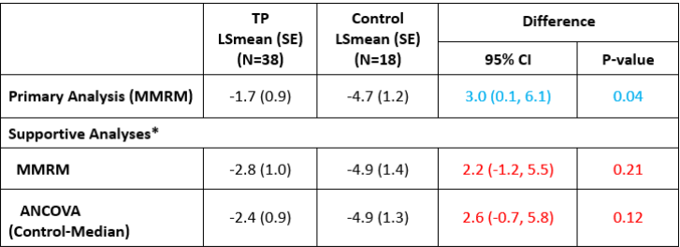
Application DETIALS
INFERENCIAL STATISTICS
This has endpoint specific analysis and advanced methods
Confidence interval
p value
risk analysis
Hypothesis testing
T test
advanced regression models
These report structure would be analysis specific
Just for illustration, Not yet included in application

Slide 8
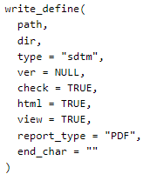
Application DETIALS
eSUB DOCUMENTATION
Metadata
ADaM / SDTM Specifications
Code lists
Section Selection Field:
1. Selection of list of dataset
2. Description
3. Mock shell / combined reports
4. Issues and details
1. Generating LoT
2, Markdown template
3. Spec and Metadata inputs
Introduction
Protocol Design
Analysis Dataset Relationship
Defines
SDRG and ADRG
Combined analysis reports
The combined report are produced in pdf, html and doc formats.
interactive plotly object in html format is created.

Slide 9
ADDITIONAL DETIALS
FUTURE ENHANCEMENTS
Report layouts recommendation,
improved SDRG/ADRG docs,
implementation of CDISC analysis result standards,
Incorporating biomedical concepts.
There is also a trial participant level report
This is also explored in the application by using patientProfileVis and patientProfiler R packages.
Additionally report specific input capture is also included for traceability.

Slide 10
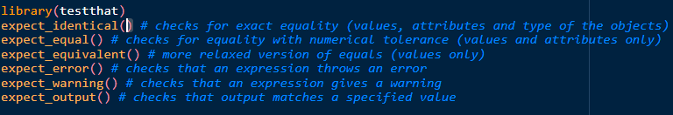
ADDITIONAL DETIALS
VALIDATION
Test scripts are created using testthat functionalities for individual utilities.
Shinytest2
Unit Tests
Server Function Tests
Snapshot-based test
shinyload test are explored for application testing.
Record
Replay
Analyze

Slide 11
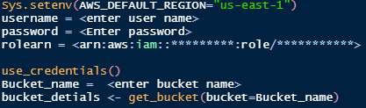
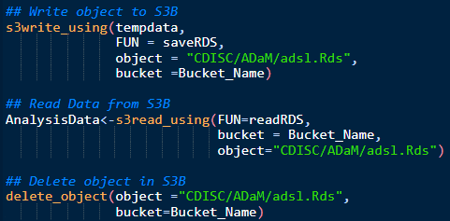
ADDITIONAL DETIALS
AUTDIT TRIAL AND TRACKING
Tracking documents and audit trail system to ensure compliance.
Generating program/application logs.
Logger
Shiny Log
Logr
logrx
If the application is hosted on a dedicated study area this implementation becomes much easier e.g. AWS S3
Aws.s3
Aws.ec2metadata
Aws.signature

Slide 12


CONCLUTION
Interactive R shiny applications and dashboards provide us interactive user interface to create analysis results with capability of embedding data and metadata documentation; therefore, they might be an efficient future option for regulatory submissions.

Slide 13

Thank YOU! Questions?

