Slide 1
Towards efficient QAT:
Implementation of QAT using PyTorch quantization module
Luca Bertone

Slide 2
Agenda
Introduction
Quantization using PyTorch
Results
Limitations

Slide 3
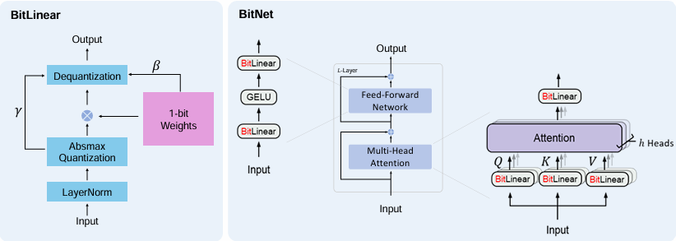
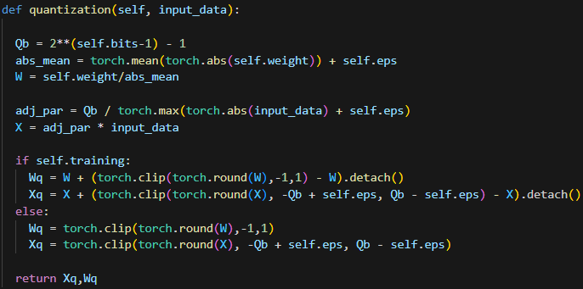
Introduction
Starting point:
a small implementation
of a language model,
which simulates QAT
through custom quantization
Source: https://arxiv.org/pdf/2310.11453

Slide 4
Introduction (cont.)
Simulated QAT
Goal:
Investigate on how to actually exploit quantization to
speedup inference and reduce memory footprint
quantized parameters are stored as if they were in full precision

Slide 5
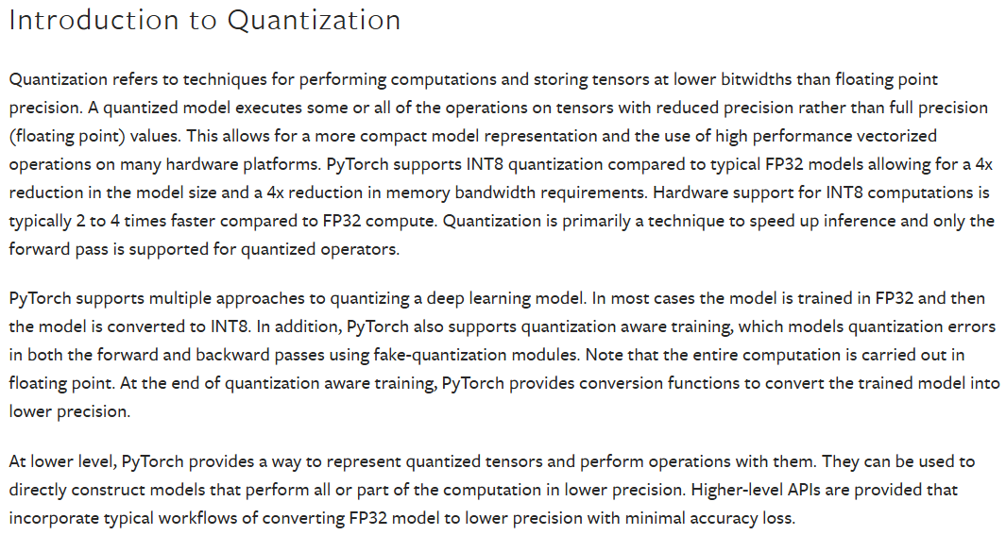
Quantization using PyTorch
Source: Quantization — PyTorch 2.6 documentation

Slide 6
Quantization using PyTorch (cont.)
Building blocks:
1️⃣ Qconfig
2️⃣ Quantization-Aware layers
3️⃣ Preparing model for QAT
4️⃣ Model training
5️⃣ Convert to quantized model

Slide 7
Quantization using PyTorch (cont.)
1️⃣ Qconfig
Define how parameters are quantized (torch.ao.quantization.get_default_qat_qconfig("fbgemm") is the default for QAT)

Slide 8
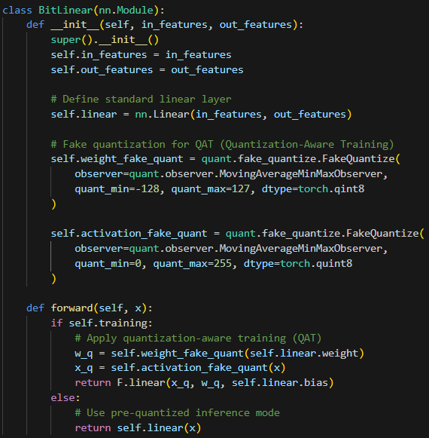
Quantization using PyTorch (cont.)
1️⃣ Qconfig
2️⃣ Quantization-Aware layers
Put FakeQuantize modules to simulate quantization and modify the methods to apply the quantization during the forward phase
Collect statistics (min/max values) of activations and weights, that are used to compute a quantization range.

Slide 9
Quantization using PyTorch (cont.)
1️⃣ Qconfig
2️⃣ Quantization-Aware layers
3️⃣ Preparing model for QAT
Call torch.ao.quantization.prepare_qat(model, inplace=True)
to actually insert fake quantization layers before training

Slide 10
Quantization using PyTorch (cont.)
1️⃣ Qconfig
2️⃣ Quantization-Aware layers
3️⃣ Preparing model for QAT
4️⃣ Model training
5️⃣ Convert to fully-quantized model
(torch.ao.quantization.convert(model, inplace=True))

Slide 11
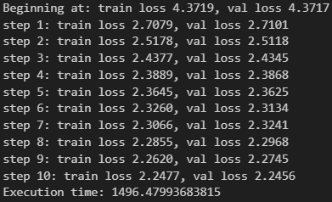
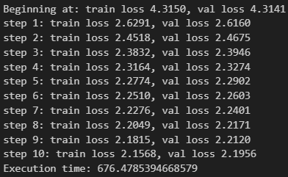
Results
#hyperparameters
batch_size = 32
block_size = 8
n_embd = 32
n_head = 4
n_layer = 6
learning_rate = 1e-3
num_epochs = 10
epoch_length = 200
eval_iters = 200
Custom quantization
PyTorch quantization

Slide 12
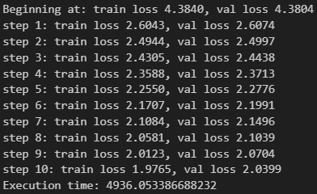

Results (cont.)
# hyperparameters
batch_size1 = 48
block_size1 = 128
n_embd1 = 32
n_head1 = 4
n_layer = 6
learning_rate = 1e-3
num_epochs = 10
epoch_length = 200
eval_iters = 200

Slide 13
Conclusions
The results are promising for small models, with comparable accuracy and extremely reduced training time
A deeper investigation on the implementation details of the quantization is needed to fully accomplish the memory reduction and to make the training efficient for bigger models.

Slide 14
Thank you

