Slide 1


Modeling
Rain in Australia
Luca Bulfon & Jack Cimorelli

Slide 2
Introduction
Project Goal: Analyze meteorological data to predict rainfall probability for the following day.
Data Source: Australian Bureau of Meteorology (BOM) dataset from Kaggle.
Motivation:
Increase understanding of weather patterns and their influence on rainfall in a location suffering from dramatic swings in trends.
Highlight the importance of weather forecasting, especially for near-term predictions.
Methodology:
Visualise and preprocess the data to perform data analysis.
Utilize data mining techniques learned throughout the semester.
Implement various machine learning models:
K-Nearest Neighbors (KNN)
Naive Bayes: Simple and efficient classifier.
Random Forest: Robust against overfitting and handles complex interactions.
Long Short-Term Memory (LSTM) neural network: Captures temporal patterns in the data.

Slide 3
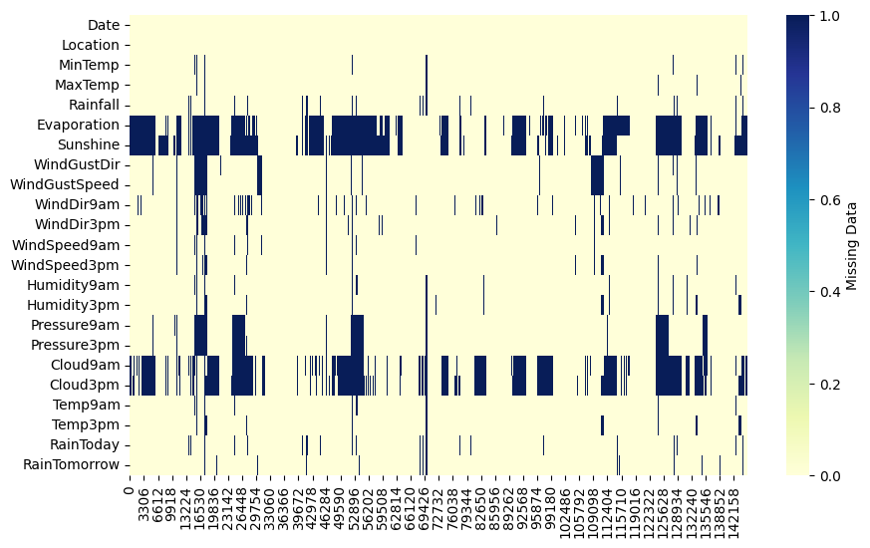
The Dataset
Before Data Processing
145460 entries
23 features
10.25% missing data
49 cities
Variable Types: mix of String and Float
Target Variable: RainTomorrow

Slide 4
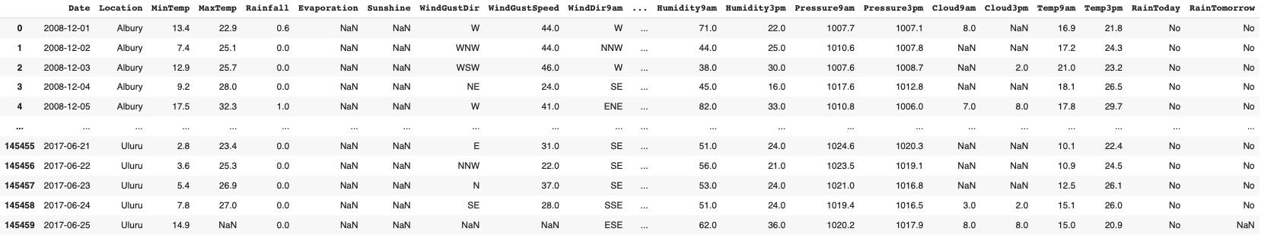
The Dataset
After Data Processing
56420 entries
23 features
0% missing data
20 cities
Variable Types: only Float
Target Variable: RainTomorrow

Slide 5
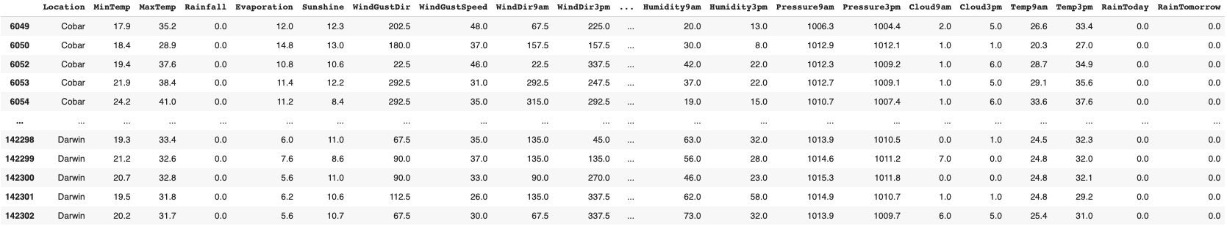
Data Processing Steps
Remove ‘Date’ column
Change String values to numbers (Wind format and Rain to 0/1)
Remove Records with Empty Values

Slide 6
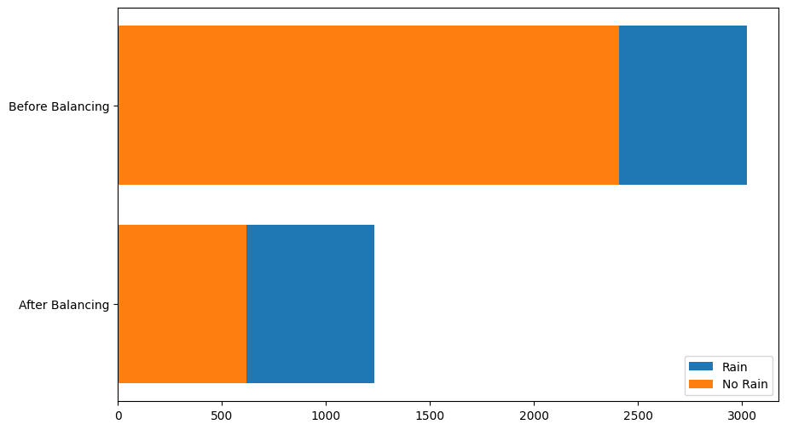
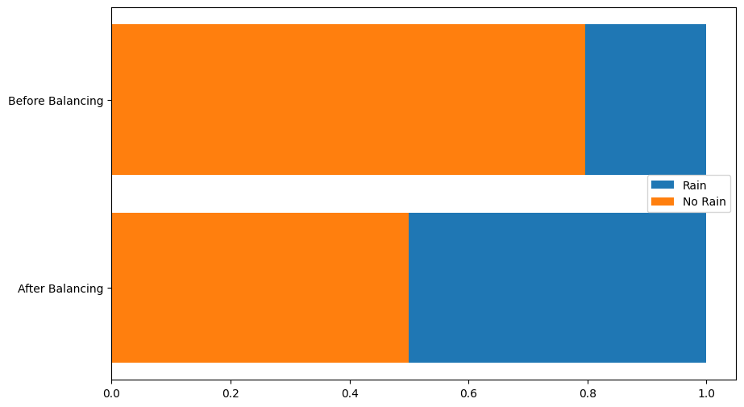
Data Processing Steps - continued
Filter data for one city (specified by user)
Undersampled the data (RainTomorrow = No RainTomorrow)
Normalized the data (Z-scores)

Slide 7
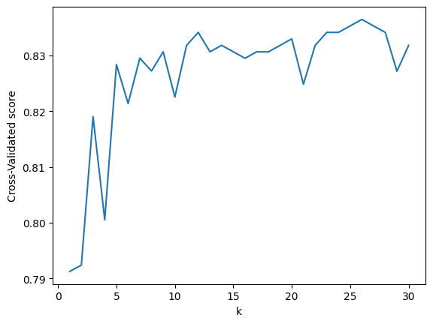
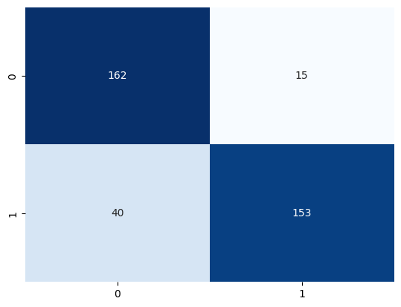
KNN Classifier Performance
Best K

Slide 8
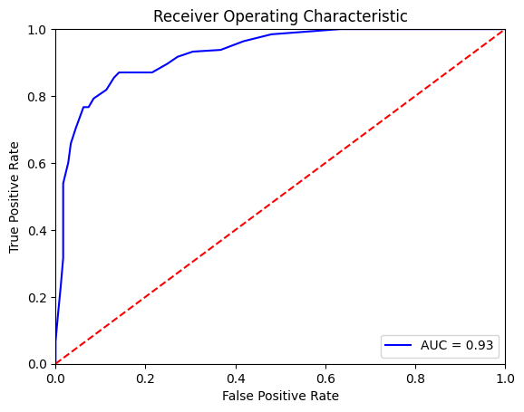
KNN Classifier Performance
Accuracy: 85.14% of the predictions were correct.
Precision: When predicted rain, it was correct 91.07% of the time.
Recall: 79.27% of the actual rain occurrences were identified
False Positive Rate (FP Rate): 8.47% of rain predictions were wrong.
ROC AUC (Area Under Curve): 0.9289. The model can effectively distinguish between rain and no rain classes.

Slide 9
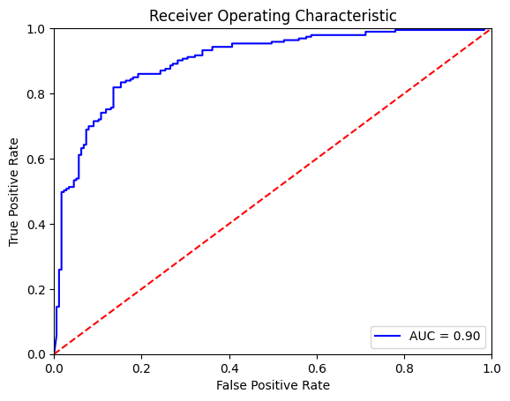
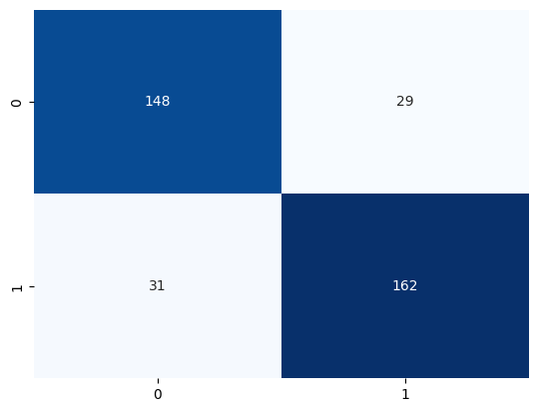
Naive Bayes Classifier Performance

Slide 10
Naive Bayes Classifier Performance
Accuracy: 83.78% of the predictions were correct.
Precision: When predicted rain, it was correct 84.82% of the time.
Recall: 83.94% of the actual rain occurrences were identified
False Positive Rate (FP Rate): 16.38% of rain predictions were wrong.
ROC AUC (Area Under Curve): 0.9008. The model can effectively distinguish between rain and no rain classes.

Slide 11
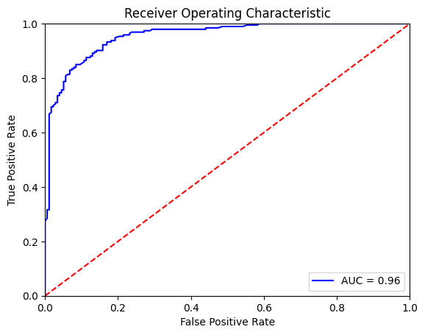
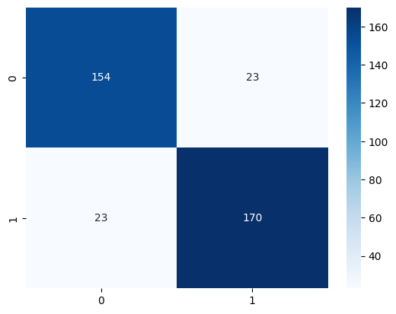
Random Forest Classifier Performance

Slide 12
Random Forest Classifier Performance
Accuracy: 87.57% of the predictions were correct.
Precision: When predicted rain, it was correct 88.08% of the time.
Recall: 88.08% of the actual rain occurrences were identified
False Positive Rate (FP Rate): 11.92% of rain predictions were wrong.
ROC AUC (Area Under Curve): 0.9551. The model can effectively distinguish between rain and no rain classes.

Slide 13
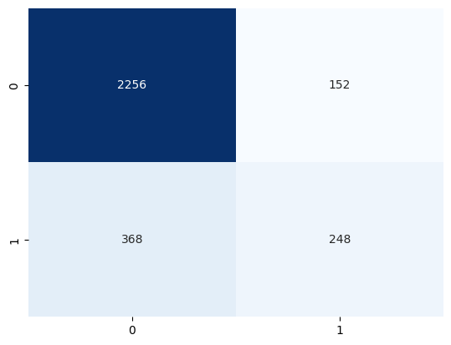
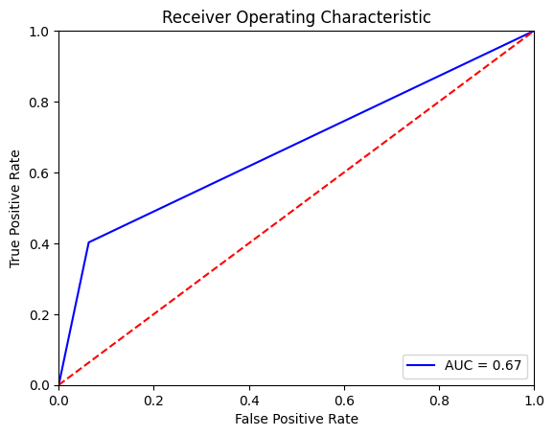
Long Term Short Memory Neural Network Performance

