Slide 1
Types of algorithms
Supervised learning → label given
Unsupervised learning → no label given, distinction between classes is inferred

Slide 2
Types of problems
Classification → output is one of x classes
Regression → output varies continuously

Slide 3
Workflow in ML
Load data
Split data into train/test datasets (or train/test/validation)
Assess model performance
Train model
Feature engineering

Slide 4
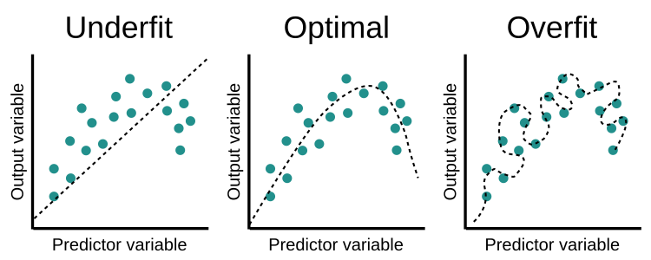
Training and overfitting

Slide 5
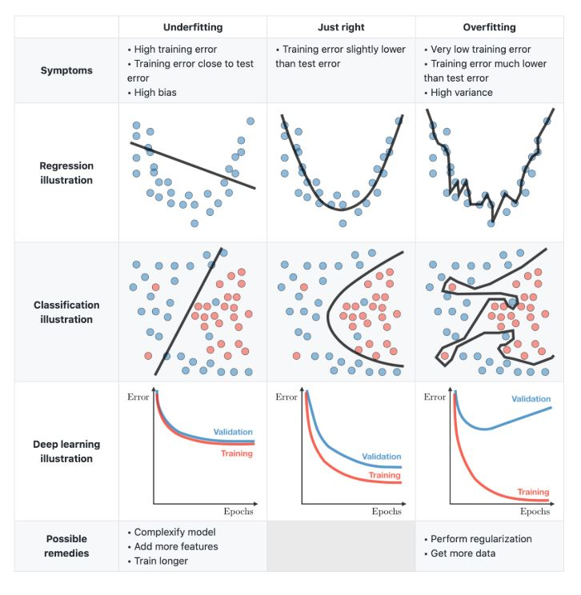
Training and overfitting

Slide 6
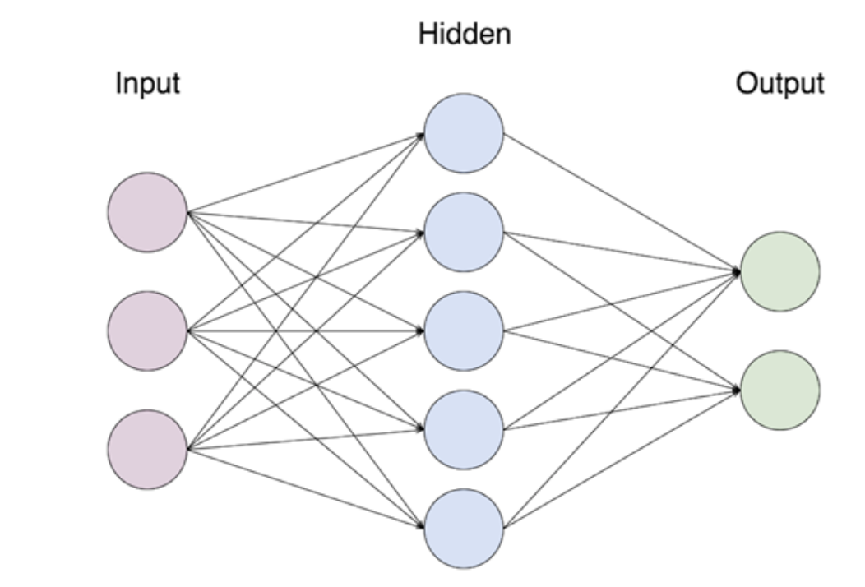
Neural networks

Slide 7
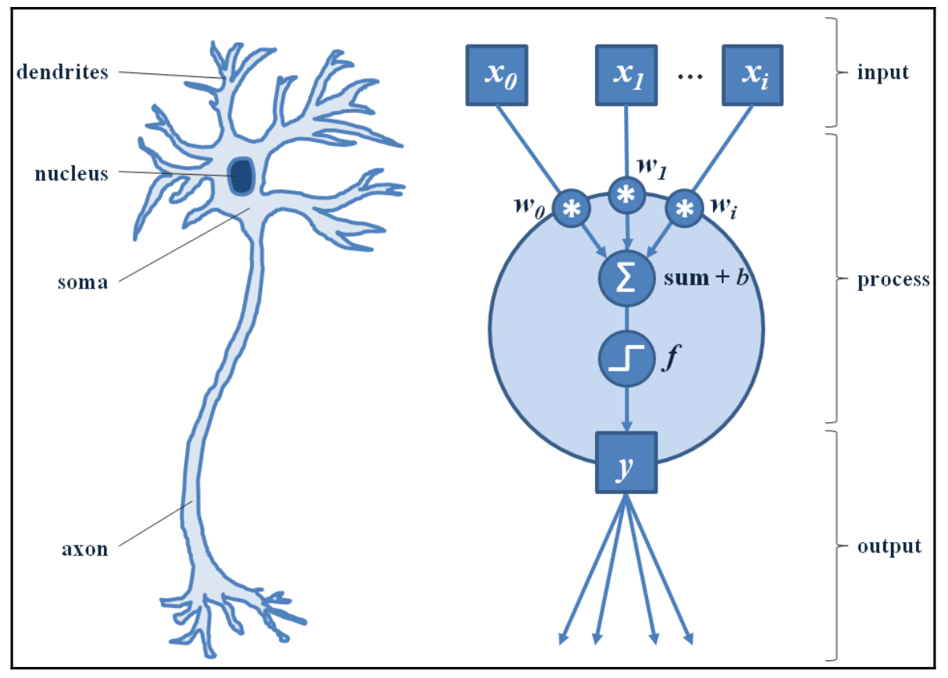
...and the neuron

Slide 8
Layers
- Input layer
- Output layer
- Fully connected (dense) layer
- Convolutional layer
- Pooling layer
- Dropout layer

Slide 9
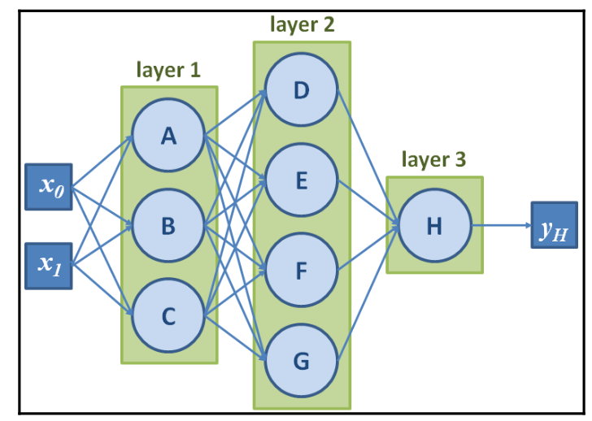
Fully Connected Layer

Slide 10
Problems with dense layers
Why not just stack a bunch of fully connected layers???
Two problems with that:
- parameters explosion: if we connect an input layer that accepts a 28X28X1 image to a 64 nodes dense layers we have 50,176 parameters
- lack of spatial reasoning: all neurons receive inputs from all other neurons, therefore information coming from different parts of an image are all mixed together from the start

Slide 11
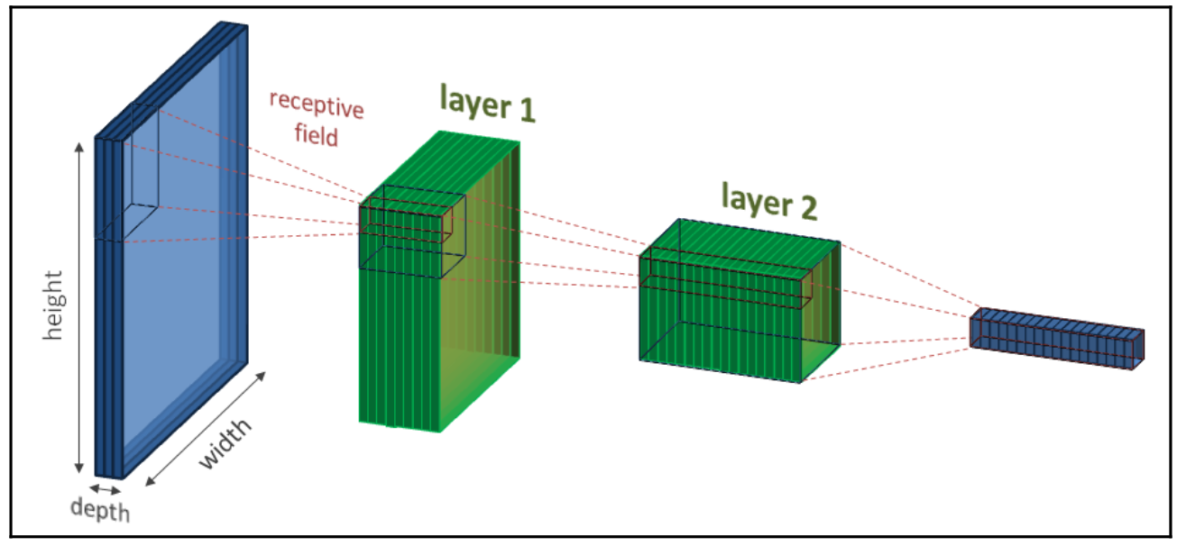
Spatial segregation

Slide 12
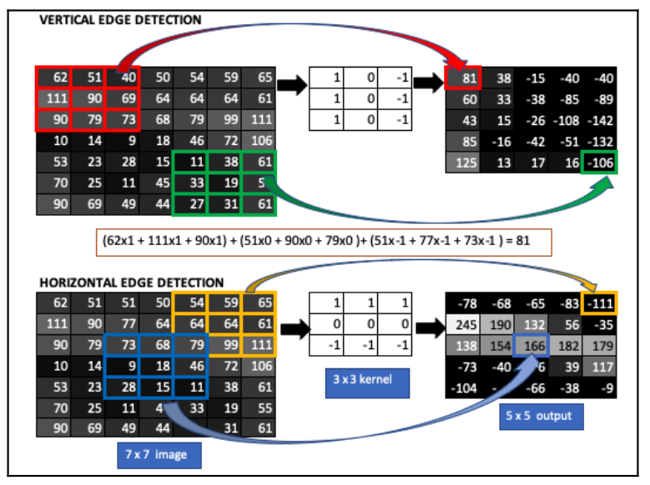
Convolutional Layer

Slide 13
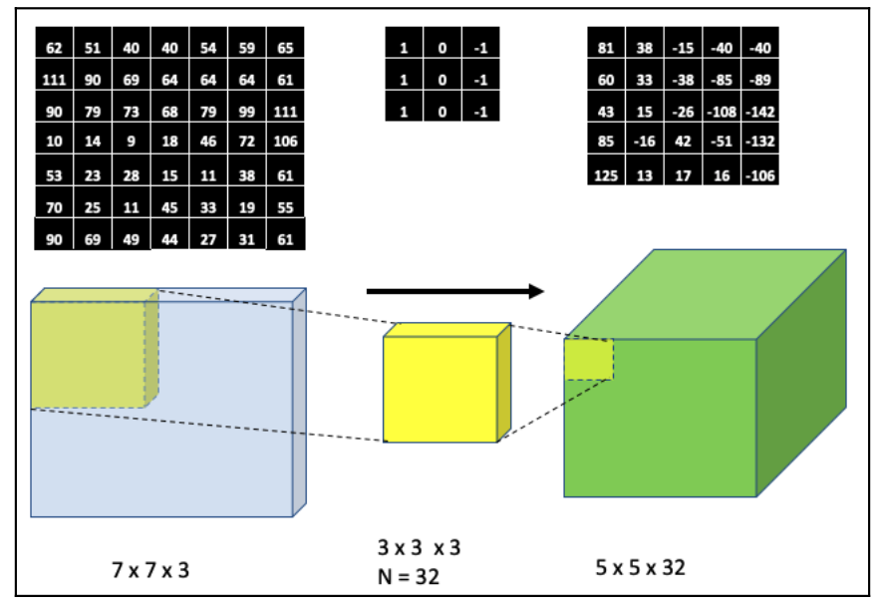
Convolutional Layer

Slide 14
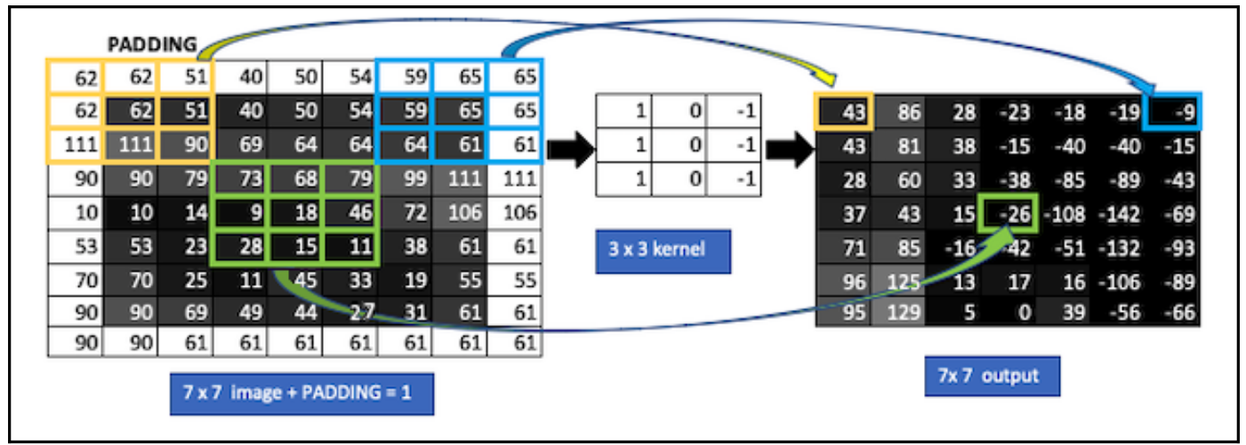
Padding

Slide 15
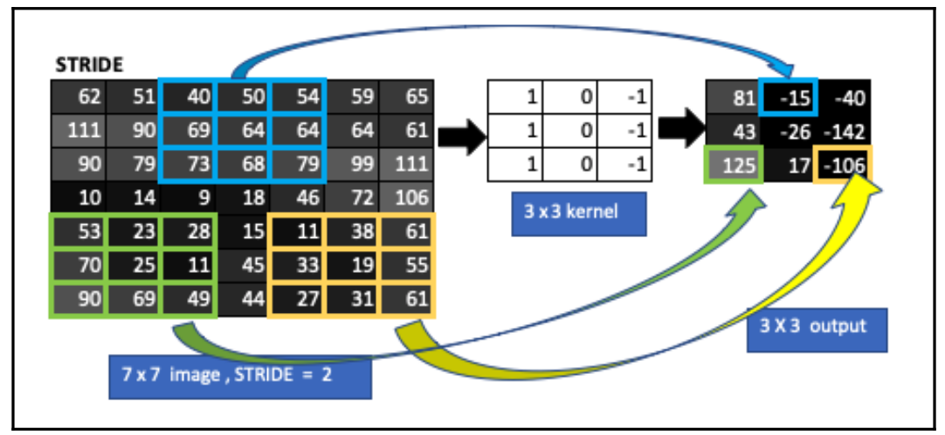
Stride

Slide 16
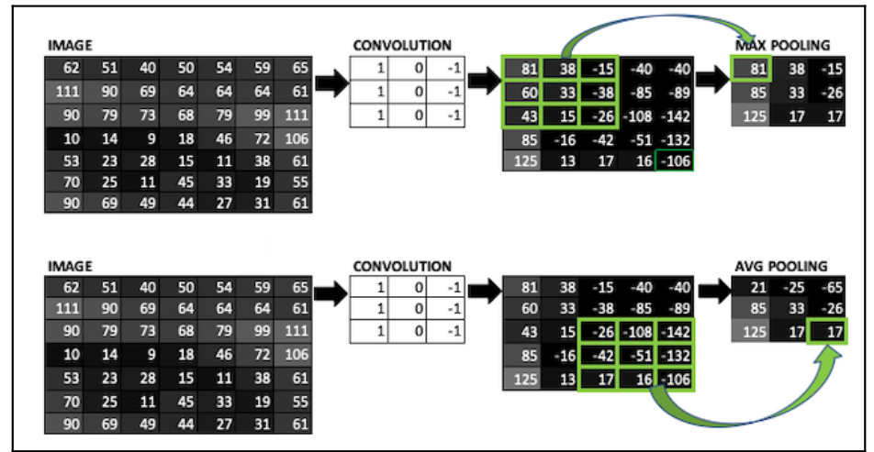
Pooling Layer

Slide 17
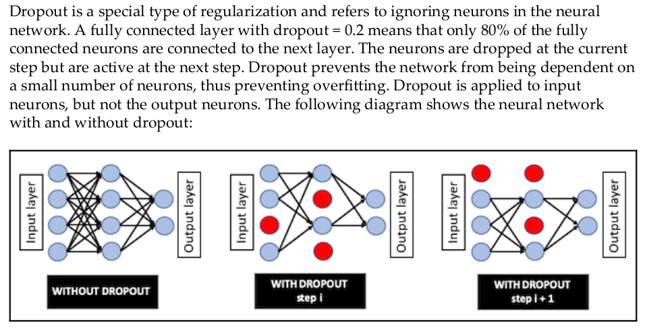
Dropout Layer

Slide 18
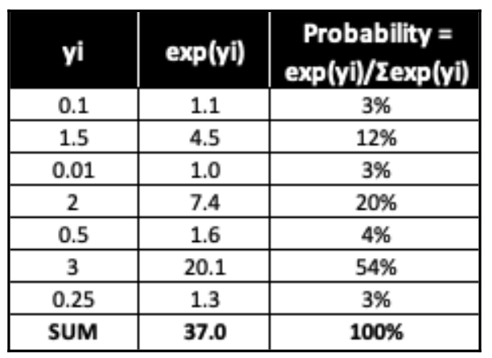
Activation function: Softmax

Slide 19
Activation function: Softmax

Slide 20
Model creation steps
Declaring model layers
Compiling model:
- Loss Function
- Optimizer

Slide 21
How many layers?
There is no magic number, it depends on the complexity of the problem!
There can be many different solution to the same problem with different numbers of layers, but the further away we move from the “sweet spot” for a given problem we incur in :
- underfitting: the neural network is too simple and there not enough parameters to properly learn how to solve the task;
- overfitting: the neural network is too complex and has too much capacity and is able to learn everything about the training sample (signal and noise) instead of generalizing

