Slide 1

CSCI E-96
Data Mining, Exploration and
Discovery
Introduction to Clustering Models
Part 1
Steve Elston
Copyright 2020,2021, 2022, 2023, 2024, 2025, Stephen F Elston. All rights reserved.

Slide 2
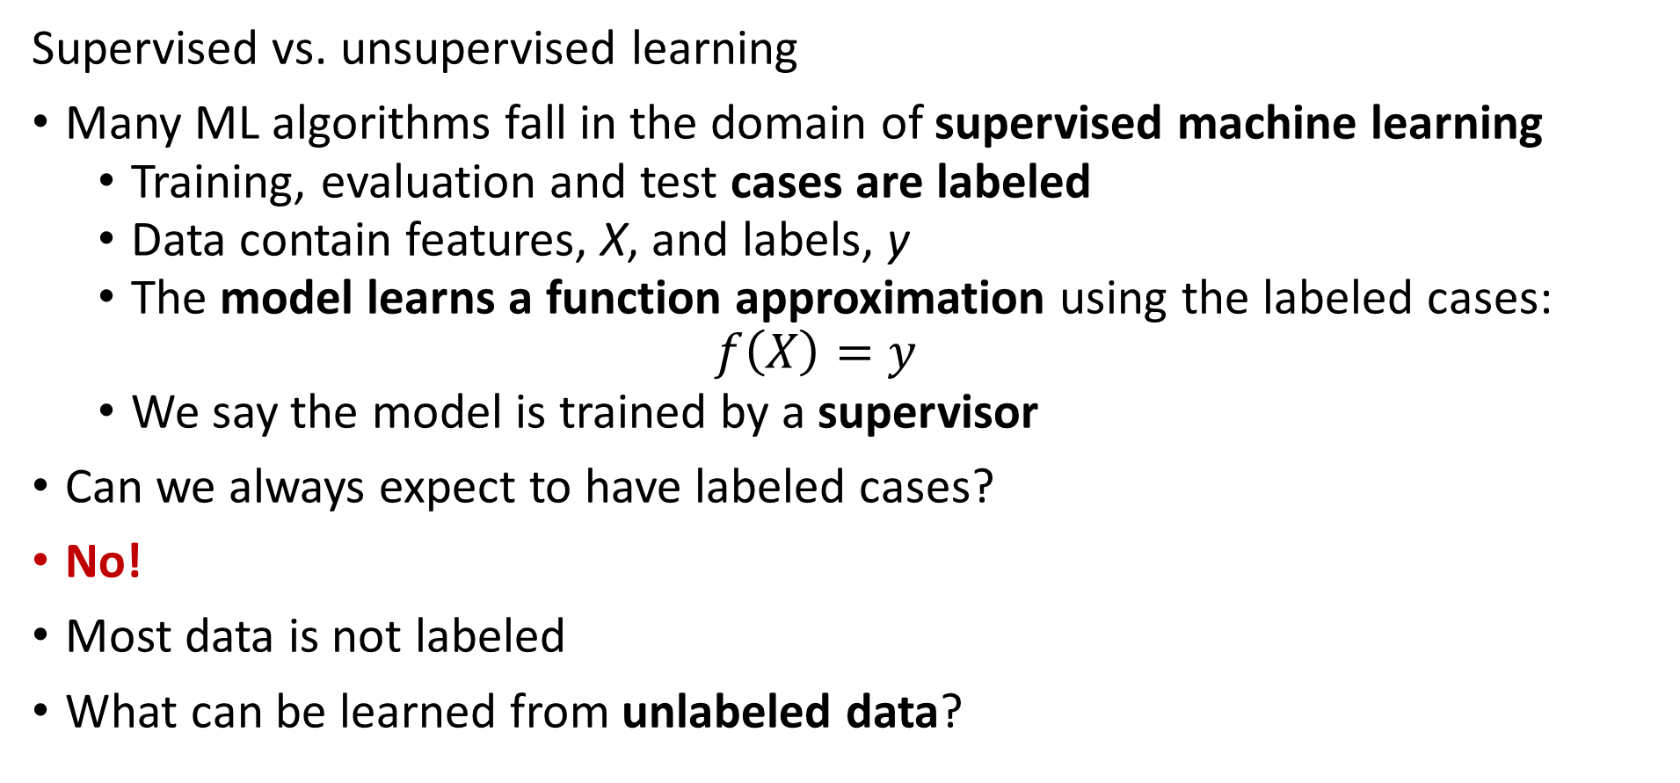
Overview, Unsupervised Learning
Supervised vs. unsupervised learning
Many ML algorithms fall in the domain of supervised machine learning
  Training, evaluation and test cases are labeled
  Data contain features, X, and labels, y
  The model learns a function approximation using the labeled cases:
  $$f\left(X\right)=y$$
  We say the model is trained by a supervisor
Can we always expect to have labeled cases?
No!
Most data is not labeled
What can be learned from unlabeled data?

Slide 3
Overview, Unsupervised Learning
Why should we care about unsupervised learning?
Most data is not labeled
Learning relationships in data is useful in many data mining solutions:
  Discover unusual or outlier events
  Similar genes in microassay data
  Group similar products
  Find groups of people with similar behaviors – e.g. voting, purchasers, products,…
  Find patients with related symptoms
  Data compression algorithms
  And many more...

Slide 4
Overview, Unsupervised Learning
Many types of unsupervised learning algorithms
Clustering models – today’s topic
Embedding models – PCA, manifold embedding,… - future lesson
Similarity search - Recommender models, document search, image search, …
Social network models
Association models – e.g. market basket analysis – future lesson
And many more…………
All methods depend on measures of distance or similarity

Slide 5
Overview, Unsupervised Learning
Without labeled data, what can a model learn?
Cluster models are a form of similarity search
Clustering algorithms are core data mining methods
  Data mining seeks to find interesting relationships in data
  Wish to find related or similar groups or associations that help us understand complex relationships in data
Cluster models create embeddings
  Embed a high-dimensional feature space in a low dimensional space
  Cluster assignments are a low-dimensional embedding
  Embeddings can greatly enhance understanding of relationships in data

Slide 6
Common Properties of Cluster Models

Slide 7
Properties of Cluster Models
Without labeled data, what can a model learn?
Can learn relationships or structure between variables
Structure is learned by determining associations between cases
  Association based on measures of similarity
  Or, distance or dissimilarity

Slide 8
Properties of Cluster Models
Properties of unsupervised learning models
Cluster models are a form of similarity search
Algorithms can use different similarity or dissimilarity metrics
  Different distance metrics can discover different relationships
  Different algorithms use different metrics
  Non-Euclidian metrics often required
What are the ideal properties of clusters?
  Compactness: minimum distance between members of a cluster, a closeness property
  Separation: maximum distance between clusters, a confidence property

Slide 9
Properties of Cluster Models
There are a wide variety of unsupervised learning models
Different similarity (dissimilarity) metrics will give different results
  Similarity metrics often matter more than model choice
  But which one should we use?
Evaluation is a significant problem for unsupervised learning
  There are no labels for objective evaluation
  Evaluation is partly subjective
Do we have to pick one best model?
  No!
  Different models can show different useful relationships
  In practice, try lots of metrics and models, keep the few useful ones!

Slide 10
Properties of Cluster Models
There is no one best clustering model!
Many classes of models
Models seeking compactness
Models seeking affinity between points
Models seeking high density regions

Slide 11
K-Means Clustering Models

Slide 12
K-Means Clustering
The K-means clustering algorithm is arguably the most widely used method
Long history
  One of the earliest data mining algorithms
  First proposed as a coding method by Stuart Lloyd in 1957 – not published until 1982
  Term ‘k-means’ coined by Jason MacQueen in 1967
The goal of the k-means algorithm is to find the best k clusters
  Most compact is considered best
  K is a chosen hyperparameter

Slide 13
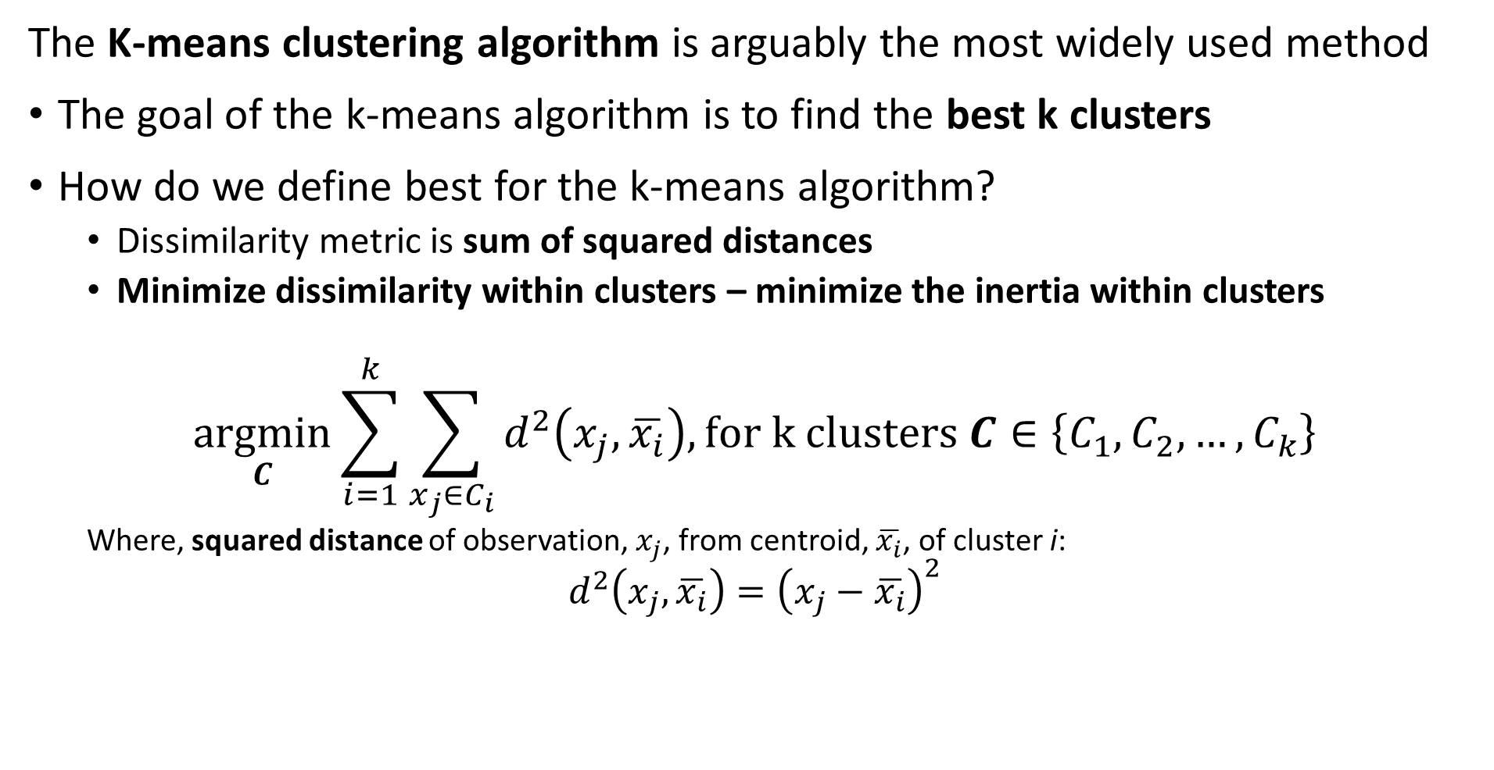
K-Means Clustering
The K-means clustering algorithm is arguably the most widely used method
The goal of the k-means algorithm is to find the best k clusters
How do we define best for the k-means algorithm?
  Dissimilarity metric is sum of squared distances
  Minimize dissimilarity within clusters – minimize the inertia within clusters
$$\underset{C}{argmin}{\sum_{i=1}^{k}{\sum_{x_{j}∈C_{i}}^{ }{d^{2}\left(x_{j},\overline{x_{i}}\right), for k clusters C∈\left\{C_{1},C_{2},…,C_{k}\right\}}}}$$
  Where, squared distance of observation, $x_{j}$, from centroid, $\overline{x_{i}}$, of cluster i:
$$d^{2}\left(x_{j},\overline{x_{i}}\right)={\left(x_{j}−\overline{x_{i}}\right)}^{2}$$

Slide 14
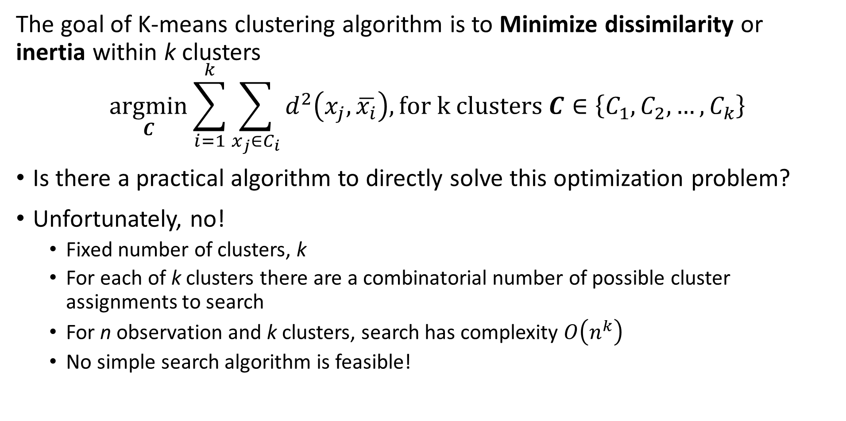
K-Means Clustering
The goal of K-means clustering algorithm is to Minimize dissimilarity or inertia within k clusters
$$\underset{C}{argmin}{\sum_{i=1}^{k}{\sum_{x_{j}∈C_{i}}^{ }{d^{2}\left(x_{j},\overline{x_{i}}\right), for k clusters C∈\left\{C_{1},C_{2},…,C_{k}\right\}}}}$$
Is there a practical algorithm to directly solve this optimization problem?
Unfortunately, no!
  Fixed number of clusters, k
  For each of k clusters there are a combinatorial number of possible cluster assignments to search
  For n observation and k clusters, search has complexity $O\left(n^{k}\right)$
  No simple search algorithm is feasible!

Slide 15
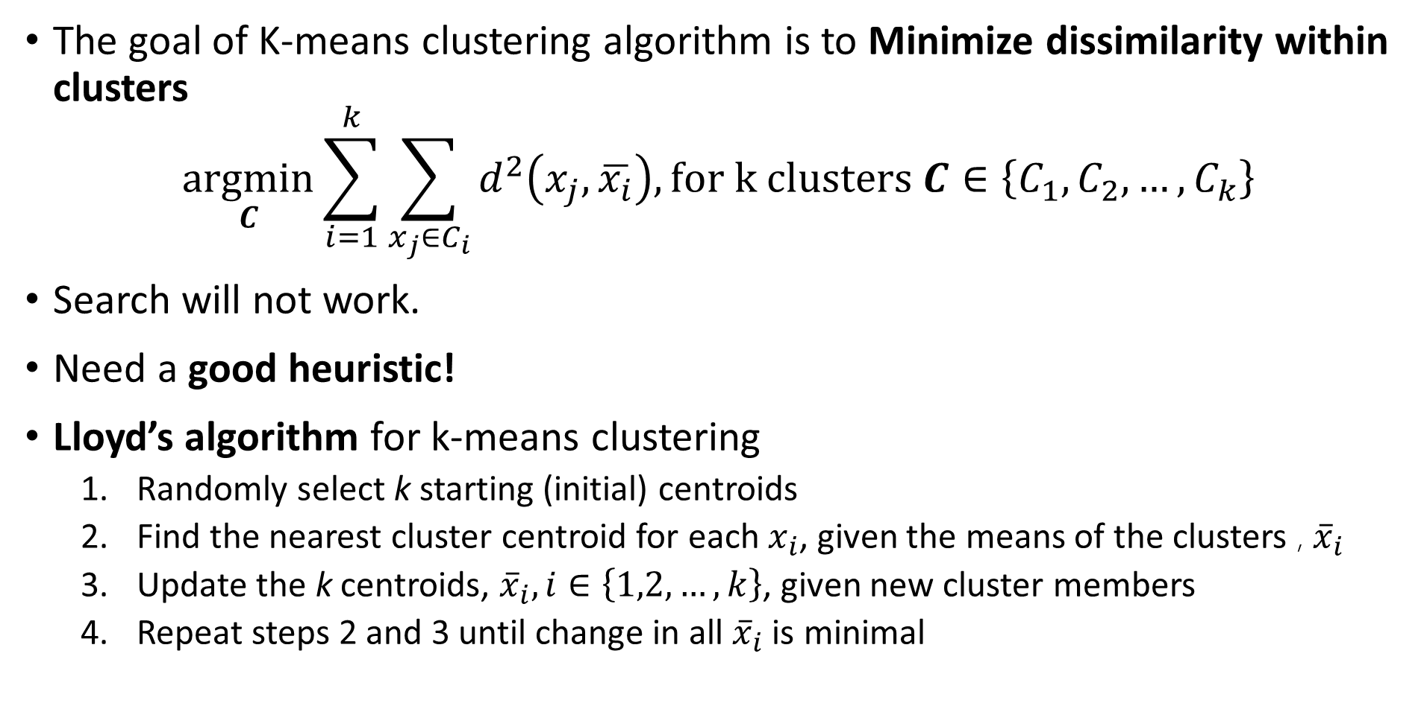
K-Means Clustering
The goal of K-means clustering algorithm is to Minimize dissimilarity within clusters
$$\underset{C}{argmin}{\sum_{i=1}^{k}{\sum_{x_{j}∈C_{i}}^{ }{d^{2}\left(x_{j},\overline{x_{i}}\right), for k clusters C∈\left\{C_{1},C_{2},…,C_{k}\right\}}}}$$
Search will not work.
Need a good heuristic!
Lloyd’s algorithm for k-means clustering
  Randomly select k starting (initial) centroids
  Find the nearest cluster centroid for each $x_{i}$, given the means of the clusters , ${\overline{x}}_{i}$
  Update the k centroids, ${\overline{x}}_{i}, i∈\left\{1,2,…,k\right\}$, given new cluster members
  Repeat steps 2 and 3 until change in all ${\overline{x}}_{i}$ is minimal

Slide 16
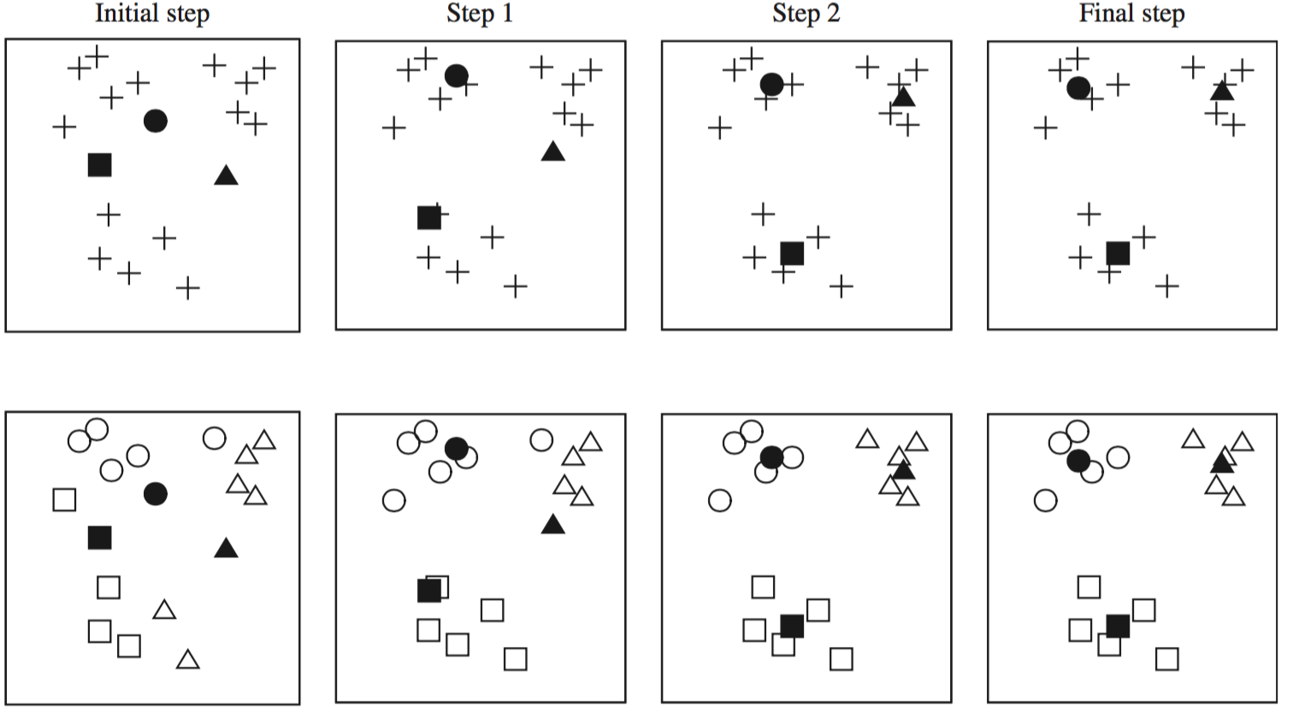
K-Means Clustering
Lloyd’s algorithm for k-means clustering, initializes with random start and iterates over several steps
Credit: Data Mining, Practical Machine Learning Tools and Techniques, Whitten et. al., fourth edition, 2016

Slide 17
K-Means Clustering
Lloyd’s algorithm for k-means clustering, initializes with random start and iterates over several steps
X
X
X
X
X
X
X
X
X
X
X
X
X
X
Start with data points
Initial cluster assignments
Update cluster centers and assignments
Iterate cluster centers and assignments until convergence
Assign Random cluster centers

Slide 18
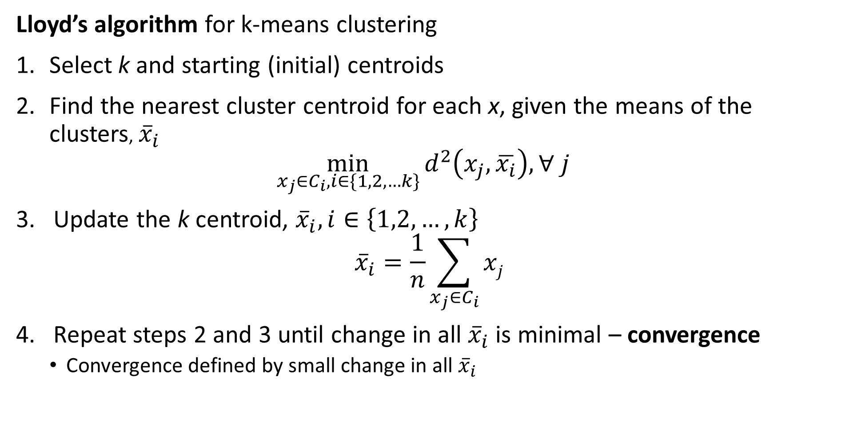
K-Means Clustering
Lloyd’s algorithm for k-means clustering
Select k and starting (initial) centroids
Find the nearest cluster centroid for each x, given the means of the clusters, ${\overline{x}}_{i}$
$$\min_{x_{j}∈C_{i},i∈\{1,2,…k\}}{d^{2}\left(x_{j},\overline{x_{i}}\right), ∀ j }$$
Update the k centroid, ${\overline{x}}_{i}, i∈\left\{1,2,…,k\right\}$
$${\overline{x}}_{i}=\frac{1}{n}\sum_{x_{j}∈C_{i}}{xj}$$
Repeat steps 2 and 3 until change in all ${\overline{x}}_{i}$ is minimal – convergence
  Convergence defined by small change in all ${\overline{x}}_{i}$

Slide 19
K-Means Clustering
There are several difficulties with using the k-means algorithm
What is the value of k, the number of clusters?
  The number of clusters should reflect fundamental relationships in the data
  Is there any way to know k in advance for high dimensional problems?
  No, k is found empirically, and the selection is often a bit subjective
How to find good starting values of the centroids?
  At convergence the resulting clusters depend on the starting values
  Is there any algorithm for finding good starting values?
  No!
  So, multiple random starts are often used

Slide 20
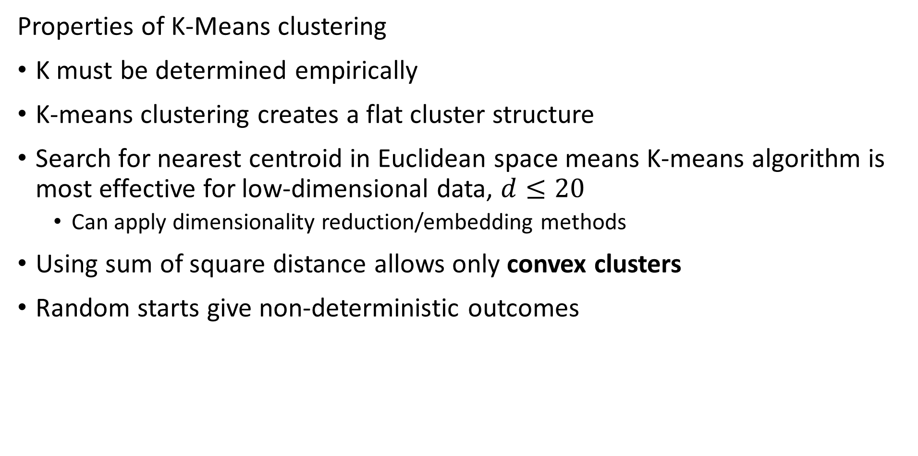
K-Means Clustering
Properties of K-Means clustering
K must be determined empirically
K-means clustering creates a flat cluster structure
Search for nearest centroid in Euclidean space means K-means algorithm is most effective for low-dimensional data, $d≤20$
  Can apply dimensionality reduction/embedding methods
Using sum of square distance allows only convex clusters
Random starts give non-deterministic outcomes

Slide 21
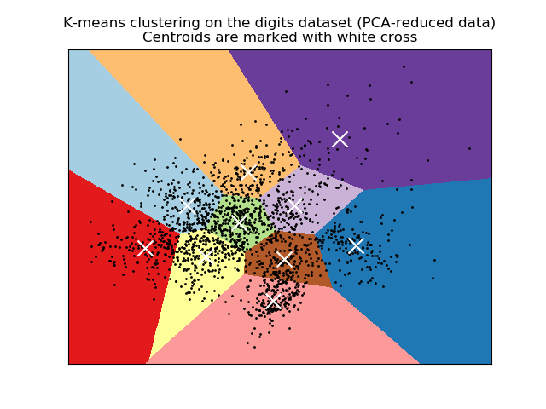
K-Means Clustering
K-means clustering produces convex clusters
Clusters are linearly separated
Clusters are within Voronoi regions
Analogous to k-NN search
Credit: Scikit-Learn development team; Pedregosa et al., JMLR 12, pp. 2825-2830, 2011

Slide 22
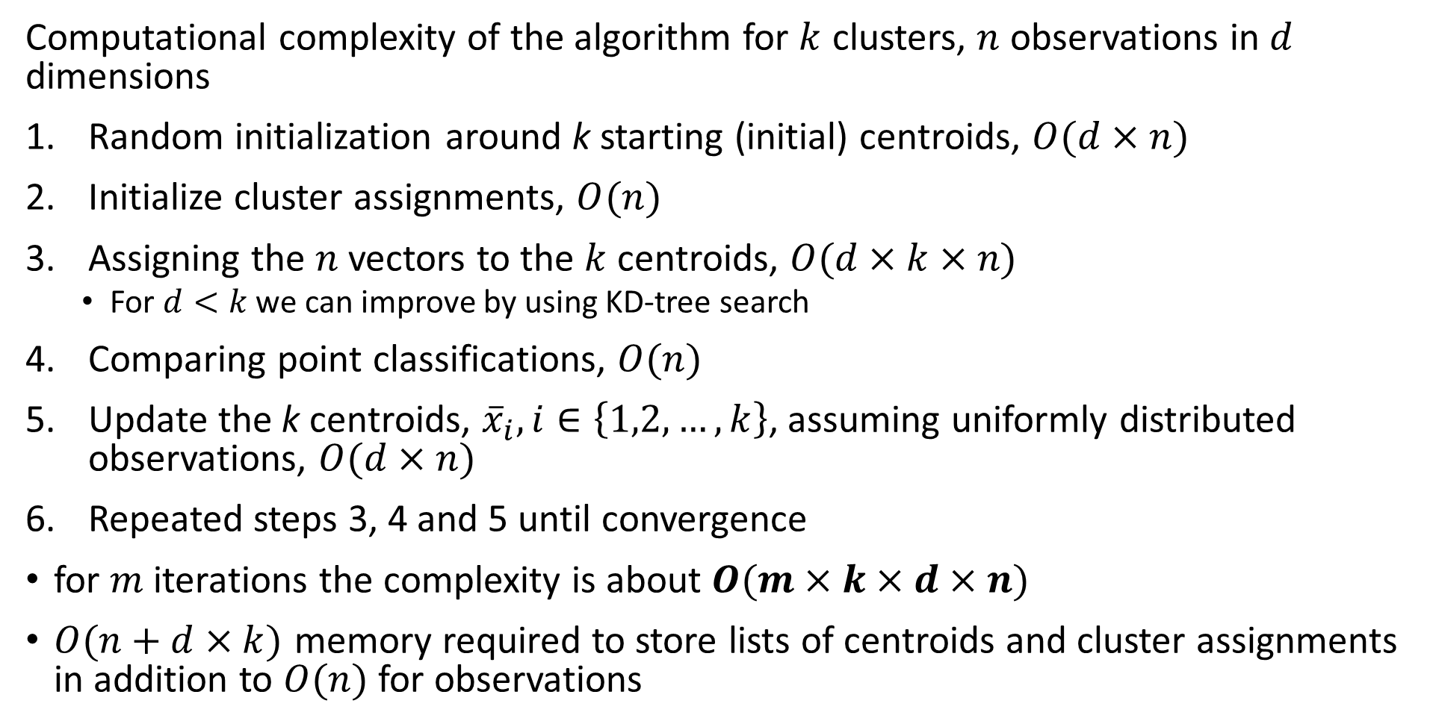
K-Means Clustering
Computational complexity of the algorithm for $k$ clusters, $n$ observations in $d$ dimensions
Random initialization around k starting (initial) centroids, $O(d×n)$
Initialize cluster assignments, $O(n)$
Assigning the $n$ vectors to the $k$ centroids, $O(d×k×n)$
  For $d<k$ we can improve by using KD-tree search
Comparing point classifications, $O(n)$
Update the k centroids, ${\overline{x}}_{i}, i∈\left\{1,2,…,k\right\}$, assuming uniformly distributed observations, $O(d×n)$
Repeated steps 3, 4 and 5 until convergence
for $m$ iterations the complexity is about $O(m×k×d×n)$
$O(n+d×k)$ memory required to store lists of centroids and cluster assignments in addition to $O(n)$ for observations

Slide 23
Evaluating Clustering Models

Slide 24
Evaluating Clustering Models
How do we evaluate clustering models?
No direct measure as with supervised machine learning
Can we use cross validation?
  Not directly, we have no labels
Use metrics that measure the properties of the clusters
  Compactness of clusters
  Separation between clusters
For k-means clustering the distance metric is quadratic
  Use sum of square metrics

Slide 25
Evaluating Clustering Models
How do we evaluate clustering models?
Within and between cluster sum of squares
  Can compare cluster models
  Determine k
  Only useful for Euclidean space!
Other methods
  Silhouette coefficients – Does not depend on Euclidian space
  Calinski-Harabasz index – Only for Euclidean space!
  Many others…….
Notice that all of these methods assume clusters are Normally distributed in a Euclidean space!

Slide 26
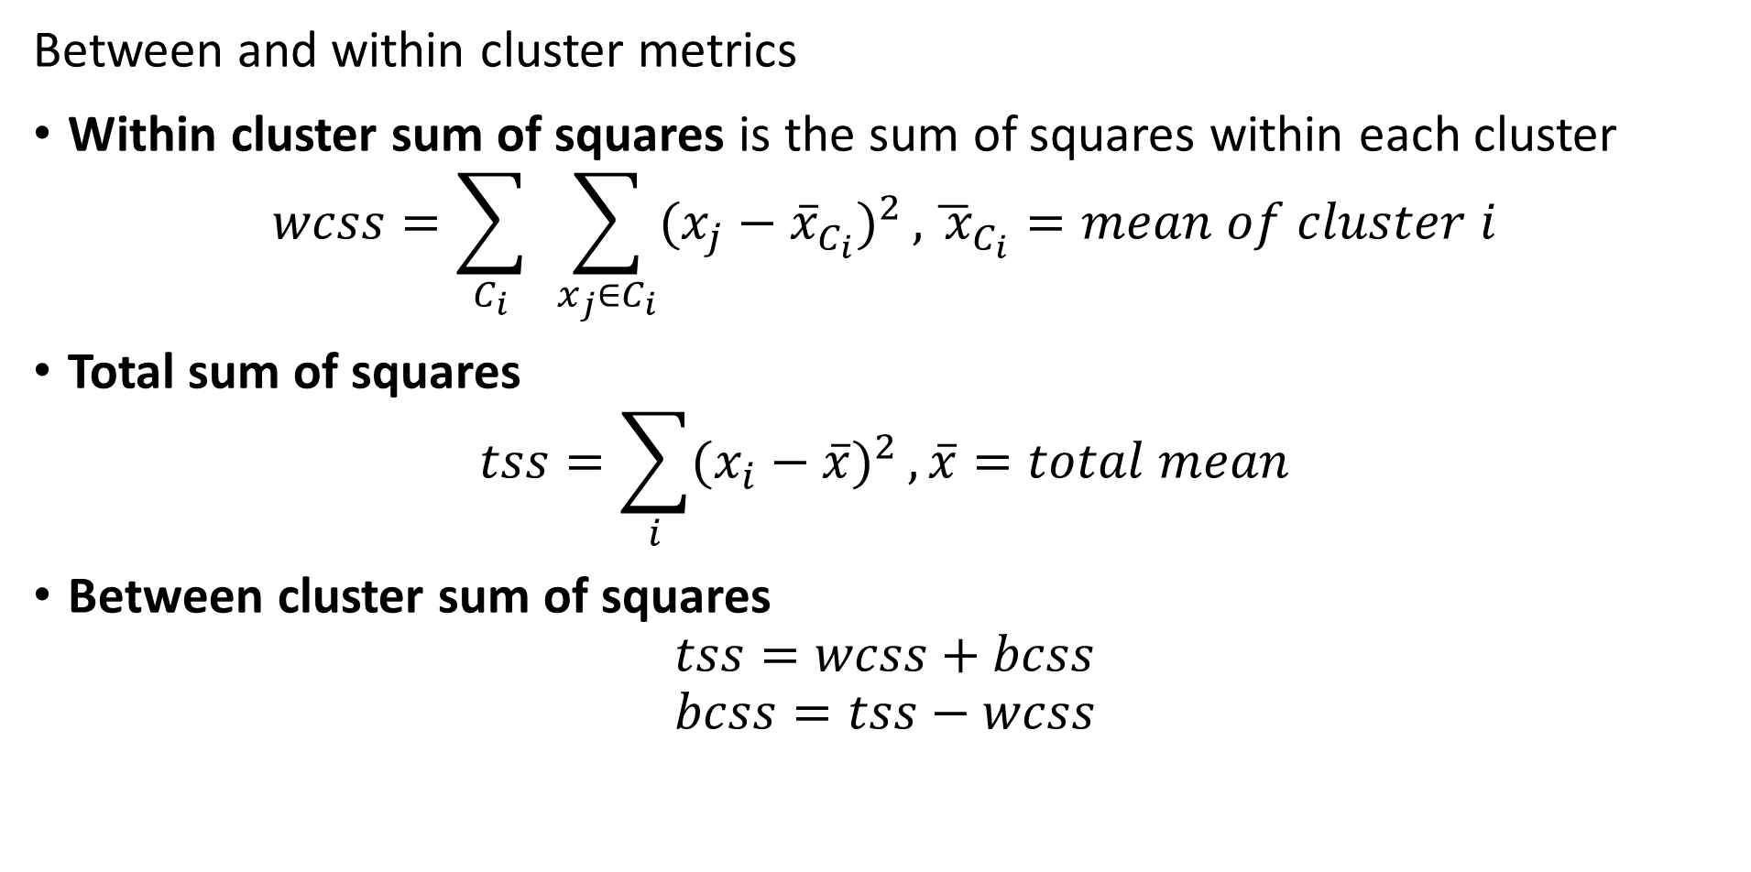
Evaluating Clustering Models
Between and within cluster metrics
Within cluster sum of squares is the sum of squares within each cluster
$$wcss=\sum_{C_{i}}^{ }{ }\sum_{x_{j}∈C_{i}}{(x_{j}−{\overline{x}}_{C_{i}})^{2}},{\overline{ x}}_{C_{i}}=mean of cluster i$$
Total sum of squares
$$tss=\sum_{i}{(x_{i}−\overline{x})^{2}},\overline{x}=total mean$$
Between cluster sum of squares
$$tss=wcss+bcss$$
$$bcss=tss−wcss$$

Slide 27
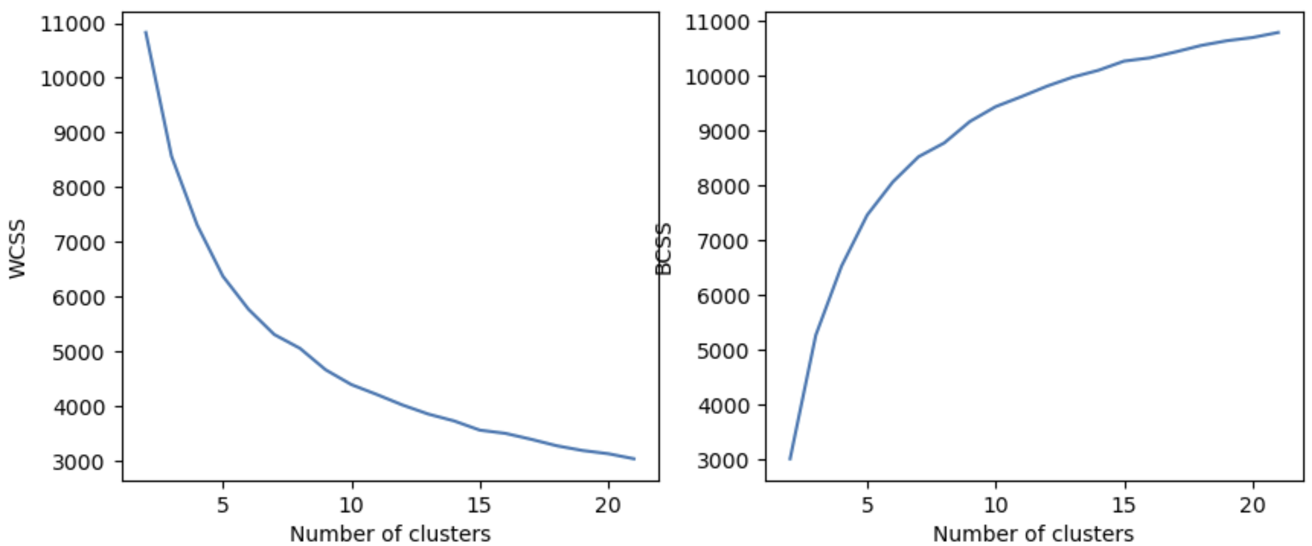
Evaluating Clustering Models
Use WCSS and BCSS to compare clustering models
Limit number of clusters where WCSS and BCSS have marginal changes

Slide 28
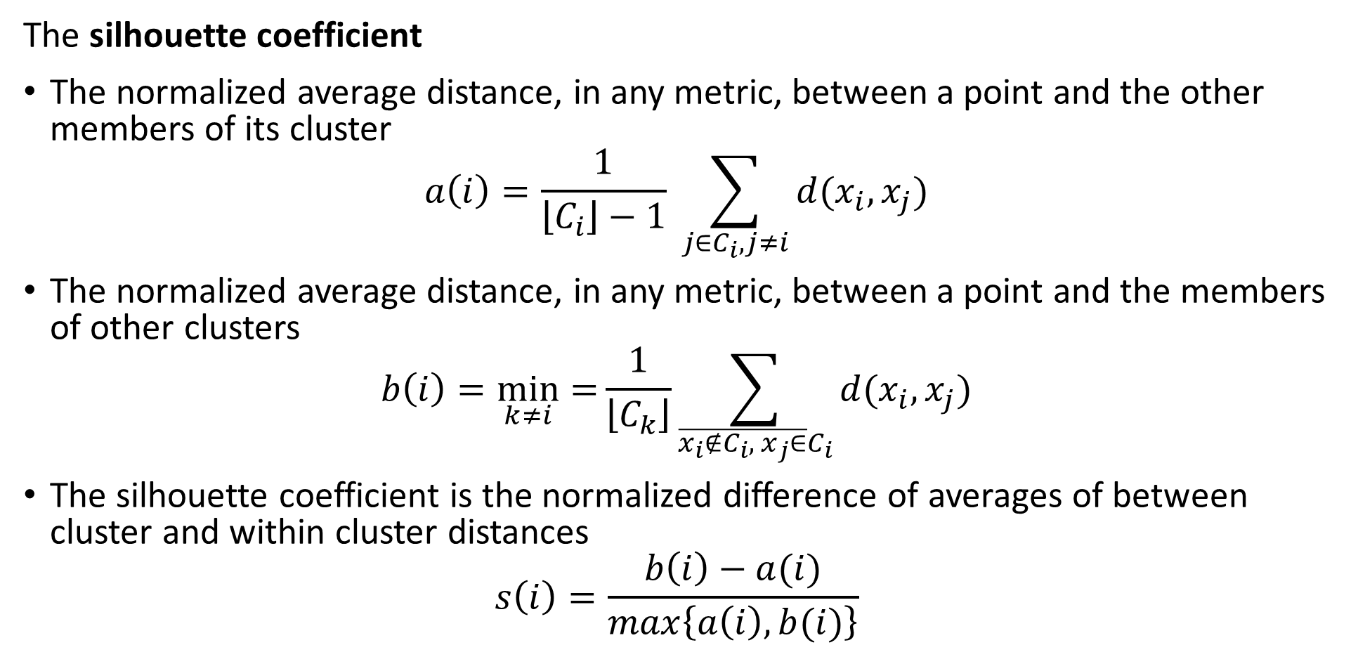
Evaluating Clustering Models
The silhouette coefficient
The normalized average distance, in any metric, between a point and the other members of its cluster
$$a\left(i\right)=\frac{1}{\left\lfloor C_{i}\right\rfloor −1} \sum_{j∈C_{i},j≠i}^{ }{d(x_{i},x_{j})}$$
The normalized average distance, in any metric, between a point and the members of other clusters
$$b\left(i\right)=\min_{k≠i}{=}\frac{1}{\left\lfloor C_{k}\right\rfloor }\sum_{\overline{{x_{i}∉C_{i}, x}_{j}∈}C_{i}}^{ }{d(x_{i},x_{j})}$$
The silhouette coefficient is the normalized difference of averages of between cluster and within cluster distances
$$s\left(i\right)=\frac{b\left(i\right)−a(i)}{max\left\{a\left(i\right),b(i)\right\}}$$

Slide 29
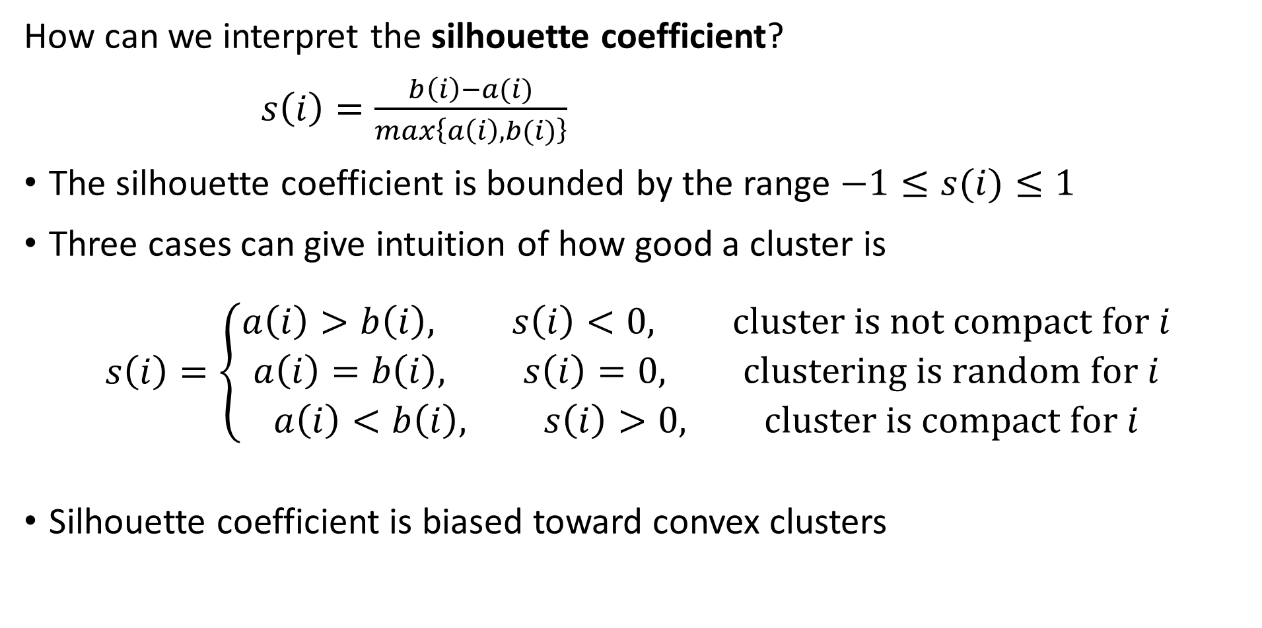
Evaluating Clustering Models
How can we interpret the silhouette coefficient?
$s\left(i\right)=\frac{b\left(i\right)−a(i)}{max\left\{a\left(i\right),b(i)\right\}}$
The silhouette coefficient is bounded by the range $−1≤s(i)≤1$
Three cases can give intuition of how good a cluster is
$$s\left(i\right)=\left\{\begin{aligned}a\left(i\right)>b\left(i\right), s\left(i\right)<0, cluster is not compact for i \\ a\left(i\right)=b\left(i\right), s\left(i\right)=0, clustering is random for i \\ a\left(i\right)<b\left(i\right), s\left(i\right)>0, cluster is compact for i\end{aligned}\right.$$
Silhouette coefficient is biased toward convex clusters

Slide 30
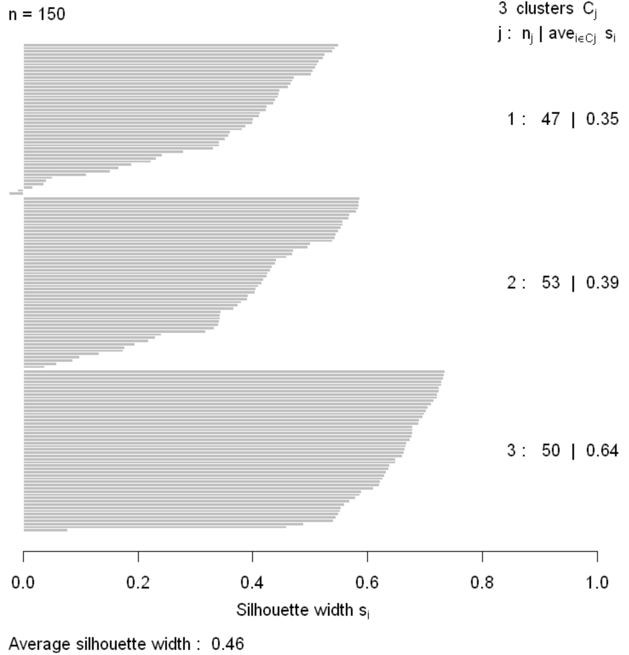
Evaluating Clustering Models
Silhouette coefficients can be graphed for small number of samples
Plot shows how compact and well separated the clusters are
Negative silhouette coefficients indicate sample incorrectly clustered

Slide 31
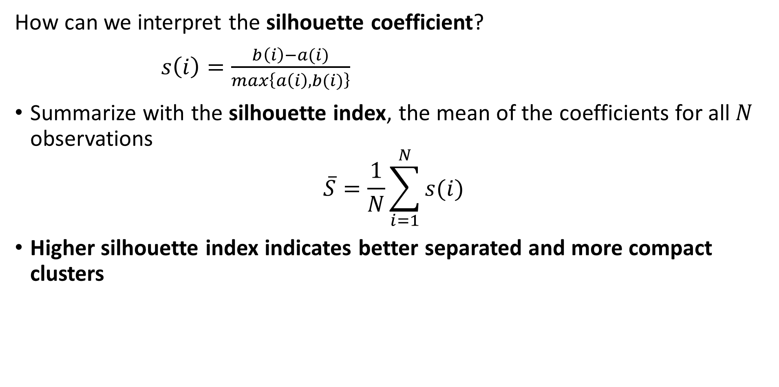
Evaluating Clustering Models
How can we interpret the silhouette coefficient?
$s\left(i\right)=\frac{b\left(i\right)−a(i)}{max\left\{a\left(i\right),b(i)\right\}}$
Summarize with the silhouette index, the mean of the coefficients for all $N$ observations
$$\overline{S}=\frac{1}{N}\sum_{i=1}^{N}{s(i)}$$
Higher silhouette index indicates better separated and more compact clusters

Slide 32
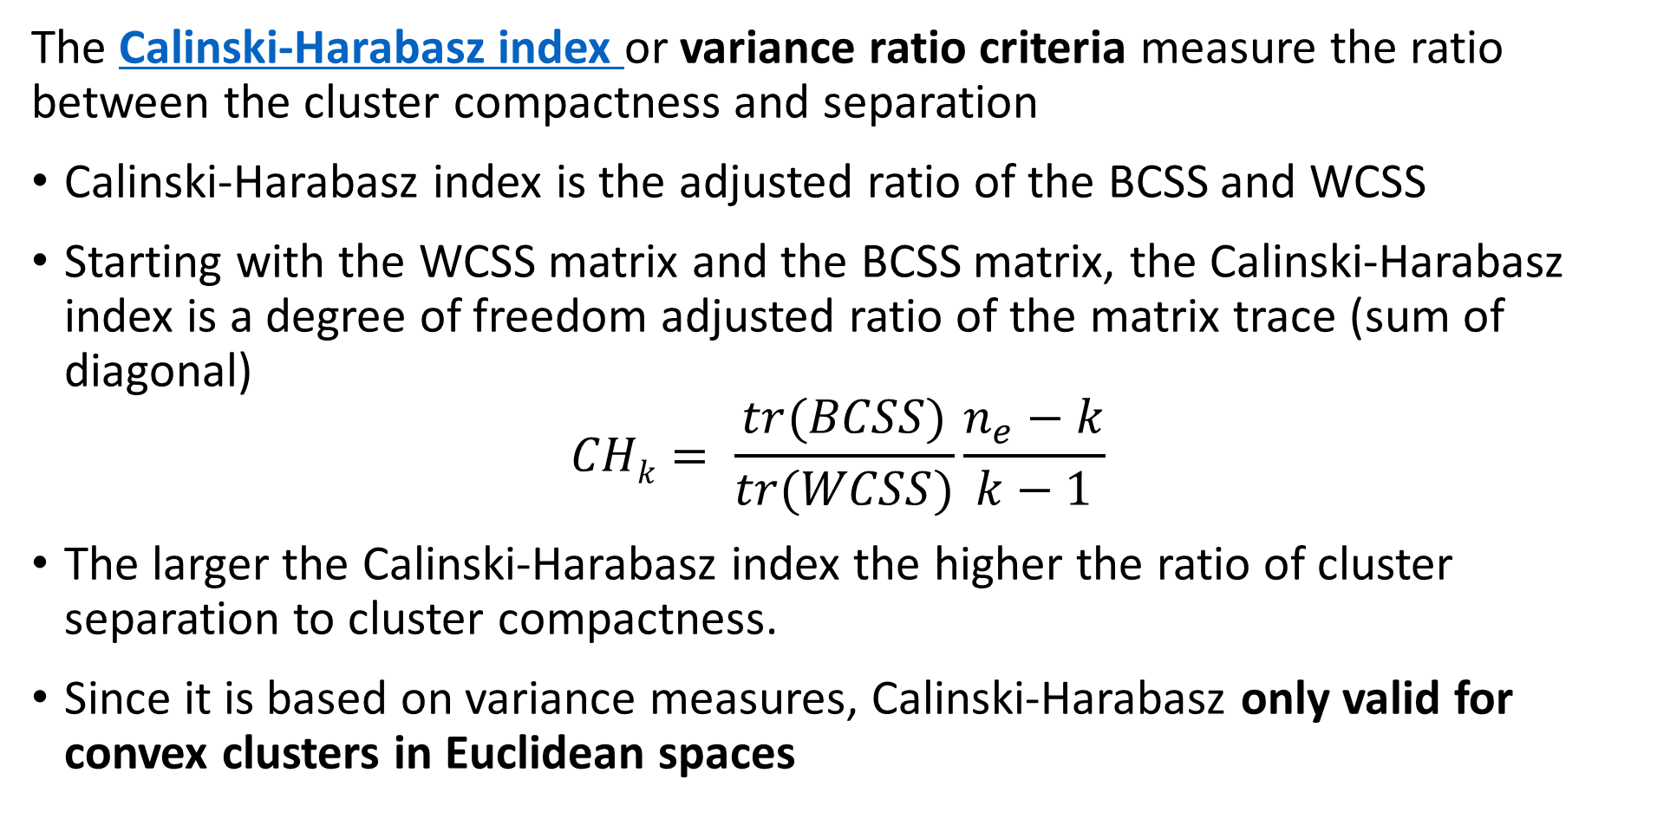
Evaluating Clustering Models
The Calinski-Harabasz index or variance ratio criteria measure the ratio between the cluster compactness and separation
Calinski-Harabasz index is the adjusted ratio of the BCSS and WCSS
Starting with the WCSS matrix and the BCSS matrix, the Calinski-Harabasz index is a degree of freedom adjusted ratio of the matrix trace (sum of diagonal)
$$CHk= \frac{tr(BCSS)}{tr(WCSS)}\frac{n_{e}−k}{k−1}$$
The larger the Calinski-Harabasz index the higher the ratio of cluster separation to cluster compactness.
Since it is based on variance measures, Calinski-Harabasz only valid for convex clusters in Euclidean spaces

Slide 33
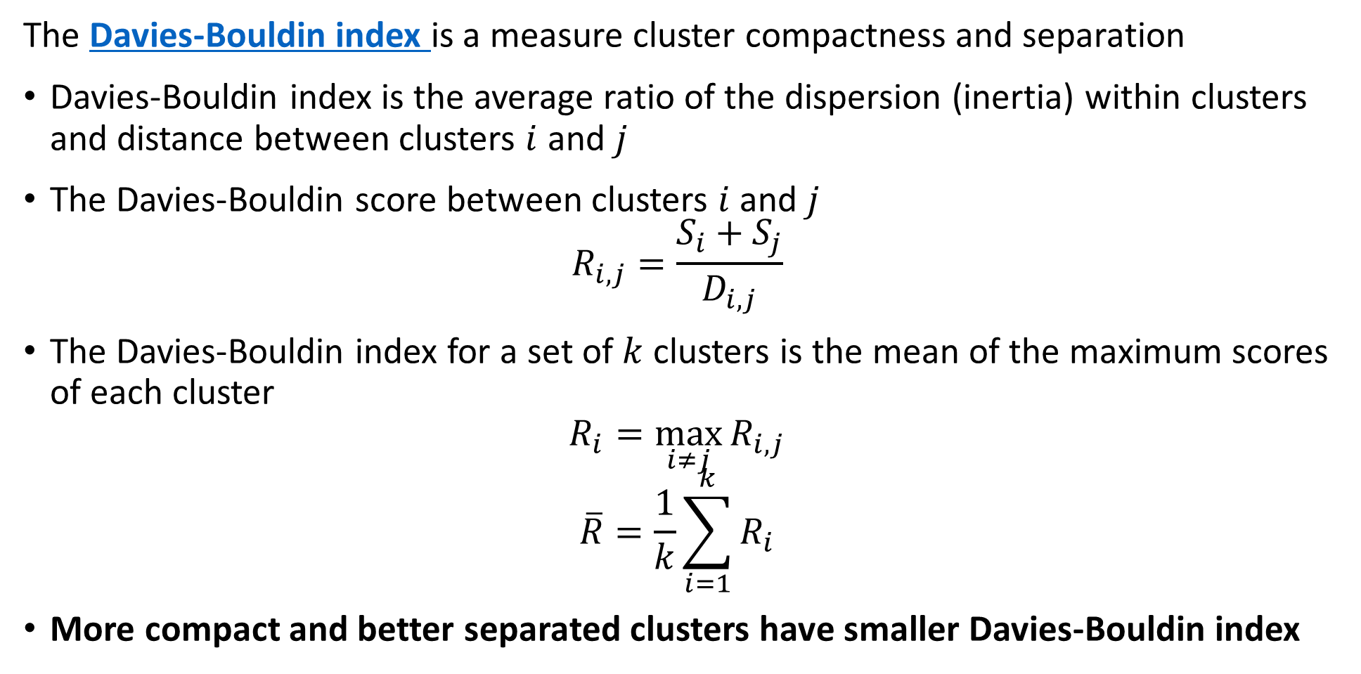
Evaluating Clustering Models
The Davies-Bouldin index is a measure cluster compactness and separation
Davies-Bouldin index is the average ratio of the dispersion (inertia) within clusters and distance between clusters $i$ and $j$
The Davies-Bouldin score between clusters $i$ and $j$
$$R_{i,j}=\frac{S_{i}+S_{j}}{D_{i,j}}$$
The Davies-Bouldin index for a set of $k$ clusters is the mean of the maximum scores of each cluster
$$R_{i}=\max_{i≠j}{R_{i,j}}$$
$$\overline{R}=\frac{1}{k}\sum_{i=1}^{k}{R_{i}}$$
More compact and better separated clusters have smaller Davies-Bouldin index

Slide 34
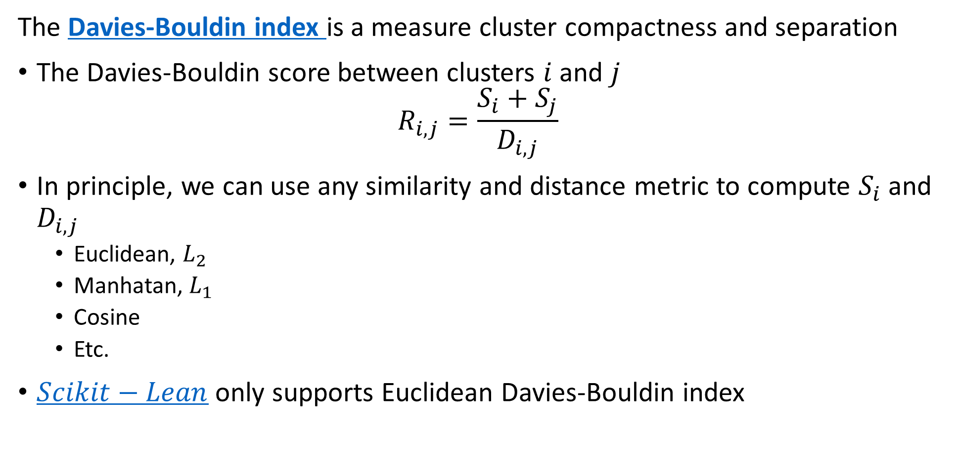
Evaluating Clustering Models
The Davies-Bouldin index is a measure cluster compactness and separation
The Davies-Bouldin score between clusters $i$ and $j$
$$R_{i,j}=\frac{S_{i}+S_{j}}{D_{i,j}}$$
In principle, we can use any similarity and distance metric to compute $S_{i}$ and $D_{i,j}$
  Euclidean, $L_{2}$
  Manhatan, $L_{1}$
  Cosine
  Etc.
$Scikit−Lean$ only supports Euclidean Davies-Bouldin index

Slide 35
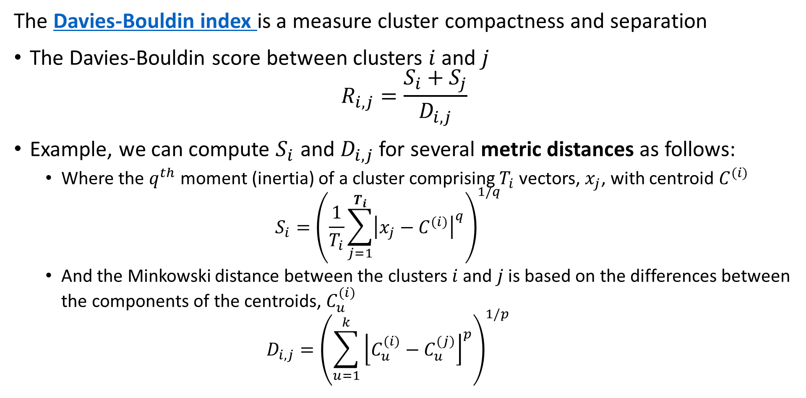
Evaluating Clustering Models
The Davies-Bouldin index is a measure cluster compactness and separation
The Davies-Bouldin score between clusters $i$ and $j$
$$R_{i,j}=\frac{S_{i}+S_{j}}{D_{i,j}}$$
Example, we can compute $S_{i}$ and $D_{i,j}$ for several metric distances as follows:
  Where the $q^{th}$ moment (inertia) of a cluster comprising $T_{i}$ vectors, $x_{j}$, with centroid $C^{(i)}$
  $$S_{i}={\left(\frac{1}{T_{i}}\sum_{j=1}^{T_{i}}{{\left|x_{j}−C^{(i)}\right|}^{q}}\right)}^{1/q}$$
  And the Minkowski distance between the clusters $i$ and $j$ is based on the differences between the components of the centroids, $C_{u}^{(i)}$
  $$D_{i,j}={\left(\sum_{u=1}^{k}{{\left\lfloor C_{u}^{(i)}−C_{u}^{(j)}\right\rfloor }^{p}}\right)}^{1/p}$$

Slide 36
Evaluating Clustering Models
Use multiple metrics to find best number of clusters
Knee in WCSS and BCSS – not very reliable!
Max of silhouette index
Max of Calinski-Harabasz index
Min of the Davies-Bouldin index
There is stochastic variation
  Must compare several methods
  Metrics may not agree
  May need to try several models
Prefer simpler models – Occam’s razor!
Too many clusters is an over-fit model

Slide 37
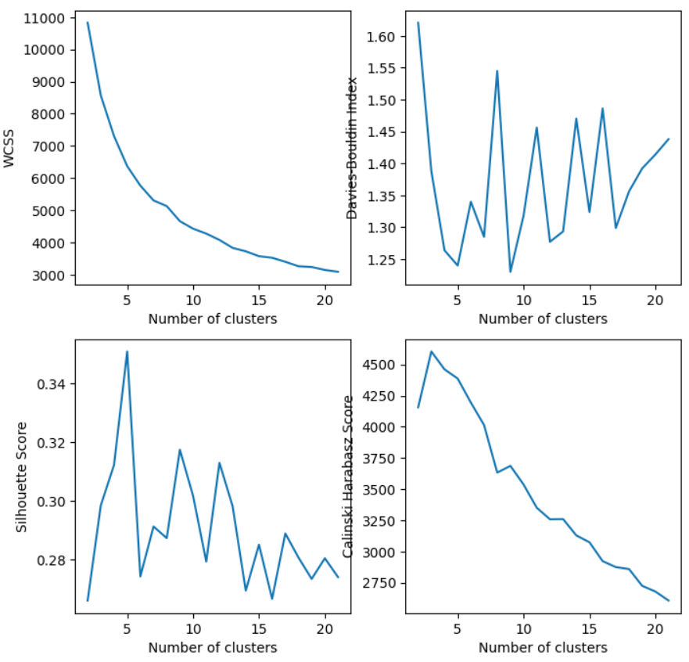
Evaluating Clustering Models
Use multiple metrics to find best number of clusters
Typically, hard to find clear ‘knee in WCSS, 5? Or 9? Or ??
Minimum of Davis-Bouldin index at 5 and 9
Peak of silhouette index at 5 and lower at 9
Value of Calinski-Harabasz index at 5 is close to peak and lower at 9
Despite the ambiguity, 5 clusters appears to be best

Slide 38
Visualizing Cluster Model Results

Slide 39
Visualizing Clustering Model Results
How can we visualize the results of a cluster model?
Visualization of any kind is difficult with high-dimensional data
  Many methods possible
  Look for domain specific methods
Scatter plot matrices between key variables
  Useful for low-dimensional data
  Impossible to see and understand for high-dimensional data
Compare distributions of clusters of key variables for clusters
Display a low-dimensional manifold projection of the high-dimensional cluster assignments

Slide 40
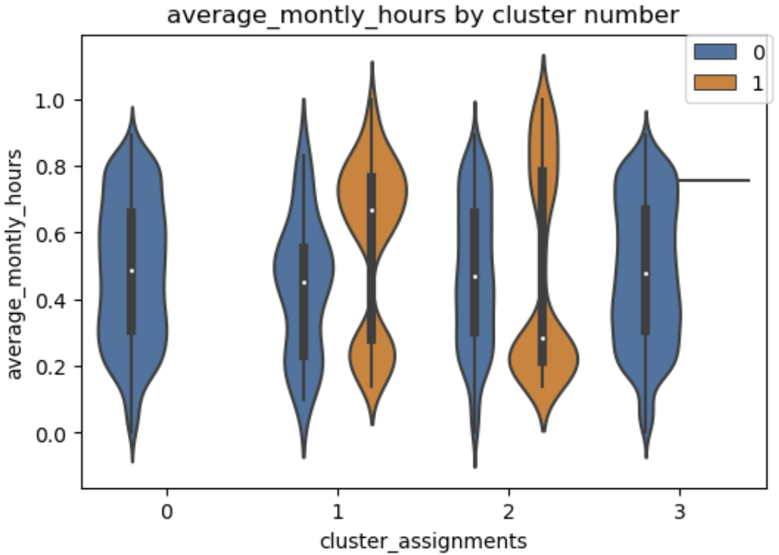
Visualizing Clustering Model Results
How can we visualize the results of a cluster model?
Compare distributions of clusters of key variables for clusters
Side by side violin plots are an excellent tool for this purpose
Compare kernel density estimates (KDE) of variables by cluster assignment
Includes box plot
Mirrored KDE with normalized areas
Box plot showing median and quartiles
Multi-modal distributions invisible in boxplots

Slide 41
Visualizing Clustering Model Results
How can we visualize the results of a cluster model?
Display a low-dimensional manifold projection of the high-dimensional cluster assignments
A manifold is a low-dimensional surface in a high-dimensional space
Principle Component Analysis (PCA) is only useful for Euclidean spaces
Uniform Manifold Approximation and Projection (UMAP) is a state of the art manifold projection algorithm
  Finds the best low-dimensional projection of a high-dimensional space
  Attempts to preserve distances
  Attempts to preserve marginal probability distributions
  Defined for most distance measures
We will explore manifold learning further in a subsequent lesson

Slide 42
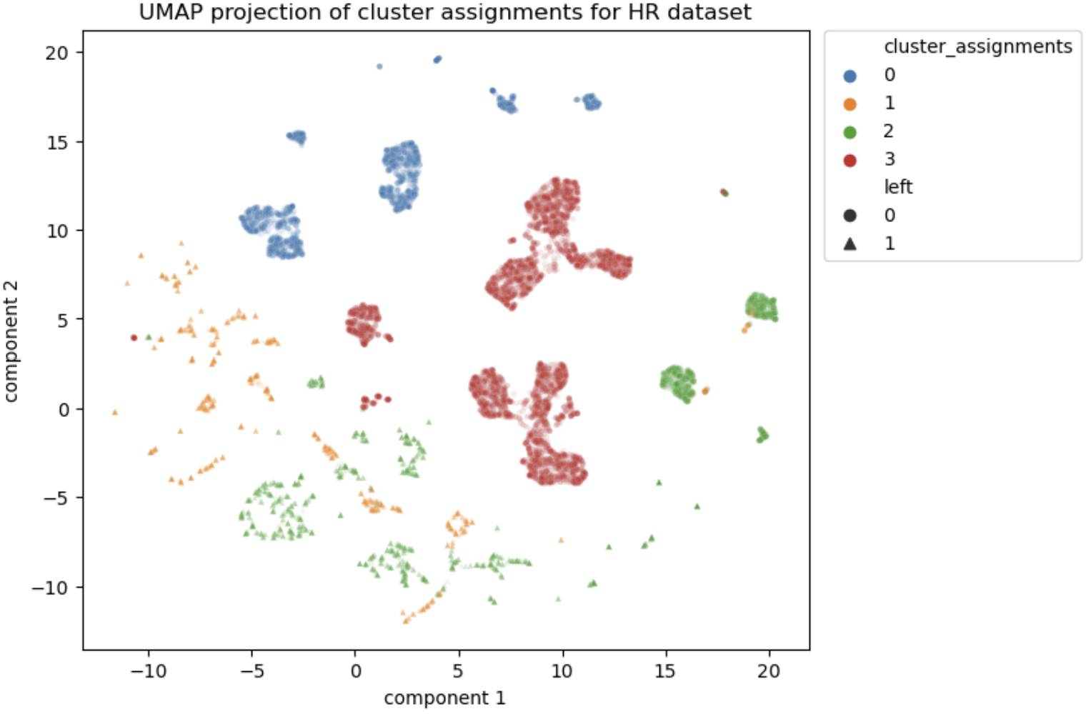
Visualizing Clustering Model Results
How can we visualize the results of a cluster model?
Uniform Manifold Approximation and Projection (UMAP) is a state of the art manifold projection algorithm
UMAP can project cluster assignments on a 2-dimensional space
Aids in visualization of cluster relationships
2-dimensional projection of cluster assignments

Slide 43
Mini-batch k-means

Slide 44
Mini-Batch K-Means
Mini-batch K-means improves scaling of the algorithm
The basic K-means algorithm requires that all data be held in main memory at once
  Limits scalability for massive data sets
The mini-batch K-means algorithm is an alternative
  Follows same steps as standard K-means algorithm
  Updates based on repeated mini-batch (small) samples of massive data set
  Incrementally update cluster centers and membership on each mini-batch
Using small mini-batch samples makes updates stochastic in nature
  Convergence to result of batch (standard) algorithm on average
  Can be small differences (stochastic error) compared to batch algorithm

Slide 45
Mini-Batch K-Means
Mini-batch K-means improves scaling of the algorithm
Mini-batch k-means algorithm
  Randomly Bernoulli sort the samples – use a hash at scale
  Round-robin, take a mini-batch sub-sample – typically round binary number
  Update the cluster centers
  Update cluster membership for members of mini-batch
  Repeat 2-4 above until stopping criteria is reached
Notice the chance of repeating the mini-batch samples
  In practice this does not create much bias
  For large samples this generally hardly matters

Slide 46
Hierarchical Clustering Models

Slide 47
Hierarchical Clustering Algorithms
Are there other ways to create compact well-separated clusters?
K-means algorithms form clusters with maximum compactness
  Clusters have minimum variance or inertia
Hierarchical clustering algorithms create compact and well-separated clusters
  Algorithm sequentially considers groups of points
  Cluster assignments made using linkage function
  Can use any distance metric
Create hierarchy of possible clusters
  One cluster at top with all samples
  Single sample clusters at the bottom – singletons
Hierarchical clustering method work for most any distance metric!

Slide 48
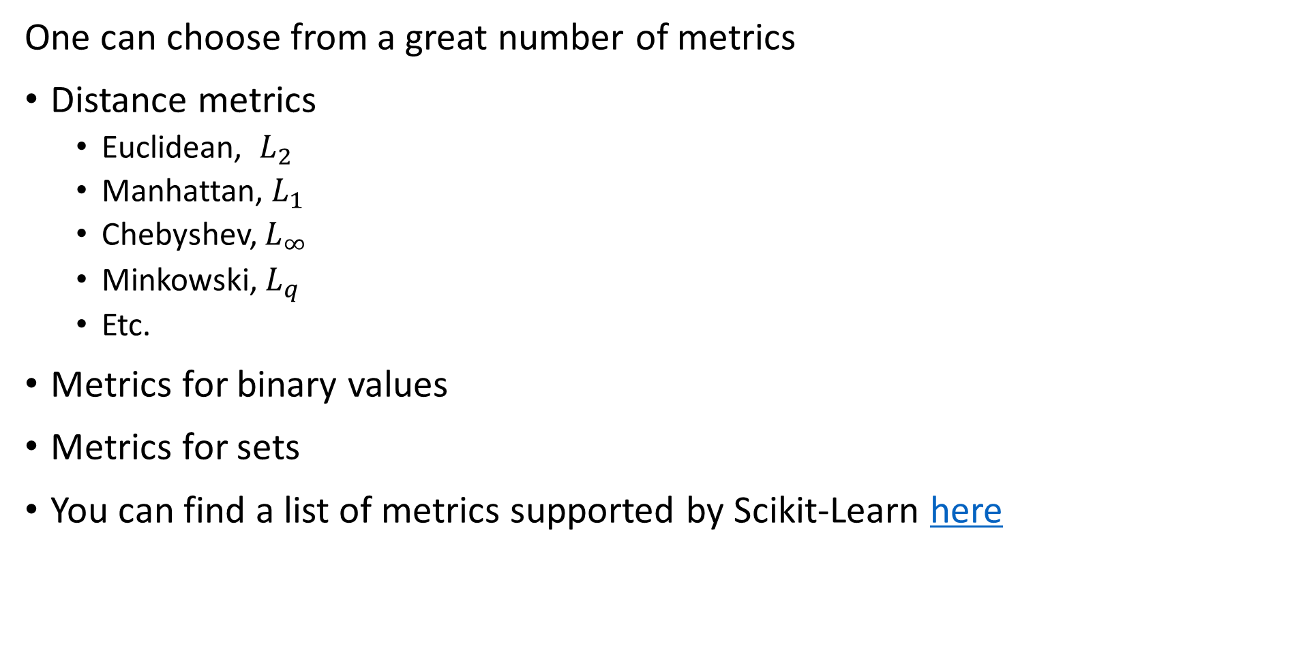
A Note on Metrics
One can choose from a great number of metrics
Distance metrics
  Euclidean, $L_{2}$
  Manhattan, $L_{1}$
  Chebyshev, $L_{∞}$
  Minkowski, $L_{q}$
  Etc.
Metrics for binary values
Metrics for sets
You can find a list of metrics supported by Scikit-Learn here

Slide 49
Hierarchical Clustering Algorithms
Hierarchical clustering models create compact clusters by creating a tree graph
Hierarchy is a form of graph: a tree
Tree graph has no cycles
Tree graph has binary splits on nodes
Edge length (weight) is distance between nodes

Slide 50
Hierarchical Clustering Algorithms
Two possible approaches to hierarchical clustering
Divisive clustering – top down
  Start will all samples in one large cluster
  Recursively split into compact clusters
  Stop when only single samples at leaves – singletons
  Not discussed further here
Agglomerative clustering – bottom up
  Start with each sample in an individual cluster - singletons
  Build maximumly compact clusters, until all samples in one cluster
  Forms a tree with singletons at the leaves and all samples at the root

Slide 51
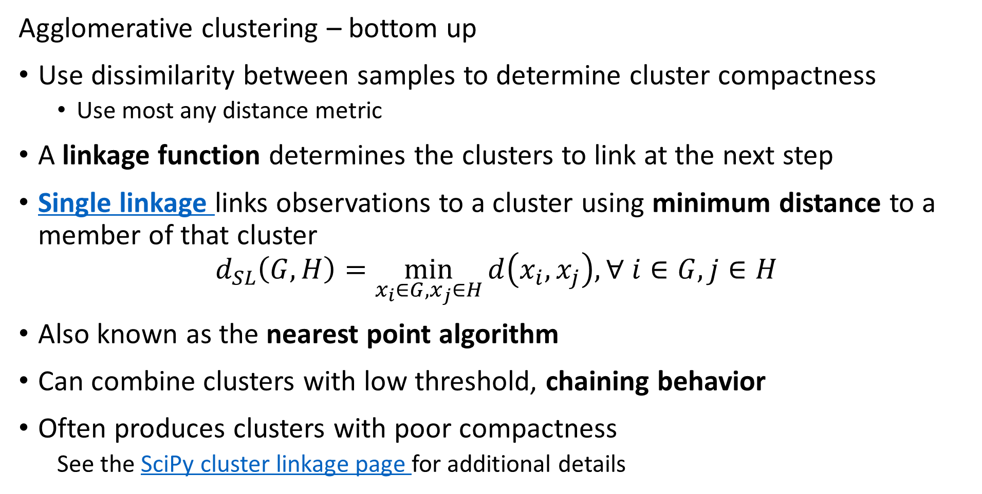
Hierarchical Clustering Algorithms
Agglomerative clustering – bottom up
Use dissimilarity between samples to determine cluster compactness
  Use most any distance metric
A linkage function determines the clusters to link at the next step
Single linkage links observations to a cluster using minimum distance to a member of that cluster
$$d_{SL}\left(G,H\right)=\min_{x_{i}∈G,x_{j}∈H}{d\left(x_{i},x_{j}\right), ∀ i∈G,j∈H}$$
Also known as the nearest point algorithm
Can combine clusters with low threshold, chaining behavior
Often produces clusters with poor compactness
  See the SciPy cluster linkage page for additional details

Slide 52
Agglomerative Clustering Example
Example of single linkage in Euclidean space
Algorithm agglomerates to 3 clusters
Next, assign observation to a cluster
Find cluster member at minimum distance to each cluster
Assign observation based on minimum distance
2
3
1

Slide 53
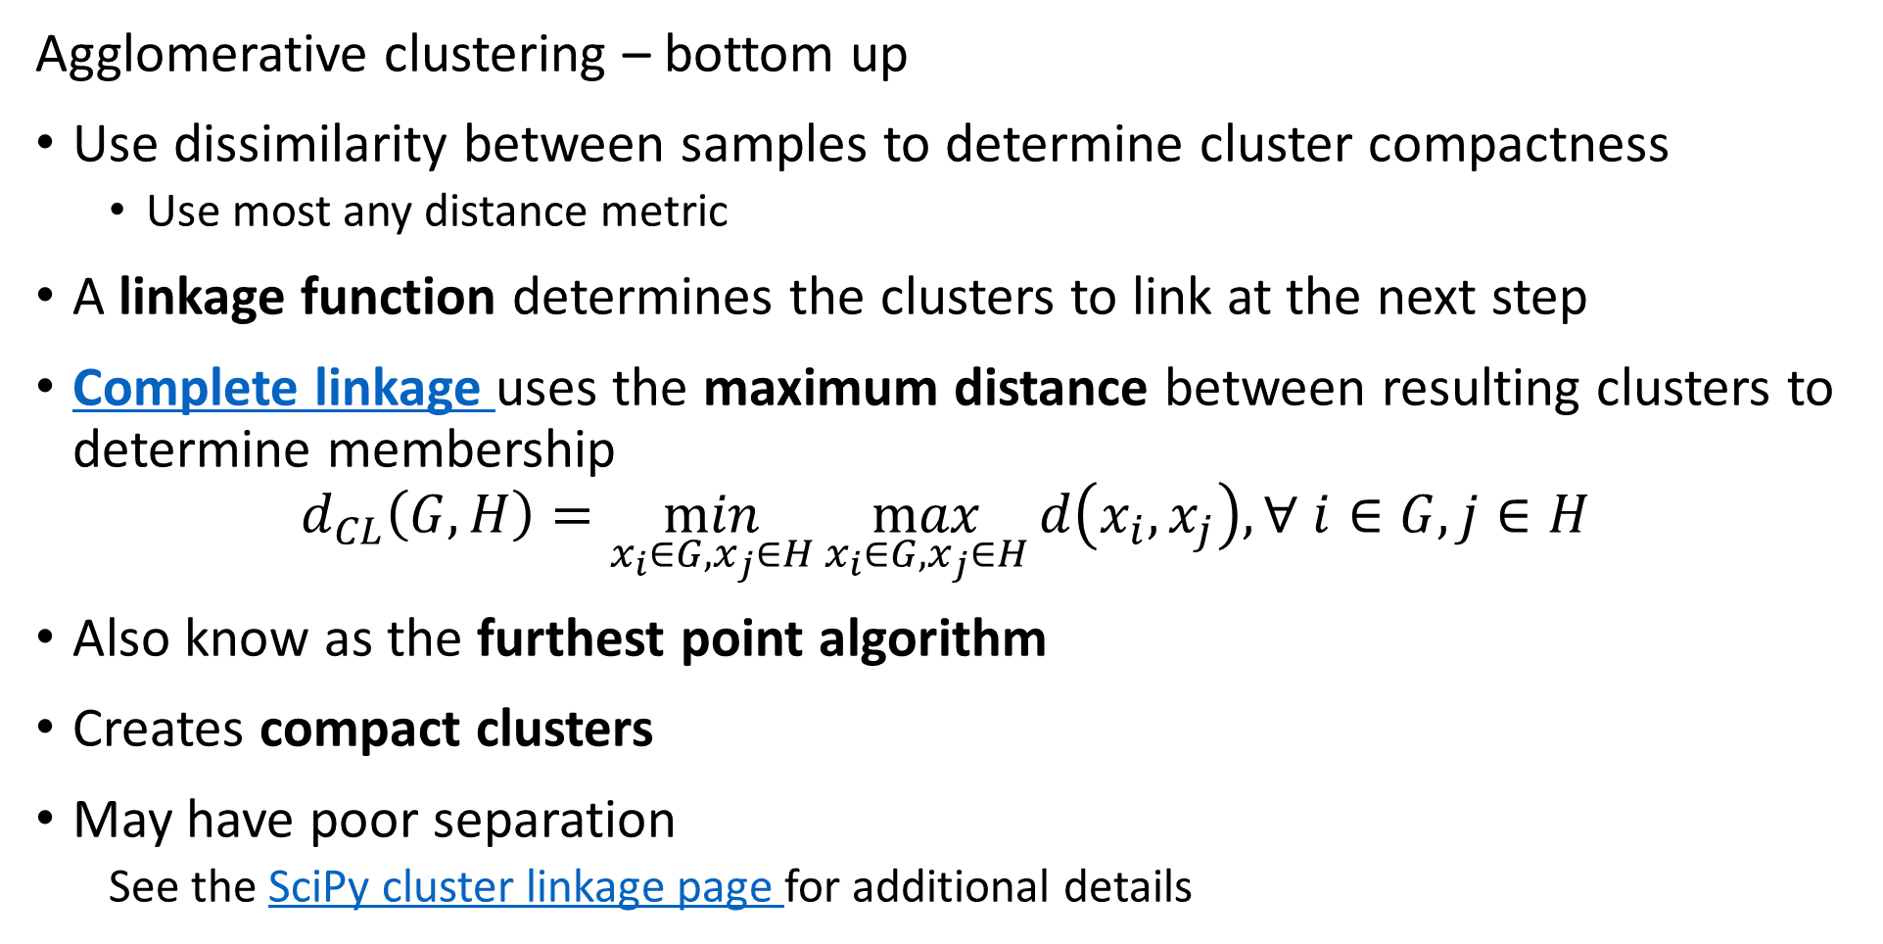
Hierarchical Clustering Algorithms
Agglomerative clustering – bottom up
Use dissimilarity between samples to determine cluster compactness
  Use most any distance metric
A linkage function determines the clusters to link at the next step
Complete linkage uses the maximum distance between resulting clusters to determine membership
$$d_{CL}\left(G,H\right)=\min_{x_{i}∈G,x_{j}∈H}\max_{x_{i}∈G,x_{j}∈H}{d\left(x_{i},x_{j}\right),∀ i∈G,j∈H}$$
Also know as the furthest point algorithm
Creates compact clusters
May have poor separation
  See the SciPy cluster linkage page for additional details

Slide 54
Agglomerative Clustering Example
Example of complete linkage in Euclidean space
Algorithm agglomerates to 3 clusters
Next, assign observation to a cluster
Find maximum distances to clusters
Assign observation based on minimum of the maximum distances
2
3
1

Slide 55
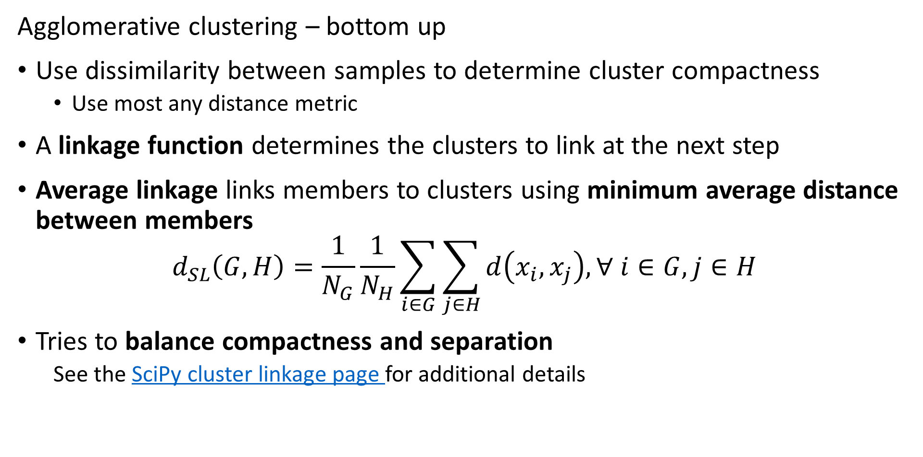
Hierarchical Clustering Algorithms
Agglomerative clustering – bottom up
Use dissimilarity between samples to determine cluster compactness
  Use most any distance metric
A linkage function determines the clusters to link at the next step
Average linkage links members to clusters using minimum average distance between members
$$d_{SL}\left(G,H\right)=\frac{1}{N_{G}}\frac{1}{N_{H}}\sum_{i∈G}^{ }{\sum_{j∈H}^{ }{d\left(x_{i},x_{j}\right),∀ i∈G,j∈H}}$$
Tries to balance compactness and separation
  See the SciPy cluster linkage page for additional details

Slide 56
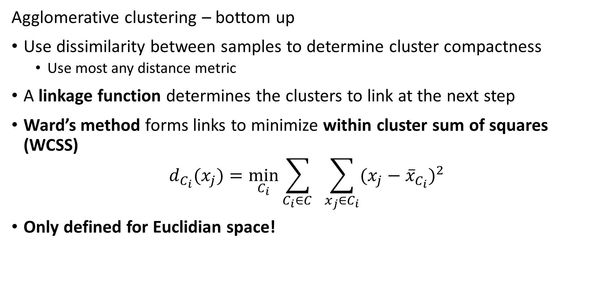
Hierarchical Clustering Algorithms
Agglomerative clustering – bottom up
Use dissimilarity between samples to determine cluster compactness
  Use most any distance metric
A linkage function determines the clusters to link at the next step
Ward’s method forms links to minimize within cluster sum of squares (WCSS)
$$d_{C_{i}}(x_{j})=\min_{C_{i}}{\sum_{C_{i}∈C_{ }}^{ }{ }\sum_{x_{j}∈C_{i}}{(x_{j}−{\overline{x}}_{C_{i}})^{2}}}$$
Only defined for Euclidian space!

Slide 57
Agglomerative Clustering Example
Start with data points in a 2-dimensional Euclidian space
Use Euclidean distance and average linkage to find the first points to link –the leaves of the hierarchy
Continue to link points into clusters
At termination of algorithm all points are linked at root of hierarchy
5
3
2
6
4
1

Slide 58
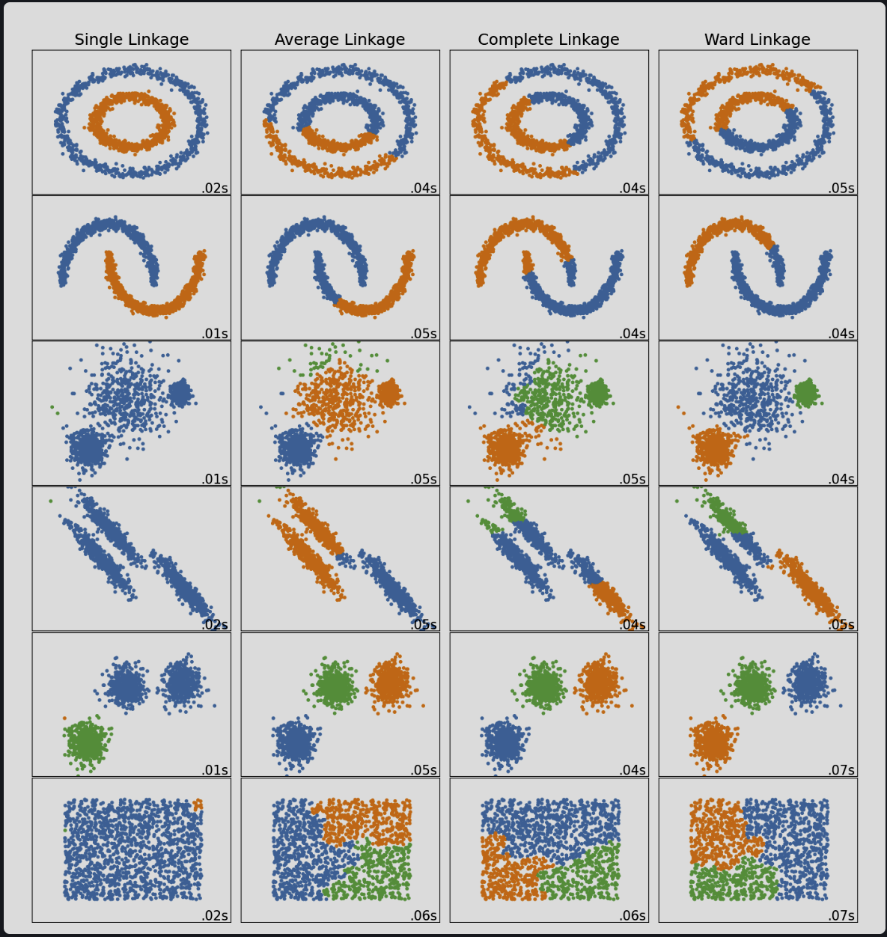
Choice of linkage function greatly changes clusters created
From Scikit-Learn Clustering User Guide

Slide 59
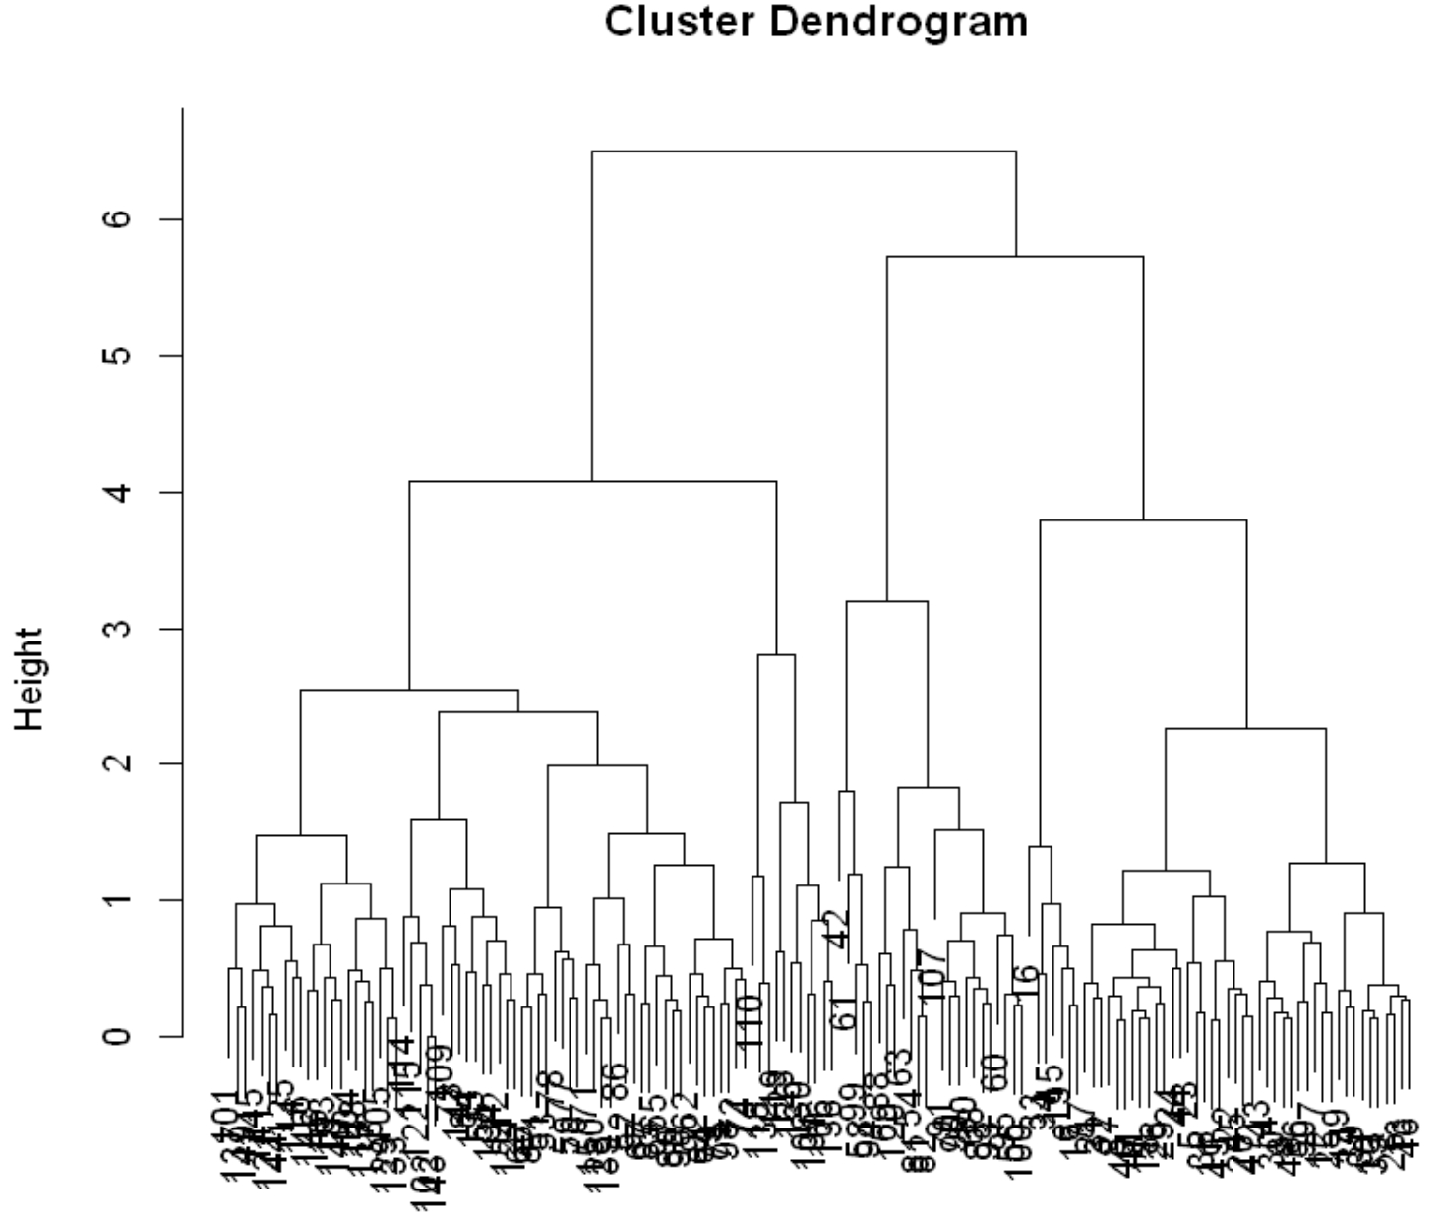
Hierarchical Clustering
Hierarchical cluster creates dendrogram
Cutting the dendrogram creates a flat cluster model
Number of clusters determined by depth of cut point
For example, the cut-point shown results in 6 clusters
Or maybe 3 clusters?
Need some domain knowledge to determine which is useful

Slide 60
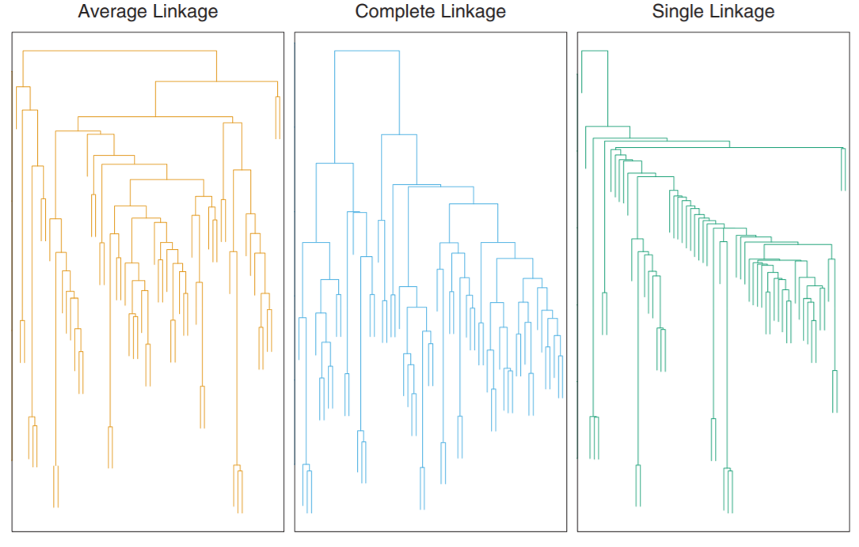
Hierarchical Clustering
Example of microasay of human tumors
The dendrograms are quite different
Choice of linkage function creates different hierarchy
Credit: Hastie, Tibsheirani and Friedeman, 2009

Slide 61
Evaluating Non-Euclidean Cluster Models

Slide 62
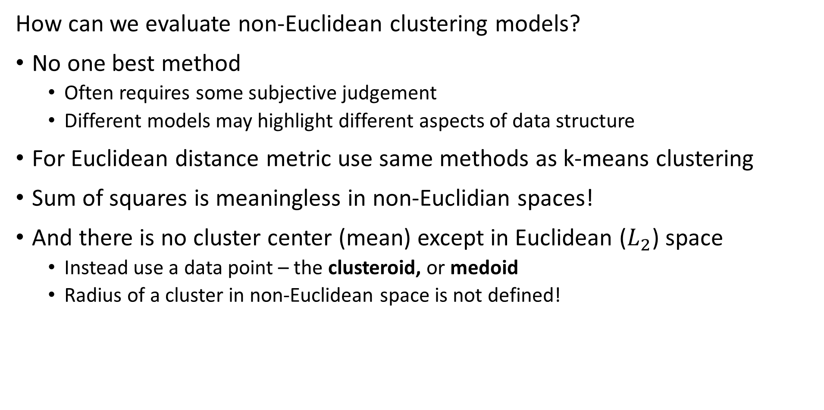
Evaluating Non-Euclidean Clustering
How can we evaluate non-Euclidean clustering models?
No one best method
  Often requires some subjective judgement
  Different models may highlight different aspects of data structure
For Euclidean distance metric use same methods as k-means clustering
Sum of squares is meaningless in non-Euclidian spaces!
And there is no cluster center (mean) except in Euclidean ($L_{2}$) space
  Instead use a data point – the clusteroid, or medoid
  Radius of a cluster in non-Euclidean space is not defined!

Slide 63
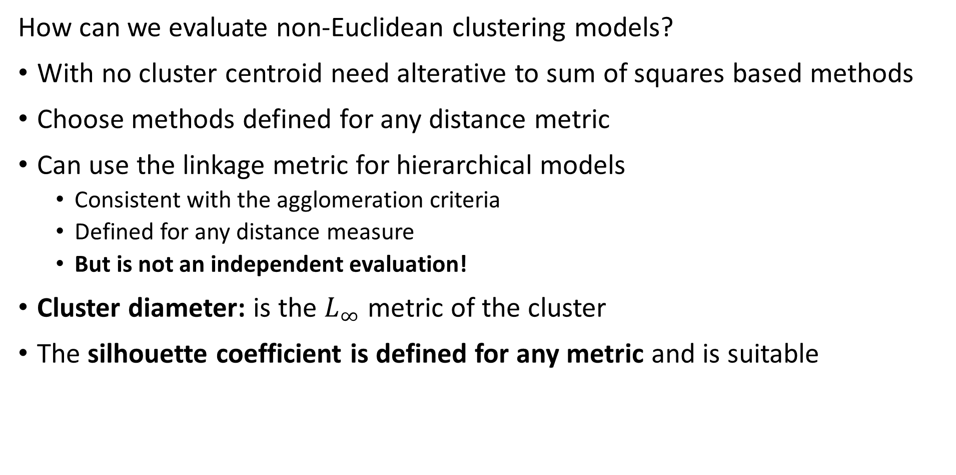
Evaluating Non-Euclidean Clustering
How can we evaluate non-Euclidean clustering models?
With no cluster centroid need alterative to sum of squares based methods
Choose methods defined for any distance metric
Can use the linkage metric for hierarchical models
  Consistent with the agglomeration criteria
  Defined for any distance measure
  But is not an independent evaluation!
Cluster diameter: is the $L_{∞}$ metric of the cluster
The silhouette coefficient is defined for any metric and is suitable

Slide 64
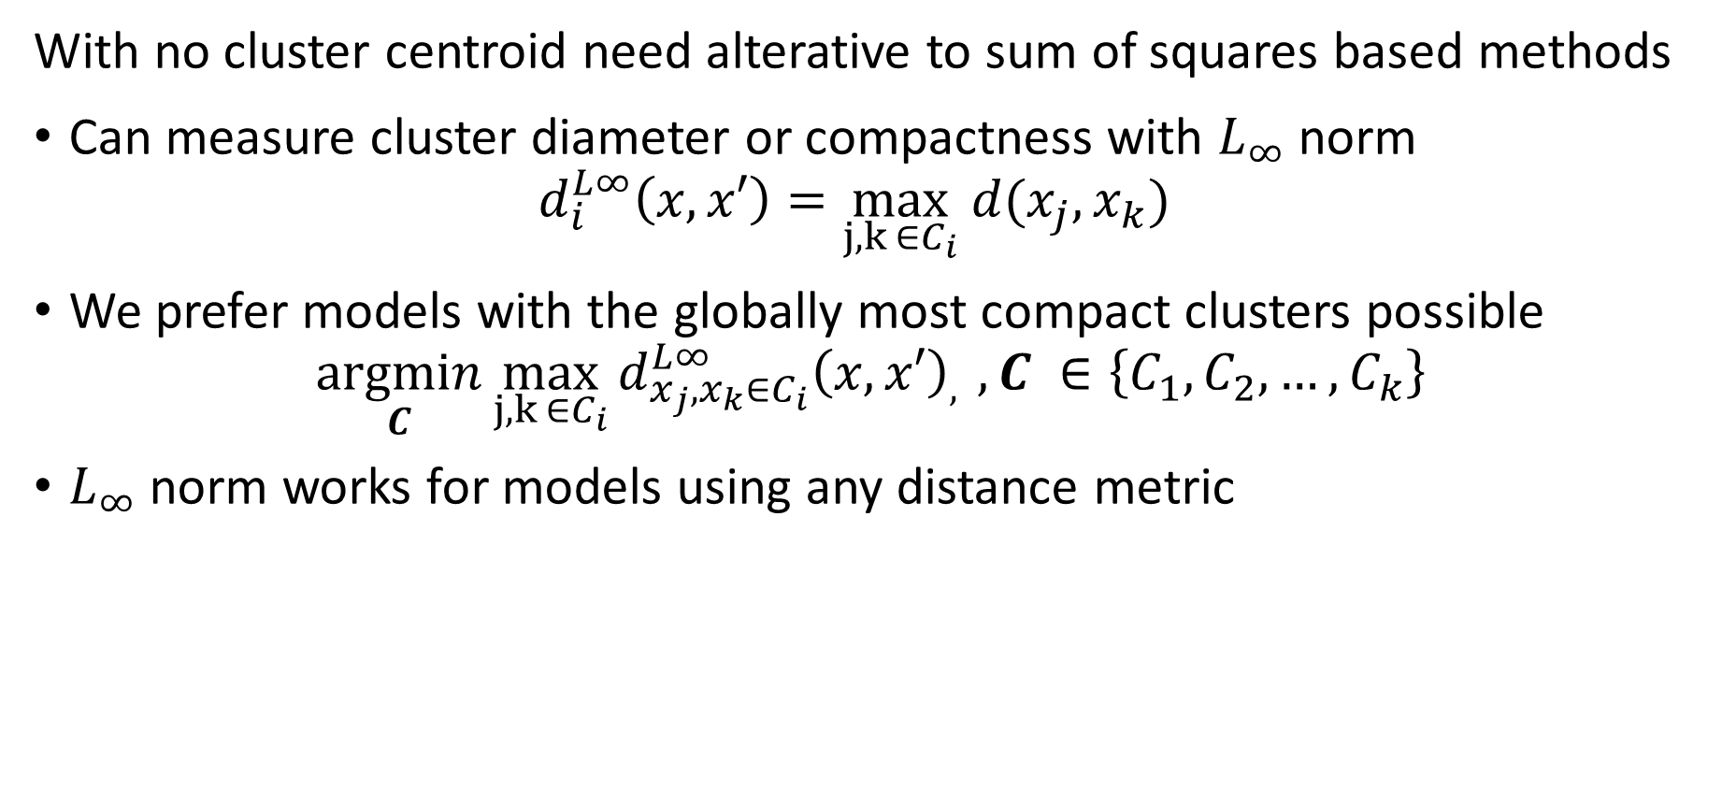
Evaluating Clustering Models
With no cluster centroid need alterative to sum of squares based methods
Can measure cluster diameter or compactness with $L_{∞}$ norm
$$d_{i}^{L∞}\left(x,x′\right)=\max_{j,k ∈C_{i}} {d(x_{j},x_{k})}_{ }{ }$$
We prefer models with the globally most compact clusters possible
$$\underset{C}{argmin}{\max_{j,k ∈C_{i}}{{d_{x_{j},x_{k}∈C_{i}}^{L∞}\left(x,x′\right)}_{, }},C_{ }∈\left\{C_{1},C_{2},…,C_{k}\right\}}$$
$L_{∞}$ norm works for models using any distance metric

Slide 65
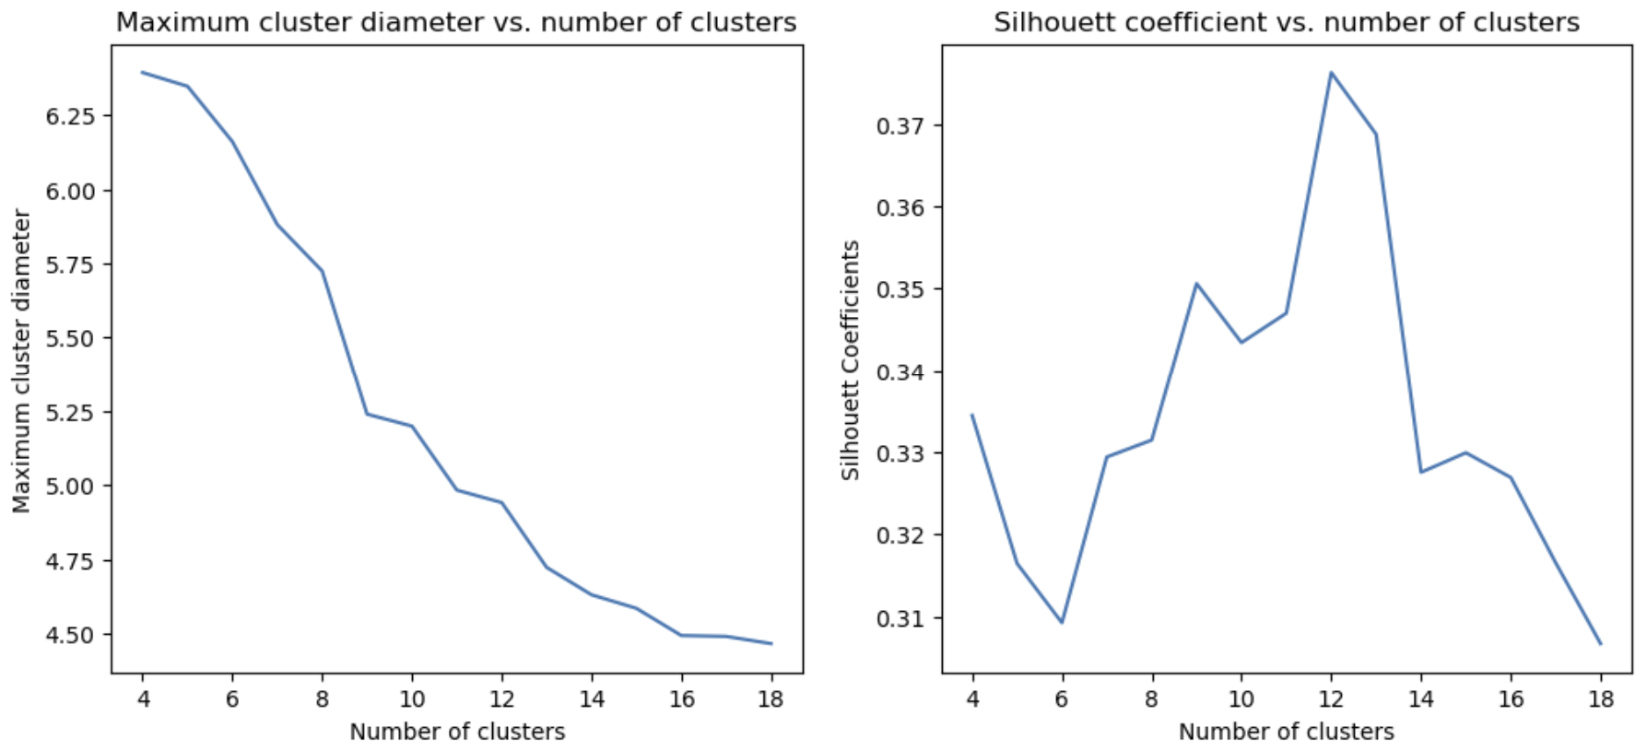
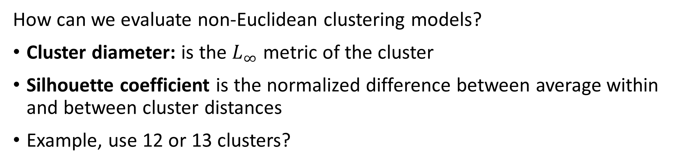
Evaluating Non-Euclidean Clustering
How can we evaluate non-Euclidean clustering models?
Cluster diameter: is the $L_{∞}$ metric of the cluster
Silhouette coefficient is the normalized difference between average within and between cluster distances
Example, use 12 or 13 clusters?

Slide 66
Summary

Slide 67
Summary
Unsupervised learning methods learn structure of data
  Structure is learned by determining association between cases
  Association based on measures of proximity, distance or dissimilarity
Clustering algorithms are core data mining methods
  Data mining seeks to find interesting relationships in data
  We have already encountered feature importance as a data mining method

Slide 68
Summary
Algorithms can use different distance or dissimilarity metrics
  Structure based on distance metrics
  Different algorithms use different metrics
What are the ideal properties of clusters?
Good clusters have two properties
  Compactness: We what the clusters to be small with members close to each other
  Separation: We want the clusters are well separated, a closeness property

Slide 69
Summary
Different models and dissimilarity metrics will give different results
  Dissimilarity metrics usually matter more than model choice
  But which one should we use?
Evaluation is a significant problem with for unsupervised learning
  There are no labels for objective evaluation
  Evaluation is often subjective
But, do we have to pick one best model?
  No
  Different models can show different useful relationships

Slide 70
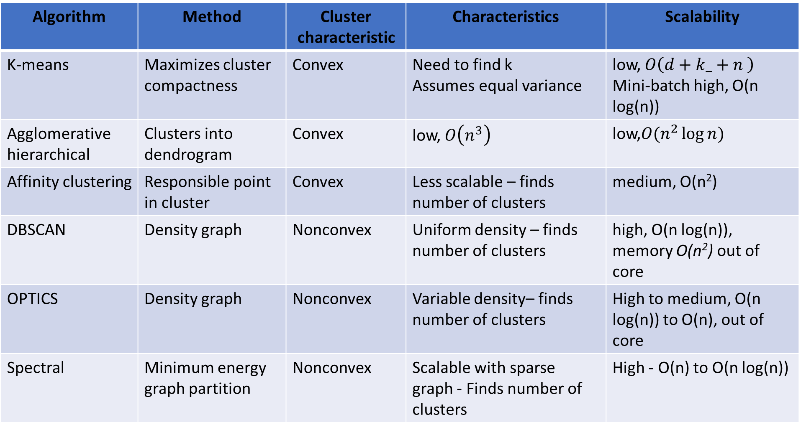
Summary
Algorithm | Method | Cluster characteristic | Characteristics | Scalability
K-means | Maximizes cluster compactness | Convex | Need to find k Assumes equal variance | low, $O\left({d+k_+n}^{ }\right)$ Mini-batch high, O(n log(n))
Agglomerative hierarchical | Clusters into dendrogram | Convex | low, $O\left(n^{3}\right)$ | low,$O(n^{2}\log{n})$
Affinity clustering | Responsible point in cluster | Convex | Less scalable – finds number of clusters | medium, O(n²)
DBSCAN | Density graph | Nonconvex | Uniform density – finds number of clusters | high, O(n log(n)), memory O(n²) out of core
OPTICS | Density graph | Nonconvex | Variable density– finds number of clusters | High to medium, O(n log(n)) to O(n), out of core
Spectral | Minimum energy graph partition | Nonconvex | Scalable with sparse graph - Finds number of clusters | High - O(n) to O(n log(n))

