Slide 1

Dai volti ai gruppi: una mappatura multidimensionale della rappresentazione percettiva dei gruppi sociali nell'infanzia
Luca Cussigh, Luciana Carraro, Luigi Castelli

Slide 2
AIP Pisa
https://www.europarl.europa.eu/doceo/document/E-10-2025-000294-ASW_EN.html
"In 2023, Member States issued more than 3.7 million residence permits to non-EUcitizens from more than 170 countries."

Slide 3
Social Categorization
Social categorization changes how people perceive, evaluate, remember, and treatone another (Amodio & Cikara, 2021; Levy et al., 2023; Rhodes & Baron, 2019)

Slide 4
The Outgroup Homogeneity Effect
Early Emergence of Ingroup favoritism vs. Childhood OHE• Ingroup favoritism: Strong evidence for ingroup preferences and visual specialization for ingroup faces (Kelly et al., 2009; Quinn et al., 2016).• OHE in childhoood: No consolidated evidence for the Outgroup Homogeneity Effect (OHE). Why?

Slide 5
1. Spontaneous bottom-up categorization
Multidimensional Scaling (MDS)• Face-Space Theory (Valentine et al., 2016): Faces exist in a continuous multidimensional perceptual space• Goal: Visually map whether faces from different ethnic groups are spontaneously perceived as more similar to one another (OHE), and how this changes across age groups.

Slide 6
2. Multi-group context
• 4-group context: Italian majority-ingroup + 3 distinct ethnic minority-outgroups (African Descent, East Asian, Andean)• 20 faces per gender group (5 per ethnic group)

Slide 7




3. The AI generated-stimuli
• Morphologies controlled using an emotional filter and FaceNet embeddings to ensure similar perceptual distinctiveness across groups

Slide 8
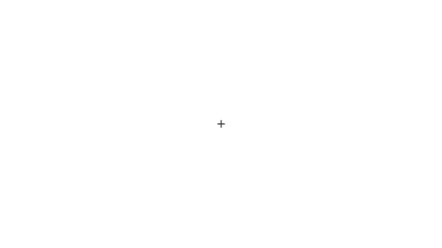

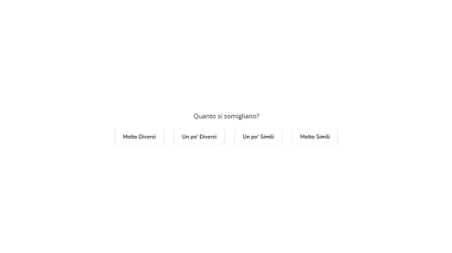
The Face Similarity Task

Slide 9
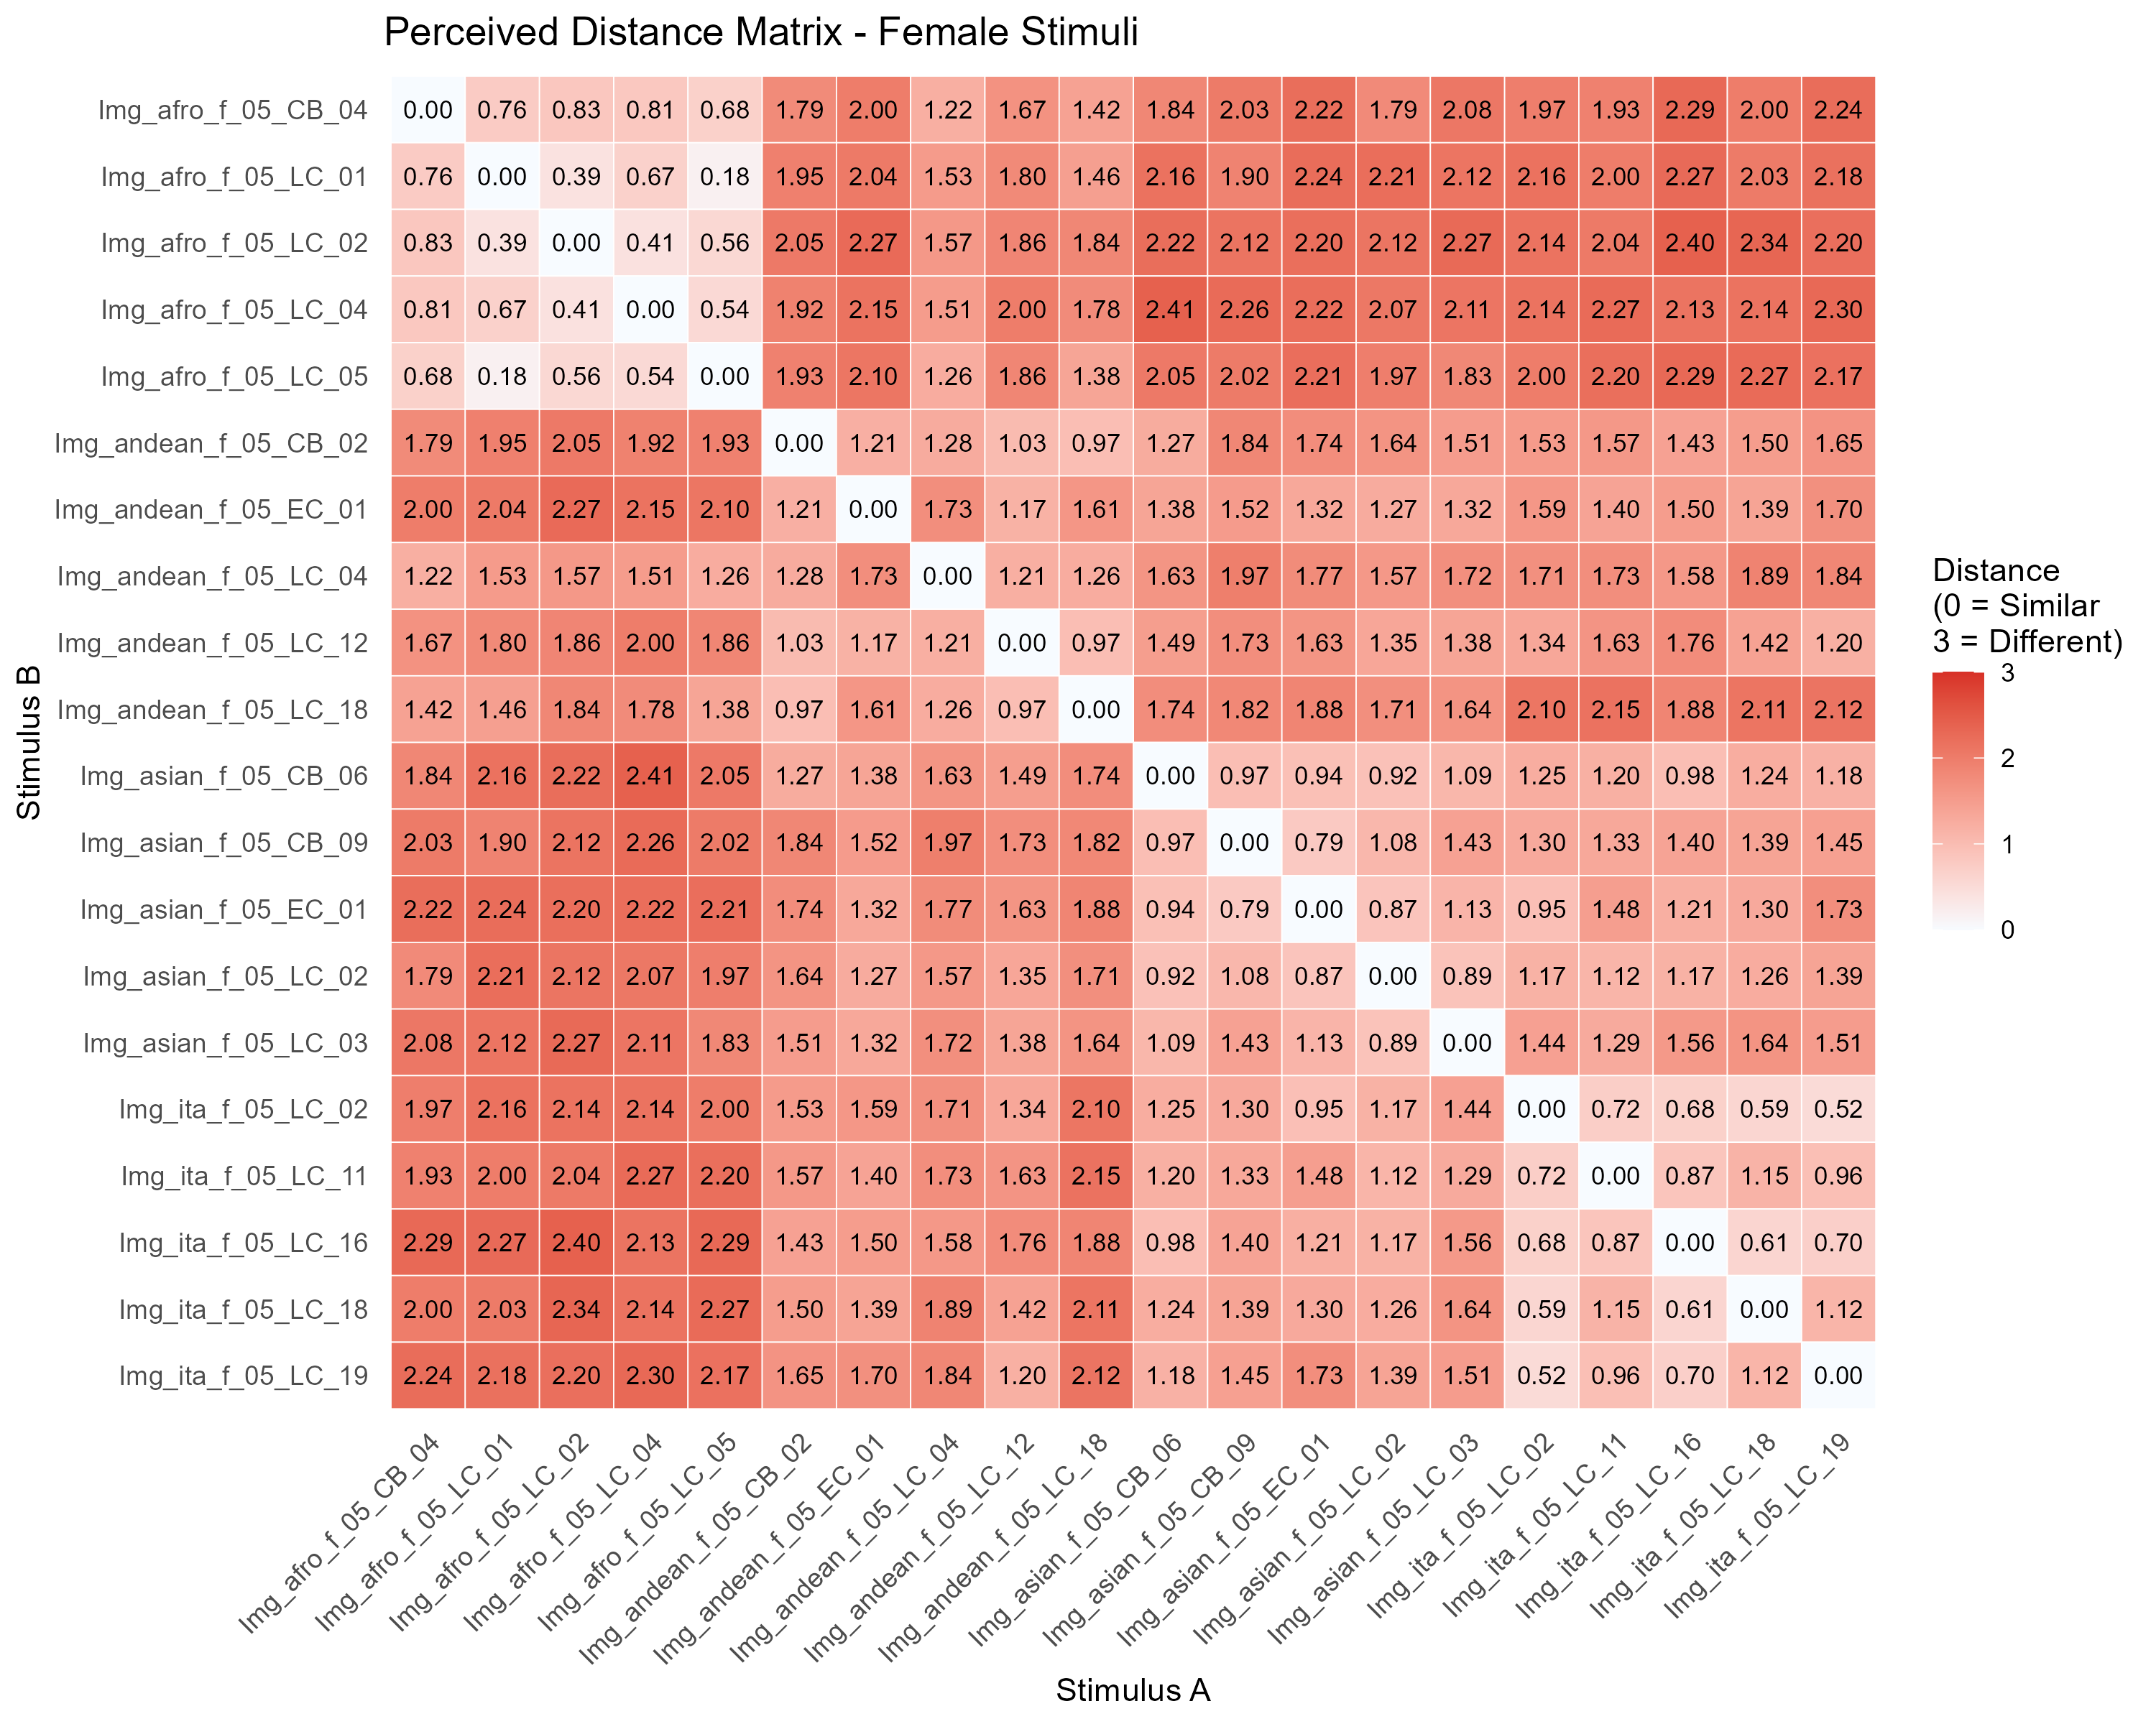
The Face Similarity Task
• Incomplete block design• 66 random dyads presented sequentially (3 faces per group)

Slide 10
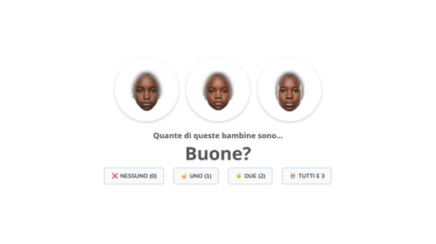
The Trait Attribution Task
4 positive (Buoni, Belli, Simpatici, Puliti) and 6 negative (Cattivi, Brutti, Antipatici, Sporchi) traits• 5 possible triads

Slide 11
Pre-registered Study
Sample:• N=249, M=5.17 years, SD=1.23, 134 boys (53.8%) and 115 girls (46.2%)• Age range: 3 to 8 years

Slide 12
MDS
3D MDS visualization

Slide 13
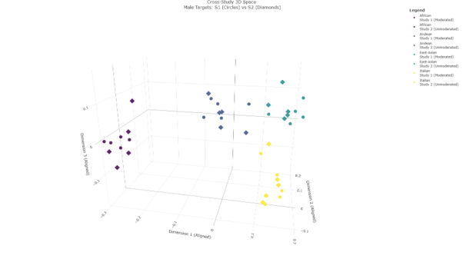
AIP Pisa

Slide 14
AIP Pisa
• # Children spontaneously visually categorized stimuli into ethnic groups

Slide 15
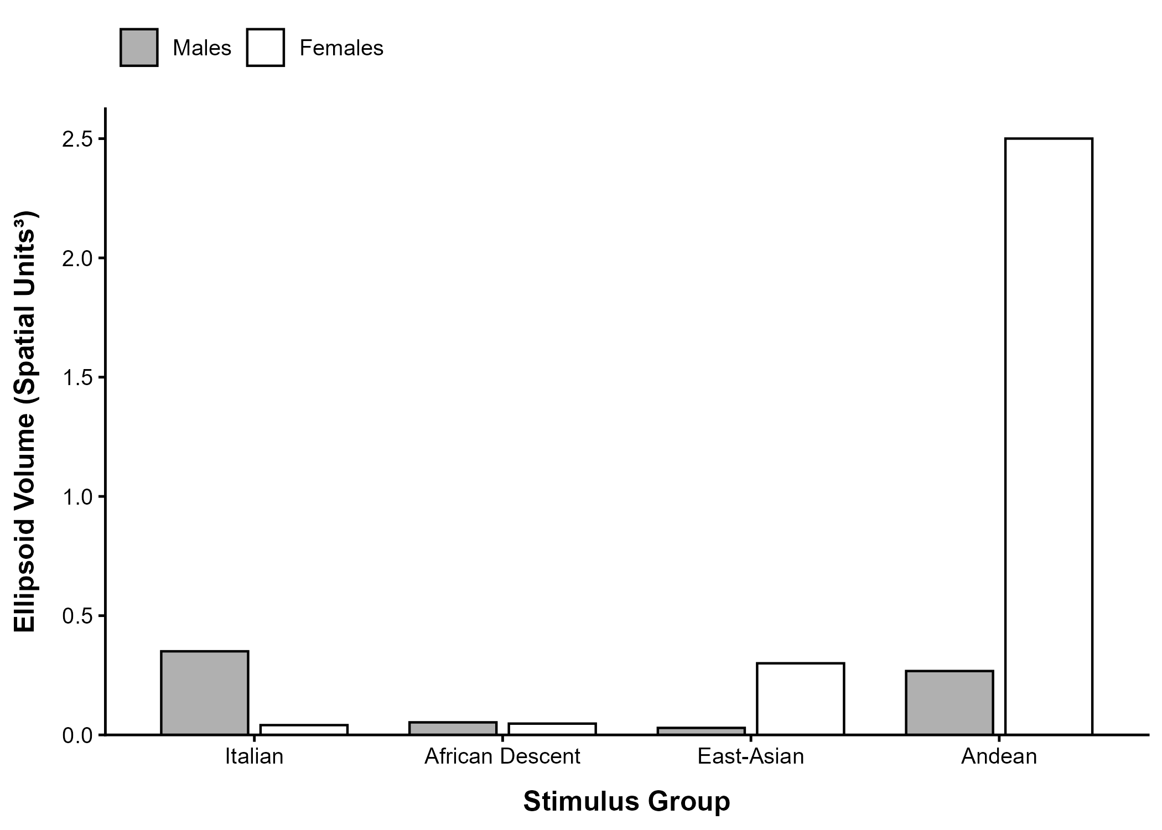
Outgroup Homogenity Effect
• Ellipsoid's volume:

Slide 16
AIP Pisa
• # No support for OHE

Slide 17
LMM - Developmental Trajectories

Slide 18
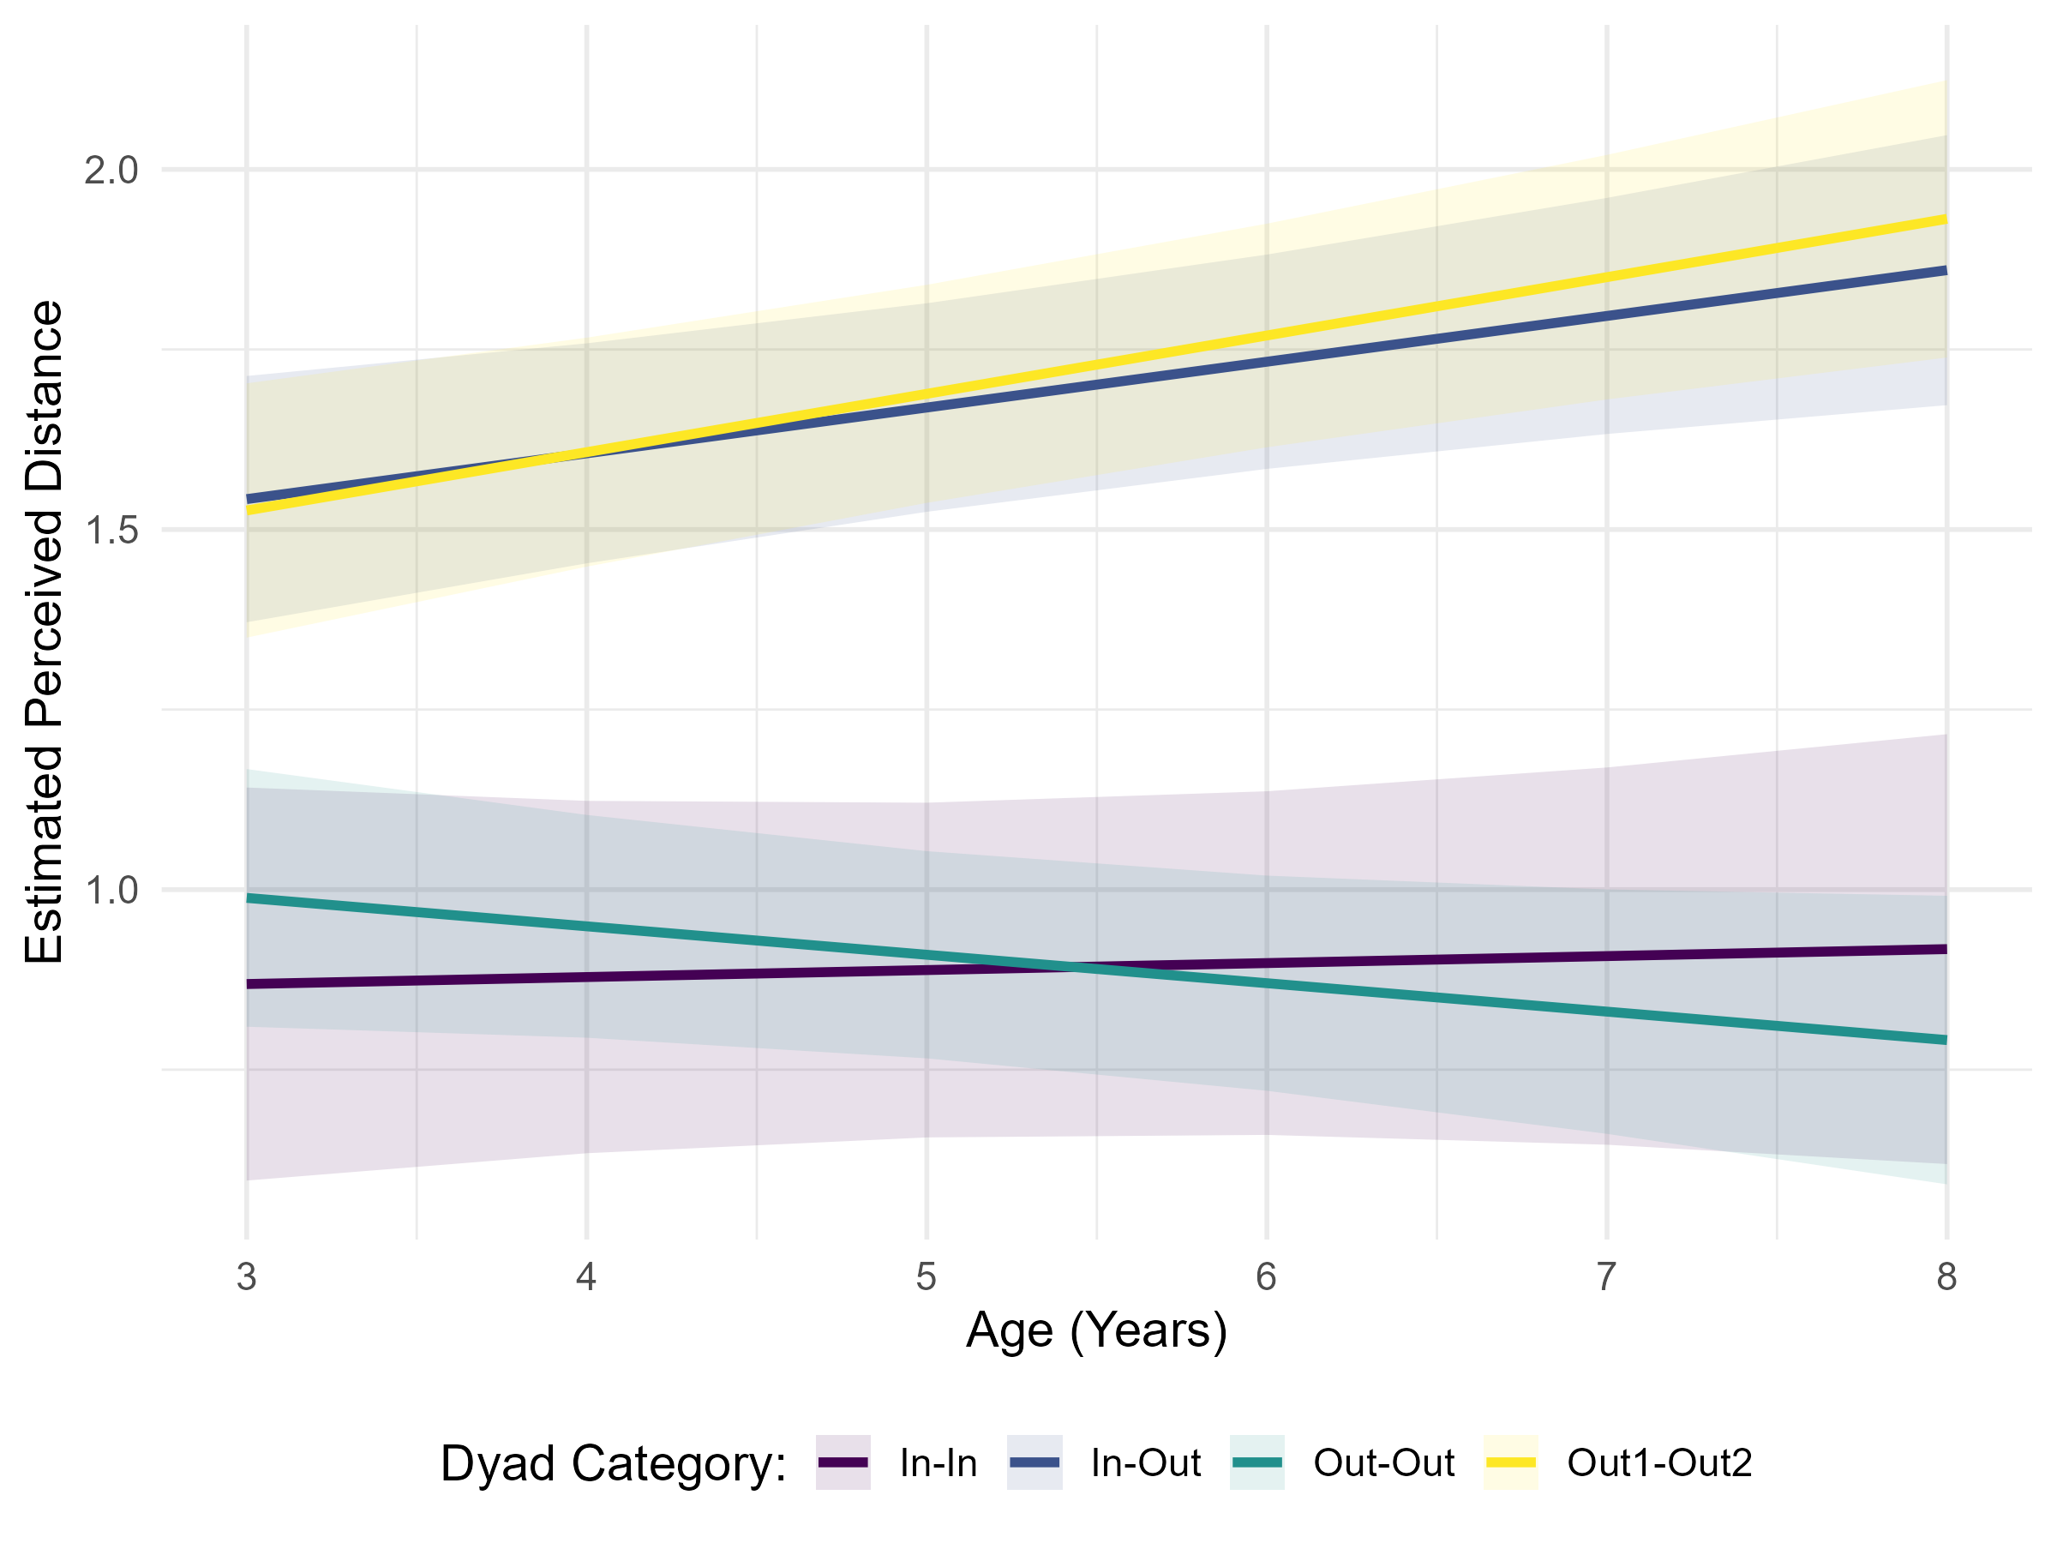
LMM - Developmental Trajectories

Slide 19
AIP Pisa
• # Intergroup dissimilarity judgments increased with age

Slide 20
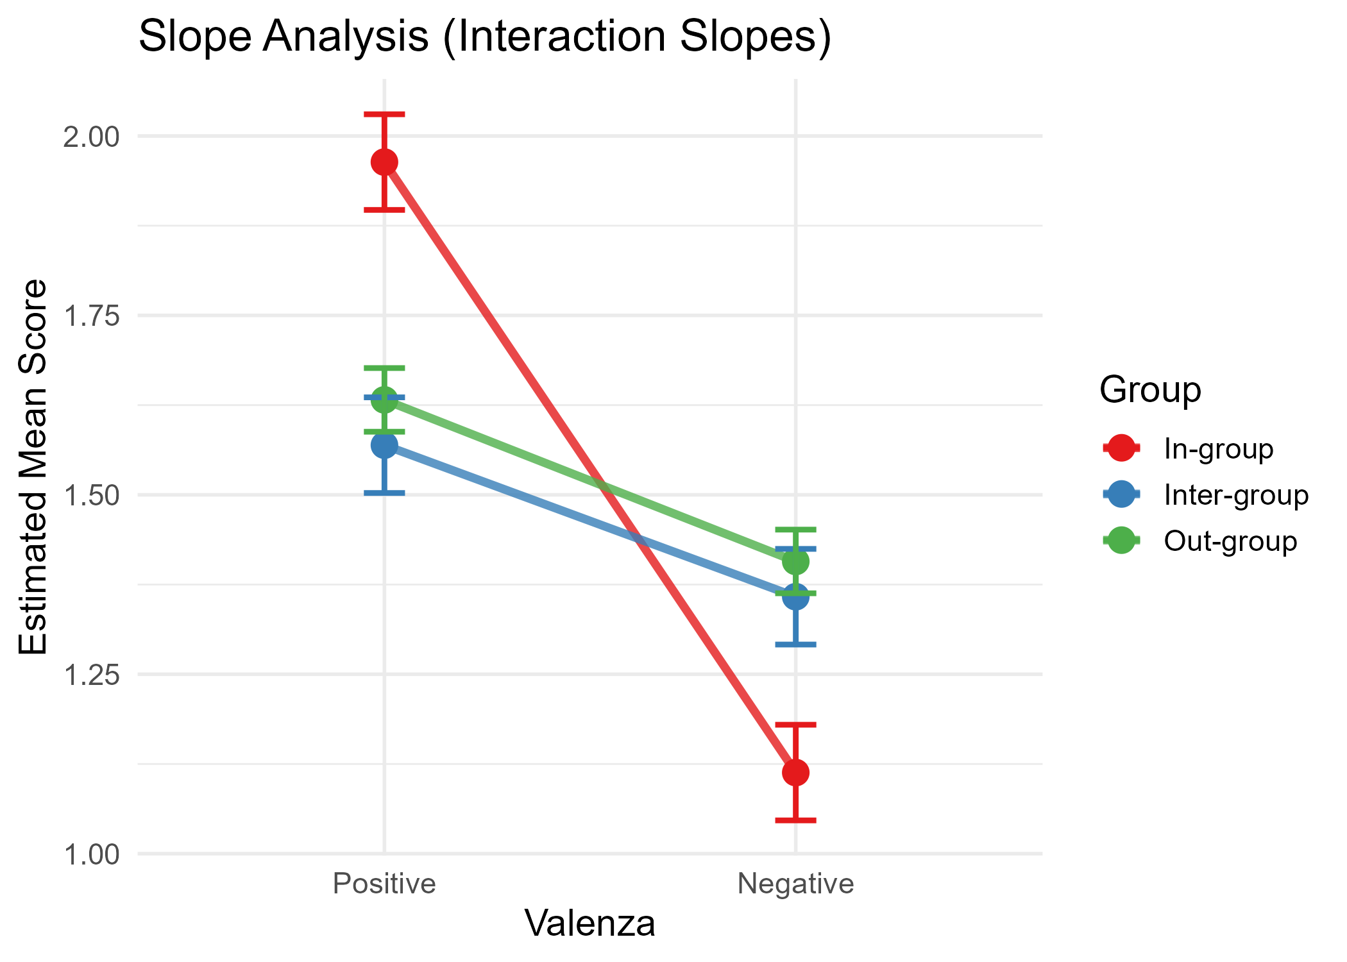
Ingroup favoritism

Slide 21
AIP Pisa
• # Support for ingroup favoritism

Slide 22
Conclusions
• ## Children spontaneously visually categorize stimuli into ethnic groups• ## No support for OHE• ## Intergroup dissimilarity judgments might increase with age• ## Ingroup favoritism supported

Slide 23
Future directions
• Individual differences: Exploring how child-level factors (e.g., social contact, intergroup attitudes) shape perceptual dispersion.• Task & contextual effects: Investigating whether the number and composition of groups alter face-space geometry.• Longitudinal trajectories: Tracking individual shifts in categorization and outgroup perceptual boundaries over time.

Slide 24
Questions? 🫰​

Slide 25

AIP Pisa

