Slide 1
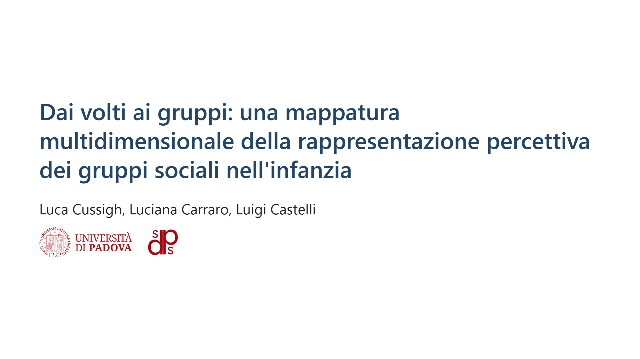

Slide 2
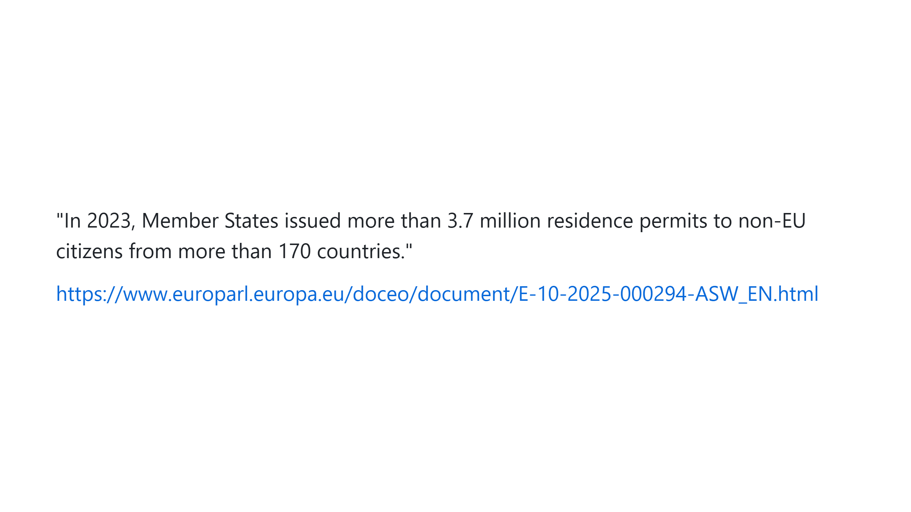

Slide 3
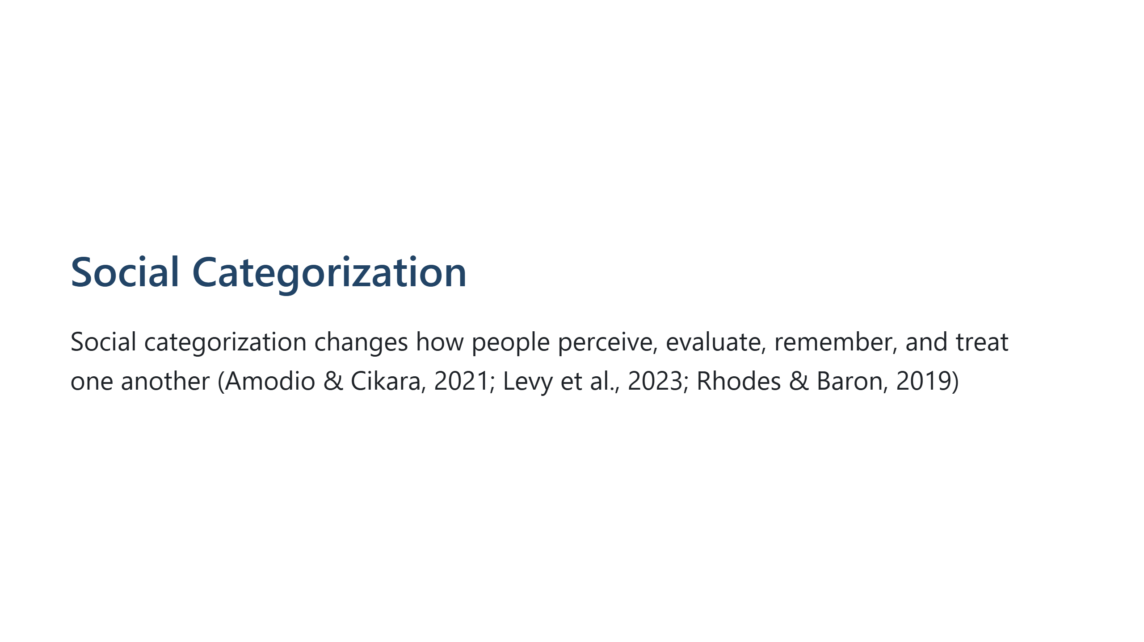

Slide 4
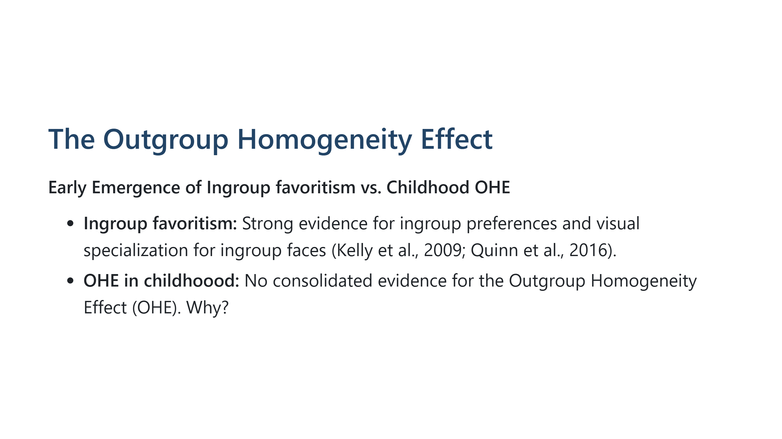

Slide 5
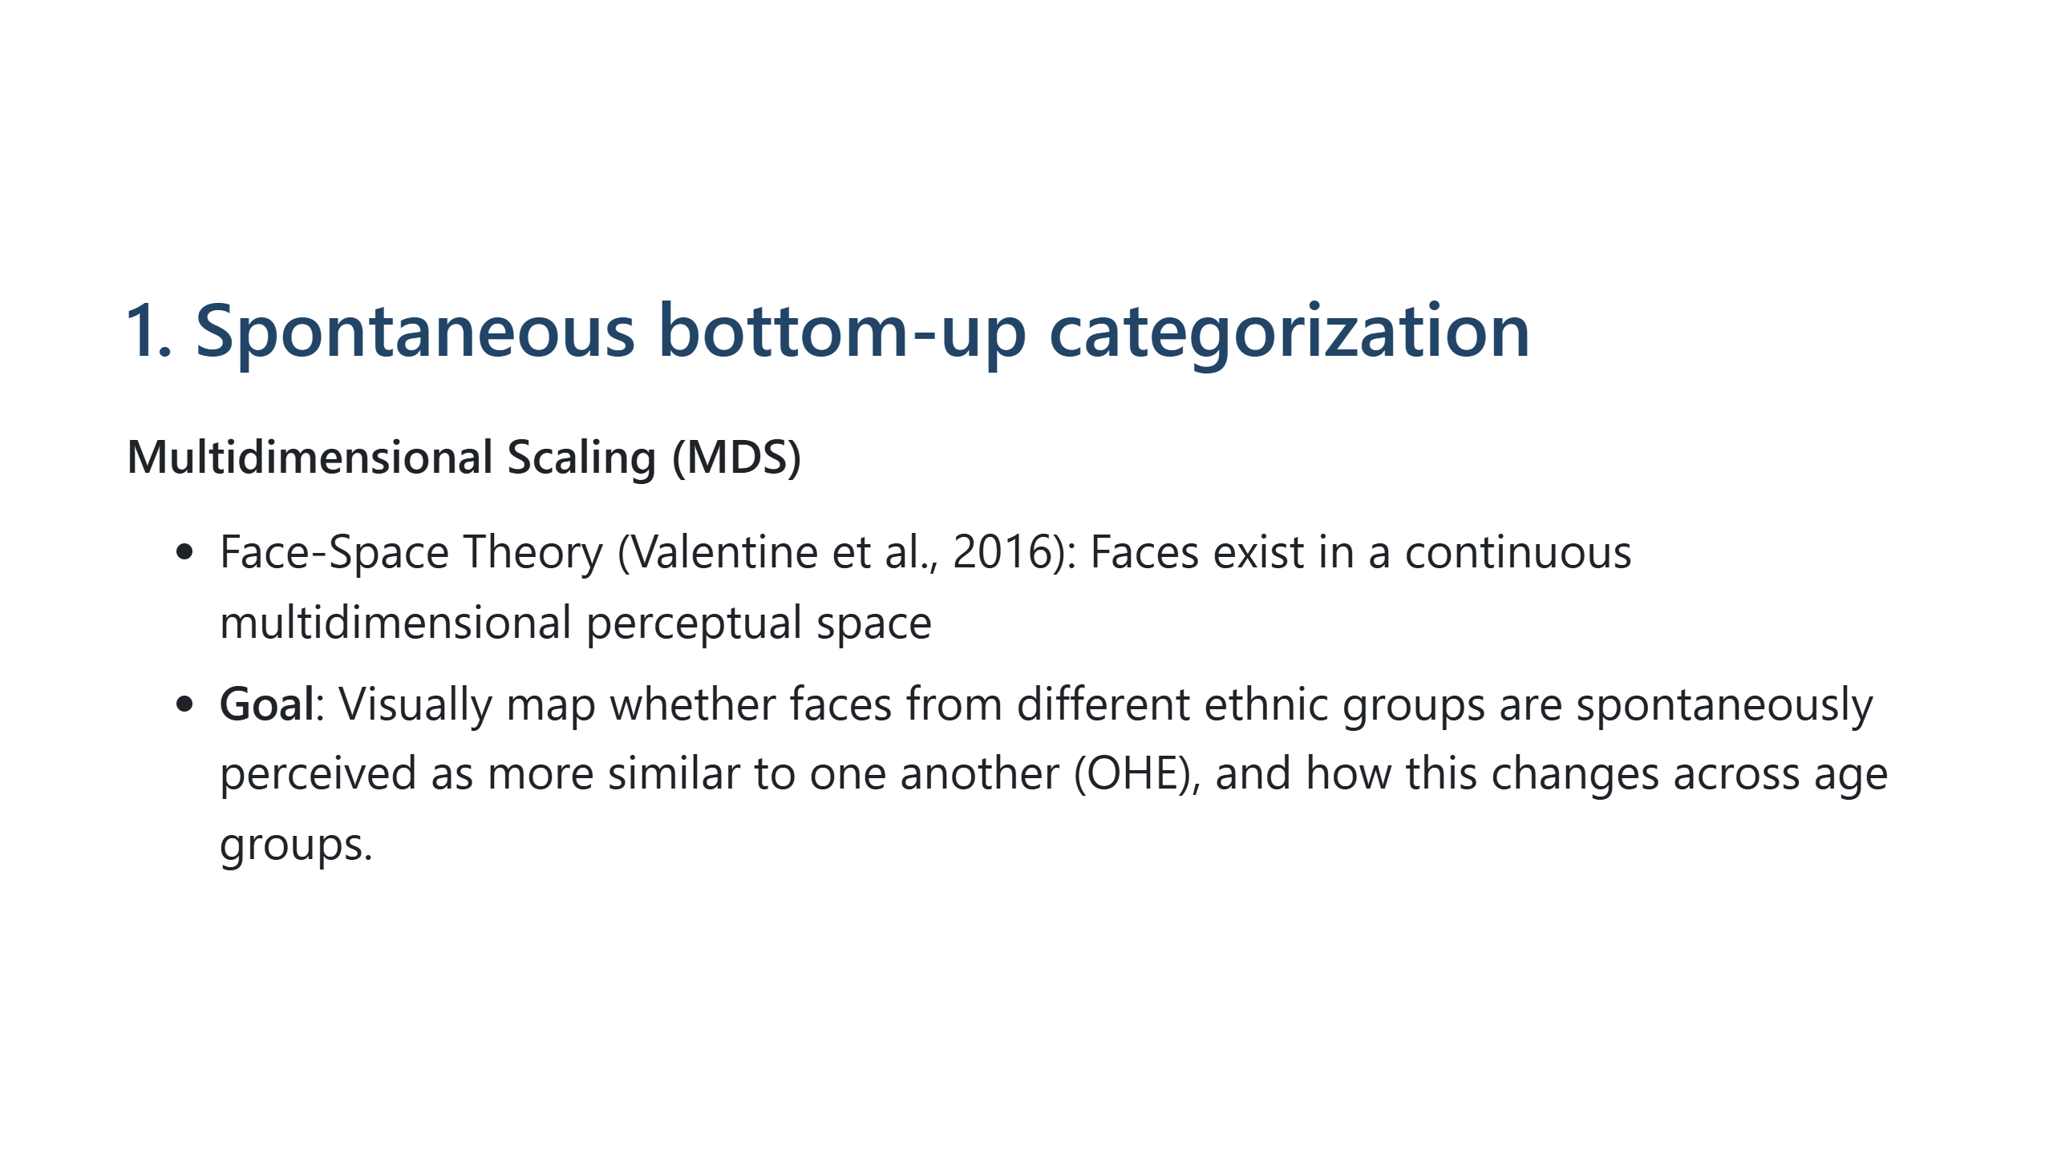

Slide 6
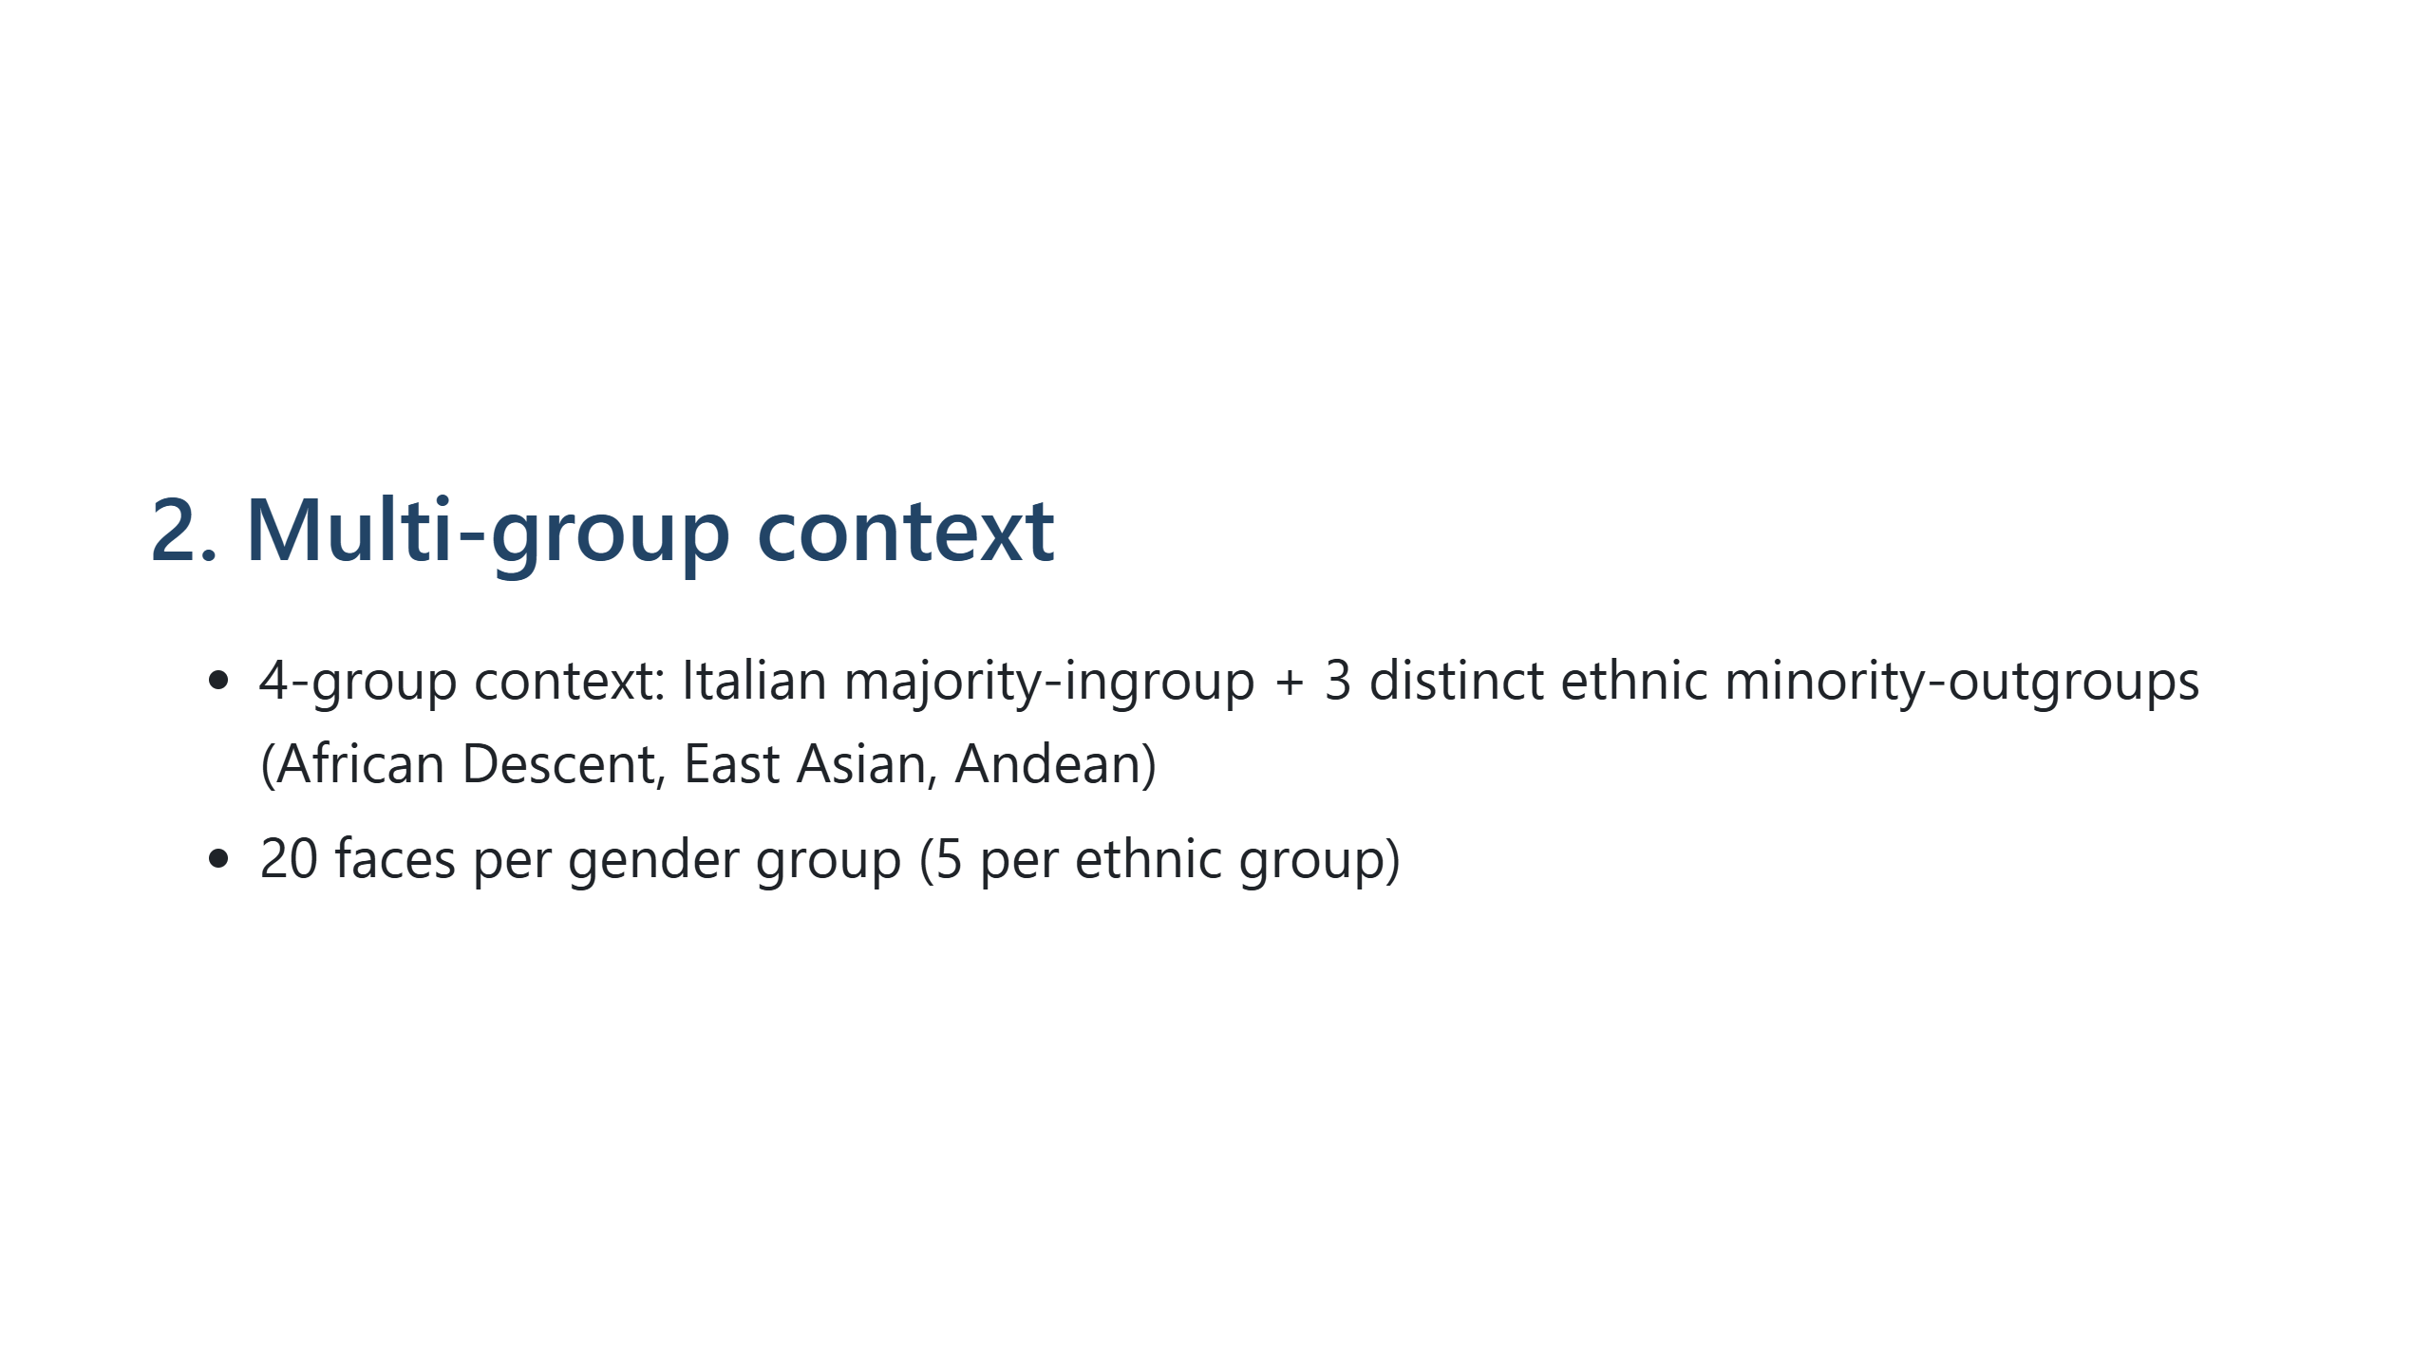

Slide 7
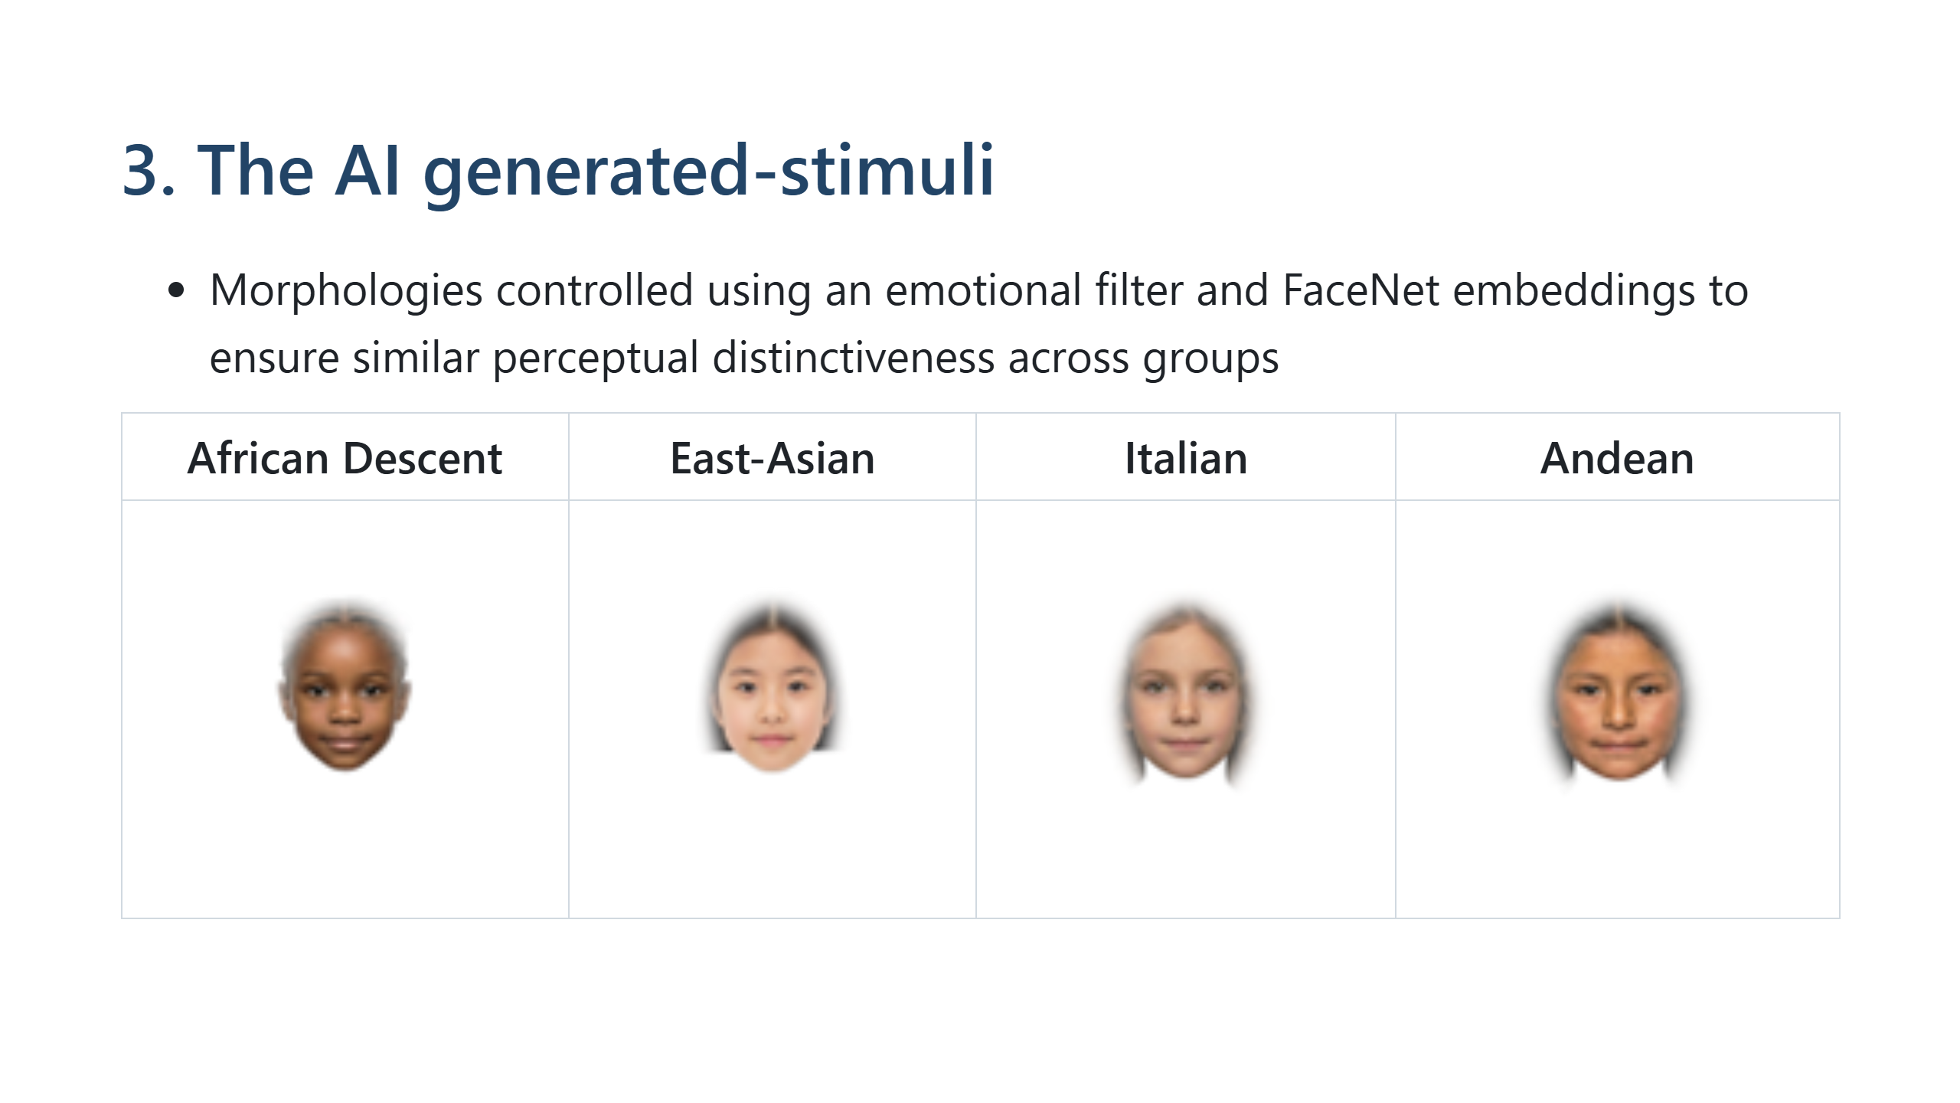

Slide 8
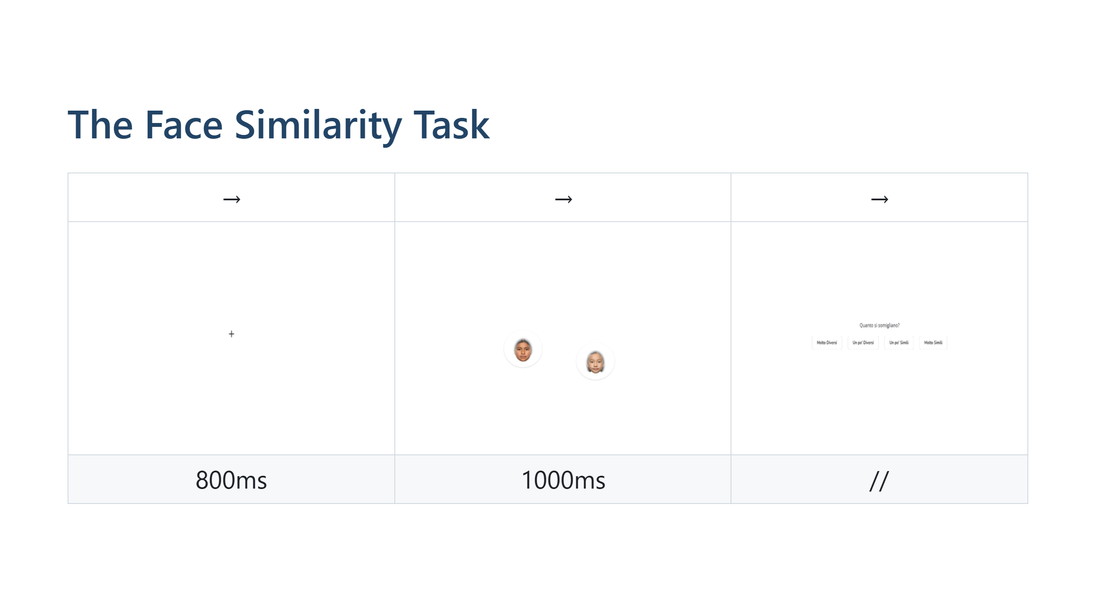

Slide 9
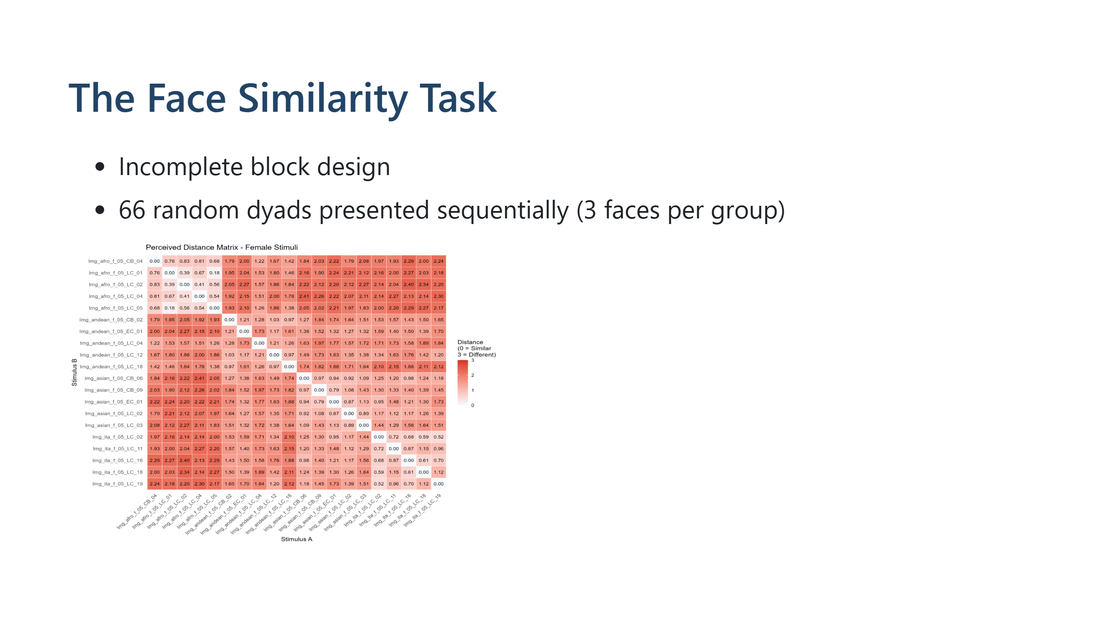

Slide 10
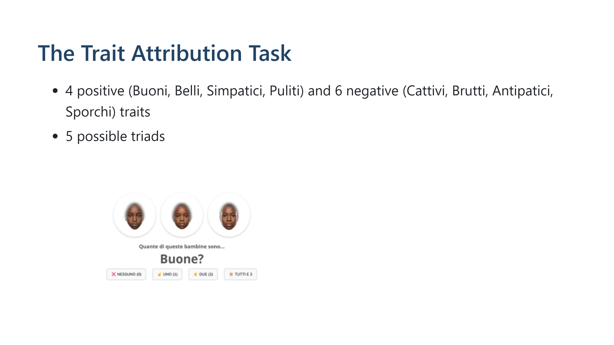

Slide 11
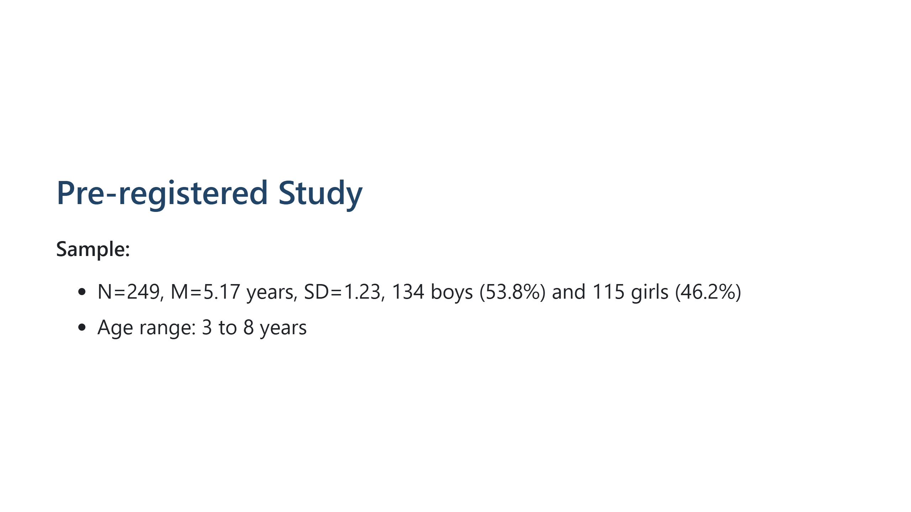
Notes:
---
# Pre-registered studies: Method & Experimental Design
---
# The Gamified Task
**Engagement Without Explicit Categorization:**
- Narrative: "Oscar the meerkat" task (no explicit ethnic labels)
- Children evaluate face pairs without social priming

Slide 12


Slide 13
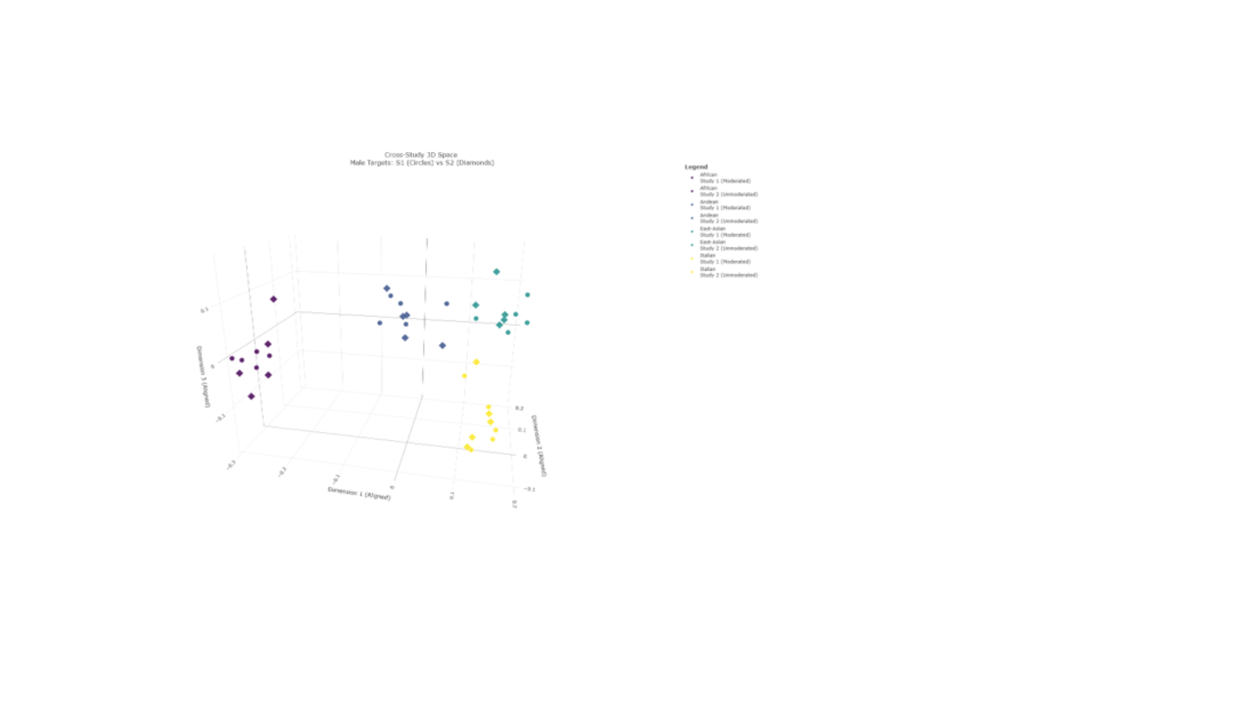
Notes:
---
Structural Replicability (S1 vs S2)
**Validating Robustness Across Contexts**
**Procrustes 3D MDS Alignment:**
- Highly consistent structural overlap between moderated (S1) and unmoderated (S2) samples
- Similar spatial arrangements despite different testing contexts
**Quantitative Validation:**
- Tucker congruence indices: >0.93 (excellent agreement)
- Mantel tests: Confirm consistent mapping structures
- **Conclusion:** Perceptual structures are robust, not artifacts of testing context
Speaker Notes
A critical question is whether these findings depend on the specific testing context. When we aligned the spatial maps from both studies using Procrustes analysis, they overlapped remarkably well. The Tucker congruence coefficients exceeded 0.93, which is well above the threshold for excellent agreement. Mantel tests confirmed that the rank-order distances between groups were consistent across contexts. This replication is crucial—it suggests that the perceptual structures we identified are genuine features of how children organize faces, not artifacts created by experimenter presence or online testing constraints.

Slide 14
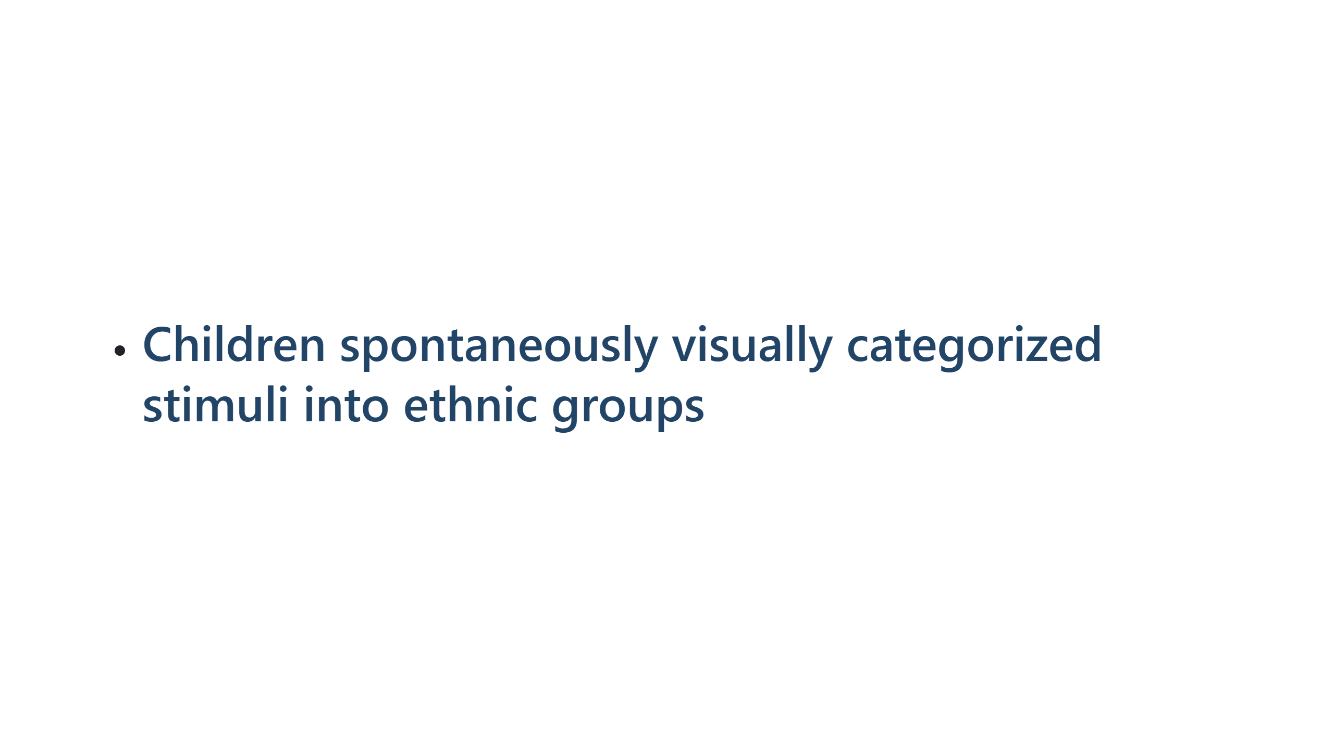

Slide 15
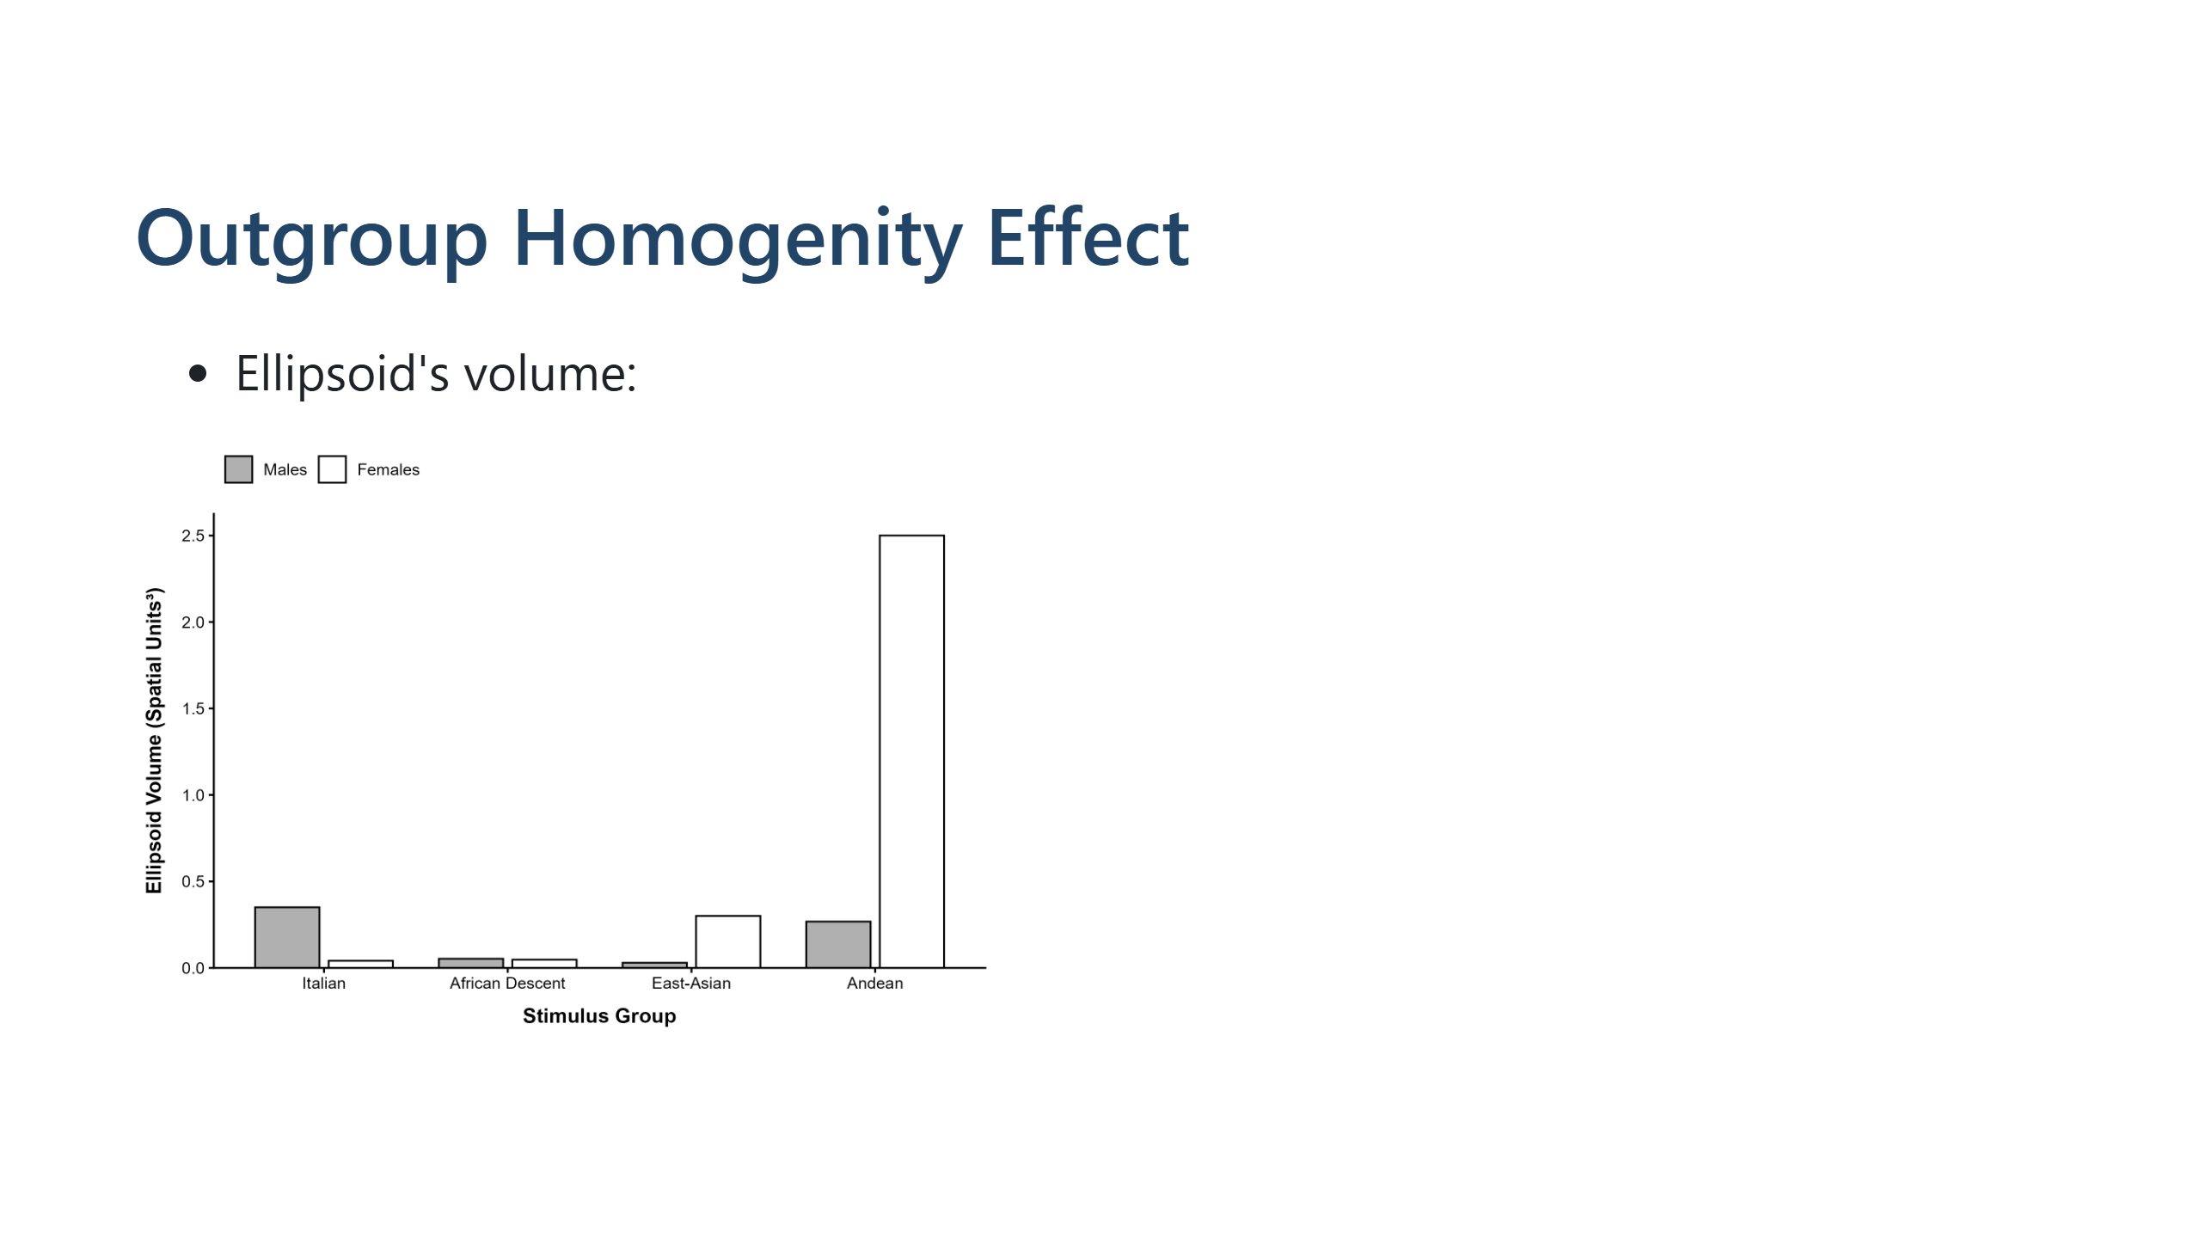
Notes:
---
<!--
# Main Spatial Metrics (OHE)
- 95% variance ellipsoids volumes
- Minimum convex hull
---
<div align="center">
<img src="Images/Figure_Volume_3D_APA7.png" alt="Minority-groups homogeneity effect" width="700">
</div>
---
# OHE not Supported
- Italian ingroup: Highly concentrated cluster
- African Descent outgroup: Highly concentrated cluster
- Andean outgroup: **Largest dispersion volume** (lowest homogeneity)
- East Asian outgroup: Intermediate compactness
**Interpretation:**
- Perceptual homogeneity ≠ predicted by ingroup/outgroup status
<!-- Speaker Notes
When we mapped the faces in a 3D perceptual space, we found something surprising: the ingroup wasn't perceived as most homogeneous. Instead, the Andean group showed the largest spread—children perceived them as the most diverse-looking group. The Italian ingroup and African Descent groups clustered tightly. This suggests that perceived homogeneity depends on the actual perceptual features of the faces, not simply on whether they're in your ingroup or outgroup. The classic Outgroup Homogeneity Effect didn't emerge.
---
# Main Spatial Metrics (Minority-groups homogeneity effect)
- Centroid distances
<!--
---
<div align="center">
<img src="Images/Figure_Distances_3D_APA7.png" alt="Minority-groups homogeneity effect" width="700">
</div>
---
# Minority-groups homogeneity effect not supported
**Key Finding: Minority-groups homogeneity effect NOT Supported**
- Outgroups were NOT closer to each other than to the ingroup
- African Descent group: Structurally most distant from other outgroups
- Ingroup-Outgroup distances: Heterogeneous (not uniformly large)
**What This Means:**
- Minority groups not perceived as interchangeably similar
- Each group occupies distinct perceptual position
- Multigroup structure more complex than binary ingroup/outgroup dichotomy
<!-- Speaker Notes
Regarding the Minority-Groups Homogeneity Effect, we found it wasn't supported either. The African Descent group, for instance, was perceptually quite distant from both East Asian and Andean groups—they didn't cluster together as a unified "outgroup." This tells us that children are sensitive to the specific perceptual characteristics of each ethnic group and don't collapse multiple outgroups into a homogeneous "other." The multigroup perceptual space is richer and more nuanced than traditional categorization models suggest.

Slide 16


Slide 17


Slide 18
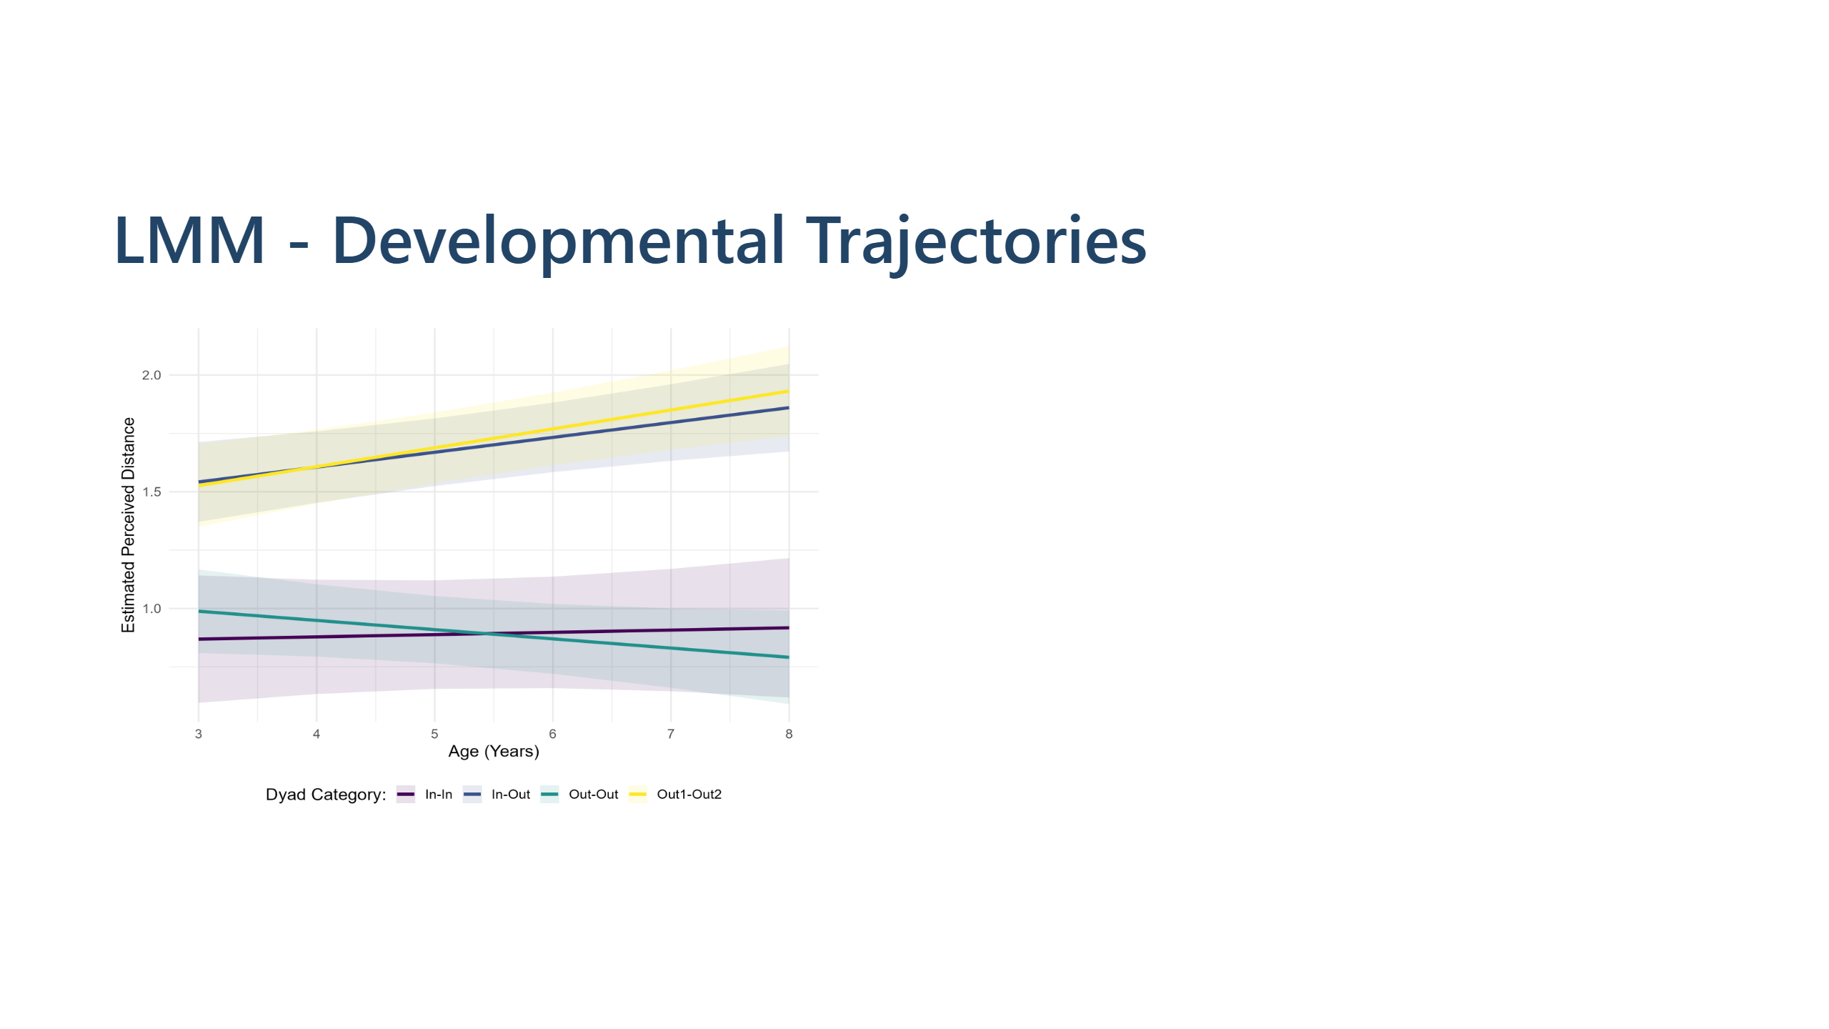

Slide 19
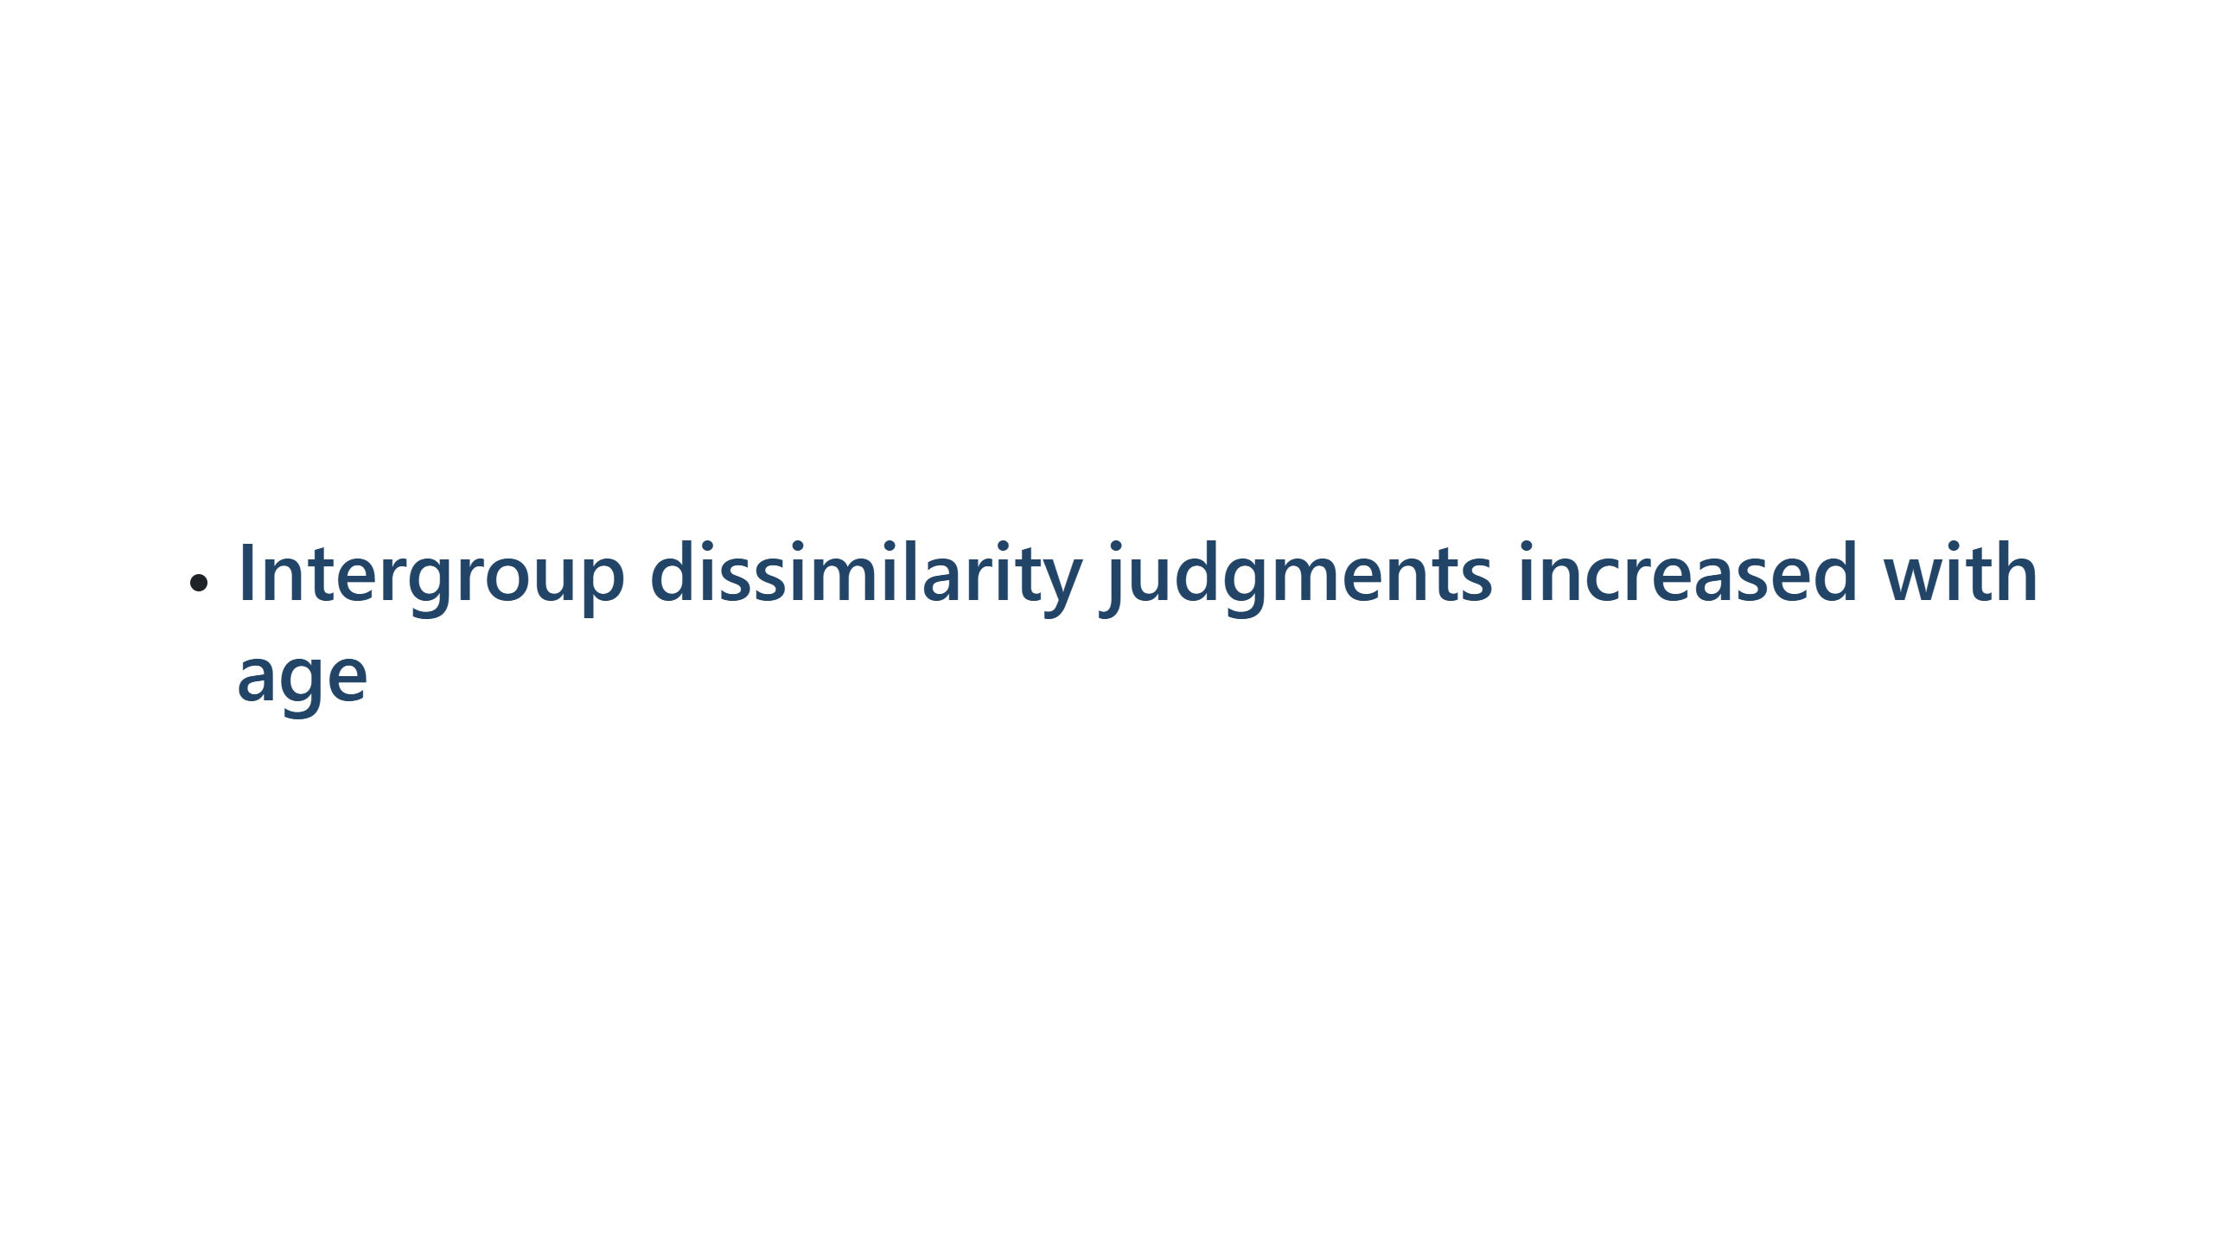

Slide 20
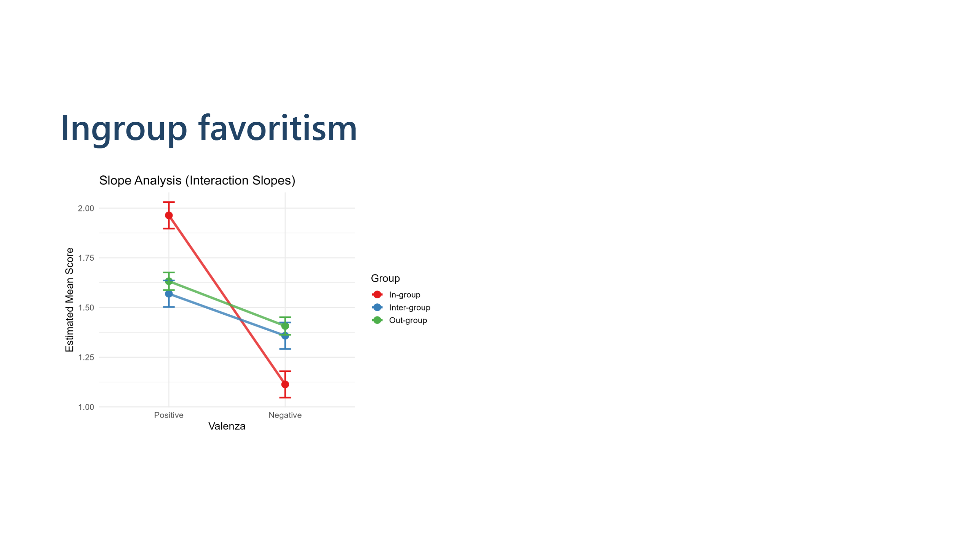

Slide 21


Slide 22
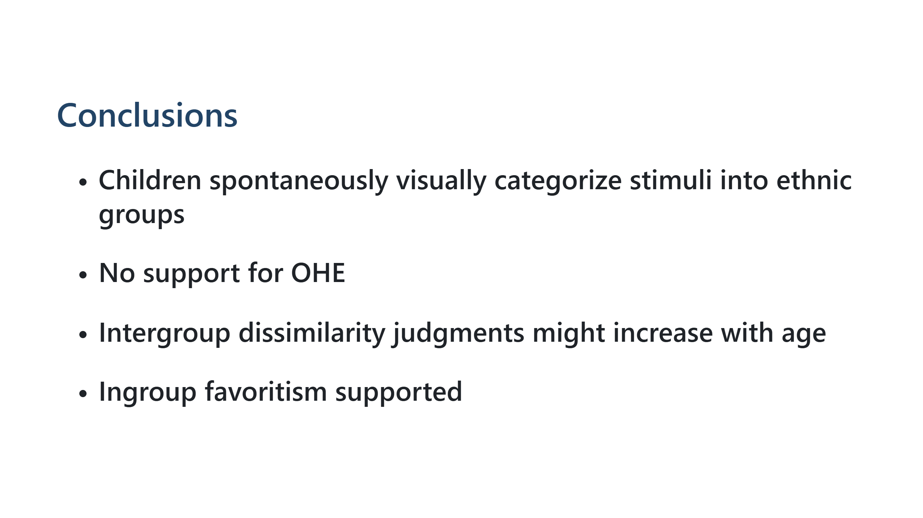
Notes:
Speaker Notes
When we tracked children across ages 3 to 8, a developmental pattern emerged. As children got older, faces from different groups seemed more dissimilar to them—the distances between intergroup dyads increased. For within-group pairs, we saw some evidence that ingroup faces became more tightly clustered with age, especially in Study 2, suggesting that children develop a more refined, consolidated representation of their own group's appearance. This developmental trajectory aligns with theories of perceptual expertise—as children become more experienced with faces, they become better at extracting the features that distinguish one group from another.
---
# Discussion & Conclusion
**Main Findings:**
- Visual essentialism & face-space similarity better explain results than OHE/MGHE
- Multigroup perceptual space: Complex, group-specific organization
- Developmental refinement: Intergroup distinctions sharpen with age
**Limitations:**
- Uneven dyad exposures in similarity task
- Perceived threat/cultural factors not directly measured
**Future Directions:**
- Interventions in multicultural schools based on perceptual similarity principles
- Integration with implicit attitude measures
- Longitudinal tracking from early childhood through adolescence
**Broader Implications:**
- Early perceptual categorization ≠ deterministic social bias
- Targeting face-perception mechanisms may offer novel intervention pathways
Speaker Notes
To wrap up: Our results paint a more nuanced picture of how children perceive ethnic diversity. The classic Outgroup Homogeneity Effect and Minority-Groups Homogeneity Effect didn't emerge as predicted. Instead, children's perceptions are guided by the actual visual features of faces and organized according to face-space principles. Importantly, we see developmental changes—older children distinguish between groups more finely. Of course, our work has limitations: we haven't directly measured threat perception or cultural factors that might moderate these effects. But looking forward, this research opens new doors. Understanding the perceptual foundations of social categorization could inform school-based interventions that leverage face-space similarity principles. By helping children develop more individuated, less stereotypical representations of outgroup members—what researchers call "personalization"—we might reduce intergroup bias from the ground up. Thank you.

Slide 23
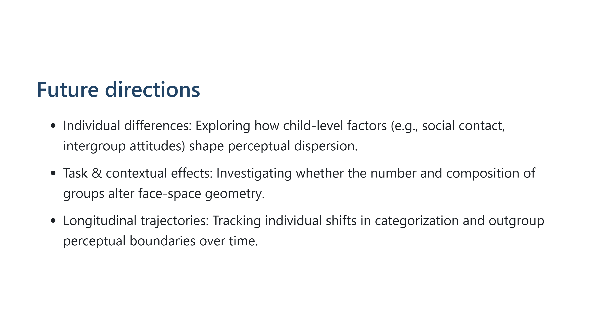

Slide 24


Slide 25


