Slide 1
The Anapole Antenna
Fera Edoardo – Fiorini Luca

Slide 2
1 · Goal and parameters
104.2 MHz
What we want
design frequency f₀
An antenna that radiates at f₀ = 104.2 MHz.
A short dipole (h ≈ 3 cm ≪ λ₀) radiates very little
Idea: add a second radiator with the same radiation pattern, to raise the far field.
Candidate: a toroidal dipole, built as a toroidal wire coil.
2.877 m
λ₀ = c / f₀
2.184 rad/m
Roadmap: 1 The antenna · 2 On paper · 3 Why it does not radiate · 4 Everything else
k₀ = 2π / λ₀

Slide 3
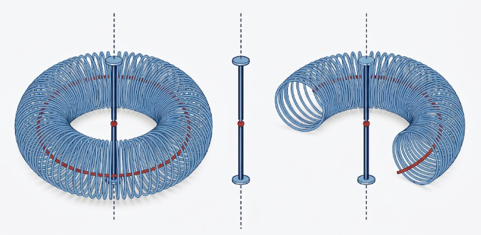
1 · Antenna layout
Legend
z: axis of the dipole
h: dipole length
R: ring radius
a: loop radius
N: number of loops
red wire: return wire along the ring
f₀ = 104.2 MHz, λ₀ = 2.877 m
Schematic, not to scale. Left: toroidal coil with the central dipole; right: cut view.

Slide 4
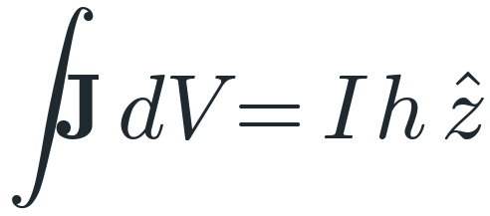
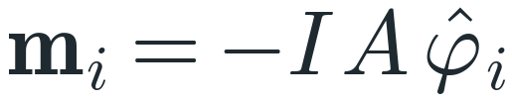
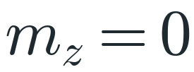
1 · Geometry and model
Short dipole
Toroidal coil
Return wire
Length h along z. End plates: uniform current I.
N circular loops, radius a, A = πa². Meridian planes, centres on a ring of radius R.
Is needed in order to nullify the magnetic dipole generated by the toroidal coil (m_z = I·πR²).
Model and assumptions
N closed loops, all carrying I; the current flows +z on the outer side of each loop when it flows +z in the dipole.
kR ≲ 0.5, a < R, N ≥ 3, time convention e^{jωt}. Design: R = 15 cm, N = 12, a = 4.7 cm → A = πa² = 6.94·10⁻³ m², kR = 0.33.

Slide 5
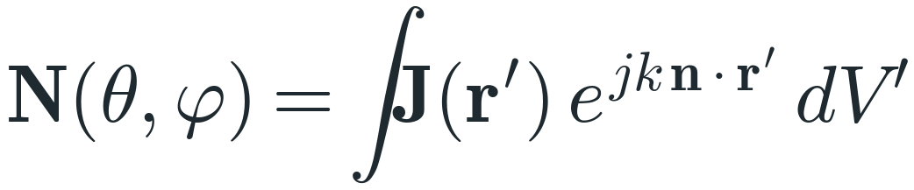

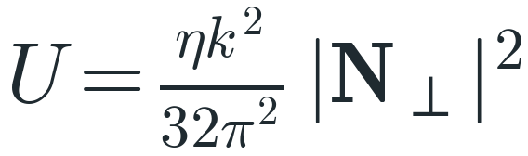
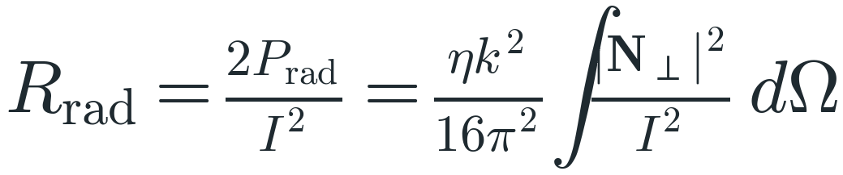
2 · From N to the field
Radiation vector: each current element weighted by its phase delay (n = direction of observation).
Far field: only the part of N transverse to n radiates, N⊥ = N − n(n·N).
Radiation intensity (W/sr) from U = r²|E|²/2η, with η = 120π Ω.
P_rad = ∫U dΩ (peak current I): Rrad is the equivalent resistance that dissipates P_rad.

Slide 6
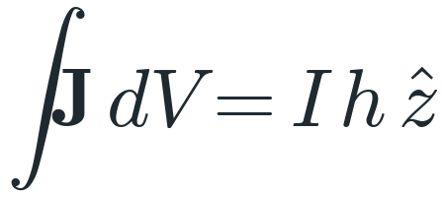
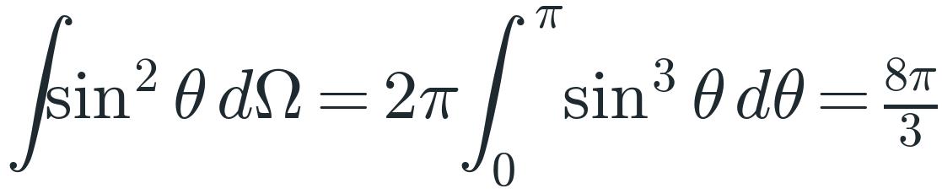
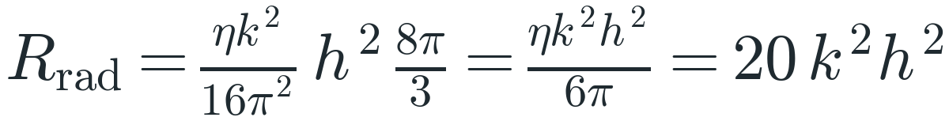
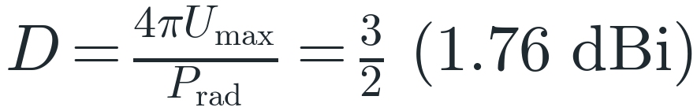
2 · Step 1: the dipole
Dipole with end plates: uniform current I over the length h.
Projection of z perpendicular to n.
Integral over the whole sphere.
Using η = 120π Ω.
k² = 4.77 m⁻²; h = 29.8 mm (fixed by the design choice).
Directivity of a short dipole (pattern sin²θ).

Slide 7

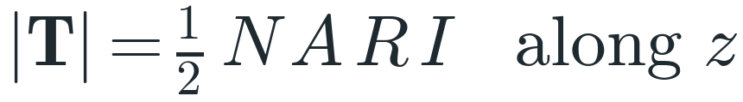
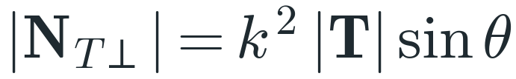
2 · Step 2: the coil
Each loop is a magnetic dipole, located at distance R from the axis.
Toroidal moment of one loop, T = ½ d × m
The N loops add up along z (N-fold symmetry).
A toroidal dipole radiates with the same sinθ pattern as an electric one.
Equivalent length: |N_T⊥| = I·h_T·sinθ (R = 15 cm, N = 12, a = 4.7 cm).

Slide 8


2 · Step 3: the sum
First-pass hypotheses
A1: The coil is in series with the dipole: same current I, hence the same phase.
A2: Same sinθ pattern: the two amplitudes add.
A1 + A2: the radiation vectors add.
Effective length of the combined radiator.
Design choice: the coil contributes as much as the dipole.

Slide 9
2 · Paper results
Quantity | Bare dipole | Paper antenna
Effective length | h = 29.8 mm | 2h = 59.6 mm
Far-field amplitude at fixed I | 1 | ×2
Rrad = 20k²h_eff² | 85 mΩ | 339 mΩ
Radiated power at fixed I | 1 | ×4 (+6.0 dB)
Directivity | 1.5 | 1.5
+6 dB
radiated power at the same current: 80k²h² vs 20k²h²
×2
far-field amplitude
Same pattern and polarization: on paper, a short dipole with a doubled effective length.

Slide 10
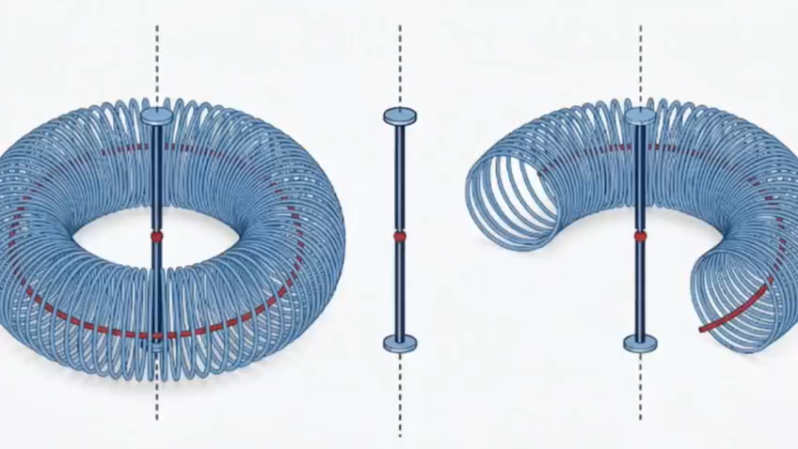

Slide 11
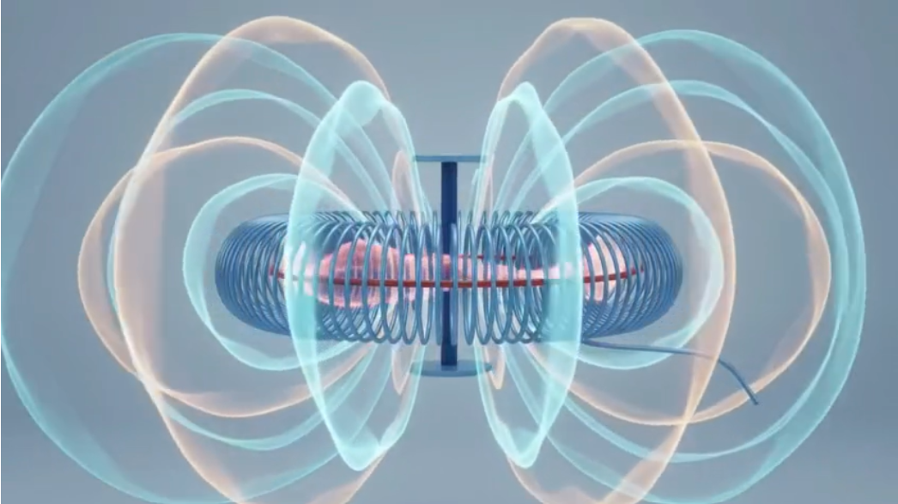

Slide 12
2 · Is the hypothesis true?
What the paper says
What we have not checked
• Same series current ⇒ same phase.
• Same sinθ pattern ⇒ the fields add.
• heff = 2h, Rrad = 339 mΩ: +6 dB.
• A short dipole with a doubled effective length.
• A1 only says that the ratio of the two amplitudes is real: 0° or 180°.
• Which one? It depends on the sign of T_z, i.e. on the winding direction.
• The toroidal term comes from the 2nd-order term (−k²/2) of the expansion of N.
Part 3: does the coil add to the dipole, or subtract from it?

Slide 13
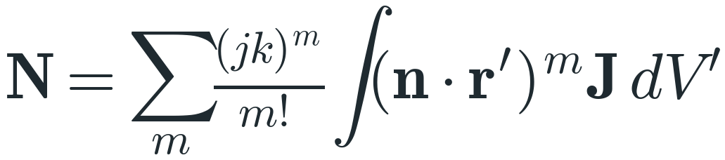
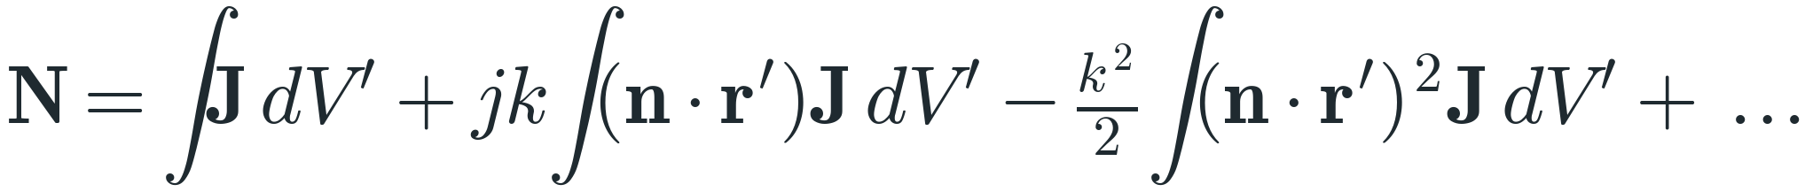
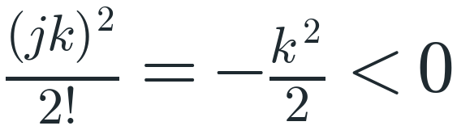
3 · Where the sign hides
Taylor series of the phase factor e^{jk n·r′}, valid for kR < 1.
Orders 0, 1, 2 have coefficients 1, jk and −k²/2.
The 2nd-order coefficient is negative: whether it adds or subtracts depends on the geometry.
Content of each order — 0: electric dipole · 1: magnetic dipole + electric quadrupole · 2: toroidal dipole + magnetic quadrupole

Slide 14
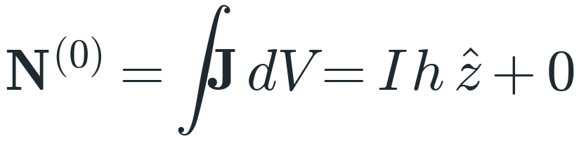
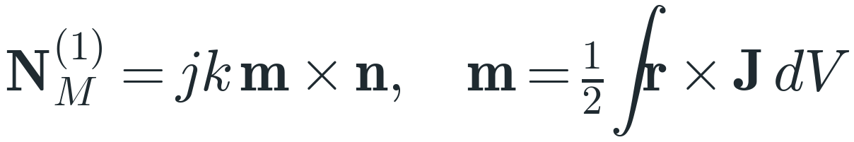
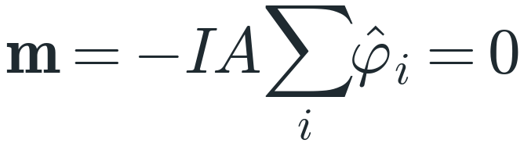
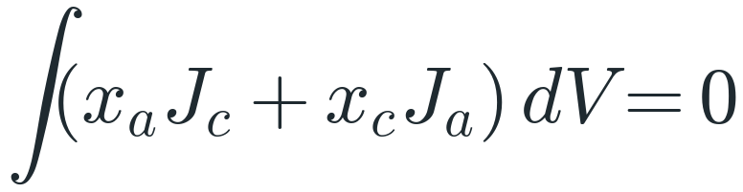
3 · Orders 0 and 1
Closed loops: ∮dl = 0. Only the dipole contributes.
Magnetic dipole: coefficient j, 90° out of phase with the dipole term.
Σφ_i = 0 for N ≥ 2. The return wire cancels the advance I·πR² of a series winding.
Without the return wire it would dominate; it is φ-polarized, so it can never cancel the dipole.
Electric quadrupole: zero for closed currents (lemma 1); for the centred dipole ∫zJ_z dz = 0.

Slide 15
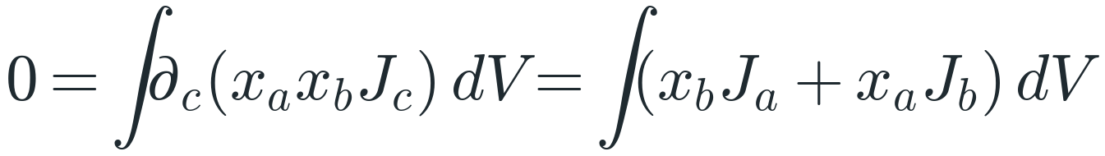
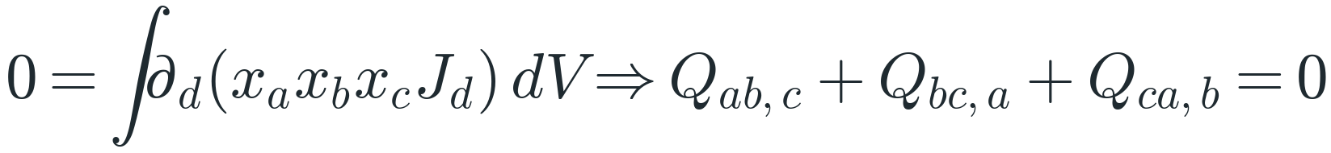
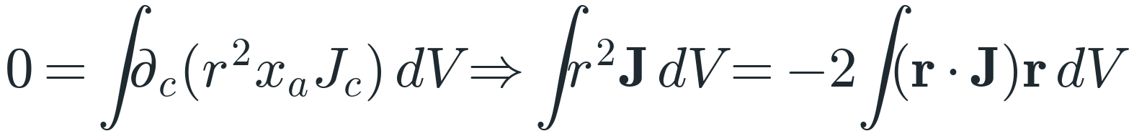
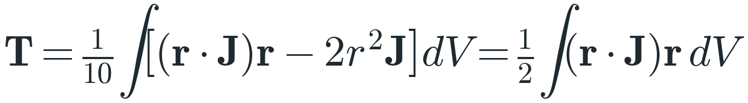
3 · Lemmas: closed currents
Lemma 1 (∇·J = 0, divergence theorem): ∫J = 0, no electric quadrupole, ∫x_aJ_c = ε_acd m_d.
Lemma 2, with Q_ab,c = ∫x_ax_bJ_c dV: the fully symmetric part of Q vanishes.
Lemma 3: ∂_c(r²x_a) = 2x_cx_a + r²δ_ca.
Toroidal moment. By lemma 3: ∫(r·J)r = 2T and ∫r²J = −4T.

Slide 16
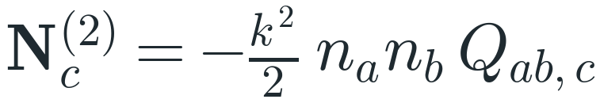
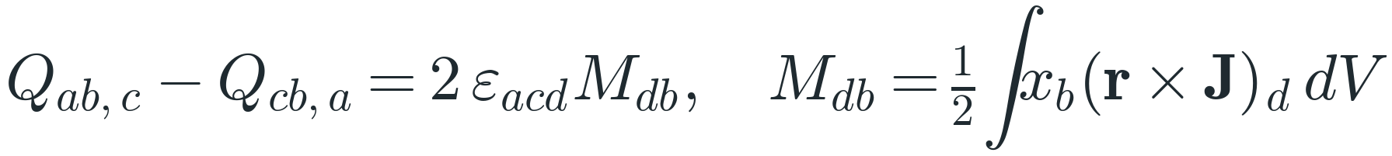
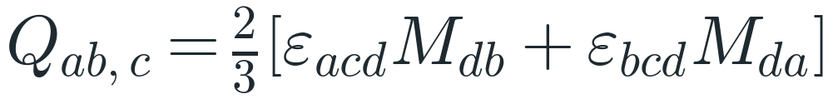
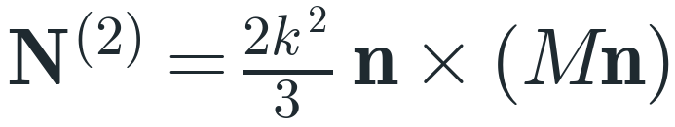
3 · Second order: the tensor
Second-order term in components; Q_ab,c is symmetric in a, b.
Lemma 2: the three cyclic permutations of Q sum to zero.
The antisymmetric combinations define the tensor M (magnetic-quadrupole type).
Substituting the third line into the second.
Contracting with n_a n_b: the result is always perpendicular to n.

Slide 17
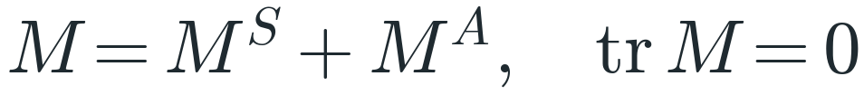
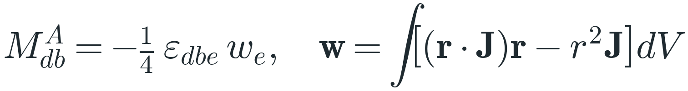
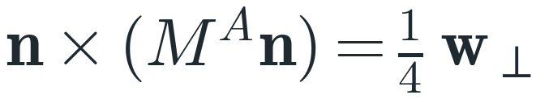

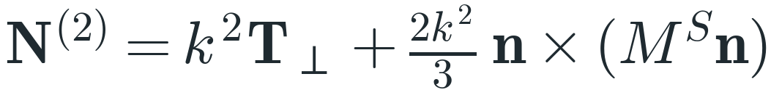
3 · Toroidal and quadrupole parts
Symmetric part M^S (magnetic quadrupole) + antisymmetric part M^A; tr M = ½∫r·(r×J) = 0.
M^A is fixed by a single vector, w.
Since M^A n = −¼ n×w and n×(n×w) = n(n·w) − w.
From lemma 3: ∫(r·J)r = 2T and ∫r²J = −4T.
Toroidal dipole (k²T⊥, like an electric dipole) + magnetic quadrupole.

Slide 18
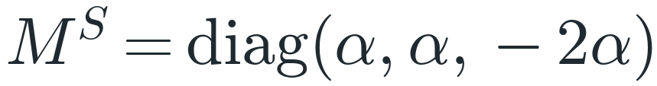
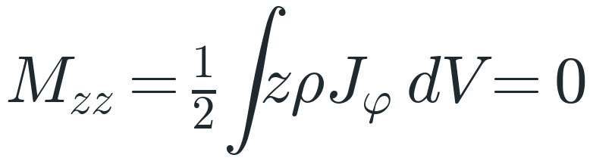
3 · Our geometry: M^S = 0
Symmetric, traceless, invariant under rotations by 2π/N (N ≥ 3): only axial symmetry survives.
Loops in meridian planes: J_φ = 0; the dipole lies on the axis.
Only the toroidal term survives at second order.
T is along z (N-fold symmetry): dipole and coil have the same pattern.

Slide 19
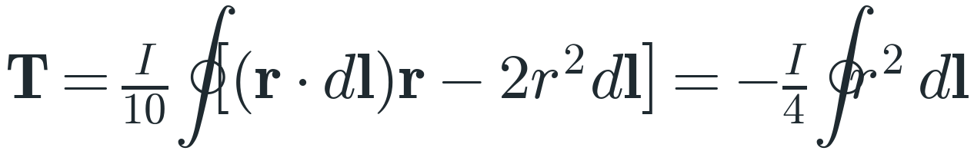
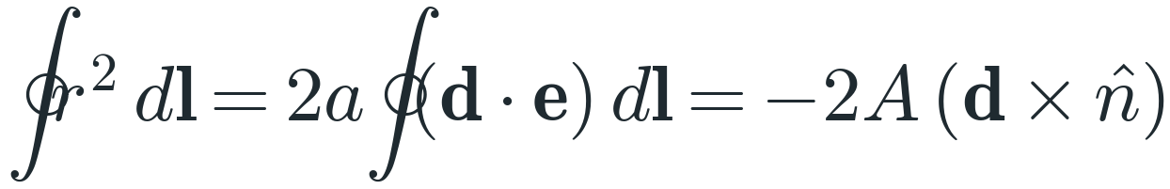
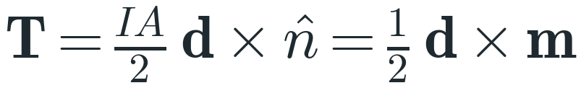
3 · Toroidal moment of one loop
Closed path: r·dl = d(r²/2), so ∮(r·dl)r = −½∮r²dl.
Loop of radius a centred at d; e(ψ) = unit vector in the loop plane.
Constants drop (∮dl = 0). With dl = a(−sinψ u + cosψ v)dψ and n = u×v.
Exact for a circular loop of any radius (m = I A n).
ρ × φ = z. The minus sign comes from the winding: current +z on the outer side.

Slide 20
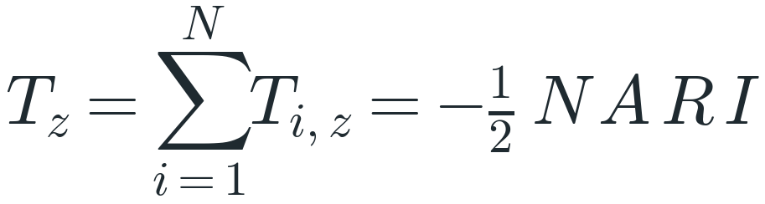
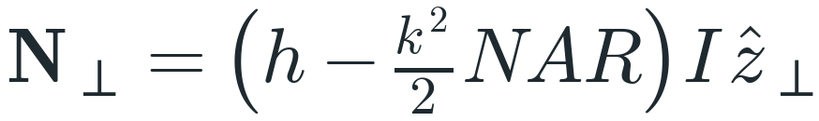

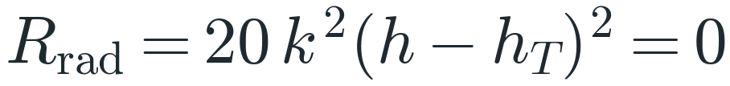
3 · The sum: anapole condition
All N loops contribute equally: same R, A and winding.
Into N⊥ = (Ih + k²T_z) z⊥: the toroidal term SUBTRACTS.
Anapole condition: zero far field in every direction.
Dimensional check and value at f₀ = 104.2 MHz.
No far field ⇒ no radiated power: Rrad = 0, radiation efficiency = 0.

Slide 21
3 · Paper versus complete analysis
 | Paper (A1: in phase) | Complete (signs tracked)
Toroidal term | +k²NAR·I/2 (assumed) | −k²NAR·I/2 (T_z < 0)
N⊥ | (h + h_T)·I·sinθ | (h − h_T)·I·sinθ
At h_T = h | 2h·I·sinθ | 0
Rrad | 339 mΩ (×4, +6 dB) | 0 (≈ 12 µΩ with all orders)
The winding direction decides: with the opposite winding the two terms add (numerical check: ×3.95, +6.0 dB). With ours they cancel.

Slide 22
4 · Numerical check
R / N / a | A | h = k²NAR/2 | kR | Peak residual | Tuned h | Residual (tuned)
10 cm / 12 / 3.0 cm | 2.83·10⁻³ m² | 8.09 mm | 0.22 | −44 dB | 8.05 mm (−0.5%) | −57 dB
15 cm / 12 / 4.7 cm | 6.94·10⁻³ m² | 29.8 mm | 0.33 | −37 dB | 29.46 mm (−1.1%) | −50 dB
20 cm / 16 / 6.0 cm | 11.3·10⁻³ m² | 86.3 mm | 0.44 | −32 dB | 84.65 mm (−1.9%) | −44 dB
Method: my own Python integration of all wire currents over 4368 directions; residual = peak |N⊥| / (I·h), bare dipole = 0 dB.
Truncating the expansion at second order leaves only 7·10⁻⁵ (−83 dB): the proof is confirmed. Also checked numerically: T_z = −½NAR, m = 0, M^S = 0.
This is not a NEC-2 simulation: it should be repeated in NEC-2 with the real connections.

Slide 23
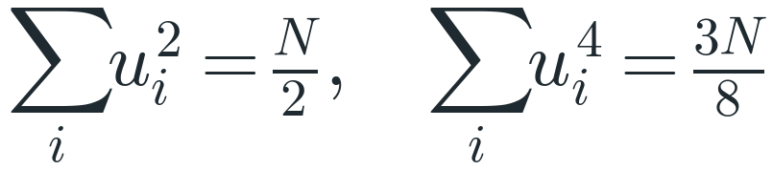
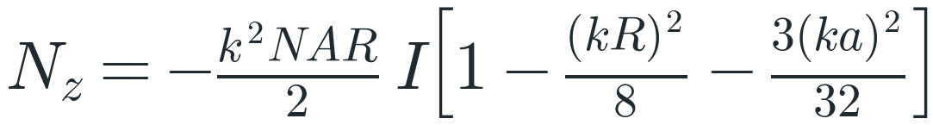
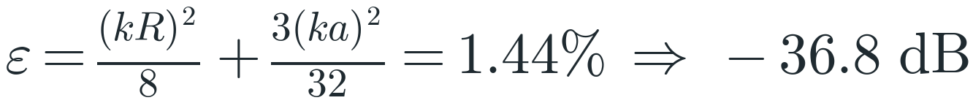
4 · Beyond second order, by hand
Equatorial plane (θ = 90°): loop integral via ∫sinψ e^{jx sinψ}dψ = 2πj J₁(x).
Series of J₁(x) = x/2 − x³/16 + … and of the exponential, to 4th order.
Sums over the N loops (N ≥ 5); odd powers of u sum to zero.
Collecting the surviving terms (the dipole gives exactly I·h at θ = 90°).
Numerical: 1.43% (−36.9 dB). Exact equatorial null at h = h_T(1 − ε) = 29.4 mm.

Slide 24
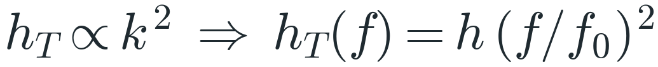
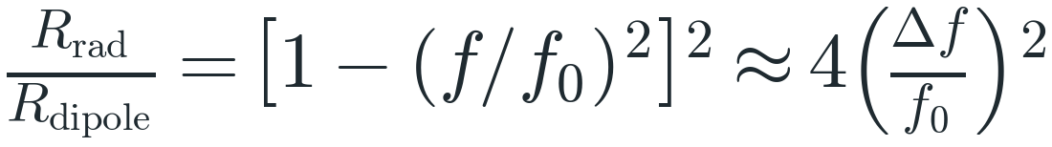
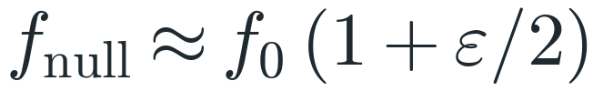
4 · Frequency and bandwidth
The coil term grows as f²; the dipole length is fixed.
Radiation resistance with the geometry fixed (k = k₀ f/f₀).
Relative to the bare dipole at the same frequency.
−20 dB: ±5% (≈ ±5 MHz); −30 dB: ±1.6%; −40 dB: ±0.5%.
All orders: the null moves up by ≈ 0.5–0.7% (≈ 104.8 MHz); Rrad(f₀) ≈ 12 µΩ, not 0.

Slide 25
4 · Tolerances
Error on the coil term | Ideal: 20·log δ | Ideal: Rrad = 85 mΩ·δ² | Numerical (all orders, h tuned)
±0.1% | −60 dB | 85 nΩ | −48 dB
±1% | −40 dB | 8.5 µΩ | −40 / −38 dB
±5% | −26 dB | 0.21 mΩ | −27 / −26 dB
±10% | −20 dB | 0.85 mΩ | −20 dB
The floor of about −50 dB (3·10⁻³ of I·h) comes from 4th-order terms: ≈ 0.03·(kR)² after tuning h, ≈ 0.13·(kR)² before (= ε). Suppression deeper than this is not reachable, however precise the construction.

Slide 26
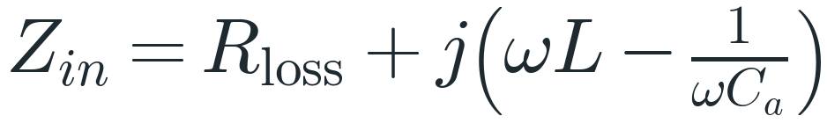
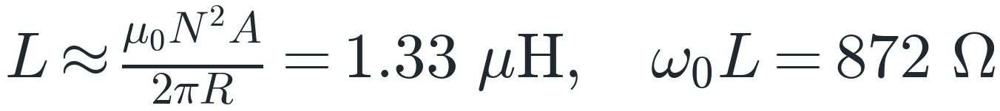


4 · Impedance, losses, near field
Series L (coil), C_a (dipole), ohmic loss. Rrad ≈ 0 does not appear.
Toroid estimate (closely wound): order of magnitude only.
At f₀ the input power is dissipated or stored: the antenna behaves as a dummy load.
Large reactive energy in the near field: high Q, narrow band, sensitive to nearby objects.

Slide 27
4 · Practical limits
What must be controlled
Feeding options
• Return wire: it must cancel m_z = I·πR² to ≲ 0.1%; a 1% mismatch already gives −26 dB (φ-polarized).
• Connection of the loops: the model has N closed loops with the same I; the real series connection must be simulated in NEC-2.
• Dipole–coil coupling: currents follow I = Y·V, so the voltages must be tuned.
• Ohmic loss of the coil: ≈ 1.5 Ω estimated for 3.5 m of 2 mm copper wire, far above Rrad.
• One generator: dipole and coil in series, I_c = I_d = I, return wire for m_z.
• Two generators: I_c / I_d = 2h / (k²NAR), a real ratio (0° or 180°): amplitude and phase can be tuned.
• The return wire is needed whenever the winding is continuous, with one generator or two.
• Alternative: N independent loops fed in parallel: no advance, no return wire, but N feed points.

Slide 28
4 · The article
Nemkov, Basharin, Fedotov
Non-radiating sources, dynamic anapole and Aharonov–Bohm effect, Phys. Rev. B 95, 165134 (2017), arXiv:1605.09033.
• Dynamic anapole: electric and toroidal dipoles interfering destructively form a point-like non-radiating source.
• Condition D = −ik·T_p·(1 + O(a²k²)); Weyl gauge: if E = 0 outside, A = 0 outside.
• Devaney–Wolf: non-radiating iff the transverse Fourier transform of J vanishes on |p| = k.
• A disk of anapoles: uniform E inside, H on the edge, nothing outside.

Slide 29
4 · Utility and limits
Where anapoles are used
Limits
• Nanophotonics: dielectric nanodisks scatter very little but store a lot of energy; used for third-harmonic generation, sensors, nanolasers.
• Metamaterials: microwave transparency and scattering suppression (Fedotov et al., 2013).
• Narrow-band stealth: the article suggests reducing the radar cross-section of protruding elements.
• Not an antenna for transmitting or receiving: it does not radiate by design; as an FM antenna it would be useless.
• Narrow band, tight tolerances, residual multipoles, ohmic loss, high Q.
• It must be designed into the object: it cannot be applied to an existing metal body.
• No commercial product that I know of: mostly research and teaching.

Slide 30
4 · Takeaway
A model is only as good as its assumptions
1 On paper: same current ⇒ same phase ⇒ the fields add: heff = 2h, Rrad = 339 mΩ, +6 dB.
2 Complete analysis: the sign of T_z is set by the winding, N⊥ = (h − k²NAR/2)·I·z⊥ = 0 for h = k₀²NAR/2.
3 Numerics: −37 dB (−50 dB with h tuned); the null shifts with frequency; a real design needs tuning and NEC-2.
The cancellation is a design condition: h = k₀²NAR/2.

