Slide 1

The Theory of Visual Analytics
Interacting with Automated Reasoning
James Schaffer, John O’Donovan, Tobias Höllerer
University of California Santa Barbara

Slide 2
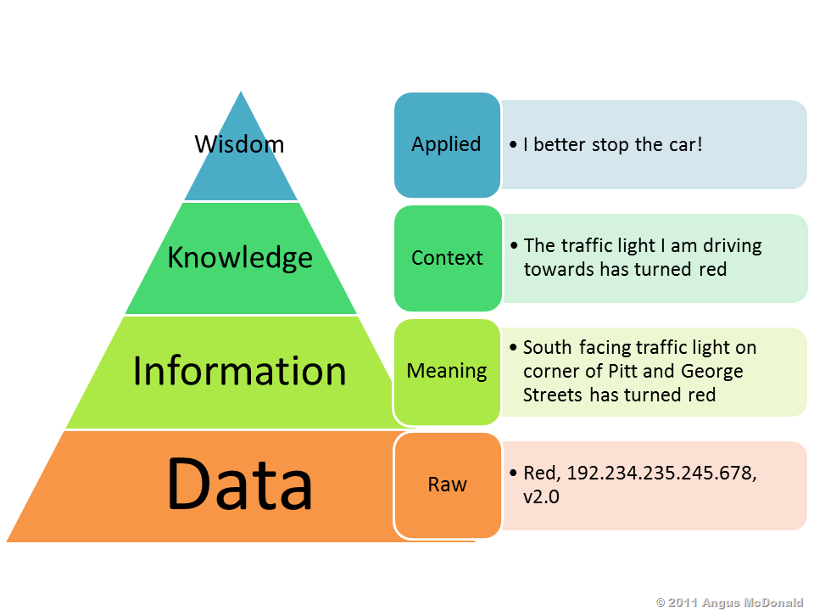
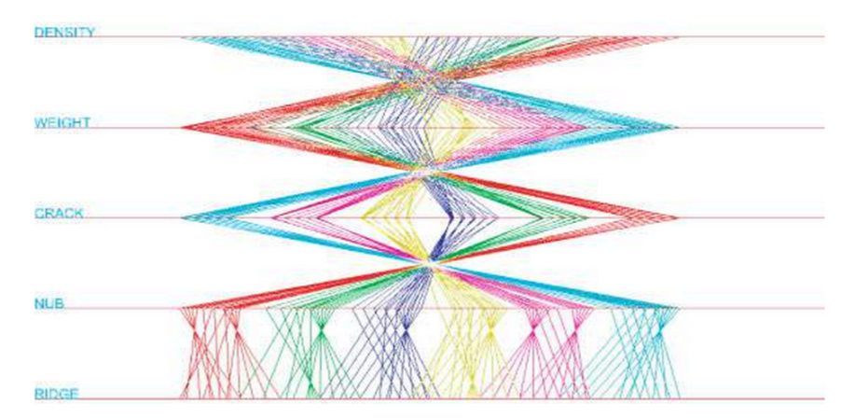
Visual Data Analysis
DIKW
Insight
Complex, deep, qualitative, unexpected, relevant
Statistics
Visualization
Automated Analysis
Machine Learning
Filters/Queries vs Data Mining

Slide 3
Human vs. Machine Analysis
About Me
My Research
Previous Studies
MOOC
Human
Rooted in domain terms
Hypothesis -> Experimentation -> Insight
Top down approach
Results in discoveries that are expected
Filtering/Querying can be quite slow when data becomes truly massive
Machine
Ignorant to domain theory, applicability
Relies on pattern recognition, information theory
Bottom up approach
Results in discoveries that are unexpected
More promise for scalability

Slide 4

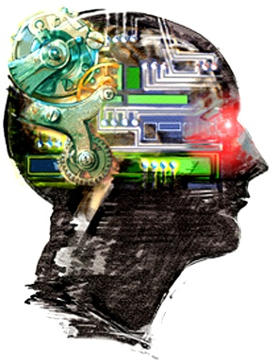
The Human-Machine System
About Me
My Research
Previous Studies
MOOC
sctroyenne | RT @SanPabloPolice: BREAKING NEWS: A bomb threat investigation has closed the Oakland Coliseum BART station. Trains are turning... http://t
davetopete | RT @SanPabloPolice: BREAKING NEWS: A bomb threat investigation has closed the Oakland Coliseum BART station. Trains are turning... http://t
beingtherewith | MY LIIIFE "@abc7newsBayArea: #BREAKING: Major BART delays due to bomb threat investigation at the Coliseum station. http://t.co/EQftIfrIsS"
oopslevine | RT @SanPabloPolice: BREAKING NEWS: A bomb threat investigation has closed the Oakland Coliseum BART station. Trains are turning... http://t
dippedinhoney | Bomb threat at the Coliseum BART station. Traffic is heavy on 880 &amp; on the streets. Police everywhere. Lotta people gonna be late for work.
SFnewsnow | Coliseum BART station reopened after bomb threat http://t.co/lb0hLRz594 #sanfrancisco
dr13isthebeast | RT @SFnewsnow: Coliseum BART station reopened after bomb threat http://t.co/lb0hLRz594 #sanfrancisco
CANARYorg | RT @SFnewsnow: Coliseum BART station reopened after bomb threat http://t.co/lb0hLRz594 #sanfrancisco
transit_tweets | RT @davefraleigh: @SFBART coliseum allegedly closed due to bomb threat. #Bart #sfbart. Srsly? http://t.co/Gk92QsXc2o
Tejada123 | LA things I'm not looking forward too: -Traffic -Parking -Dodger's fans -_- LA things I'm looking forward too: -turning 21 -bomb food
arkanciscan | http://t.co/UJ1VRnFi3g - Toucan Photobombs a Traffic Camera in Brazil http://t.co/gUrEnhMvQ7 via @po_st
ebaumsworld | Toucan Photobombs A Traffic Camera http://t.co/M7IB9S3hLo
eman__ais | RT @absolutkiran: More than just girl power. Teens reinvent process of bomb detection in #Kurdistan, while also improving traffic flow. htt
SashaFontana | #FoldedWaffleBlog Toucan Photobombs a Traffic Camera in Brazil http://t.co/KLGcITAV6j [http://t.co/ewCrEVee34]
OPDChris | The bomb threat has been cleared at 7th and Center. Normal traffic to resume soon.
oaklandpoliceca | RT @OPDChris: The bomb threat has been cleared at 7th and Center. Normal traffic to resume soon.

Slide 5
Issues
About Me
My Research
Previous Studies
MOOC
Error
Sometimes errors occur and sometimes they slip through to the decision making process – this causes a trust issue
Tuning and Flexibility
Out-of-the-box approaches may have sub-standard performance on complex, novel datasets
New hypotheses may be difficult to test as existing algorithms may not support them – user/programmer gap!
Domain Relevance
Automatically extracted patterns may be meaningless and not contribute to domain theory
Knowledge Transfer – what does this mean?

Slide 6
Improving the Process with HCI
About Me
My Research
Previous Studies
MOOC
Knowledge Transfer
Intelligent systems – early ‘90s
Insight, as defined previously in interdisciplinary visualization
Situational Awareness – Endsley (US Air Force)
Theory of Explanation
Control
Recommender Systems and Transparency
Data Mining, Computer Graphics and interactive parameter tuning (Weka)
Scientific Workflow Systems – why do they work?
Reproducibility
Provenance
Abstraction/Domain Relevance
Computational Plumbing

Slide 7
Focus
About Me
My Research
Previous Studies
MOOC
Questions
How can knowledge transfer be properly measured and quantified?
How does interacting with automated algorithms limit, enhance, or bias insight discovery?
How can explanations be designed to maximize provenance and control to improve interaction with automated algorithms?
Research Approach
Collaboration with cognitive scientists to advance the theory
Massive online user studies working with specially designed datasets and algorithms
Experimentation with different types of interaction and varying levels of control and information exposure

Slide 8
Questions?
About Me
My Research
Previous Studies
MOOC

