Slide 1
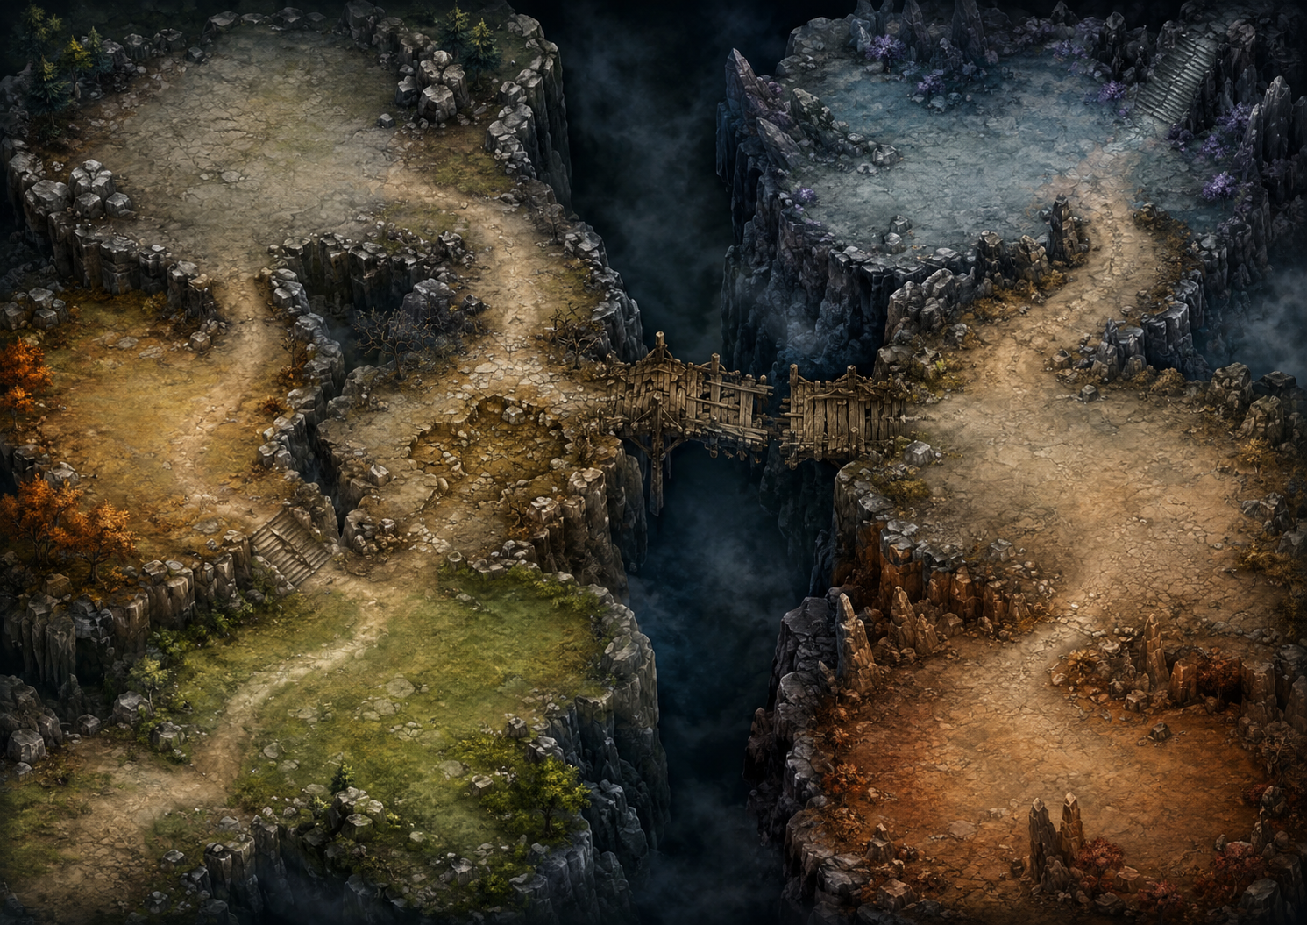
L
N
I
M
H
O
E
D
F
A
C
P
G
B
Z
A

