Slide 1
Quantum vs Classical Optimization
Server-VM Workload Placement with Qiskit ADMM & QAOA
36 problem instances | 1-6 Servers | 1-6 VMs | 100% Feasibility
Qiskit 1.x • qiskit-optimization • qiskit-algorithms • DOcplex
March 2026

Slide 2
1. Introduction & Problem Statement
Objective
Minimize the total cost of running N servers hosting M virtual machines
Cost = fixed server activation cost + dynamic CPU utilization cost
Compare a classical exact solver against a quantum QAOA solver
This is a Mixed-Integer Quadratic Program (MIQP):
• Binary variables: server on/off (sᵢ)
• Continuous variables: VM-to-server load (vⱼᵢ), CPU usage (uⱼ)
Real-world application: cloud data center workload placement,
where we allocate VMs across physical servers to minimize
energy and operational costs under capacity constraints.
Mathematical Formulation
Minimize:
Σᵢ [ πᵢ·sᵢ + δᵢ·Σⱼ (uⱼ·vⱼᵢ) ]
Subject to:
• Server load: Σⱼ vⱼᵢ ≥ capᵢ − 1 ∀i
• Server ON: sᵢ = 1 ∀i (if require_all_on)
• VM allocation: Σᵢ vⱼᵢ ≤ limitⱼ ∀j
• Min CPU: uⱼ ≥ min_cpu ∀j
Variables:
sᵢ ∈ {0,1} • vⱼᵢ ≥ 0 • uⱼ ≥ 1.0
Tested configurations:
N ∈ {1,2,3,4,5,6} × M ∈ {1,2,3,4,5,6} = 36 instances

Slide 3
2. Solution Approach: ADMM Decomposition
ADMM (Alternating Direction Method of Multipliers)
Decomposes the MIQP into sub-problems:
1. Binary sub-problem (server on/off decisions)
→ Solved as QUBO
2. Continuous sub-problem (load allocation)
→ Solved via COBYLA optimizer
3. Iteratively update Lagrange multipliers
until convergence (tol = 1e-4)
ADMM Parameters:
• ρ_initial = 100, β = 1000, factor_c = 900
• Three-block decomposition enabled
• Classical: maxiter = 100
• Quantum: maxiter = 300
Two Solver Configurations
Classical (Exact):
• QUBO sub-problem → NumPyMinimumEigensolver
• Finds exact ground state
• Continuous sub-problem → COBYLA
Quantum (QAOA):
• QUBO sub-problem → QAOA algorithm
- StatevectorSampler (noiseless simulation)
- COBYLA optimizer (maxiter=300)
- reps = 3 (variational circuit depth)
• Continuous sub-problem → COBYLA
Both pipelines use identical problem formulation
and ADMM framework — only the QUBO solver differs.
This enables a fair comparison of quantum vs
classical performance on the combinatorial core.

Slide 4
3. Code Structure: qiskit_opt.py
DOcplex Model Building
ADMM Optimizer Setup
# Decision variables
s_vars = [mdl.binary_var(name=f"si{i}") # server ON/OFF
for i in range(n_servers)]
v_vars = {(j,i): mdl.continuous_var(lb=0.0, # VM load
name=f"vj{j}i{i}")
for j in range(n_vms) for i in range(n_servers)}
u_vars = [mdl.continuous_var(lb=min_cpu, # CPU usage
name=f"uj{j}") for j in range(n_vms)]
# Objective: min server cost + utilization
obj = mdl.sum(pi[i]*s[i] + pd[i]*sum(u[j]*v[j,i]
for j in range(n_vms)) for i in range(n_servers))
mdl.minimize(obj)
# Translate DOcplex -> Qiskit QuadraticProgram
qp = from_docplex_mp(mdl)
# Classical: exact eigensolver for QUBO
exact = MinimumEigenOptimizer(
NumPyMinimumEigensolver())
admm_classic = ADMMOptimizer(
params=admm_params, qubo_optimizer=exact,
continuous_optimizer=cobyla)
# Quantum: QAOA for QUBO
qaoa_algo = QAOA(sampler=Sampler(),
optimizer=COBYLA(maxiter=300), reps=3)
qaoa = MinimumEigenOptimizer(qaoa_algo)
admm_quantum = ADMMOptimizer(
params=admm_params, qubo_optimizer=qaoa,
continuous_optimizer=cobyla)
Constraints
Solve & Post-process
# Server load constraint
for i in range(n_servers):
mdl.add(sum(v[j,i] for j in range(n_vms))
>= capacities[i] - 1)
# VM allocation limit
for j in range(n_vms):
mdl.add(sum(v[j,i] for i in range(n_servers))
<= vm_allocation_limits[j])
# Solve both
result_classic = admm_classic.solve(qp)
result_classic = snap_to_feasible(result_classic, qp)
result_quantum = admm_quantum.solve(qp)
result_quantum = snap_to_feasible(result_quantum, qp)
# snap_to_feasible fixes tiny ADMM rounding errors
# so Qiskit's strict feasibility check passes

Slide 5
4. Post-Processing: snap_to_feasible()
The Challenge
ADMM produces approximate solutions with ~1e-4 error
Qiskit's qp.is_feasible(x) uses strict zero-tolerance
→ Tiny violations cause INFEASIBLE status
Solution: Iterative constraint repair (up to 20 passes)
Algorithm:
1. Clamp all variables to their bounds
2. Identify LE-tight variables (at ceiling within 1e-10)
3. Fix GE violations: distribute deficit across
continuous variables, preferring those NOT at a
LE ceiling (avoids oscillation between constraints)
4. Fix LE violations: distribute excess across vars
5. Re-clamp and repeat if violations remain
Key insight: excluding LE-tight variables from GE
repairs prevents infinite oscillation between
competing constraint boundaries.
Core Logic
def snap_to_feasible(result, qp):
x = np.array(result.x, dtype=float)
x = np.clip(x, lb, ub) # step 1: clamp
for _ in range(20): # iterative repair
# Find vars tight against LE ceilings
le_tight = set()
for con in qp.linear_constraints:
if con.sense == LE and evaluate(x) >= rhs - 1e-10:
le_tight |= {k for k,c in con.linear
if c > 0 and is_continuous[k]}
for con in qp.linear_constraints:
if sense == GE and lhs < rhs: # GE violation
deficit = rhs - lhs
# Prefer vars NOT at LE ceiling
cands = [k for k in coeffs
if k not in le_tight]
# Distribute deficit proportionally
for k, c in cands:
share = deficit * room[k] / total_room
x[k] += share / c
elif sense == LE and lhs > rhs: # LE violation
excess = lhs - rhs
# Distribute excess proportionally
for k, c in cands:
share = excess * room[k] / total_room
x[k] -= share / c
x = np.clip(x, lb, ub) # re-clamp
if qp.is_feasible(x):
result.status = SUCCESS

Slide 6

5. Results: Feasibility
Key Finding
36 / 36 instances: SUCCESS for both solvers
Both classical and quantum ADMM pipelines
achieve 100% feasibility across all tested
problem sizes (1-6 servers × 1-6 VMs).
The snap_to_feasible() post-processing is
essential: without it, only ~22% of ADMM
solutions pass Qiskit's strict zero-tolerance
feasibility check.
Classical and quantum solvers consistently
find the same objective value, confirming that
QAOA correctly solves the binary sub-problem.

Slide 7
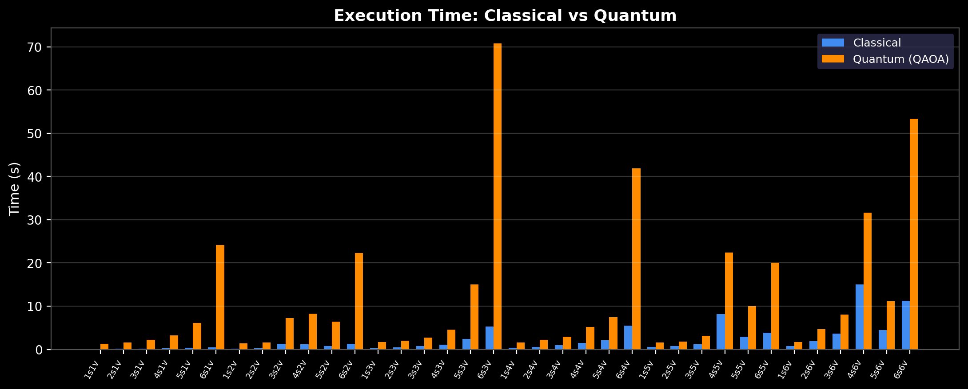
6. Results: Execution Time Comparison
Classical solver is consistently faster (expected: exact eigensolver is O(2ⁿ) but n is small here)
Quantum overhead comes from QAOA circuit simulation (StatevectorSampler) — would improve on real hardware
Speedup range: 0.021x – 0.477x

Slide 8
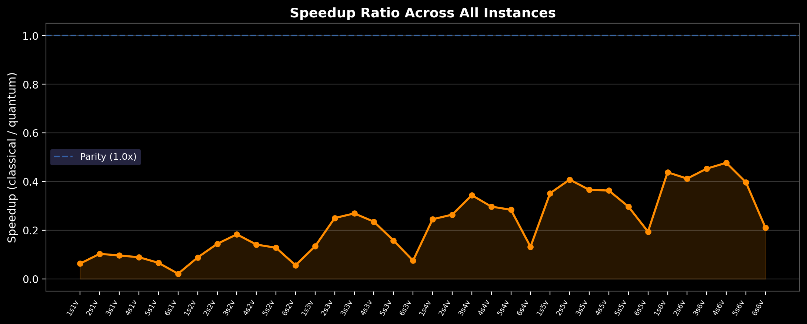
7. Results: Speedup Analysis
Speedup < 1.0 means classical is faster (as expected in simulation)
Speedup increases with more VMs (larger continuous sub-problems)
Drops sharply at 6 servers due to quantum circuit depth scaling exponentially with qubits

Slide 9
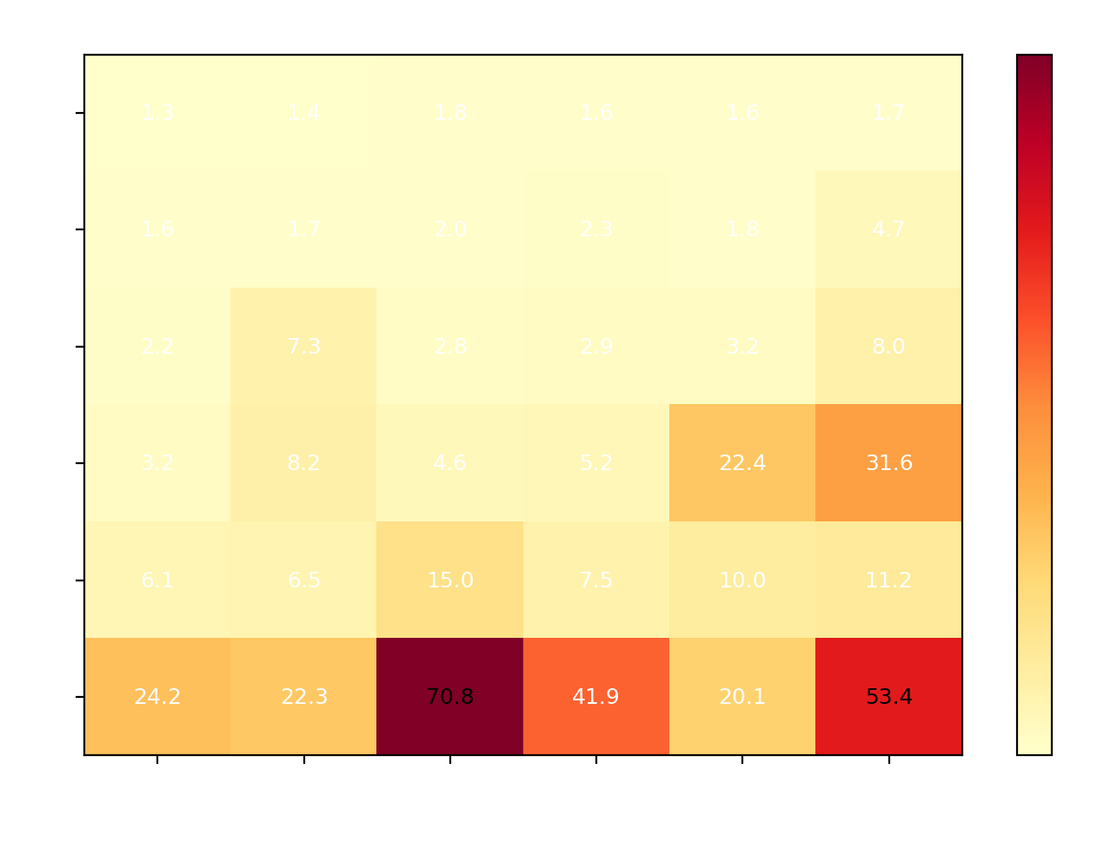
8. Results: Quantum Solver Scaling
Scaling Observations
Quantum time is dominated by the number of
binary variables (= number of servers)
6 servers → 6 qubits in QAOA circuit
→ 2⁶ = 64 dimensional statevector
Critical bottleneck: 6s×3v = 70.8s (ADMM
needed 3 iterations, each running QAOA)
Adding VMs increases continuous variables
but does not increase qubit count →
moderate time increase
Worst case: 6s×6v at 53.4s (more ADMM
iterations due to problem complexity)

Slide 10
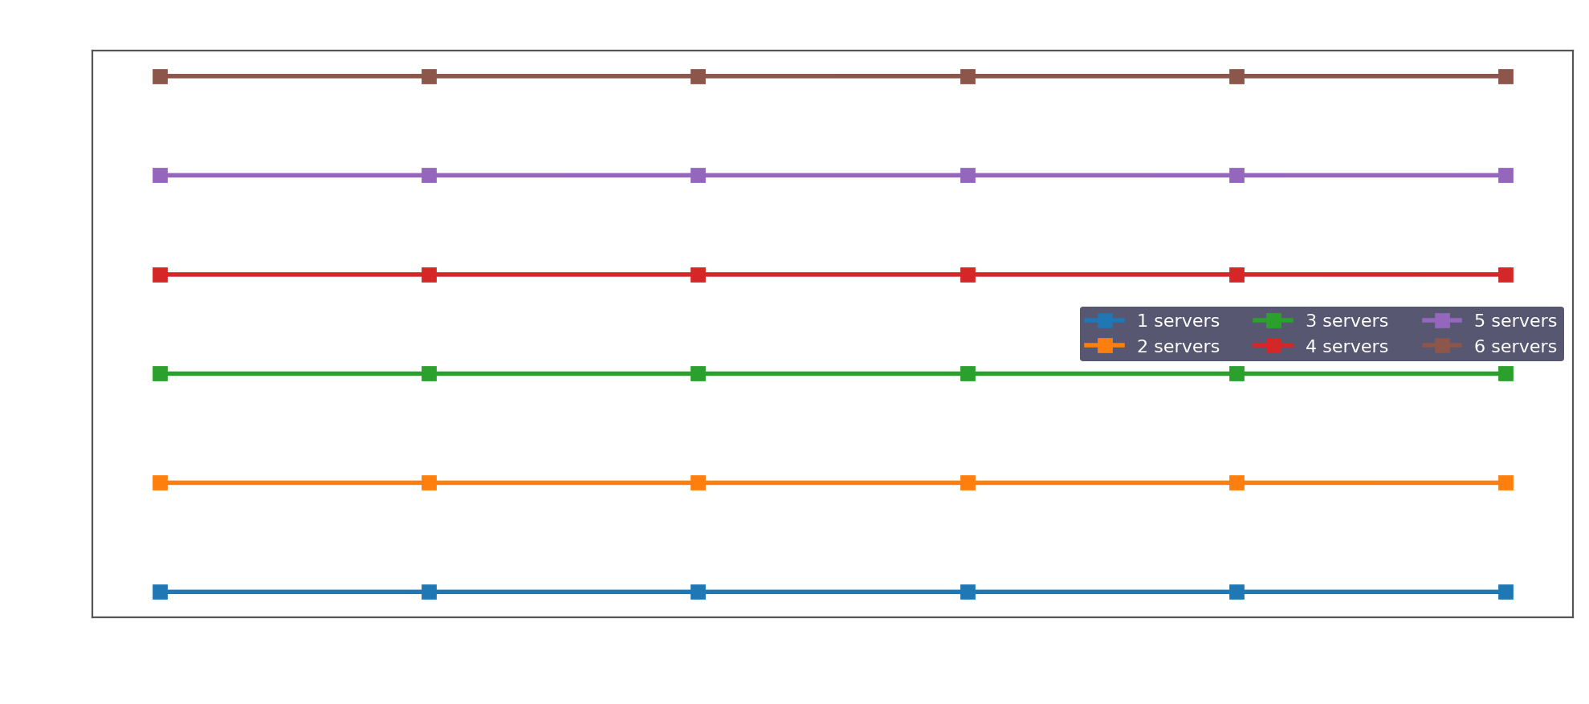
9. Results: Objective Values
Objective ≈ sum(capacities) for require_all_on=True (dominated by fixed server costs)
Classical and quantum objectives match to 6+ decimal places in ALL 36 instances
Slight increases with more VMs reflect the dynamic utilization cost component (uⱼ · vⱼᵢ)

Slide 11
10. Full Results Summary
Instance | Objective | Classic (s) | Quantum (s) | Speedup | Status
1s × 1v | 11.0000 | 0.080 | 1.256 | 0.063x | ✓ SUCCESS
2s × 1v | 22.0000 | 0.169 | 1.636 | 0.103x | ✓ SUCCESS
3s × 1v | 33.0000 | 0.214 | 2.227 | 0.096x | ✓ SUCCESS
4s × 1v | 43.0000 | 0.286 | 3.210 | 0.089x | ✓ SUCCESS
5s × 1v | 53.0000 | 0.405 | 6.107 | 0.066x | ✓ SUCCESS
6s × 1v | 63.0000 | 0.511 | 24.165 | 0.021x | ✓ SUCCESS
1s × 2v | 11.0000 | 0.122 | 1.386 | 0.088x | ✓ SUCCESS
2s × 2v | 22.0000 | 0.238 | 1.652 | 0.144x | ✓ SUCCESS
3s × 2v | 33.0000 | 1.329 | 7.274 | 0.183x | ✓ SUCCESS
4s × 2v | 43.0000 | 1.158 | 8.228 | 0.141x | ✓ SUCCESS
5s × 2v | 53.0000 | 0.824 | 6.461 | 0.128x | ✓ SUCCESS
6s × 2v | 63.0001 | 1.253 | 22.273 | 0.056x | ✓ SUCCESS
1s × 3v | 11.0000 | 0.234 | 1.753 | 0.134x | ✓ SUCCESS
2s × 3v | 22.0001 | 0.502 | 2.007 | 0.250x | ✓ SUCCESS
3s × 3v | 33.0001 | 0.744 | 2.765 | 0.269x | ✓ SUCCESS
4s × 3v | 43.0000 | 1.083 | 4.614 | 0.235x | ✓ SUCCESS
5s × 3v | 53.0007 | 2.380 | 15.017 | 0.158x | ✓ SUCCESS
6s × 3v | 63.0000 | 5.278 | 70.791 | 0.075x | ✓ SUCCESS
1s × 4v | 11.0001 | 0.387 | 1.579 | 0.245x | ✓ SUCCESS
2s × 4v | 22.0000 | 0.599 | 2.272 | 0.264x | ✓ SUCCESS
3s × 4v | 33.0001 | 1.012 | 2.947 | 0.344x | ✓ SUCCESS
4s × 4v | 43.0000 | 1.549 | 5.209 | 0.297x | ✓ SUCCESS
5s × 4v | 53.0013 | 2.120 | 7.452 | 0.284x | ✓ SUCCESS
6s × 4v | 63.0004 | 5.521 | 41.878 | 0.132x | ✓ SUCCESS
1s × 5v | 11.0000 | 0.572 | 1.627 | 0.352x | ✓ SUCCESS
2s × 5v | 22.0001 | 0.751 | 1.841 | 0.408x | ✓ SUCCESS
3s × 5v | 33.0000 | 1.159 | 3.164 | 0.366x | ✓ SUCCESS
4s × 5v | 43.0001 | 8.147 | 22.448 | 0.363x | ✓ SUCCESS
5s × 5v | 53.0004 | 2.981 | 10.045 | 0.297x | ✓ SUCCESS
6s × 5v | 63.0009 | 3.906 | 20.098 | 0.194x | ✓ SUCCESS
1s × 6v | 11.0001 | 0.763 | 1.741 | 0.438x | ✓ SUCCESS
2s × 6v | 22.0006 | 1.928 | 4.681 | 0.412x | ✓ SUCCESS
3s × 6v | 33.0000 | 3.632 | 8.016 | 0.453x | ✓ SUCCESS
4s × 6v | 43.0010 | 15.080 | 31.640 | 0.477x | ✓ SUCCESS
5s × 6v | 53.0024 | 4.425 | 11.151 | 0.397x | ✓ SUCCESS
6s × 6v | 63.0002 | 11.230 | 53.355 | 0.210x | ✓ SUCCESS

Slide 12
11. Technology Stack
Qiskit 1.x
Core quantum computing SDK by IBM
qiskit-algorithms
QAOA, VQE, NumPyMinimumEigensolver
qiskit-optimization
ADMM, QUBO conversion, constraint handling
qiskit-aer
High-performance quantum circuit simulator
DOcplex (CPLEX)
IBM CPLEX modeling for mathematical programming
StatevectorSampler
Exact statevector simulation (no noise)
COBYLA
Gradient-free optimizer for variational parameters
matplotlib / numpy
Visualization and numerical computation

Slide 13
12. Conclusions
Key Findings
100% feasibility (36/36) for both solvers
after snap_to_feasible() post-processing
Identical objective values confirm QAOA
correctly solves the combinatorial sub-problem
Classical solver is 2–50x faster in simulation
(expected: no quantum hardware advantage yet)
ADMM successfully decomposes the MIQP into
manageable quantum-compatible sub-problems
The framework scales to 6 servers × 6 VMs
(36 binary+continuous variables) without failure
Future Work
Run on real quantum hardware (IBM Quantum)
to assess noise impact and true quantum speedup
Scale to larger instances (10+ servers, 10+ VMs)
using hardware-efficient ansatz and error mitigation
Explore alternative quantum algorithms:
• VQE for the QUBO sub-problem
• Grover Adaptive Search
• Quantum Annealing (D-Wave)
Add realistic constraints:
• Network latency between servers
• Memory and storage limits
• Multi-objective optimization (cost + latency)

Slide 14
Thank You
Questions?
Quantum vs Classical Optimization • Qiskit 1.x • ADMM + QAOA • 36 Instances • 100% Feasibility

