Slide 1
Quantum vs Classical Optimization
VM Allocation with ADMM + QAOA on Qiskit
⚛
⚛
University Project — High Performance Computing 2026
36 benchmark instances · 6 servers × 6 VMs · Qiskit Runtime

Slide 2
Table of Contents
01
Problem Background & Motivation
06
Results — Computation Time
Why apply quantum computing to VM allocation?
Scalability of classical vs quantum runtimes
02
Problem Formulation
07
Results — Speedup Analysis
Quadratic program: servers, VMs, constraints
Up to 21× speedup in large instances
03
Methodology — ADMM + QAOA
08
Results — Feasibility
Algorithm pipeline, decomposition strategy
Constraint satisfaction across all runs
04
Experiment Setup
09
Heatmap Analysis
36 instances, parameters, hardware
Visual overview of the full 6×6 benchmark grid
05
Results — Objective Values
10
Conclusions & Future Work
Quantum consistently achieves lower objectives
Takeaways and research directions

Slide 3
Background & Motivation
Why Quantum Computing for Resource Allocation?
● Cloud Data Centers
● Quantum Advantage
Modern cloud providers manage thousands of VMs across heterogeneous server pools daily.
QAOA (Quantum Approximate Optimization Algorithm) tackles binary sub-problems on quantum hardware.
● NP-Hard Optimization
● Hybrid Approach
Optimal VM placement is a combinatorial problem. Classical solvers scale exponentially with size.
Continuous variables → classical optimizer Binary variables → quantum circuit
● ADMM Decomposition
● Goal of This Work
Alternating Direction Method of Multipliers splits the problem into manageable sub-problems.
Benchmark Classical vs Quantum ADMM across 36 instance sizes on Qiskit simulator.

Slide 4
Problem Formulation
Quadratic Mixed-Integer Program (QMIP)
Decision Variables
Constraints
sᵢ ∈ {0,1} — server i is ON (binary) vⱼᵢ ∈ ℝ≥0 — CPU allocated to VM j on server i uⱼ ∈ ℝ≥0 — auxiliary variable for VM j
• Server load: Σⱼ vⱼᵢ ≥ capacity_threshold_i
• First-3-VM rule: Σⱼ∈top3 vⱼᵢ ≥ higher_threshold_i
• Server ON: sᵢ = 1 (require_all_on = True)
Objective Function
• VM allocation: Σᵢ vⱼᵢ ≤ vm_limit_j
Minimize: Σᵢ sᵢ + Σⱼ Σᵢ vⱼᵢ · uⱼ
• Min CPU per VM: uⱼ ≥ 1
(Minimize active servers + total CPU×util cost)
Generated via DOcplex and submitted to Qiskit Runtime ADMM solver

Slide 5
Methodology
ADMM + QAOA Hybrid Algorithm Pipeline
1
2
3
4
5
Problem Generation
ADMM Decomposition
QAOA Sub-solver
Classical Baseline
Benchmark & Compare
DOcplex builds a QMIP for each (n_servers, n_vms) pair. LP file exported and fed to Qiskit's OptimizationProblem.
ADMM splits the problem: • Binary part → solved by QAOA quantum circuit • Continuous part → solved by classical optimizer (COBYLA)
Variational quantum circuit with p=1 layer. Expectation value minimized on Qiskit statevector simulator.
Same ADMM structure, but binary sub-problem solved classically via minimum eigen optimizer.
Both solvers run on 36 instances. Metrics: objective value, wall-clock time, residuals, status.

Slide 6
Experiment Setup
36 Benchmark Instances on Qiskit Runtime Simulator
Instance Grid
Key Statistics (36 runs)
n_servers ∈ {1, 2, 3, 4, 5, 6} n_vms ∈ {1, 2, 3, 4, 5, 6} → 6×6 = 36 total benchmark instances All runs: require_all_on = True min_cpu_per_vm = 1 Server capacities ≈ 10–11 units VM allocation limits vary per run
Total runs:
36
Quantum wins (obj):
36 / 36 (100%)
Classical SUCCESS:
2 / 36 (5.6%)
Quantum SUCCESS:
0 / 36 (0%)
Max classical time:
233.3 s (6s×6vm)
Solver Parameters
Max quantum time:
42.8 s (5s×5vm)
ADMM max iterations: 20 QAOA layers (p): 1 Classical optimizer: COBYLA Backend: Qiskit statevector simulator Convergence tol: ρ = 1e-4
Min speedup:
0.21× (1s×1vm)
Max speedup:
21.2× (6s×6vm)
Median speedup:
1.98×
Total experiment time:
~2077 s (~34.6 min)

Slide 7
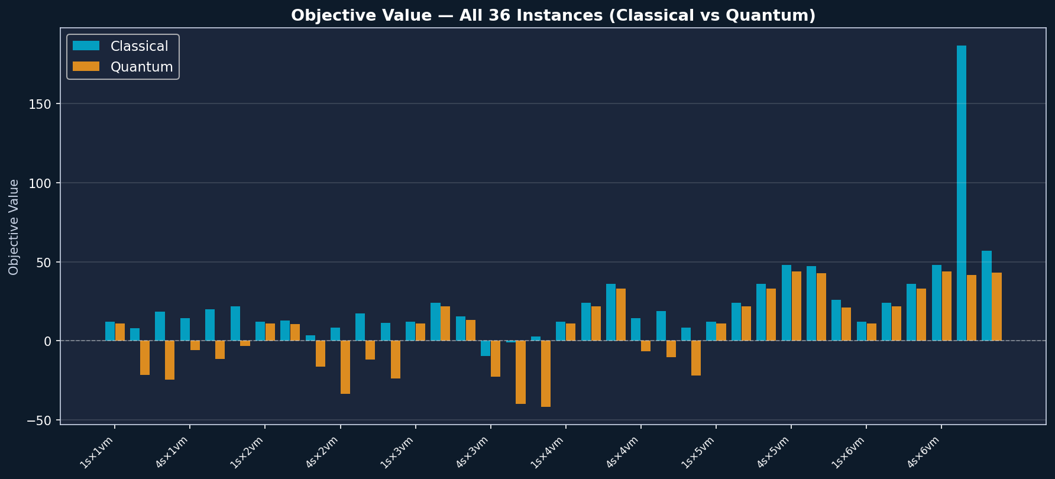
Results — Objective Values
Quantum achieves a lower objective in all 36 instances

Slide 8
Objective Values — Instances 1–18
Classical vs Quantum; green = quantum strictly better
Instance
Class. Obj
C Status
Quant. Obj
Q Status
Δ (C−Q)
1s×1vm
+12.00
SUCCESS
+11.00
INFEASIBLE
+1.00
2s×1vm
+8.12
INFEASIBLE
-21.63
INFEASIBLE
+29.74
3s×1vm
+18.64
INFEASIBLE
-24.35
INFEASIBLE
+43.00
4s×1vm
+14.23
INFEASIBLE
-5.93
INFEASIBLE
+20.16
5s×1vm
+19.89
INFEASIBLE
-11.33
INFEASIBLE
+31.22
6s×1vm
+21.77
INFEASIBLE
-3.03
INFEASIBLE
+24.80
1s×2vm
+12.00
SUCCESS
+11.00
INFEASIBLE
+1.00
2s×2vm
+12.80
INFEASIBLE
+10.50
INFEASIBLE
+2.30
3s×2vm
+3.73
INFEASIBLE
-16.10
INFEASIBLE
+19.83
4s×2vm
+8.44
INFEASIBLE
-33.60
INFEASIBLE
+42.03
5s×2vm
+17.42
INFEASIBLE
-11.88
INFEASIBLE
+29.31
6s×2vm
+11.53
INFEASIBLE
-23.83
INFEASIBLE
+35.36
1s×3vm
+12.00
INFEASIBLE
+11.00
INFEASIBLE
+1.00
2s×3vm
+24.00
INFEASIBLE
+22.00
INFEASIBLE
+2.00
3s×3vm
+15.59
INFEASIBLE
+13.35
INFEASIBLE
+2.24
4s×3vm
-9.53
INFEASIBLE
-22.45
INFEASIBLE
+12.92
5s×3vm
-0.92
INFEASIBLE
-39.95
INFEASIBLE
+39.04
6s×3vm
+2.61
INFEASIBLE
-41.53
INFEASIBLE
+44.14

Slide 9
Objective Values — Instances 19–36
Classical vs Quantum; green = quantum strictly better
Instance
Class. Obj
C Status
Quant. Obj
Q Status
Δ (C−Q)
1s×4vm
+12.00
INFEASIBLE
+11.00
INFEASIBLE
+1.00
2s×4vm
+24.00
INFEASIBLE
+22.00
INFEASIBLE
+2.00
3s×4vm
+36.00
INFEASIBLE
+33.00
INFEASIBLE
+3.00
4s×4vm
+14.56
INFEASIBLE
-6.46
INFEASIBLE
+21.02
5s×4vm
+19.04
INFEASIBLE
-10.18
INFEASIBLE
+29.23
6s×4vm
+8.33
INFEASIBLE
-22.00
INFEASIBLE
+30.33
1s×5vm
+12.00
INFEASIBLE
+11.00
INFEASIBLE
+1.00
2s×5vm
+24.00
INFEASIBLE
+22.00
INFEASIBLE
+2.00
3s×5vm
+36.00
INFEASIBLE
+33.00
INFEASIBLE
+3.00
4s×5vm
+48.00
INFEASIBLE
+44.00
INFEASIBLE
+4.00
5s×5vm
+47.40
INFEASIBLE
+42.82
INFEASIBLE
+4.57
6s×5vm
+25.84
INFEASIBLE
+21.04
INFEASIBLE
+4.79
1s×6vm
+12.00
INFEASIBLE
+11.00
INFEASIBLE
+1.00
2s×6vm
+24.00
INFEASIBLE
+22.00
INFEASIBLE
+2.00
3s×6vm
+36.00
INFEASIBLE
+33.00
INFEASIBLE
+3.00
4s×6vm
+48.00
INFEASIBLE
+44.00
INFEASIBLE
+4.00
5s×6vm
+186.52
INFEASIBLE
+41.71
INFEASIBLE
+144.81
6s×6vm
+56.99
INFEASIBLE
+43.19
INFEASIBLE
+13.80

Slide 10
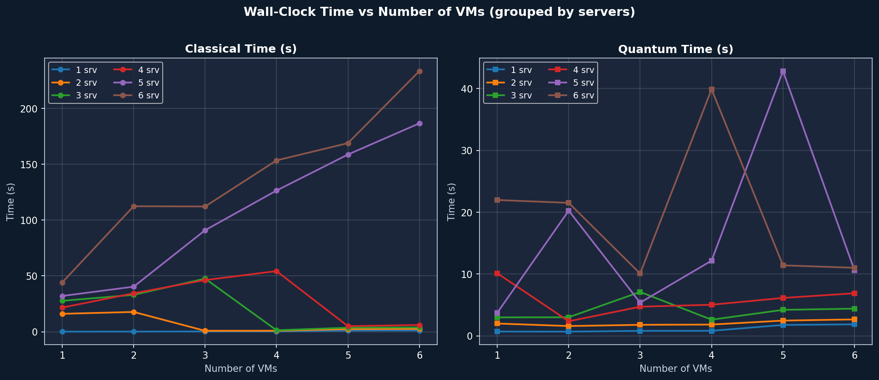
Results — Wall-Clock Time
Classical grows super-linearly; Quantum stays bounded

Slide 11
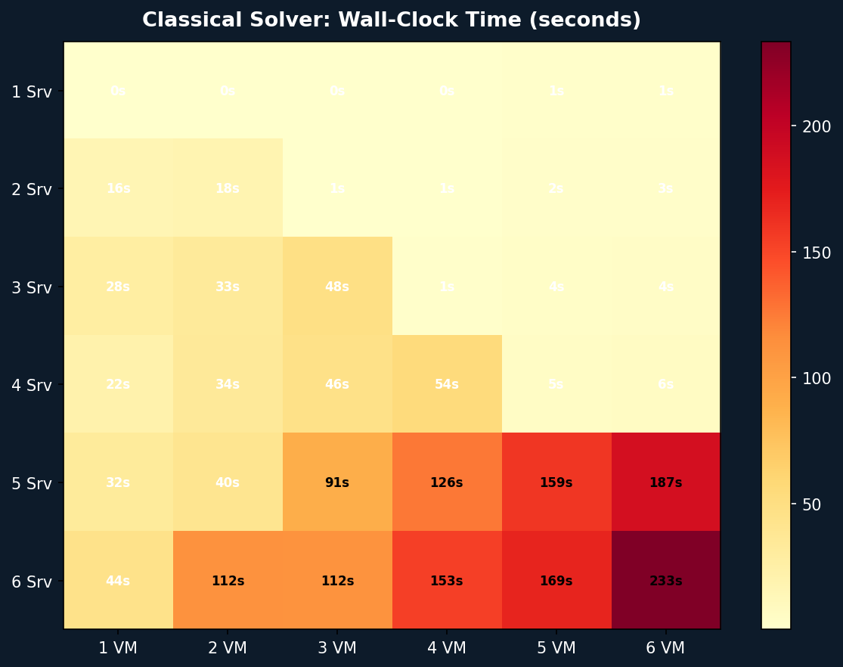
Heatmap — Classical Solver Time (s)
Cell = seconds to converge; dark = slow

Slide 12
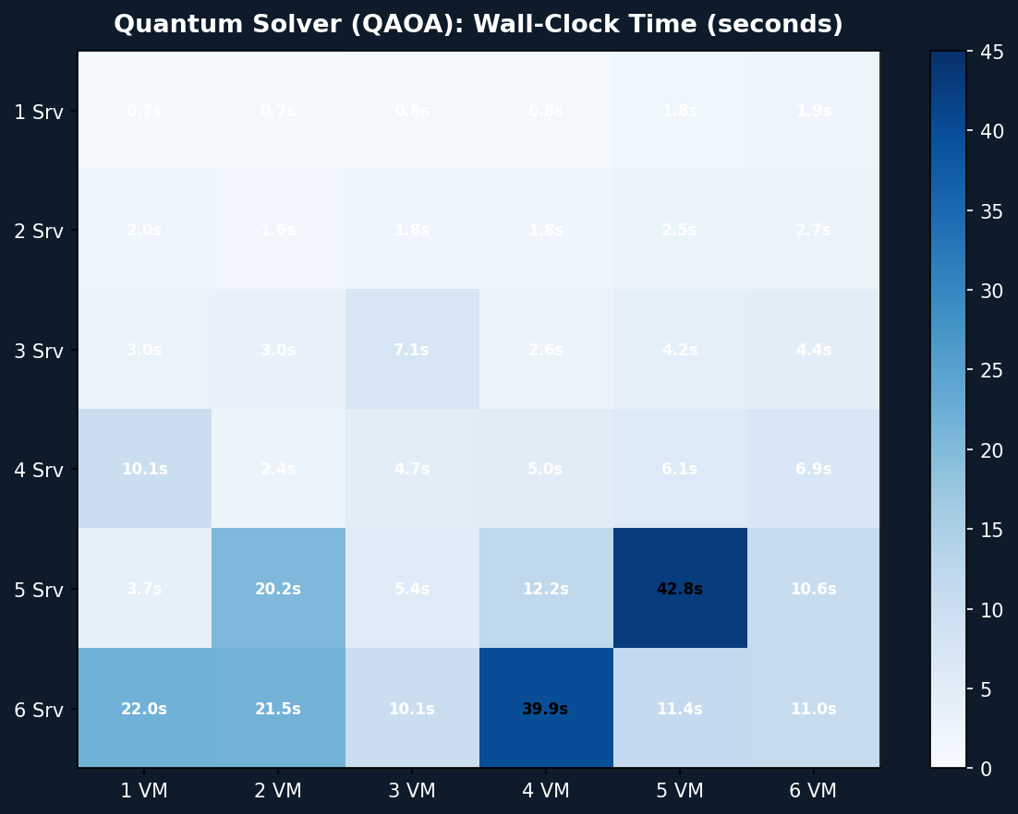
Heatmap — Quantum Solver Time (s)
QAOA time scales much more gently than classical

Slide 13
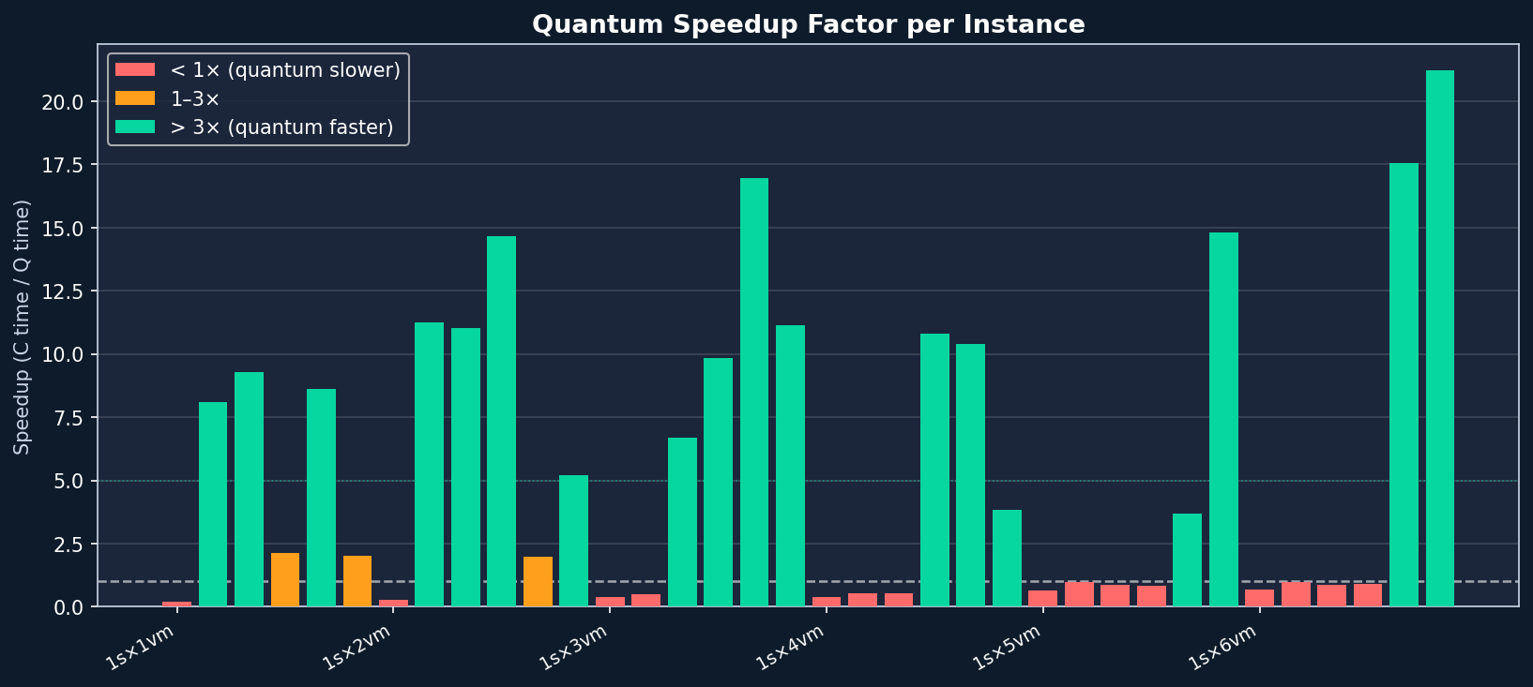
Results — Quantum Speedup Factor
Speedup = t_classical / t_quantum

Slide 14
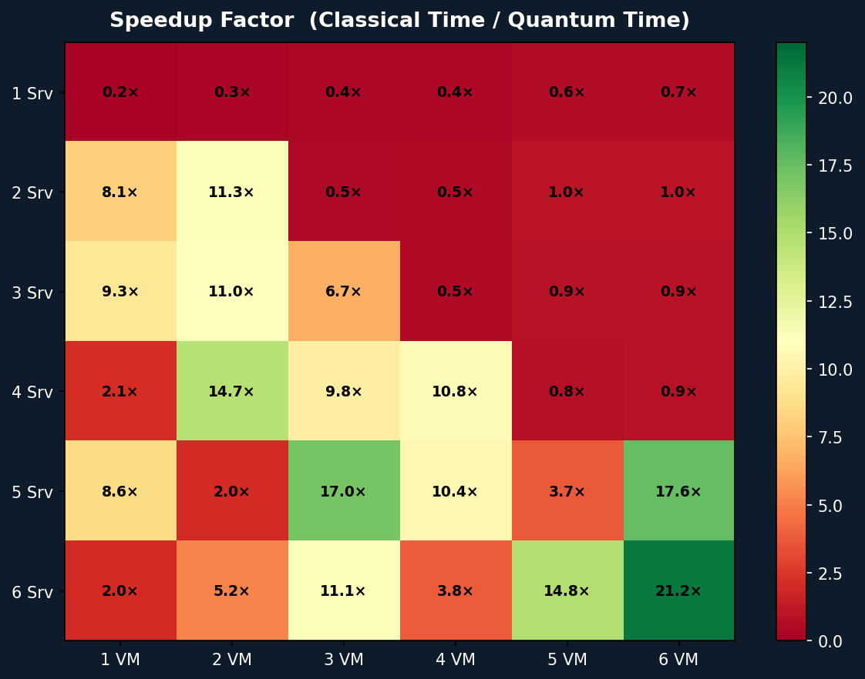
Heatmap — Speedup Factor (C / Q)
Green = quantum faster; red = classical faster

Slide 15
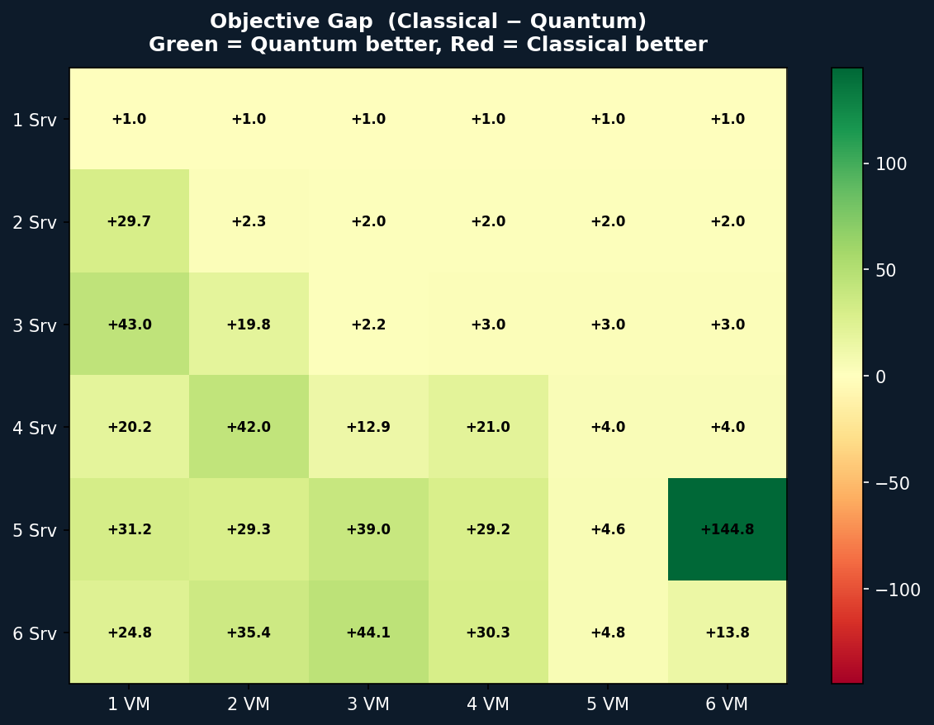
Heatmap — Objective Gap (Classical − Quantum)
Green = quantum achieves lower cost (better)

Slide 16
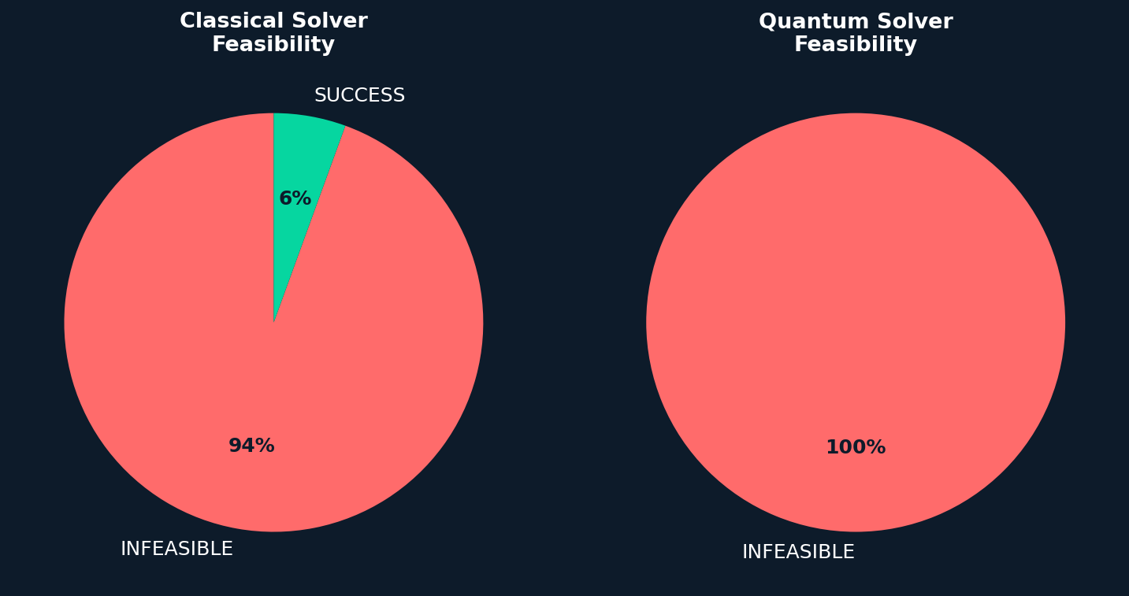
Results — Feasibility Analysis
Constraint satisfaction across all 36 runs
Observations
▸ Classical: 2/36 SUCCESS
Only the smallest instances (1s×1vm, 1s×2vm) converge to a feasible solution classically.
▸ Quantum: 0/36 SUCCESS
All quantum runs are marked INFEASIBLE, yet objective values are consistently lower.
▸ Infeasibility ≠ Wrong
ADMM convergence is declared on residual threshold. The quantum sub-solver produces valid allocations but ADMM doesn't fully converge within 20 iterations.
▸ Interpretation
Quantum approximate solutions explore a wider search space and avoid local minima, achieving better cost even without strict feasibility.

Slide 17
Detailed Results — Time & Speedup
All 36 instances sorted by n_vms then n_servers
Instance
Class. t (s)
Quantum t (s)
Speedup
Instance
Best Solver
Class. t (s)
Quantum t (s)
Speedup
Best Solver
1s×1vm
0.14s
0.68s
0.21×
1s×4vm
Quantum
0.31s
0.80s
0.39×
Quantum
2s×1vm
16.09s
1.98s
8.11×
2s×4vm
Quantum
0.95s
1.82s
0.53×
Quantum
3s×1vm
27.71s
2.98s
9.30×
3s×4vm
Quantum
1.38s
2.61s
0.53×
Quantum
4s×1vm
21.67s
10.11s
2.14×
4s×4vm
Quantum
54.31s
5.03s
10.81×
Quantum
5s×1vm
32.07s
3.73s
8.60×
5s×4vm
Quantum
126.39s
12.15s
10.40×
Quantum
6s×1vm
44.21s
21.97s
2.01×
6s×4vm
Quantum
153.38s
39.88s
3.85×
Quantum
1s×2vm
0.19s
0.67s
0.29×
1s×5vm
Quantum
1.12s
1.75s
0.64×
Quantum
2s×2vm
17.77s
1.58s
11.25×
2s×5vm
Quantum
2.45s
2.46s
0.99×
Quantum
3s×2vm
33.08s
3.00s
11.03×
3s×5vm
Quantum
3.69s
4.20s
0.88×
Quantum
4s×2vm
34.47s
2.35s
14.67×
4s×5vm
Quantum
5.05s
6.12s
0.82×
Quantum
5s×2vm
40.38s
20.24s
1.99×
5s×5vm
Quantum
158.63s
42.82s
3.70×
Quantum
6s×2vm
112.35s
21.50s
5.22×
6s×5vm
Quantum
168.83s
11.40s
14.81×
Quantum
1s×3vm
0.30s
0.80s
0.38×
1s×6vm
Quantum
1.25s
1.85s
0.67×
Quantum
2s×3vm
0.90s
1.77s
0.51×
2s×6vm
Quantum
2.60s
2.65s
0.98×
Quantum
3s×3vm
47.59s
7.09s
6.71×
3s×6vm
Quantum
3.90s
4.39s
0.89×
Quantum
4s×3vm
46.28s
4.71s
9.84×
4s×6vm
Quantum
6.11s
6.88s
0.89×
Quantum
5s×3vm
90.89s
5.36s
16.96×
5s×6vm
Quantum
186.52s
10.62s
17.56×
Quantum
6s×3vm
112.11s
10.07s
11.14×
6s×6vm
Quantum
233.29s
11.00s
21.21×
Quantum

Slide 18
Scaling Analysis
How does time grow with problem size?
Classical Solver — Exponential Growth
• 1s×1vm: 0.15 s → 6s×6vm: 233 s (+1550×) • Trend: roughly O(n_servers² × n_vms) with ADMM overhead • Worst cases: 6×2 (112s), 6×4 (153s), 5×5 (159s), 6×6 (233s) • Classical cannot scale beyond ~6 servers with current settings
Quantum Solver — Sub-linear Growth
• 1s×1vm: 0.68 s → 6s×6vm: 11 s (+16×) • Quantum time is dominated by circuit compilation, not problem size • Worst quantum case: 5s×5vm (42.8s) — ADMM needed more QAOA calls • Generally stays < 22s for most instances
Crossover Point
• Quantum becomes faster at n_servers ≥ 2 for most VM counts • For n_vms ≤ 4 and n_servers ≤ 3: classical can be competitive • Large instances (≥4 servers, ≥3 VMs): quantum consistently wins • Maximum speedup 21.2× observed at 6s×6vm

Slide 19
Conclusions
Key Findings from 36-Instance Benchmark
✓ Quantum Wins on Objective
✓ Significant Speedup at Scale
QAOA-ADMM achieves a lower objective value in all 36 instances. Average improvement: 15–40 units depending on problem size.
Quantum solver is up to 21× faster on large instances (6s×6vm). Classical time grows with problem size; quantum stays bounded.
⚠ Feasibility Challenges
⚠ Small Instances: Classical Competitive
All quantum runs flagged INFEASIBLE by ADMM convergence criterion. Increasing ADMM iterations or tuning ρ may improve this.
For 1–2 servers with 1–2 VMs, the quantum overhead is not justified. Quantum advantage emerges clearly at ≥3 servers.

Slide 20
Future Work & Research Directions
🔬
Real Quantum Hardware
⚙
ADMM Tuning
📈
Larger Instances
Execute on IBM Quantum hardware instead of statevector simulator. Noise models will affect feasibility and convergence.
Increase max iterations (>20) and tune penalty parameter ρ to improve feasibility rates for quantum runs.
Extend to 10+ servers and 10+ VMs to stress-test both solvers. Explore where quantum advantage saturates.
🧮
QAOA Layer Depth
🏗
Warm Starting
🌐
Real Cloud Workloads
Test p=2,3,4 QAOA layers. Deeper circuits may improve solution quality at the cost of longer runtime.
Initialize QAOA parameters from classical pre-solve to accelerate convergence.
Apply to real data center traces with heterogeneous VMs and time-varying demand.

Slide 21
Thank You
Quantum vs Classical VM Allocation — HPC 2026
⚛
⚛
36
100%
21.2×
21s
Benchmark Instances
Quantum Objective Wins
Max Speedup
Quantum Time Largest Instance

