Slide 1
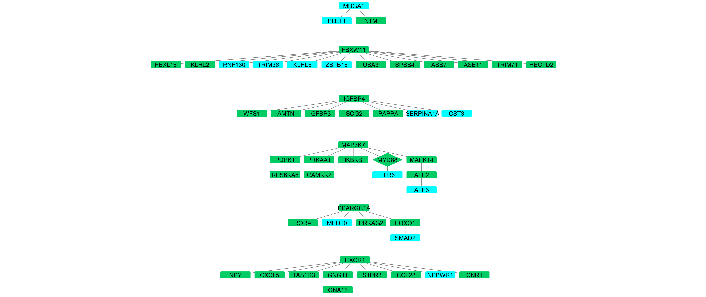

Slide 2
GPI-anchored
synthesis
v
MHC and Antigen processing
IGF regulation
TLR cascades
FOXO
GPCR and G signaling

Slide 3
GPI-anchored
synthesis
miR-669c-3p
v
miRTarBase
TargetScan
MHC and Antigen processing
target genes (tg)
Best 15% TargetScan
genes (tsg)
IGF regulation
StringDB
(score>=900)
TLR cascades
Interactions:
{tg-tsg, tg-neighbour-tsg, tg-tg, tsg-tsg}
FOXO
ReactomePA
GPCR and G signaling
Pathways enriched for each strong connected component (p.adjusted<=0,01)

Slide 4
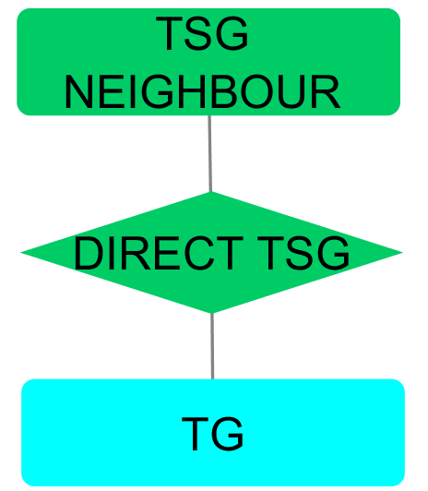
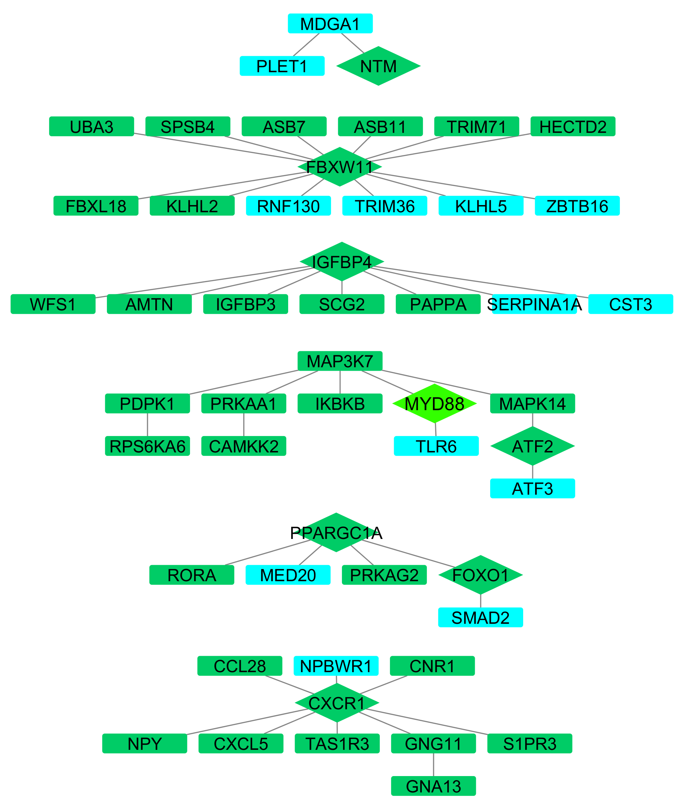
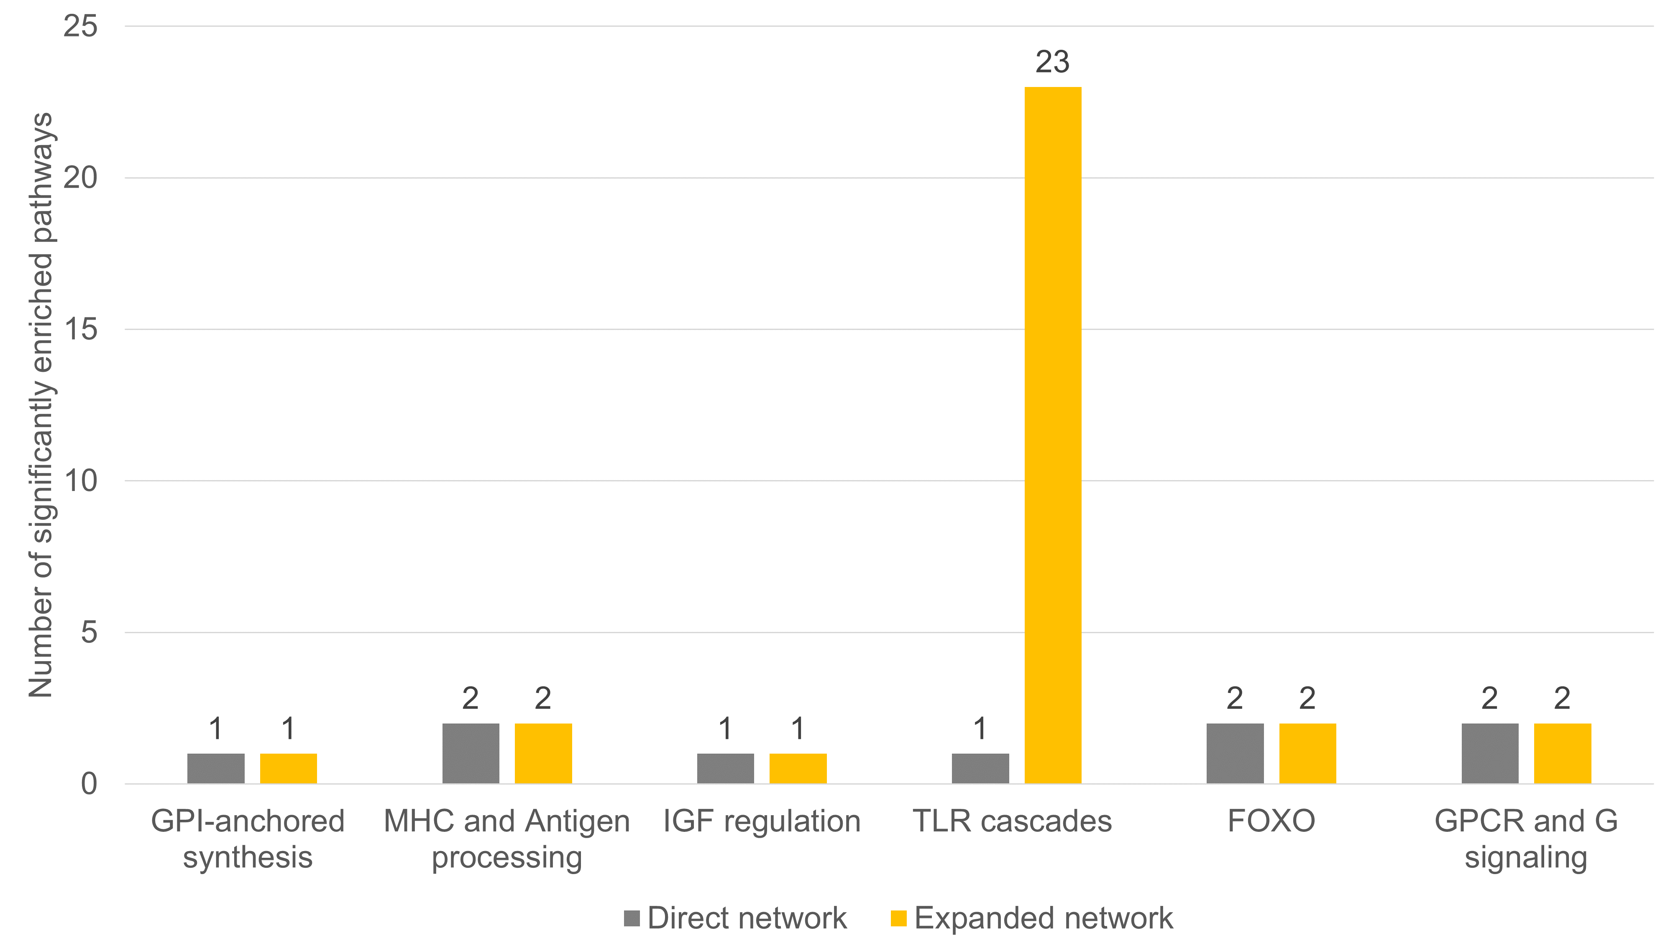

Slide 5
TargetScan
Best 15% TargetScan
genes (tsg)
miR-669c-3p
miRTarBase
target genes (tg)
StringDB
(score>=900)
Interactions:
{tg-tsg, tg-neighbour-tsg, tg-tg, tsg-tsg}
ReactomePA
Pathways enriched for each strong connected component (p.adjusted<=0,01)

Slide 6
TargetScan
miR-669c-3p
miRTarBase
Best 15% TargetScan genes (tsg)
target genes (tg)
StringDB (score>=900)
Interactions: {tg-tsg, tg-neighbour-tsg, tg-tg, tsg-tsg}
ReactomePA
Pathways enriched for each strong connected component (p.adjusted<=0,01)

Slide 7
input
miR-669c-3p
output
miRTarBase
TargetScan
target genes (tg)
Best 15% TargetScan genes (tsg)
StringDB (score>=900)
Interactions: {tg-tsg, tg-neighbour-tsg, tg-tg, tsg-tsg}
ReactomePA
Pathways enriched for each strong connected component (p.adjusted<=0,01)

Slide 8
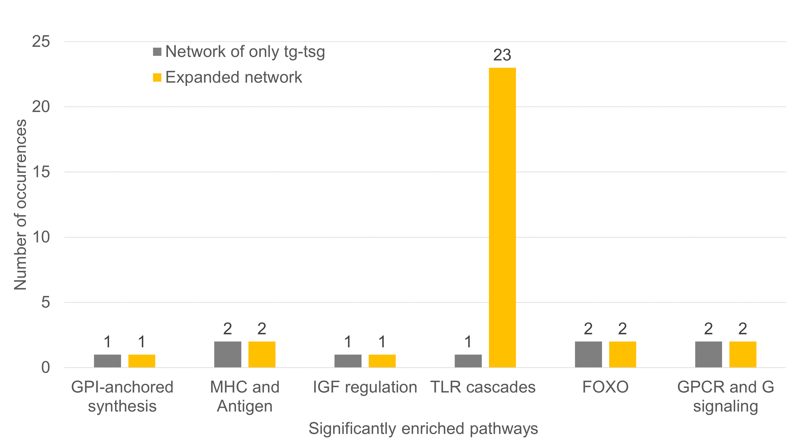
input
miR-669c-3p
output
miRTarBase
TargetScan
target genes (tg)
Best 15% TargetScan genes (tsg)
StringDB (score>=900)
Interactions: {tg-tsg, tg-neighbour-tsg, tg-tg, tsg-tsg}
ReactomePA
Pathways enriched for each strong connected component (p.adjusted<=0,01)

Slide 9
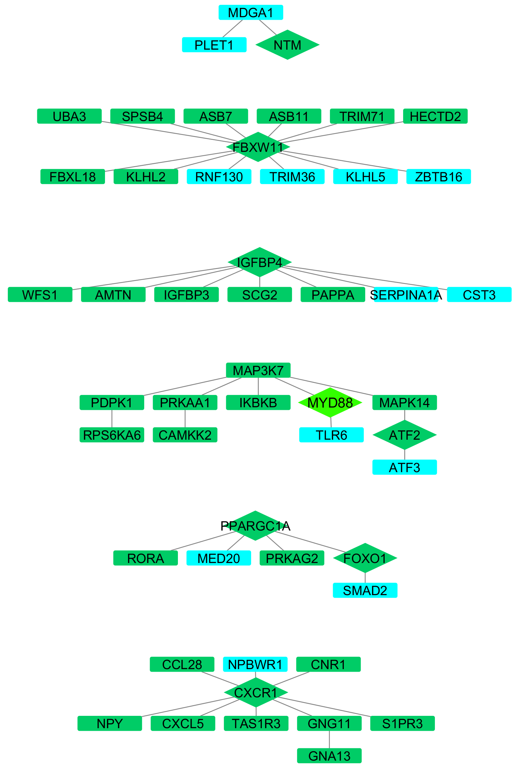
input
miR-669c-3p
GPI-anchored synthesis
output
miRTarBase
TargetScan
MHC and Antigen
target genes (tg)
Best 15% TargetScan genes (tsg)
StringDB (score>=900)
Interactions: {tg-tsg, tg-neighbour-tsg, tg-tg, tsg-tsg}
IGF regulation
ReactomePA
Pathways enriched for each strong connected component (p.adjusted<=0,01)
TLR cascades
FOXO med. transcription
GPCR and G signaling

Slide 10
a
miR-669c-3p
c
GPI-anchored synthesis
input
output
miRTarBase
TargetScan
MHC and Antigen
target genes (tg)
Best 15% TargetScan genes (tsg)
StringDB (score>=900)
Interactions: {tg-tsg, tg-neighbour-tsg, tg-tg, tsg-tsg}
IGF regulation
ReactomePA
Pathways enriched for each strong connected component (p.adjusted<=0,01)
TLR cascades
b
FOXO med. transcription
GPCR and G signaling

Slide 11
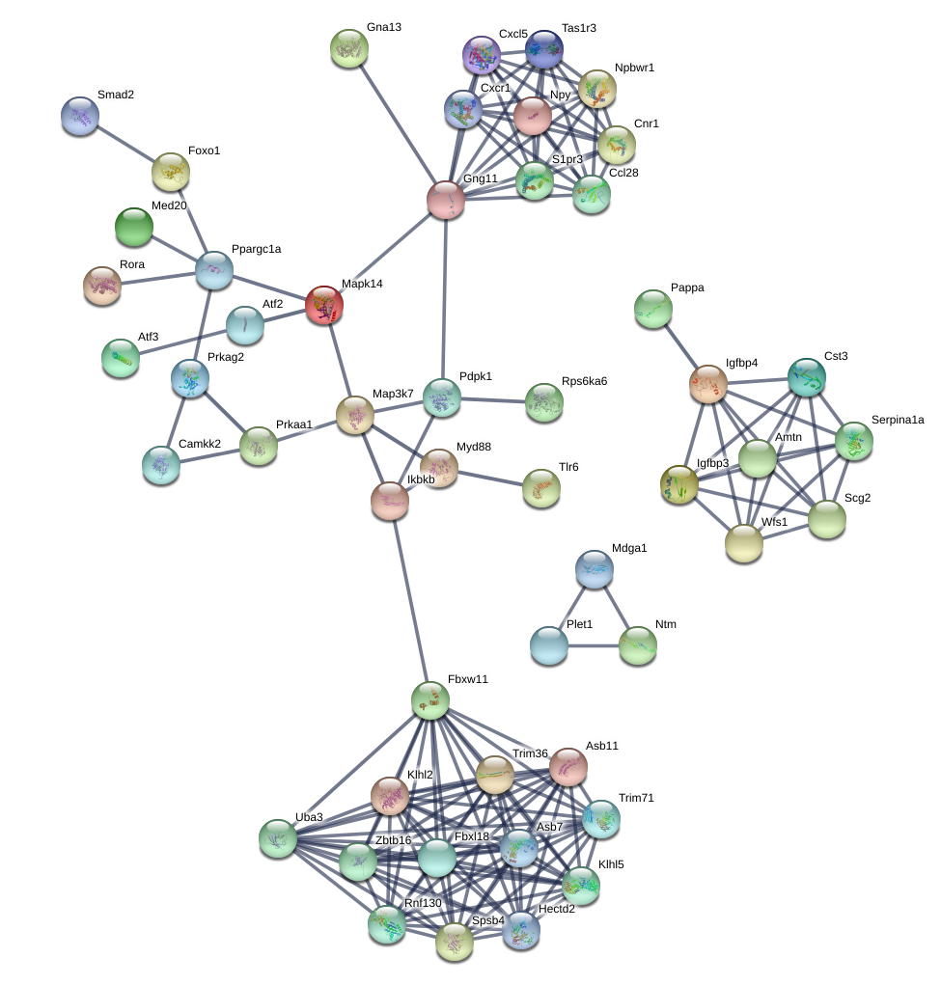
miR-669c-3p
miRTarBase
TargetScan
target genes (tg)
Best 15% TargetScan
genes (tsg)
StringDB
(score>=900)
TLR cascades
Interactions:
{tg-tsg, tg-neighbour-tsg, tg-tg, tsg-tsg}
ReactomePA
Pathways enriched for each strong connected component (p.adjusted<=0,01)

