Slide 1
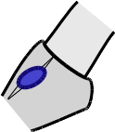
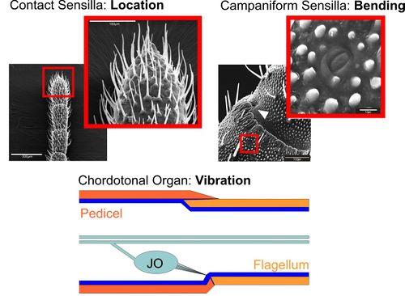
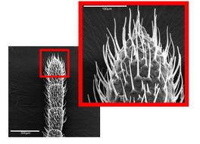
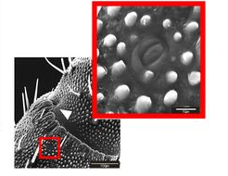
Mechanoreceptors
Contact Sensilla:
Local Contact
Campaniform Sensilla:
Bending
Johnston’s Organ:
Vibrations
Guitar pickup
Vibrations
Contact Sensilla: Location
Campaniform Sensilla: Bending
Johnston’s Organ:
Vibration
!
Sense it ...
… Climb it!

Slide 2
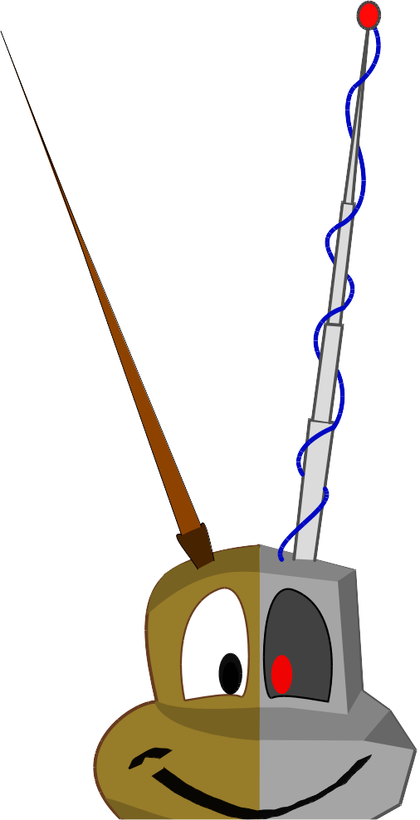
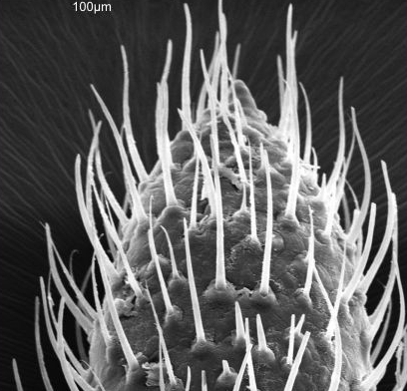
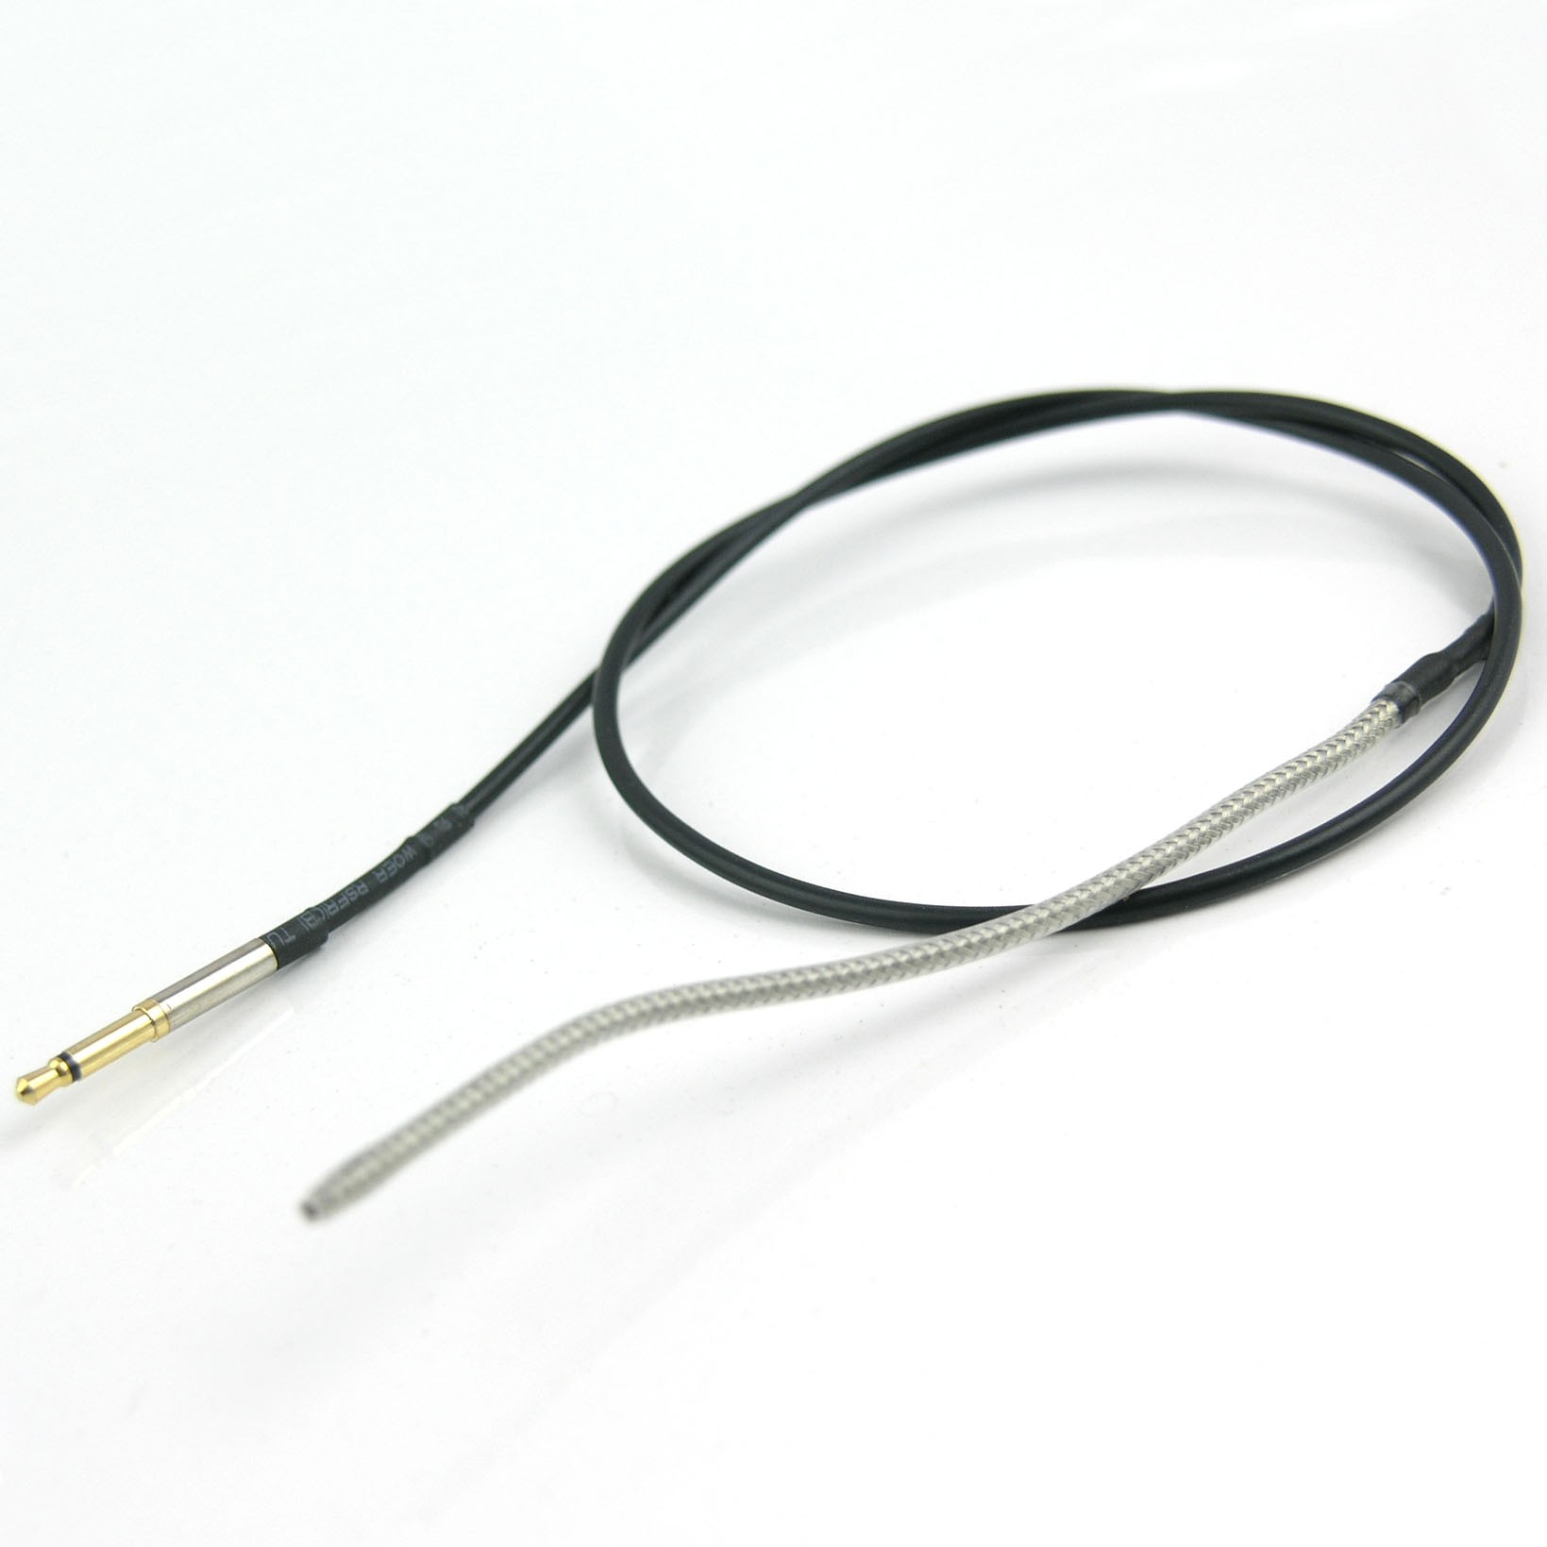


Toward a biomimetic Johnston’s organ for touch localization
Contact Sensilla:
Local Contact
Campaniform Sensilla:
Bending
Johnston’s Organ:
Vibrations
Poster Nr.: NB 5
Piezoelectric sensor:
Vibrations
!
Contact location?

