Slide 1

MAZE SOLVER
Computer Vision
Author: Luca Iacopino (564278)
UNIVERSITÀ
DI PAVIA

Slide 2


Technologies used
Programming language:
Java
Python (extra, to generate mazes)
Libraries:
OpenCV (image processing)
Java utilities (common programming tasks)
Pillow (extra, to create and draw mazes)

Slide 3
Maze Solving Flow
Input image loading:
Grayscale: used for extracting the maze grid
Color: used to find red pixels (start and exit)
Start and End Detection:
MazeProcessor.findRedPixel() = finds the start point (first red pixel)
MazeProcessor.findRedPixelOnBorder() = finds the exit point (red pixel on the maze border)
Maze Grid Extraction:
GridExtractor.extractGrid() converts the binary image into a grid:

Slide 4
Maze Solving Flow
Pathfinding (Fastest Route):
GridSolver.solve() = uses Breadth-First Search (BFS) to find the shortest path from start to end.
Drawing the Solution:
MazeDrawer.drawPath() draws green dots on each point of the solution path directly on the color image.
Output Image Saving:
The final solved maze is saved as a png file

Slide 5
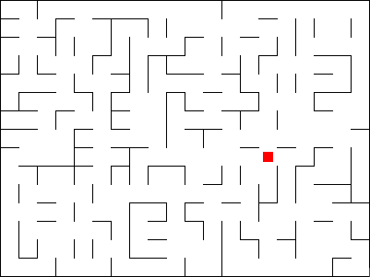
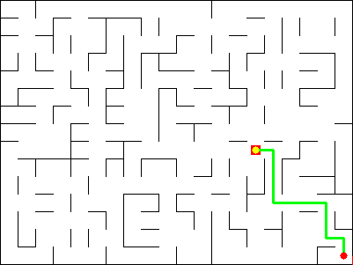
Before vs After
Raw maze
Solved maze

Slide 6
Conclusion
OpenCV
Automatic resolution
The project uses OpenCV to analyze and process the maze image.
The maze is fully solved from image input with no manual steps.
Optimal pathfinding
Clear visual output
The BFS algorithm guarantees the shortest valid solution.
The resulting path is drawn on the image in a readable and precise way.

