Slide 1
Inverse Reinforcement Learning and learning from videos
By Luca Ianniello, s327313

Slide 2
Inverse Reinforcement Learning
Inverse Reinforcement Learning, or IRL, aims to infer the reward function that explains an expert’s behaviour, using experts state-action pairs
Challenges:
Reward Ambiguity – Multiple reward functions may explain the same behavior.
Computational Cost – Learning rewards from demonstrations is expensive.
Types of IRL:
Maximum-Margin IRL – Maximizes the margin between expert and alternative behaviors.
Maximum Entropy IRL – Models expert behavior probabilistically to handle uncertainty.
Bayesian IRL – Uses priors and updates beliefs as more demonstrations are observed.
Notes:
Introduction to Inverse Reinforcement Learning (IRL)
Inverse Reinforcement Learning, or IRL, aims to infer the reward function that explains an expert’s behavior. Unlike imitation learning, which directly mimics actions, IRL tries to understand why the expert makes certain decisions. By learning this reward function, an agent can generalize beyond demonstrations and adapt to new situations.
How IRL Works
IRL relies on state-action pairs, representing decisions made by an expert. Instead of directly learning a policy, IRL estimates the reward function that best explains these choices. Once inferred, this reward function is used in Reinforcement Learning to train an agent that optimizes its behavior.
Challenges in IRL
Despite its advantages, IRL is computationally expensive since it involves solving multiple RL problems. Another key challenge is reward ambiguity—a single expert policy can correspond to multiple reward functions, making it difficult to determine the true underlying motivation. Additionally, most IRL methods assume knowledge of the environment’s transition model, which is often unknown in real-world applications.
Approaches to IRL
To address these challenges, different IRL methods have been developed:
• Maximum-Margin IRL: Finds a reward function that maximizes the margin between the expert’s behavior and all other possible behaviors, ensuring the expert’s actions are significantly better than alternatives.
• Maximum Entropy IRL (MaxEnt IRL): Assumes that the expert is acting optimally but accounts for uncertainty by modeling the expert’s behavior probabilistically, assigning higher probability to trajectories with higher rewards while maintaining maximum entropy to avoid overfitting.
• Bayesian IRL: Models the reward function as a probability distribution and updates beliefs about it as more expert demonstrations are observed, incorporating prior knowledge and uncertainty into the learning process.

Slide 3
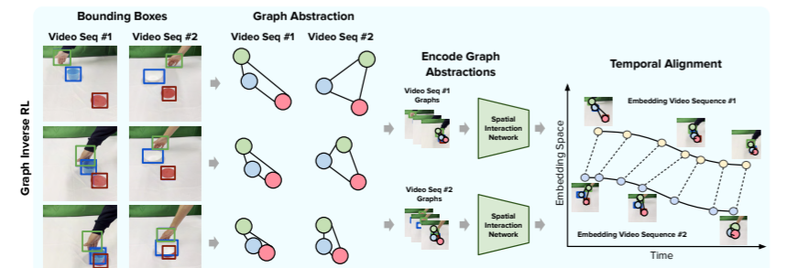
Graph-Based Representation
Graph-Based Video IRL – Learning from Diverse Demonstrations (Graph Inverse Reinforcement Learning from Diverse Videos)
Graph abstraction to replace raw pixel data, filtering out irrelevant information. It also integrates Interaction Networks (INs) to explicitly model object-object interactions over time.
It uses Temporal Cycle Consistency (TCC), which ensures that sequences align properly across different videos
Notes:
Graph-Based Video IRL – Learning from Diverse Demonstrations (Graph Inverse Reinforcement Learning from Diverse Videos)
A key challenge in video-based IRL is dealing with diverse, unstructured videos. This paper proposes using graph abstraction to replace raw pixel data, filtering out irrelevant information like textures or lighting variations. Objects and interactions are mapped as nodes and edges, making it easier to extract meaningful behavioral patterns.
To improve reward learning, this method also integrates Interaction Networks (INs) to explicitly model object-object interactions over time. Additionally, it uses Temporal Cycle Consistency (TCC), which ensures that sequences align properly across different videos—this helps IRL models better track task progression and infer reward signals even in varied environments.
Another key innovation is the embedding space representation, where videos are mapped based on task progression. This allows the agent’s reward function to be continuously adjusted based on how closely its actions align with expert demonstrations, rather than just evaluating final outcomes.

Slide 4
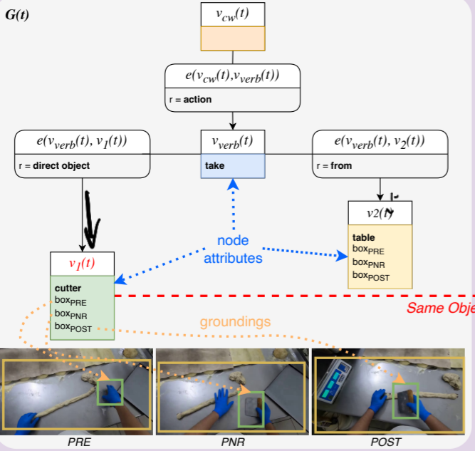
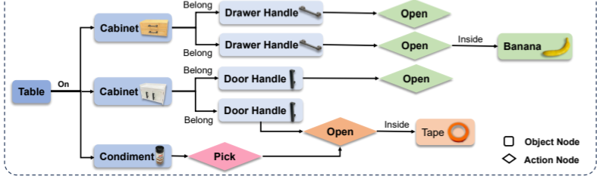
Graph-Based Representation
Egocentric Action Scene Graphs (EASGs) – Long-Term Behavior Understanding (Action Scene Graphs for Long-Form Understanding of Egocentric Videos)
A structured representation of actions over time, used for long-term understanding of egocentric videos.
It models actions in three key stages: Precondition, Point of No Return, and Postcondition
Prediction of future scene graphs
Action-Conditioned Scene Graphs (ACSGs) – Interactive Learning in Robotics (RoboEXP: Action-Conditioned Scene Graph via Interactive Exploration for Robotic Manipulation)
It is actively constructed as a robot interacts with its environment.
It captures causal relationships between actions and objects, It supports incremental learning, It enables zero-shot generalization
Notes:
Graph-Based Representations for IRL
In video-based IRL, one way to represent human behavior is through graph-based representations, where actions, objects, and interactions are structured in a way that captures temporal relationships. Unlike raw image-based methods, graph representations focus on meaningful relationships, filtering out unnecessary visual details.
Egocentric Action Scene Graphs (EASGs) – Long-Term Behavior Understanding (Action Scene Graphs for Long-Form Understanding of Egocentric Videos)
One effective graph representation is Egocentric Action Scene Graphs (EASGs), which model human actions in three key stages: Precondition, Point of No Return, and Postcondition. A structured representation of actions over time, used for long-term understanding of egocentric videos. Nodes represent the camera wearer, action verb, and objects involved, while edges capture relationships between them.
In IRL, this structured representation is valuable because it provides richer learning signals, making it easier for agents to infer reward functions. Additionally, EASGs can predict future scene graphs, meaning an agent can anticipate upcoming actions and adjust its behavior accordingly—something traditional image-based representations struggle with.
Action-Conditioned Scene Graphs (ACSGs) – Interactive Learning in Robotics (RoboEXP: Action-Conditioned Scene Graph via Interactive Exploration for Robotic Manipulation)
A similar approach in robotics is the Action-Conditioned Scene Graph (ACSG), which is actively constructed as a robot interacts with its environment. This graph encodes both spatial relationships and action effects, allowing the robot to understand how its interactions influence the world.
Unlike passive observation, this enables an IRL agent to learn through exploration, updating its graph dynamically as new objects and actions are encountered.
This is particularly useful in IRL because:
It captures causal relationships between actions and objects, aiding in more accurate reward inference.
It supports incremental learning, meaning agents refine their behavior over time instead of relying on fixed datasets.
It enables zero-shot generalization, allowing an agent trained in one environment to transfer knowledge to new scenarios without additional training.
By structuring interactions in this way, IRL agents can learn not just what actions to take, but why, improving their ability to generalize behavior from human demonstrations.

Slide 5
Image-Based Representation
Value-Implicit Pretraining (VIP) (Towards Universal Visual Reward and Representation via Value-Implicit Pre-Training)
VIP enables generalizable visual reward learning by training on large, unlabeled human video datasets, making it useful for robotic tasks without task-specific fine-tuning.
VIP first pretrains an encoder on large, unlabeled human video datasets. This encoder maps video frames into an embedding space where similar states (frames) are close together, and different states are farther apart.
VIP uses goal-conditioned reinforcement learning to extract reward signals from human goal-directed behavior.
Unsupervised Perceptual Rewards for Imitation Learning (Unsupervised Perceptual Rewards for Imitation Learning)
This method automatically discovers task sub-goals from human demonstration videos.
The model learns which steps matter by training classifiers on high-level visual features extracted from a deep learning model
Notes:
1. Value-Implicit Pretraining (VIP): Learning Rewards from Unlabeled Human Videos
The first paper we’ll discuss is “Towards Universal Visual Reward and Representation via Value-Implicit Pre-Training.” This method, called VIP, introduces a new way of learning generalizable visual reward functions from large, unlabeled human video datasets.
Unlike traditional reinforcement learning models that require task-specific fine-tuning, VIP learns from human behavior passively, making it more scalable. This is crucial for Inverse Reinforcement Learning (IRL) because it allows agents to derive reward functions that generalize across multiple tasks, just as humans can adapt their behaviors to different contexts.
But how does VIP do this?
• Learning a Visual Representation
VIP first pretrains an encoder on large, unlabeled human video datasets.
This encoder maps video frames into an embedding space where similar states (frames) are close together, and different states are farther apart.
• Defining the Reward Function
Instead of relying on explicit robot action labels, VIP uses goal-conditioned reinforcement learning to extract reward signals from human goal-directed behavior.
It measures the distance between the robot’s current state and a goal state in an embedding space—the closer the robot is to the goal representation, the higher the reward.
This makes VIP a self-supervised learning approach, meaning it can train on massive datasets without the need for hand-annotated labels.
The result? A generalizable reward model that can be applied to unseen tasks. And this is where VIP becomes particularly valuable for IRL—since IRL aims to extract reusable reward functions, VIP provides a structured way to transfer these functions across different tasks and environments.
So how does VIP actually obtain its reward function?
First, it learns from unlabeled human videos, observing changes in visual data rather than explicit action labels.
Second, it uses goal-conditioned rewards, measuring how close the current visual embedding is to the goal state.
Finally, VIP operates in a self-supervised manner, where the reward signal emerges naturally from visual progress toward the goal.
The big takeaway? VIP doesn’t require explicit demonstrations or manually designed reward labels—it learns by simply watching humans in action.
3. Unsupervised Perceptual Rewards for Imitation Learning
Next, let’s discuss the paper “Unsupervised Perceptual Rewards for Imitation Learning.” This method automatically discovers task sub-goals from human demonstration videos.
Instead of requiring predefined rewards, the model learns which steps matter by training classifiers on high-level visual features extracted from a deep learning model.
Why is this important?
It provides structured feedback at different stages of a task, helping an agent learn not just the final goal but also the intermediate steps—something that’s often missing in traditional RL and IRL methods.
The learned reward function is based on step-wise classifiers, which means the agent receives continuous feedback throughout the task rather than just at the end.
This aligns well with IRL methodologies that focus on decomposing complex tasks into smaller, more manageable steps.
This approach is similar to Sub-goal Weighted IRL (SWIRL) and other segmentation-based IRL methods, which also aim to break down tasks into meaningful sub-goals for improved learning efficiency.

Slide 6
Image-Based Representation
Model-Based IRL from Visual Demonstrations (Model-Based Inverse Reinforcement Learning from Visual Demonstrations.
The system consists of three main components:
A Keypoint Detector – extracts meaningful low-dimensional visual features from images.
A Dynamics Model – predicts state transitions based on these keypoints.
A Gradient-Based Model Predictive Planner (MPC) – optimizes actions using the learned cost function and transition model.
The system learns a time-dependent cost function
Time-Contrastive Networks (TCNs) (Time-Contrastive Networks: Self-Supervised Learning from Video)
Learning viewpoint-invariant representations
TCNs use triplet loss to structure the embedding space. Pulls together temporally aligned frames from different viewpoints. Pushes apart visually similar frames that are temporally distant.
TCNs build on pretrained deep networks
Notes:
4. Model-Based IRL from Visual Demonstrations
The third paper we’ll discuss is “Model-Based Inverse Reinforcement Learning from Visual Demonstrations.” Unlike model-free IRL, which learns policies directly from experience, this method explicitly learns a dynamics model of the environment.
Why does this matter?
A model-based approach allows for planning over predicted future states, reducing the need for trial-and-error learning.
The system consists of three main components:
A Keypoint Detector – extracts meaningful low-dimensional visual features from images.
A Dynamics Model – predicts state transitions based on these keypoints.
A Gradient-Based Model Predictive Planner (MPC) – optimizes actions using the learned cost function and transition model.
This enables visual model-predictive control (MPC), where the agent predicts and optimizes its actions based on learned visual representations.
A major advantage of this approach is that it doesn’t rely on full raw images—instead, it extracts keypoints, which serve as a structured representation of the environment.
Why is this important for IRL?
Traditional IRL struggles with high-dimensional visual inputs, making it computationally expensive.
Keypoints provide a compact, structured representation that simplifies learning and planning.
The system learns a time-dependent cost function, meaning different keypoints are weighted dynamically depending on the stage of the task—this ensures that the agent focuses on the most task-relevant features at each moment.
Lastly, instead of assuming fixed start and end positions, this method learns from relative demonstrations, meaning it can generalize across different initial conditions—a key benefit for real-world robotics applications.
Time-Contrastive Networks (TCNs): Learning Structured Representations from Video
One of the biggest challenges in learning from video is viewpoint variation—the same action can look very different depending on the camera angle. Time-Contrastive Networks (TCNs) tackle this by learning viewpoint-invariant representations that focus on motion-relevant features rather than raw appearance.
How TCNs Learn Structured Representations
1️⃣ Viewpoint-Invariant Embeddings for Imitation Learning
TCNs use self-supervised learning to align similar actions across different viewpoints.
This is crucial for learning human behaviors from videos without requiring the same camera angle during training and deployment.
2️⃣ Learning a Metric Space for Task-Relevant Actions
TCNs use triplet loss to structure the embedding space:
Pulls together temporally aligned frames from different viewpoints.
Pushes apart visually similar frames that are temporally distant.
This results in a feature space where: ✅ Task-relevant actions cluster together, independent of viewpoint. ✅ Unrelated motions remain distinguishable, avoiding confusion from similar-looking but irrelevant frames.
3️⃣ Leveraging Pretrained Features to Reduce Data Needs
Instead of learning from scratch, TCNs build on pretrained deep networks (e.g., ResNet, ImageNet).
This enables efficient feature extraction with fewer labeled demonstrations.
4️⃣ Self-Supervised Learning Without Labels
Unlike traditional imitation learning, which requires explicit trajectory labels, TCNs learn directly from raw video demonstrations.
This makes them highly scalable and annotation-free.
How TCNs Enhance IRL
While TCNs do not directly infer IRL reward functions, they provide a structured embedding space that makes reward learning more effective in IRL.
1️⃣ Feature Representation for Reward Learning
IRL models typically struggle with raw pixel data.
TCNs transform video frames into task-relevant embeddings, making IRL more structured and robust.
3️⃣ Handling Partial Observability & Viewpoint Variations
Traditional IRL assumes consistent state representations, which is difficult with video data.
TCNs ensure the same action looks similar across viewpoints, improving generalization.
TCNs: Image-Based, Not Graph-Based
TCNs are image-based: They learn from raw video pixels rather than structured graphs.
However, TCN embeddings can be used in graph-based IRL by representing nodes in a state transition graph.

Slide 7
Image-Based Representation
Temporal Cycle-Consistency Learning (TCC) (Temporal Cycle-Consistency Learning)
Learning temporally aligned embeddings for video frames
Nearest-Neighbor Matching -> Cycle-Consistency Loss -> Training Process
XIRL: Learning from Human Demonstrations Across Different Embodiments (XIRL: Cross-embodiment Inverse Reinforcement Learning)
Learn embodiment-invariant visual representations.
Extracts a reward function from human videos without requiring expert action labels.
Training the Encoder to extract feature embeddings
Computing the Goal Embedding
Defining the Reward Function as the negative distance between the agent’s current state embedding and the goal embedding
Notes:
Temporal Cycle-Consistency Learning (TCC): Aligning Demonstrations Across Variability
One of the biggest challenges in video-based IRL is aligning multiple demonstrations when execution speeds, viewpoints, and motion styles vary. Traditional methods like keypoint tracking and feature matching struggle with these inconsistencies, leading to misaligned reward inferences.
TCC solves this problem by learning temporally aligned embeddings for video frames in a self-supervised manner.
Key Advantages of TCC for IRL:
Learns per-frame correspondences across multiple video demonstrations.
Captures temporal structure, ensuring actions align despite differences in appearance or speed.
Improves state representations by normalizing execution styles, making reward inference more stable.
How TCC Works:
Nearest-Neighbor Matching: For each frame in a video, TCC finds its closest match in another demonstration using learned embeddings.
Cycle-Consistency Loss: The method ensures that if a frame A in one video maps to frame B in another, then B should map back to A, enforcing temporal consistency.
Training Process: TCC uses self-supervised learning with a neural network encoder to refine these embeddings over time.
How TCC Enhances IRL:
Aligns Video Demonstrations: Ensures different expert trajectories match temporally, making reward extraction more accurate.
Reduces Noise in State Representations: Helps IRL models generalize better across variations in human execution styles.
Enhances Feature Representations: Provides structured embeddings that improve reward function estimation from video data.
XIRL: Learning from Human Demonstrations Across Different Embodiments
Another major challenge in IRL is transferring skills from one embodiment to another, such as teaching a robot to imitate human actions when their physical structures differ significantly.
XIRL (Cross-Embodiment Inverse Reinforcement Learning) addresses this by leveraging TCC to learn embodiment-invariant visual representations.
Key Contributions of XIRL:
Learns task-relevant representations rather than direct physical actions, allowing generalization across embodiments.
Extracts a reward function from human videos without requiring expert action labels.
Uses a self-supervised learning approach to align similar task phases across different embodiments.
How XIRL Works:
Training the Encoder (φ): A neural network extracts feature embeddings from video frames while TCC ensures alignment across different embodiments.
Computing the Goal Embedding (g): The goal state is defined as the average embedding of the final frames of multiple expert demonstrations.
Defining the Reward Function:
The agent's current state embedding is compared to the goal embedding.
The reward is computed as the negative distance between these embeddings, encouraging the agent to align with expert demonstrations.
How XIRL Fits into IRL:
Learning an Embodiment-Invariant Representation: Uses TCC to align video frames across different embodiments, ensuring task progression is preserved.
Defining a Reward Function from Video Demonstrations: Instead of traditional IRL reward recovery, XIRL defines rewards based on similarity to goal embeddings extracted from human demonstrations.
Using the Reward in IRL or RL: The learned reward function can be used in standard reinforcement learning frameworks to guide policy learning

