Slide 1
Retinal Vessel Segmentation

Slide 3
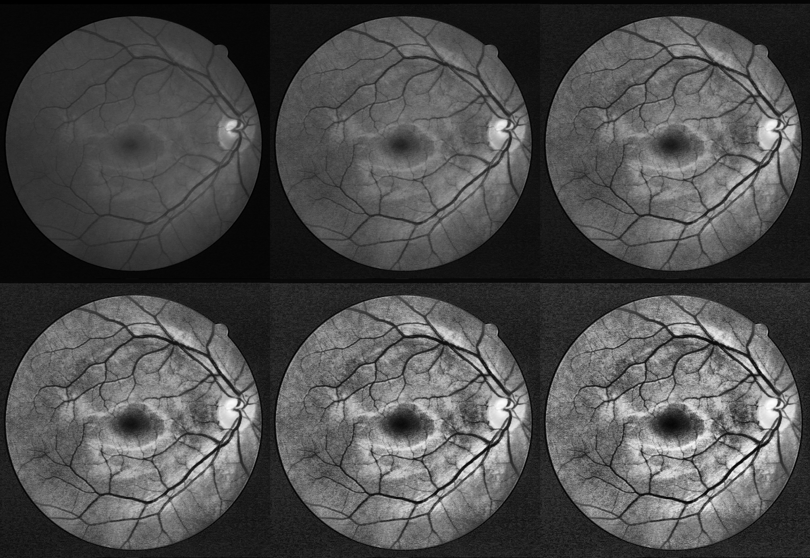
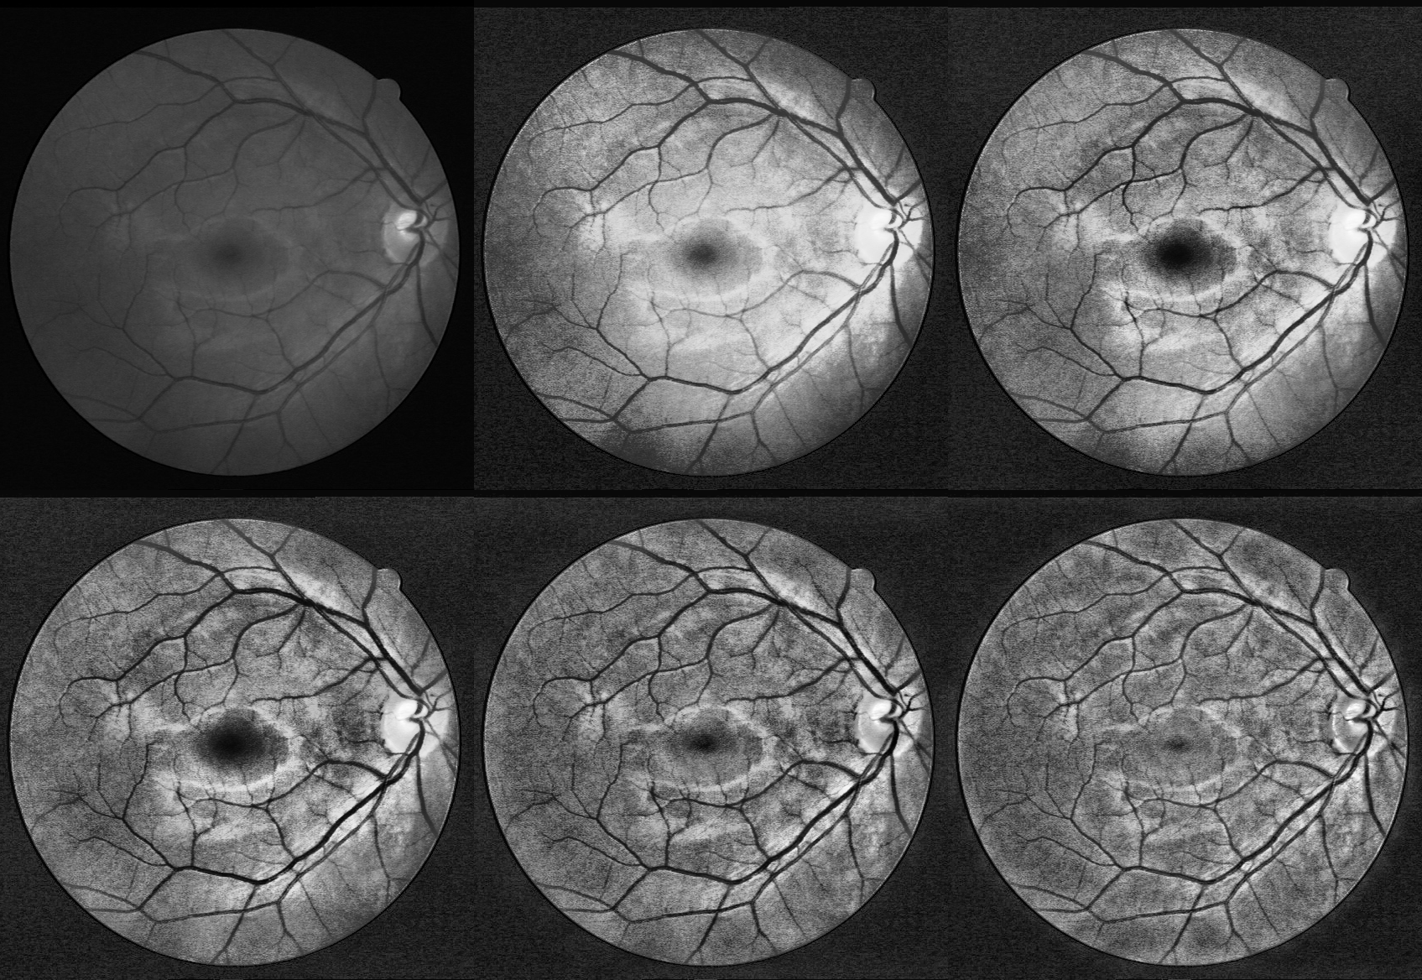
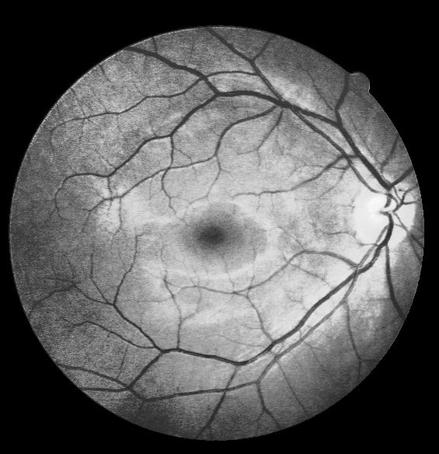
cv2.createCLAHE(clipLimit,tileGridSize)
G, cliplimit 2,10,2 grid=(2,2)
G,tile Grid=(2,2)**1,2,3,4 , clip=8
Luo Z, Zhang Y, Zhou L, et al. Micro-vessel image segmentation based on the AD-UNet model[J]. IEEE Access, 2019, 7: 143402-143411.

Slide 4
TODO:
Test diff clip grid influence to dl
Test gaussian blur

