Slide 1
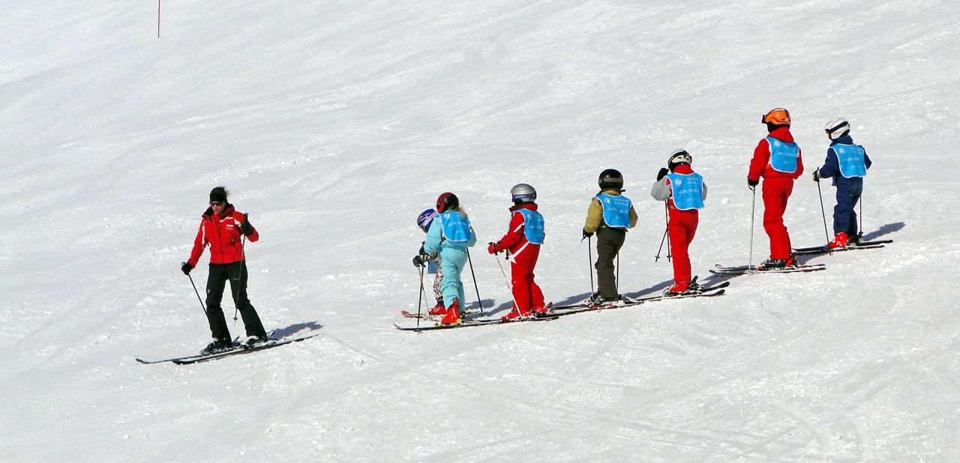
Ski School
Group 10 – Luca Milchrahm, Fabian Wagner

Slide 2

Requirements
1. Business selection and analysis
Business domain
Business activities/processes
Explain how those activities/processes need and use data
2. Database design
UML diagram
Functional dependencies
Queries for business activities

Slide 3
Business domain - Ski School
Ski school offering lessons and equipment rental
Handles both individual customers and group bookings
Lesson planning requires coordination of a lot of things
That’s why it requires structured data management for every daily operation

Slide 4
Core Business Activities
Customer management
Instructor management
Equipment rental
Lesson scheduling
Mountain and condition tracking

Slide 5
Customer Management
Customer registration requires inserting
Updating contact info or skill level requires updating
Removing inactive customers requires deleting
Lesson bookings and rentals need to retrieve customer data to link them to their activities

Slide 6
Instructor Management
Hiring instructors requires inserting
Experience and salary must be updated regularly
Removing former instructors requires deleting
Scheduling lessons requires retrieving instructor qualifications and availability

Slide 7
Equipment Rental
Creating a rental transaction requires inserting records into Rent and RentItem
Removing canceled or wrong rentals requires deleting
Determining availability requires retrieving rental records linked to the equipment

Slide 8
Lesson Scheduling
Creating a lesson (date, group, instructor, mountain, condition) requires inserting
Changing the instructor, date, price, or skill requirement requires updating
Canceling a planned lesson requires deleting
Planning and overviews require retrieving lesson details

Slide 9
Mountain & Condition Tracking
Recording mountain details or weather/snow conditions requires inserting
Updating mountain difficulty or changing weather data requires updating
Removing outdated or unused entries requires deleting
Safe lesson planning requires retrieving mountain height, difficulty, and conditions

Slide 10
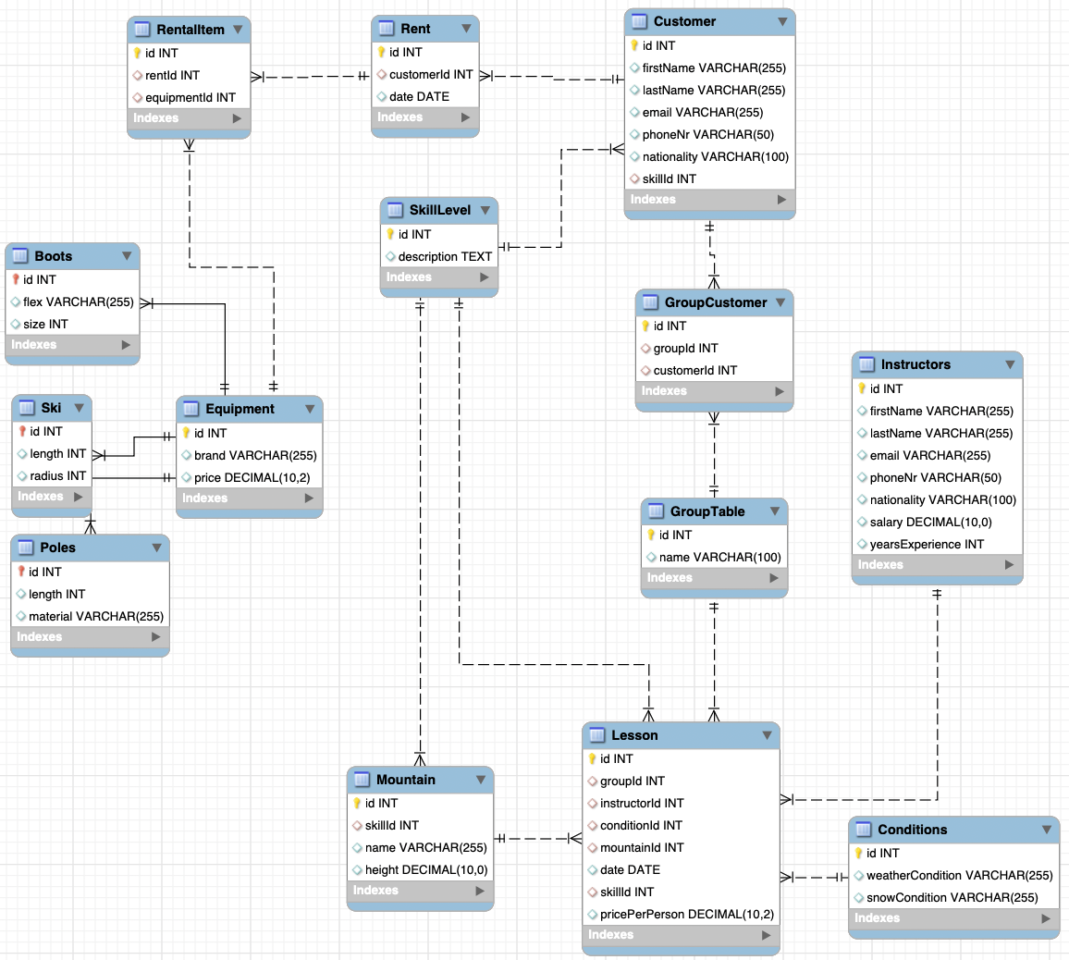
Database Design

Slide 11
Business Queries (1/2)
Use case 1: Retrieves all lessons taught by a specific instructor, including the skill level, mountain name, and lesson date.
Use case 2: Fetches all lessons a specific customer participated in, showing the mountain and lesson date.
Use case 3: Equipment Manger wants to see how many skis are available for rent on a given date by excluding all skis already rented out.
Use case 4: Returns detailed information about an instructor, including first name, last name, salary, and years of experience.
Use case 5: Updates the salary of a specific instructor based on their first and last name.

Slide 12
Business Queries (2/2)
Use case 6: Retrieves the weather and snow conditions for all lessons scheduled on a specific date.
Use case 7: Returns the number of customers in a group for lessons of a given skill level on a specific date.
Use case 8: Aggregates customers by nationality and lists how many customers come from each country, ordered from most to least.
Use case 9: Fetches all mountains that match a chosen skill level, including their names and heights.
Use case 10: Calculates the total revenue generated by a specific customer based on all lessons they participated in.

Slide 13
Functional dependencies
RentalItem Table: id → rentId, equipmentId
Rent Table: id → customerId, date
Customer Table: id → firstName, lastName, email, phoneNr, nationality, skillId
SkillLevel Table: id → description
GroupCustomer Table: id → groupId, customerId
GroupTable Table: id → name
Instructors Table: id → firstName, lastName, email, phoneNr, nationality, salary, yearsExperience
Poles Table: id → length, material
Ski Table: id → length, radius
Equipment Table: id → brand, price
Mountain Table: id → skillId, name, height
Lesson Table: id → groupId, instructorId, conditionId, mountainId, date, skillId, pricePerPerson
Conditions Table: id → weatherCondition, snowCondition

Slide 14
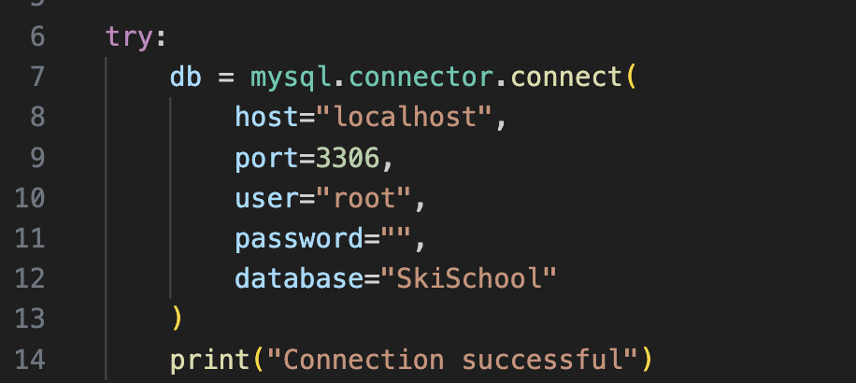
Requirements to test the application
Open and run the SkiSchool.ipynb file
run “pip install flask mysql-connector-python” in terminal
Open main.py, fill in the password for your connection and run the file

