Slide 1
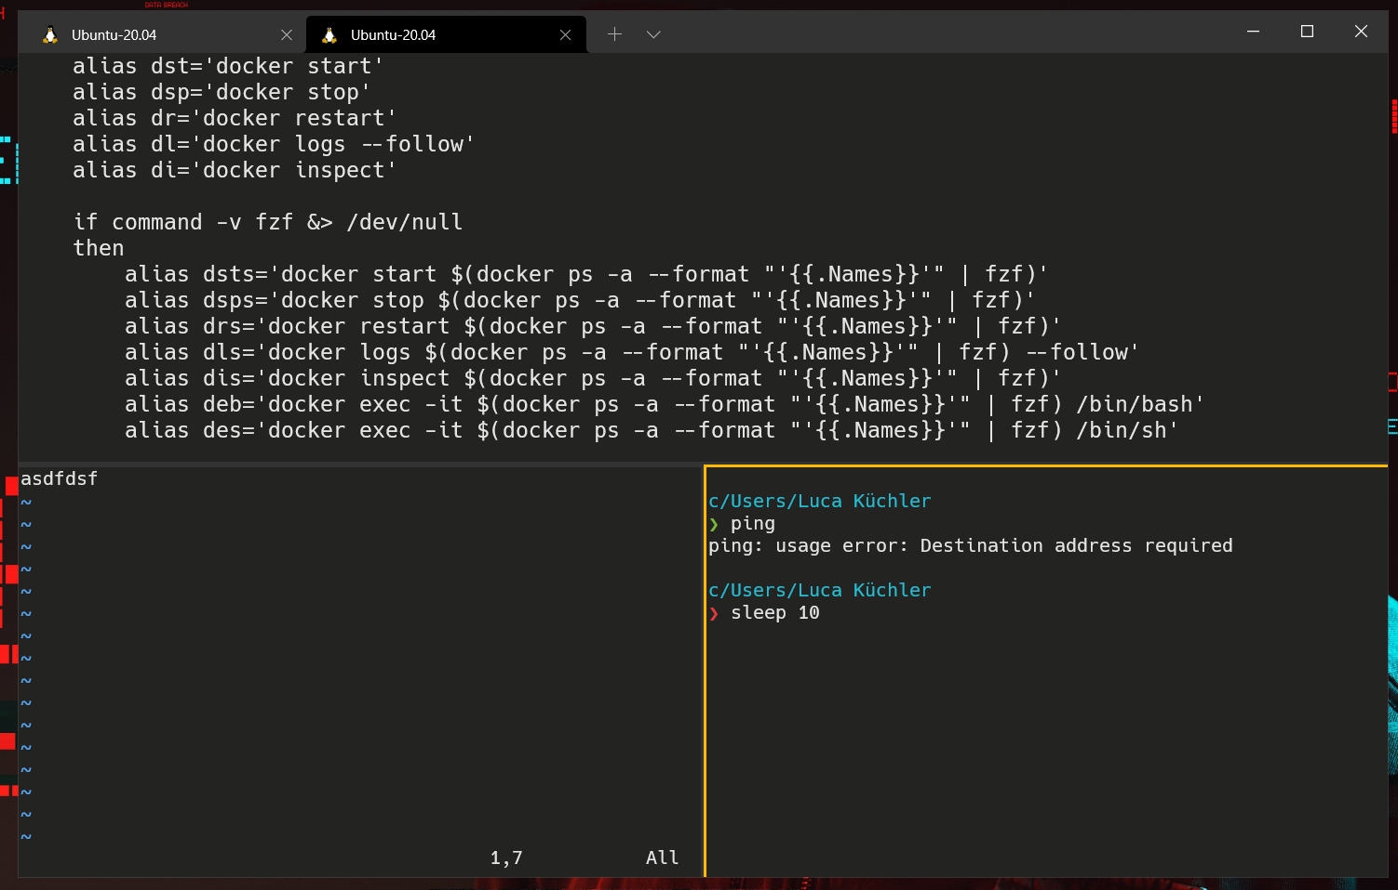

PANE 1
PANE 2
PANE 3

Slide 2
WINDOW 2

Slide 3
SESSION 1
SESSION 2

