Slide 1

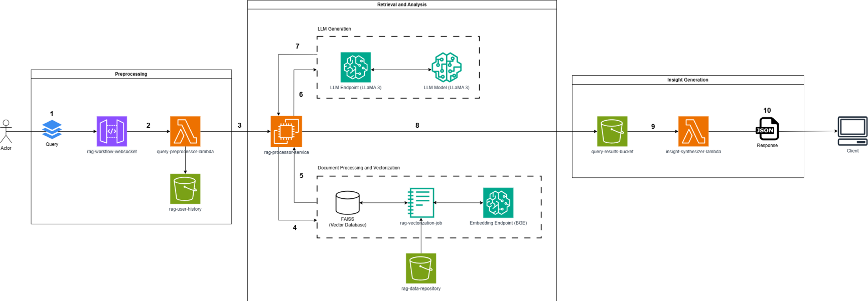
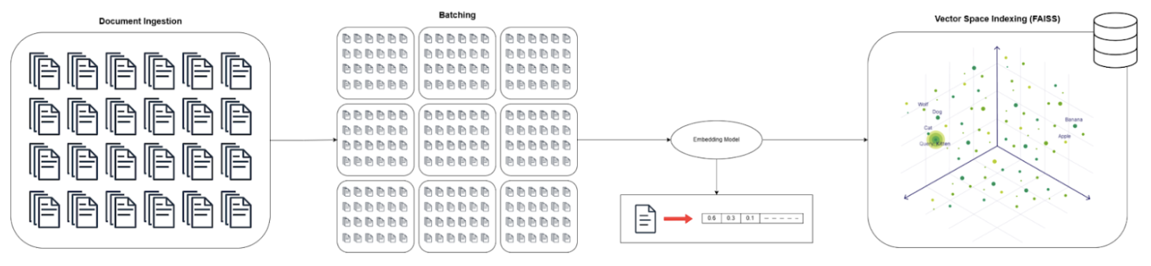
Generative AI For Data Analysis (Name Pending, it will fill up two lines)
Luca Macesanu, Aarin Mhashelkar, Aayush Dwivedi, Euni Wu, Farhan Majid, Nick Otwani, Kamyrin Paiz
Mentored by Dr.Emmanuel Tutuc
Industry Contact: Thomas Lai
Introduction
Design Solution
Results
Abstract:
Our project introduces a cloud-based platform that allows users to ask healthcare-related questions and receive precise, context-specific insights from extensive technical datasets. Utilizing a Retrieval-Augmented Generation (RAG) architecture, the system uses BGE embeddings to process and index domain-specific documents, retrieves pertinent information with the FAISS library, and produces accurate, grounded answers using the advanced LLaMA 3 language model. The platform is engineered for flexibility, supporting multiple domains and scaling effectively to handle thousands of documents for Texas Instruments. Users can interact seamlessly through a user-friendly chat interface and are guaranteed rapid retrieval and accurate synthesis of information due to the robust backend architecture.
Underlying Theory: Retrieval-Augmented Generation (RAG):
RAG enhances LLM accuracy by grounding responses in retrieved, relevant information through semantic search and generative AI, reducing hallucinations.
System I/O:
Image of frontend
Image of i/o with or without frontend
Operating Principles:
Query Ingestion & Routing: User questions via a web interface are sent to a scalable AWS backend.
Semantic Document Retrieval: The query is vectorized into a semantic embedding (BGE model) and used to find relevant document snippets within an indexed knowledge base (FAISS).
Contextualized Response Generation: The user's query and the retrieved document snippets are combined into a prompt for the LLaMA 3 model on AWS.
Confidence-Driven Refinement: The generated response is evaluated for confidence. Low-confidence answers trigger automatic query refinement and regeneration (up to 3 attempts).
Output & Persistence: The final, confident answer is displayed to the user via the web interface and stored with metadata for future use.
Accuracy Info:
Accuracy data about llm performance
Chart comparison between each iteration
Key Aspects: Seamless web-hosted platform with an intuitive user interface. Scalable architecture on AWS enables adaptability to new data/LLMs.
Conclusion
RAG Module
Outcome: Early testing with data confirms system responsiveness and alignment with performance targets, including sub-2-minute response times and ≥70% precision.
Performance: Initial performance tests show the architecture meets key benchmarks for speed, accuracy, and scalability
Future work includes adding more datasets to train the model on, optimizing RAG with improved hallucination detection and ranking mechanisms, and refining cost-aware deployment strategies for full-scale AWS migration
System Requirements
Web Hosted: Our product will be a web service similar in style to the GPT website, providing interactive data analysis via chat.
Flexible: Users can input data in multiple formats, access chat history, and send language-based queries for insights.
Domain Adaptable: The system should allow plug and play of different LLM models as well as configuration of the information database.
Acknowledgments
We would like to thank Dr. David Harwath for his guidance in audio representation and analysis techniques.

