Slide 1
LMS Security System
Alfonso Lentini, Luca Mannella, Stefano Sacco
Projects and Laboratory
on Communication Systems
Academic Year 2015/2016
A SECURITY SYSTEM GADGETEER BASED
Alfonso Lentini, Luca Mannella, Stefano Sacco
PROJECTS AND LABORATORY ON COMMUNICATION SYSTEMS
2015/2016
Notes:
Carmelo Loiacono, Luca Mannella
Operating Systems 2015/2016

Slide 2
What the system does
  Our project is a security system able to identify if in a room is present an intruder
  The main component of the system is the camera
  A setup picture is taken in the configuration phase
  Pictures are taken periodically
  A picture is send to server, if there are significant differences between
    The setup picture
    The last taken picture
  It is the server that decide if a picture is critical or not
  If the picture is judged critical by the server the alarm is raised
Alfonso Lentini, Luca Mannella, Stefano Sacco
PROJECTS AND LABORATORY ON COMMUNICATION SYSTEMS
2015/2016

Slide 3
Hardware Modules
  Our project is a security system based on C# and Microsoft .NET Gadgeteer
  GHI electronics modules:
    FEZ spider I mainboard
    Display T35 (3,5’’ with touchscreen)
    USB Client DP Module (used as power supply)
    Camera
    Multicolor LED
    Button
    Ethernet J11D
    Joystick
    Extender
  Our modules:
    Buzzer
    Camera motion support
    Orange board for the power supply
Alfonso Lentini, Luca Mannella, Stefano Sacco
PROJECTS AND LABORATORY ON COMMUNICATION SYSTEMS
2015/2016

Slide 4
Software Modules
The gadgeteer based client
The C# server
The C# Web Service
A MySQL Database
A WAMP base web application
  Windows Operating System
  Apache HTTP server
  MySQL database
  PHP
Alfonso Lentini, Luca Mannella, Stefano Sacco
PROJECTS AND LABORATORY ON COMMUNICATION SYSTEMS
2015/2016

Slide 5




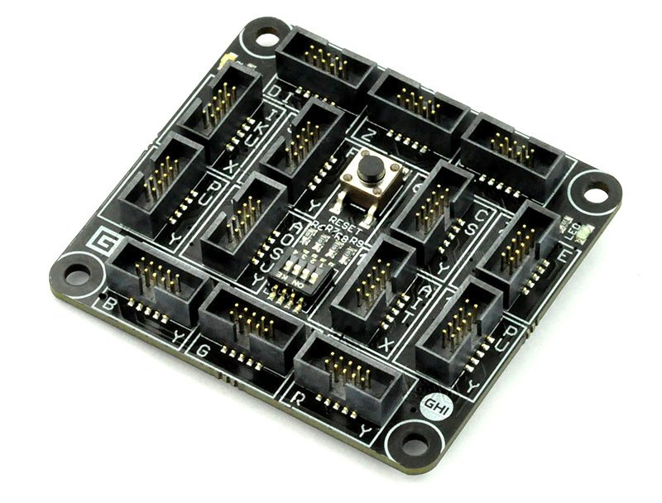

The Application Workflow
User
1
WebSite
Database
2
3
Web Service
Gadgeteer
4
Server
Alfonso Lentini, Luca Mannella, Stefano Sacco
PROJECTS AND LABORATORY ON COMMUNICATION SYSTEMS
2015/2016

Slide 6







Gadgeteer Elaboration Function
Take Picture
Heuristic Elaboration
End
No suspicious
picture
Suspicious
picture
Every 3 seconds
Send Picture
No Alarm
Throw Alarm
Aforge Elaboration
Alarm
Alfonso Lentini, Luca Mannella, Stefano Sacco
PROJECTS AND LABORATORY ON COMMUNICATION SYSTEMS
2015/2016

Slide 7






Gadgeteer Keep Alive Function
Take System Time
Send Time to Service
SERVER SIDE
Continuos check of time
Every 35 seconds
Send Time to Server
Save Time
Alfonso Lentini, Luca Mannella, Stefano Sacco
PROJECTS AND LABORATORY ON COMMUNICATION SYSTEMS
2015/2016

Slide 8
Particularities
  The heuristic approach for the image differences in the client side
    9 squares of dimension 8x8 pixels
    From 76800 pixels to 576 pixels (two orders of magnitude)
  The Aforge.NET library
    Find differences between two pictures
    Highlight the differences in the suspicious pictures
  The Web Application
    Allows the user to register an account
    Allows the user to see all the suspicious pictures analyzed by the server
Alfonso Lentini, Luca Mannella, Stefano Sacco
PROJECTS AND LABORATORY ON COMMUNICATION SYSTEMS
2015/2016

Slide 9
Weakness
  The CPU computational power of the FEZ spider (just 72 MHz)
    Quite impossible to add a thread for the PIR
    Very difficult to augment the frequency of the keep alive
    Impossible to manage the camera regulation in a more fluid way
  Electromagnetic interference between
    Buzzer
    Camera motion support
  Lack of some security features
    PIN not encrypted between client and server
    No authentication mechanism between client and server / web serivice
Alfonso Lentini, Luca Mannella, Stefano Sacco
PROJECTS AND LABORATORY ON COMMUNICATION SYSTEMS
2015/2016
Notes:
Operating Systems 2015/2016
Carmelo Loiacono, Luca Mannella

Slide 10

Alfonso Lentini, Luca Mannella, Stefano Sacco
PROJECTS AND LABORATORY ON COMMUNICATION SYSTEMS
2015/2016

Slide 11

Alfonso Lentini, Luca Mannella, Stefano Sacco
PROJECTS AND LABORATORY ON COMMUNICATION SYSTEMS
2015/2016

