Slide 1
Final Project - FINTECH
ESTIMATING FINANCIAL NEEDS
Emanuele Bellini
Vincent Karakoseian
Luca Meanti
Eddie Nevander
Guido Rossoni
Academic Year 2023-2024

Slide 2
RECOMMENDATION SYSTEM Project overview
Goal
Procedure
The project begins with an exploratory analysis and dataset filtering to eliminate less significant features, creating a refined dataset optimized for machine learning algorithms. Following this, we perform customer profiling, utilizing two labels to assess each client's investment propensity. The final stage involves generating product recommendations based on the client's risk profile.
The aim of this project is to develop a financial product recommendation system tailored to client-specific features.

Slide 3
DATA EXPLORATION
01.

Slide 4
GOAL & METHODOLOGY
Goal: Enhance the model's accuracy in identifying clients with an above-average propensity to invest; standardize the data to ensure seamless integration with machine learning algorithms; enhance the model's generalization capabilities.
Methodology: Feature engineering leveraging the correlation matrix; random Forest to determine feature importance ; log transformation to address asymmetric feature distributions; one-Hot Encoding and Min-Max scaling for data preparation; filter the dataset to focus on relevant clients.

Slide 5
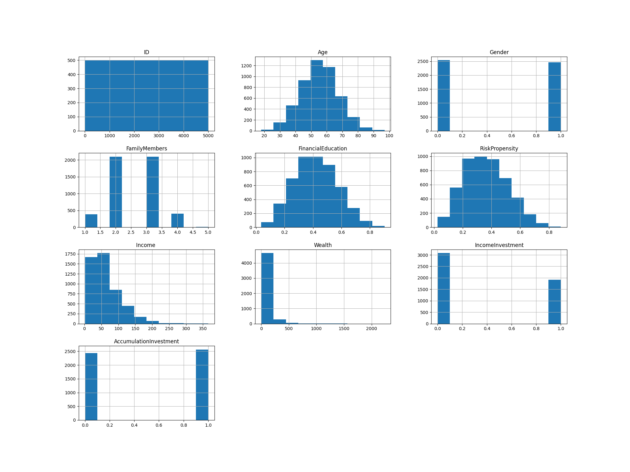
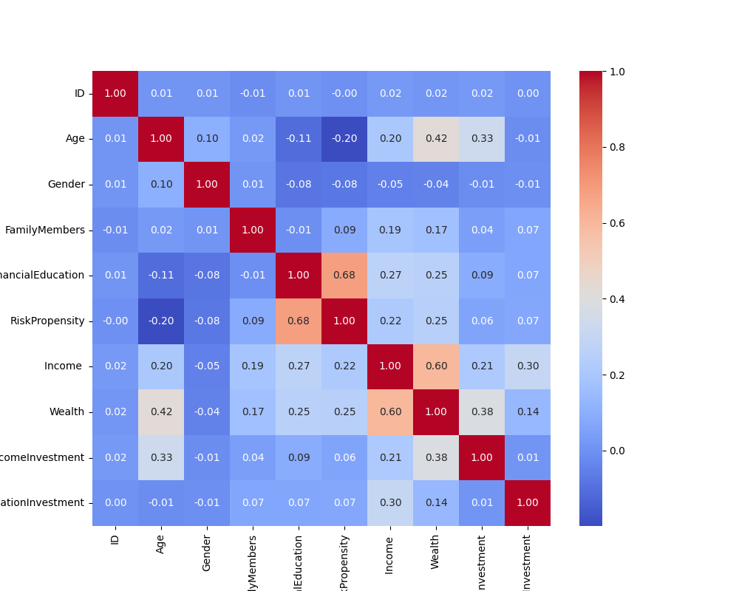
BEFORE DATA MODELING

Slide 6
01.
Add a new feature: Income/Wealth
02.
Remove less correlated features
03.
Logarithmic transformation on the asymmetric variables
04.
Scaling

Slide 7
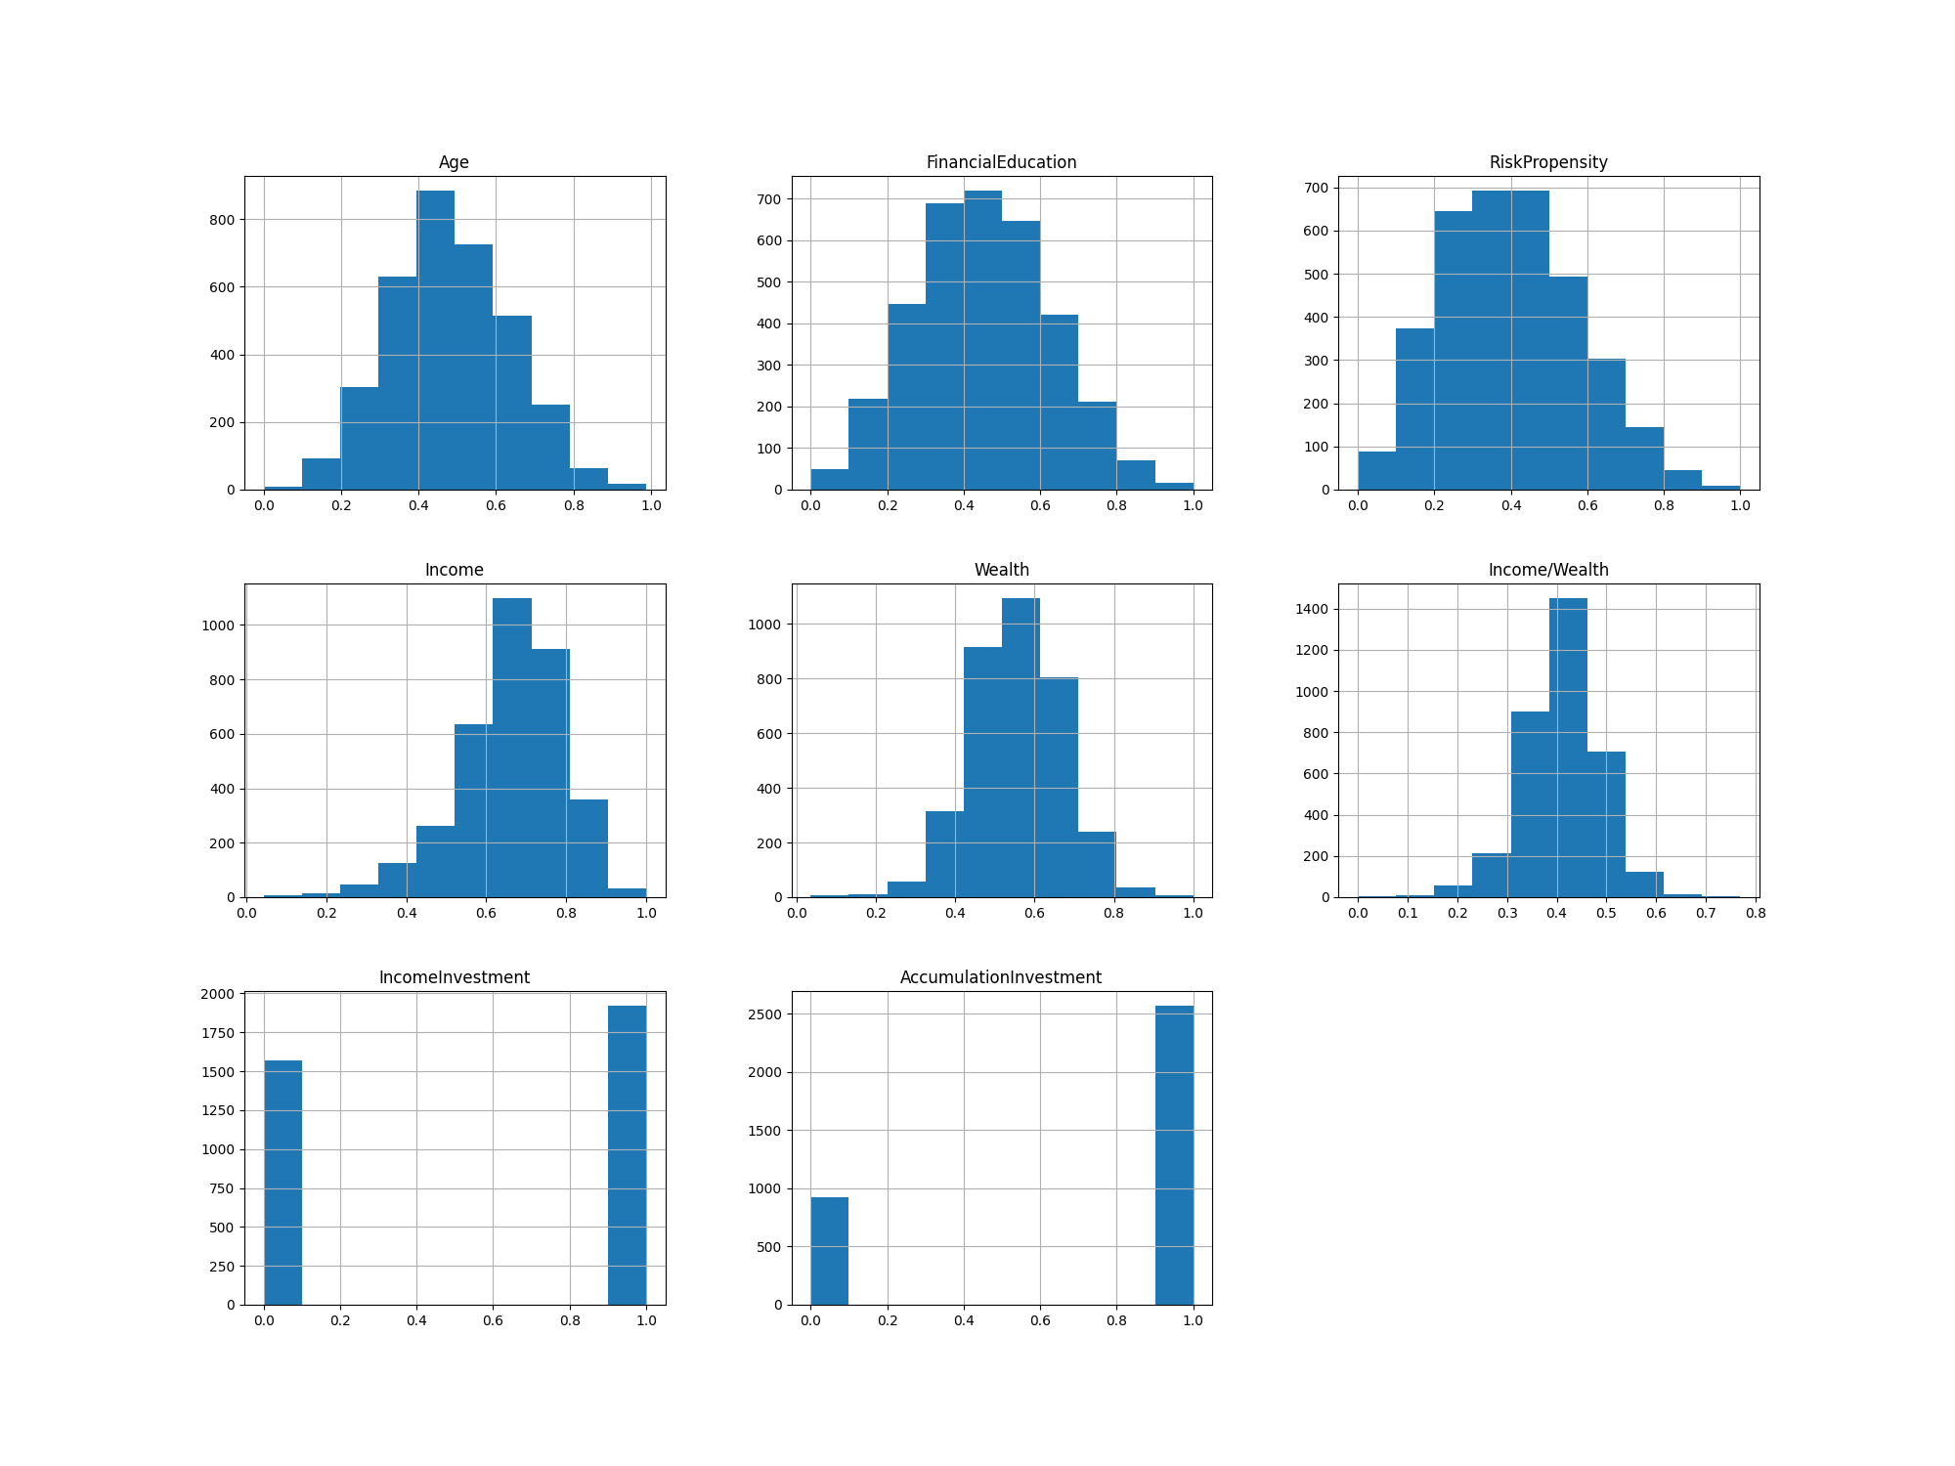
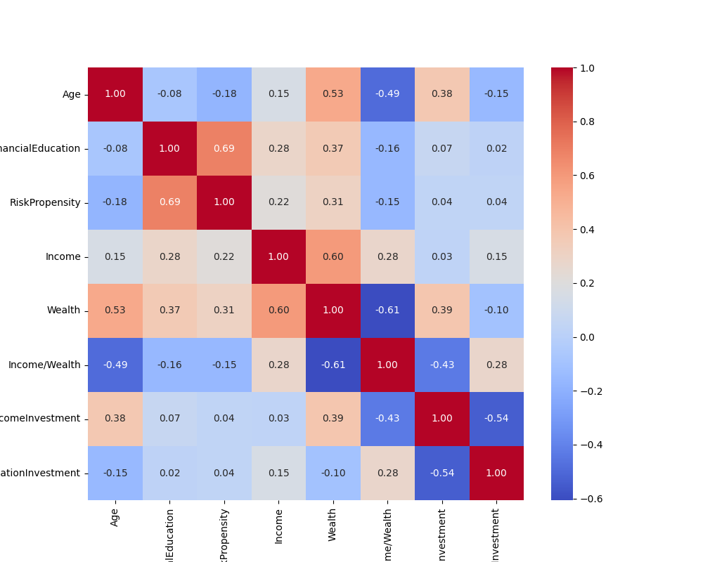
AFTER DATA MODELING

Slide 8
DATASET FILTERING
The original dataset contains many clients labeled as 0 in both target variables, IncomeInvestment and AccumulationInvestment.
To balance the dataset and slightly skew it towards the positive classes, we chose to remove these clients. This decision aims to enhance the performance of our classifier by mitigating the adverse effects their lack of purchasing interest could have.
The next slide demonstrates notable improvements in the recall indicator—our primary focus—for one of the selected classifiers, the multi-layer perceptron.

Slide 9
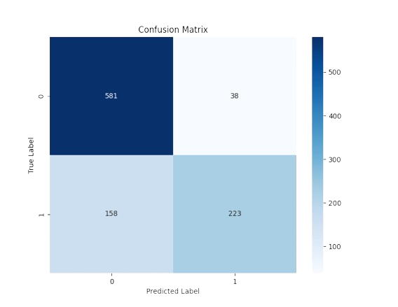
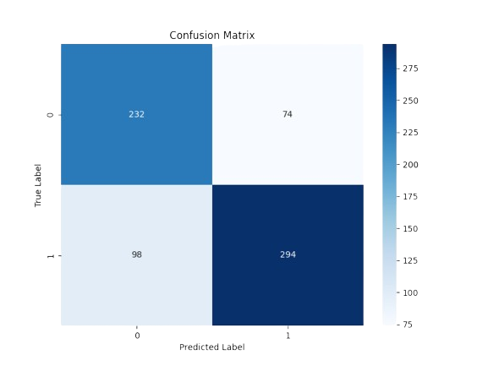
PERFORMANCE IMPROVEMENTS
Complete dataset
Filtered dataset
Accuracy: 0.804
Recall score: 0.585
Accuracy: 0.753
Recall score: 0.75

Slide 10
CLASSIFICATION
02.

Slide 11
GOAL & METHODOLOGY
EVALUATION METRICS
Goal:
Classify client investment preferences for
'IncomeInvestment’
'AccumulationInvestment'.
Methodology:
Utilize 9 different classifiers;
select the top 5 classifiers based on accuracy.
Perform majority voting (bagging) for the final prediction.
Accuracy:
The percentage of correct predictions.
Recall:
The proportion of true positive predictions to the total actual positives.
Considerations:
Accuracy ensures overall prediction correctness.
Recall was prioritized to ensure the model effectively identifies clients likely to invest, thereby reducing the risk of missing potential investors.

Slide 12
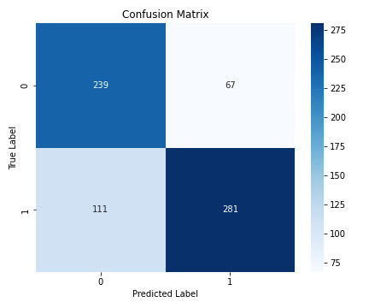
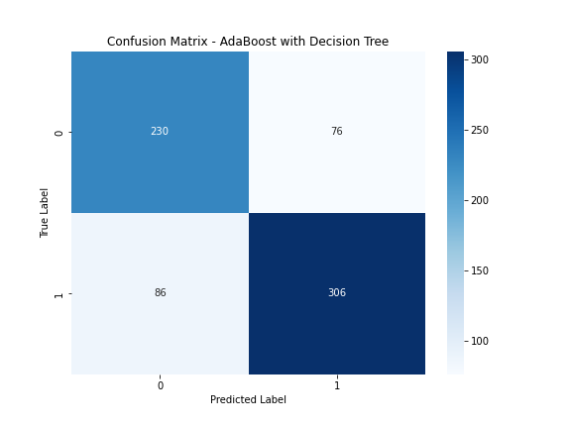

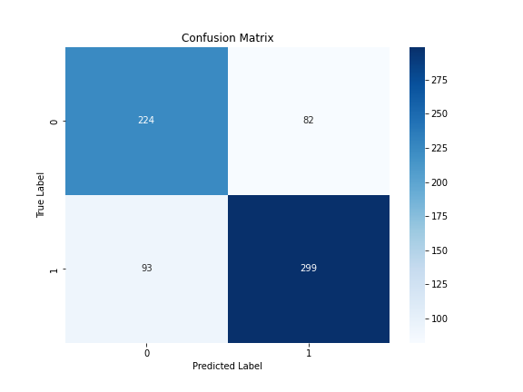
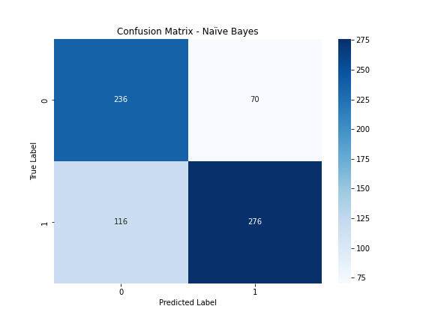
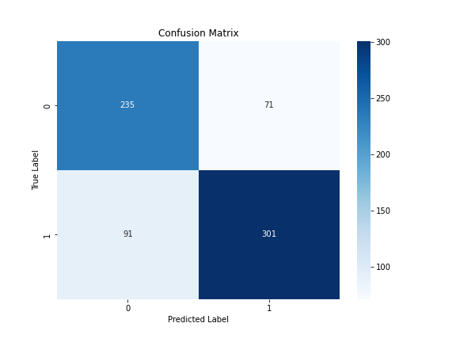


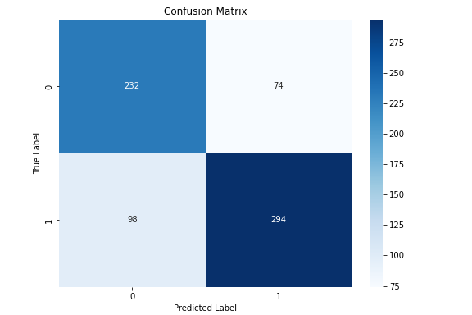
INCOME INVESTMENT
Confusion Matrices
KNN
AdaBoost + Dec. Tree
Gradient Boosting
Logistic Regression
Naive Bayes
Multi-layer Perceptron
Isolation Forest
Support Vector Machine
XGBoost

Slide 13
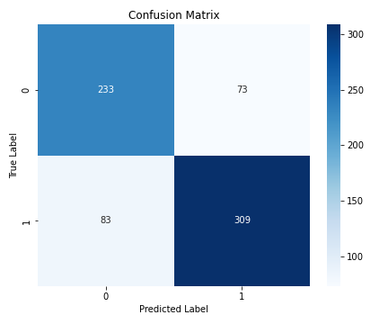
INCOME INVESTMENT
Ensemble model
Classifiers selected:
Multi-layer Perceptron
Isolation Forest
Logistic Regression
Gradient Boosting
Decision Trees + AdaBoost

Slide 14
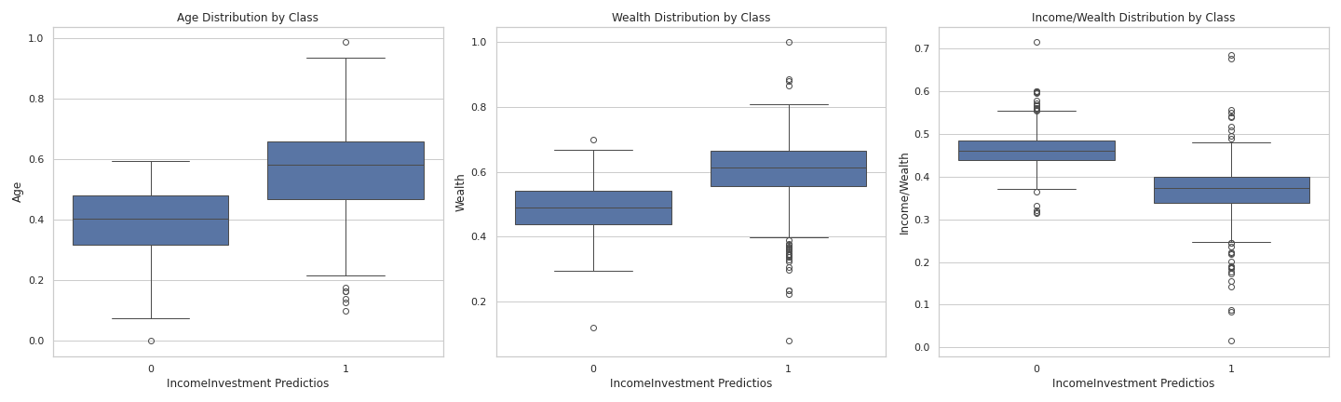
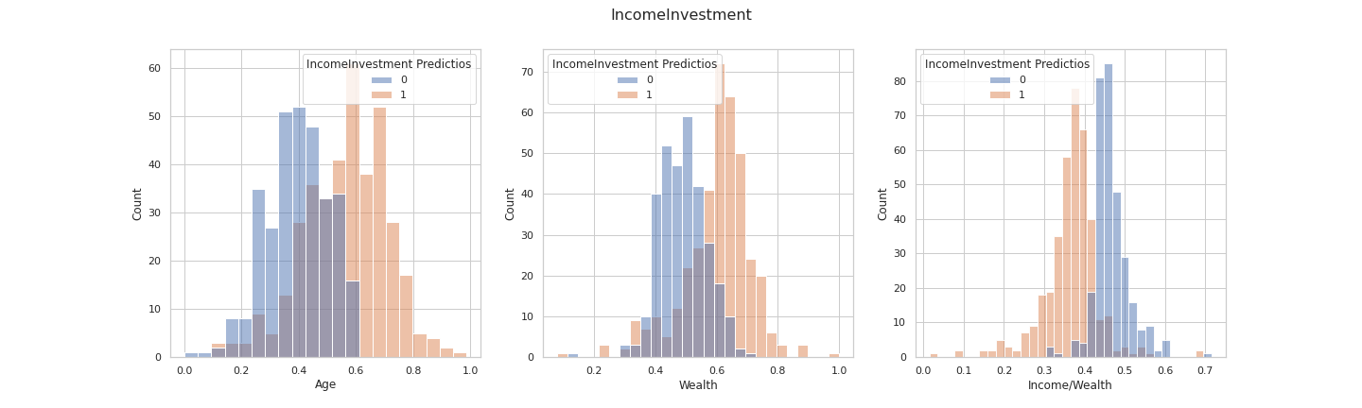
INCOME INVESTMENT
Classification analysis
Analyzing the distributions of the most important features after the classification has been performed, it emerged that the clients more prone to invest in an income product are older and have greater wealth than those less inclined to invest in these types of products.

Slide 15
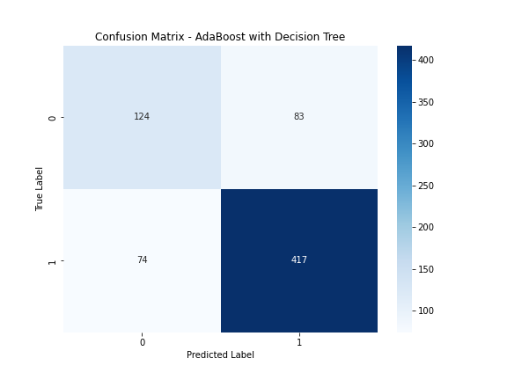
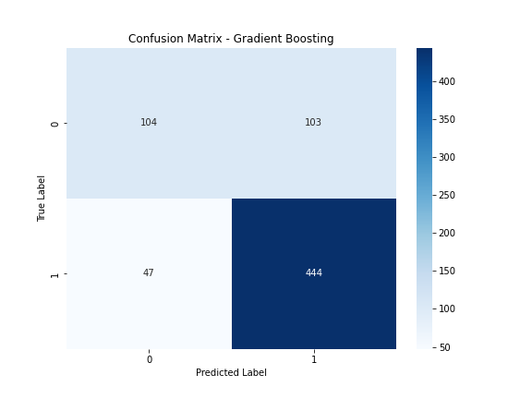
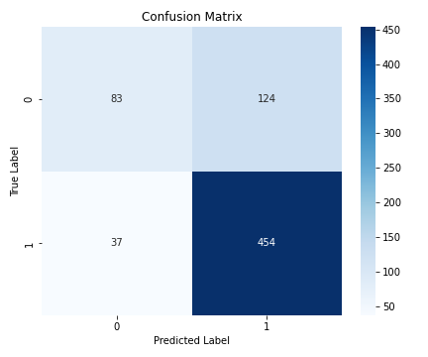
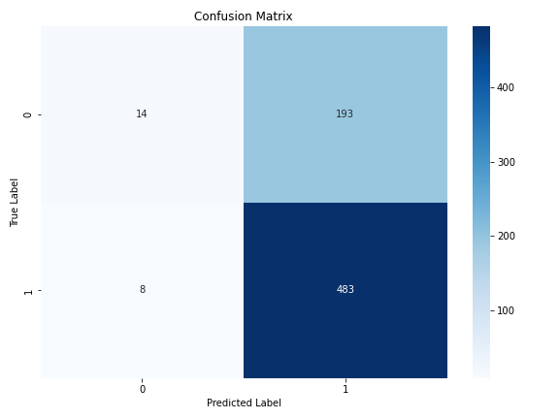
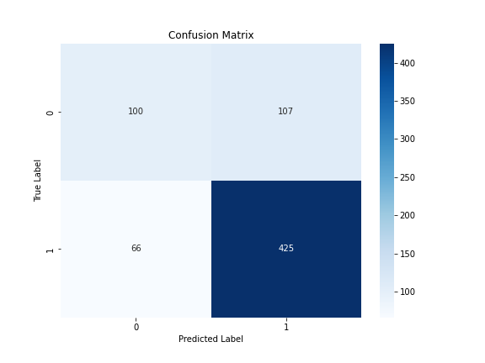
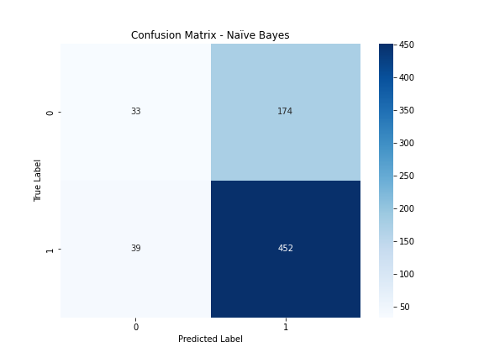

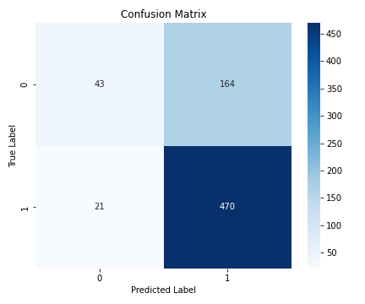
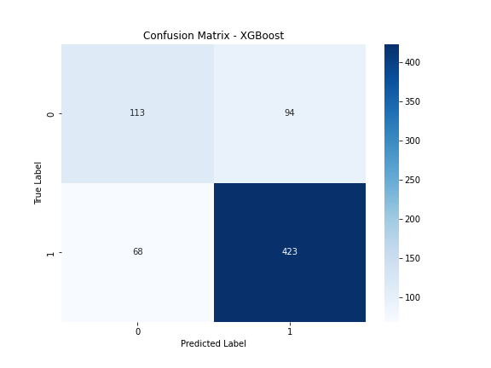
ACCUMULATION INVESTMENT
Confusion Matrices
KNN
AdaBoost + Dec. Tree
Gradient Boosting
Logistic Regression
Naive Bayes
Multi-layer Perceptron
Isolation Forest
Support Vector Machine
XGBoost

Slide 16
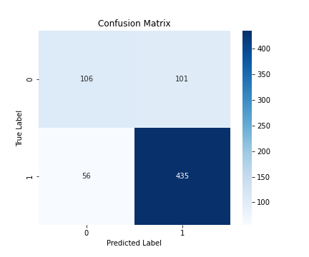
ACCUMULATION INVESTMENT
Ensemble model
Classifiers selected:
Multi-layer Perceptron
Isolation Forest
K-Nearest Neighbours
Gradient Boosting
Ex. Gradient Boosting

Slide 17
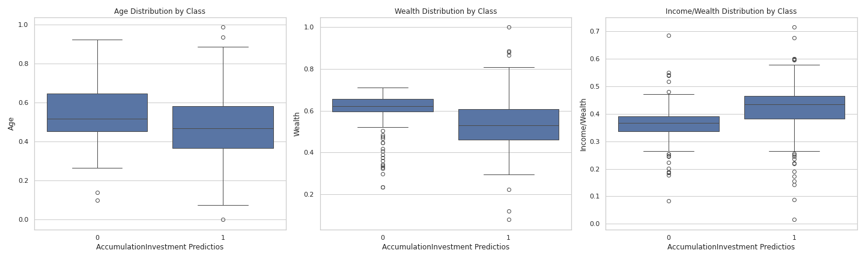
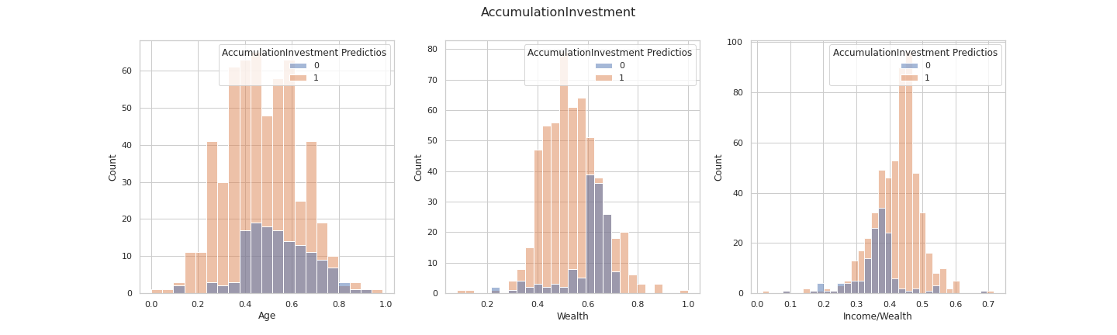
ACCUMULATION INVESTMENT
Classification Analysis
Analyzing the distributions of the most important features after the classification, it emerged that the clients more prone to invest in an accumulation product are younger and have less wealth than those less inclined to invest in these types of products.

Slide 18
RECOMMENDATION
03.

Slide 19
GOAL & METHODOLOGY
Goal:
Provide personalized investment recommendations.
Enhance client engagement and conversion by offering suitable
investment products.
Methodology:
Propose the first corresponding product with an affordable risk profile
aligned with the client's investment type.
For potential buyers with no affordable product found, suggest the lowest-risk
investment products as attractive alternatives to encourage reconsideration of
investment.

Slide 20
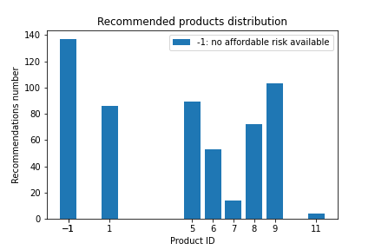
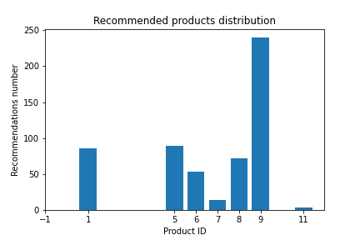
INCOME INVESTMENT Recommendation
Basic recommendation
Alternative recommendation

Slide 21
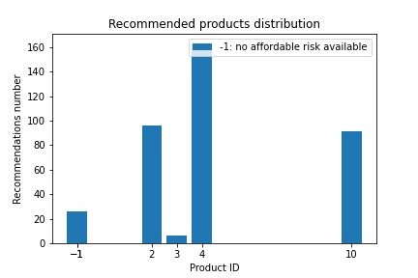
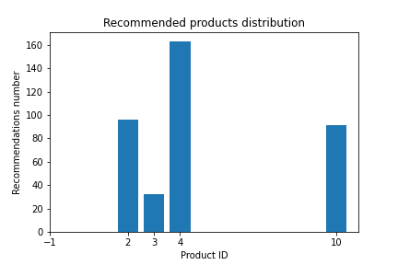
ACCUMULATION INVESTMENT Recommendation
Basic recommendation
Alternative recommendation

