Slide 1

Laboratory of data science
Group 21
Giulia Calvo
Luca Palla

Slide 2

The project
The main goal of the various assignments was to design from the scratch a whole database, performing on it various analysis. To archive the result, we present now the 3 phases involved in process.
Data processing and loading
2. SQL Server integration services
3. SQL Server analysis services and Power BI analysis

Slide 3


1. DATA PROCESSING
AND LOADING
In order to create and populate a database starting from .csv files and perform different operations on it, we started using Python to clean the data and organize it in different tables.

Slide 4
1. Data processing and loading
In particular, the database is about data of answers given by students to various multiple-choice questions. The main tables to create were:
Answer, the fact table (AnswerId, QuestionId, UserId, OrganizzationId, DateId, SubjectId, AnswerValue, CorrectAnswer, IsCorrect, Confidence)
Organization (OrganizationId, GroupId, QuizId, SchemeOfWorkId)
Geography (GeoId, Region, CountryName, Continent)
Subject (SubjectId, Description)
Date (DateId, Date, Day, Month, Year, Quarter)
User (UserId, DateOfBirthId, GeoId, Gender)

Slide 5
1. Data processing and loading
After .csv file were created we uploaded them on SQL management studio
Using the python file WORKING_CODE-iterative we tried to control the updating also because sometimes the tool used didn’t run as we expected.
Here we decided also the structure in SQL management studio of the database: the logic that guided our decisions was the balance between velocity and memory
For example, in the table DATE to design the columns “Day” and “Month” we put as type Small_Int knowing that it is impossible to have a value more that 100.
We take care also of the fact that the database could be updated in the future: for example, in “GEOGRAPHY” we put as type nchar(4) for the Continent knowing that with only 5 Continents we cannot have situation with more than 2 character

Slide 6

2. SQL Server integration services
The second part regarded the finding of solutions to some business problems using Sequel Server Integration Services. In order to reach our goals only standard nodes were used avoiding work on client side.

Slide 7
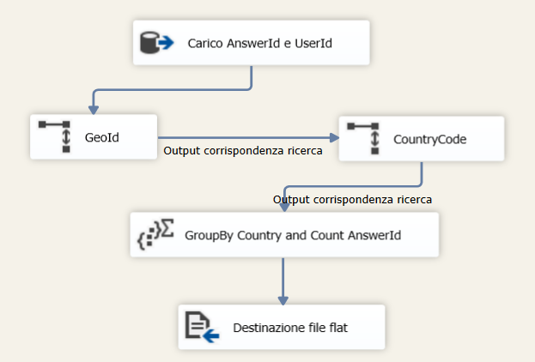
2. SQL SERVER INTEGRATION SERVICES
The first assignment asked: "For every country, the number of total answers. "
From Answer's table AnswerId and UserId were loaded
With lookup function GeoId was loaded from User's table matching UserId
With lookup function CountryCode was loaded from Geography's table matching GeoId
With aggregation function a groupBy was performed on CountryCode and a count was performed on AnswerId. All the other columns were discarded.

Slide 8
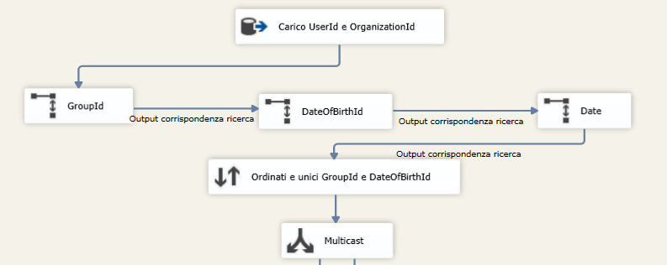
2. SQL SERVER INTEGRATION SERVICES
The second assignment asked: "A group (identified by GroupId) is said to have an age mismatch if the difference between the date of birth of the youngest participating student and the oldest is greater than 365 days. List all the groups with an age mismatch."​
From Answer's table UserId and OrganizationId were loaded
With lookup function GroupId was loaded from Organization’s table matching OrganizationId
With lookup function DateOfBirthID was lodded from User’s table matching UserId
With lookup function Date was loaded from Date’s table matching DateOfBirthId with DateId
To achieve the removal of the duplicates, we ordered by GroupId and DateOfBirthId
To achieve the double usage of the outputting data, we used Multicast

Slide 9
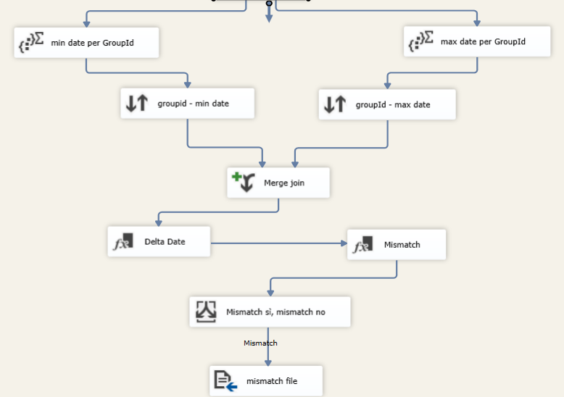
2. SQL SERVER INTEGRATION SERVICES
After the multicast aggregation function, on the two lines we calculated the min and the max date for GroupId
In order to compute the Merge, we ordered the results of the previous Phase for GroupId
We merged the results on GroupId
With function Derived Column, we compute the delta between max and min date as DATEDIFF("dd",(DT_DBDATE)min_date,(DT_DBDATE)max_dat
With function Derived Column, we compute the mismatch column [Delta Date (days)] > 365 ? 1 : 0

Slide 10
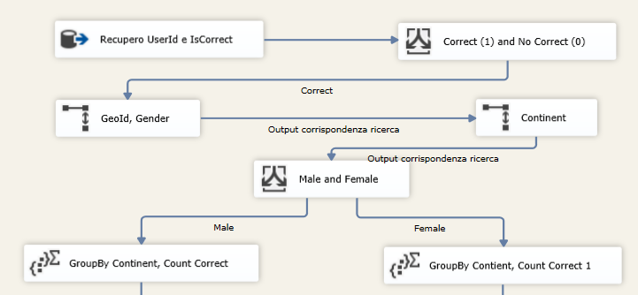
2. SQL SERVER INTEGRATION SERVICES
The second assignment asked: "For each continent the ratio between correct answers of males and correct answers of females"
From Answer's table UserId and IsCorrect were loaded
With Conditional Split, we separated correct from no correct answers to output only correct answers
With lookup function GeoId and Gender were loaded from User’s Table matching UserId
With Lookup function Continente was loaded from Geography’s Table matching GeoId
With conditional split, we divided the process for male and female
Groping By continent, we counted the correct answer for male and female

Slide 11
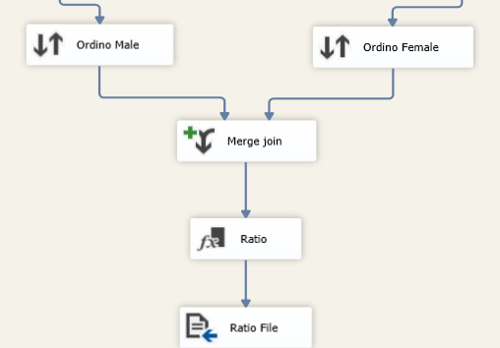
2. SQL SERVER INTEGRATION SERVICES
In order to compute the Merge, we ordered the results of the previous Phase for Continent
We joined on Continent and took the Is_correct Count for male and female
With function Derived Column, we compute the delta between male and female as (DT_DECIMAL,5)IsCorrect_Male / (DT_DECIMAL,5)IsCorrect_female
We wrote on the CSV Continent, Is_correct Female, Is_correct Male and Ratio

Slide 12


3. SQL Server analysis services and Power BI analysis
In the third and last phase of the project we focalized our attention on the creation of a cube structure which allowed us to answer some business questions with MDX language.
After that some dashboard were created to give a visual rappresentation to several interesting aspect regardings the data.

Slide 13
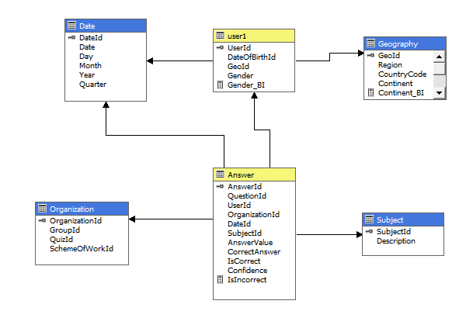
3. SQL SERVER ANALYSIS SERVICES AND POWER BI ANALYSIS
In order to create the cube various steps were followed:
As first a connection was created with the database origin source so that data were imported
As second a view was created for each table imported
In third step dimensions were created. Excluding Answer a dimension was created for each table taking in account needed hierarchies.
The last step was the creation of the cube in figure using the dimensions in point c.

Slide 14
3. SQL SERVER ANALYSIS SERVICES AND POWER BI ANALYSIS
During the third pahse's execution some mesaures were created in the cube and some columns were added in our original schema. The most important changes are:
User's dimension involved also Geography's attributes due to some problems in MDX query results
Some columns were created, in particular:
Continent_BI and Region_BI in Geography
Gender_BI in User
IsIncorrect in Answer
Some group of mesaures were created:
Answer (Conteggio di answer, IsCorrect, IsIncorrect)
User (Conteggio di User)

Slide 15
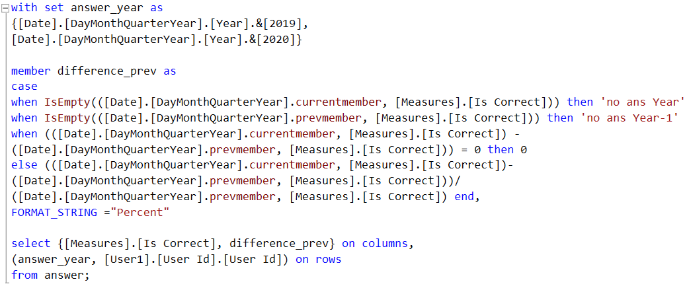
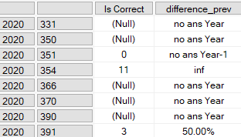
3. SQL SERVER ANALYSIS SERVICES AND POWER BI ANALYSIS
When the cube was created and elaborated, some MDX queries were executed in order to answer at some business questions. The first was: "Show the percentage increase or decrease in correct answers with respect to the previous year for each student "
5 possible cases:
currentmember is empty: returned ‘no ans Year’
prevmember is empty: returned “no ans Year-1”
absolute difference in correct answer between one year and the previous one is 0: 0% will be returned.
The last one is when data are present for both years and so we just performed the formula
0 division: returned “inf”

Slide 16
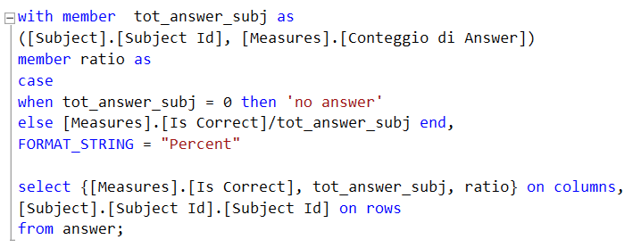
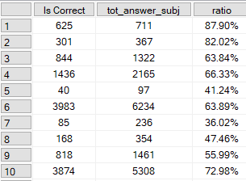
3. SQL SERVER ANALYSIS SERVICES AND POWER BI ANALYSIS
The second question was: "For each subject show the total correct answers in percentage with respect to the total answers of that subject"
We calculated two different member:
Tot_answer_subj
Ratio
In ratio we consider the possible case where no answer were given for a specific subject

Slide 17
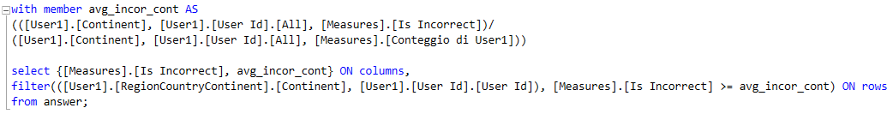
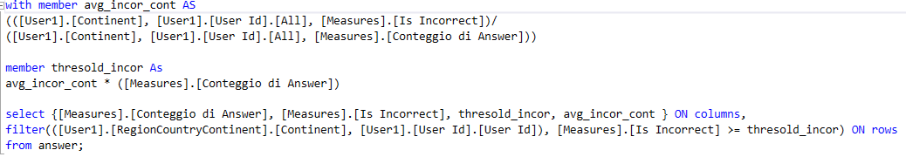
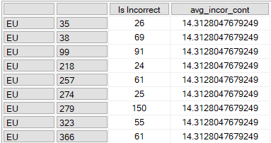
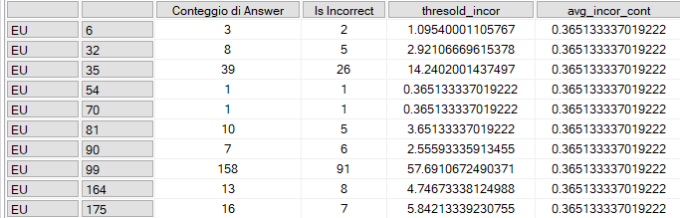
3. SQL SERVER ANALYSIS SERVICES AND POWER BI ANALYSIS
The third question was: "Show the students having a total incorrect answers greater or equal than the average incorrect answers in each continent"
Query version 1
Query version 2

Slide 18
3. SQL SERVER ANALYSIS SERVICES AND POWER BI ANALYSIS
The last two assignments of part 3 were about dashboard
Assignment 4 was about creating a dashboard that shows the geographical distribution of correct answers and incorrect answers.
Geo_BI has been used in order to geolocate correctly the distribution; moreover, the logic of this dashboard was to split the report in two areas: is correct and is incorrect.
Assignment 5 was decided by us, so we decided to go through Gender using the analysis of correct and incorrect answer.
Here the logic was to understand the performances of Female and Male in the two years for which we had data. To archive the result, we added previously the column Gender_BI

