Slide 1

ANTISYMMETRICRNN: A DYNAMICAL SYSTEM VIEW ON RECURRENT NEURAL NETWORKS
https://arxiv.org/abs/1902.09689
Luca Palumbo
639750

Slide 2
Introduction
Recurrent Neural Networks (RNNs) suffer from the vanishing gradient problem, which interfere with their ability to learn long-term dependencies in sequential data. Several solutions have been proposed — such as gated architectures or constraining the weight matrix to be orthogonal — but these approaches only partially address the issue.
This paper proposes a novel perspective based on dynamical systems theory: by designing the RNN as a stable differential equation, the model naturally preserves information over time, improving its ability to capture long-term dependencies.

Slide 3


RNN-ODE Connection
Considers the following ODE: $h^{′}\left(t\right)=\tanh\left(Wh\left(t\right)\right)$
Now we can discretize it by means of Forward Euler Method: $h_{t}=h_{t−1}+ε\tanh\left(Wh_{t−1}\right)$
This equation resemble a recurrent neural network without input data. ($W$ are the model parameters, $ε$ is an hyperparameter, $h_{t}$ is the hidden state)

Slide 4
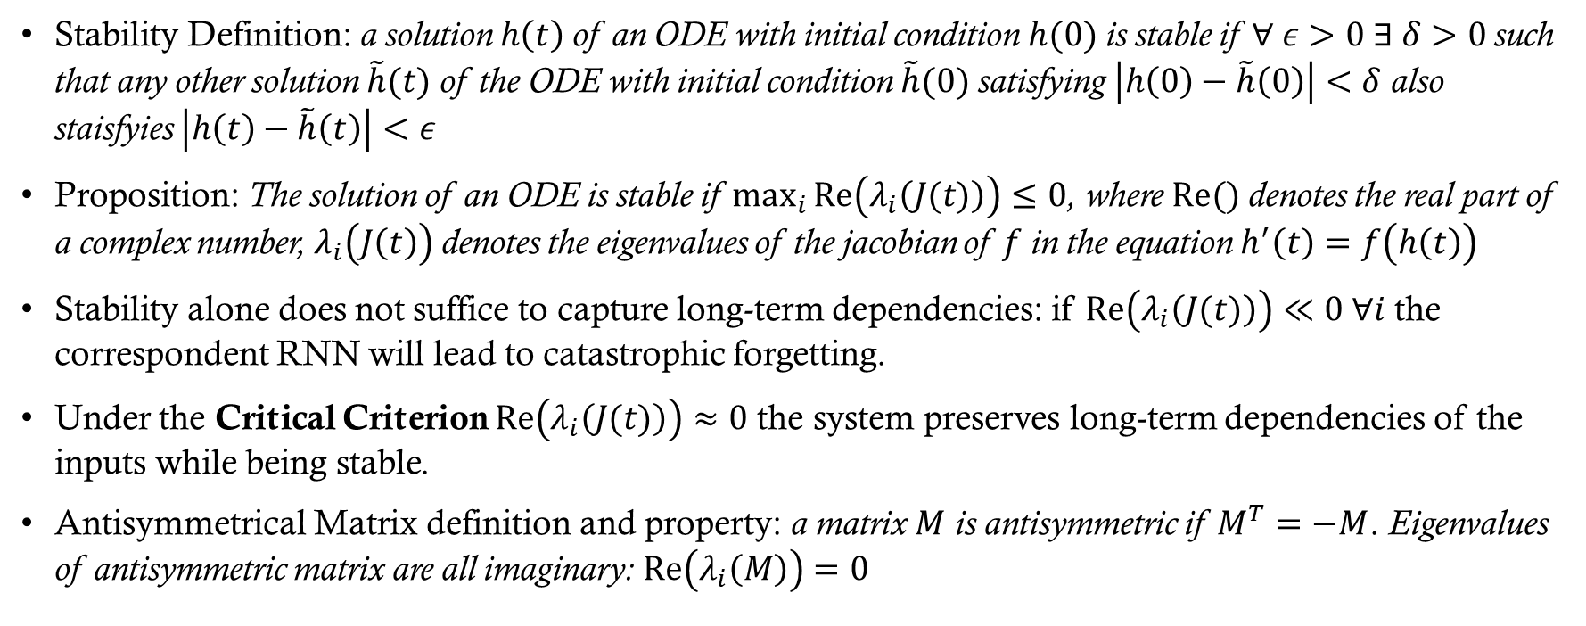
Mathematical pills
Stability Definition: a solution $h\left(t\right)$of an ODE with initial condition $h(0)$ is stable if $∀ ε>0 ∃ δ>0$such that any other solution $\tilde{h}(t)$ of the ODE with initial condition $\tilde{h}(0)$ satisfying $\left|h\left(0\right)−\tilde{h}\left(0\right)\right|<δ$ also staisfyies $\left|h\left(t\right)−\tilde{h}\left(t\right)\right|<ε$
Proposition: The solution of an ODE is stable if $\max_{i}{Re\left(λ_{i}\left(J(t)\right)\right)}≤0$, where $Re()$ denotes the real part of a complex number, $λ_{i}\left(J\left(t\right)\right)$ denotes the eigenvalues of the jacobian of $f$ in the equation $h^{′}\left(t\right)=f\left(h\left(t\right)\right)$
Stability alone does not suffice to capture long-term dependencies: if $Re\left(λ_{i}\left(J(t)\right)\right)≪0 ∀i$ the correspondent RNN will lead to catastrophic forgetting.
Under the Critical Criterion $Re\left(λ_{i}\left(J(t)\right)\right)≈0$ the system preserves long-term dependencies of the inputs while being stable.
Antisymmetrical Matrix definition and property: a matrix $M$ is antisymmetric if $M^{T}=−M$. Eigenvalues of antisymmetric matrix are all imaginary: $Re\left(λ_{i}\left(M\right)\right)=0$

Slide 5

Full model description
$$z_{t}=σ\left(\left(W_{h}−W_{h}^{T}−γ1\right)h_{t−1}+V_{z}x_{t}+b_{z}\right)$$
$$h_{t}=h_{t−1}+εz_{t}∗ \tanh\left(\left(W_{h}−W_{h}^{T}−γ1\right)h_{t−1}+V_{h}x_{t}+b_{h}\right)$$
$W_{h}−W_{h}^{T}$ is the antisymmetric weight matrix that make the critical criterion satisfied
$−γ1$ is required to make the discretized ode stable – a stable ode doesn’t necessary imply a stable discretized version
$z_{t}$ is the input gate and $∗$ is the hadamard product

Slide 6
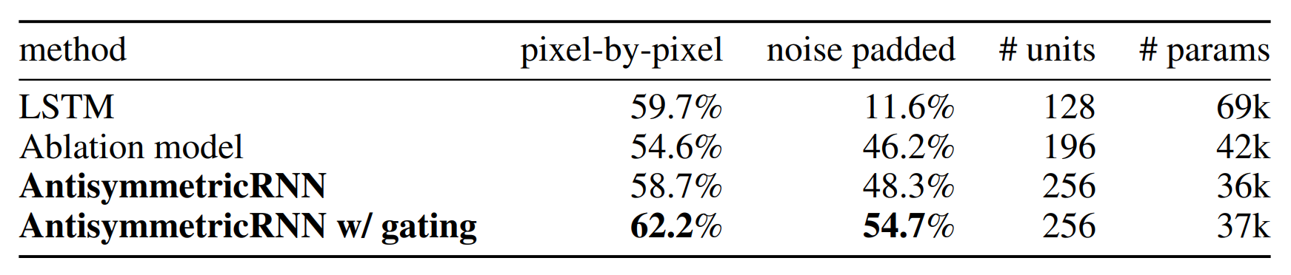
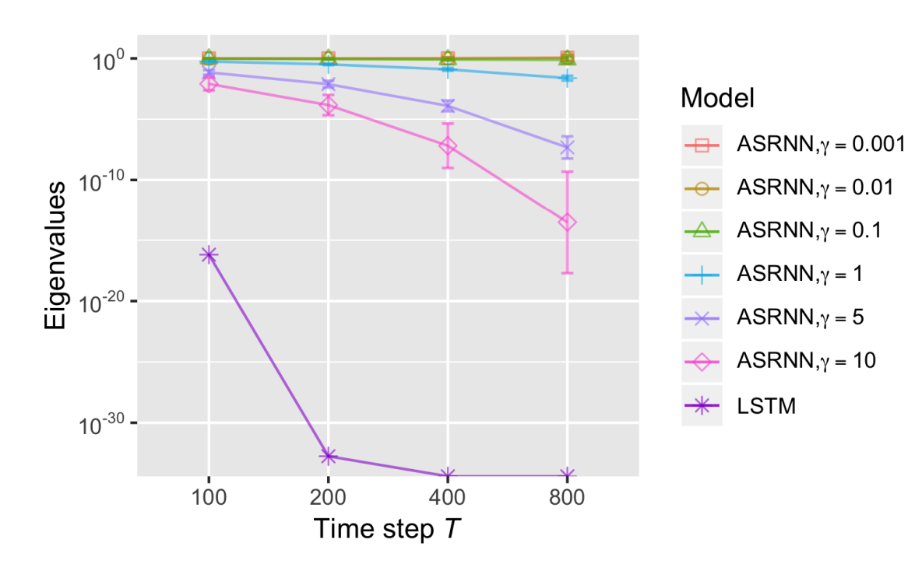

Experiment: NOISE PADDED CIFAR-10
Authors inputted each row of a CIFAR-10 image at every time step. After the first 32 time steps, they inputted independent standard Gaussian noise for the remaining time steps. The total number of time steps is set to $T=1000$. In other words, only the first 32 time steps of input contain salient information, all remaining 968 time steps are merely random noise. For a model to correctly classify an input image, it has to remember the information from a long time ago.
An additional set of experiments varying the length of noise padding was performed. In the graph we can visualizes the mean and standard deviation of the eigenvalues of the end-to-end Jacobian matrices. Unitary eigenvalues, i.e., mean close to 1 and standard deviation close to 0, indicate non-exploding and non-vanishing gradients

Slide 7
Conclusion
This research drew connections between RNNs and the ordinary differential equation theory
The model AntisymmetricRNN was proposed which is a discretization of ODEs that satisfy the critical criterion with competitive performance
Hopefully this work will inspire future research in both communities of RNN and ODE.

Slide 8

Thanks for your attention

