Slide 1

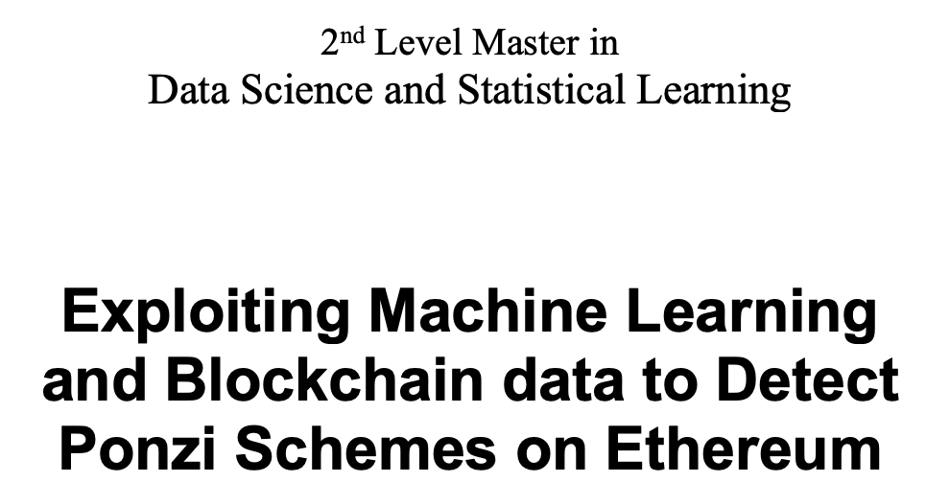
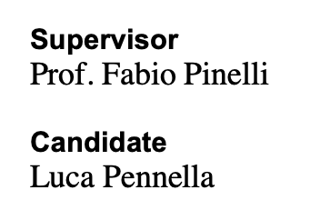

Slide 2
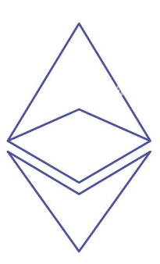


Main goals
The identification of Ponzi schemes (type of scam) on the Ethereum blockchain through Machine Learning.
The creation of publicly available dataset enriched with data related to the smart contract code.
The use of Explainable Machine Learning for the identification of the main features for the detection of Ponzi contracts.

Slide 3
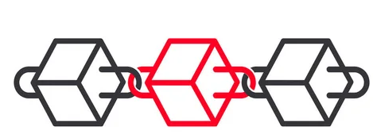

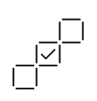

The blockchain
A Blockchain is a shared, immutable ledger that facilitates the process of recording transactions and tracking assets in a network.
A blockchain consists of immutable records organized in blocks, no participant (nodes) can modify or tamper with a transaction after it is recorded.
Transactions are blocked together in an irreversible chain: a blockchain.
Each block carries information from the previous block and transactions are public throughout the network, creating a secure and trustworthy structure.

Slide 4
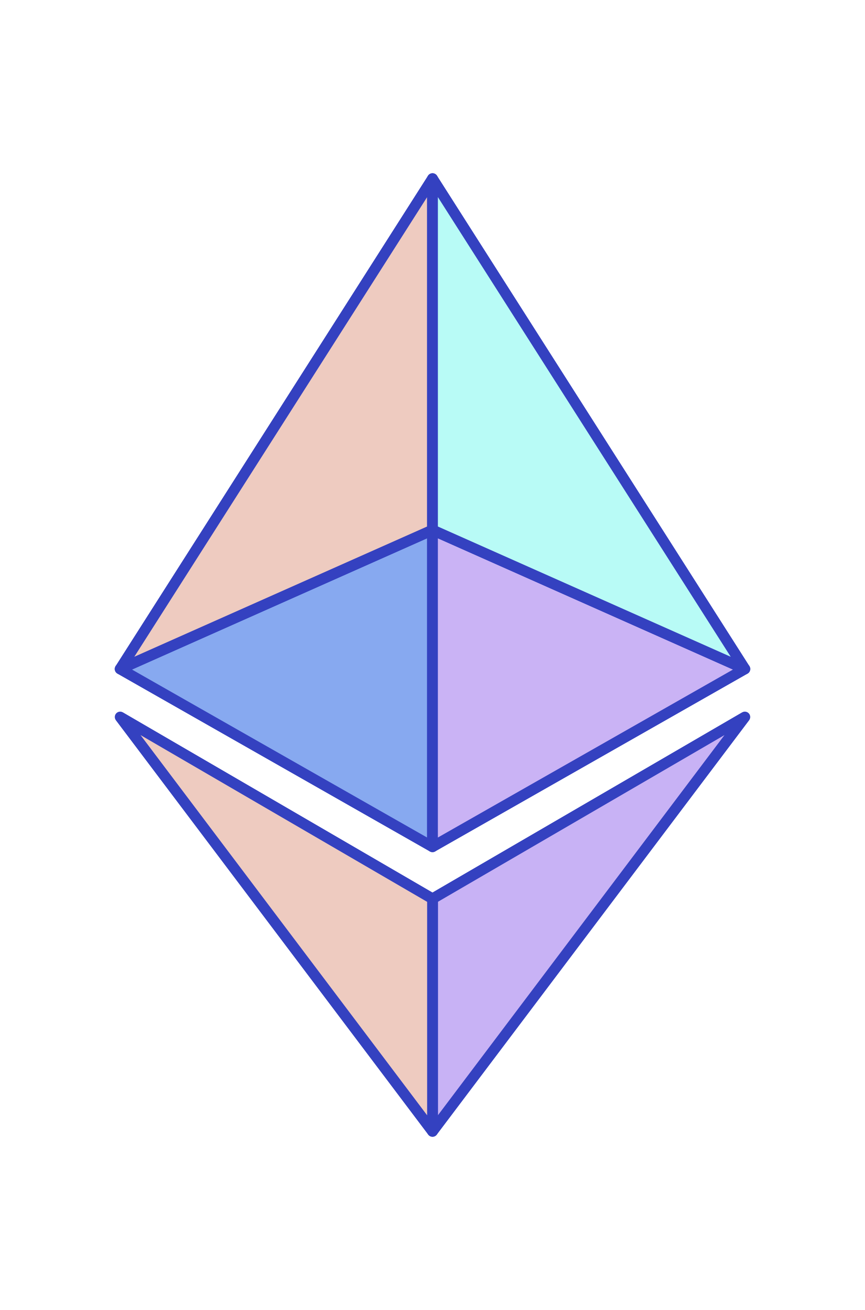
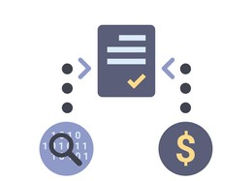

Ethereum: next-generation blockchain
Ethereum is an open-source public blockchain platform with a computer embedded in it.
A Smart Contract consist of software built on the Ethereum with the goal of automating and decentralizing any kind of application.
Consensus with Proof-of-stake leading to better energy efficiency, lower hardware requirements and greater decentralization.

Slide 5


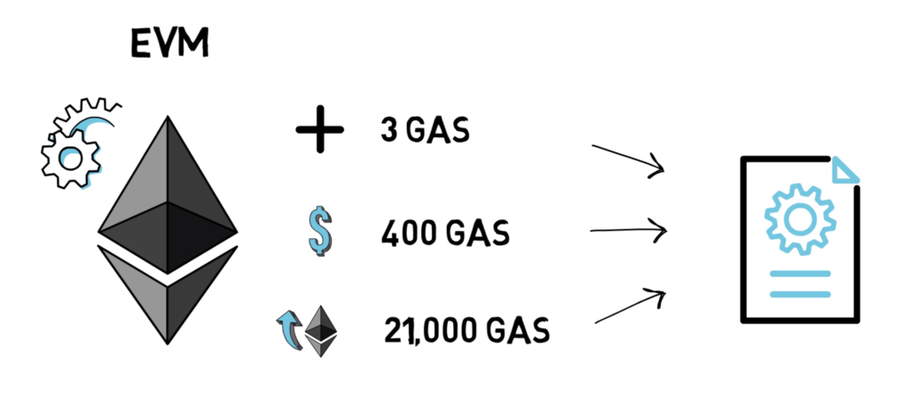
Smart contract journey
The smart contracts are written in the Solidity language.
To be executed, the contract must be translated into machine language, in our case into bytecode.
Bytecode is a sequence of commands, called an Opcode. These instructions describe the step-by-step operations performed by the EVM (the computer embedded in Ethereum).

Slide 6
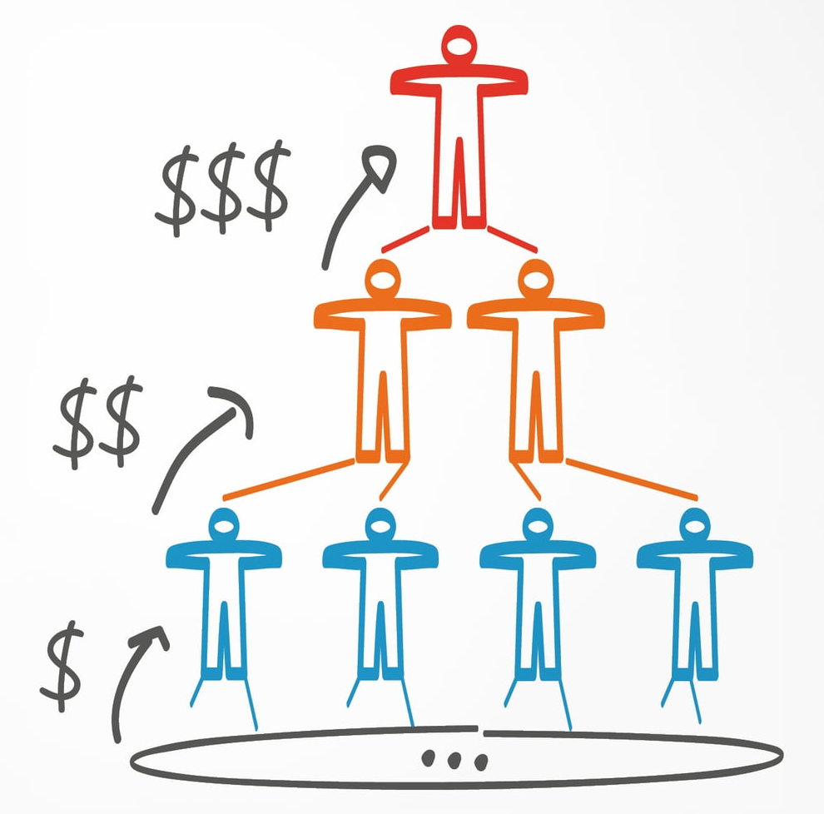
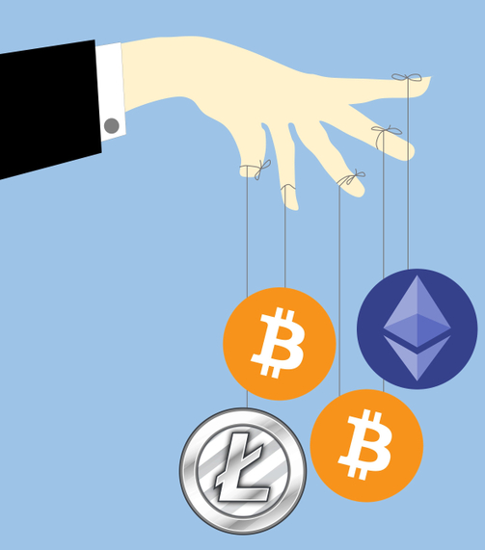
From Ponzi Schemes to Smart Ponzi
Ponzi schemes are classic frauds that promise high-yield investment return. The starter of the scheme generates returns for existing investors through revenue paid by new investors.
Smart contracts creates new opportunities for scammers, including the creation of Ponzi schemes, thanks to several attractive features:
Creators can stay anonymous
smart contracts are unmodifiable and unstoppable
Investors may gain a false sense of trustworthiness

Slide 7


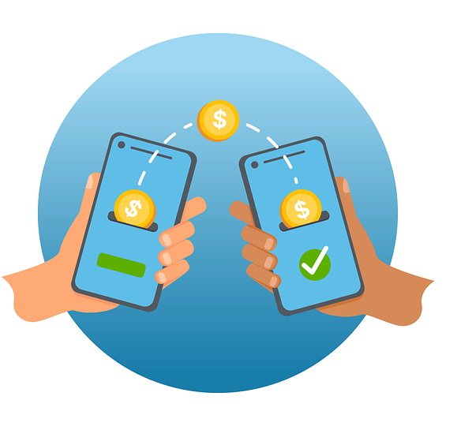
Dataset construction
The dataset is made by 4422 smart contracts, where 3749 (85%) are labelled as not-Ponzi and 673 (15%) as Ponzi.
The main contribution at the dataset level is the enrichment with data of the code (opcode) linked to the smart contract that allow the improvement of our classifier.
Dataset is made by two types of features:
Code Features
Account Features

Slide 8
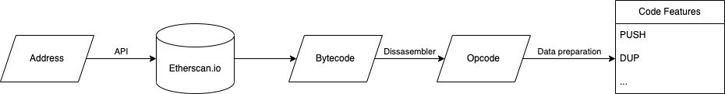
Code Features
The frequency (absolute and relative) of each type of opcode for each smart contract is calculated and considered as a features.
With this procedure we obtained 77 different features, each feature corresponds to the frequency of a different Opcode within the different contracts analyzed.

Slide 9
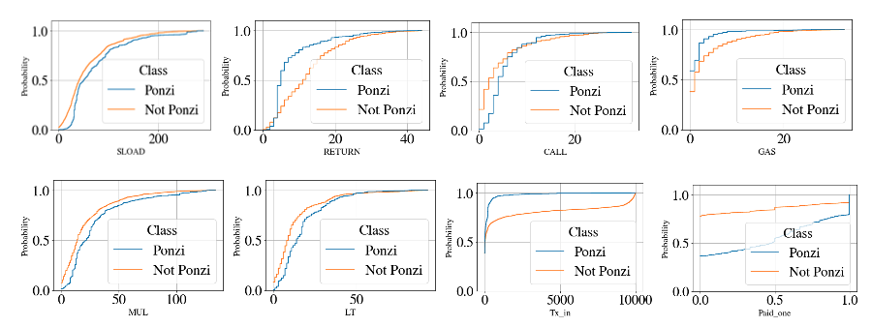
Qualitative analysis of the features
The two populations have a different distribution for many opcodes, among the account variables the ones with differences seem to be Tx_in and Paid_one.
We can hypothesize that these characteristics provide the classifier with a relevant contribution to discriminate between the two classes.

Slide 10

The dataset structure of the experiments performed
We use 7 different dataset for the project:
paper, features used in the work of Chain et al.¹ that use only 14 account variables.
full_dataset, contains the features used by Pinelli and Galletta² which have developed additional variables related to transactions (28 features).
new_dateset, enriched with all the variables related to the code (28 account features + 77 code features).
only_opcodes, a dataset with only opcodes.
¹Chen, Weili, et al. ”Exploiting blockchain data to detect smart ponzi schemes on Ethereum” IEEE Acces 7 (2019)
²Galletta, Letterio, and Fabio Pinelli.”Sharpening Ponzi Schemes Detection on Ethereum with Machine Learning” arXiv preprint (2023)

Slide 11
The dataset structure of the experiments performed
new_dataset_best_features, the best set of variables on new_dataset defined by feature selection process (40 variables between account and code features).
weighted_opcode, which considers the proportion of each opcode within the contract and not just the frequency plus account features.
weighted_opcode_best_features, the best set of variables on weighted_opcode defined by feature selection process (35 variables between account and code features).

Slide 12
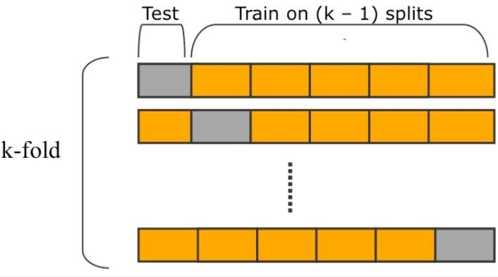
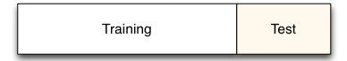
Data Analytics Pipeline
Dataset Construction.
We split the data into an 80% training set and a 20% test set stratified on the target variable.
The cross-validation splits the training data into 5 folds. Then, the model is trained and tested 5 times, varying the fold used as a validation set.

Slide 13
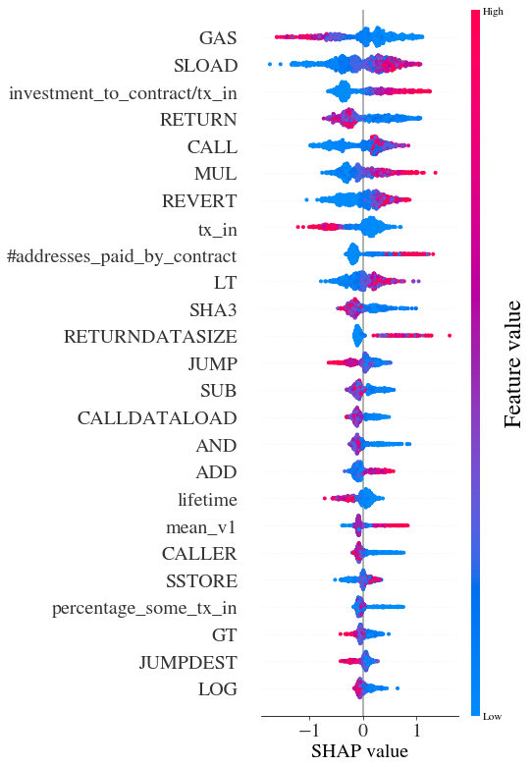

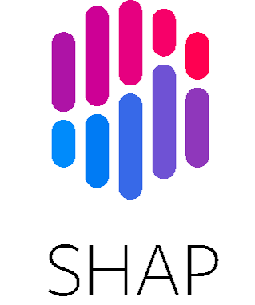
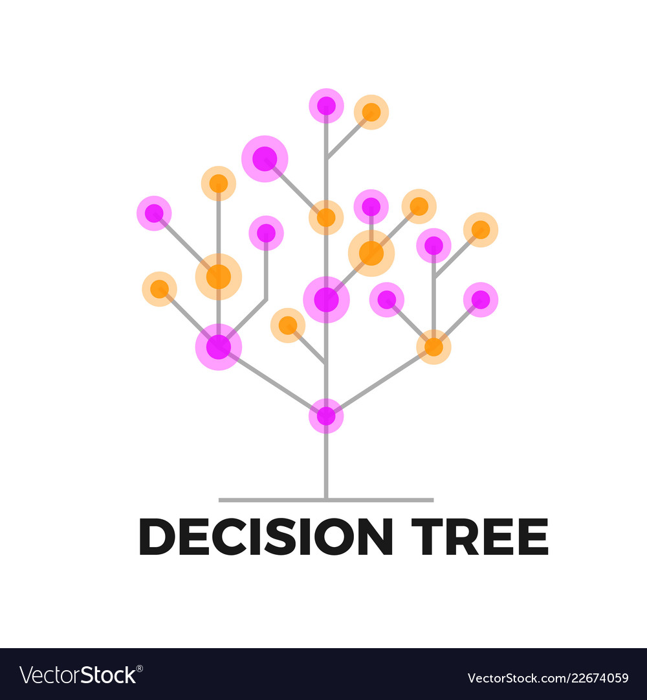
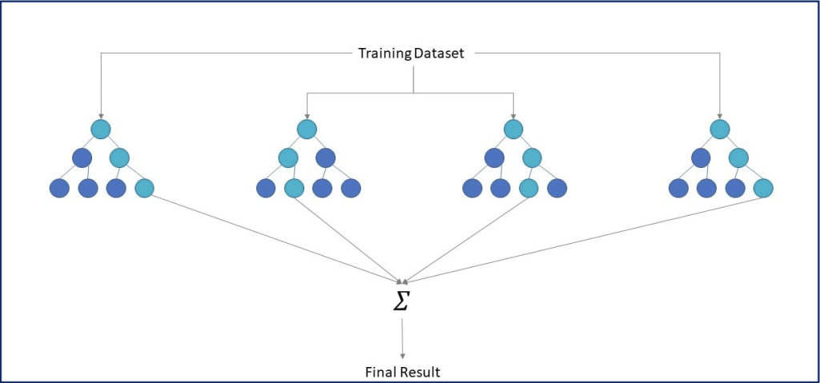
Data Analytics Pipeline
Once we have selected the best values for the hyper-parameters for each data set and classifier, we compute the standard evaluation metric.
We adopt the eXplainable Artificial Intelligence library SHAP to visually investigate how the most important features impact the classification process.

Slide 14
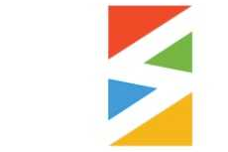
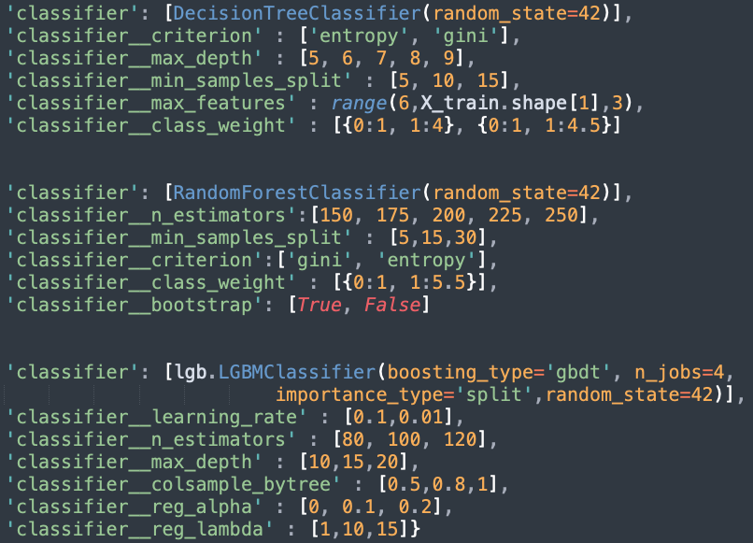
Algorithms used
We used Tree-Based Models to solve the classification problem:
Decision Tree
Random Forest
LightGBM
We used the grid search technique to get the best hyper-parameters:

Slide 15
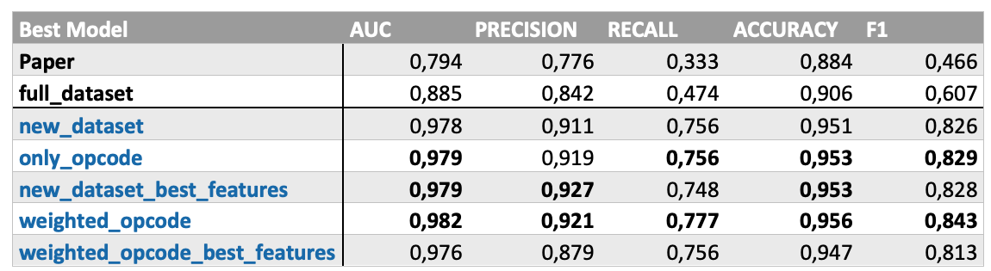
Result
We used Tree-Based Models to solve the classification problem:
We can see an important improvement in all evaluation metrics. As for the methods used, the performances are quite similar.

Slide 16
XAI
GAS
SLOAD
investment_to_contract/tx_in
RETURN
CALL
MUL
REVERT
tx_in
#addresses_paid_by_contract
LT
SHA3
RETURNDATASIZE
JUMP
SUB
CALLDATALOAD
AND
ADD
lifetime
mean_v1
CALLER
SSTORE
Percentage_some_tx_in
GT JUMPDEST
LOG
Through SHAP it is possible to detect the importance of the features, as we can see in the image both the account variables and those of the code are among the twenty most relevant.
The variables implemented in our project are highlighted in blue, those of Pinelli and Galletta in green and the remaining ones of the starting paper of Chain et al.

Slide 17
Conclusion
Achieved results
We have highlighted how the use of additional features combined with complex classification algorithms has improved performance.
The explanation techniques allow us to make the work much more understandable even to external listeners.
Further improvements
Extension of the dataset with additional types of scams.
Creation of an ensemble of models with the aim of further improving the performances.
Improved problem explainability using additional Explainable Artificial Intelligence techniques. Among those identified: dlime, Anchors, PDP and Ice.

Slide 18
Paper Improvements
Papers identified for new smart contract
Heterogeneous Feature Augmentation for Ponzi Detection in Ethereum (191 Ponzi Contract)
Securing the Ethereum from Smart Ponzi Schemes: Identification Using Static Features(link).
Obtained DS with 7963 Smart Contract, 935 Ponzi (11,8%)
PDP for the most relevant variables identified by SHAP

Slide 19
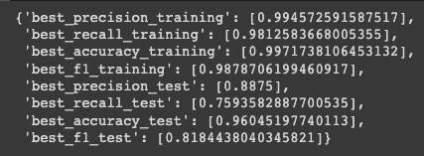
Paper Improvements – Result
New DS

Slide 20

Thank you very much for your attention!

