Slide 1
EventStorming
A Collaborative Approach to Understanding Complex Business Domains
University of Bologna - Campus of Cesena
Software Engineering @ Digital Transformation Management

Slide 2
Speakers
Luca Samore'
Cesena
MSc Student in CSE
University of Bologna
Lucia Castellucci
Milan
MSc Student in CSE
University of Bologna
Software Engineer
@ Iron Lynx Motorsport Lab
luca.samore@studio.unibo.it
linkedin.com/in/luca-samore
Backend Software Engineer
@ Generali Italia
lucia.castellucci2@studio.unibo.it
linkedin.com/in/lucia-castellucci

Slide 3
Domain Driven Design (recap)
Domain-Driven Design (DDD) is a structured software design process that places the business domain at the center of the design process, ensuring the software model reflects the real-world problem space faithfully.
2003 Eric Evans publishes “Domain-Driven Design: Tackling Complexity in the Heart of Software”
(the "Blue Book"), formally introducing the DDD vocabulary, strategic patterns, and tactical building blocks.
2013 Vaughn Vernon publishes “Implementing Domain-Driven Design”, making DDD more implementation-focused. Alberto Brandolini introduces Event Storming as a collaborative DDD discovery technique.
2014–present DDD heavily influences microservices architecture. Bounded Contexts, CQRS, and Domain Events become central to modern distributed system design.
1

Slide 4
Complexity is our enemy
“Complexity is anything related to the structure of a software system that makes it hard to understand and modify the system.” – John Ousterhout, A philosophy of software design.
In large software systems, the primary source of complexity is not the technology, but the domain itself.
There are two kinds of complexity in software:
Essential complexity, which is inherent to the business problem. We cannot completely eliminate it; we can only manage it.
Accidental complexity, which is introduced by poor design choices, misunderstood requirements, and broken communication. This must be minimized.
2

Slide 5
Problems with unmanaged complexity
Communication gap Developers and domain experts speak different languages. Requirements are mistranslated into code, and misalignments accumulate silently over time.
Anemic Domain Model Business logic is scattered across services, utility classes, and procedural scripts. No central model embodies domain knowledge; objects become mere data containers.
Big Ball of Mud No clear structural boundaries: every part of the system depends on every other. Any change carries unpredictable ripple effects, making evolution expensive and risky.
Implicit knowledge Critical business rules live only in domain experts' minds or buried in opaque code. There is no shared, explicit representation of the domain's invariants and policies.
3

Slide 6
Strategic vs. Tactical Design
DDD addresses domain complexity through two complementary layers: Strategic Design and Tactical Design.
Strategic Design — defines the large-scale structure through three key tools:
Bounded Context An explicit boundary within which a model is valid. Prevents concepts from different sub-domains from contaminating one another.
Ubiquitous Language A shared, precise vocabulary co-created by developers and domain experts; used consistently in code, conversation, and documentation. Eliminates translation errors.
Context Map A visual diagram of all bounded contexts and their integration relationships (e.g. Customer/Supplier, Shared Kernel, Anti-Corruption Layer).
Tactical Design — the building blocks inside each bounded context:
Entities & Value Objects Distinguish identity-based objects (Entity) from value-based ones (Value Object) for precise domain modelling.
Aggregates Clusters of related objects treated as a single consistency unit, controlled by an Aggregate Root that enforces all invariants.
Domain Events First-class, immutable representations of significant business occurrences; the foundation of Event Storming and event-driven architectures.
4

Slide 7
Questions
Should you trust the domain experts?
How do we spot Bounded Contexts?
5

Slide 8
EventStorming
EventStorming is a family of collaborative modeling workshop formats that allows you to explore complex domains effectively and engagingly — by bringing domain experts, developers, and stakeholders together around a shared model.
It was introduced by Alberto Brandolini in 2013 and has evolved into three distinct, widely adopted variants:
Big Picture EventStorming — explore an entire business line: discover events, people, systems, pain points, and the most critical bottlenecks.
Process Modeling EventStorming — model a specific end-to-end business process in detail: commands, policies, and read models.
Software Design EventStorming — design the software model: identify Aggregates and Bounded Contexts aligned with the domain.
Each format can be used independently or combined into a progressive flow — starting broad and zooming into areas of highest complexity.
6

Slide 9
History
2013 — Alberto Brandolini publishes "Introducing Event Storming" on his blog, presenting a collaborative workshop for domain modeling based on Domain Events.
The format spreads organically through the DDD community. Practitioners adapt it to different contexts, scales, and organizations, gradually revealing its versatility.
Over time, three distinct variants emerge — each suited to a different granularity and purpose: Big Picture, Process Modeling, and Software Design.
2019 — Brandolini publishes the book "Introducing EventStorming", formalising the approach, its variants, and the facilitation techniques behind them.
Today EventStorming is a core technique in the DDD community, widely adopted in organisations that need to align business understanding with software design.
7

Slide 10
(Academic) Case Study: Nucleo
Context: The Italian Fascicolo Sanitario Elettronico (FSE), conceived to centralize citizens health data, operates in practice as a static archive: appointments are scattered across platforms, sharing documents is cumbersome, and managing family health records requires navigating isolated individual accounts.
Nucleo addresses these shortcomings with three core features:
Unified Health Records — unified platform for uploading, reading and downloading medical records
Appointment Booking — streamlined booking system replacing fragmented regional platforms
Family Delegation — manage health data for the entire family from a single account
GitHub Repo: https://github.com/ToRenameTeam/Nucleo
8

Slide 11
Business Requirements
ID | Requirement | Description
BR1 | Reduction of Administrative Fragmentation | Centralize healthcare data management and booking processes
BR2 | Operational Efficiency Improvement | Improve efficiency in booking and health documentation management
BR3 | Increased User Satisfaction | Increase satisfaction of patients and doctors through simplification
BR4 | Family Data Centralization | Centralize health data of all family members in a single platform
BR5 | Administrative Workload Reduction | Reduce administrative workload for patients and healthcare operators
9

Slide 12
Functional Requirements: Users (Patients and Doctors)
ID | Requirement | Description
F1 | Authentication | Users authenticate through credentials: email and password
F2 | Dual Doctor-Patient Profiles | A user can access the system both as a doctor and as a patient
F3 | Active Delegation Management | A patient can delegate access to their health data to other authorized users (e.g. family members, caregivers)
F4 | Passive Delegation Management | A patient can access health data of users who granted them a delegation
10

Slide 13
Functional Requirements: Patients — Appointments
ID | Requirement | Description
F5 | Manual Appointment Booking | Patients can book appointments through manual service search
F6 | Prescription-Based Booking | Patients can book appointments using an existing medical prescription
F7 | Appointment Modification | Patients can modify details of existing appointments
F8 | Appointment Cancellation | Patients can cancel existing appointments
F9 | Appointment List View | Booked appointments are displayed in an ordered list
F10 | Appointment Calendar View | Booked appointments are displayed in calendar format
11

Slide 14
Functional Requirements: Patients — Documentation
ID | Requirement | Description
F11 | Reading Doctor Documents | Patients can view documents uploaded by their doctors
F12 | Uploading Personal Documents | Patients can independently upload personal health documents
F13 | Deleting Personal Documents | Patients can delete documents they personally uploaded
12

Slide 15
Functional Requirements: Doctors
ID | Requirement | Description
F14 | Availability Entry | Doctors can enter their time availability for appointments
F15 | Booked Appointment Management | Doctors can view and manage appointments booked by patients
F16 | Document Upload | Doctors can upload documents (prescriptions, reports) after completed appointments
F17 | Medical Record View | Doctors can view the complete patient medical record in read-only mode
F18 | Drug Prescription | Doctors can issue pharmaceutical prescriptions for patients
F19 | Specialist Visit Prescription | Doctors can prescribe specialist visits for patients
13

Slide 16
Functional Requirements: System
ID | Requirement | Description
F20 | Delegation Notifications | Patients are notified when a delegation is created, accepted, or rejected
F21 | Appointment Change Notifications | Patients are notified when a doctor changes an appointment date or time
F22 | Prescription Notifications | Patients are notified when a doctor creates a prescription or medication
F23 | Doctor Booking Notifications | Doctors are notified when a patient books, modifies, or cancels an appointment
F24 | Document Analysis | System extracts key data and information from user-uploaded documents
14

Slide 17
Main Recipes
Big Picture
EventStorming
Process Modelling
EventStorming
Software Design
EventStorming
15

Slide 18
Big Picture EventStorming
Big Picture EventStorming is a large-scale workshop aiming to discover the intricacies of an entire business line.
Structure is incremental. Each step adds a new layer of information: a raw timeline of events, then people and systems, then a validated narrative. The model starts thin and grows richer as more perspectives enter the room.
The main purpose is to maximize learning across silos. Participants from different departments — often working in silos, rarely talking to each other — build a shared model. Inconsistencies surface automatically. Problems that were invisible become visible.
Participants: 15–30 people — domain experts, developers, UX designers, managers.
Outcome: a visible process, consensus around the core problem, and early hints at system boundaries (Bounded Contexts).
16

Slide 19
Notation
Big Picture EventStorming uses a minimal, colour-coded notation based on sticky notes:
■ Domain Events (orange) — Something meaningful that happened in the system, phrased as a verb in the past tense (e.g., Order Placed, Payment Received). The backbone of the entire model.
■ People (small yellow) — A person, role, or team involved in the flow. Definition is intentionally loose.
■ Systems (large pink) — Software components, external services, offices, third-party entities. Everything that is not a human.
■ Hotspots (magenta, placed crooked) — A signal: something here is unclear, contested, or unknown. Placed deliberately to acknowledge a problem without getting stuck on it.
Notation is intentionally minimal. The simplicity removes barriers: anyone in the room can participate without learning a formal modelling language.
17

Slide 20
Preparation
A Big Picture session requires three key ingredients before the first sticky note goes up:
1. Invite the right people. 15–30 participants — domain experts and explorers, ideally a mix of business, IT, and UX. Ensure the group can both answer and ask key questions. Avoid inviting only managers or only developers.
2. Provide an unlimited modeling surface. A plotter paper roll on a 10–12 meters straight surface. Most whiteboards are not wide enough. Bring sticky notes in all required colours and enough black markers for everyone.
3. Model a whole business line. Big Picture does not focus on a specific area or team. The scope is the entire end-to-end flow, from the first customer interaction to the last system event.
In Nucleo, the Big Picture session covered all three core features of the platform: FSE Records, Appointment Booking, and Family Delegation.
18

Slide 21
Chaotic Exploration — Appointment Booking
19

Slide 22
Chaotic Exploration
20

Slide 23
Enforce the Timeline — Appointment Booking
21

Slide 24
Enforce the Timeline
22

Slide 25
Pain Points — Appointment Booking
23

Slide 26
Pain Points
24

Slide 27
Pivotal Points — Appointment Booking
25

Slide 28
Pivotal Points
26

Slide 29
Process Modelling EventStorming
Process Modeling EventStorming is used for discovering the intricacies of complex business processes and designing new ones. The team works collaboratively against a shared opponent: the complexity of the process itself.
Scope: a single end-to-end process with a clear starting point and goal.
Team: 4–8 interdisciplinary people.
New notation elements:
■ Commands (blue) — an intent to change state, phrased as verb + noun (e.g., Place Order).
■ Policies (lilac) — the business rule connecting an Event to a Command: whenever X, then always Y.
■ Read Models (green) — the information a person needs to make a decision before issuing a command.
Grammar: Event → Policy → Command → System → Event (repeating pattern enforced throughout the session).
27

Slide 30
Commands, People & Systems — Appointment Booking
28

Slide 31
Commands & People/Systems
29

Slide 32
Policies — Appointment Booking
30

Slide 33
Policies
31

Slide 34
Read Models — Appointment Booking
32

Slide 35
Read Models
33

Slide 36
Software Design EventStorming
Software Design EventStorming aims to design software models to support complex business processes, with Domain-Driven Design in mind. It extends the Process Modeling game with two new rules.
From Systems to Aggregates. Pink System sticky notes are replaced by yellow Aggregate sticky notes when the team decides to design and own a component. This means: no longer a black box — we take responsibility for it.
Defining Aggregates correctly. The typical mistake is to start by naming Aggregates (e.g., Order, Customer) and fill them with commands and events. The right approach is the opposite: let the behaviour define the Aggregate. Find clusters of coherent commands and events; let the name emerge from that.
Bounded Contexts. A self-contained part of the system with its own language, model, and team. Boundaries reveal themselves through linguistic mismatches: different departments using different words for the same concept, or the same word for different concepts.
Outcome: Aggregates shaped by behavior, Bounded Contexts highlighted, and the foundation for smart system decomposition.
34

Slide 37
Aggregates — Appointment Booking
35

Slide 38
Aggregates
36

Slide 39
Bounded Contexts — Appointment Booking
37

Slide 40
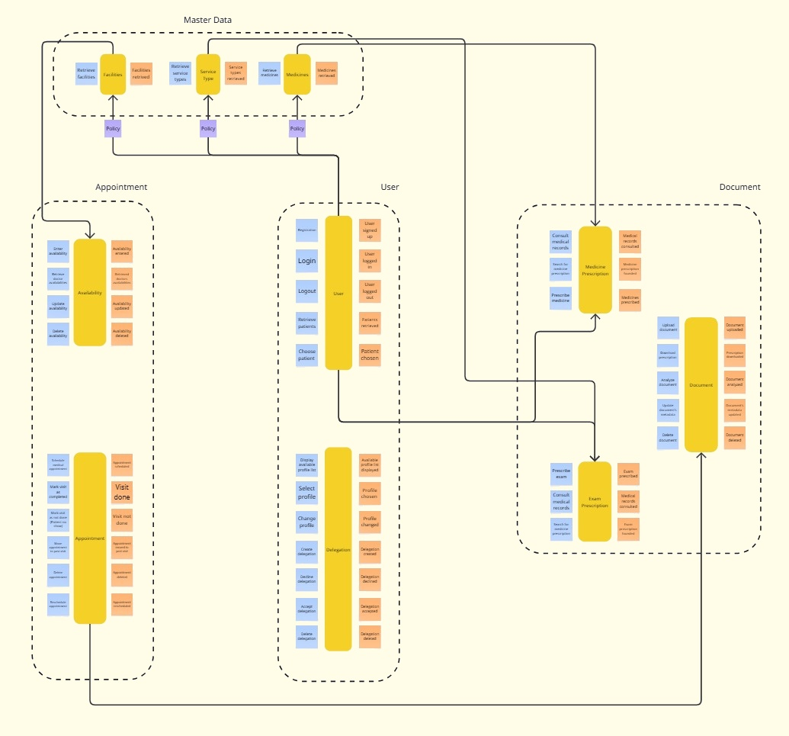
Bounded Contexts
38

Slide 41
Nucleo Final Architecture
39

Slide 42
References
- Evans, E. (2003). Domain-Driven Design: Tackling Complexity in the Heart of Software. Addison-Wesley.
- Cunningham, W., & Beck, K. (1989). Class-Responsibility-Collaborator (CRC) Cards. OOPSLA ’89 Workshop.
- Beck, K. (1996). Smalltalk Best Practice Patterns. Prentice Hall.
- Fowler, M. (1999). Refactoring: Improving the Design of Existing Code (1st ed.). Addison-Wesley.
- Fowler, M. (2002). Patterns of Enterprise Application Architecture. Addison-Wesley.
- Vernon, V. (2013). Implementing Domain-Driven Design. Addison-Wesley.
- Brandolini, A. (2013). EventStorming (workshop format). https://www.eventstorming.com
- Foote, B., & Yoder, J. (1997). Big Ball of Mud. PLoP ’97. Monticello, Illinois.
- Conway, M. E. (1968). How do committees invent? Datamation, 14(4), 28–31.
- Brooks, F. P. (1987). No Silver Bullet: Essence and Accidents of Software Engineering. IEEE Computer, 20(4), 10–19.
- Fowler, M. (2003). Anemic Domain Model. martinfowler.com. https://martinfowler.com/bliki/AnemicDomainModel.html
- Young, G. (2010). CQRS Documents. https://cqrs.files.wordpress.com/2010/11/cqrs_documents.pdf
40

Slide 43
Thank You!
Thank you all for your attention
and to the Professor Ciatto for this wonderful opportunity.
— Lucia & Luca

