Slide 1
Ethical Considerations

Slide 2
Ethics – Risks and Concerns
Participation in a research study involves multiple agreements between the participant and the researcher. The participant agrees to perform certain tasks as needed by the experiment and the experimenter frequently agrees to provide some incentive or compensation to the participant. Perhaps more importantly, experimenters agree to conduct responsible research that protects participants' rights, health, privacy, and safety.

Slide 3
Ethics – Key Definitions
Key definitions:
data controller: a party who decides about the contents and use of personal data
personal data: any information relating to an identified or identifiable individual
data subject: the individual about whom the personal data concerns

Slide 4
Ethics - Principles
PRINCIPLE | DESCRIPTION
1. Collection Limitation | There should be limitations on the collection of data, it should only be collected in legal and fair means and, where appropriate, with the knowledge and consent of the data subject.
2. Data Quality | Personal data should be relevant to the purposes for which it was collected and used, and it should be accurate, complete, and up-to-date.
3. Purpose Specification | The purposes for which personal data is collected should be stated at the time it is collected and subsequent use should be limited to those purposes.
4. Use Limitation | Personal data should not be disclosed or used for purposes other than those specified unless it is with the consent of the data subject or under the authority of law.

Slide 5
Ethics - Principles
PRINCIPLE | DESCRIPTION
5. Security Safeguards | Personal data should be protected by reasonable security safeguards against unauthorized access, use, or disclosure.
6. Openness | There should be openness about the practices and policies concerning personal data. Means should be readily available to establish the existence and nature of personal data, the purpose of their use, and the identity of the data controller.
7. Individual Participation | An individual should have the right to find out if a data controller has personal information about him or her and be able to challenge data relating to him or her including having the data erased, corrected, completed or modified.
8. Accountability | The data controller should be accountable for adhering to these principles.

Slide 6
Ethics - Consent
Potential Risks:
Failure to obtain consent for the collection and use of personal information is unethical and may lead to mistrust from the research participants and refusal to participate in future studies. Failure to obtain consent may also be counter to laws or regulations and could lead to legal liabilities.
Questions to Consider:
Do you periodically review your consent procedures and forms?
Do you document any cases where consent was not given by a research participant?
Have you established informed consent procedures for cases where data will be shared with collaborators?
Do you take into account the sensitivity of the information when determining how to seek consent? (e.g., Collecting particularly sensitive information may require that explicit, written consent statements be signed and witnessed.)

Slide 7
Ethics - Limiting Collection
Principle:
Researchers should limit the collection of personal information to that which is absolutely necessary for the research being conducted.
Potential Risks:
Failure to limit the collection of personal information increases the amount of data to be processed and unnecessarily increases privacy risks. Collecting personal information that is unrelated to the stated purposes of the research could lead to mistrust by the participants.
Questions to Consider:
Is it necessary to collect any personal information, or could the research proceed with anonymous data?
If anonymous collection is intended, what measures are in place to ensure the anonymity of participants? (e.g., This may be especially important in online data collection where Internet traffic logs might be used to link personal data to Internet host numbers, which can often be linked to specific individuals.)
If personal information is collected, it is restricted to data that the participant has consented to?
Are participants given an option to restrict the collection of some personal data? (e.g., Can participants opt-out of some portions of the research?)
Do you regularly review your collection practices to ensure that data that was collected was truly necessary?

Slide 8
Ethics - Identifying Purposes
Principle:
The purpose for which personal information is collected shall be determined before it is collected.
Potential Risks:
Collecting more information than is needed could expose the researcher and data subject to unnecessary risks. Collecting unintended information could also add to the costs and complexity of the research. Failure to explain to research subjects the purposes for collecting personal information could lead to mistrust and ill-will and may be unethical.
Questions to Consider:
Are the reasons for collecting personal information considered by the researchers and explained to the research participants before any data collection is done?
Are the purposes for collecting personal information reviewed and updated regularly? (e.g., Avoiding using survey questions simple because “we have always collected that information”.)
Are steps in place to ensure that research participants understand the personal information that is collected and the intended purposes? (e.g., Ensuring that consent forms are understandable and that questions are answered fully before data collection begins.)
Is a procedure in place to seek informed consent from research participants before any personal information is used for purposes that were not disclosed at the time of collection? (e.g., Having contact information so that participants can be reached in the future.)

Slide 9
Ethics - Limiting Use, Disclosure, and Retention
Principle:
Researchers will not use or disclose personal information for purposes other than those for which it was intended, except with the informed consent of the research participant. Personal information shall only be retained for the minimum time necessary to conduct the research, and it will then be destroyed or rendered anonymous.
Potential Risks:
Using personal information for purposes other than the original research agreed to by the participants is unethical and could lead to legal repercussions. Retaining personal information for unduly long periods increases the risk of improper use and disclosure.
Questions to Consider:
Is personal information only used for the purposes it was collected?
Is personal information only disclosed where it is necessary to conduct the research, and consent for this disclosure has been obtained from the participants?
Do you have policy and technical measures in place to limit use and disclosure to the predetermined purposes?
Have you established data retention times and methods before data are collected?
Do you ensure that personal information is properly destroyed or rendered anonymous when the data retention time has elapsed?
Do you have measures in place to ensure that data thought to be rendered anonymous cannot be tied to an individual now or in the future?

Slide 10
Ethics - Safeguards
Principle:
Personal information should be protected by security measures that are appropriate for the sensitivity of the information.
Potential Risks:
Without appropriate security measures, unauthorized people could access the personal information and possibly misuse or disclose it. If the information is sensitive, it could cause significant harm to the participants and damage the reputation for the researcher.
Questions to Consider:
Is the research environment appropriate for handling personal information? (e.g., Does the physical setup and protocol allow the researcher or others to observe personal information as it is recorded, such as “shoulder surfing” when participants are in a study?)
Do you have facilities to securely store personal information?
Do you use encryption or other digital secure storage mechanisms when appropriate?
Do you regularly audit and evaluate your security procedures?
Are all people involved with the project aware of the safeguards that are in place?
Do you have a documented policy for access to personal information and restrict access to authorized personnel?
Does each person with authority to access personal information have their own identifier and key (e.g., login and password) to facilitate monitoring?
Are the access controls in place appropriate for the sensitivity of the information?
If data records are stored on computers, are appropriate security and intrusion detection mechanisms in place?

Slide 11
Ethics - Openness
Principle:
Information about the policies and practices related to the handling of personal information should be readily available to research participants and other stakeholders.
Potential Risks:
Not making information about policies and practices known to others can lead to a failure to develop trust, and may prevent potential participants from giving informed consent.
Questions to Consider:
Are you open about your policies and practices regarding the handling of personal information?
Do you make it clear what types of information are collected and
stored?
Do you make it easy for participants and others to learn about your policies and practices?

Slide 12
Ethics - Challenging Compliance
Principle:
A participant or other stakeholder should be able to address a challenge concerning the handling of personal information, and that challenge should be responded to effectively.
Potential Risks:
Without an effective challenge and response mechanism, interested parties will not be able to assess your policies and practices. Failure to provide such mechanisms could lead to a lack of trust and confidence in the researchers.
Questions to Consider:
Do you have a simple and accessible means for people to communicate questions and concerns?
Do you have mechanisms in place to ensure fair, accurate, and timely responses to challenges?
Do you regularly evaluate any challenges and responses that do occur?

Slide 13
Ethics - Accountability
Principle:
A researcher is responsible for the personal information under their control and, if necessary, shall designate a person or persons to establish and maintain privacy principles and practices.
Potential Risks:
Unclear accountability could lead to a lack of control of the information. Failing to have an accountable person will make it difficult to review practices and deal with any problems.
Questions to Consider:
Do you regularly review your privacy policies and practices,
including having discussions with any staff or collaborators?
Do you have written policies and procedures in place for handling personal information?
Are you and your staff trained to handle personal information properly?
Have you developed a privacy monitoring system?
Have you clearly articulated the responsibilities of each individual for privacy protection?
Is the handling of personal information included in the performance evaluation of staff and research projects?

Slide 14
Ethics – Informed Consent
The notion of informed consent has two parts. “Informed” means that study participants must understand the reason for conducting the study, the procedures that are involved, potential risks, and how they can get more information about the study. Without this information, participants do not have the information necessary to make a truly meaningful decision as to whether or not they wish to participate.
If potential participants are not told that the use of a specific virtual-reality environment can occasionally cause nausea, particularly sensitive individuals may agree to participate without being aware that they might be subjecting themselves to an unpleasant experience. For these reasons, researchers should strive to clearly provide information that is relevant and necessary for appropriate decision-making. Truly informing potential participants means that the information must be provided in a manner that is comprehensible.

Slide 15
Ethics – Informed Consent
The second, equally important notion is “consent”: participation in research studies should be entirely voluntary and free from any implied or implicit coercion. Potential participants should not be given any reason to believe that a decision not to participate will lead to repercussions or retaliation, whether in the form of punishment by employers; withholding of medication or the use of a system; or disapproval from the researcher.

Slide 16
Ethics – Typical sections for consent document
Institution and Researcher Identification:
Who is responsible for the research? Specifically, which individuals and institutions are conducting the study?
Contact Information:
Who should participants contact if they have questions or concerns? This section should contain names and contact information for the researchers in charge of the study
Title and Purpose :
Why is the study being done?
Description of Procedures:
What will be asked of participants?

Slide 17
Ethics – Typical sections for consent document
Duration:
How long will each participant be involved in the study? This should tell the user how much time will be involved. If there are multiple sessions, the number of sessions, the length of each session, and the elapsed interval required should all be specified.
Risks:
What risks might be involved in participation? Fatigue, boredom, and perhaps slight discomfort due to repetitive motion are possible risks for studies involving desktop computers. Virtual-reality systems may involve some risk of nausea or disorientation. Studies involving mobile devices, computers in cars, or other interfaces in nontraditional settings may involve additional health or safety risks. Evaluation of the potential distractions caused by computing devices in cars should probably not be conducted in cars driving on public roads! Other interfaces involving social interactions may pose emotional risks, if tasks or content may prove upsetting to participants. The privacy risks of photography and video or audio recording; projects involving online conferencing or ongoing use of online chat systems may present similar concerns. Experimenters should, of course, design studies to minimize all risks. Any remaining risks should be described in detail in informed consent forms and then discussed honestly and thoroughly with study participants.

Slide 18
Ethics – Typical sections for consent document
Benefits:
What are the benefits of participation? Some researchers may provide participants with ongoing access to software that is being evaluated. In other cases, financial or material compensation is the main benefit.
Alternatives to Participation:
What other options are available? Common alternatives include simply not participating, opting out of the study at any point in time, and continuing to use the software that was being used before the study.

Slide 19
Ethics – Typical sections for consent document
Confidentiality:
Participants' privacy should be respected. This section of the form generally includes comments indicating that personally identifying information will not be used or published in any way. Confidentiality is a particularly important issue involving observation of user behavior such as search or information use activity. Web search, email organization, and other activities may reveal sensitive personal information that could compromise confidentiality. Proper protection of participant privacy involves limiting the use, disclosure, and retention of data; taking appropriate measures to protect data, including encryption and secure storage; openly describing policies and practices; providing avenues for challenging compliance with data protection procedures; and providing for training and related measures to ensure accountability

Slide 20
Ethics – Typical sections for consent document
Costs/Additional Expenses:
Are there any financial expenses or other costs associated with participation? Although such costs may not be inappropriate, they may discourage some users from participating. If you are going to ask participants to make costly trips to travel to your location, to purchase software for their computer, or to spend significant amounts of time entering data into diaries, you need to make sure that they are aware of these costs.

Slide 21
Ethics – Typical sections for consent document
Participant's Rights:
This section should make three important points:
Participation is voluntary.
Participants can choose to stop participating at any time, without penalty. The informed consent form should describe what will be done with data for participants who withdraw.
Participants have the right to be informed of any new information that will affect their participation in the study. Supplemental Information: Where should participants go for further information? This section should list resources that can be used for additional information, including (but not limited to) descriptions of the research program and institutional policies and procedures for research involving human subjects.

Slide 22
Ethics – Typical sections for consent document
Supplemental Information:
Where should participants go for further information? This section should list resources that can be used for additional information, including (but not limited to) descriptions of the research program and institutional policies and procedures for research involving human subjects.
Signature:
Participants should sign a copy of the consent form. The signature should be accompanied by a statement indicating that the participant:
has volunteered to participate;
has been informed about the tasks and procedures;
has had a chance to ask questions and had questions answered;
is aware that he/she can withdraw at any time;
consented prior to participation in the study

Slide 23

Ethics – Respecting Participants
https://www.youtube.com/watch?v=zZ3l1jgmYrY

Slide 24
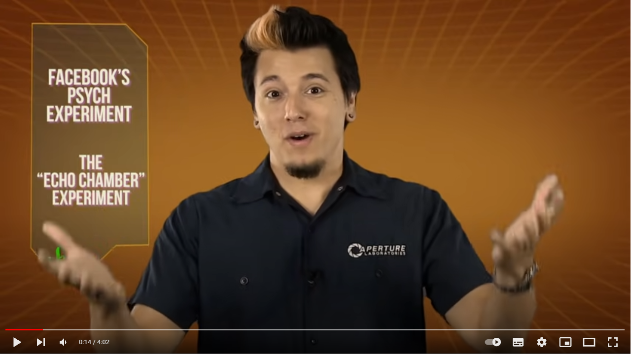
Ethics – Respecting Participants
https://www.youtube.com/watch?v=WXsNh7QV_4Y

Slide 25
Ethics – MCAST Consent Form templates
https://www.mcast.edu.mt/wp-content/uploads/DOC_164_CORP_REV_-G_RESEARCH-PROPOSAL-STATEMENT-OF-INTENT-FORM.doc

