Slide 1
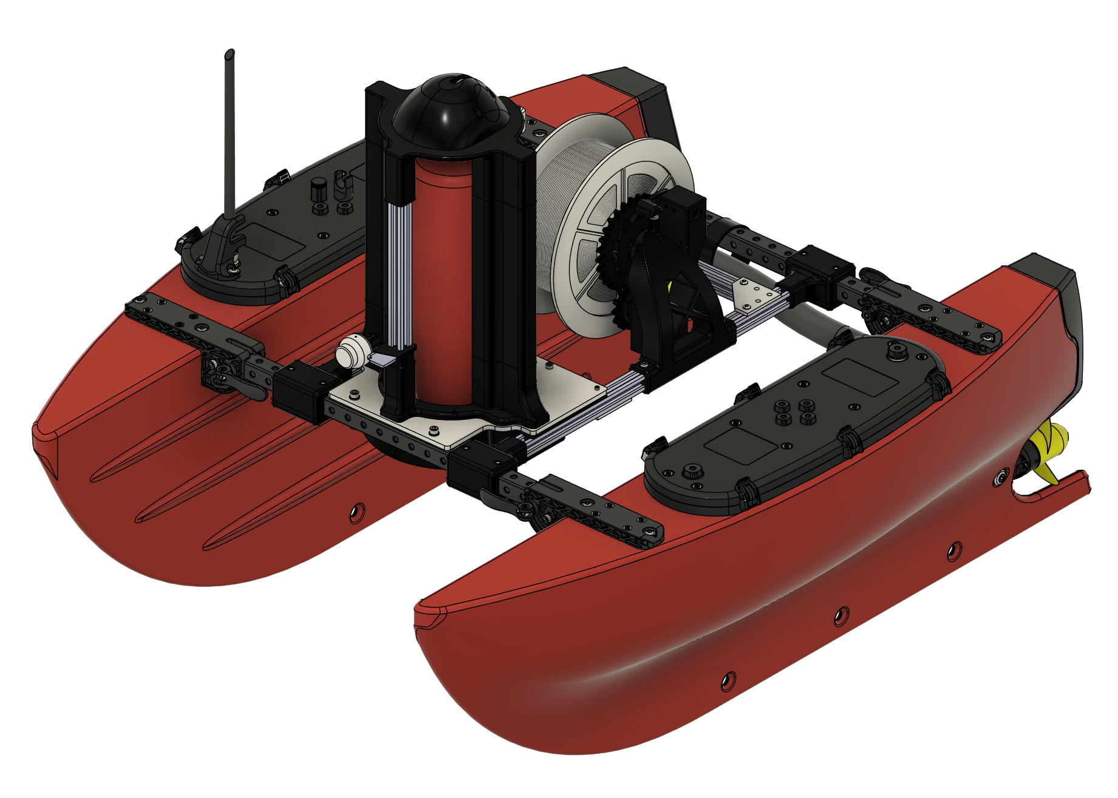
BLUEBOAT
CTD WINCH
ASSEMBLY GUIDE

Slide 2
ASSEMBLY SEQUENCE
Build the individual mounts first, then assemble the winch platform and install it on the boat.
01
Storage Platform
06
Starboard Support
3 illustrations
2 illustrations
02
Camera Mount
07
Spool Support
3 illustrations
2 illustrations
03
CTD Mount
08
CTD Winch Platform
4 illustrations
21 illustrations
04
Spool Mount
09
BlueBoat Installation
2 illustrations
Final installation
05
Port Support
6 illustrations
BLUEBOAT / CTD WINCH ASSEMBLY GUIDE
02

Slide 3
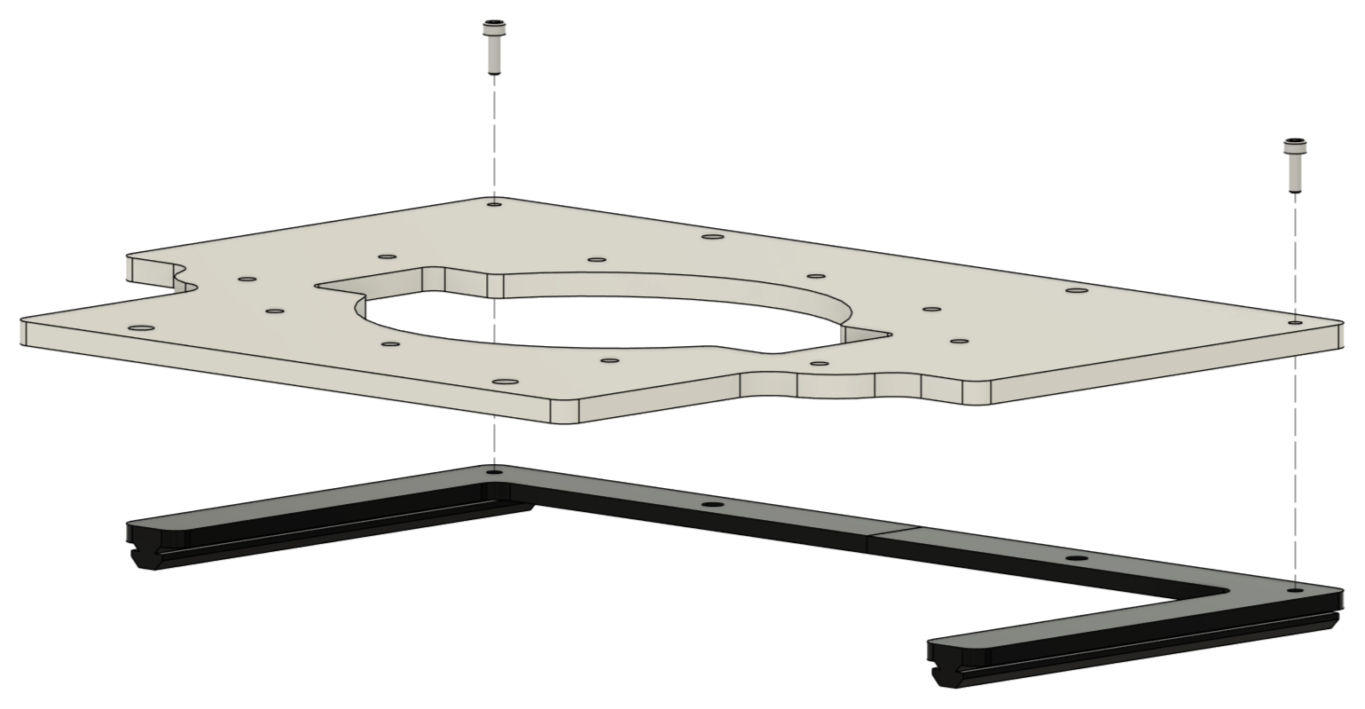
01 / STORAGE PLATFORM
ASSEMBLY STEP 01
BLUEBOAT / CTD WINCH ASSEMBLY GUIDE
03

Slide 4
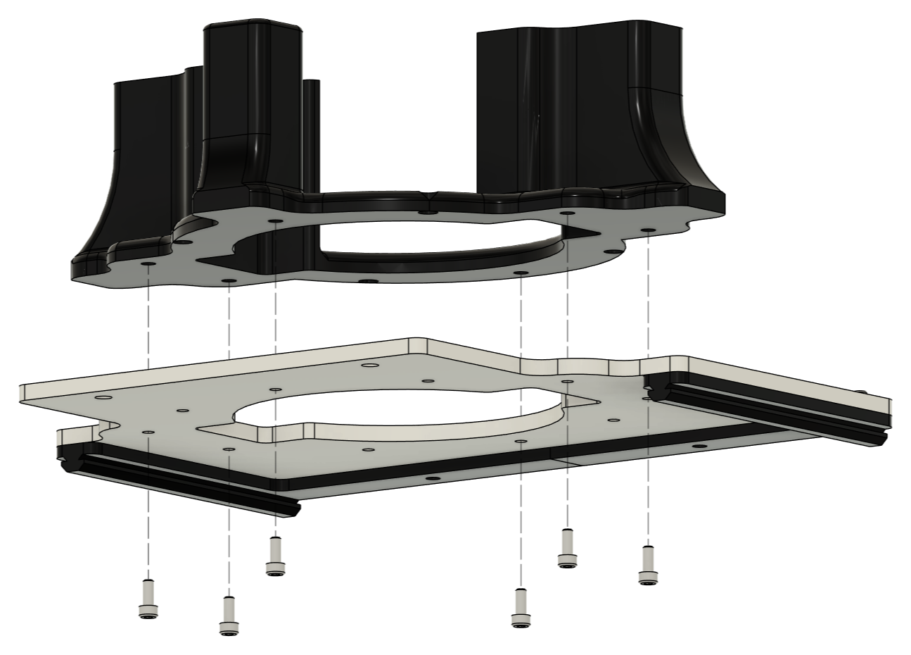
01 / STORAGE PLATFORM
ASSEMBLY STEP 02
BLUEBOAT / CTD WINCH ASSEMBLY GUIDE
04

Slide 5
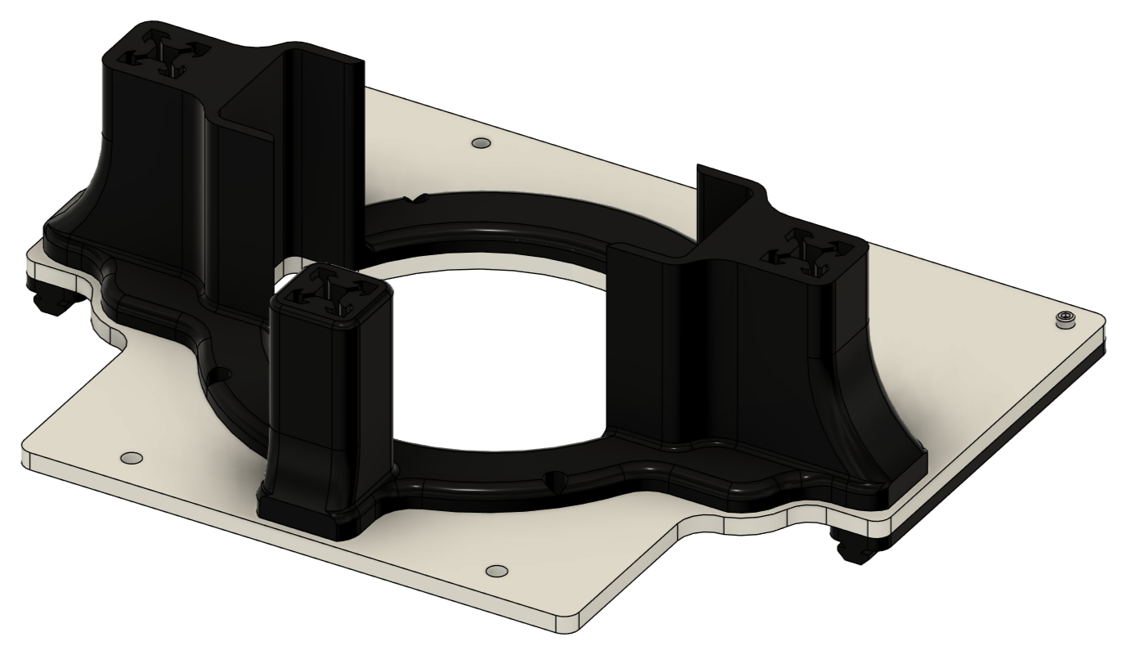
01 / STORAGE PLATFORM
FINAL ASSEMBLY
BLUEBOAT / CTD WINCH ASSEMBLY GUIDE
05

Slide 6
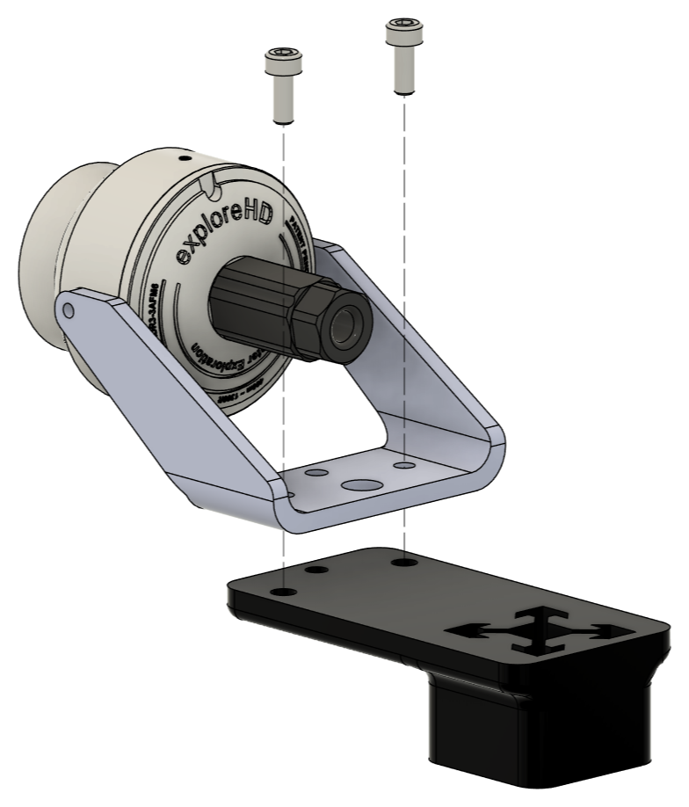
02 / CAMERA MOUNT
ASSEMBLY STEP 01
BLUEBOAT / CTD WINCH ASSEMBLY GUIDE
06

Slide 7
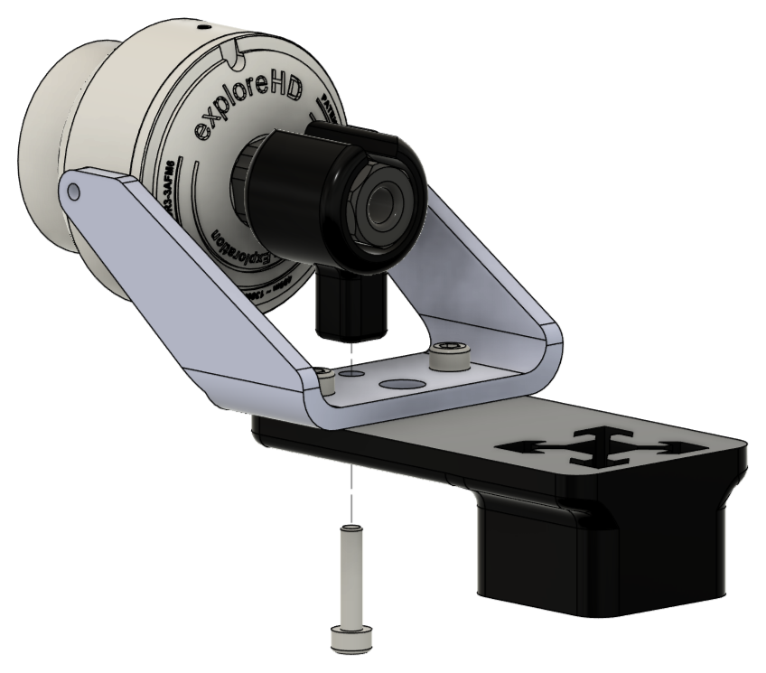
02 / CAMERA MOUNT
ASSEMBLY STEP 02
BLUEBOAT / CTD WINCH ASSEMBLY GUIDE
07

Slide 8
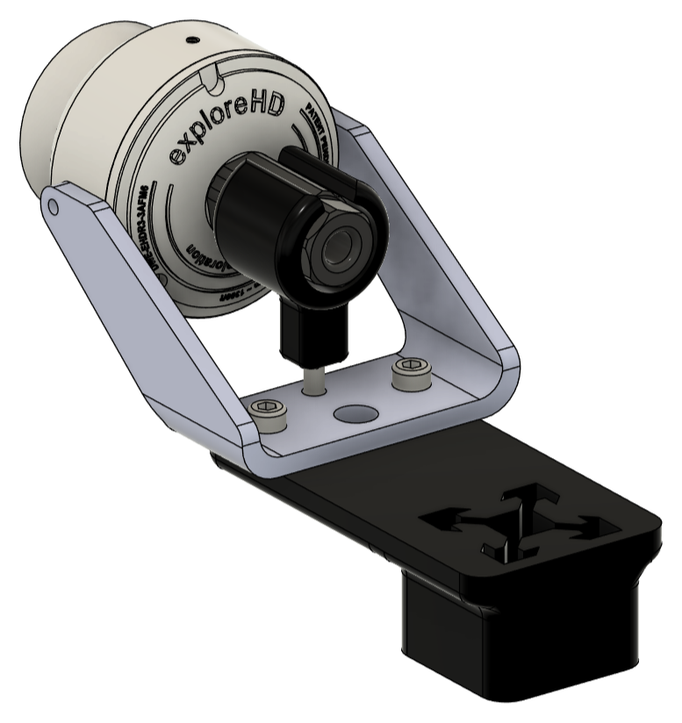
02 / CAMERA MOUNT
FINAL ASSEMBLY
BLUEBOAT / CTD WINCH ASSEMBLY GUIDE
08

Slide 9
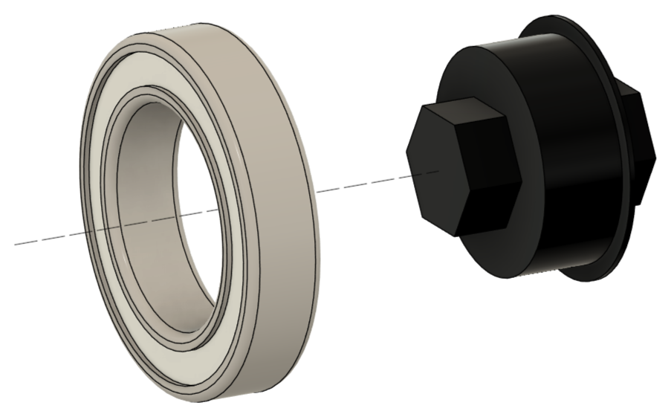
03 / CTD MOUNT
ASSEMBLY STEP 01
BLUEBOAT / CTD WINCH ASSEMBLY GUIDE
09

Slide 10
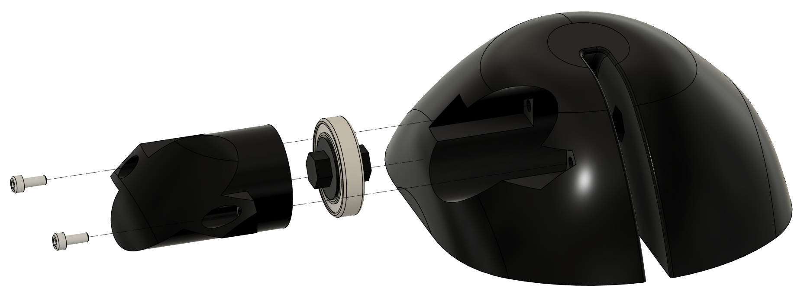
03 / CTD MOUNT
ASSEMBLY STEP 02
ASSEMBLY NOTE
Route the spool cable behind the bearing before completing this assembly.
BLUEBOAT / CTD WINCH ASSEMBLY GUIDE
10

Slide 11
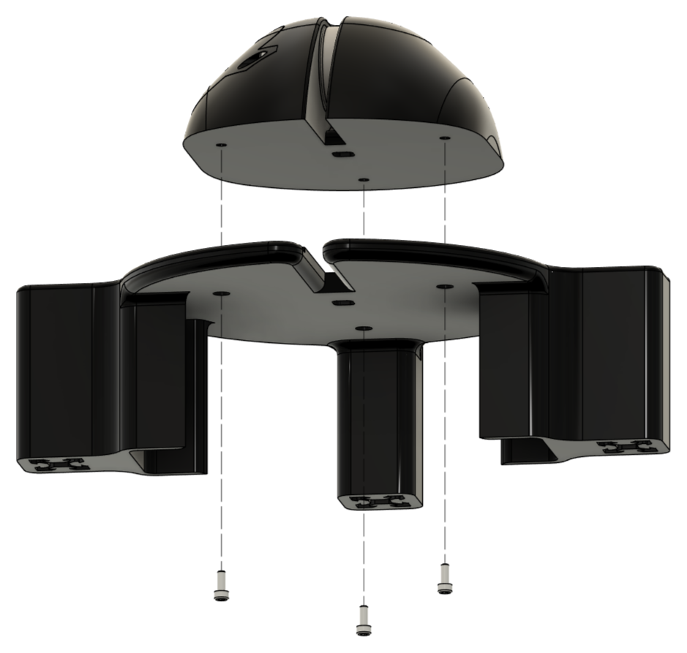
03 / CTD MOUNT
ASSEMBLY STEP 03
BLUEBOAT / CTD WINCH ASSEMBLY GUIDE
11

Slide 12
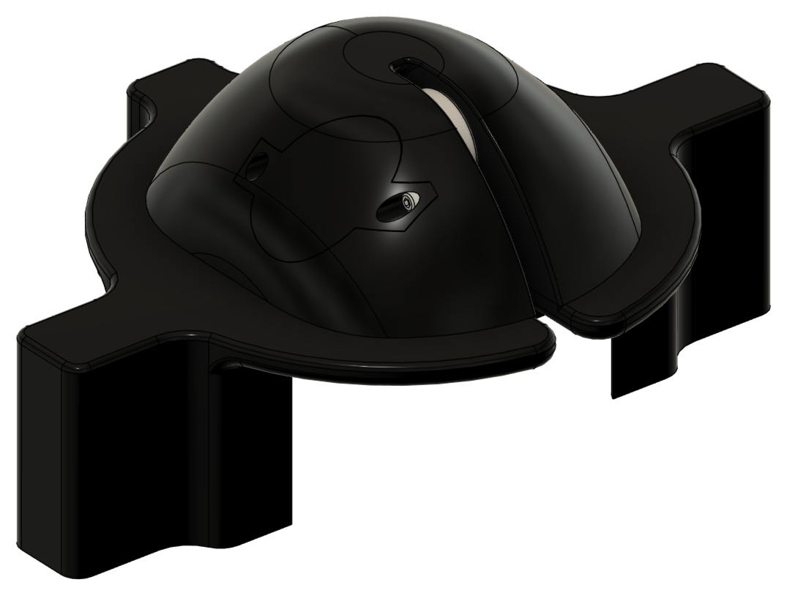
03 / CTD MOUNT
FINAL ASSEMBLY
BLUEBOAT / CTD WINCH ASSEMBLY GUIDE
12

Slide 13
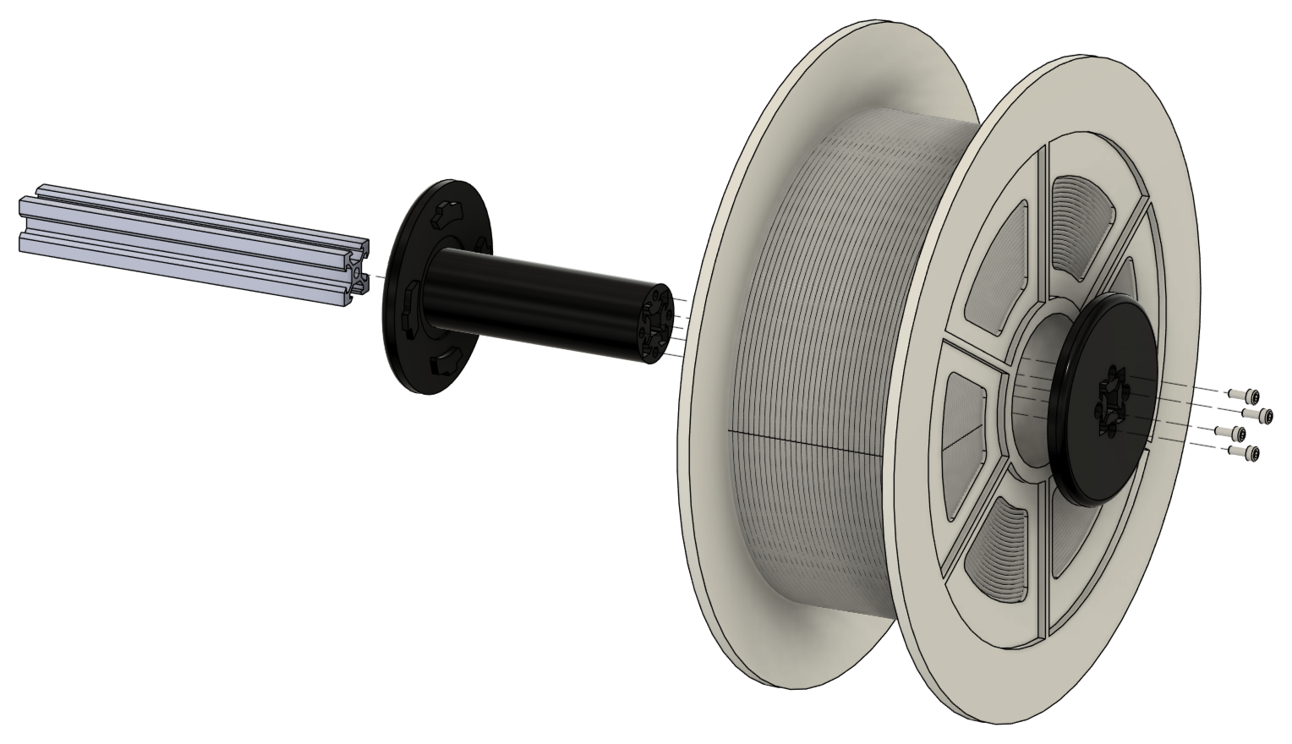
04 / SPOOL MOUNT
ASSEMBLY STEP 01
BLUEBOAT / CTD WINCH ASSEMBLY GUIDE
13

Slide 14
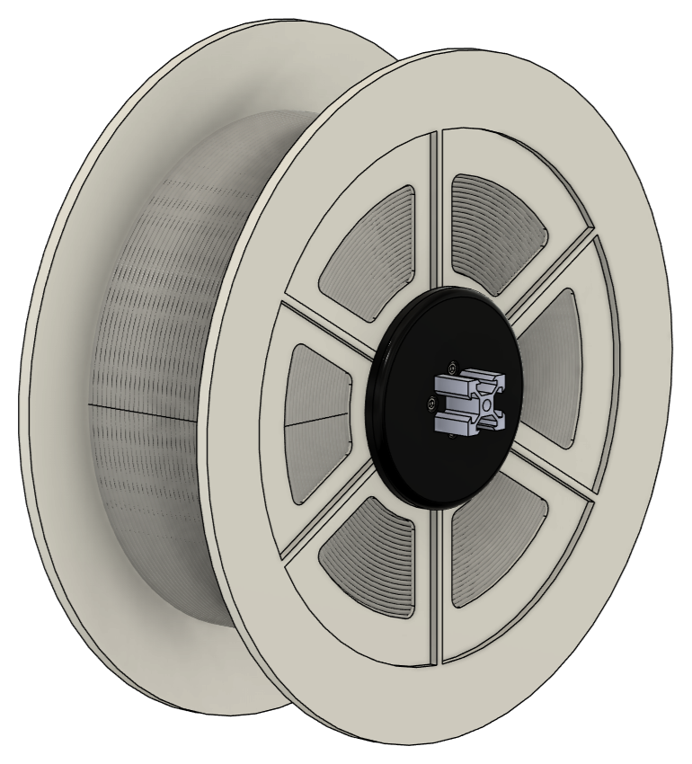
04 / SPOOL MOUNT
FINAL ASSEMBLY
BLUEBOAT / CTD WINCH ASSEMBLY GUIDE
14

Slide 15
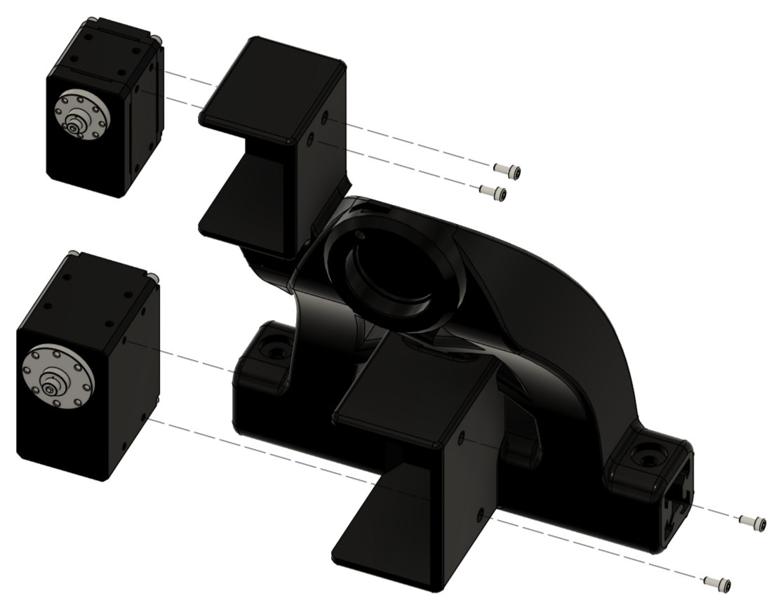
05 / PORT SUPPORT
ASSEMBLY STEP 01
ASSEMBLY NOTE
Connect the motor cables before installing the motors.
BLUEBOAT / CTD WINCH ASSEMBLY GUIDE
15

Slide 16
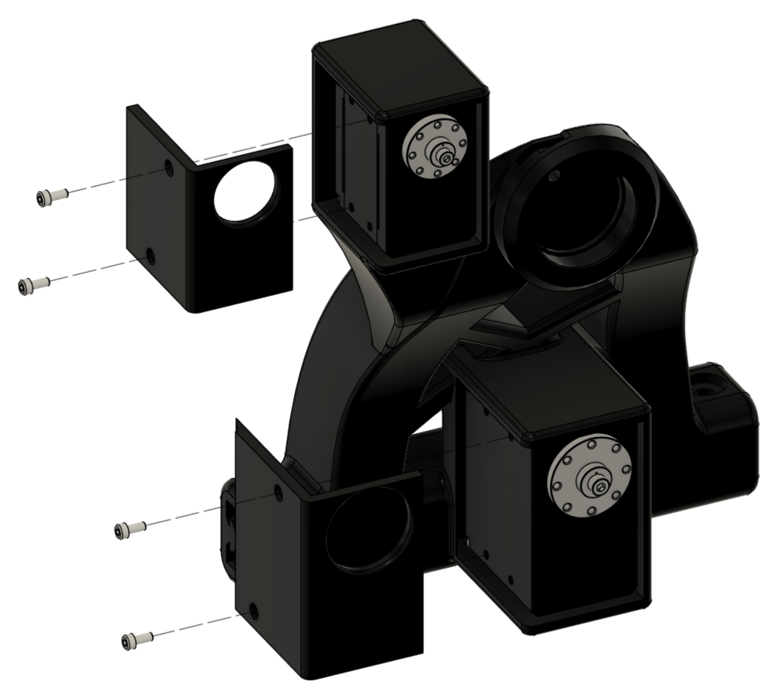
05 / PORT SUPPORT
ASSEMBLY STEP 02
BLUEBOAT / CTD WINCH ASSEMBLY GUIDE
16

Slide 17
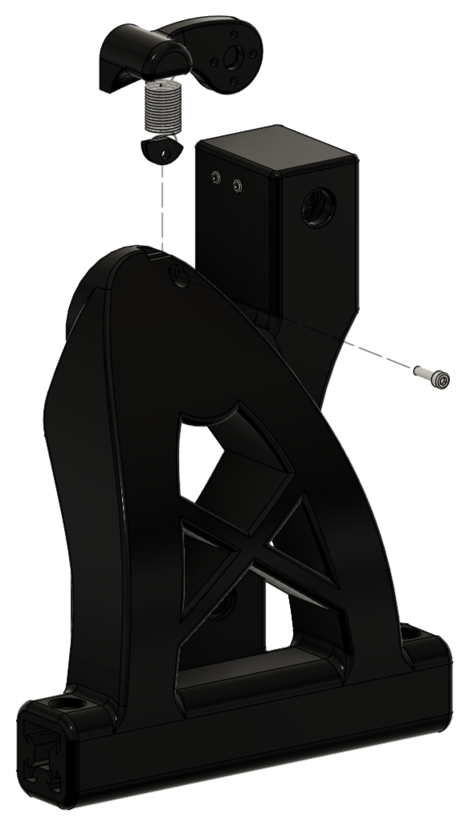
05 / PORT SUPPORT
ASSEMBLY STEP 03
BLUEBOAT / CTD WINCH ASSEMBLY GUIDE
17

Slide 18
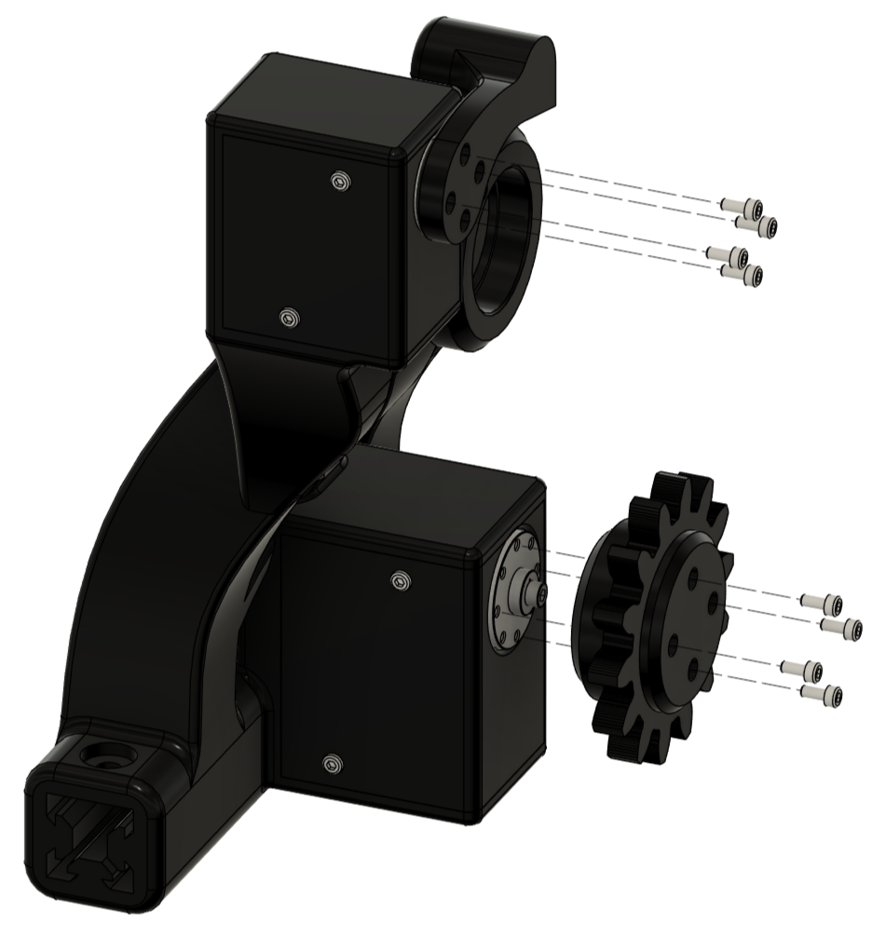
05 / PORT SUPPORT
ASSEMBLY STEP 04
BLUEBOAT / CTD WINCH ASSEMBLY GUIDE
18

Slide 19
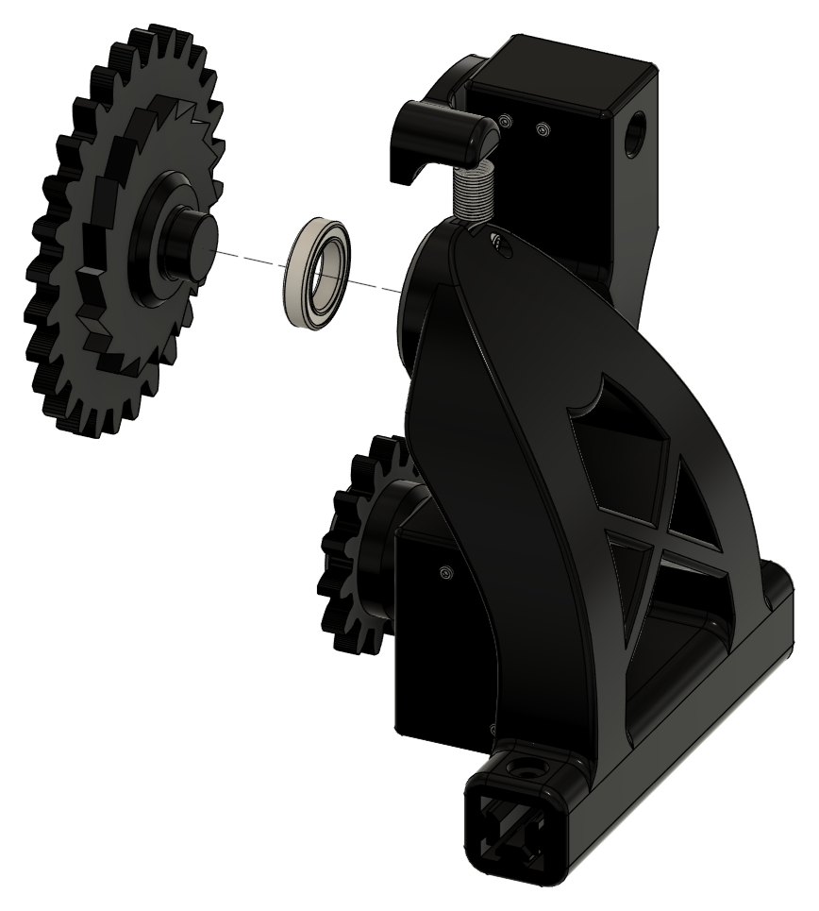
05 / PORT SUPPORT
ASSEMBLY STEP 05
BLUEBOAT / CTD WINCH ASSEMBLY GUIDE
19

Slide 20
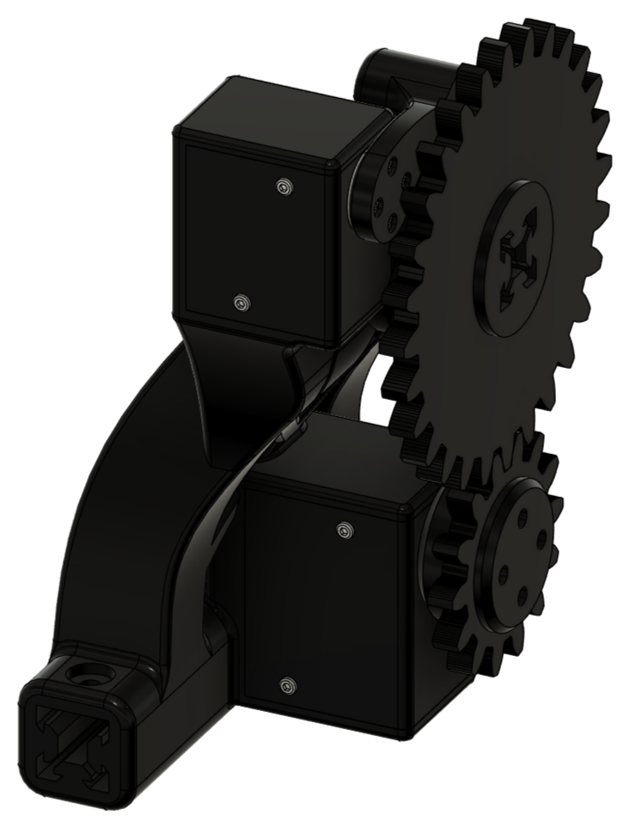
05 / PORT SUPPORT
FINAL ASSEMBLY
ASSEMBLY NOTE
To disconnect the motor cables, disassemble the port support, remove the caps, pull out the motors, then unplug the cables.
BLUEBOAT / CTD WINCH ASSEMBLY GUIDE
20

Slide 21
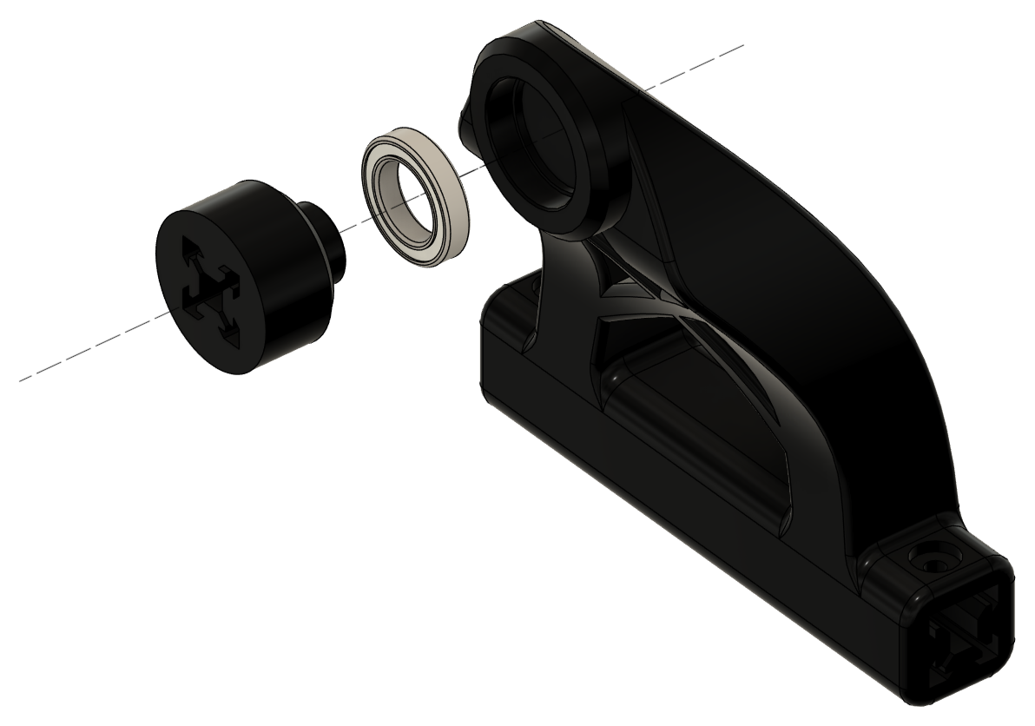
06 / STARBOARD SUPPORT
ASSEMBLY STEP 01
BLUEBOAT / CTD WINCH ASSEMBLY GUIDE
21

Slide 22
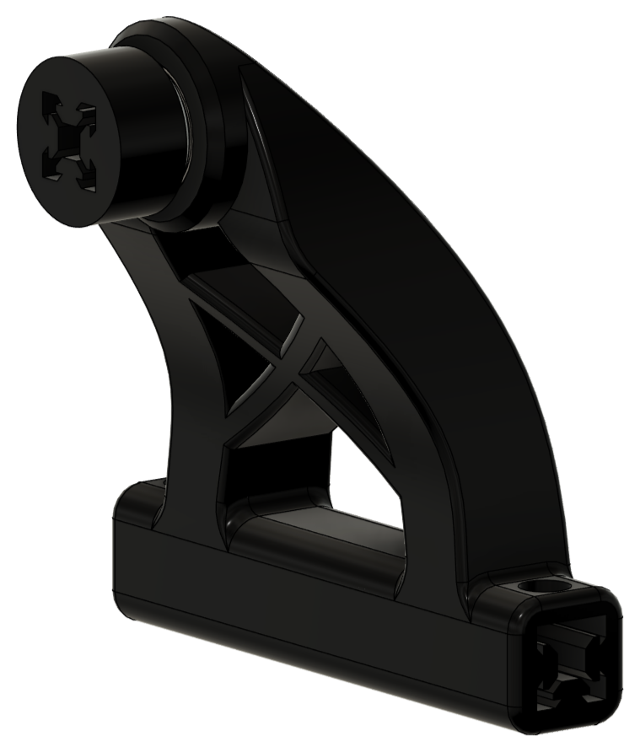
06 / STARBOARD SUPPORT
FINAL ASSEMBLY
BLUEBOAT / CTD WINCH ASSEMBLY GUIDE
22

Slide 23
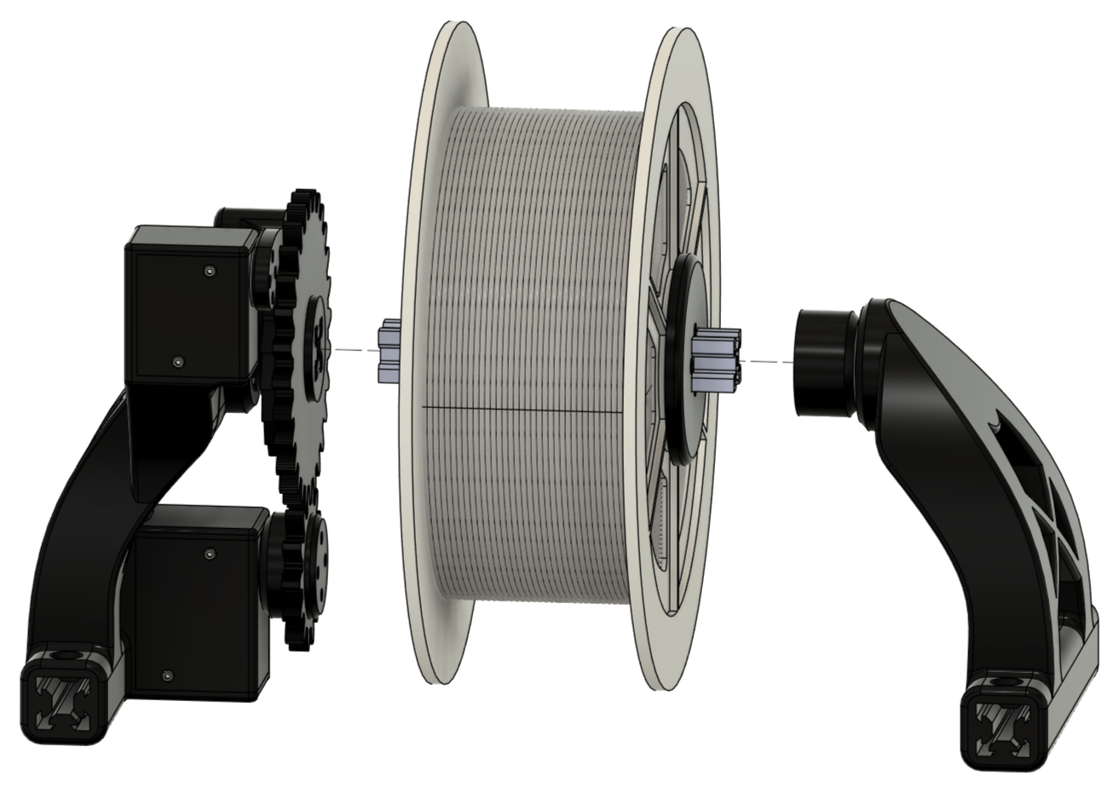
07 / SPOOL SUPPORT
ASSEMBLY STEP 01
ASSEMBLY NOTE
Orient the spool so the cable can be pulled from the rear and underneath, as shown.
BLUEBOAT / CTD WINCH ASSEMBLY GUIDE
23

Slide 24
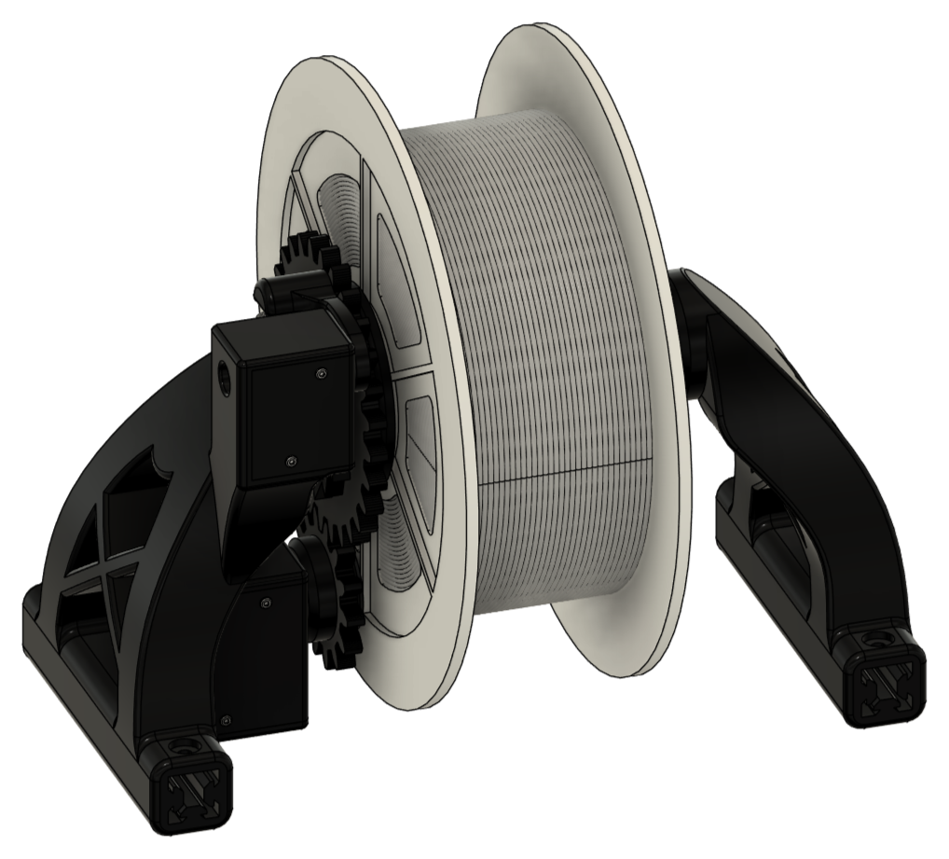
07 / SPOOL SUPPORT
FINAL ASSEMBLY
ASSEMBLY NOTE
To disconnect the motor cables, disassemble the spool support and port support (see Port Support, Final Assembly).
BLUEBOAT / CTD WINCH ASSEMBLY GUIDE
24

Slide 25
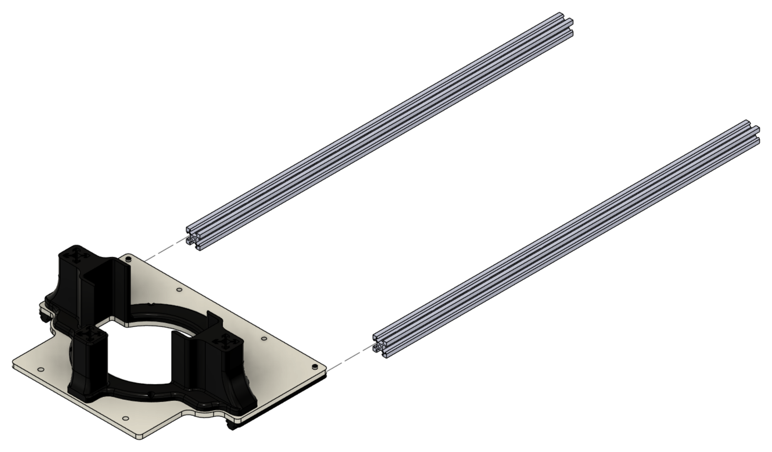
08 / CTD WINCH PLATFORM
ASSEMBLY STEP 01
BLUEBOAT / CTD WINCH ASSEMBLY GUIDE
25

Slide 26
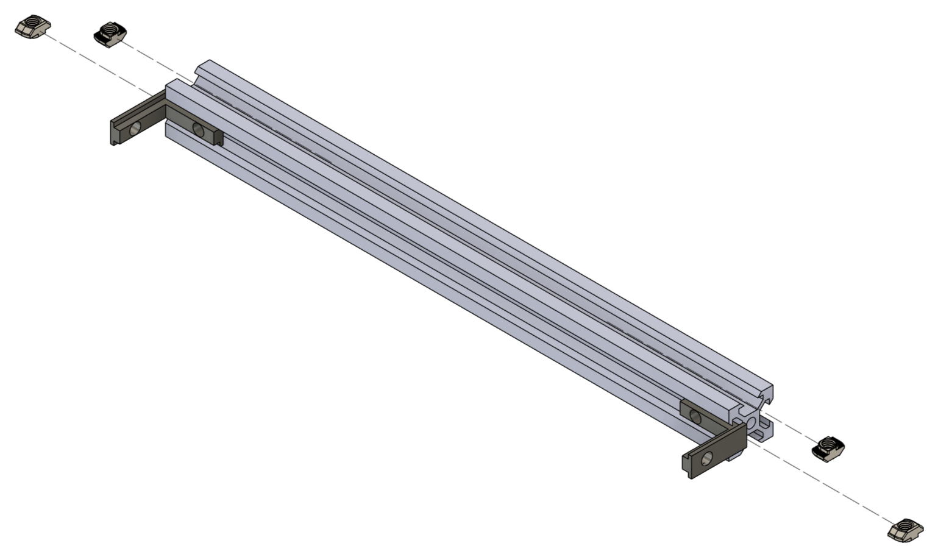
08 / CTD WINCH PLATFORM
ASSEMBLY STEP 02
ASSEMBLY NOTE
Insert the T-nuts at this stage, before the slots become inaccessible.
BLUEBOAT / CTD WINCH ASSEMBLY GUIDE
26

Slide 27
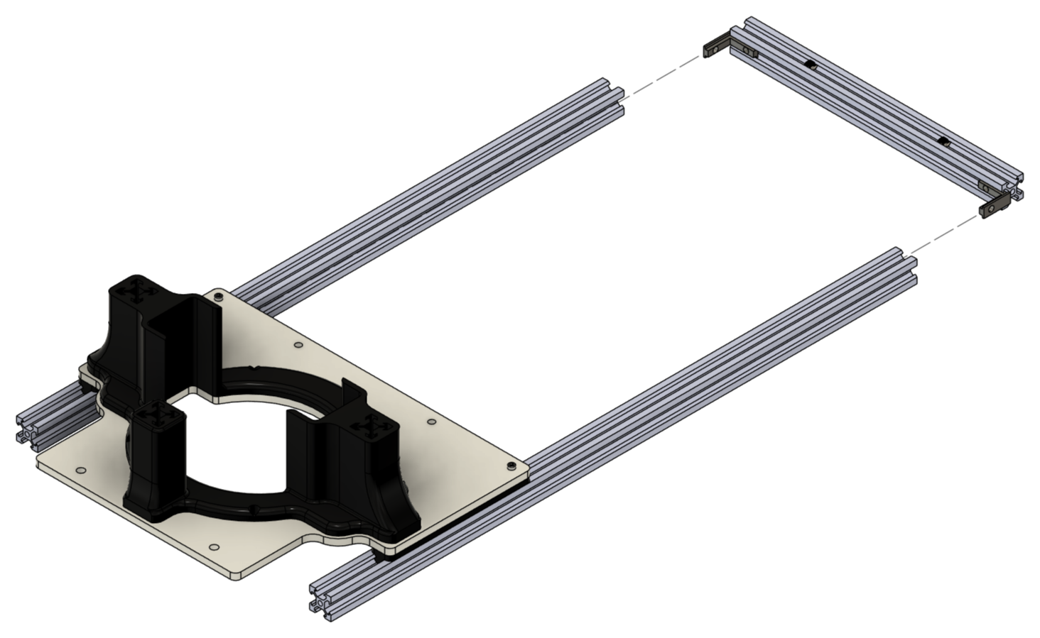
08 / CTD WINCH PLATFORM
ASSEMBLY STEP 03
BLUEBOAT / CTD WINCH ASSEMBLY GUIDE
27

Slide 28
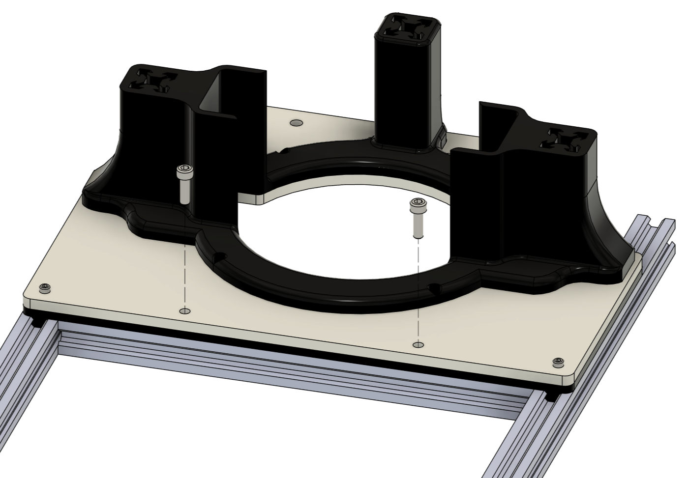
08 / CTD WINCH PLATFORM
ASSEMBLY STEP 04
BLUEBOAT / CTD WINCH ASSEMBLY GUIDE
28

Slide 29
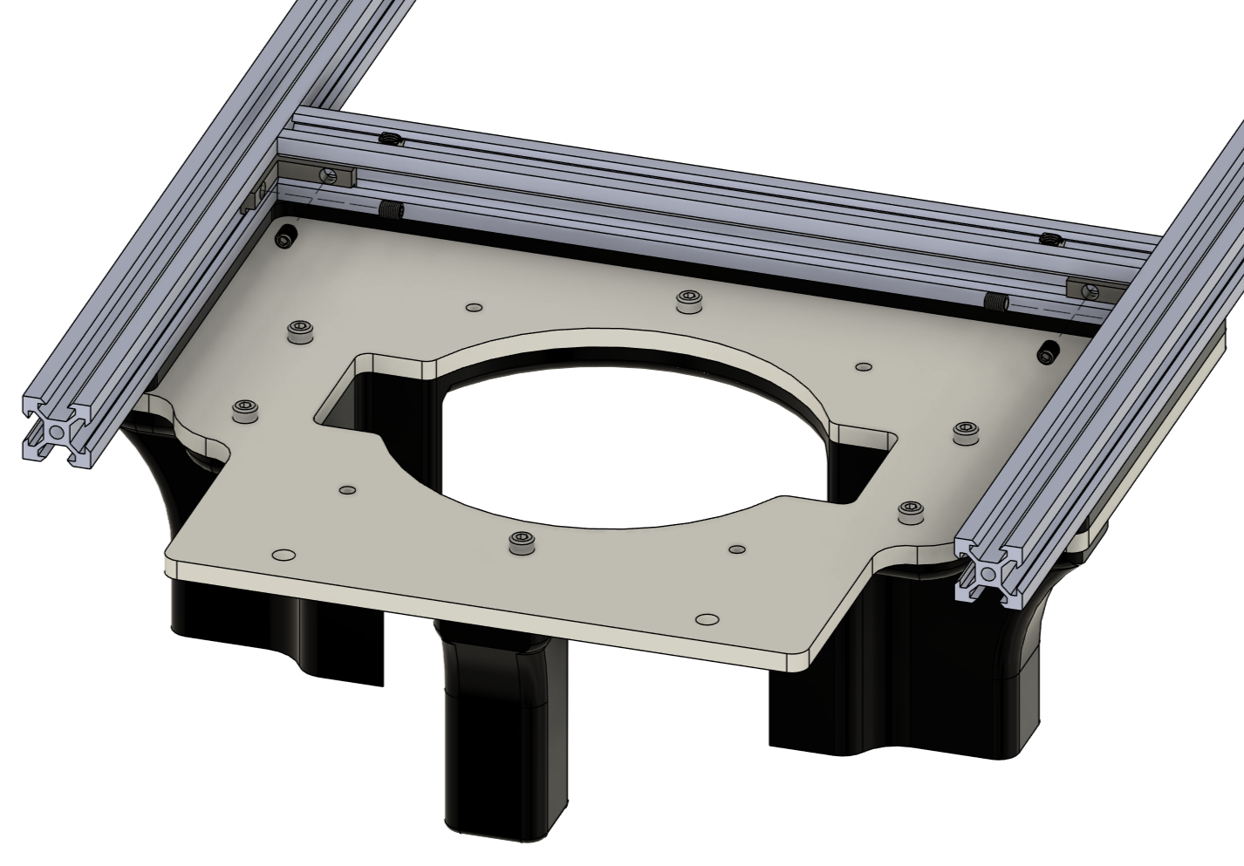
08 / CTD WINCH PLATFORM
ASSEMBLY STEP 05
BLUEBOAT / CTD WINCH ASSEMBLY GUIDE
29

Slide 30
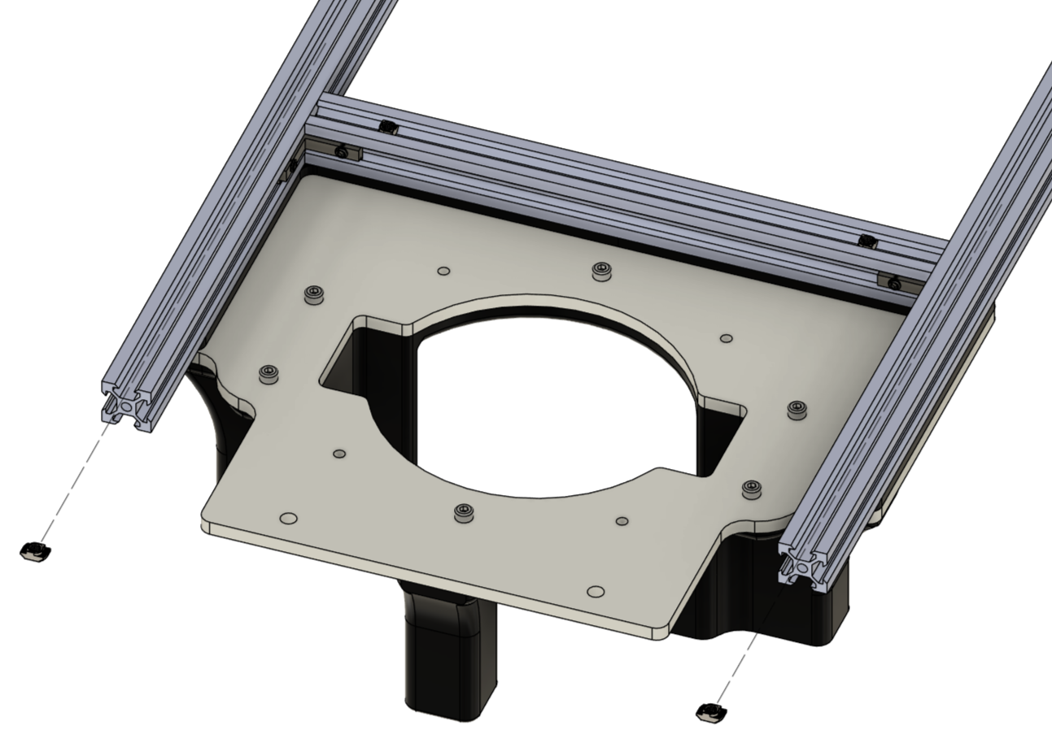
08 / CTD WINCH PLATFORM
ASSEMBLY STEP 06
ASSEMBLY NOTE
Insert the T-nuts at this stage, before the slots become inaccessible.
BLUEBOAT / CTD WINCH ASSEMBLY GUIDE
30

Slide 31
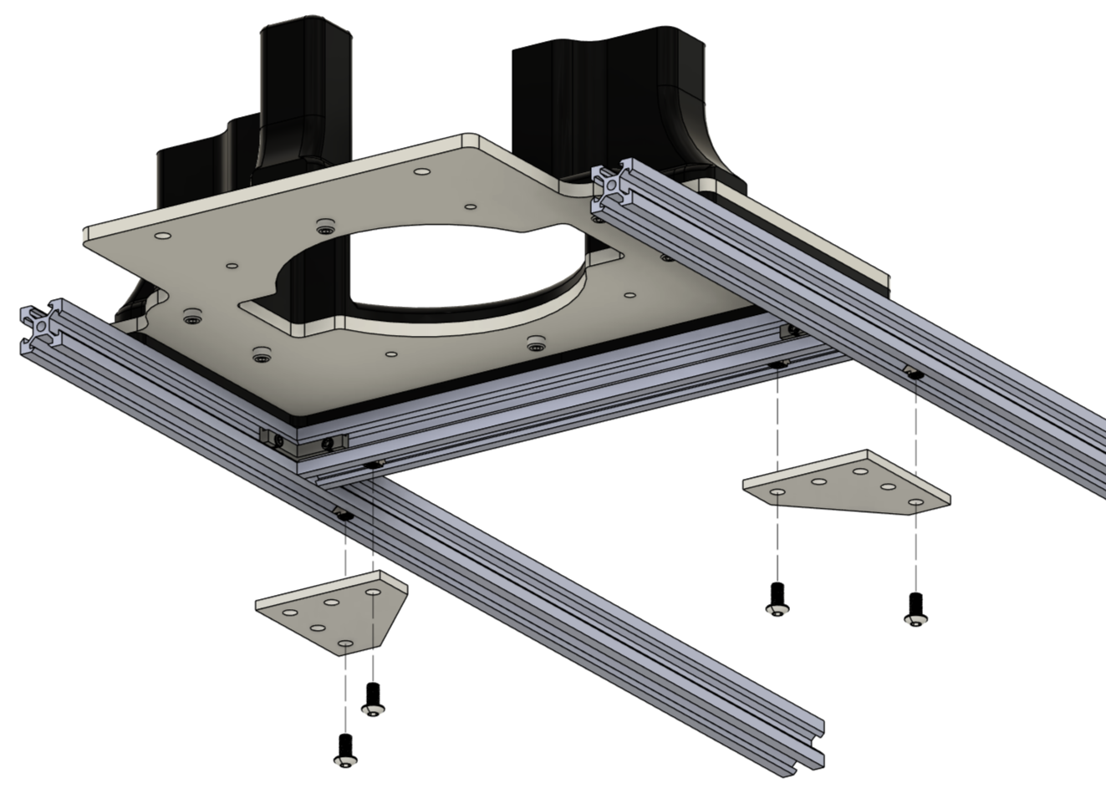
08 / CTD WINCH PLATFORM
ASSEMBLY STEP 07
BLUEBOAT / CTD WINCH ASSEMBLY GUIDE
31

Slide 32
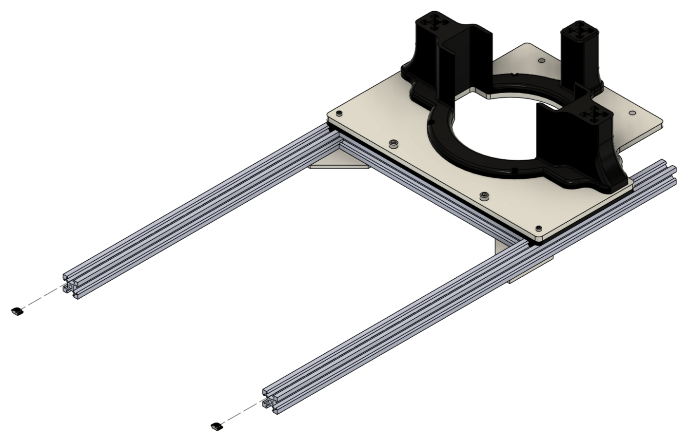
08 / CTD WINCH PLATFORM
ASSEMBLY STEP 08
ASSEMBLY NOTE
Insert the T-nuts at this stage, before the slots become inaccessible.
BLUEBOAT / CTD WINCH ASSEMBLY GUIDE
32

Slide 33
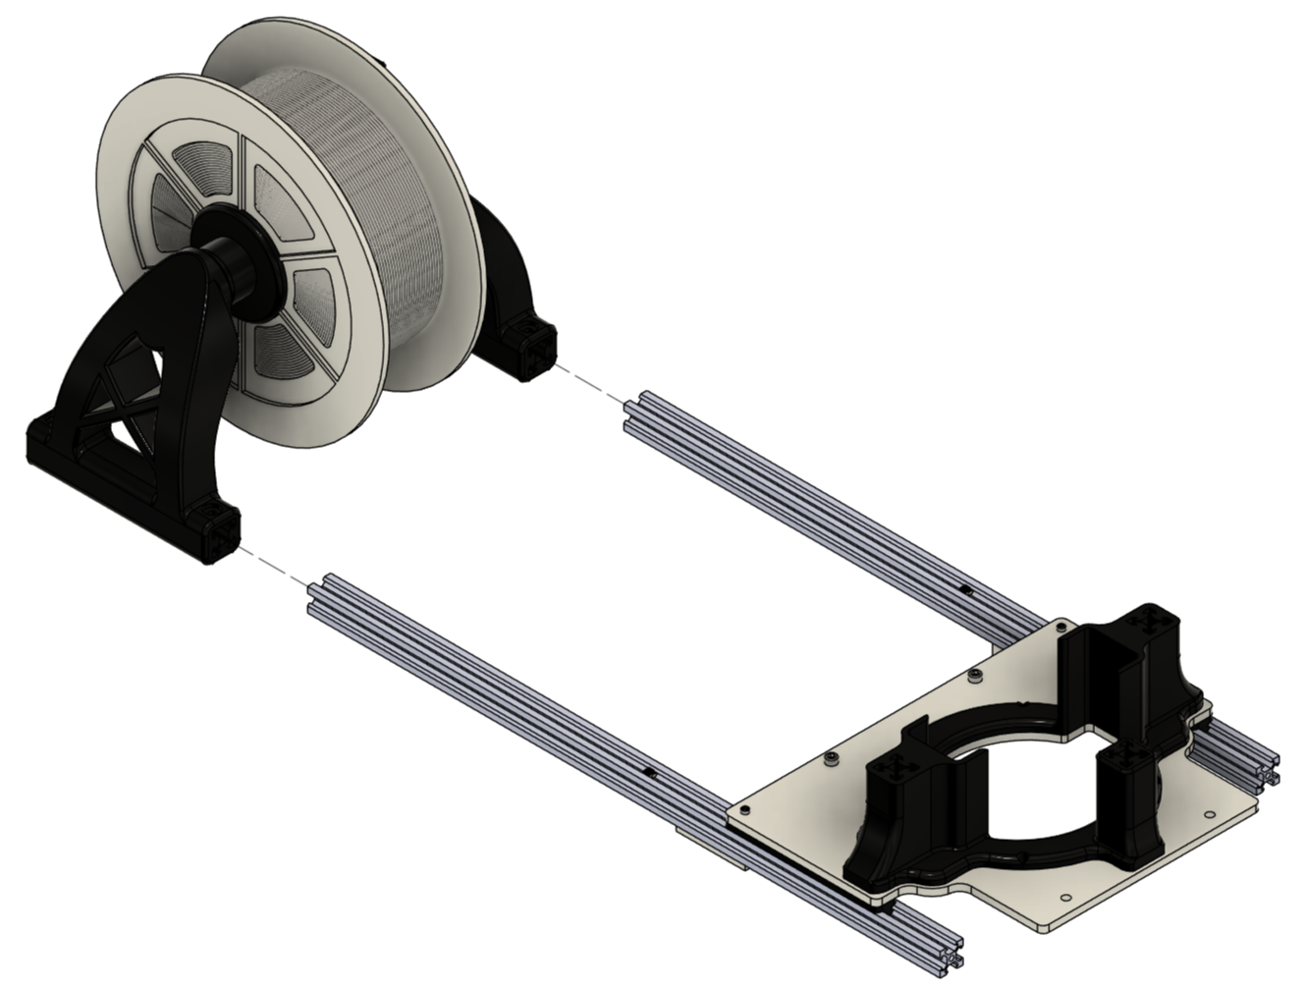
08 / CTD WINCH PLATFORM
ASSEMBLY STEP 09
ASSEMBLY NOTE
Position the motors on the port side, as shown.
BLUEBOAT / CTD WINCH ASSEMBLY GUIDE
33

Slide 34
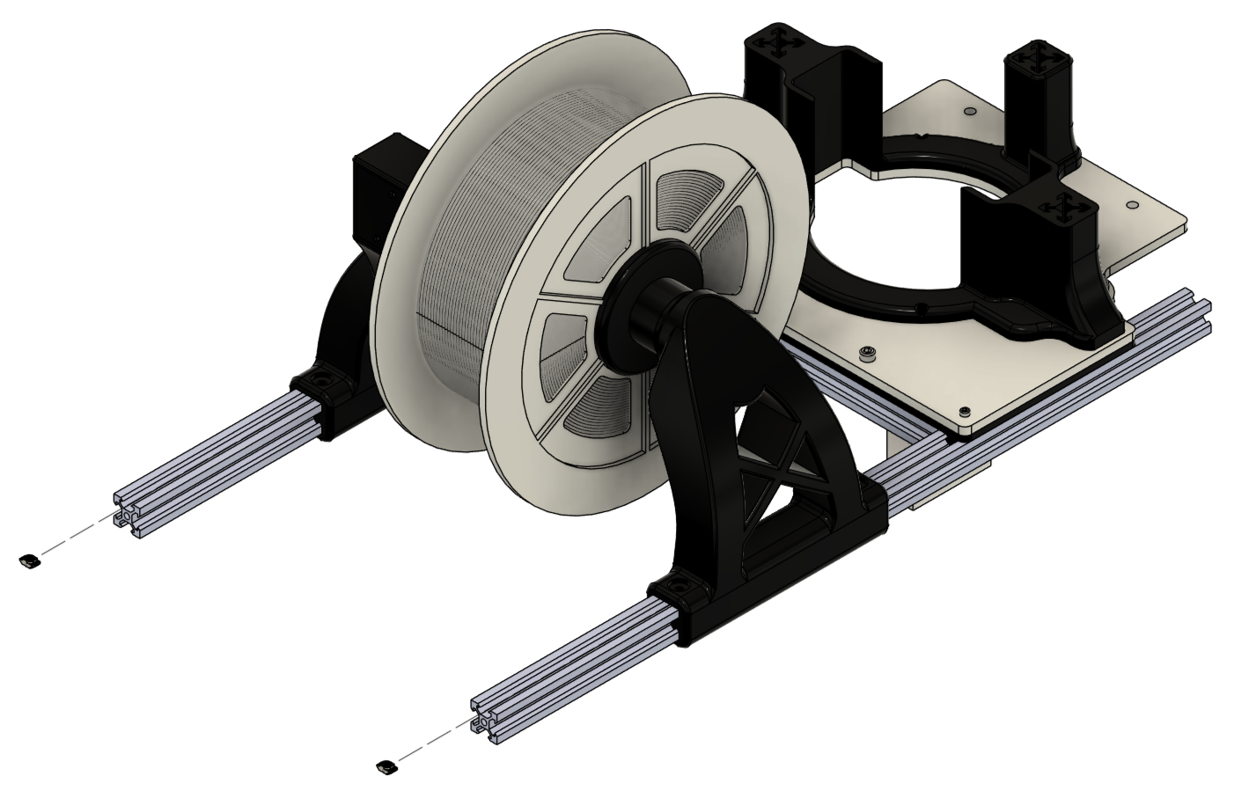
08 / CTD WINCH PLATFORM
ASSEMBLY STEP 10
ASSEMBLY NOTE
Insert the T-nuts at this stage, before the slots become inaccessible.
BLUEBOAT / CTD WINCH ASSEMBLY GUIDE
34

Slide 35
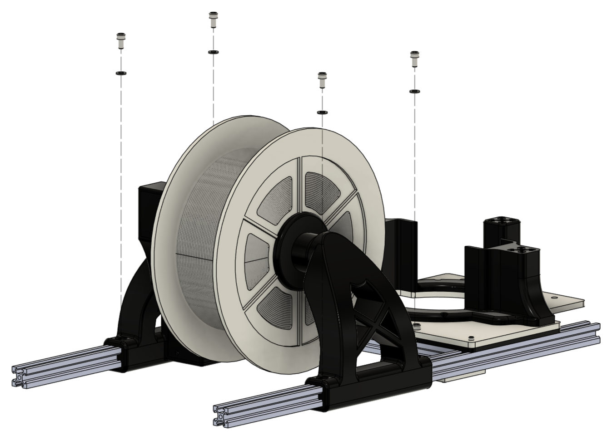
08 / CTD WINCH PLATFORM
ASSEMBLY STEP 11
BLUEBOAT / CTD WINCH ASSEMBLY GUIDE
35

Slide 36
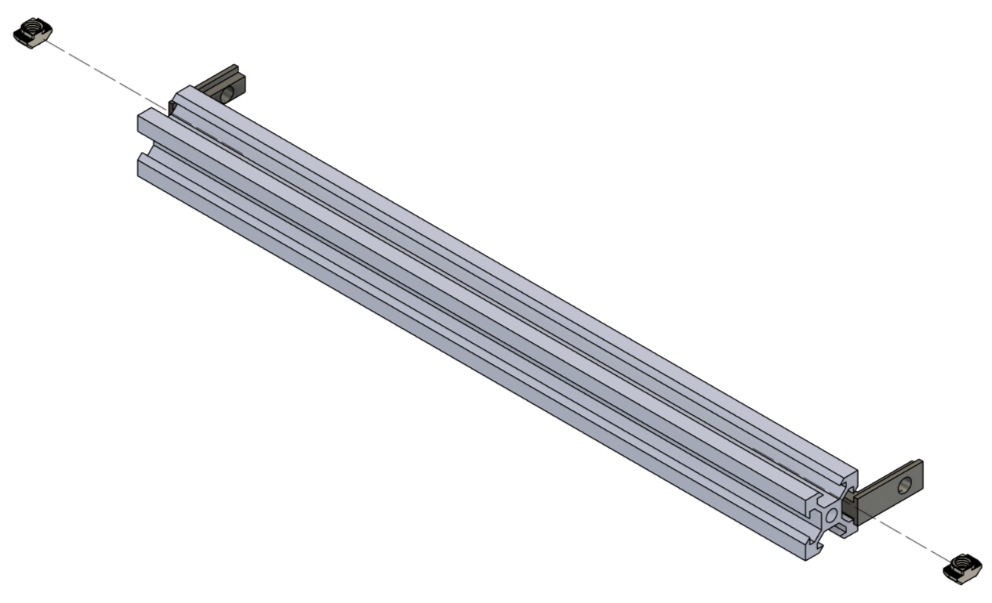
08 / CTD WINCH PLATFORM
ASSEMBLY STEP 12
ASSEMBLY NOTE
Insert the T-nuts at this stage, before the slots become inaccessible.
BLUEBOAT / CTD WINCH ASSEMBLY GUIDE
36

Slide 37
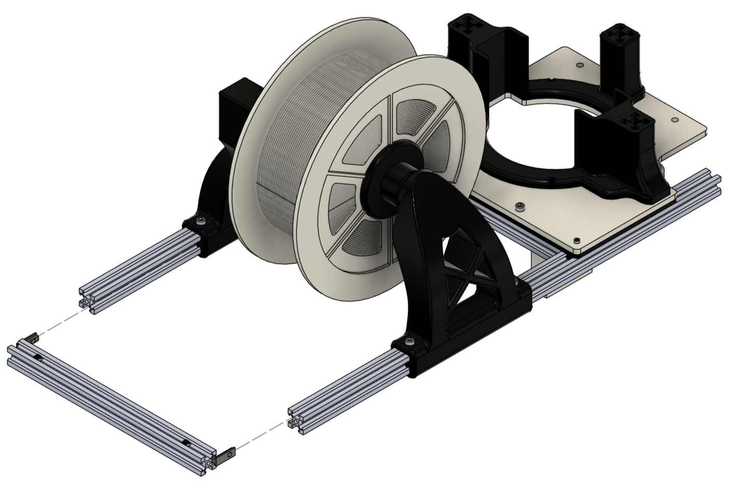
08 / CTD WINCH PLATFORM
ASSEMBLY STEP 13
BLUEBOAT / CTD WINCH ASSEMBLY GUIDE
37

Slide 38
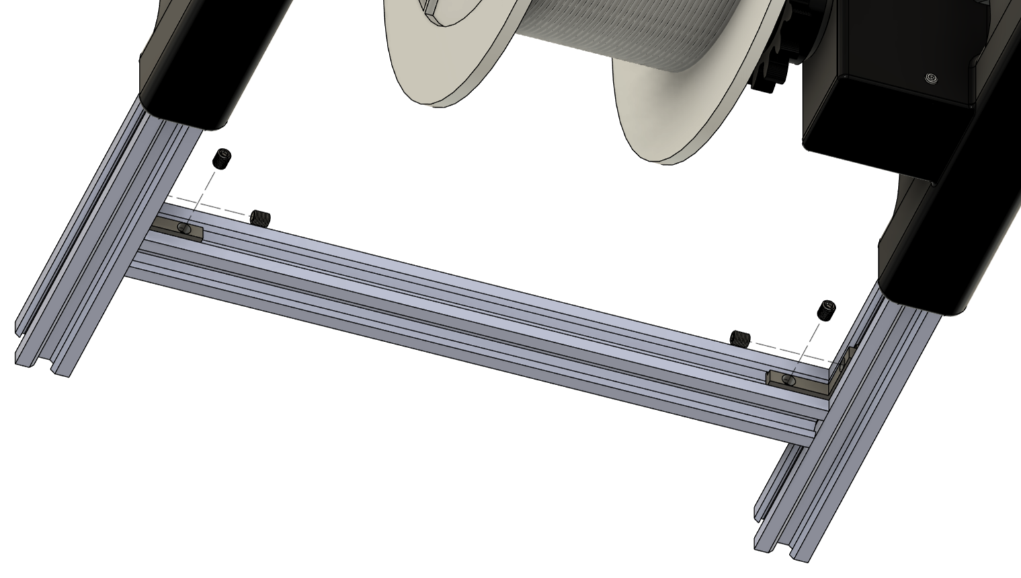
08 / CTD WINCH PLATFORM
ASSEMBLY STEP 14
BLUEBOAT / CTD WINCH ASSEMBLY GUIDE
38

Slide 39
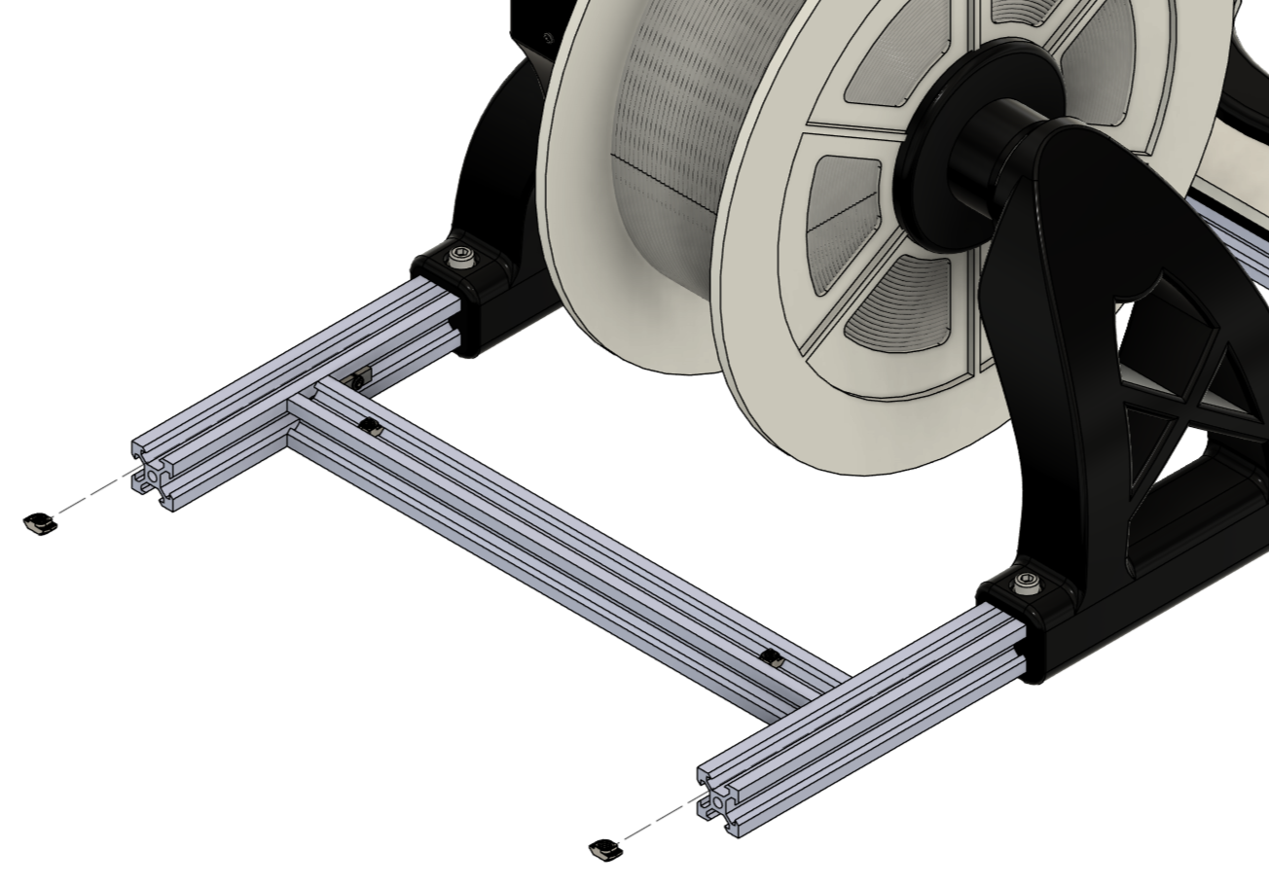
08 / CTD WINCH PLATFORM
ASSEMBLY STEP 15
BLUEBOAT / CTD WINCH ASSEMBLY GUIDE
39

Slide 40
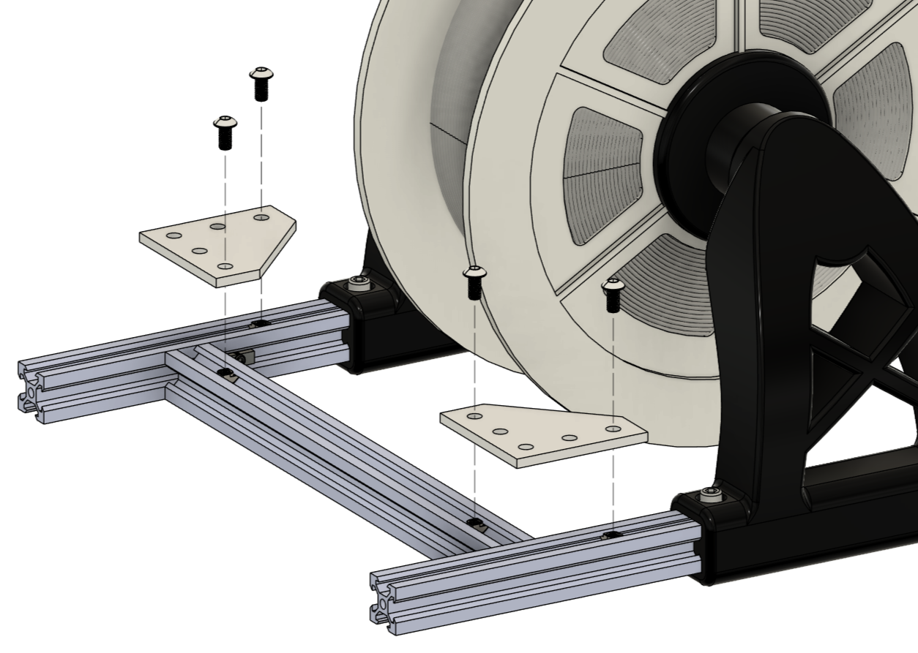
08 / CTD WINCH PLATFORM
ASSEMBLY STEP 16
BLUEBOAT / CTD WINCH ASSEMBLY GUIDE
40

Slide 41
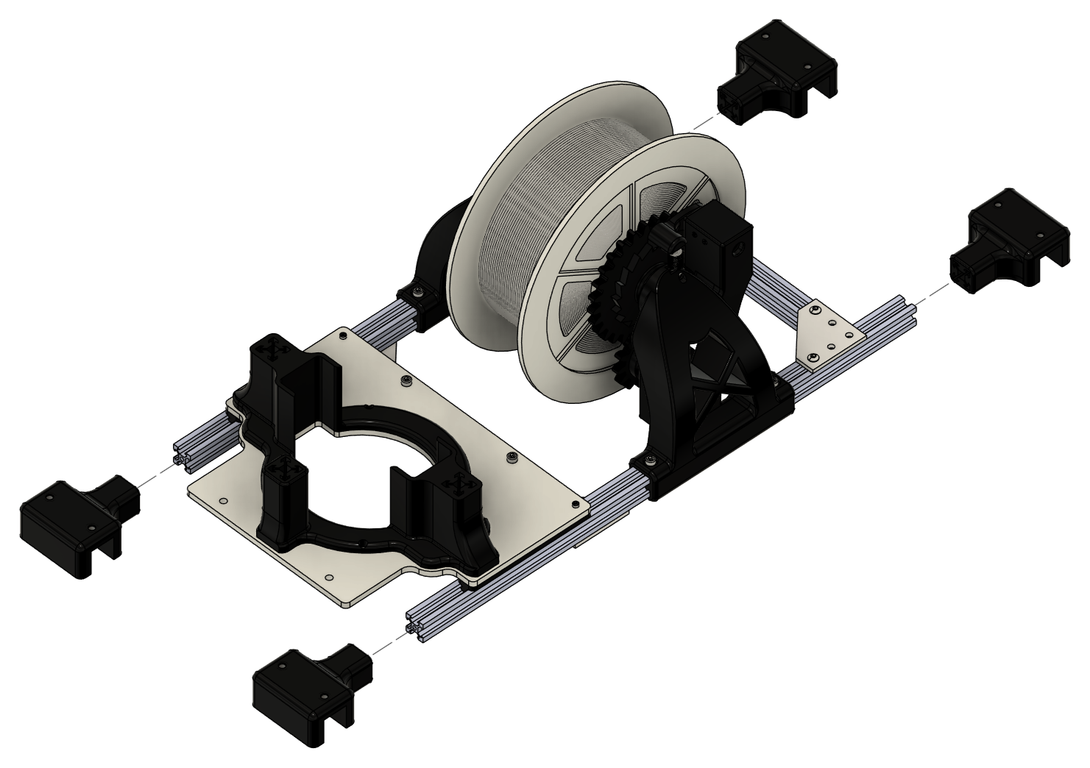
08 / CTD WINCH PLATFORM
ASSEMBLY STEP 17
BLUEBOAT / CTD WINCH ASSEMBLY GUIDE
41

Slide 42
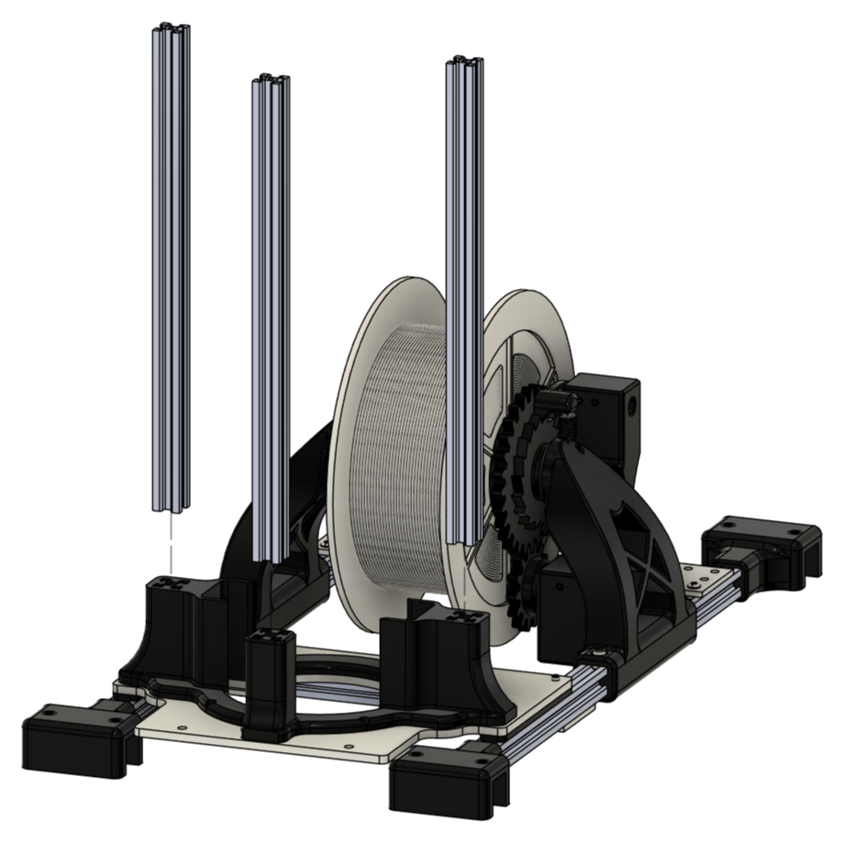
08 / CTD WINCH PLATFORM
ASSEMBLY STEP 18
BLUEBOAT / CTD WINCH ASSEMBLY GUIDE
42

Slide 43
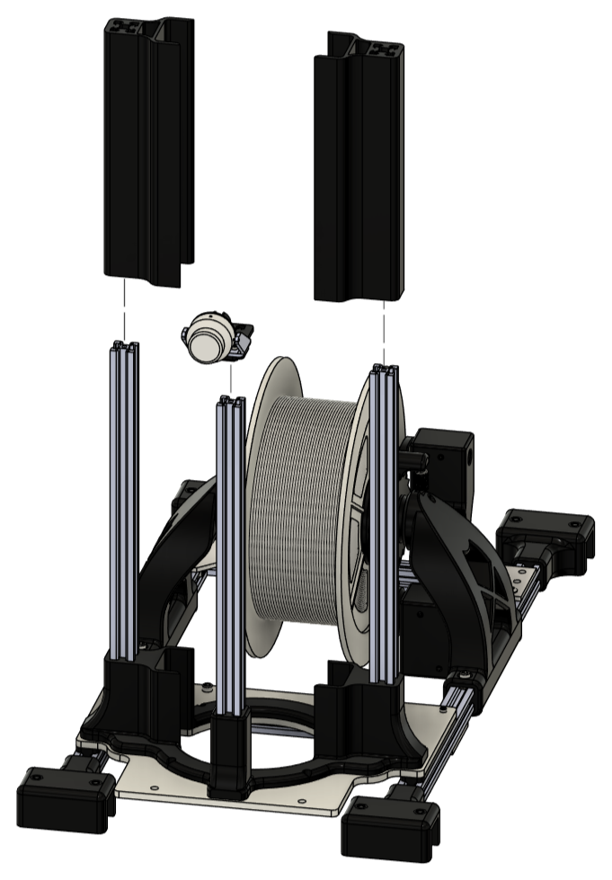
08 / CTD WINCH PLATFORM
ASSEMBLY STEP 19
BLUEBOAT / CTD WINCH ASSEMBLY GUIDE
43

Slide 44
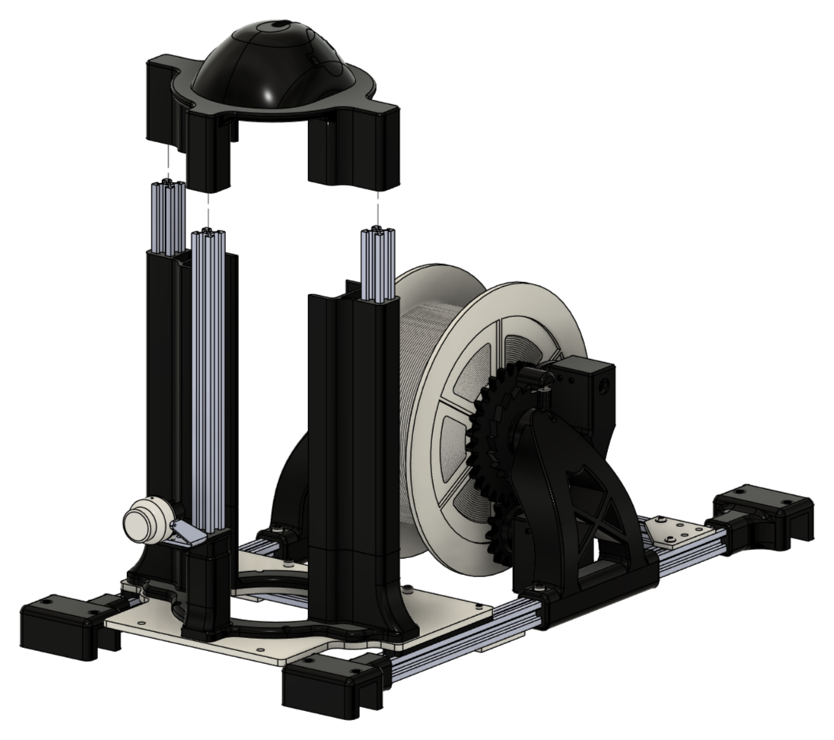
08 / CTD WINCH PLATFORM
ASSEMBLY STEP 20
BLUEBOAT / CTD WINCH ASSEMBLY GUIDE
44

Slide 45
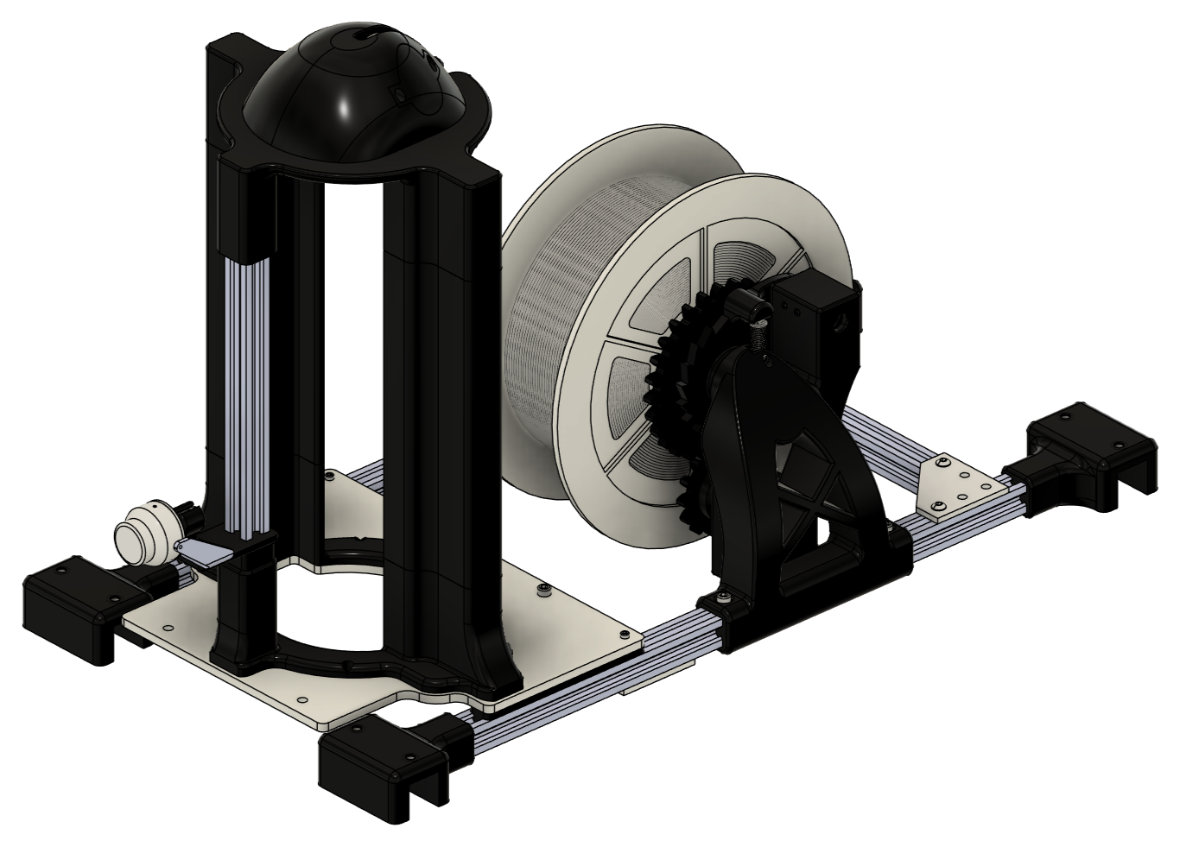
08 / CTD WINCH PLATFORM
FINAL ASSEMBLY
BLUEBOAT / CTD WINCH ASSEMBLY GUIDE
45

Slide 46
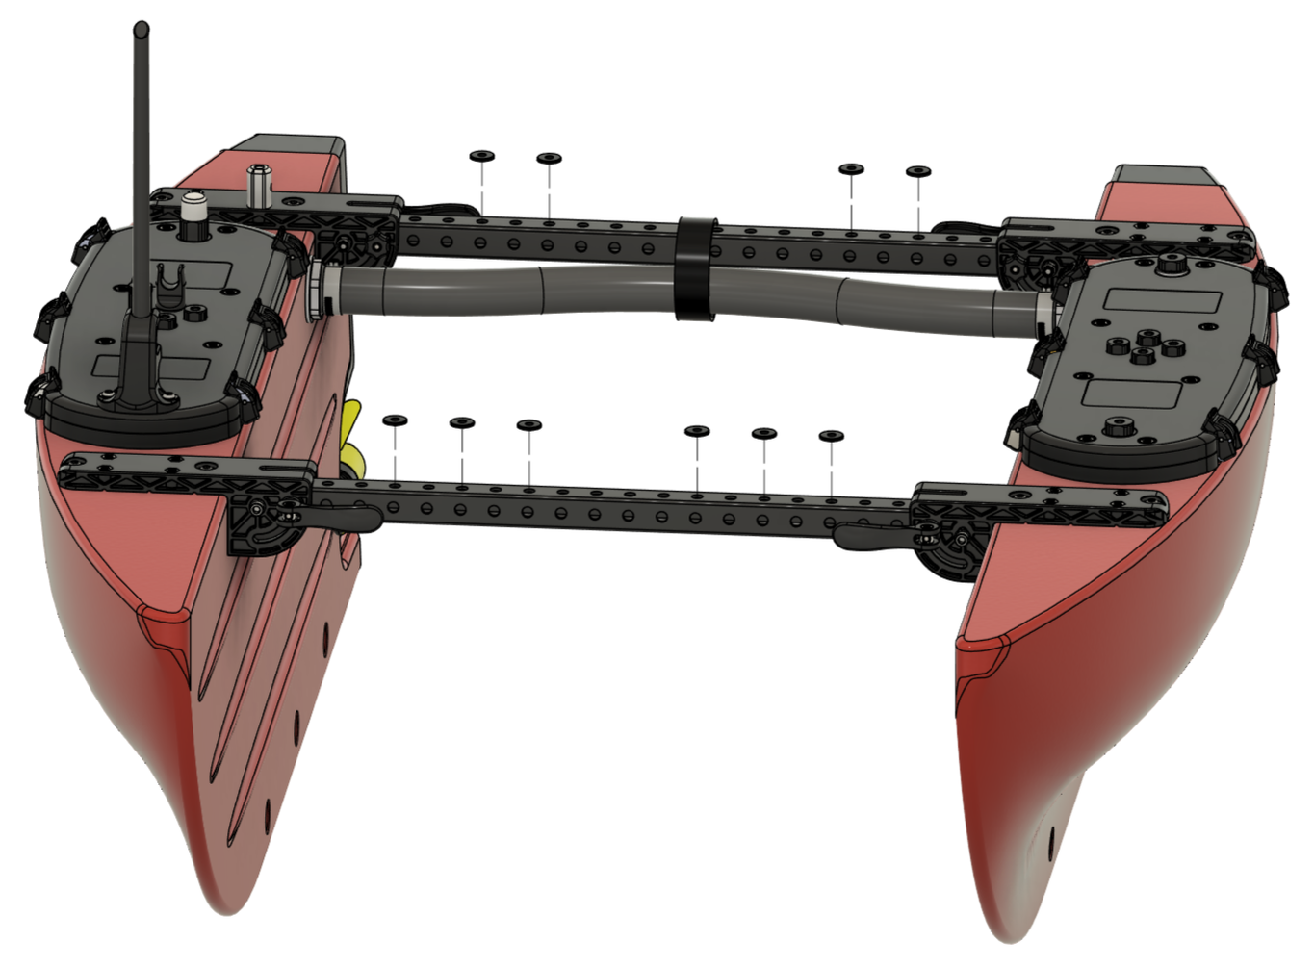
09 / BLUEBOAT INSTALLATION
ASSEMBLY STEP 01
BLUEBOAT / CTD WINCH ASSEMBLY GUIDE
46

Slide 47
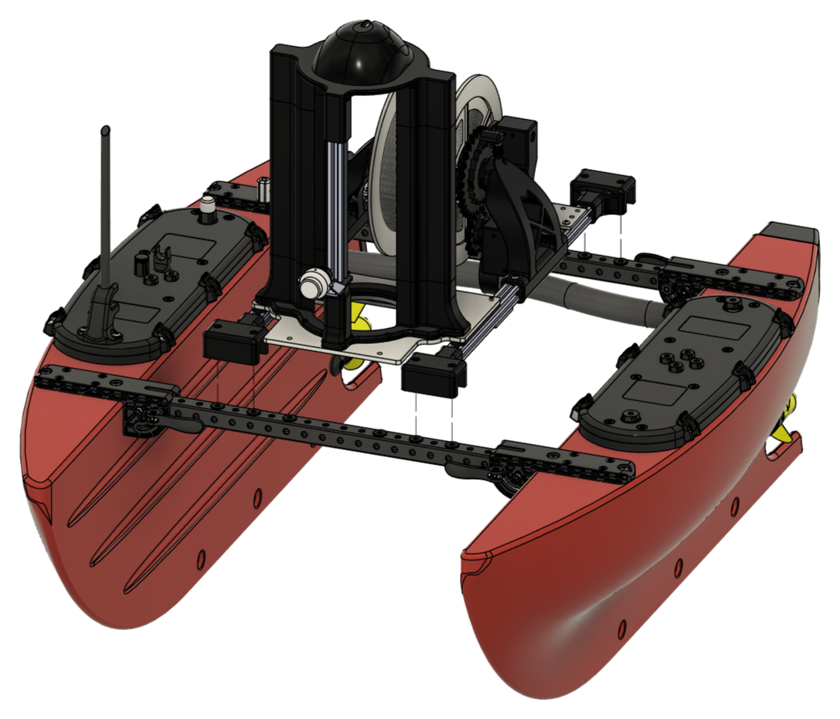
09 / BLUEBOAT INSTALLATION
ASSEMBLY STEP 02
ASSEMBLY NOTE
Position the spool aft and the CTD forward. Ensure the crossbar mounts are fully seated in the aluminium profiles so the platform fits easily onto
the crossbars.
BLUEBOAT / CTD WINCH ASSEMBLY GUIDE
47

Slide 48
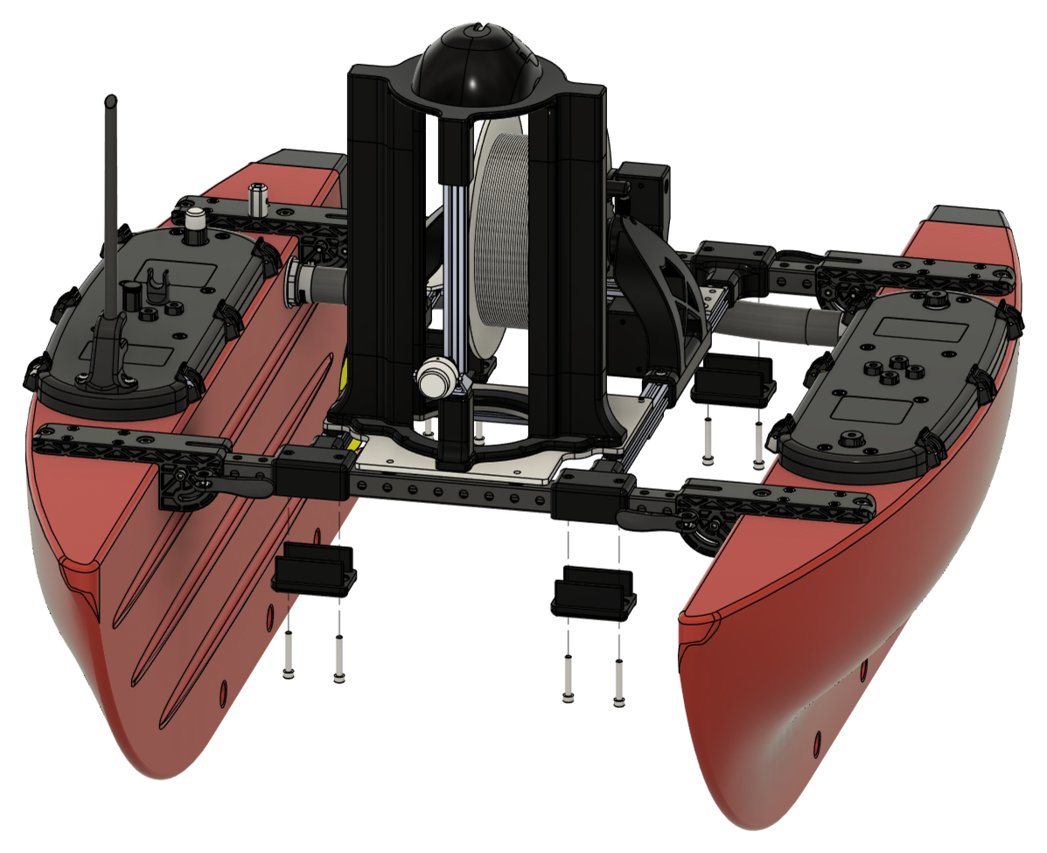
09 / BLUEBOAT INSTALLATION
ASSEMBLY STEP 03
BLUEBOAT / CTD WINCH ASSEMBLY GUIDE
48

Slide 49
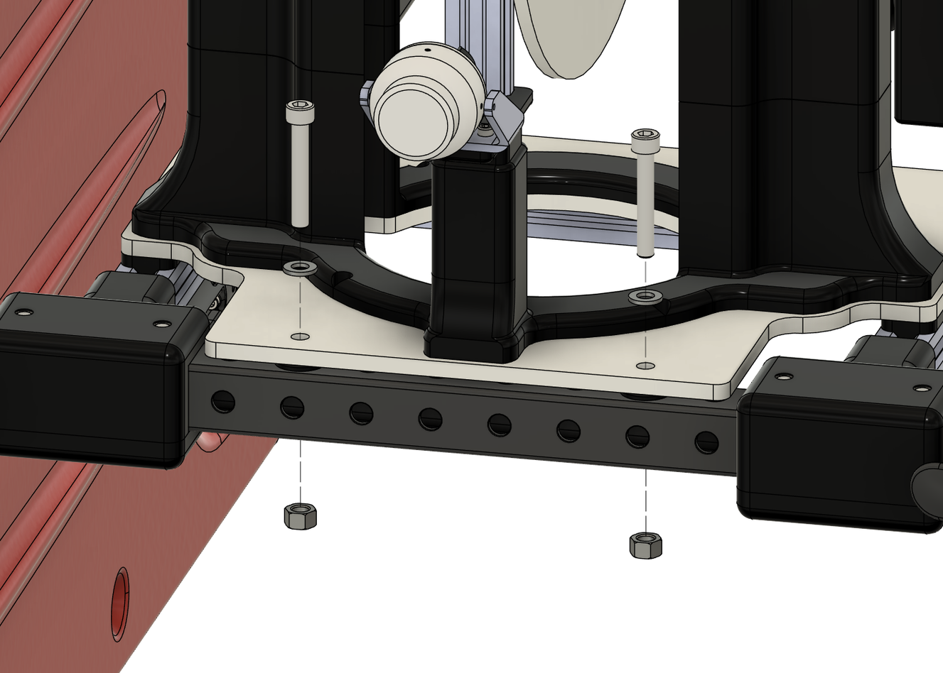
09 / BLUEBOAT INSTALLATION
ASSEMBLY STEP 04
ASSEMBLY NOTE
If the screws do not align with the crossbar holes, adjust the platform position. First loosen the socket set screws in the T-slot corner connectors
and the round-head screws in the corner brackets (see CTD Winch Platform, Step 5 and CTD Winch Platform, Step 7).
BLUEBOAT / CTD WINCH ASSEMBLY GUIDE
49

Slide 50
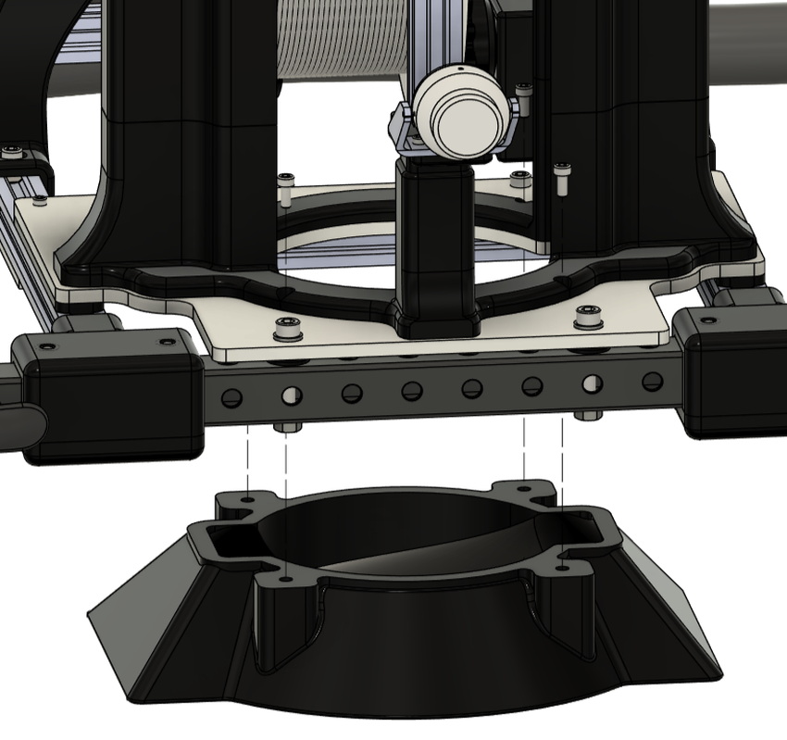
09 / BLUEBOAT INSTALLATION
ASSEMBLY STEP 05
BLUEBOAT / CTD WINCH ASSEMBLY GUIDE
50

Slide 51
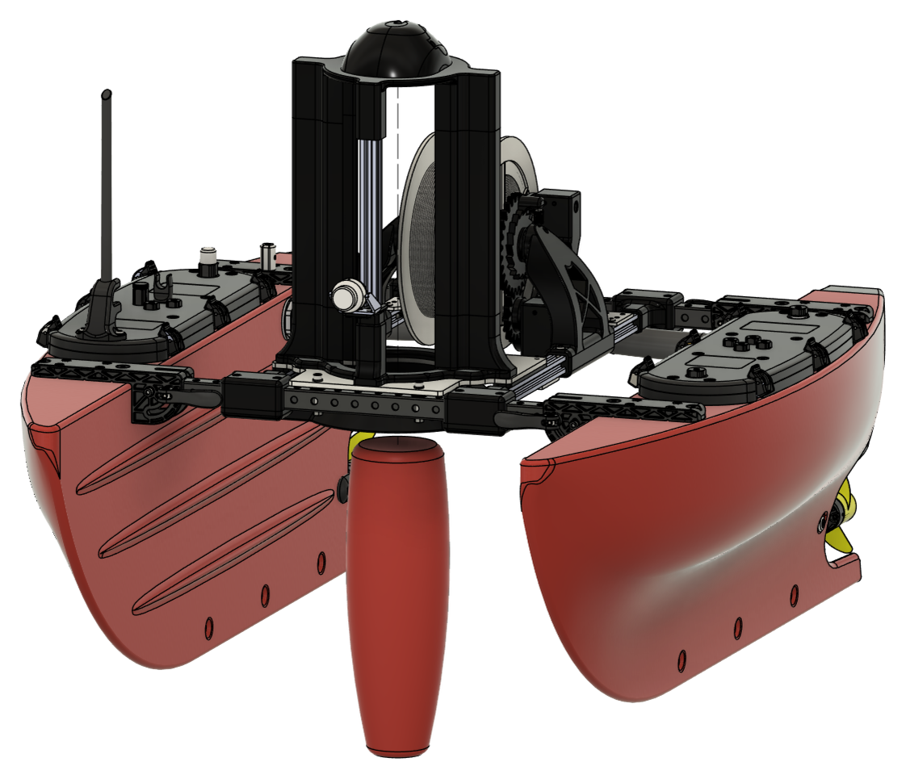
09 / BLUEBOAT INSTALLATION
ASSEMBLY STEP 06
BLUEBOAT / CTD WINCH ASSEMBLY GUIDE
51

Slide 52

09 / BLUEBOAT INSTALLATION
FINAL ASSEMBLY
COMPLETED SYSTEM
CTD winch platform installed on the BlueBoat
BLUEBOAT / CTD WINCH ASSEMBLY GUIDE
52

Slide 53
REMOVAL FOR TRANSPORT
BlueBoat / CTD winch platform
For carrying and transport, remove the CTD winch platform from the boat:
01
Open the port hatch and disconnect all cables. Lift the hatch lid clear of its hull compartment.
02
Remove the four funnel screws and detach the funnel.
03
Remove the two front screws that pass through the crossbar into the nuts underneath.
04
Remove the eight crossbar-mount screws, then take off the four caps.
05
Detach the camera mount and secure it safely on or inside the boat.
06
For easier transport, shorter aluminium profiles may be used with the CTD mount left attached. Carry the long profiles separately.
07
Move the hatch lid and CTD winch platform separately as needed.
BLUEBOAT / CTD WINCH ASSEMBLY GUIDE
53

