Slide 1




Computer Scientists
Retrieval
WEB INFORMATION RETRIEVAL 2019/2020

Slide 2


Our Team
Luca Tomei 1759275
Daniele Iacomini 1706790
Andrea Aurizi 1706890

Slide 3
Motivation & Related Work
Outline of Talk
Methodology & Experimental Design
Results
Conclusions and Future Works

Slide 4
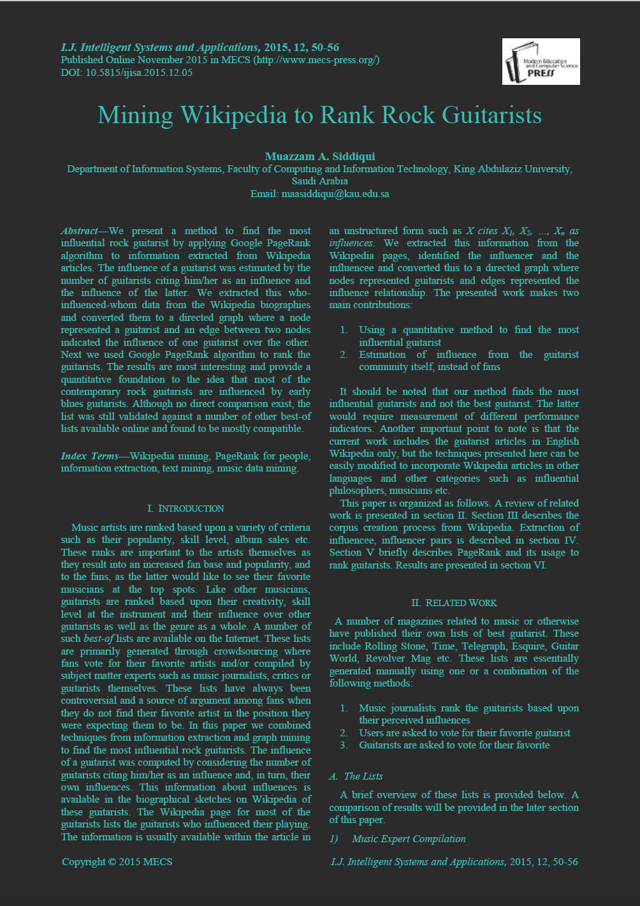

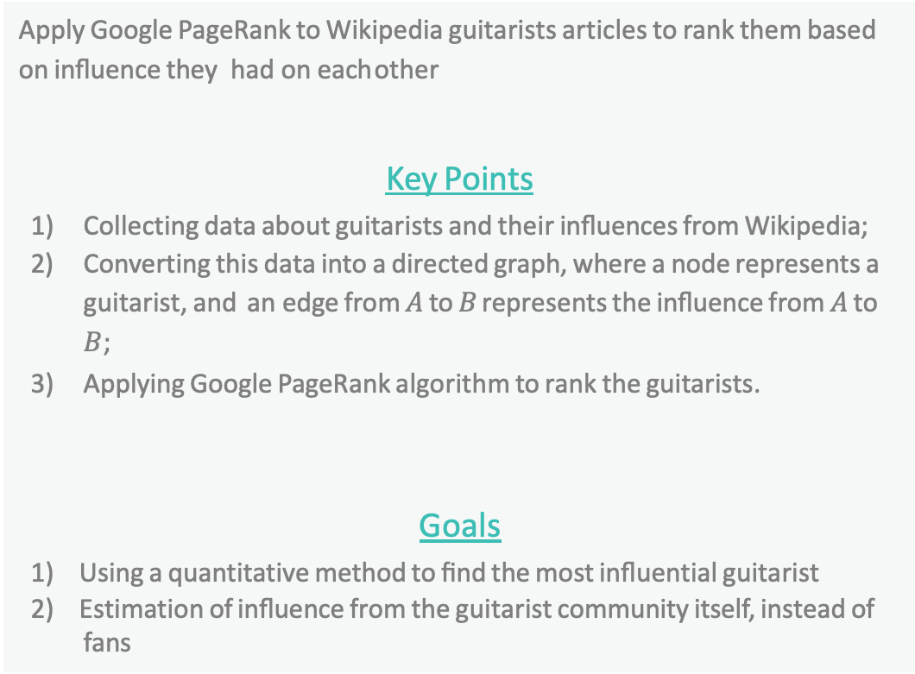
Motivation & Related Work:
Ranking Guitarists
Apply Google PageRank to Wikipedia guitarists articles to rank them based on inﬂuence they had on each other
Key Points
1) Collecting data about guitarists and their inﬂuences from Wikipedia;
2) Converting this data into a directed graph, where a node represents a
guitarist, and an edge from $A$ to $B$ represents the inﬂuence from $A$ to $B$;
3) Applying Google PageRank algorithm to rank the guitarists.
Goals
Using a quantitative method to ﬁnd the most inﬂuential guitarist
Estimation of inﬂuence from the guitarist community itself, instead of
fans

Slide 5
Methodology - Our Approach
Replicate the paper by finding the most influential computer scientists
Dataset is computed by SPARQL queries, to retrieve computer scientist influenced and influencers, and by scraping the Wikipedia pages of each computer scientist
Results are computed using two different methods:
Blind meta-data link picking
“Influences” section analysis

Slide 6
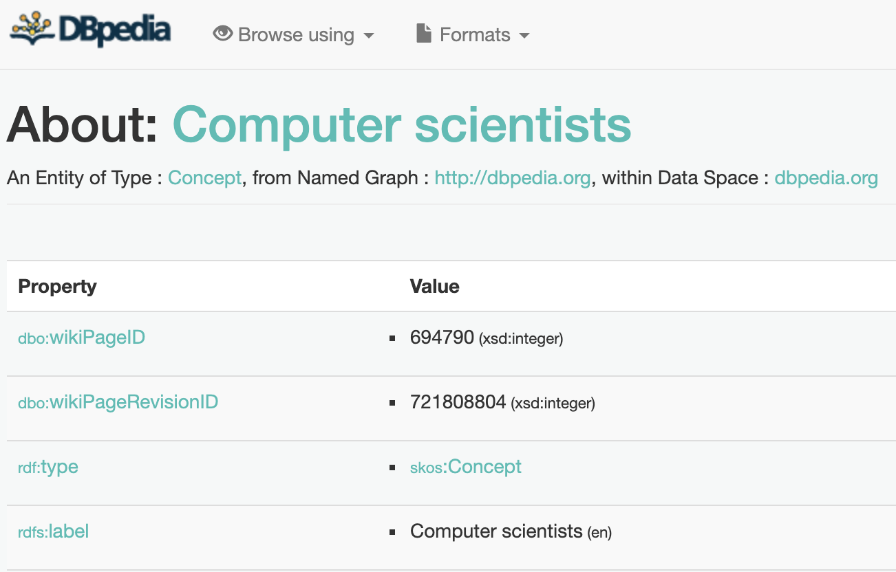
Methodology:
DBpedia Dataset Construction
Retrieve all the computer scientists from DBpedia
SPARQL queries
Lists of computer scientist
Few results
As the figure above shows, DBpedia does not retrieve results for computer scientists, because there is no dataset on them.
In DBpedia the majority of computer scientists is assigned to a generic class dbpedia:Person and not distinguished from other people.
DBpedia returns to the Wikipedia page

Slide 7
Methodology:
Manual Wikipedia scraping
01
02
03
04
Collect all C.S. Links
Check biography table
Computing Pagerank
C.S. Fields Classification
Collect in a file all the links of computer scientists present on Wikipedia
Check whether the relative page contains information about his influences
Quantify the importance of computer scientists
Classification of the various fields of study of a computer scientist

Slide 8
Methodology:
Wikipedia Dataset Construction
Lists of computer scientists
Retrieve all the computer scientists from Wikipedia
Associate each computer scientist in order to consider his influences
Download each Wikipedia page associated to each computer scientist
Python scripts are being used in order to provide the lists and download the pages, resulting in 509 different computer scientist.
Retrieve Computer Scientists Wikipedia pages
Applying Google PageRank algorithm to rank computer scientists.
Computer Scientist branches classification

Slide 9
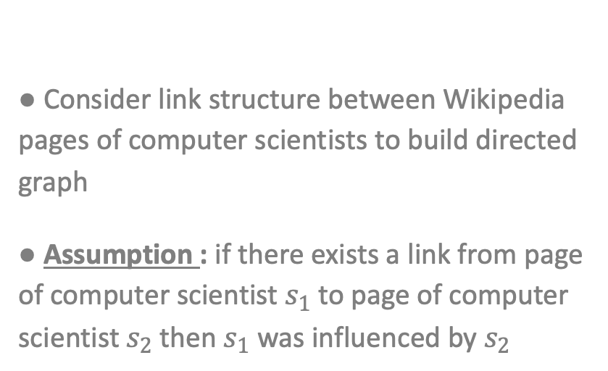
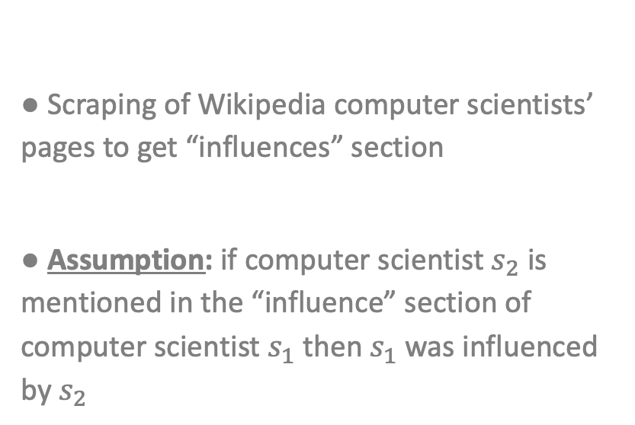
Methodology – Methods Used
1) Blind meta-data link picking
Consider link structure between Wikipedia pages of computer scientists to build directed graph
Assumption : if there exists a link from page of computer scientist $s_{1}$ to page of computer scientist $s_{2}$ then $s_{1}$ was influenced by $s_{2}$
2) “Influences” section analysis
Scraping of Wikipedia computer scientists’ pages to get “influences” section
Assumption: if computer scientist $s_{2}$ is mentioned in the “influence” section of computer scientist $s_{1}$ then $s_{1}$ was influenced by $s_{2}$

Slide 10
Results & Personalized Pagerank
Donald_Knuth | 0.08372
Rudy_Rucker | 0.07940
Fred_Brooks | 0.07389
Adi_Shamir | 0.06984
Douglas_Engelbart | 0.06941
Allen_Newell | 0.06934
Stephen_Wolfram | 0.06704
Alan_Kay | 0.06534
Niklaus_Wirth | 0.06421
Alan_Perlis | 0.06368
E._Allen_Emerson | 0.06327
Herbert_A._Simon | 0.06236
Dennis_Ritchie | 0.06233
Edmund_M._Clarke | 0.06215
Amir_Pnueli | 0.06165
Dana_Scott | 0.06021
John_McCarthy | 0.05920
John_Cocke | 0.05905
Barbara_Liskov | 0.05878
Charles_Bachman | 0.05854
Donald_Knuth | 0.01353
Vint_Cerf | 0.01129
Niklaus_Wirth | 0.01079
Fred_Brooks | 0.01050
Silvio_Micali | 0.01032
Shafi_Goldwasser | 0.01005
Marvin_Minsky | 0.00987
Douglas_Engelbart | 0.00981
Leslie_Valiant | 0.00957
Allen_Newell | 0.00956
Adi_Shamir | 0.00918
Alan_Kay | 0.00916
John_McCarthy | 0.00911
Herbert_A._Simon | 0.00910
Robert_Tarjan | 0.00909
John_Hopcroft | 0.00898
Richard_Karp | 0.00891
Dennis_Ritchie | 0.00890
Stephen_Wolfram | 0.00882
John_Cocke | 0.00861
Robert_Tarjan | 0.01675
Donald_Knuth | 0.01673
Adi_Shamir | 0.01672
Michael_O._Rabin | 0.01672
E._Allen_Emerson | 0.01671
Ron_Rivest | 0.01671
Leonard_Adleman | 0.01671
Edmund_M._Clarke | 0.01671
Allen_Newell | 0.01667
John_McCarthy | 0.01666
Herbert_A._Simon | 0.01665
Silvio_Micali | 0.01664
Shafi_Goldwasser | 0.01662
Richard_Karp | 0.01661
John_Cocke | 0.01661
Niklaus_Wirth | 0.01654
Fred_Brooks | 0.01650
Douglas_Engelbart | 0.01649
Vint_Cerf | 0.01648
Leslie_Valiant | 0.01647
Personalized Pagerank
NetworkX Pagerank
NetworkX Hits

Slide 11
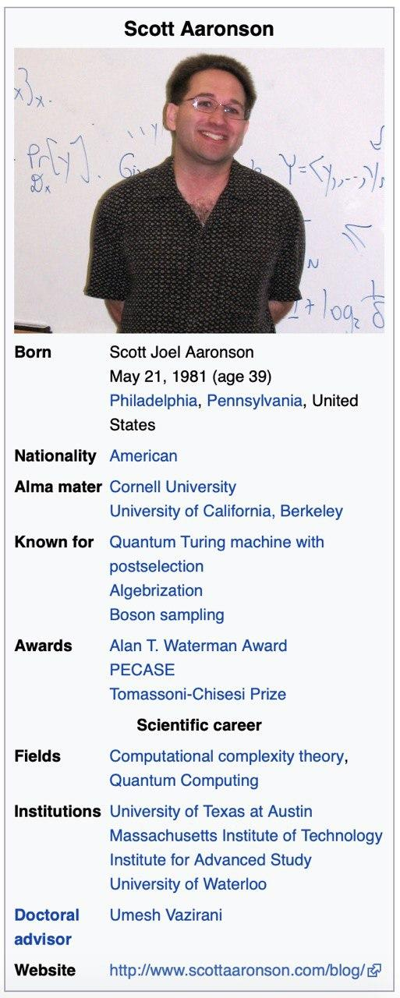
Another Approach:
Computer Scientists Branches
A further experiment was to try to draw up a ranking of the best branches of study carried out by these people.
In evaluating the fields that can be used, it has been verified that the majority of computer scientists present in the famous Wikipedia infobox table a field called Field which is right for us: it contains every category of study carried out from the person being examined.

Slide 12
Applying Pagerank and HITS on Branches
Computer science | 0.04921
Mathematics | 0.02152
Artificial intelligence | 0.01889
Human-computer interaction | 0.01111
Theoretical computer science | 0.00921
Logic | 0.00838
Semantic web | 0.00812
Machine learning | 0.00812
Robotics | 0.00786
Electrical engineering | 0.00776
Entrepreneur | 0.00673
Statistics | 0.00673
Computer engineering | 0.00673
Computational information systems | 0.00673
Cognitive science | 0.00658
Cryptography | 0.00622
Parallel computing | 0.00622
Computer graphics | 0.00622
Operating systems | 0.00622
Engineering | 0.00596
Computer science | 0.32612
Mathematics | 0.0905
Artificial intelligence | 0.06685
Logic | 0.03428
Electrical engineering | 0.02833
Human-computer interaction | 0.02135
Cognitive psychology | 0.01891
Internet | 0.01787
Cryptography | 0.01739
Engineering | 0.01721
Parallel computing | 0.01688
Computer engineering | 0.01667
Cognitive science | 0.01277
Machine learning | 0.012120
Theoretical biology | 0.01152
Cryptanalysis | 0.01152
Complex systems | 0.0111
Political science | 0.01052
Economics | 0.01052
Biology | 0.01038
What We Can Do
Compare the results given by the Pagerank algorithm with other qualitative methods
NetworkX Pagerank
NetworkX HITS

Slide 13
Conclusions
Future Works
Successful appliance of procedures descripted in the original paper to computer scientists
The discrepancy between the rankings is minimal
Major difficulty in the experiment: polishing the data in order to provide reliable results
We realized that through the scraping of Wikipedia we can access to some other information.
In fact, most of the biographical tables of a computer scientist also report the universities that he attended or those in which he held the role of teacher.
In the future, these data could be accessed to draw up a ranking of the best universities.

Slide 14


Our Team
Luca Tomei 1759275
Daniele Iacomini 1706790
Andrea Aurizi 1706890
Thanks

