Slide 1

Symbolic Execution of Malicious Software: Countering Sandbox Evasion Techniques
Intro Evasion Study Extension Evaluation Conclusions
Luca Tomei
Advisors: Andrea Vitaletti
October 24, 2020
Master of Science in Engineering in Computer Science
M.Sc. Engineering in Computer Science

Slide 2
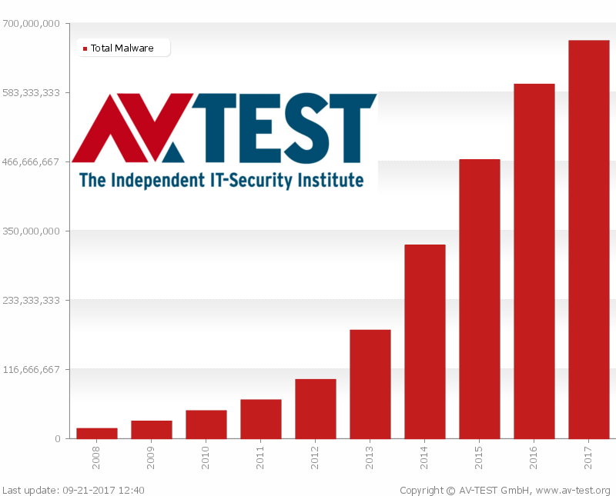
Intro Evasion Study Extension Evaluation Conclusions Malware analysis Symbolic execution
Malicious software - An ever growing threat
M.Sc. Engineering in Computer Science

Slide 3



Intro Evasion Study Extension Evaluation Conclusions
Malware analysis Symbolic execution
Malware analysis
Static analysis
Dynamic analysis
M.Sc. Engineering in Computer Science

Slide 4
Intro Evasion Study Extension Evaluation Conclusions
Malware analysis Symbolic execution
Concrete execution - Example
int foo() {
int x = 1;
int y = read_int(); int z = y * 2 + x if (z == 13) {
return ERROR;
} else {
return SUCCESS;
}
}
M.Sc. Engineering in Computer Science

Slide 5
Intro Evasion Study Extension Evaluation Conclusions
Malware analysis Symbolic execution
Concrete execution - Example
int foo() {
int x = 1;
int y = read_int(); int z = y * 2 + x if (z == 13) {
return ERROR;
} else {
return SUCCESS;
}
}
3
4 / 20
M.Sc. Engineering in Computer Science

Slide 6
Intro Evasion Study Extension Evaluation Conclusions
Malware analysis Symbolic execution
Concrete execution - Example
int foo() {
int x = 1;
int y = read_int(); int z = y * 2 + x if (z == 13) {
return ERROR;
} else {
return SUCCESS;
}
}
3
7
4 / 20
M.Sc. Engineering in Computer Science

Slide 7
Intro Evasion Study Extension Evaluation Conclusions
Malware analysis Symbolic execution
Concrete execution - Example
int foo() {
int x = 1;
int y = read_int(); int z = y * 2 + x if (z == 13) {
return ERROR;
} else {
return SUCCESS;
}
}
3
7
4 / 20
M.Sc. Engineering in Computer Science

Slide 8
Intro Evasion Study Extension Evaluation Conclusions
Malware analysis Symbolic execution
Symbolic execution - Example
int foo() {
int x = 1;
int y = read_int(); int z = y * 2 + x if (z == 13) {
return ERROR;
} else {
return SUCCESS;
}
}
5 / 20
M.Sc. Engineering in Computer Science

Slide 9
Intro Evasion Study Extension Evaluation Conclusions
Malware analysis Symbolic execution
Symbolic execution - Example
int foo() {
int x = 1;
int y = read_int(); int z = y * 2 + x if (z == 13) {
return ERROR;
} else {
return SUCCESS;
}
}
λ
5 / 20
M.Sc. Engineering in Computer Science

Slide 10
Intro Evasion Study Extension Evaluation Conclusions
Malware analysis Symbolic execution
Symbolic execution - Example
int foo() {
int x = 1;
int y = read_int(); int z = y * 2 + x if (z == 13) {
return ERROR;
} else {
return SUCCESS;
}
}
λ
λ * 2 + 1
5 / 20
M.Sc. Engineering in Computer Science

Slide 11

Intro Evasion Study Extension Evaluation Conclusions
Malware analysis Symbolic execution
Symbolic execution - Example
int foo() {
int x = 1;
int y = read_int(); int z = y * 2 + x if (z == 13) {
return ERROR;
} else {
return SUCCESS;
}
}
λ
λ * 2 + 1
Forking!
5 / 20
M.Sc. Engineering in Computer Science

Slide 12
Intro Evasion Study Extension Evaluation Conclusions
Malware analysis Symbolic execution
Symbolic execution - Example
int foo() {
int x = 1;
int y = read_int(); int z = y * 2 + x if (z == 13) {
return ERROR;
} else {
return SUCCESS;
}
}
λ
λ * 2 + 1
Forking!
, , _{z}if λ * 2 + 1 == 13 _{r}
, ,
_{z}if λ * 2 + 1 != 13 _{r}
M.Sc. Engineering in Computer Science

Slide 13

Symbolic execution of malware
Intro Evasion Study Extension Evaluation Conclusions Malware analysis Symbolic execution
Symbolic execution applications have been practically exclusively confined to general software testing, with excellent results.
The ability to potentially cover all possible execution paths and subsequently identify the corresponding concrete input values that would elicit them, make it an ideal instrument for the study of the trigger-based behaviors extremely common in malware.
M.Sc. Engineering in Computer Science

Slide 14

Intro Evasion Study Extension Evaluation Conclusions
Definition Problem
Malware evasion defined
Malware evasion
The set of techniques employed by malware to avoid being detected by an automated dynamic analysis product.
An evasive malware is a malware that exhibits no malicious behavior in a sandbox, but that infects the intended target.
if observed:
act_innocent()
else:
do_bad_things()
7 / 20
M.Sc. Engineering in Computer Science

Slide 15
The problem with malware evasion
Intro Evasion Study Extension Evaluation Conclusions Definition Problem
Evasive checks represent critical branching points
8 / 20
M.Sc. Engineering in Computer Science

Slide 16
The problem with malware evasion
Intro Evasion Study Extension Evaluation Conclusions Definition Problem
Evasive checks represent critical branching points
8 / 20
M.Sc. Engineering in Computer Science

Slide 17
The problem with malware evasion
Intro Evasion Study Extension Evaluation Conclusions Definition Problem
Evasive checks represent critical branching points
8 / 20
M.Sc. Engineering in Computer Science

Slide 18


The problem with malware evasion
Intro Evasion Study Extension Evaluation Conclusions Definition Problem
Evasive checks represent critical branching points
8 / 20
M.Sc. Engineering in Computer Science

Slide 19
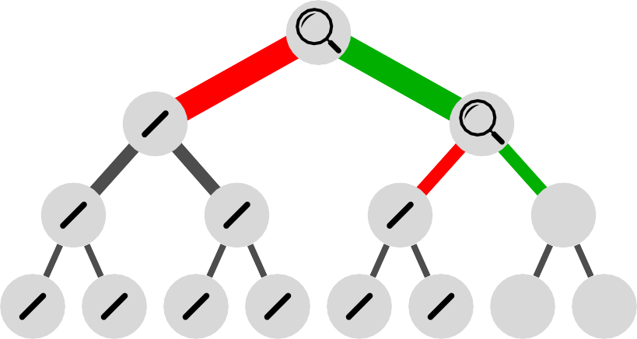
The problem with malware evasion
Intro Evasion Study Extension Evaluation Conclusions Definition Problem
Evasive checks represent critical branching points
8 / 20
M.Sc. Engineering in Computer Science

Slide 20
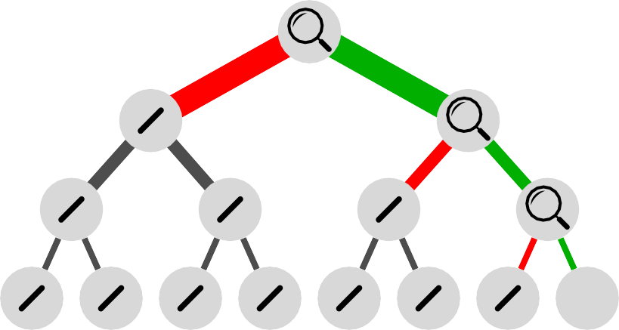
The problem with malware evasion
Intro Evasion Study Extension Evaluation Conclusions Definition Problem
Evasive checks represent critical branching points
8 / 20
M.Sc. Engineering in Computer Science

Slide 21
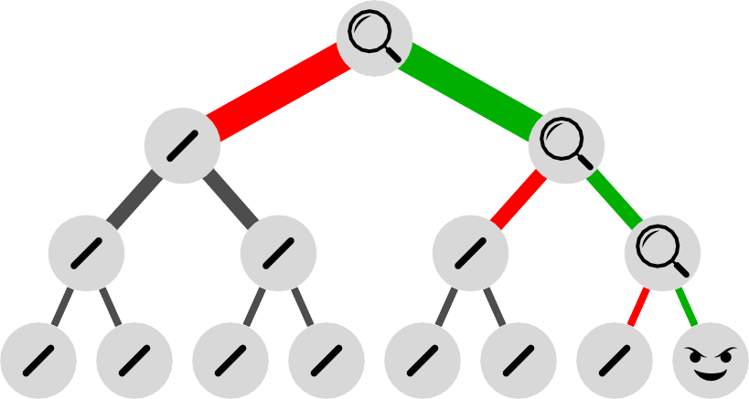
The problem with malware evasion
Intro Evasion Study Extension Evaluation Conclusions Definition Problem
Evasive checks represent critical branching points
8 / 20
M.Sc. Engineering in Computer Science

Slide 22
Contribution: malware evasion categorization
Intro Evasion Study Extension Evaluation Conclusions Evasion categorization API pattern study
OS
Artifact-based
Process
File-system
Reactive-Detection
Hardware-based
Time-based
Reverse-Turing-Tests
Evasion
Time-based
Proactive-Attack
Instruction-based
9 / 20
M.Sc. Engineering in Computer Science

Slide 23
Contribution: common Windows API interaction patterns
Intro Evasion Study Extension Evaluation Conclusions Evasion categorization API pattern study
Category
Check
Involved APIs
OS artifacts detection
Registry key presence RegOpenKeyEx
RegOpenKeyEx RegQueryValueEx
Registry key value
User name GetUserName
Process enumeration CreateToolhelp32Snapshot
Windows FindWindow
10 / 20
M.Sc. Engineering in Computer Science

Slide 24
Contribution: common Windows API interaction patterns
Intro Evasion Study Extension Evaluation Conclusions Evasion categorization API pattern study
Category
Check
Involved APIs
Process artifacts detection
Hooks -
Injected DLLs GetModuleHandle
IsDebuggerPresent OutputDebugString CheckRemoteDebuggerPresent
Debugging
11 / 20
M.Sc. Engineering in Computer Science

Slide 25
Contribution: common Windows API interaction patterns
Intro Evasion Study Extension Evaluation Conclusions Evasion categorization API pattern study
Category
Check
Involved APIs
File system artifacts detection
GetFileAttributes CreateFile
File system artifact presence
Execution path GetModuleFileName
GetLogicalDriveStrings GetFileAttributes
Common file names
12 / 20
M.Sc. Engineering in Computer Science

Slide 26
Contribution: common Windows API interaction patterns
Intro Evasion Study Extension Evaluation Conclusions Evasion categorization API pattern study
Category
Check
Involved APIs
Hardware-based detection
Single-CPU GetSystemInfo
Small amount of RAM GlobalMemoryStatusEx
DeviceIoControl GetDiskFreeSpaceEx
Small drive size
CPUID fingerprinting CPUID
Network adapter details GetAdaptersAddresses
13 / 20
M.Sc. Engineering in Computer Science

Slide 27
Contribution: common Windows API interaction patterns
Intro Evasion Study Extension Evaluation Conclusions Evasion categorization API pattern study
Category
Check
Involved APIs
Time-based detection
GetTickCount Sleep
Sleep patched
Uptime GetTickCount
RDTSC timing RDTSC
Network adapter details GetAdaptersAddresses
Reverse Turing tests
Mouse movement GetCursorPos
14 / 20
M.Sc. Engineering in Computer Science

Slide 28

Contribution: Angr anti-evasion extension
Intro Evasion Study Extension Evaluation Conclusions
Angr: an open source python framework for analyzing binaries that combines both static and dynamic symbolic analysis (http://angr.io/).
15 / 20
M.Sc. Engineering in Computer Science

Slide 29
Contribution: Angr anti-evasion extension
Intro Evasion Study Extension Evaluation Conclusions
Constrain the symbolic exploration to pass the evasive detection checks
16 / 20
M.Sc. Engineering in Computer Science

Slide 30
Contribution: Angr anti-evasion extension
Intro Evasion Study Extension Evaluation Conclusions
Constrain the symbolic exploration to pass the evasive detection checks
16 / 20
M.Sc. Engineering in Computer Science

Slide 31
Contribution: Angr anti-evasion extension
Intro Evasion Study Extension Evaluation Conclusions
Constrain the symbolic exploration to pass the evasive detection checks
16 / 20
M.Sc. Engineering in Computer Science

Slide 32
Contribution: Angr anti-evasion extension
Intro Evasion Study Extension Evaluation Conclusions
Constrain the symbolic exploration to pass the evasive detection checks
16 / 20
M.Sc. Engineering in Computer Science

Slide 33
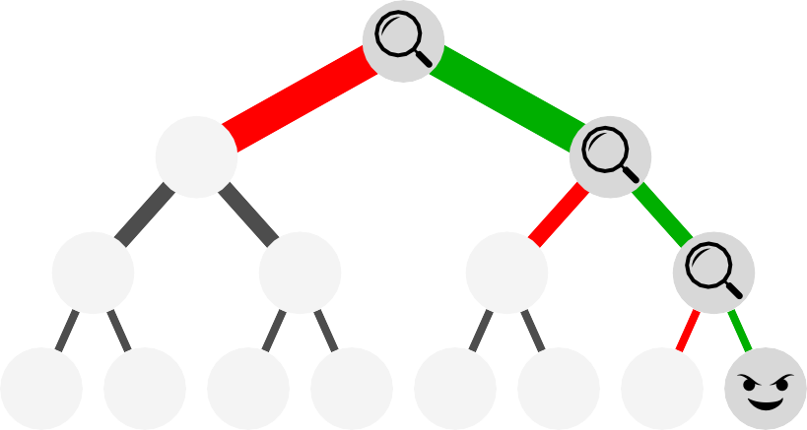
Contribution: Angr anti-evasion extension
Intro Evasion Study Extension Evaluation Conclusions
Constrain the symbolic exploration to pass the evasive detection checks
16 / 20
M.Sc. Engineering in Computer Science

Slide 34

Extension evaluation - Paranoid Fish
Intro Evasion Study Extension Evaluation Conclusions Paranoid Fish Kasidet malware
Paranoid Fish: open source tool that demonstrates several
techniques employed by malware families to detect whether they are being executed in an analysis
environment, be it a debugger, a VM, or a sandbox.
57 different checking functions
Unaided Aided by extension
17 / 20
M.Sc. Engineering in Computer Science

Slide 35
Intro Evasion Study Extension Evaluation Conclusions
Paranoid Fish Kasidet malware
Extension evaluation - Kasidet
Kasidet malware: backdoor, gathers information and communicates with a C&C server, allowing a remote attacker to take over the infected machine by exchanging files with the server and executing shell commands.
Sample de1af0e97e94859d372be7fcf3a5daa5.
17 different detective evasion functions Unaided Aided by extension
18 / 20
M.Sc. Engineering in Computer Science

Slide 36
Conclusions - Summary
Intro Evasion Study Extension Evaluation Conclusions
Thesis focus:
improving the applicability of symbolic execution to the malware domain by patching evasion techniques.
Contributions:
high level categorization of evasive techniques
Windows API interaction patterns study for the most widespread detective evasion techniques
Angr anti-evasion extension
19 / 20
M.Sc. Engineering in Computer Science

Slide 37
Thesis, slides, and code are all available at
Intro Evasion Study Extension Evaluation Conclusions
https://github.com/LucaTomei/Electric-Scooter-Wheelchair
Thank you!
Luca Tomei
tomei.1759275@studenti.uniroma1.it
20 / 20
M.Sc. Engineering in Computer Science

