Slide 1



Wails & Vue
bit.ly/esd-wails
or
github.com/sebivenlo/esd-2024-wailsvue
Kristijan, Luca & Miro

Slide 2



Our Goals
Learn some Vue.js
Bring Web-Technology to the Desktop
Have it bundled in a single executable

Slide 3
Wails Framework
Builds desktop apps using Go
Has quick start templates (for Svelte, React, Vue, Preact, Lit & Vanilla)
Uses native elements for an OS appropriate look and feel
Go & JS interoperability helps connecting frontend

Slide 4
Wails Framework
Provides runtime library to handle eventing, logging, dialogs etc.
Live development – automatic rebuilds and reloads
Allows developing in a browser (auto-refresh when assets change on disk)

Slide 5

Competition – Electron 1/2
Category | Electron | Wails
Footprint | >100MB | <10MB
Architecture | Bundled Chromium/Node.js Engine | Relies on System's Webview
Stack | JavaScript/TypeScript + any Frontend | GoLang + any Frontend
Community | Large, Matured Community | Growing radidly among Go developers
Notes:
* Tauri can technically be used to distribute single executables, but they never claim to support this is the standard way, since dependencies might be missing that way.

Slide 6
Competition – Electron 2/2
Category | Electron | Wails
Performance | Resource intensive | Lower resource usage
Complexity | Higher degree of customization + control over underlying system | Designed to be more accessible and easier to use
Notes:
* Tauri can technically be used to distribute single executables, but they never claim to support this is the standard way, since dependencies might be missing that way.

Slide 7

Competition - Tauri
Category | Tauri | Wails
Language | Rust | Go
Community support | Larger and rapidly growing | Smaller but rapidly growing
Package | Installer Only* | Single Executable
Trade-offs | Steeper learning curve, but more secure | Easier to use, but lacks some advanced features
Notes:
* Tauri can technically be used to distribute single executables, but they never claim to support this is the standard way, since dependencies might be missing that way.

Slide 8
Why choose Wails?
Advantages compared to other frameworks:
Startup & Execution Speed
Go backend
Small Footprint
No Node.js runtime
Wails build → single executable

Slide 9
Architecture
GO → BACKEND
←FRONTEND
Communication layer (JS bindings)

Slide 10
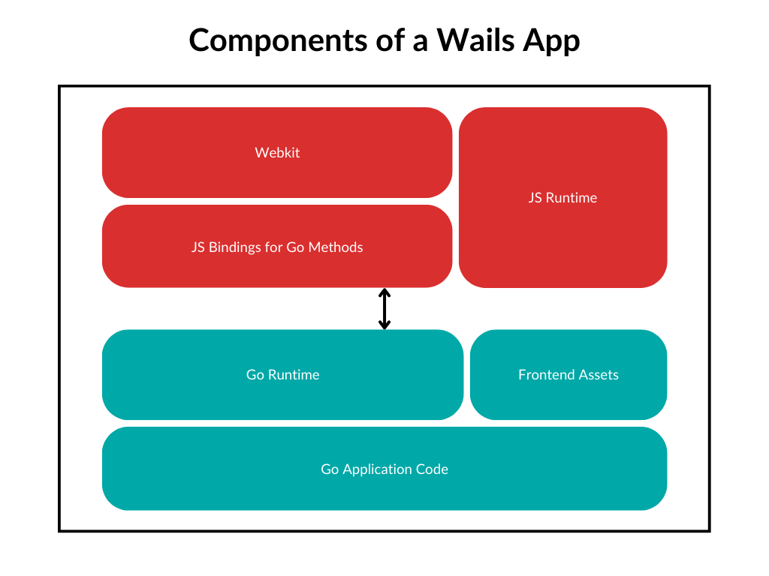
Architecture

Slide 11
Vue – one of the frontend options
JS framework used for building UIs
Created by Evan You in 2014
Builds on top of HTML CSS & JS

Slide 12

Vue – Key Features
Declarative
Rendering
Reactive
Components
Template
Syntax
Reusable
Components

Slide 13
Vue – Benefits of use
Easy to learn – gentle learning curve
Can be used for small to large scale apps
Can be progressively added to apps
Single file components
Already large community
Lightweight

Slide 14
Vue - Basic Concepts You’ll Learn
Templating
Components
Data Binding
Event Handling
Conditional Rendering

Slide 15
Thank you for your attention! Let’s start with the workshop!

Slide 16
Sources
wails.io/docs/introduction
vuejs.org/guide/introduction

