Slide 1
Revisione
revisione del precedente

Slide 2
Basic
To import the pandas library under the alias pd, you would use the statement
import pandas as pd

Slide 3
Basic
Correct the Error
df = pd.Dataframe({'A': [1, 2, 3], 'B': [4, 5, 6]})
df = pd.dataframe({'A': [1, 2, 3], 'B': [4, 5, 6]})
df = pd.DataFrame({'A': [1, 2, 3], 'B': [4, 5, 6]})
s = pd.Series(1, 2, 3, 4)
s = pd.series([1, 2, 3, 4])
s = pd.Series([1, 2, 3, 4])

Slide 4
Basic
To read a CSV file named 'data.csv' into a DataFrame, use the command
read_csv
pd.__________('data.csv')

Slide 5
Basic
The pandas I/O API is a set of top level reader functions accessed like pandas.read_csv() that generally return a pandas object. The corresponding writer functions are object methods that are accessed like DataFrame.to_csv(). Below is a table containing available readers and writers.

Slide 6
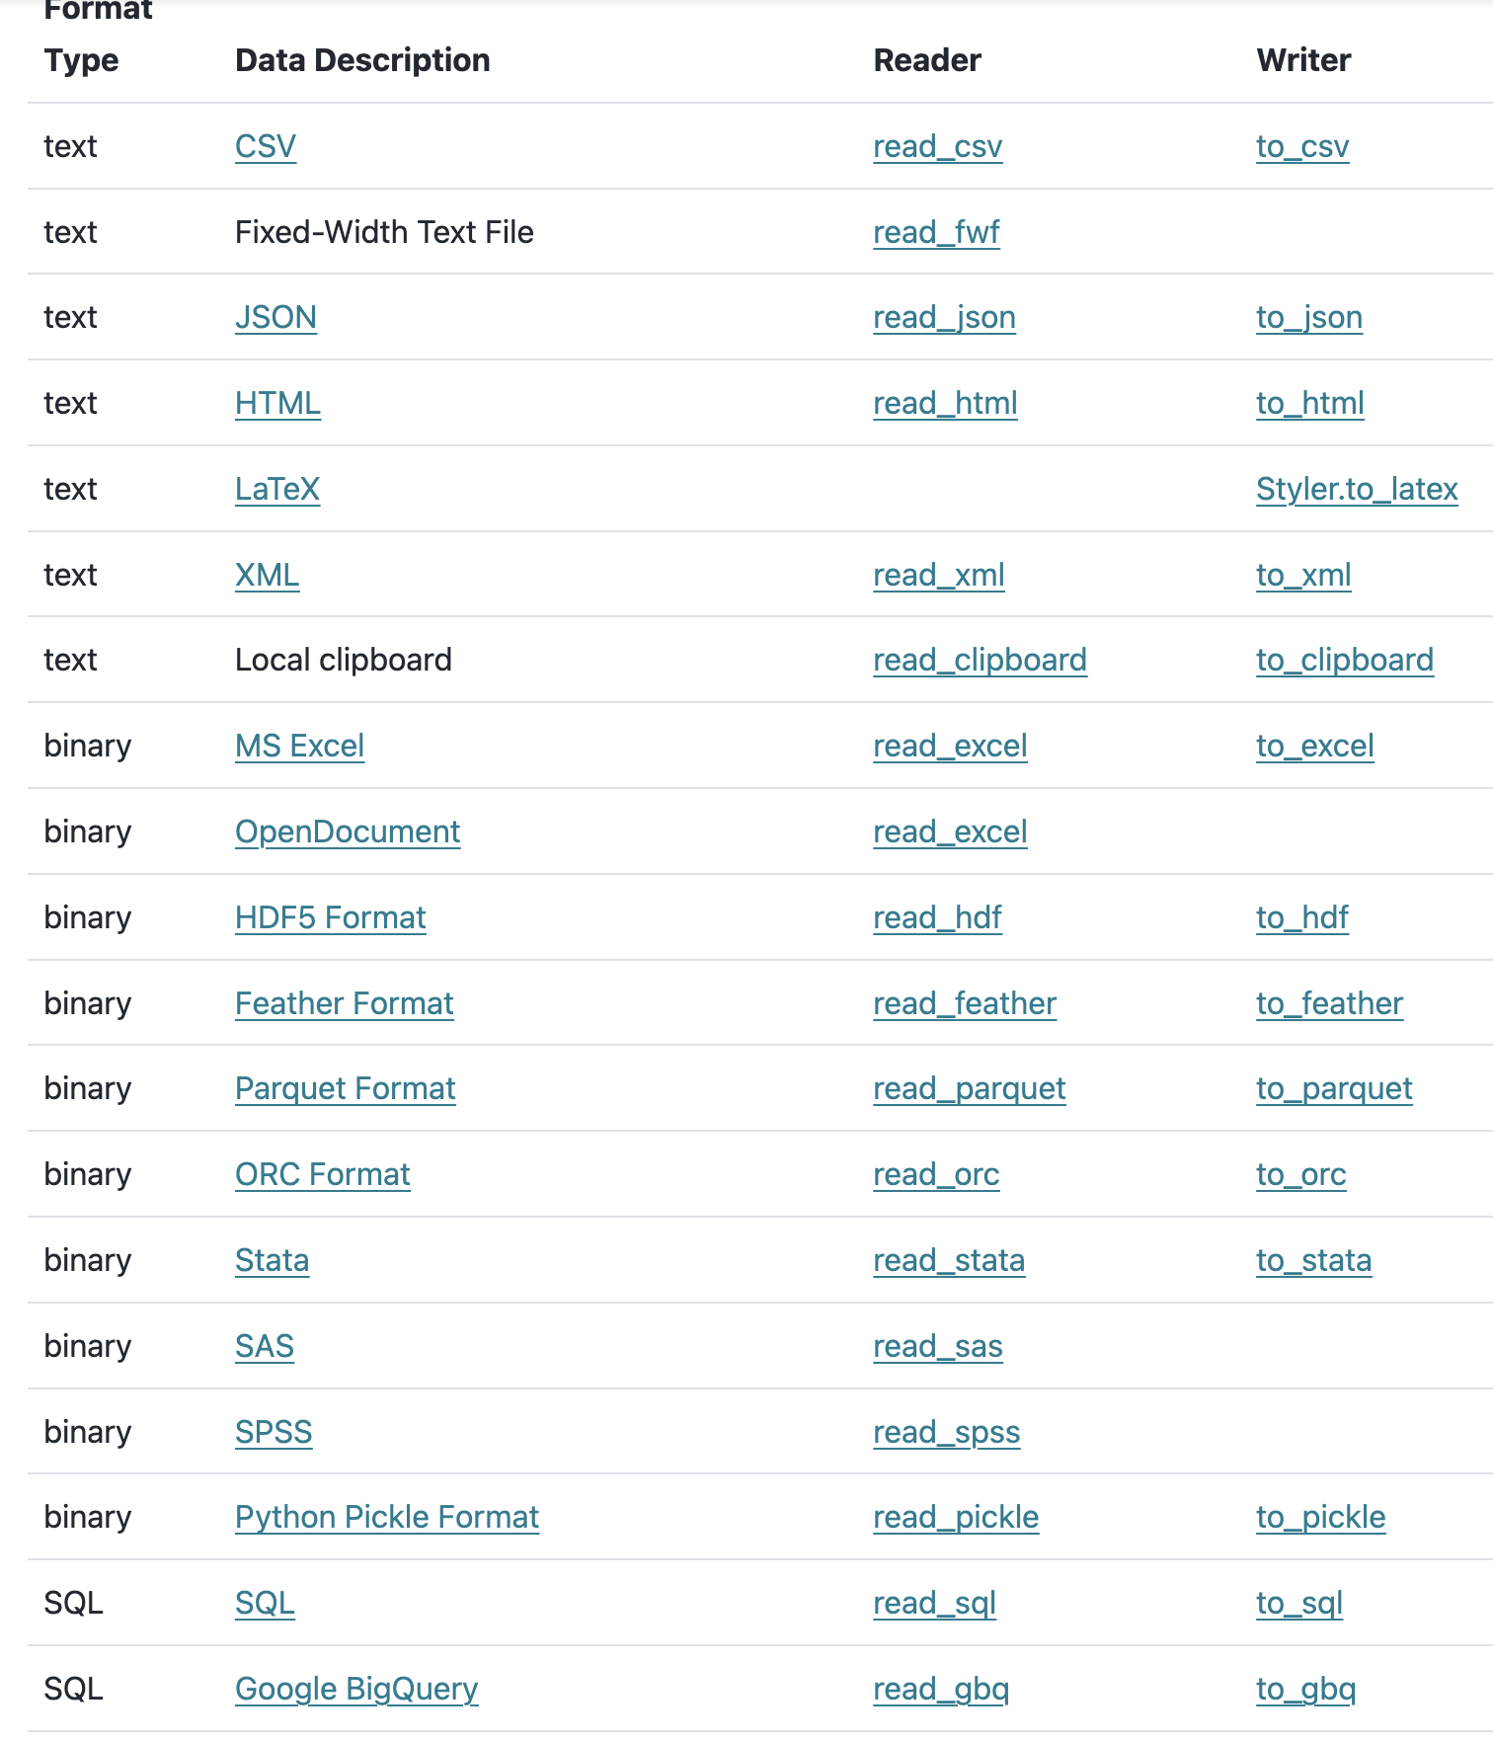
https://pandas.pydata.org/docs/user_guide/io.html

Slide 7
DataFrame Operations
To select a column named 'Age' from a DataFrame called df, you would use
df ['Age’] or df.Age

Slide 8
DataFrame Operations
To drop rows with any missing values from the DataFrame df, use the method
how
df.dropna(__________='any')

Slide 9
Data Manipulation
To apply a function named calculate_age across the 'Birthdate' column of a DataFrame df,
apply
df['Birthdate'].__________(calculate_age)

Slide 10
Data Manipulation
To group data in df by the 'Year' column and then calculate the mean of the 'Sales' column, you would use
'Year'
'agg'
df.groupby(__________).__________['Sales'].mean()
df.agg('mean') # Computes the mean of each column
df.groupby('column').agg('sum') # Computes the sum of groups defined by 'column'
df.agg(['sum', 'min', 'max']) # Applies sum, min, and max to each column
df.groupby('column').agg(['mean', 'std']) # Computes mean and std dev of groups
df.agg({'A': 'sum', 'B': 'mean'}) # Applies sum to column A and mean to column B

Slide 11
Filtering Data
To filter rows in df where the column 'Age' is greater than 25, you would use
25
df[df['Age'] > _________]

Slide 12
Filtering Data
To select rows in df where 'Age' is greater than 20 and less than 30, use
30
df[(df['Age'] > 20) & (df['Age'] < _________)]
df[~(df['column'] == value)]
df[(df['column1'] > value1) | (df['column2'] == value2)]
df[(df['column1'] > value1) & (df['column2'] == value2)]

Slide 13
Merging and Joining
To merge two DataFrames, df1 and df2, on a key column named 'ID',
'ID'
pd.merge(df1, df2, on=_________)

Slide 14
df.merge()
Syntax:
df.merge(right, how='inner', on=None, left_on=None, right_on=None, left_index=False, right_index=False, sort=False)
Purpose: Merges df (left DataFrame) with right (another DataFrame) based on some form of alignment: either on common columns (keys) or common index levels (or a combination of both).
Key Parameters:
right: The DataFrame you are joining with.
how: Specifies how to determine which keys are to be included in the resulting table. Can be one of 'left', 'right', 'outer', 'inner'. Default is 'inner'.
on: Column or index level names to join on. Must be found in both DataFrames.
left_on: Columns from the left DataFrame to use as keys.
right_on: Columns from the right DataFrame to use as keys.
left_index: If True, use the index (row labels) from the left DataFrame as its join key(s).
right_index: If True, use the index from the right DataFrame as its join key.

Slide 15
Merging and Joining
To perform a left join of df1 and df2 on the column 'ID',
left
pd.merge(df1, df2, how=_________, on='ID')

Slide 16
Advanced Operations
To pivot data in df creating a pivot table that shows the mean of 'Sales' indexed by 'Year' and columns as 'Region',
Year
df.pivot_table(values='Sales', index=_________, columns='Region', aggfunc='mean')

Slide 17
Advanced Operations
To replace all occurrences of -999 in df with NaN
-999
df.replace(_________, np.nan)

Slide 18
Time Series
To convert the string column 'Date' in df to datetime format
'Date'
pd.to_datetime(df[_________])

Slide 19
Time Series
For resampling a time-series DataFrame df on the 'Date' column to find the mean of monthly data,
df.resample('M', on='Date').mean()

Slide 20
Column / Row selection
df [‘Column_name’] or df.column_name
df.loc['index_label']
label-based indexing
df.iloc[0]
integer position-based indexing
df[df['column_name'] == some_value]
Conditional selection using boolean indexing

Slide 21
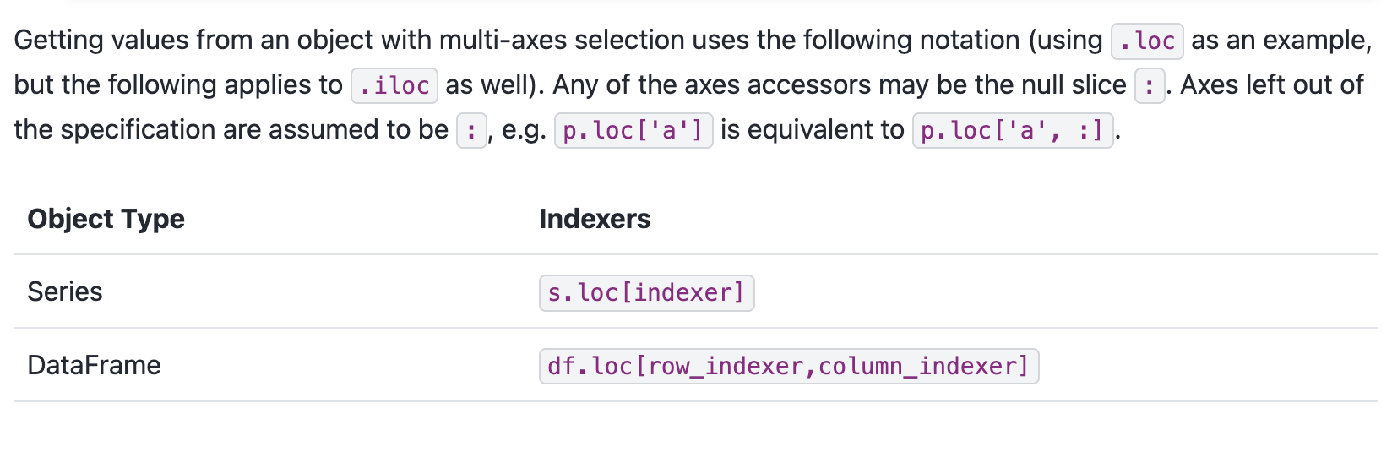
loc and iloc

Slide 22
loc and iloc
df.iloc[0]
df.iloc[-1]
df.iloc[:3]
Row # ?
s[s > s.median()]
s.iloc[[4, 3, 1]]

Slide 23
Axis
axis=0
row-wise, like summing the values in each column, dropping rows
axis=1
column-wise, like summing the values in each row, dropping columns, applying a function to each row,
df.drop('ColumnName', axis=1)
df.apply(your_function, axis=1)

Slide 24
Apply function
pow2 = lambda x : x**2
import pandas as pd
# Create a pandas DataFrame
df = pd.DataFrame({'A': [1, 2, 3], 'B': [4, 5, 6]})
# Apply the lambda function to each element of the DataFrame
df_squared = df.applymap(pow2)
print(df_squared)
import pandas as pd
# Create a pandas Series
s = pd.Series([1, 2, 3, 4])
# Define the lambda function
pow2 = lambda x: x ** 2
# Apply the lambda function to the Series
squared = s.apply(pow2)
print(squared)

Slide 25
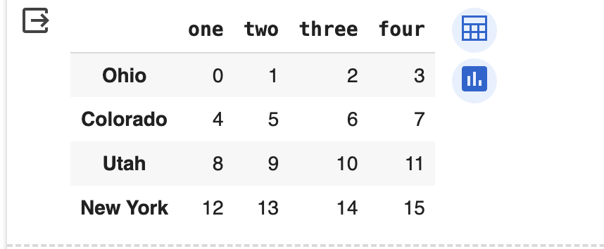
Drop
df = DataFrame(np.arange(16).reshape((4, 4)),
index=['Ohio', 'Colorado', 'Utah', 'New York'],
columns=['one', 'two', 'three', 'four'])
df

Slide 26
Drop
df_ = df.drop(['Colorado', 'Utah’])
describe(df_)
#dropping rows - by default axis=0
df_ = df.drop(['one','four'], axis=1)
describe(df_)
# dropping columns

Slide 27
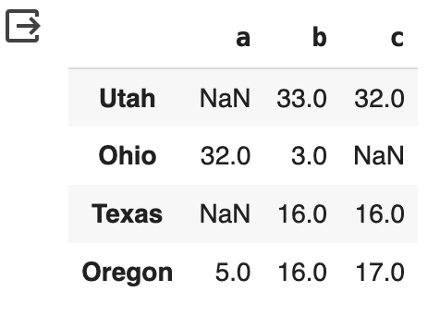
Drop
df.dropna()
df.dropna(how='all')
df = DataFrame(np.random.randint(0,50,12).reshape(4, 3), columns=list('abc'), index=['Utah', 'Ohio', 'Texas', 'Oregon'])
df = df.astype(np.float32) # convert the dataset to floating point
df.values[[0,1,2], [0,2,0]] = than
df

Slide 28
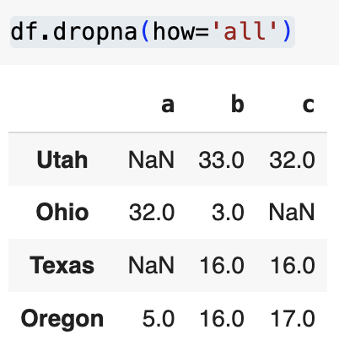
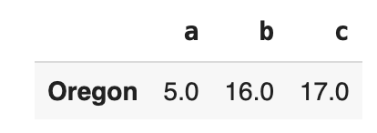
Drop
df.dropna()
df.dropna(how='all')
df = DataFrame(np.random.randint(0,50,12).reshape(4, 3), columns=list('abc'), index=['Utah', 'Ohio', 'Texas', 'Oregon'])
df = df.astype(np.float32) # convert the dataset to floating point
df.values[[0,1,2], [0,2,0]] = than
df

Slide 29
Fill
df['a'].fillna(0, inplace=True)
df

Slide 30
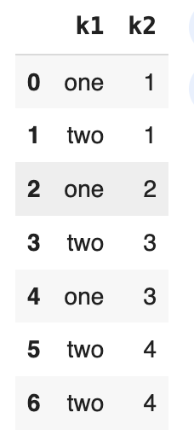
Removing Duplicate
df = pd.DataFrame({'k1': ['one', 'two'] * 3 + ['two'], 'k2': [1, 1, 2, 3, 3, 4, 4]})
df

Slide 31
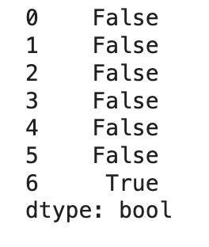
Removing Duplicate
duplicated = df.duplicated() # return a mask
duplicated

Slide 32
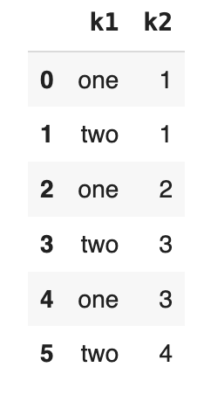
Removing Duplicate
df.drop_duplicates()

Slide 33
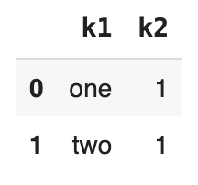
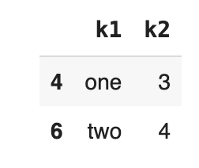
Removing Duplicate
df.drop_duplicates(['k1'])
df.drop_duplicates(['k1'], keep='last')

Slide 34
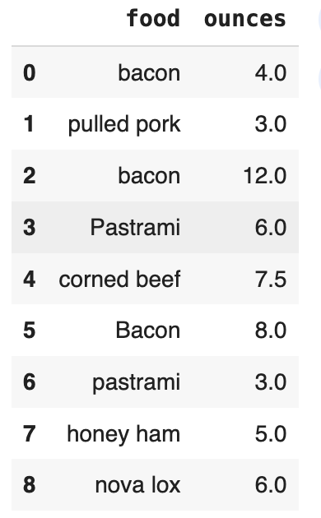
Transforming Data
data = pd.DataFrame({'food': ['bacon', 'pulled pork', 'bacon', 'Pastrami', 'corned beef', 'Bacon', 'pastrami', 'honey ham', 'nova lox'],'ounces': [4, 3, 12, 6, 7.5, 8, 3, 5, 6]})
meat_to_animal = {
'bacon': 'pig',
'pulled pork': 'pig',
'pastrami': 'cow',
'corned beef': 'cow',
'honey ham': 'pig',
'nova lox': 'salmon'
}
data

Slide 35
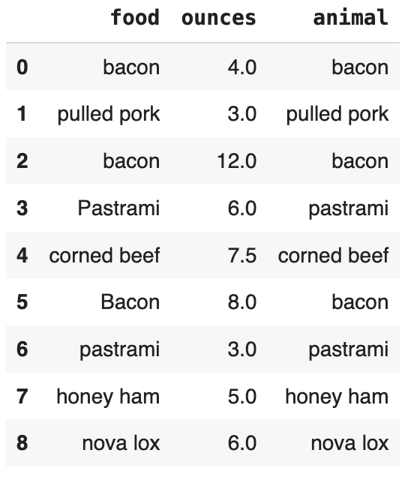
Transforming Data
we need to convert each value to lowercase using the str.lower Series method:
data
data['animal'] = data.food.str.lower()
data

Slide 36
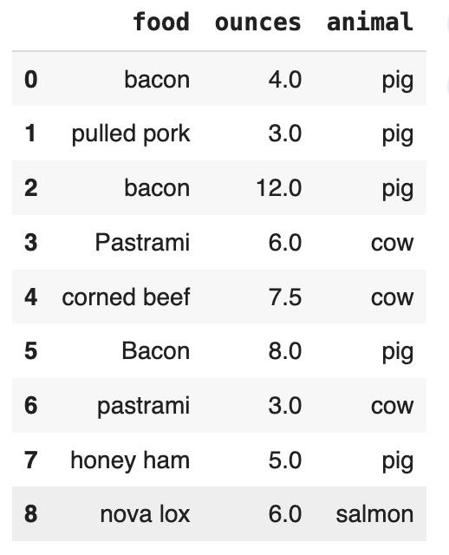
Transforming Data
map
data['animal'] = data.animal.map(meat_to_animal)
data

Slide 37
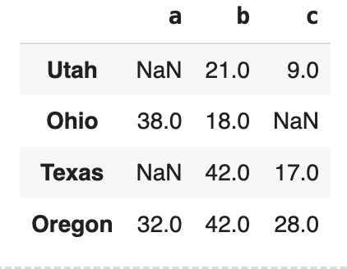
Exercise
df = DataFrame(np.random.randint(0,50,12).reshape(4, 3), columns=list('abc'), index=['Utah', 'Ohio', 'Texas', 'Oregon'])
df = df.astype(np.float32) # convert the dataset to floating point
df.values[[0,1,2], [0,2,0]] = np.nan
df
0
0

Slide 38
Exercise
Create a new column 'd' where there is 'Missing' if
the corresponding row contains a Nan in the column 'a', otherwise
'd' will contain the value 'not missing'
0
df['d'] = np.where(df['a'].isnull(), 'Missing', 'not missing')
0

Slide 39
Discretization and Binning
Suppose you have data about a group of people in a study, and you want to group them into discrete age buckets.
ages = [20, 22, 25, 27, 21, 23, 37, 31, 61, 45, 41, 32]
bins = [18, 25, 35, 60, 100]
cats = pd.cut(ages, bins)
cats

Slide 40
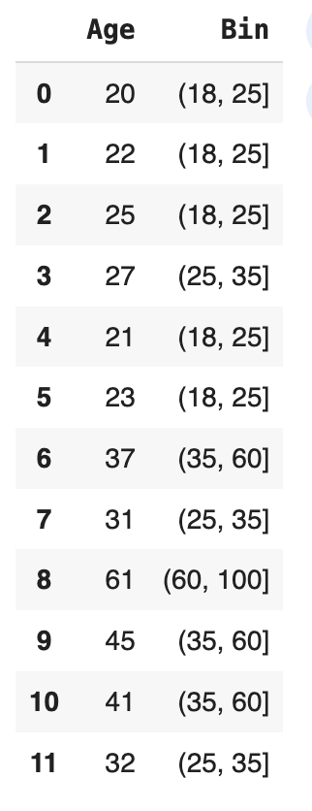
Discretization and Binning
df = pd.DataFrame(np.column_stack([ages, cats]), columns=['Age', 'Bin'])
df

Slide 41
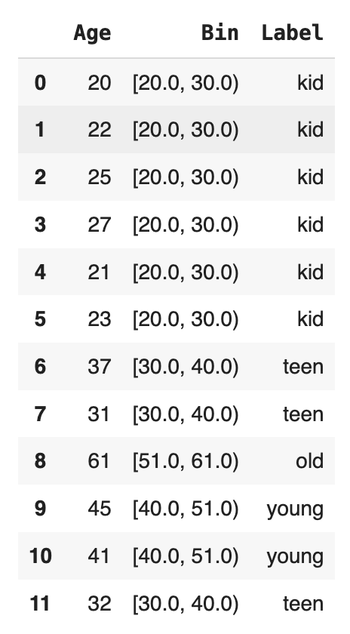
Discretization and Binning
df['Bin'] = pd.cut(ages,4,right=False, precision=0)
df['Label'] = pd.cut(ages,4, labels=['kid', 'teen', 'young', 'old'], right=False)
df

Slide 42
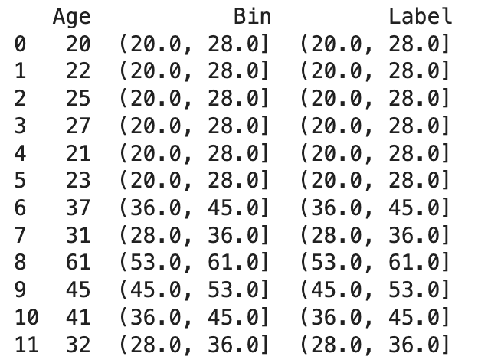
Discretization and Binning
df['Bin'] = pd.cut(df['Age'], 5, precision=0)
df['Label'] = pd.cut(df['Age'], 5, precision=0)

Slide 43
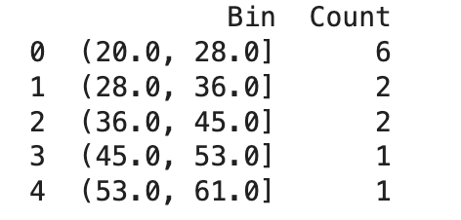
Discretization and Binning
df['Bin'] = pd.cut(df['Age'], 5, precision=0)
df['Label'] = pd.cut(df['Age'], 5, precision=0)
df_ = df.groupby('Bin').count().reset_index().iloc[:, 0:2].rename(columns={'Age': 'Count'})

Slide 44
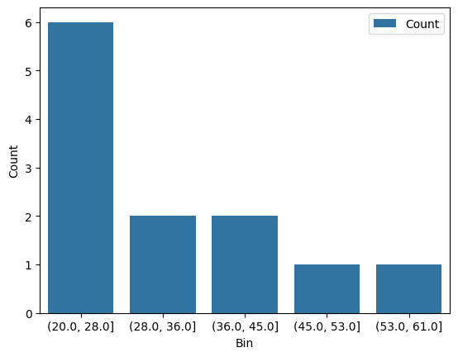
Discretization and Binning
_ = sns.barplot(x='Bin', y='Count', data=df_, label='Count')

Slide 45
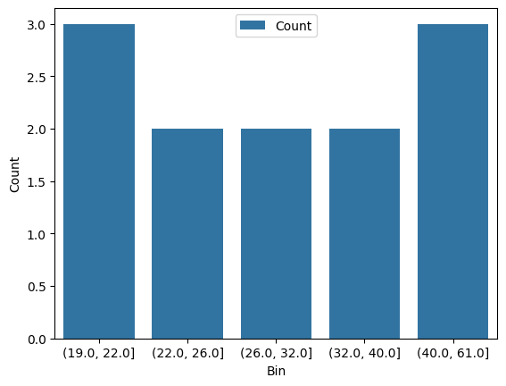
Discretization and Binning (qcut and cut)
df['Bin'] = pd.cut(df['Age'], 5, precision=0)
df['Label'] = pd.cut(df['Age'], 5, precision=0)
df['Bin'] = pd.qcut(df['Age'], 5, precision=0)
df['Label'] = pd.qcut(df['Age'], 5, precision=0)
df_ = df.groupby('Bin').count().reset_index().iloc[:, 0:2].rename(columns={'Age': 'Count'})
print(df_)

Slide 46
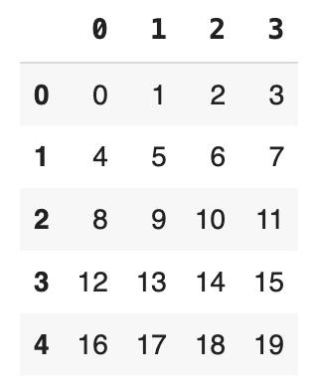
Permutation and Random Sampling
np.random.permutation(10)
array([1, 4, 9, 7, 8, 3, 0, 5, 6, 2])
df = pd.DataFrame(np.arange(5 * 4).reshape((5, 4)))
Extract a random subset from the dataframe of size 3
df_subset = df.sample(3)
df_subset

Slide 47
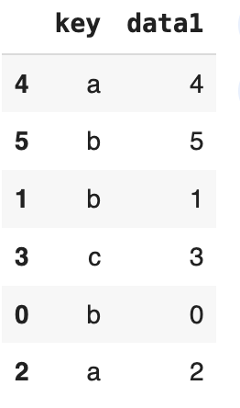
Permutation and Random Sampling
df_subset = df.sample(3)
df_subset
indexes = np.random.permutation(df.shape[0])
df.take(indexes)#np.random.permutation(indexes)

Slide 48
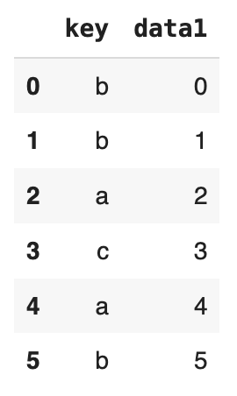
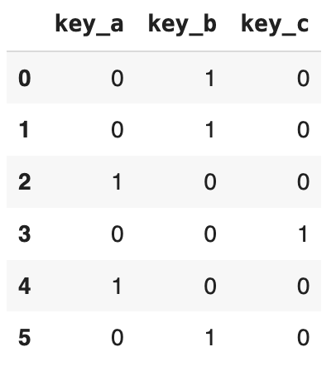
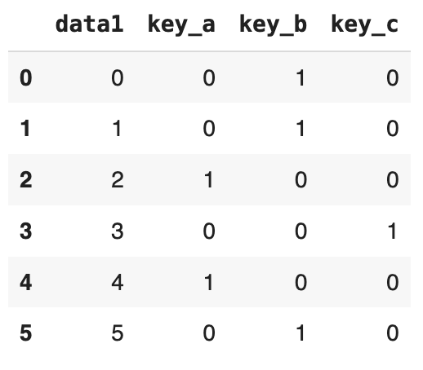
Computing Indicator/Dummy Variables/One Hot Encoding
df = pd.DataFrame({'key': ['b', 'b', 'a', 'c', 'a', 'b'], 'data1': range(6)})
df
df_ = pd.get_dummies(df['key'], prefix='key')
df_
df.join(df_).drop('key', axis=1)

Slide 49
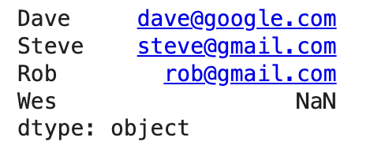
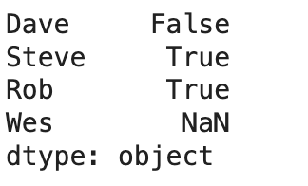
Vectorized String Functions in pandas
data = {'Dave': 'dave@google.com', 'Steve': 'steve@gmail.com',
'Rob': 'rob@gmail.com', 'Wes': np.nan}
data = Series(data)
data
import re
print(data.str.contains('gmail'))

Slide 50
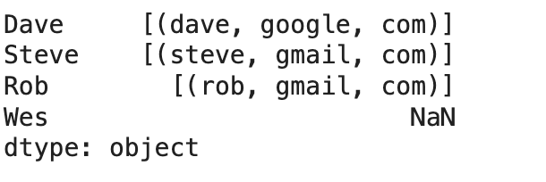
Vectorized String Functions in pandas
print(data.str.findall('([A-Z0-9._%+-]+)@([A-Z0-9.-]+)\\.([A-Z]{2,4})', flags=re.IGNORECASE))

Slide 51
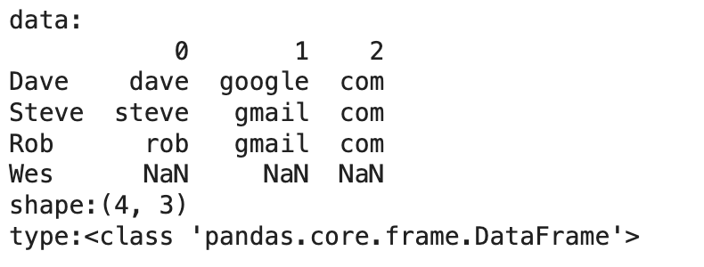
Vectorized String Functions in pandas
describe(data.str.extract('([A-Z0-9._%+-]+)@([A-Z0-9.-]+)\\.([A-Z]{2,4})', flags=re.IGNORECASE))

Slide 52
Reshaping and Pivoting
data = DataFrame(np.arange(6).reshape(2,3), index=pd.Index(['Ohio', 'Colorado'], name='state'), columns=pd.Index(['one', 'two', 'three'], name='number'))
print(data)
print(Hrule(20, "Stacking"))
# produce a dataframe with a hierarchical index (state, number)
stacked = data.stack()
print(stacked)
# accessing element
print("Ohio->one:{}".format(stacked.loc['Ohio', 'one']))
print(Hrule(20, "Unstacking"))
unstacked = stacked.unstack() # return in the original form
print(unstacked)

Slide 53
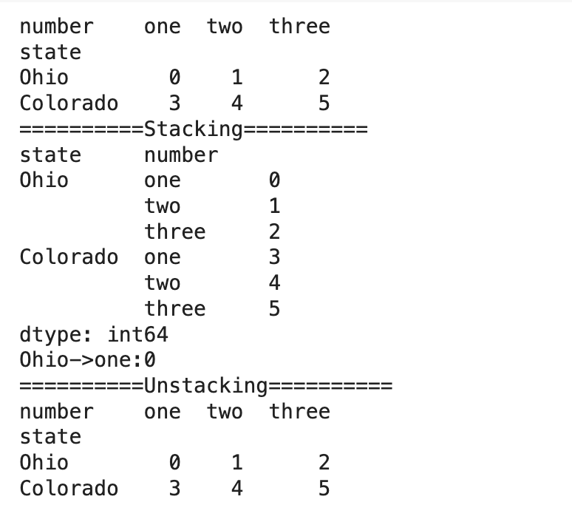
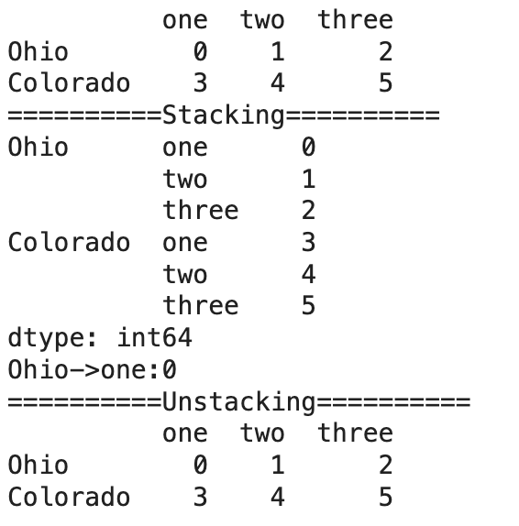
Reshaping and Pivoting
data = DataFrame(np.arange(6).reshape(2,3), index=pd.Index(['Ohio', 'Colorado']), columns=pd.Index(['one', 'two', 'three']))

Slide 54
Pivoting
Return reshaped DataFrame organized by given index / column values.
Reshape data (produce a “pivot” table) based on column values. Uses unique values from specified index / columns to form axes of the resulting DataFrame. This function does not support data aggregation, multiple values will result in a MultiIndex in the columns.

Slide 55
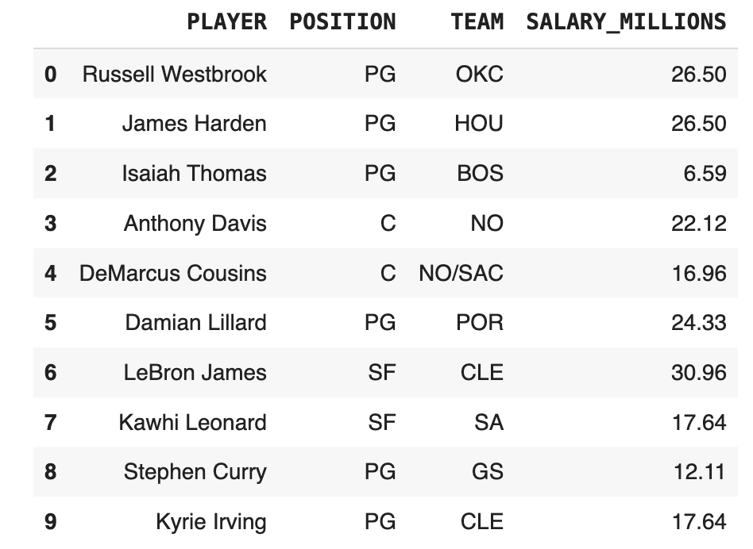
Pivoting
df = pd.read_csv(Data('nba.csv'), usecols=['PLAYER', 'POSITION', 'SALARY_MILLIONS', 'TEAM'], nrows=100)
df.drop_duplicates(subset='PLAYER', keep='first', inplace=True)
df.head(10)

Slide 56
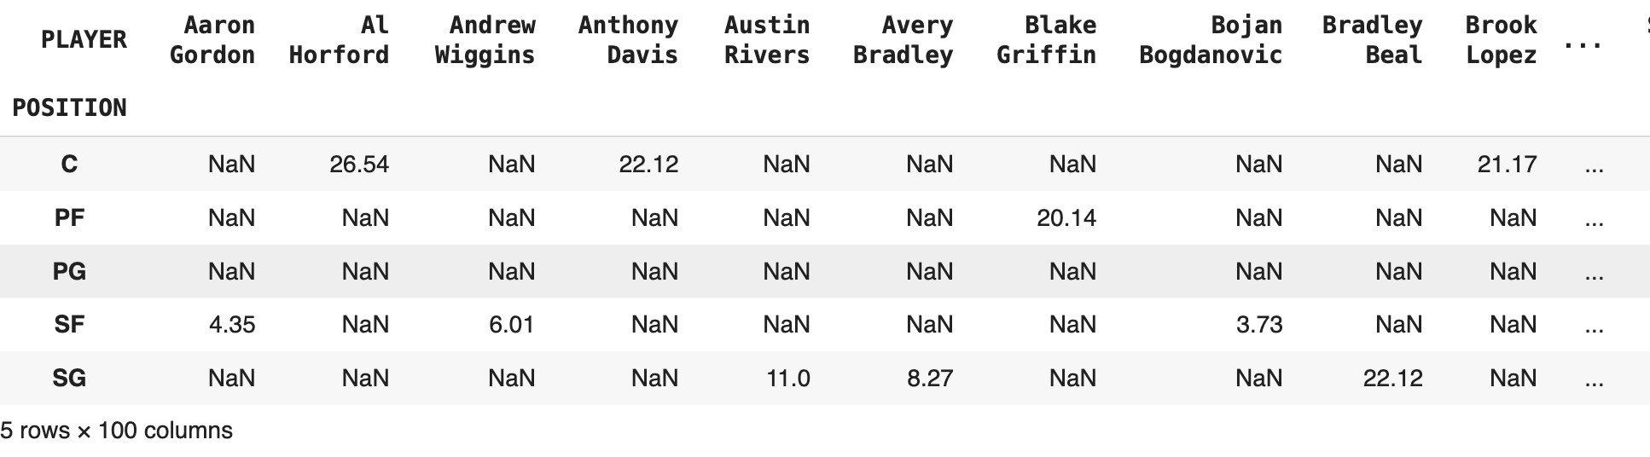
Pivoting
#pivoting
pivoted = df.pivot(index='POSITION', columns="PLAYER", values="SALARY_MILLIONS")
pivoted.head(5)
melted = pd.melt(df, ['TEAM'])
melted.head(20)

Slide 57
Data Visualization with Matplotlib
import matplotlib.pyplot as plt
# set a style
print(plt.style.available)
plt.style.use('seaborn-white')
['tableau-colorblind10', 'fivethirtyeight', 'fast', 'grayscale', 'dark_background', 'seaborn-dark-palette', 'seaborn-muted', 'seaborn-paper', 'classic', 'seaborn-bright', 'seaborn', 'seaborn-poster', 'seaborn-dark', 'seaborn-darkgrid', 'seaborn-talk', 'seaborn-notebook', 'seaborn-whitegrid', 'seaborn-deep', 'bmh', 'ggplot', 'Solarize_Light2', '_classic_test', 'seaborn-colorblind', 'seaborn-pastel', 'seaborn-ticks', 'seaborn-white']

Slide 58
Figure and Subplots
Plots in matplotlib reside within a Figure object.
You can create a new figure with plt.figure()
fig = plt.figure()
<Figure size 640x480 with 0 Axes>

Slide 59
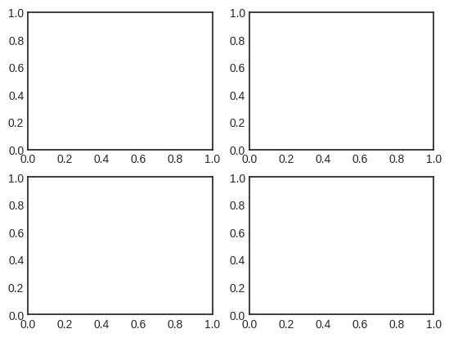
Subplot
fig = plt.figure() # take the reference to the active figure
# add_subplot(num_of_rows, num_of_columns, index)
ax1 = fig.add_subplot(2,2, 1)
ax2 = fig.add_subplot(2,2, 2)
ax3 = fig.add_subplot(2,2, 3)
ax4 = fig.add_subplot(2,2, 4)

Slide 60
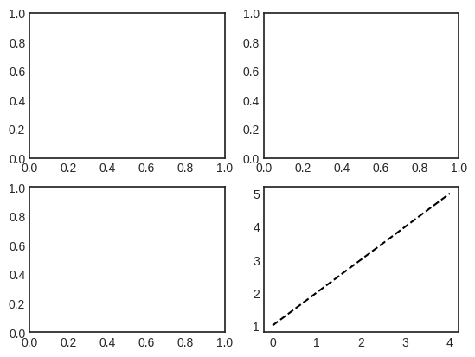
Subplot
fig = plt.figure() # take the reference to the active figure
# add_subplot(num_of_rows, num_of_columns, index)
ax1 = fig.add_subplot(2,2, 1)
ax2 = fig.add_subplot(2,2, 2)
ax3 = fig.add_subplot(2,2, 3)
ax4 = fig.add_subplot(2,2, 4)
_ = plt.plot([1,2,3,4,5], 'k--')

Slide 61
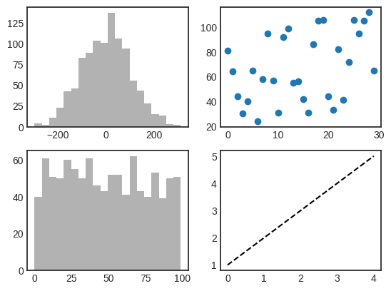
Subplot
fig = plt.figure() # take the reference to the active figure
# add_subplot(num_of_rows, num_of_columns, index)
ax1 = fig.add_subplot(2,2, 1)
ax2 = fig.add_subplot(2,2, 2)
ax3 = fig.add_subplot(2,2, 3)
ax4 = fig.add_subplot(2,2, 4)
plt.plot([1,2,3,4,5], 'k--') # draw on ax4
ax1.hist(np.random.normal(0,100, 1000), bins=20, color='k', alpha=0.3)
ax3.hist(np.random.randint(0,100, 1000), bins=20, color='k', alpha=0.3)
_ = ax2.scatter(np.arange(30), np.arange(30) + 3*np.random.randint(0,30,30))

Slide 62
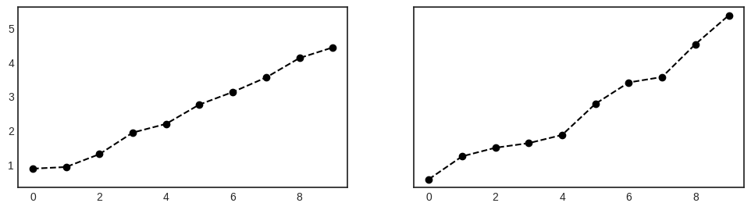
Subplot
fig, axes = plt.subplots(1,2, sharey=True, sharex=True)
fig.set_size_inches(12,3)
axes[0].plot(np.random.random(10).cumsum(), 'ko--')
_ = axes[1].plot(np.random.random(10).cumsum(), linestyle='dashed', color='k', marker='o')

Slide 63
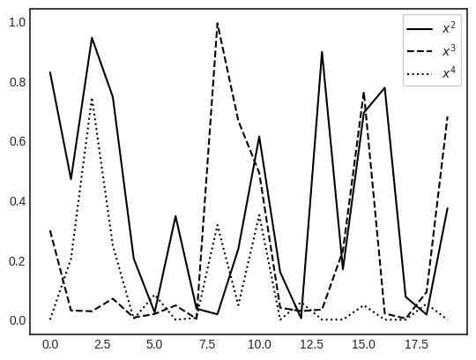
Subplot
y1 = np.power(np.random.random(20),2)
y2 = np.power(np.random.random(20), 3)
y3 = np.power(np.random.random(20), 4)
fig = plt.figure()
ax = fig.add_subplot(1,1,1)
ax.plot(y1, 'k', label=r'$x^2$')
ax.plot(y2, 'k--', label=r'$x^3$')
ax.plot(y3, 'k:' , label=r'$x^4$')
_ = ax.legend(loc='best', frameon=True, framealpha=1)

Slide 64
Plotting with seaborn
import matplotlib.pyplot as plt
plt.style.use('classic')
%matplotlib inline
import numpy as np
import pandas as pd

Slide 65
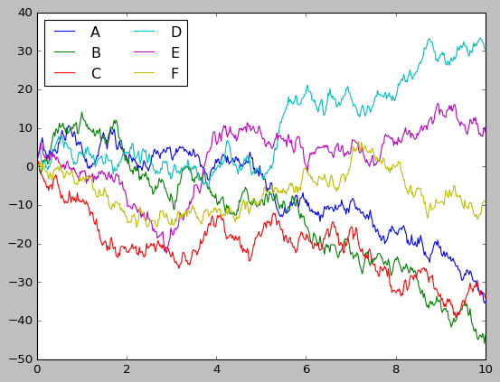
Plotting with seaborn
rng = np.random.RandomState(0) # set seed of the random generator
x = np.linspace(0,10,500)
y = np.cumsum(rng.randn(500,6),0)
plt.plot(x, y)
plt.legend('ABCDEF', ncol=2, loc='upper left')

Slide 66
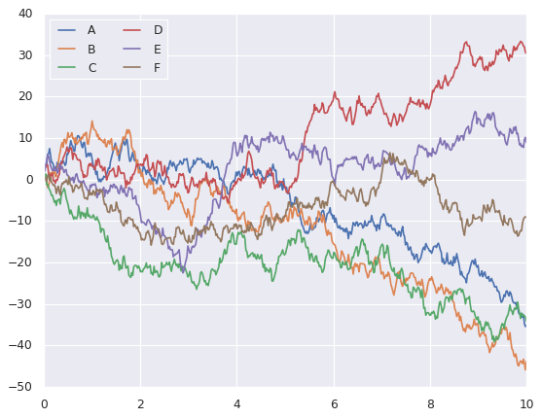
Plotting with seaborn
sns.set() # searborn is on
plt.plot(x,y)
plt.legend('ABCDEF', ncol=2, loc='upper left')

Slide 67
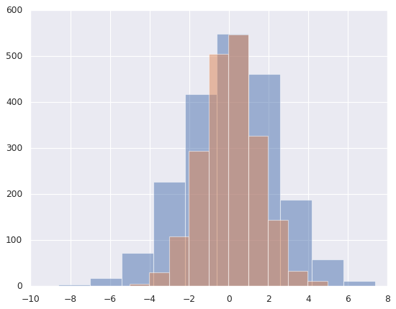
Plotting with seaborn
data = np.random.multivariate_normal([0, 0], [[5, 2], [2, 2]], size=2000)
data = pd.DataFrame(data, columns=['x', 'y'])
for col in 'xy':
plt.hist(data[col], alpha=0.5)

Slide 68
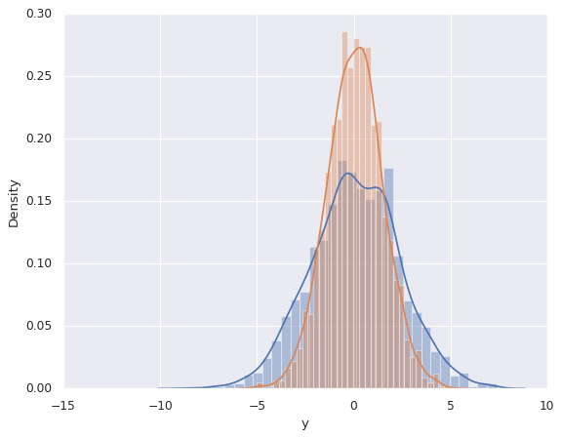
Plotting with seaborn
sns.distplot(data['x'])
sns.distplot(data['y'])

Slide 69
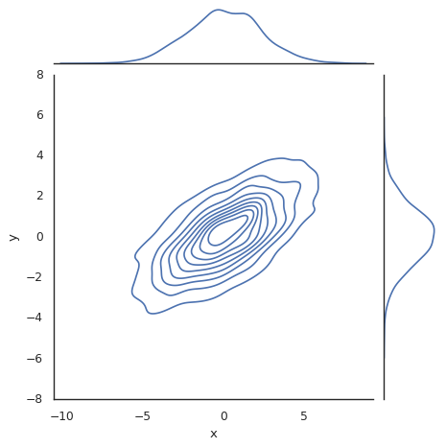
Plotting with seaborn
with sns.axes_style('white'):
sns.jointplot(data=data, x='x',y='y', kind='kde')

Slide 70
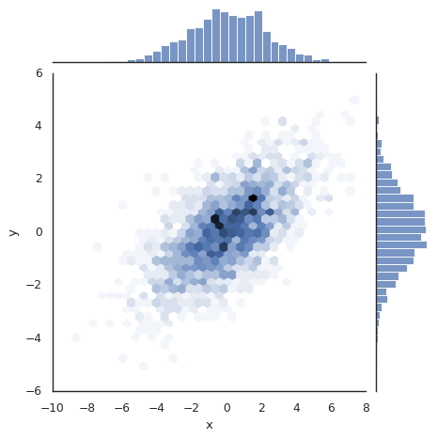
Plotting with seaborn
with sns.axes_style('white'):
sns.jointplot(x='x',y= 'y', data=data, kind='hex')

