Slide 1
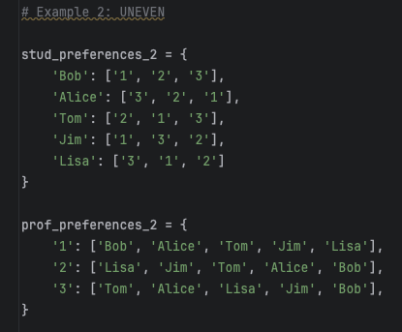
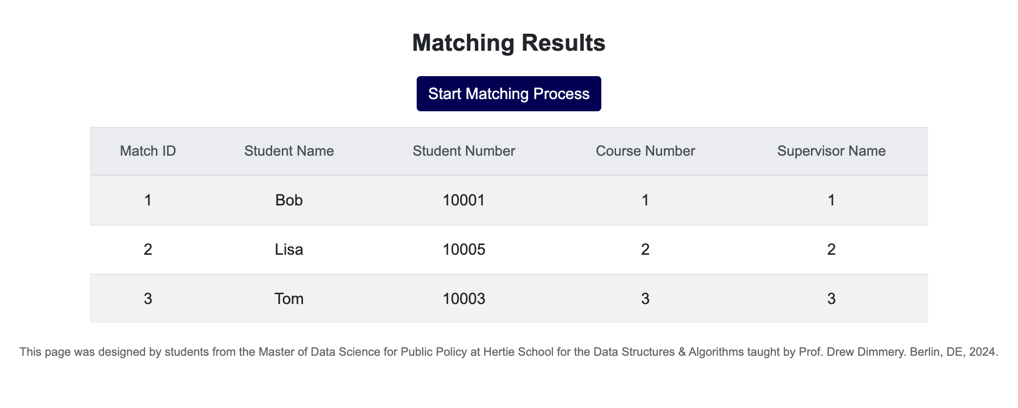

UNEVEN PREFERENCES
INPUT
APP’S OUTPUT
ALGORITHM’S OUTPUT

Slide 2
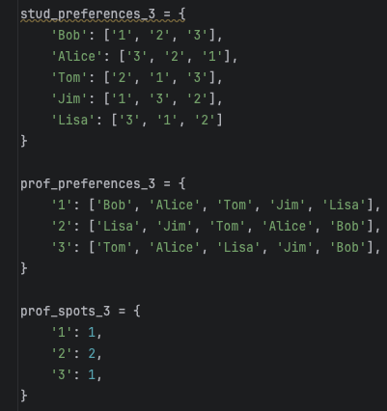
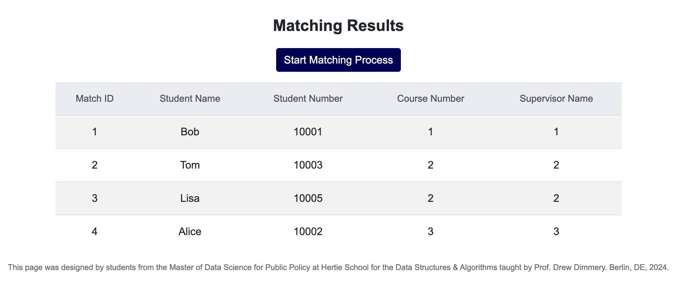

LIMITED PROF CAPACITY
INPUT
APP’S OUTPUT
ALGORITHM’S OUTPUT

