Slide 1
BreakThru
Board Game with AI

Slide 2
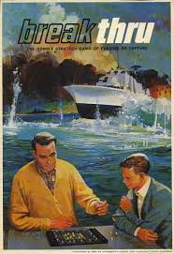
The Game
Based on a 11*11 board
Gold team: 12 pawns or ships + 1 flagship
Silver team: 20 pawns or ships

Slide 3
Programming language and Libraries
Python
pygame 1.9.6
PyCharm

Slide 4
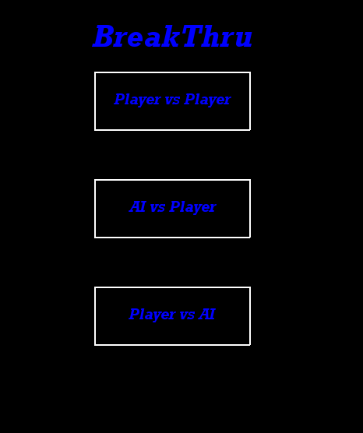
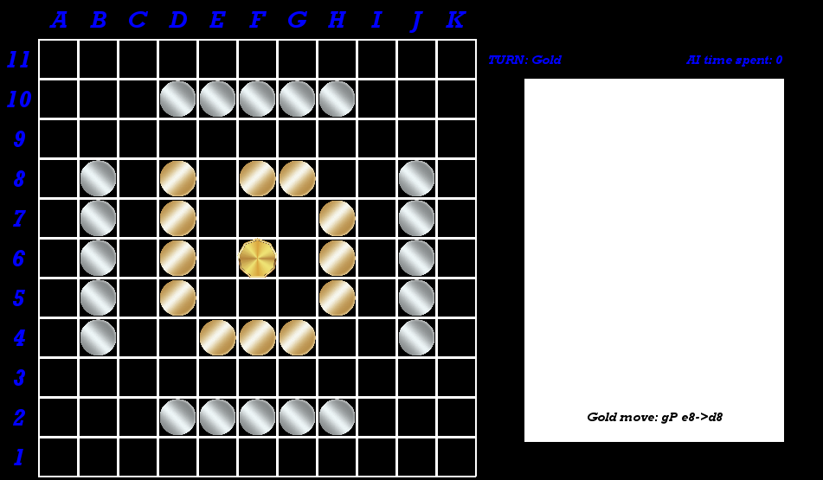
Menu and Board
.

Slide 5
Moves logic and turn handling
def moveCost(self, move): if move.pieceCaptured != "-": self.secondMove = 2
self.pieceCaptured.append(move.pieceCaptured)
if move.pieceCaptured == 'gFS':
self.flagShip = 0
elif move.pieceCaptured[0] == 'g':
self.goldFleet -= 1
else:
self.silverFleet -= 1
elif move.pieceMoved[1] == "F":
self.secondMove = 2
else:
self.secondMove += 1
def changeTurn(self):
self.goldToMove = not self.goldToMove
self.turnCounter += 1
self.secondMove = 0

Slide 6
Evaluation function
Number of silver ships and number of gold ships plus flagship
Flagship under attack
Flagship can escape
Flagship movements

Slide 7
Minimax & Alpha beta
Calculate the score of a state using the evaluation function, according to the player.
Uses the score to save the best move that has to be executed
nextState( action, gameState)
Does a copy of the state and executes the move
Alpha Beta introduces the prunings, thanks to un upper and a lower bound decides when to prune a node

Slide 8
Iterative deepening
Introduces a new loop when we have to decide the move.
uses a timer to stop the execution if we go out of time or we reach the max defined depth

Slide 9
Transposition Table
Reduces the number of visited nodes
Use an hashkey of 64 bit to represent the state
Store all the values inside a table to avoid calculating the same state more than once

Slide 10
Move ordering
Idea of ordering moves to make them more prone to be pruned.
This is due to the fact that moves with better scores are placed in the beginning and get explorated before

Slide 11
References
Ai programming, D. Galles, https://www.cs.usfca.edu/~galles/cs662/lecture/lecture5.pdf

