Slide 1
FROM MODEL DIFFS TO CAUSAL MECHANISMS
The case
The model solved the task—then kept writing.
Using a CrossCoder to explain behavioral differences between base and fine-tuned code models
A single latent feature helped control that continuation.
DSTK100 · preliminary causal model diffing
1
Notes:
Open with the behavioral paradox, not the architecture. The scientific question is whether a shared sparse representation can explain why the models diverge.

Slide 2
RESEARCH QUESTION
The evaluation tells us what changed. The CrossCoder asks why.
BEHAVIOR
REPRESENTATION
●
Base passes / fine-tuned fails
●
Paired layer-16 residuals
●
Base fails / fine-tuned passes
●
Shared sparse features
●
What kind of error occurred?
●
Decoder directions for intervention
Behavior localizes the difference. Features turn it into a testable hypothesis.
DSTK100 · preliminary causal model diffing
2

Slide 3
METHOD
DSTK100 gives both models a shared sparse vocabulary
BASE
layer 16
same tokens
CROSSCODER
100 active features
→
→
16,384 latents ReLU + TopK 100
per evaluated token
FINE-TUNED
layer 16
2,608 code texts · 617,959 evaluated tokens · same-text alignment
DSTK100 · preliminary causal model diffing
3

Slide 4
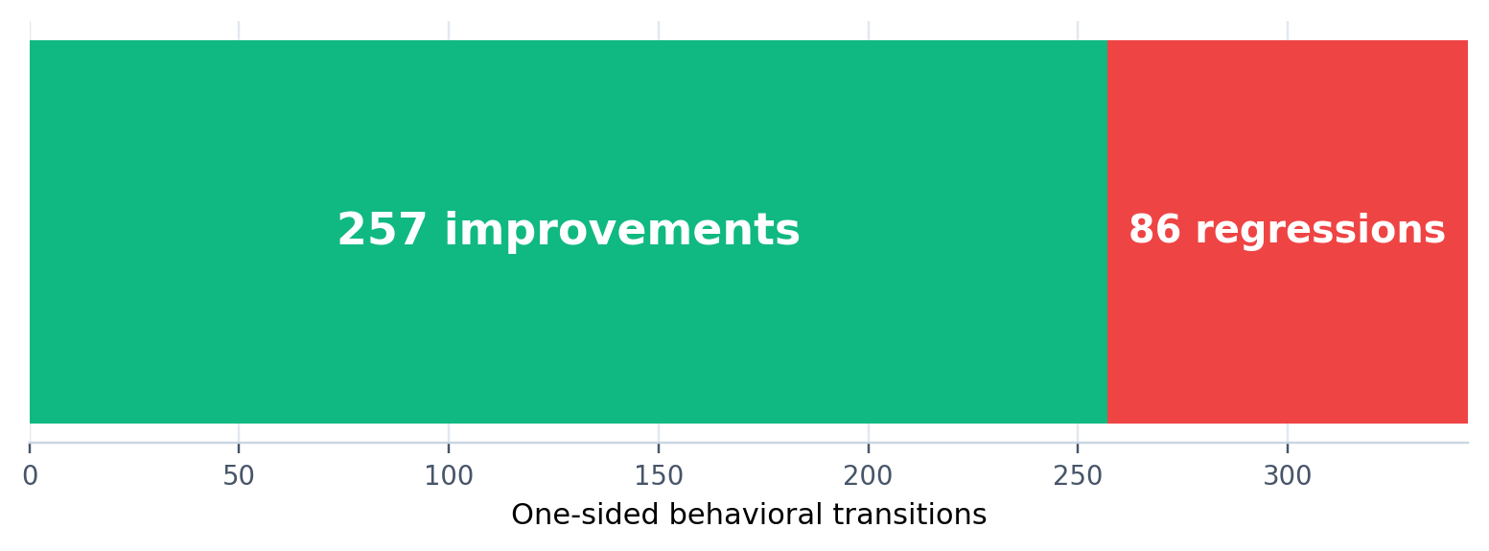
BEHAVIORAL MAP
One-sided transitions expose where the models actually diverge
343
257
86
one-sided transitions
base fail → FT pass
base pass → FT fail
DSTK100 · preliminary causal model diffing
4

Slide 5
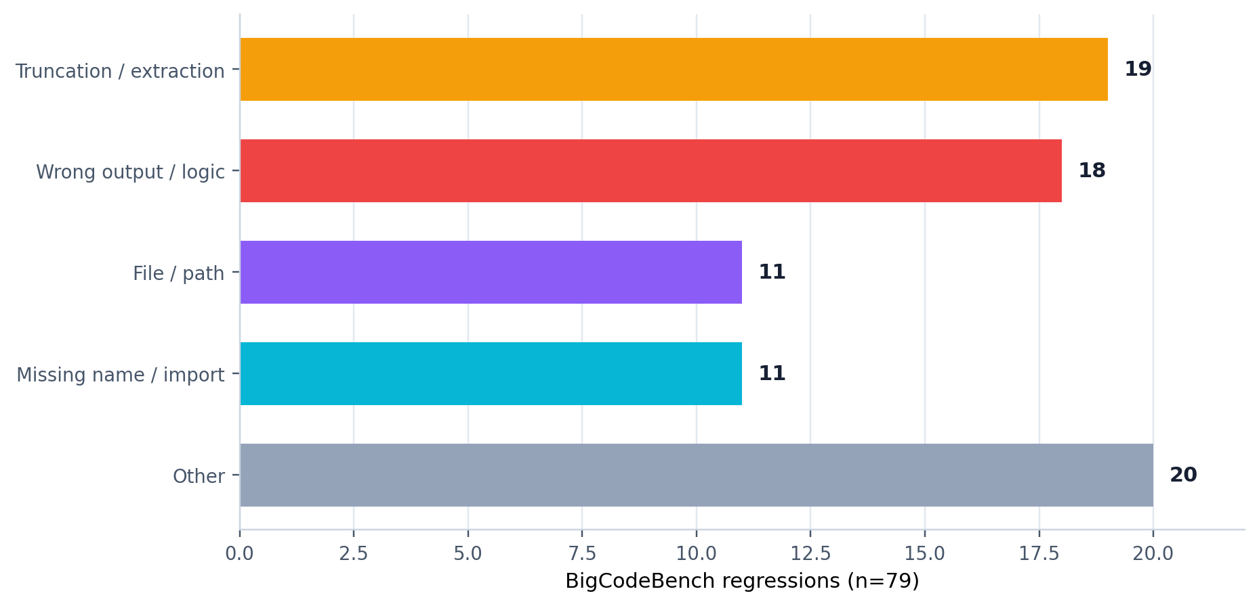
ERROR TAXONOMY
“Regression” is an outcome—not a single mechanism
Why classify first?
●
Different errors imply different causal hypotheses.
●
A global fail label can mix incompatible mechanisms.
●
Taxonomy defines the cohort we should intervene on.
DSTK100 · preliminary causal model diffing
5

Slide 6
FEATURE SCREENING
We ranked stable contrasts—not raw activation alone
4 summaries
Δ per task
Observed effect
200 permutations
E/V
→
→
→
→
max · early_max mean · active fraction
aggregate(FT text) − aggregate(base text)
mean Δ positives − mean Δ controls
shuffle labels; recompute effect
effect ÷ null SD
Minimum support
max(3 tasks, 10% of positives)
E/V is a permutation signal-to-noise score—not a z-score or a p-value.
DSTK100 · preliminary causal model diffing
6

Slide 7
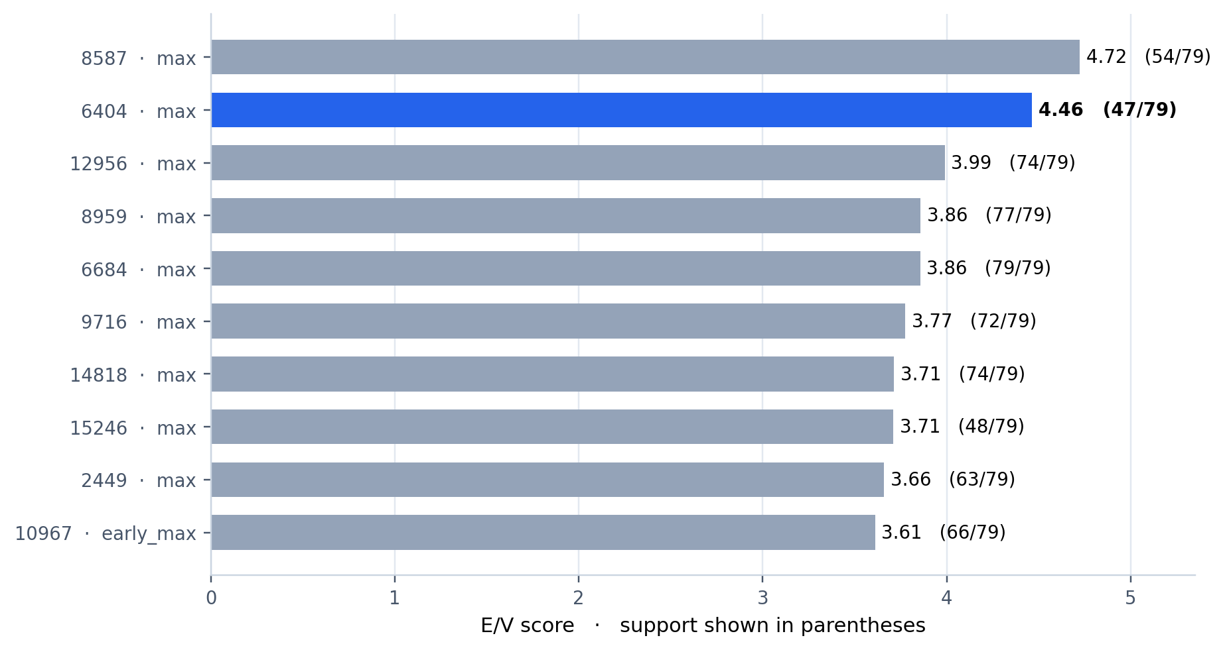
SCREENING RESULT
Feature 6404 ranked #2—and the result was specification-robust
6404
E/V 4.47
47 / 79 support
Same Top 10 with all four aggregations or E/V alone
DSTK100 · preliminary causal model diffing
7

Slide 8
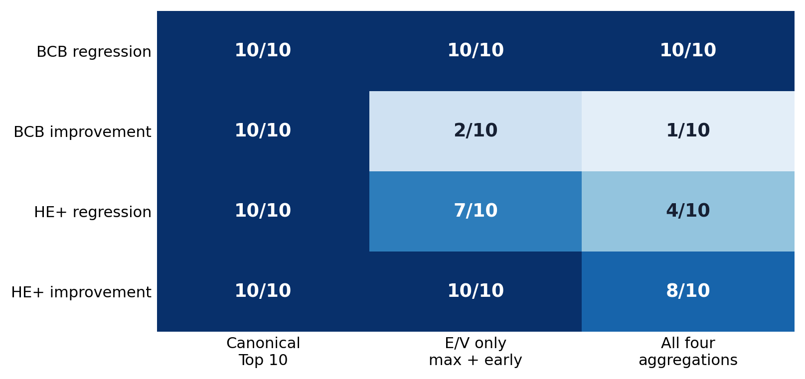
SENSITIVITY AUDIT
Aggregation choices matter elsewhere—but not for the 6404 shortlist
Interpretation
●
BCB regressions: identical Top 10.
●
BCB improvements: persistent features dominate when mean/frequency enter.
●
Aggregation encodes a mechanistic preference, not a neutral preprocessing choice.
DSTK100 · preliminary causal model diffing
8

Slide 9
SELECTION LOGIC
A good causal candidate aligns meaning, failure mode, and timing
MEANING
FAILURE MODE
TIMING
What tokens and contexts activate the feature?
Which behavioral transition is it associated with?
Does activation precede the relevant decision?
Semantic clarity alone is not enough: a late feature may be a consequence or style marker.
DSTK100 · preliminary causal model diffing
9

Slide 10
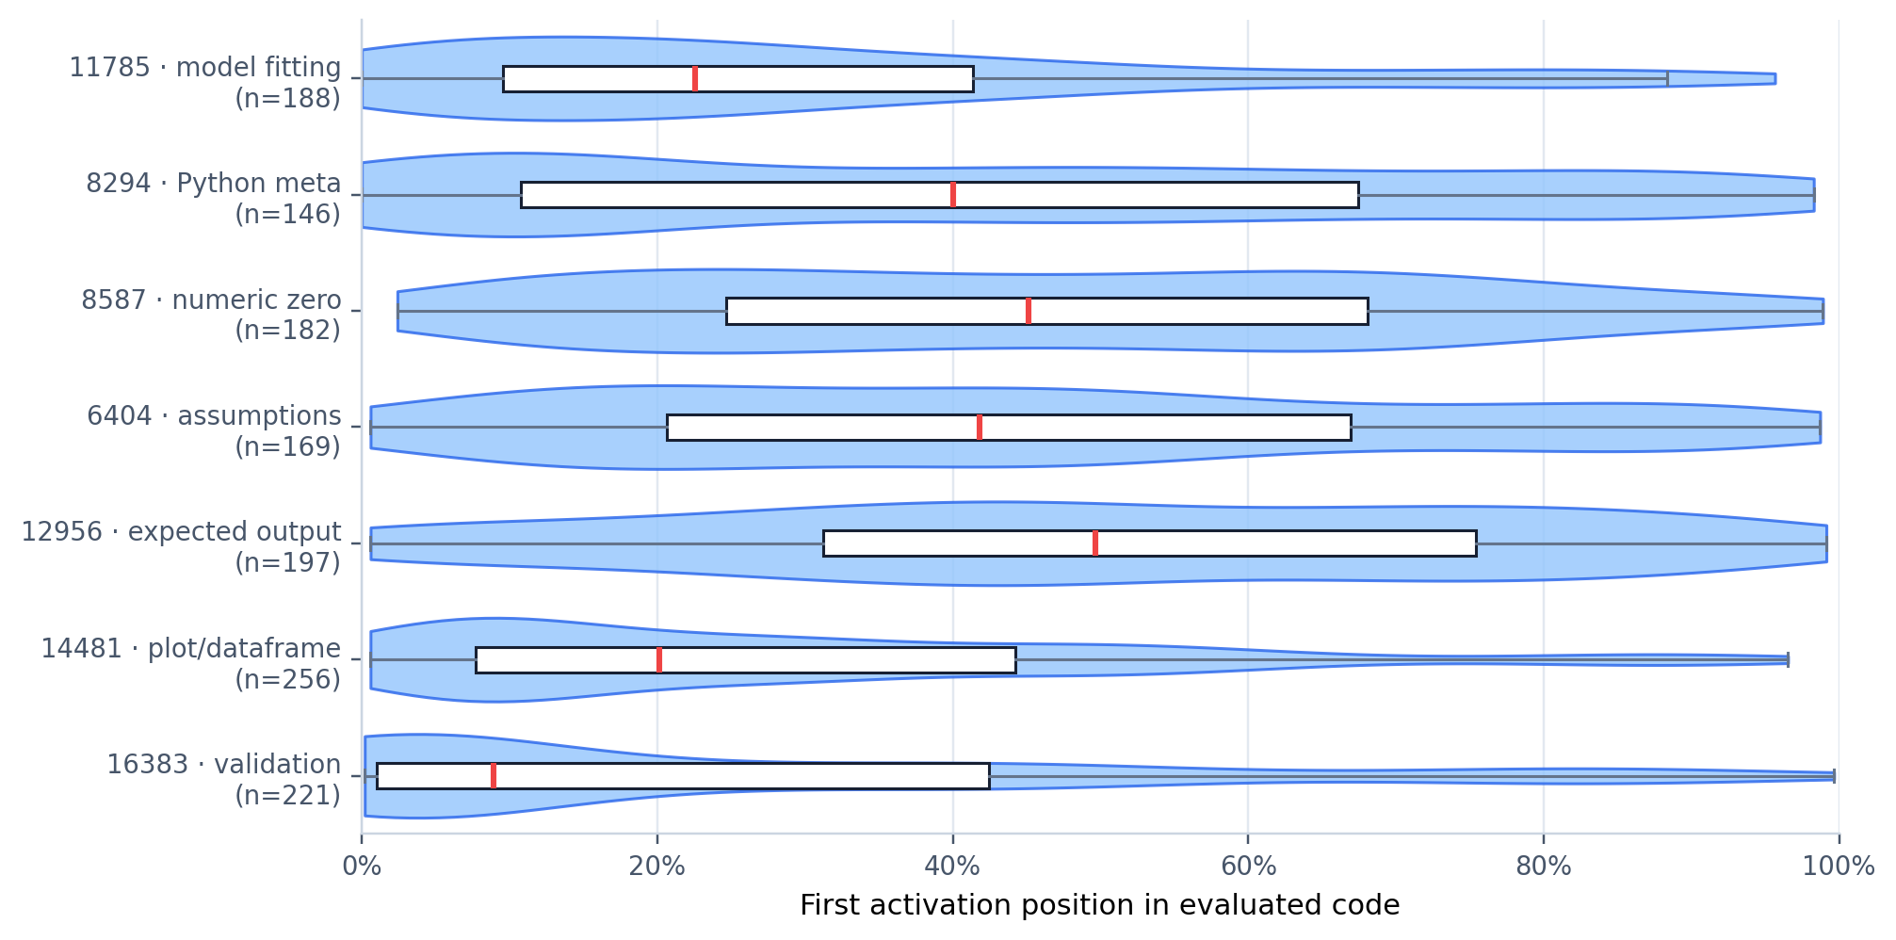
TEMPORAL PLAUSIBILITY
First-activation position separates plausible causes from late markers
Example
Feature 12956
Expected output / examples
Semantically clear—often too late to explain the implementation decision.
DSTK100 · preliminary causal model diffing
10

Slide 11
MECHANISTIC DISCOVERY
The pearl: many ‘improvements’ were simply cleaner stopping behavior
119 / 215
def task_func(...): ... plausible solution ... - -# tests -from task_func import task_func
BigCodeBench improvements
55%
test/import contamination in the base output
The fine-tuned model often won by stopping—not by implementing a different algorithm.
DSTK100 · preliminary causal model diffing
11

Slide 12
FEATURE INTERPRETATION
Feature 6404 matched the semantics of post-solution continuation
6404
67%
31%
vs
Dominant activation contexts
contamination cases
other improvements
expected
should
Exploratory odds ratio ≈ 4.44
assumptions / caveats
comments and boilerplate
Association generated the hypothesis; it did not establish causality.
DSTK100 · preliminary causal model diffing
12

Slide 13
CAUSAL DESIGN
A deliberately selected cohort turned the hypothesis into a test
1
2
3
4
Base failed
Fine-tuned passed
Base generated tests/imports
Feature 6404 was naturally active
80
mechanistic cases
Selected for mechanism—not an out-of-sample estimate.
DSTK100 · preliminary causal model diffing
13

Slide 14
ONLINE GATED STEERING
We intervened only when 6404 entered the natural TopK
Current token
→
Paired residuals
→
DSTK100
→
6404 active?
→
Next token
capture layer 16
RMS normalize
ReLU + TopK 100
gate intervention
continue generation
h′ₜ = hₜ + α · z₆₄₀₄,ₜ · RMS(hₜ) · d₆₄₀₄,base
The intervention changes the next-token distribution; it does not rewrite earlier tokens.
DSTK100 · preliminary causal model diffing
14

Slide 15
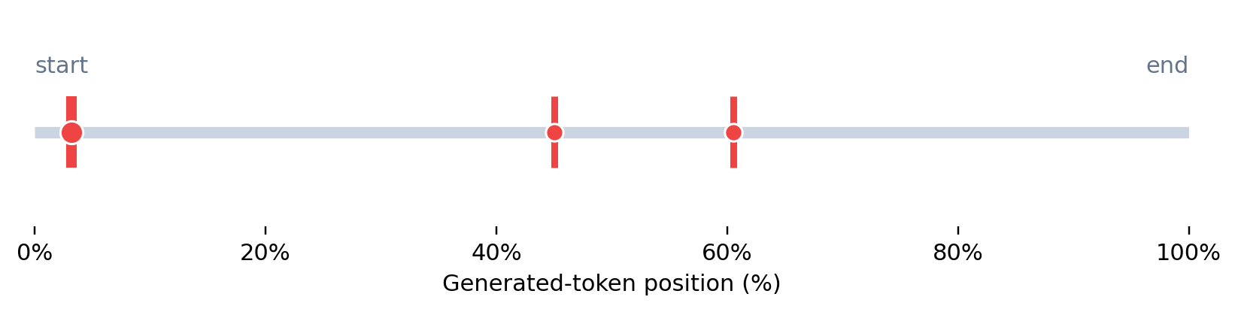
TOKEN-LEVEL CASE
One example: the baseline solved the task, then imported its own test
BASELINE · FAIL
6404 SUPPRESSION · PASS
return [] # tests/test_task_func.py import unittest from task_func import task_func
return min_subsequence # task_func({...}) # task_func({...})
The plausible function body is followed by test/import contamination.
Official pass; no generated test module import.
Red marks: online steps where feature 6404 entered the active TopK in the steered trajectory.
DSTK100 · preliminary causal model diffing
15
Notes:
Representative task: BigCodeBench/668. Show the exact full outputs in the appendix/source data if challenged; the slide uses a compact excerpt. Active gate steps were 8, 113, and 152 of 251 generated-token steps.

Slide 16
MAIN CAUSAL RESULT
The intervention recovered official passes—not just prettier text
19 / 80
41 / 80
fail → official pass
test/import contamination removed
α = −2 · TopK-gated · exact code evaluated with extraction v4
Cohort selected for this mechanism; do not read 23.75% as general benchmark gain.
DSTK100 · preliminary causal model diffing
16

Slide 17
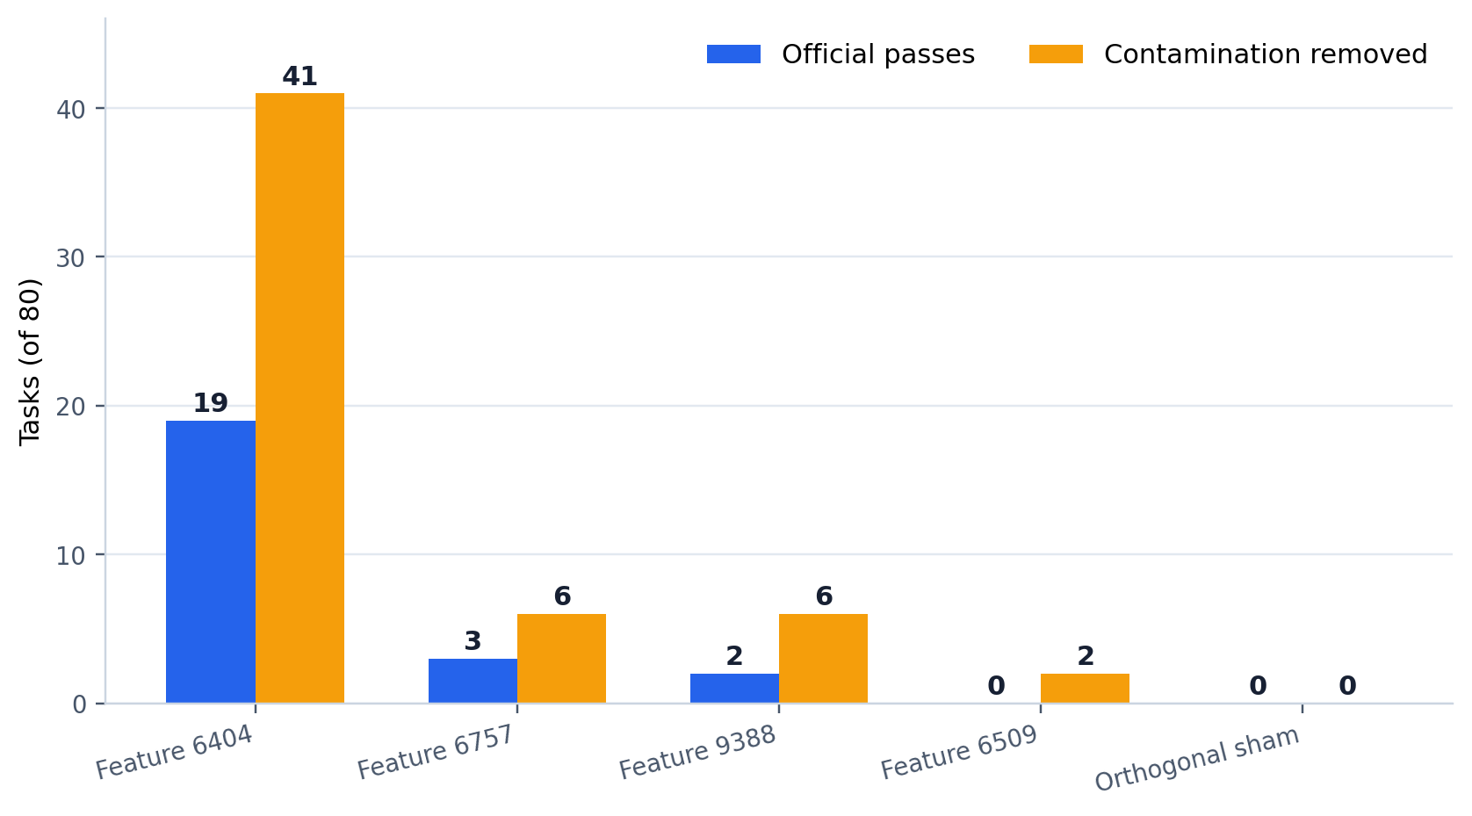
SPECIFICITY
Matched controls isolate the 6404 direction
Controls matched
●
decoder norm
●
activation support
●
temporal profile
●
online gate activity
vs sham
pass p ≈ 3.8×10⁻⁶ cleanup p ≈ 9.1×10⁻¹³
DSTK100 · preliminary causal model diffing
17

Slide 18
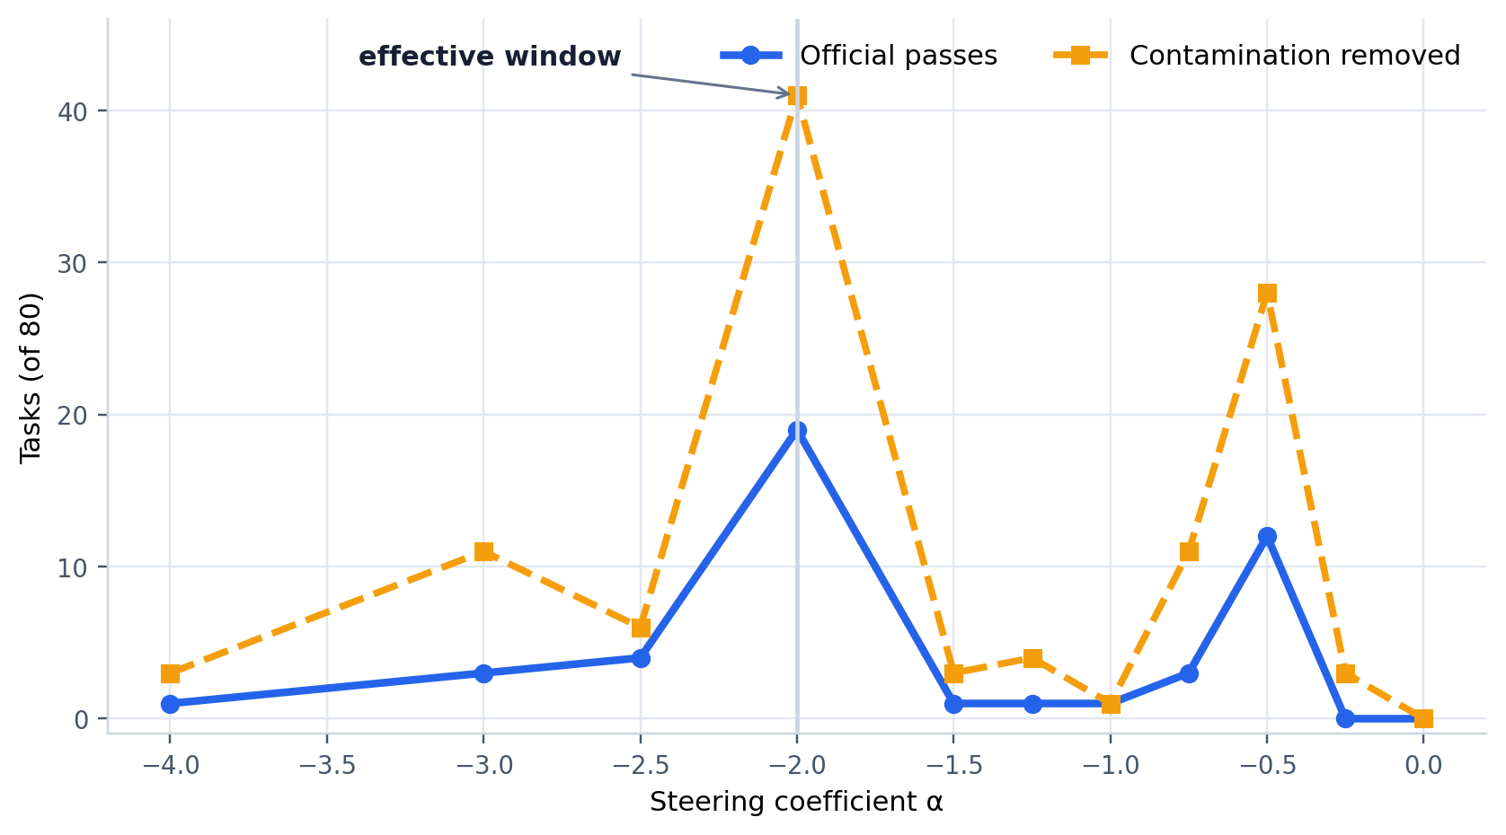
NON-MONOTONICITY
Steering is not a volume knob
Why jagged?
●
Token choice is discrete.
●
One token changes the future context.
●
Future gates then change.
●
Pass/fail is discontinuous.
●
One seed per task adds noise.
DSTK100 · preliminary causal model diffing
18

Slide 19
CALIBRATED CONCLUSION
The evidence supports a specific mechanism—not a universal correction vector
SUPPORTED
NOT YET SUPPORTED
●
Interpretable association with post-solution boilerplate
●
Generalization beyond the selected cohort
●
Causal removal of test/import contamination
●
Stable alpha peak across generation seeds
●
Specificity against sham and matched features
●
Every 6404 activation means test generation
●
Official evaluation changes on exact extracted code
●
A general pass/fail steering direction
DSTK100 · preliminary causal model diffing
19

Slide 20
A model difference became a testable causal mechanism.
Taxonomy → sparse features → semantics → timing → gated steering → controls
We did not find a universal feature of correctness. We found a representation that helps explain why two models behave differently—and changing it changes behavior.
Next: multi-seed replication · negative cohort · held-out selection/evaluation · token-level mechanism audit
DSTK100 · preliminary causal model diffing
20

Slide 21
METHOD DETAIL
Appendix · exact screening interpretation
E/V
÷
effect observed
SD of 200 permuted effects
Permutation procedure
●
Keep feature deltas fixed; shuffle positive/control labels within benchmark × transition.
●
Recompute the mean contrast for every feature after each shuffle.
●
Use the feature-wise null SD as the denominator; compute nominal tail p separately.
●
With 200 permutations, minimum nominal p = 1/201 ≈ 0.00498; initial screen was not maxT-corrected.
DSTK100 · preliminary causal model diffing
21

