Slide 1
Operations Research in RT - Meeting
Lucas McCullum
March 28, 2022

Slide 2
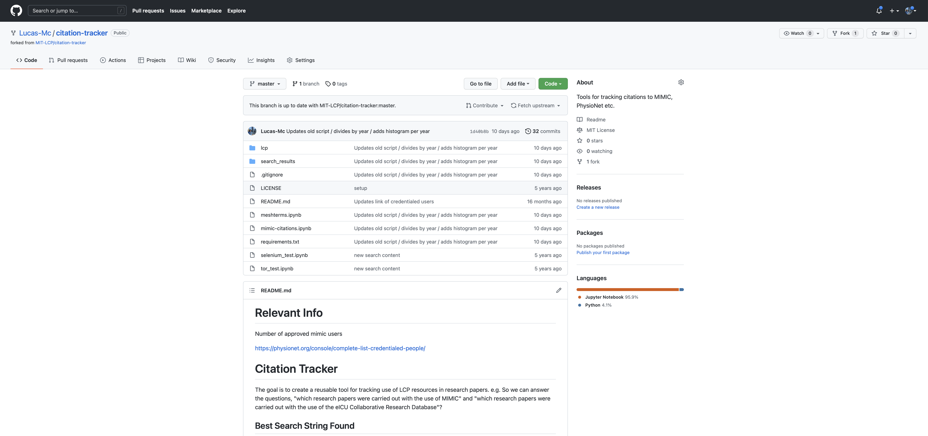

Slide 4
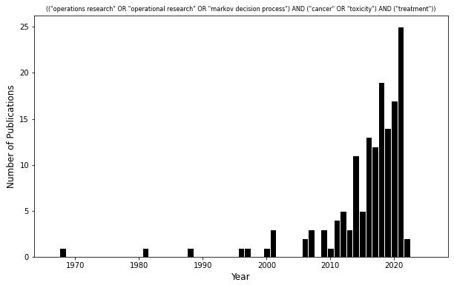
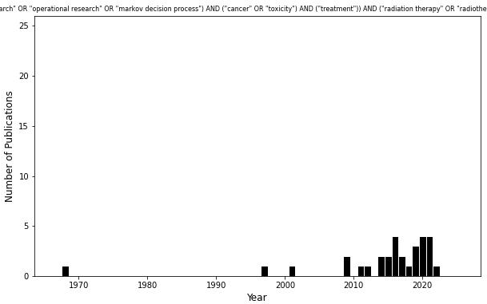
N = 148
N = 30

Slide 5
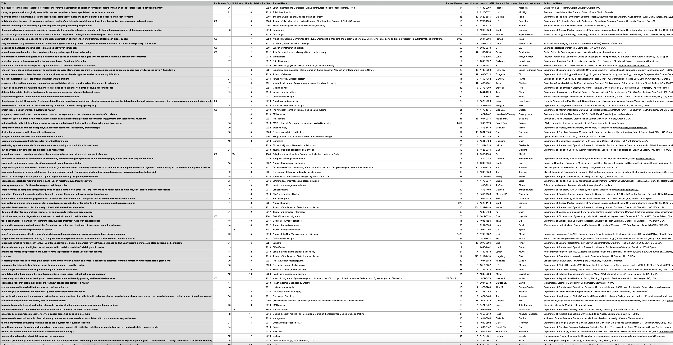

Slide 6
Future Directions
Since with H+N cancer returns 30 results (pre-filtering), should we think about moving to multiple sites?
What is ideal number of articles sufficient for meta-analysis / review out of the 30 results? … 10? … 15? … 20?
Do we need to refine our search queries?
(("operations research" OR "operational research" OR "markov decision process") AND ("cancer" OR "toxicity") AND ("treatment"))
(("operations research" OR "operational research" OR "markov decision process") AND ("cancer" OR "toxicity") AND ("treatment")) AND ("radiation therapy" OR "radiotherapy" OR "head and neck")

Slide 7
(("radiation therapy" OR "radiotherapy") AND/OR ("head and neck" OR "squamous cell carcinoma")
AND
("robust optimization" OR "queuing systems" OR "operations research" OR "operational research" OR
"markov decision process" OR "stochastic program" OR "stochastic processes" OR
"combinatorial optimization" OR "discrete optimization" OR "approximation algorithms" OR
"heuristics" OR "dynamic program" OR "dynamic programming" OR "linear program" OR
"linear programming" OR "integer program" OR "integer programming" OR "mixed-integer program" OR
"mixed-integer programming" OR "stochastic optimization" OR "convex optimization" OR
"quadratic optimization" OR "quadratic program" OR "quadratic programming" OR
"non-smooth optimization" OR "non-convex optimization" OR "multicriteria optimization" OR
"goal programming" OR "queuing theory" OR "game theory" OR "tabu search" OR
"genetic algorithm" OR "simulated annealing" OR "variable neighborhood search" OR "ant colony")
AND
("treatment" OR "toxicity")

Slide 8
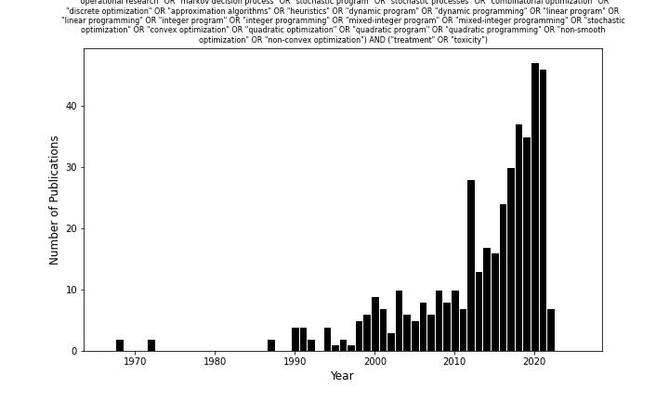
N=424

Slide 9
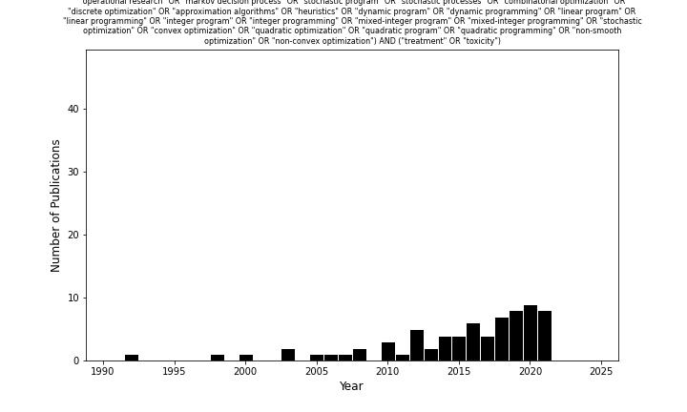
N=71

Slide 10
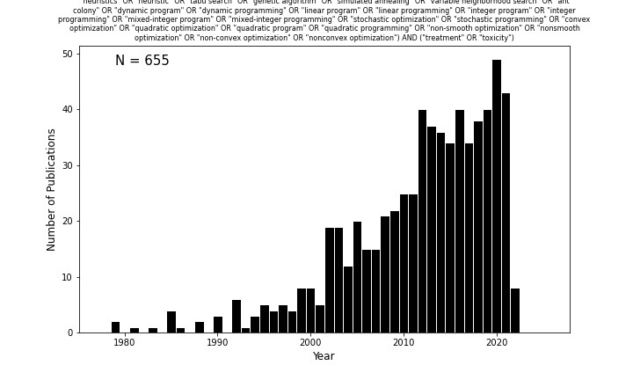

Slide 11
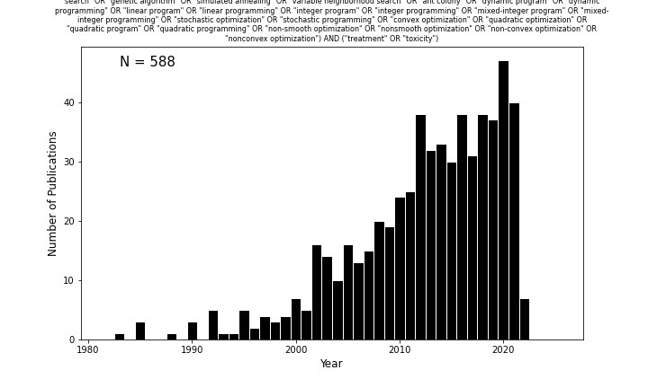

Slide 12
