Slide 1



MOURA
CAMISETAS
LUCAS JOSÉ DE ALMEIDA MOURA

Slide 2



FRONT-END
HTML5, CSS3
ANGULAR
TAILWIND

Slide 3


BACK-END
C#
ASP.NET CORE

Slide 4


IA
CHATGPT
GITHUB COPILOT

Slide 5

BANCO DE DADOS
SQL SERVER

Slide 6

TESTES
CYPRESS

Slide 7

OUTROS
IDE INTELLIJ
POSTMAN
VSCODE
GIT
ORM
REST-API

Slide 8


SOBRE O E-COMMERCE
Nossas estampas unem design inovador e paixão autêntica, transformando nostalgia e tendências em peças estilosas.
INTEGRANTES
Lucas José de Almeida Moura

Slide 9

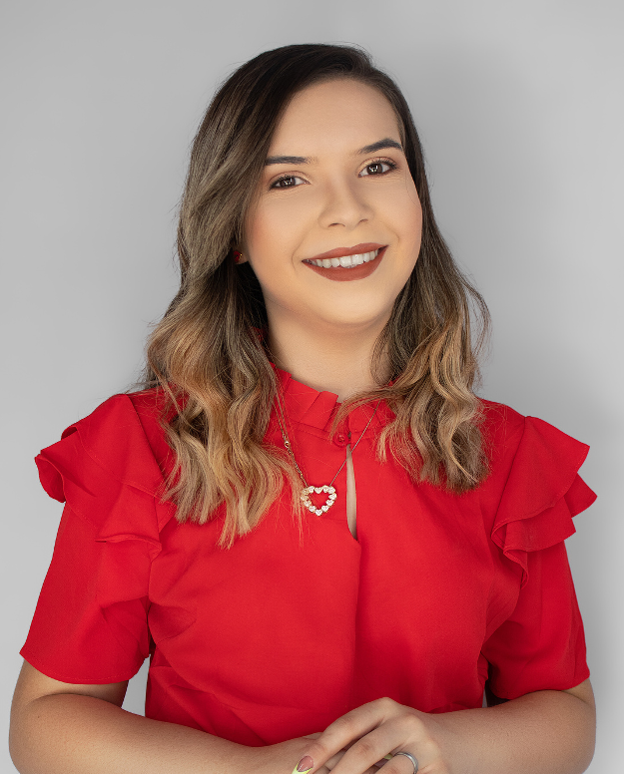


TEAM MEMBERS
JOHN DOE
Write a brief description here
JANE DOE
JANE DOE
Write a brief description here
Write a brief description here

Slide 10
CATEGORIES
QUIRKS & HABITS
FOOD&
DRINKS
HOLIDAY
RANDOM
SPORTS
NAMES

Slide 11



FOOD

Slide 12




QUESTION 1
WHAT’S MY
FAV DESSERT?
If your answer is correct,
you win 10 points!

Slide 13



ANSWER
CUPCAKES
+10 POINTS

Slide 14


QUESTION 2
WHAT ARE MY TWO FAV CHIPS
HINT
One is a Type of
Lays chips
If your answer is correct,
you win 30 points!

Slide 15

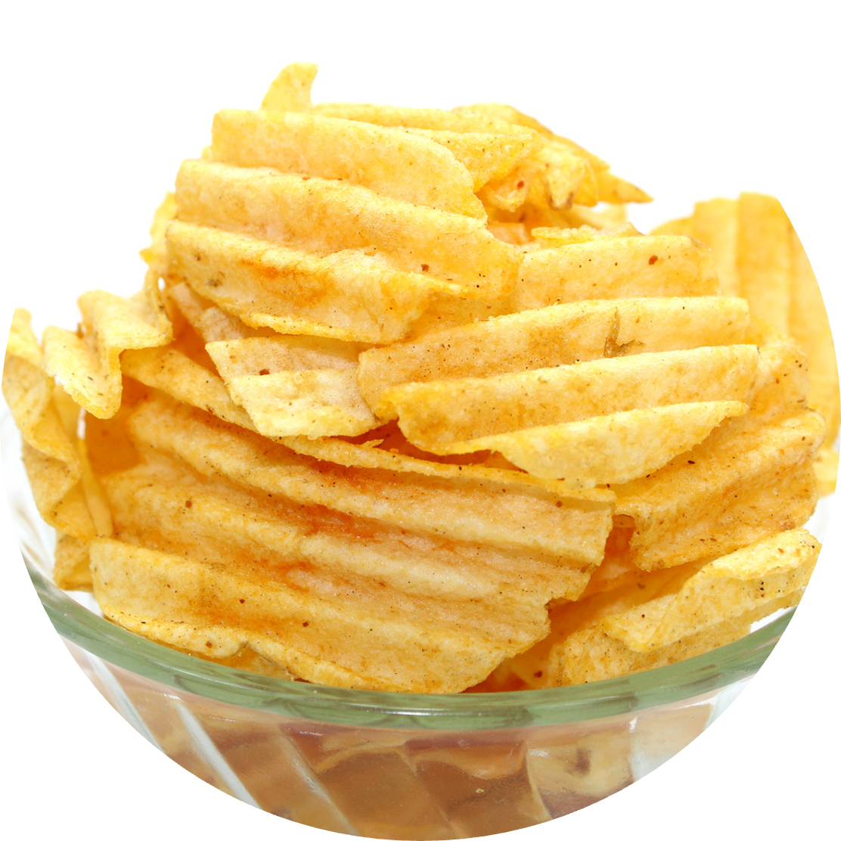
ANSWER
+30 POINTS
SALT &
VINEGAR
PEPPER

Slide 16




QUIRKS & HABITS

Slide 17



QUESTION 1
DO I PUT CILANTRO IN MY PHO?
If your answer is correct,
you win 15 points!

Slide 18

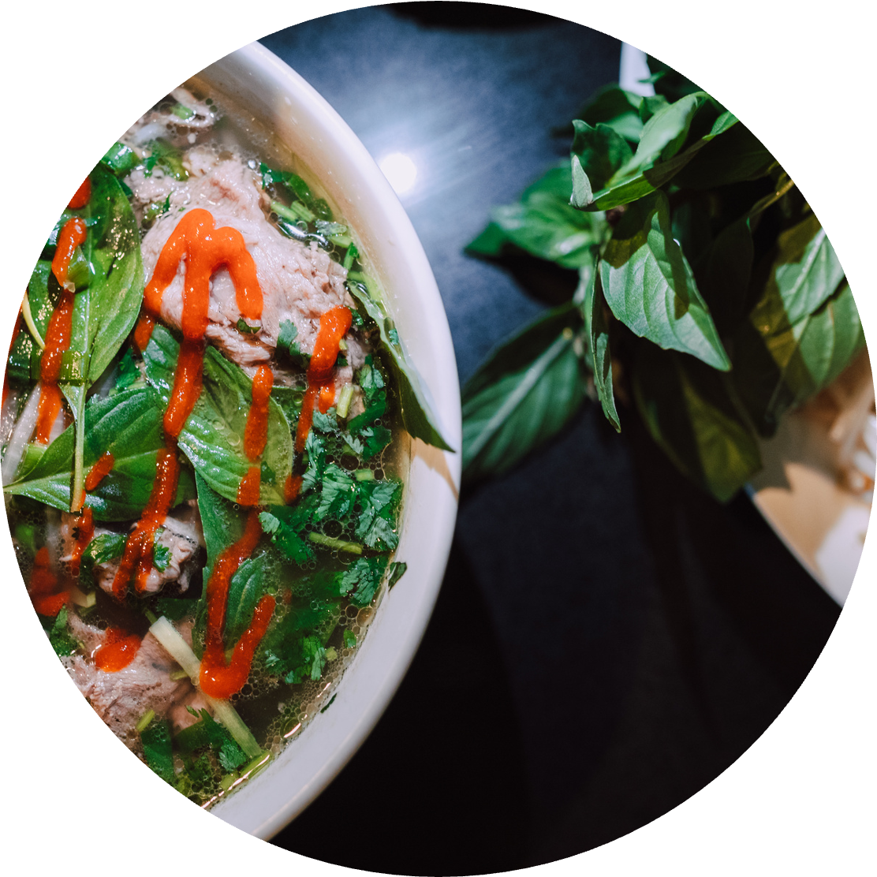

ANSWER
+15 POINTS
YES

Slide 19


If your answer is correct,
you win 50 points!
QUESTION 2
HOW DO I TAKE MY COFFEE OR TEA?
The details matter - is it black, with sugar, or do I have a unique preference?

Slide 20


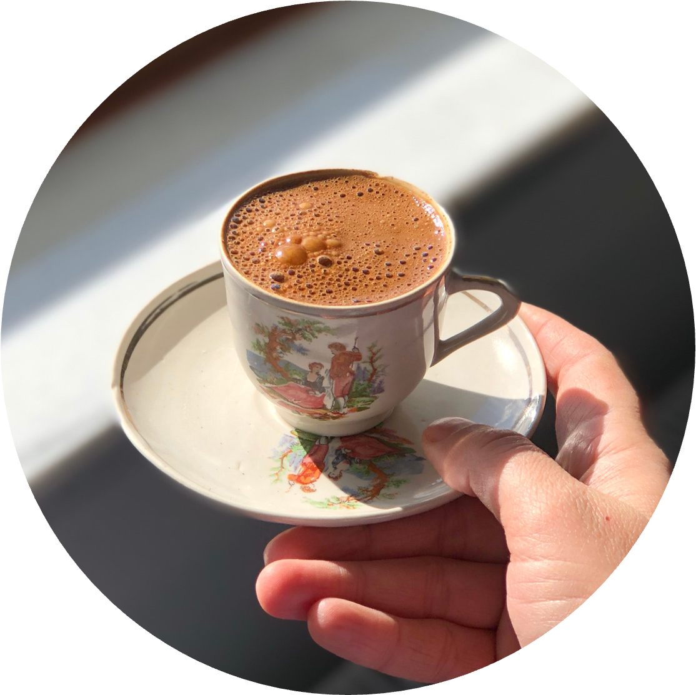
ANSWER
+50 POINTS
ESPRESSO WITH SUGAR CUBES

Slide 21

SCOREBOARD
 | Team A | Team B | Team C
1ST ROUND | 25 | 20 | 30
2ND ROUND | 15 | 25 | 20
3RD ROUND | 30 | 35 | 25
TOTAL | 70 | 80 | 75

Slide 22





THE WINNER IS
Team B

Slide 23

























Resource
Page
Use these design resources
in your Canva Presentation.
This presentation template
uses the following free fonts:
Titles: League Spartan
Headers: Blinker
Body Copy: Blinker
You can find these fonts
online too. Happy designing!
Don't forget to delete this
page before presenting.

Slide 24

CREDITS
This presentation template is free for everyone to use thanks to the following:
SlidesCarnival
for the presentation template
Pexels
for the photos

