Slide 1

Team Butterfly: Adam Lechliter, Ben Mathys, Jing Wen, Lucas Wu, Songyuan Wu
Notes:
The Progressive
JavaScript Framework

Slide 2
Outline
About Vue.js
History
Setup
General Concepts
Creating an Application Instance
Directive
One-way Binding
Two-way Binding
Components
Lifecycle Hooks
Pros and Cons
Examples
References

Slide 3
About
Evan You, the creator of Vue, worked in various AngularJS projects while working at Google. He built a lightweight solution by extracting the best parts of AngularJS without all the extra concepts involved. That's how he created Vue.js.
Vue was made to address the shortcomings of Angular, but, in reality, it combines the best parts of two most popular frameworks: AngularJS and ReactJS.
Notes:
From Angular, it took similar templates with good syntax and the way it is easy to use in already existing projects. From React, Vue got the component-based approach, props, one-way data flow for component hierarchy, performance, virtual rendering ability, and the understanding of the critical role proper state management of apps plays in web applications.

Slide 4
About
Vue is a progressive framework for building user interfaces.
Unlike other monolithic frameworks, Vue is designed from the ground up to be incrementally adoptable.
Example: You can use jQuery.js and Vue.js in the same project
Notes:
If you are using jquery and it doesn't meet the needs of your new page. Then you can use vue to develop the new page without refactoring the whole project
Some pages use jQuery, other pages use vue

Slide 5
Compare to Angular
TypeScript
Forced in Angular
Flexibility
Vue is more flexible than Angular.
The learning curve
Notes:
Angular actually has to be developed in TypeScript because its documentation and learning resources are almost entirely oriented towards TS. TS has a lot of benefits - static type checking is very useful in large-scale applications, and it is also very development-enhancing for developers with Java and C# backgrounds.
However, not everyone will want to use TS - in small to medium sized projects, introducing TS may not bring too many obvious advantages. In these cases, using Vue would be a better choice, as using Angular without TS can be challenging.
Flexibility
Vue is more flexible than Angular. Vue officially provides build tools to assist you in building your project, but it doesn't limit how you go about organizing your application code. Some people may prefer having strict code organization specifications, but there are developers who prefer a more flexible and free approach.
To learn Vue, all you need is a good foundation in HTML and JavaScript. With these basic skills, you can very quickly get into development by reading guides.
The learning curve for Angular is very steep - as a framework, it has a much larger API area than Vue, and you therefore need to understand more concepts to start working efficiently. Of course, Angular's inherent complexity is due to the fact that it's designed to target only large, complex applications; but that undeniably makes it quite unfriendly to less experienced developers.

Slide 6
Four primary ways of adding Vue.js to a project:
Import it as a CDN package on the page
Download the JavaScript files and host them yourself
Install it using npm
Use the official CLI to scaffold a project, which provides batteries-included build setups for a modern frontend workflow (e.g., hot-reload, lint-on-save, and much more)

Slide 7
Import vue to your project
Import this framework at the head of the html page
<script src="https://unpkg.com/vue@next"></script>
Download and Self Host
Download form https://cdn.jsdelivr.net/npm/vue@next/dist/ and add it under the directory
Use npm to install the latest stable version of vue
npm install vue@next

Slide 8
General Concepts -- Creating an Application Instance
In Vue 3, every Vue application starts by creating a new application instance.
The application instance created by the new createApp method.
const app = Vue.createApp({
/* options */
})
The application instance provides an application context.
The instance is used to register ‘globals’ that components can use within the application.
Most methods exposed by an application instance return the same instance, allowing chaining, so other methods can be chained after it.

Slide 9
General Concepts -- Directive
Vue. js Directives are special HTML attributes that allow us to manipulate the DOM.
The default prefix is v.
Can register custom directives.
Do not recommend using these two directives together on one element.
<element
prefix-directiveId = ="[argument:] expression [| filters...]">
</element>

Slide 10
General Concepts -- Directive
Conditional Directive
v-if: control the rendering of an element bases on the truthiness of the expression value.
v-show: control the displaying of an element based on a variable.
v-else: used to indicate an “else block” for v-if.
Loop Directive
v-for: render the element or template block multiple times based on the source data.

Slide 11
General Concepts -- Directive
The sample instance for v-for directive
<p v-for=”(item, i) in list”>
--index--{{i}} --value--{{item}}
</p>
data (){
return{
msg: ‘Welcome to your Vue.js’,
input: ‘hello binding’,
show:true,
list:[1,2,3,4,5]
}
},
Notes:
This is a sample instance for loop directive. We created one list object which contains the numbers from 1 to 5. I set the v-for element in the view, which causes the viewmodel to render these five elements as the child elements of tag p sequentially.

Slide 12
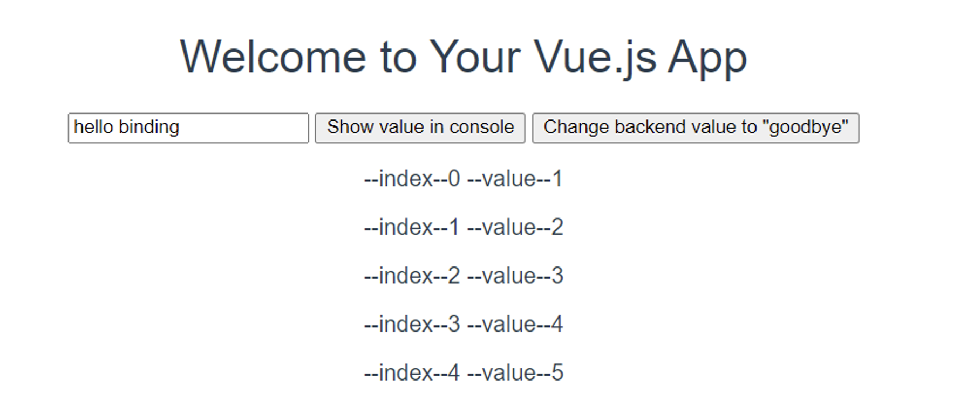
General Concepts -- Directive
Notes:
This is what has been rendered by the model.

Slide 13
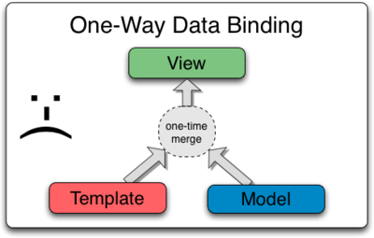
General Concepts -- One-way Binding
One way data flow means that the model is the single source of truth
Only the model has the access to change the app’s state
v-bind is used for one-way data binding

Slide 14
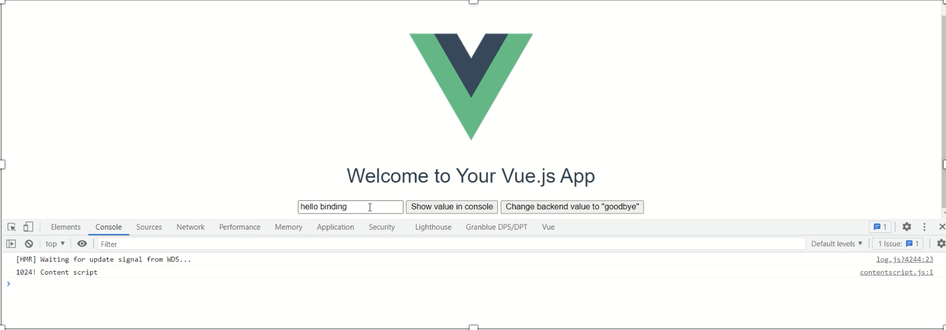
General Concepts -- One-way Binding
Notes:
Here is a sample,
in this simple web application, there is a text box (view) and users can be free to enter any value in it. We can see that the original view value is “hello binding”.

Slide 15
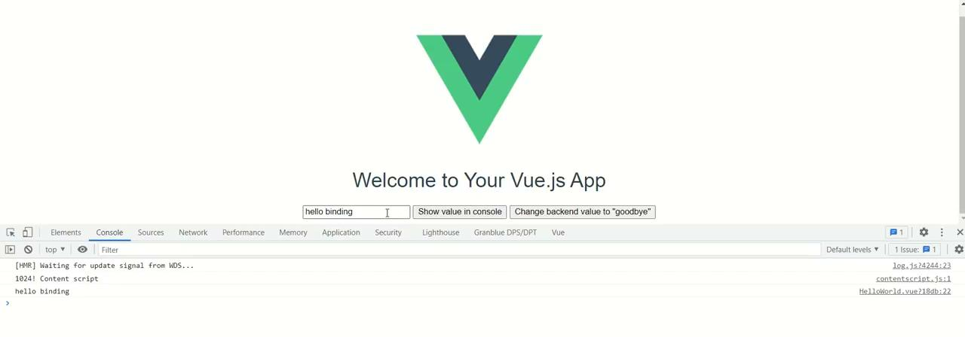
General Concepts -- One-way Binding
Notes:
In this sample video, we can see that:
if we change the view value to ‘hello binding123’, the model value would not be changed, which still is ‘hello binding’.
While after clicking the second button to change the model value to ‘goodbye’, it will affect and change the view value to ‘goodbye’.

Slide 16
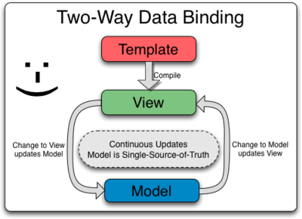
General Concepts -- Two-way Binding
v-model is used for two-way data binding
Binding to text input elements
To bind the value of an input element to a property of the component’s data.
Binding to checkboxes and radio buttons
A checkbox binding will either be true or false.
A radio button binding will be whatever the contents of its value property is.

Slide 17
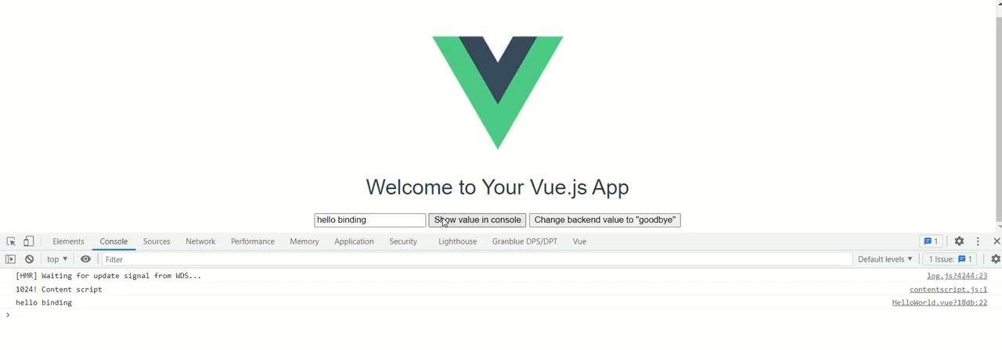
General Concepts -- Two-way Binding
Notes:
In this sample video, we can see that:
if we change the view value from ‘hello binding’ to ‘hello two way binding’, it will affect and change the model value at the same time. And then, after clicking the second button to change the model value to ‘goodbye’, it will also affect and change the view value to ‘goodbye’.

Slide 18
Components
Reusing Components: Components are reusable instances with a name, which could be reused as many times as you want
Organizing components: It’s common for an app to be organized into a tree of nested components. To use these components in templates, they must be registered into certain way that Vue knows about them
global registration
local registration
Props: Props are custom attributes you can register on a component. When a value is passed to a prop attribute, it becomes a property on that component instance which is accessible within the template

Slide 19
The Difference
Code reuse without component:
Copy code directly to the file.
Research the code carefully worrying about some code will mess up the whole project
High coupling
Code reuse with component
Just use tags in the file
Without any worry about the inner code
Low coupling

Slide 20
Example
1.Install the component by npm:npm install vue-fullcalendar
2.Import and register the component in main.js
import fullCalendar from ‘vue-fullcalendar’
Vue.component(‘full-calendar’, fullCalendar)
3.Just use <full-calendar> tag in our vue frontend file.
<full-calendar></full-calendar>

Slide 21
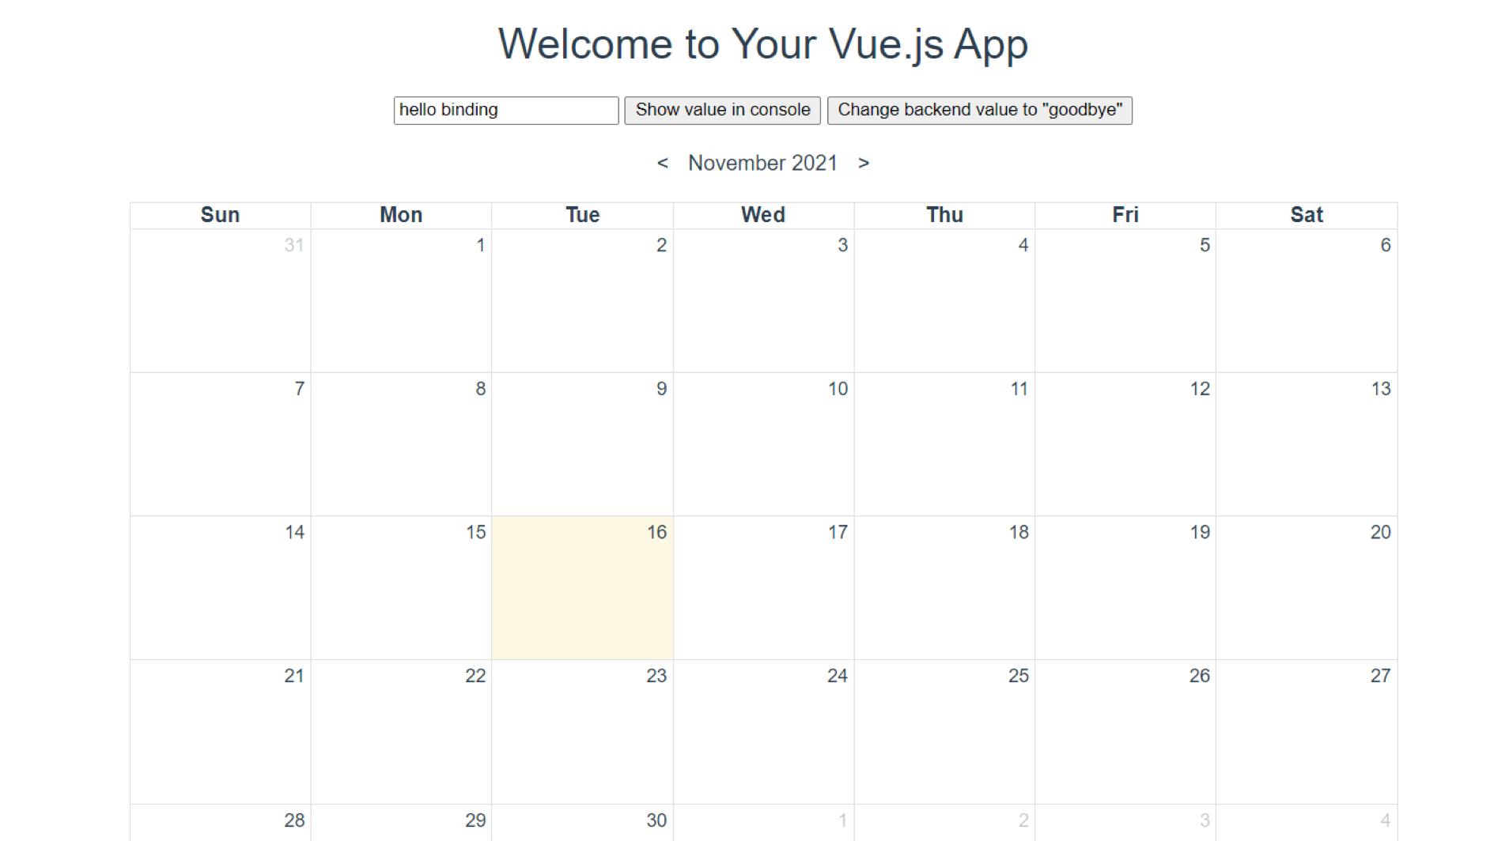

Slide 22
Define a event list according to the component API:
events: [
{
title : ‘event1’,
start : ‘2021-11-10’
cssClass : ‘family’,
YOUR_DATA : {}
},
{
title : ‘event2’,
start : ‘2021-11-13’,
end : ‘2021-11-15’,
cssClass :[ ‘family’, ‘career’],
YOUR_DATA : {}
},
]
Pass the data to component:
<full-calendar: events=”events”></full-calendar>

Slide 23
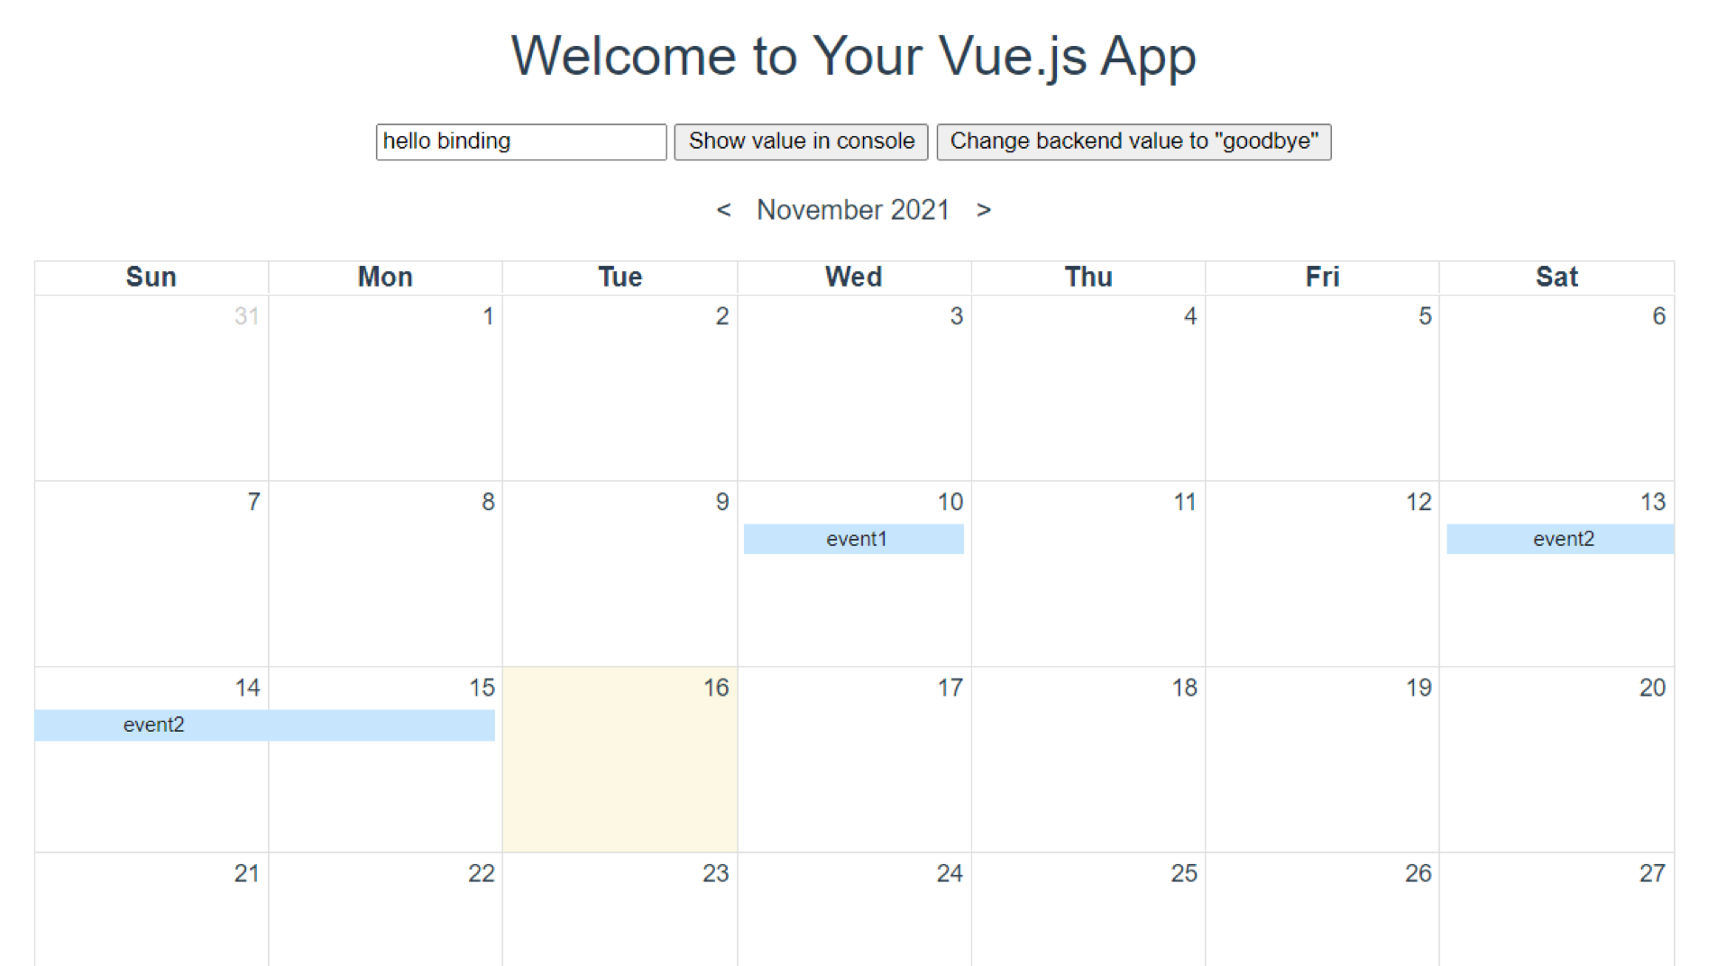

Slide 24
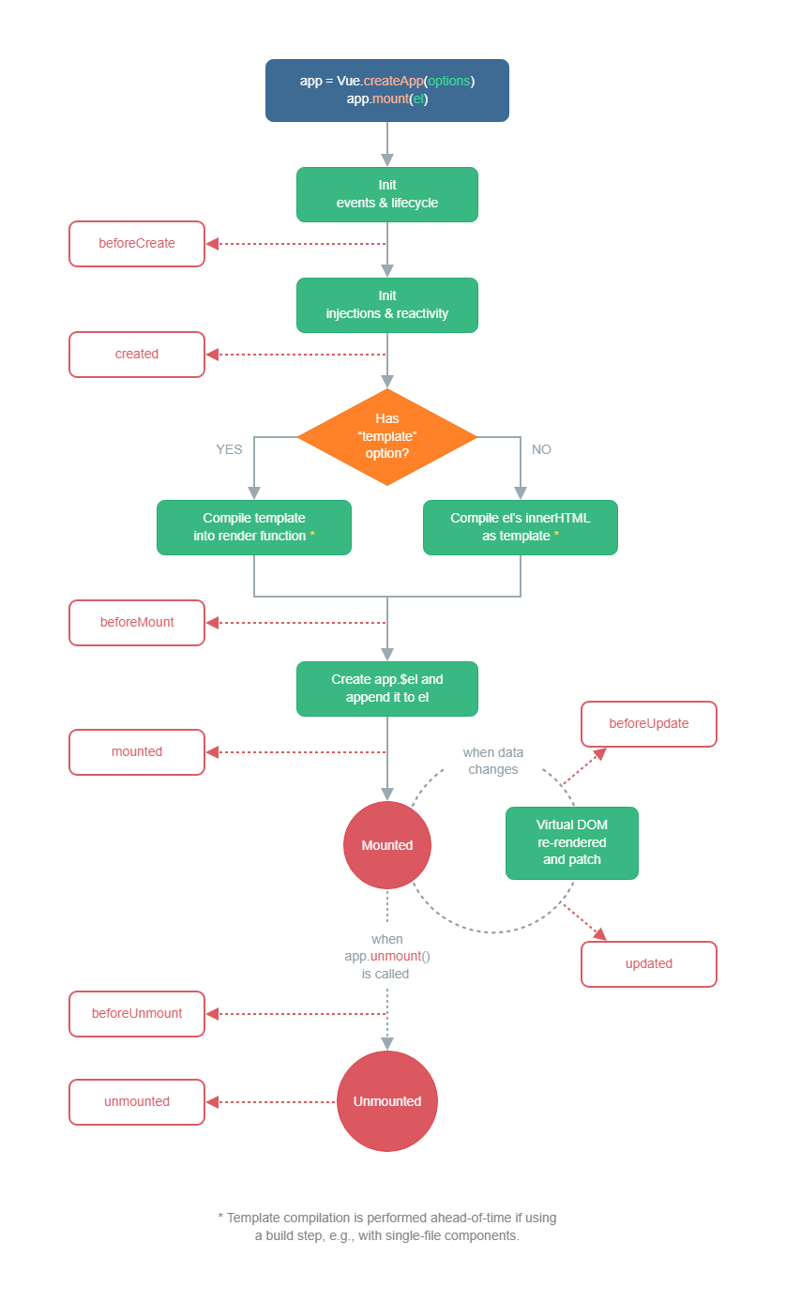
General Concepts -- Lifecycle Hooks
As many frontend framework, vue does have a lifecycle
We can hook many phase stages in the life cycle to add some own code
The life cycle is as shown below.

Slide 25
Created() {
this.events.push({
title : ‘oncreate’,
start : ‘2021-11-16’,
end : ‘2021-11-17’,
cssClass : [‘family’, ‘career’],
YOUR_DATA : {}
})
}

Slide 26
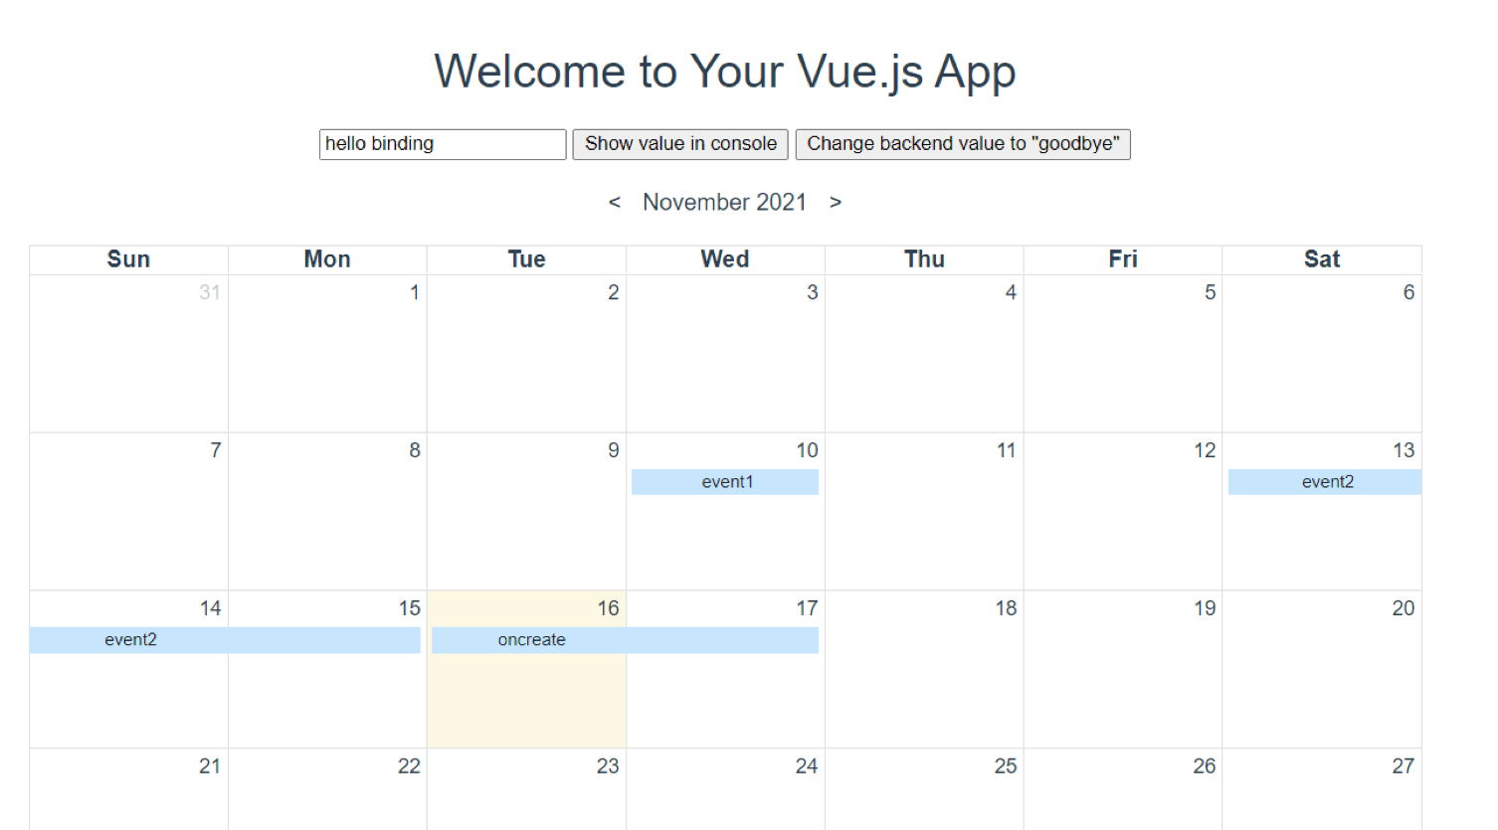

Slide 27
Pros and Cons - Benefits of Using Vue.js
Lightweight
Framework is only about 18 KB
Performance
Virtual DOM
Reactive Binding
Two-way binding allows for the connection between model data the view
Readability
A single file can represent a component
Integration Capabilities and Flexibility
Use existing technologies
Easy to learn
Already familiar with HTML, CSS, and JavaScript
Community Support

Slide 28
Pros and Cons - Drawbacks of Using Vue.js
Not yet a standard framework
Lack of resources and limited developers
No access to application state operations
Advanced Topic - Complicates debugging
Slower than some frameworks
Currently, Vue.js renders slower than React
Complex Reactive Structure
A known issue that is addressed in the Vue.js documentation
Lack of large-scale project support
Less financial support
Too much flexibility
Giving a team more flexibility can lead to more issues later on

Slide 29
Practice
How would you create a counter that increments everytime you click the button?
<script>
// Create a Vue application
const app = Vue.createApp({})
// Define the button-counter component
app.component('button-counter', {
data() {
return {
count: 0
}
}
})
app.mount('#counter')
</script>
<div id="counter">
<button v-on:click="count++">
You clicked me {{ count }} times.
</button>
</div>

Slide 30
Practice (continued)
How could we make the previous example more reusable?
<script>
const app = Vue.createApp({})
app.component('button-counter', {
data() {
return {
count: 0
}
},
template: `
<button v-on:click="count++">
You clicked me {{ count }} times.
</button>`
})
app.mount('#app)
</script>
<div id="app">
// display 3 button counters
<button-counter></button-counter>
<button-counter></button-counter>
<button-counter></button-counter>
</div>
example provided by: Components Basics | Vue.js (vuejs.org)

Slide 31
Practice (countinued)
How would you bind an input label to a data model so that changing one affects the other?
<script>
// Create a Vue application
const app = Vue.createApp({})
// Define the input component
app.component('button-counter', {
data() {
return {
message: 'change me'
}
}
})
app.mount('#app')
</script>
<div id="counter">
<p>{{ message }}</p>
<p><input v-model="message"></p>
</div>

Slide 32
References
a. The Good and the Bad of Vue.js Framework Programming
b. Vue.JS : The Progressive Framework!
c. WHAT IS PROGRESSIVE JAVASCRIPT FRAMEWORK?
d. Introduction | Vue.js (vuejs.org)
e. What is Vue.js (w3schools.com)
f. Vue.js — One-way Data Binding
g. Why Is Vue.js Growing so fast? 4 Reasons Behind the Framework's Success (netguru.com)

