Slide 1
ChaCha
lucas.zw.ye@outlook.com

Slide 2
History
Salsa20, the original cipher, was designed in 2005, then later submitted to the eSTREAM European Union cryptographic validation process by Bernstein.
In 2008, Bernstein published ChaCha, which aim to increase the diffusion per round while achieving the same or slightly better performance.
ChaCha is a modification of Salsa20 published in 2008. It uses a new round function that increases diffusion and increases performance on some architectures.

Slide 3
Algorithm
Initial State Matrix
Quarter-Round Function
Transform between each round

Slide 4
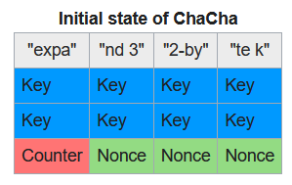
Initial State Matrix
32 * 4 bit Constant ("expand 32-byte k")
32 * 8 bit Key
32 * 2 bit Counter
32 * 2 bit Nonce

Slide 5
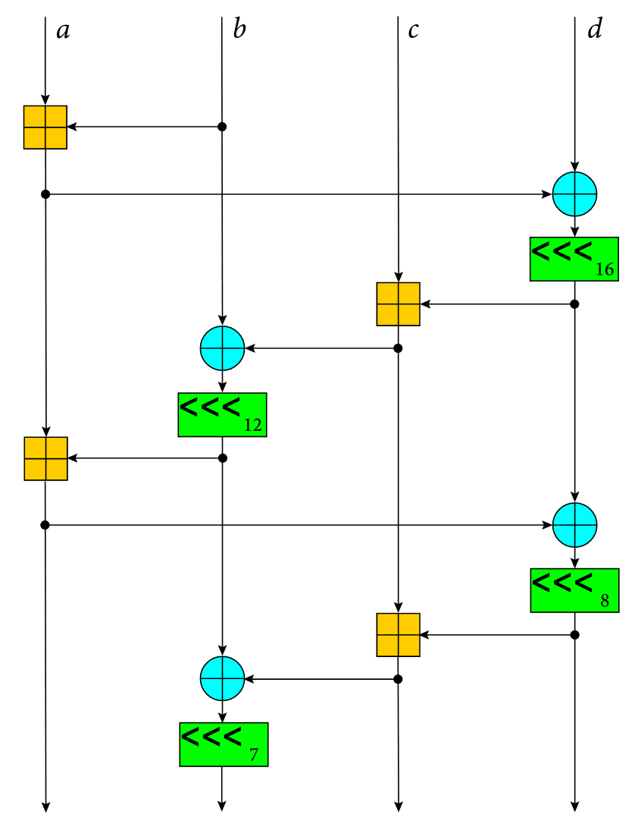
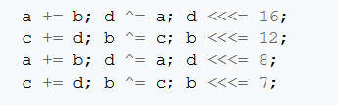
Quarter-Round Function
QR(a, b, c, d):
- 32 bit addition mod 2³²
- xor
- shift
20 rounds in total

Slide 6
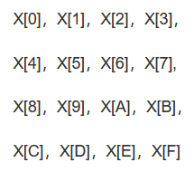
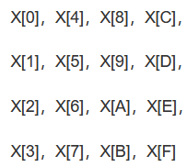
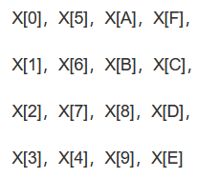
Transform between each round
Origial Matrix Row Transform (odd round) Diagonal Transform (even round)

Slide 7
void chacha_block(uint32_t out[16], uint32_t const in[16])
{
int i;
uint32_t x[16];
for (i = 0; i < 16; ++i)
x[i] = in[i];
// 10 loops × 2 rounds/loop = 20 rounds
for (i = 0; i < ROUNDS; i += 2) {
// Odd round
QR(x[0], x[4], x[ 8], x[12]); // column 0
QR(x[1], x[5], x[ 9], x[13]); // column 1
QR(x[2], x[6], x[10], x[14]); // column 2
QR(x[3], x[7], x[11], x[15]); // column 3
// Even round
QR(x[0], x[5], x[10], x[15]); // diagonal 1 (main diagonal)
QR(x[1], x[6], x[11], x[12]); // diagonal 2
QR(x[2], x[7], x[ 8], x[13]); // diagonal 3
QR(x[3], x[4], x[ 9], x[14]); // diagonal 4
}
for (i = 0; i < 16; ++i)
out[i] = x[i] + in[i];
}

Slide 8
Thanks

