Slide 1
Real estate Searching System
Gangyu Pan

Slide 2
Project Description
Suitable house is very important
Lots of factors affecting people choice
Provide buyers with more suitable options

Slide 3








The process of project

Slide 4
Datasets:
Realtor API
Crime API
School Dataset
Porcess data:
Missing values, outliers, data type conversion.

Slide 5
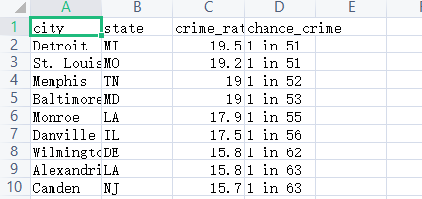
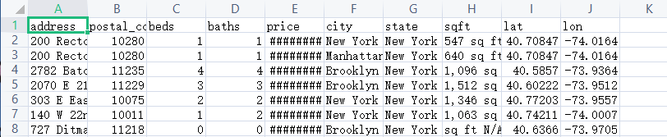
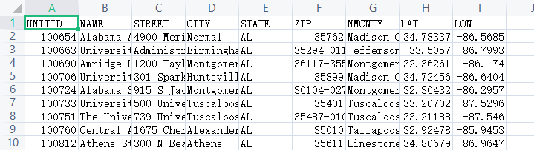
Crime
Real estate
School

Slide 6
Spark process data:
Get average price by zip code(Real estate)
Get average sqft by zip code(Real estate)
Get disatance bewteen house and school
(Real estate&& School )
Store data:
CSV file, JSON file
Upload to Firebase Realtime Database

Slide 7
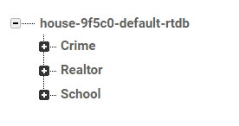
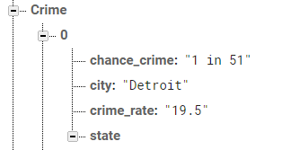
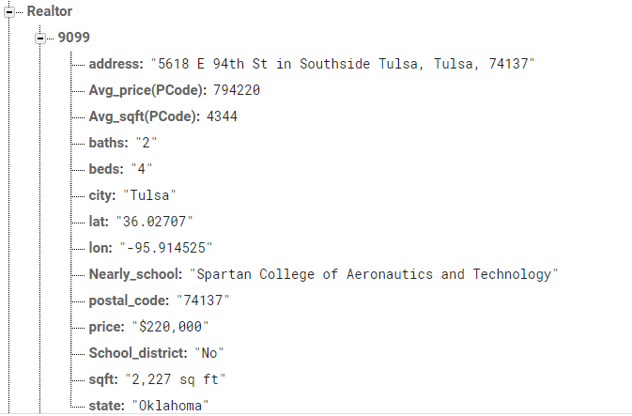
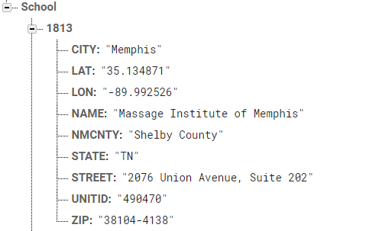

Slide 8
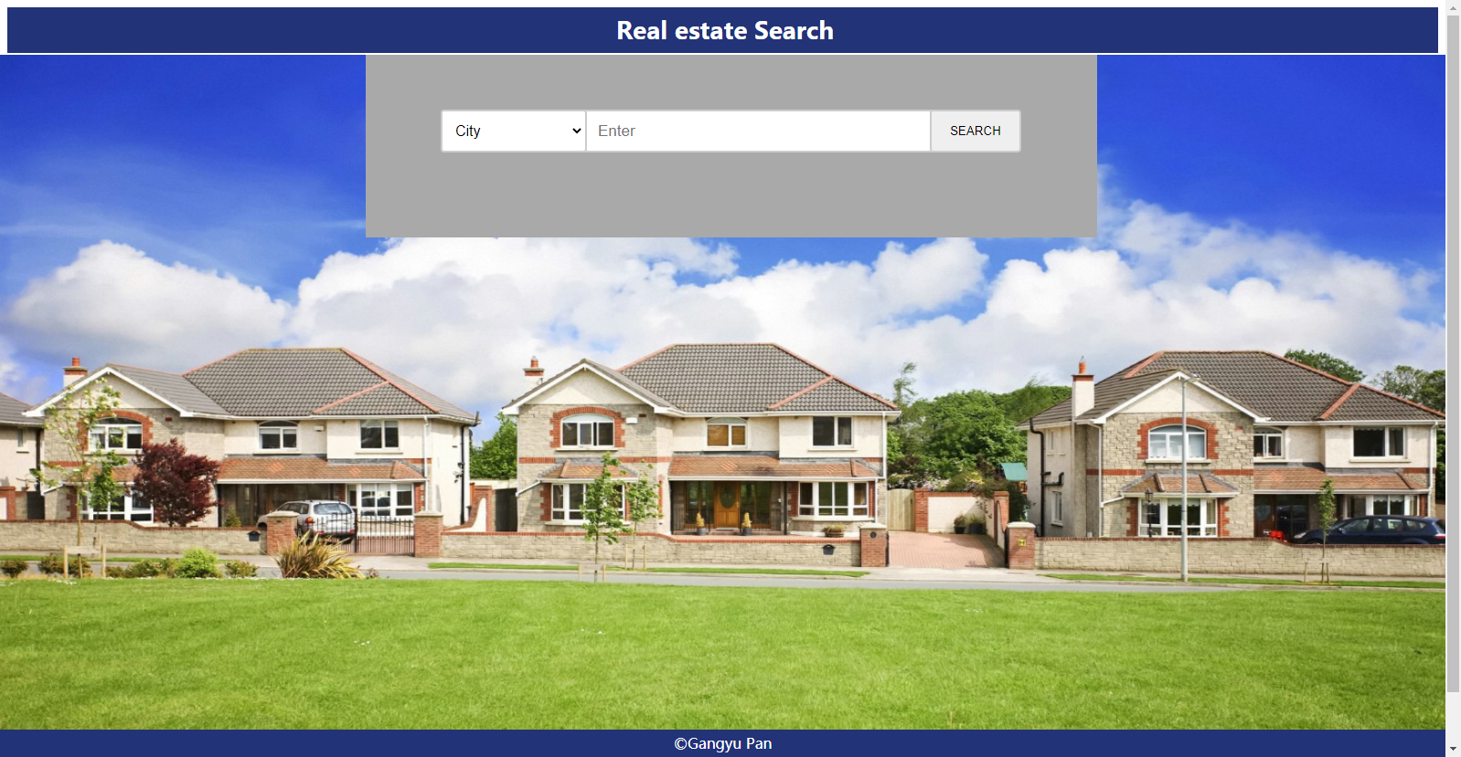
UI

