Slide 1
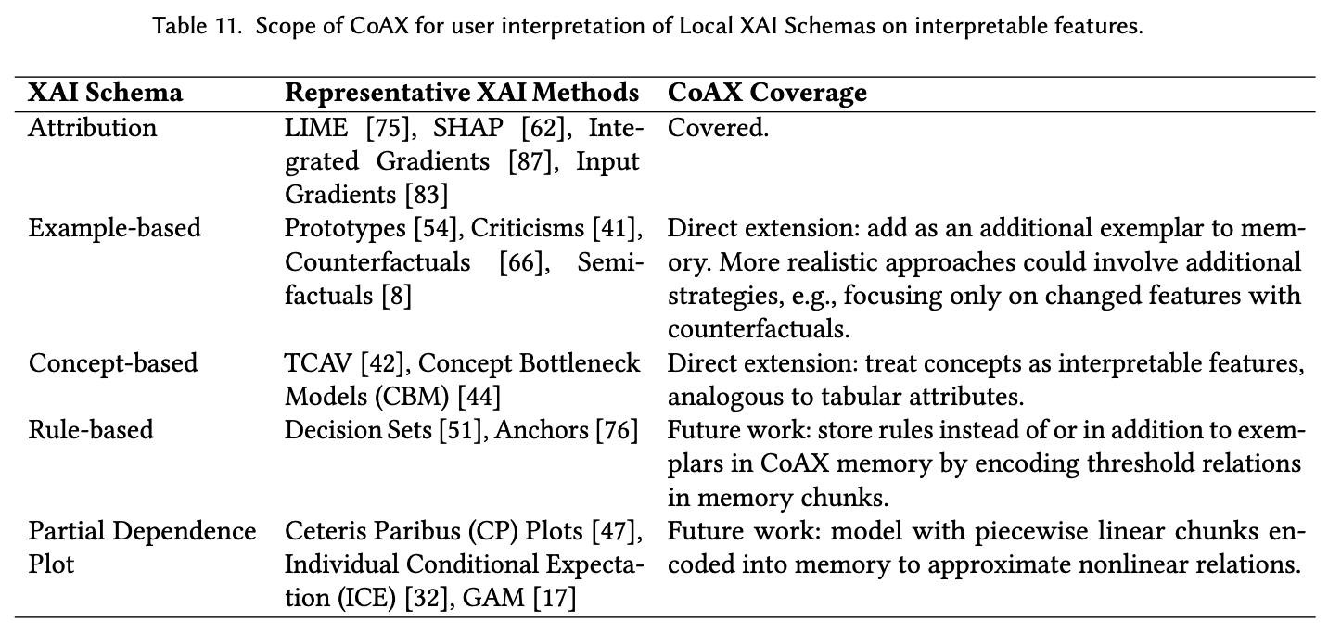
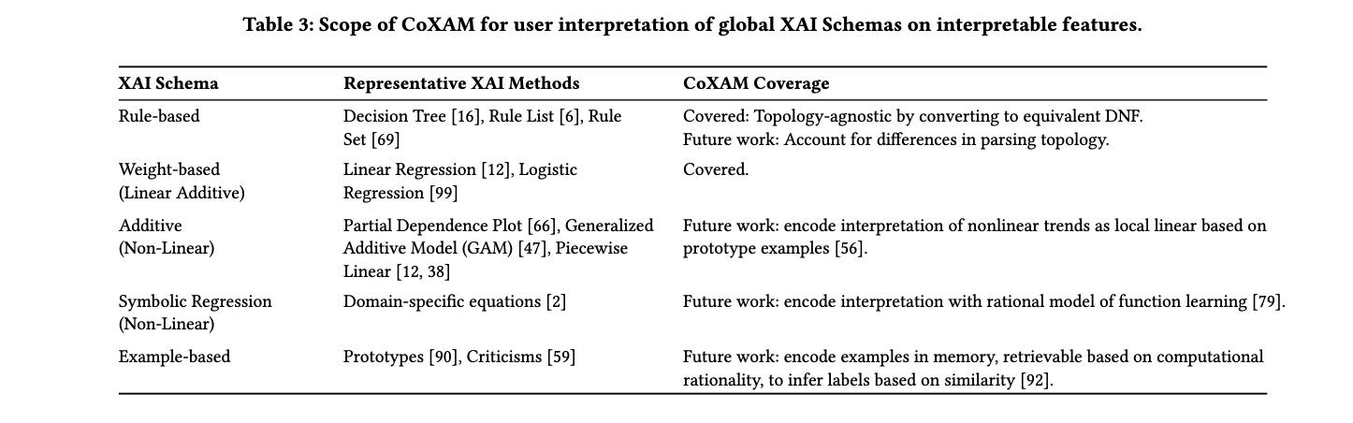
xai_adapter:
Implemented XAI Types
2 Classes
Weight-based/
Attribution
Rule-based
LIME, SHAP,
Linear Regression,
Logistic Regression, Integrated Gradients,
Input Gradients
Decision Trees,
Rule List,
and Rule Set

Slide 2
xai_adapter:
Architecture & Design Patterns
Class Hierarchy
Design Patterns
XAIAdapter (Abstract) fit() | explain()
1
Template Method Base class defines skeleton; subclasses fill in steps
Local v.s. Global
CoAX v.s CoXAM
2
Strategy Switch between Attribution vs Surrogate seamlessly
3
Registry Dynamically create & register methods by name
Attribution
Surrogate
LIME, SHAP,
Integrated Gradients,
Input Gradients
Linear Regression,
Logistic Regression
Decision Trees,
Rule List,
and Rule Set
✓ Extensible (add new methods without touching base)
✓ Unified Interface (all methods return XAIAdapterResult)
✓ Pluggable I/O (custom algorithms via make_attribution() and make_surrogate())

Slide 3


Extension Points & Data Flexibility
Two Extension Paths
XAI Developer
AI
XAI Adapter
Subclassing
Custom Function
Create new subclasses of existing adapters
Wrap already defined method
Final Explanation Data Format
explain() always returns a standardized explanation result; the adapter-specific logic decides how to compute the feature scores and metadata.

Slide 4
Extension Points & Data Flexibility
Input Flexibility
Raw Data (X, y) → Train XAI on fly
Precomputed Tables (explanation_df + metadata_df)

