Slide 1

T S F S 1 2 H A N D - I N E X E R C I S E 5 Learning for Autonomous Vehicles
Mohamed ZAROUAL – Lucas Alvaro

Slide 2
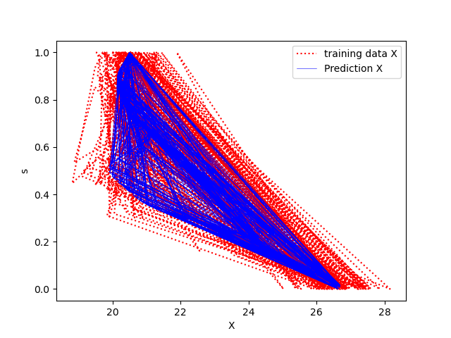
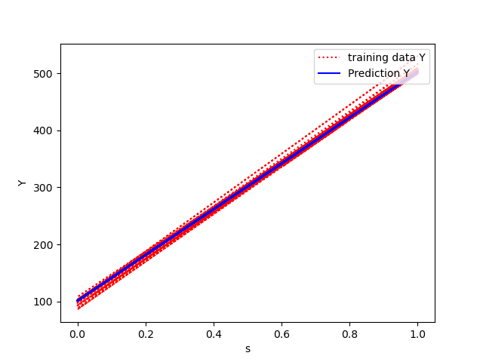
the training data and the predicted mean for x
the training data and the predicted mean for y

Slide 3
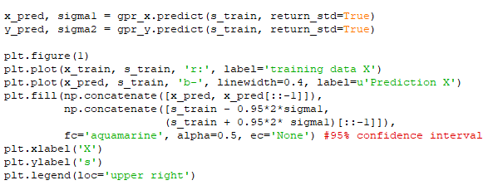
confidence interval for the prediction
Root Mean Square Error (RMSE) is the standard deviation of the residuals, it thus estimates the concentration of the data around the fitted equation,
If the data are roughly normal, then most of the residuals lie within about ± 2 RMSE of their mean

Slide 4
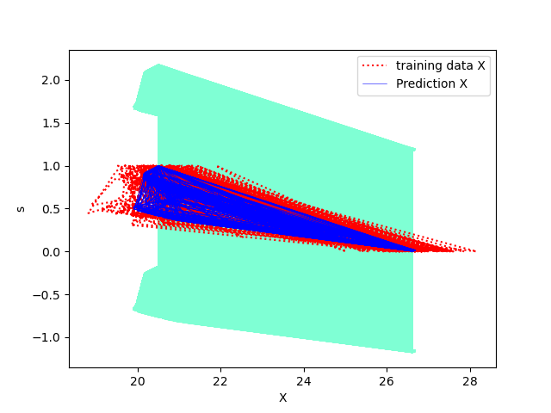
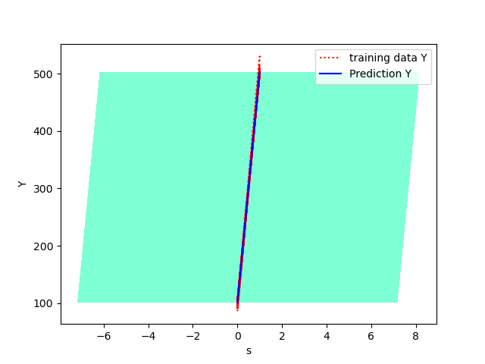
the training data and the predicted mean for x with a 95% a confidence interval
the training data and the predicted mean for y with a 95% a confidence interval

Slide 5
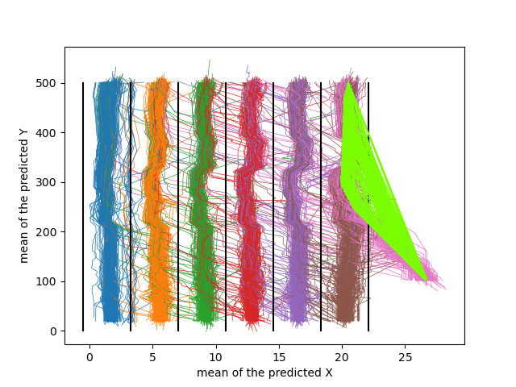
the mean of the predicted x and y

Slide 6
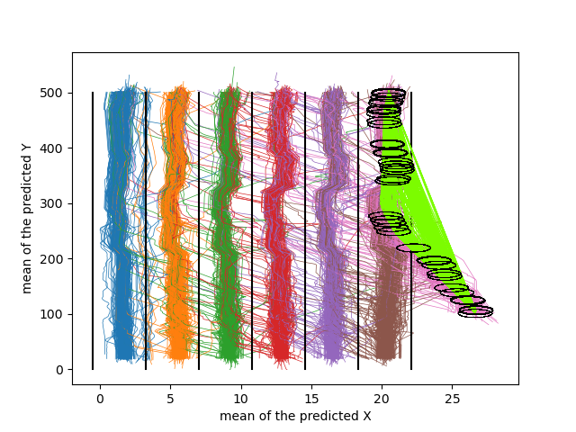
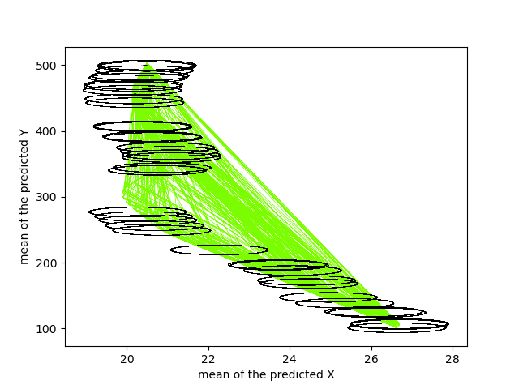
the mean of the predicted x and y with ellipses showing the uncertainty (ellipses with the half axis determined as two times the standard deviations)

Slide 7
the predicted means from the GP models are not always in good agreement with the training data (we have some means crossing the road )

Slide 8
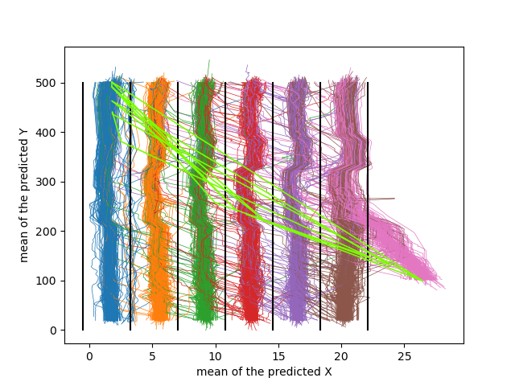
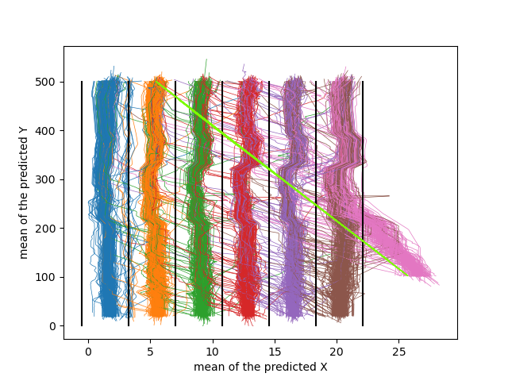
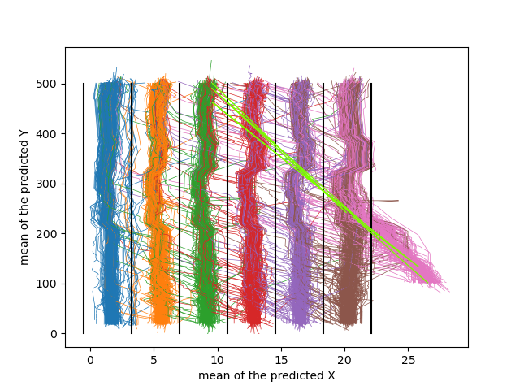
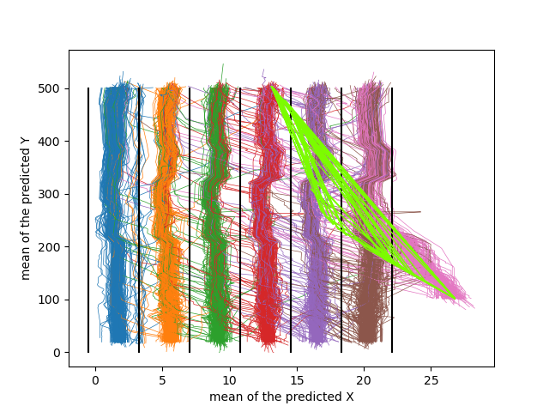
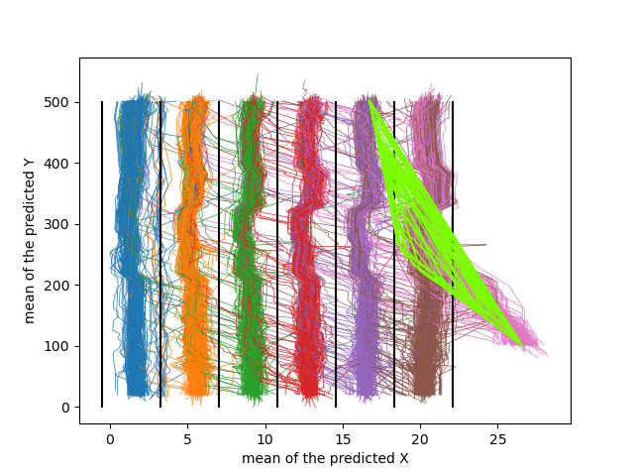
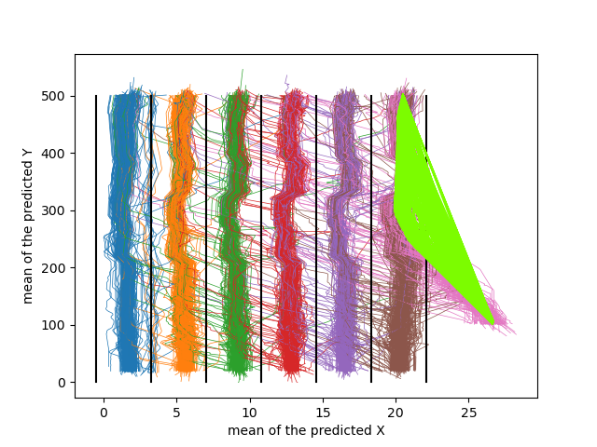
GP MODELS FOR SCENARIOS STARTING AT THE ON-RAMP BUT WITH DIFFERENT FINAL LANE

Slide 9
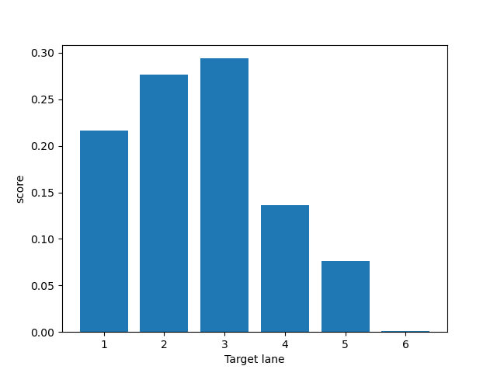
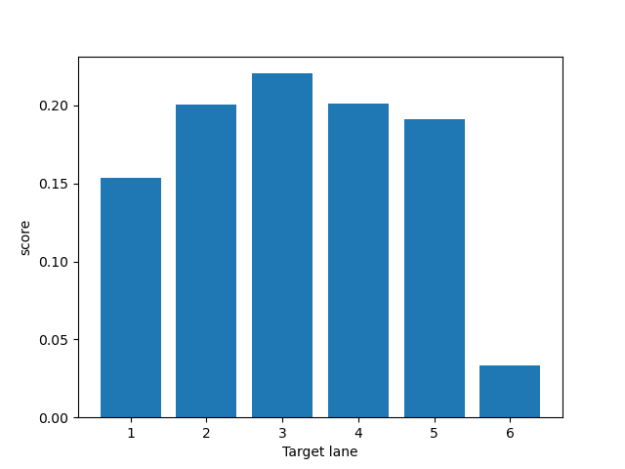
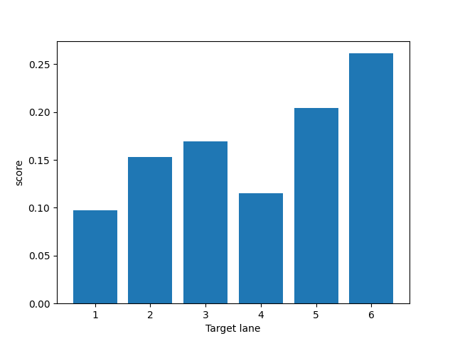
THE PREDICTION OF SCORES AND PROBABILITIES FOR CLASS ASSOCIATION
FINAL LINE IS 2
FINAL LINE IS 4
FINAL LINE IS 6

Slide 10
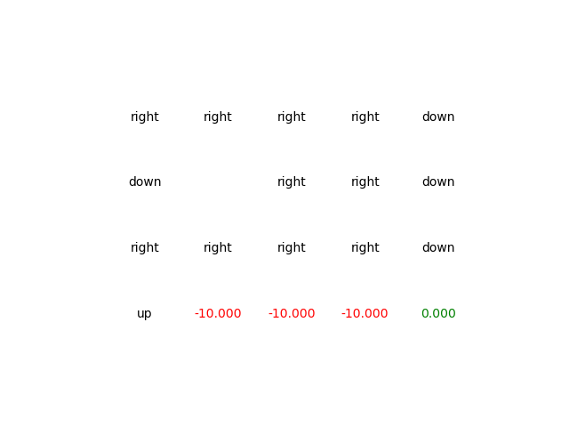
Reinforcement learning: value iteration
Optimal Path
State policy for each state

Slide 11
P_move_action
Gamma
Is the probability thatthe car is going in the right way. If it’s set up at 1, the reward are optimum because it’s always the right case that is rewarded, if it’s too low it will never converge because the rewards are false.
Is the discount factor, if it’s lower than 1 it prioritize the first iterations else the rewards are increasing during the iterations.

Slide 12
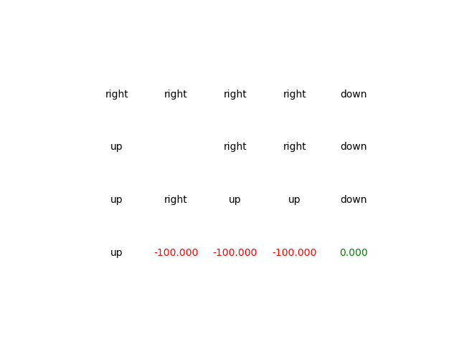
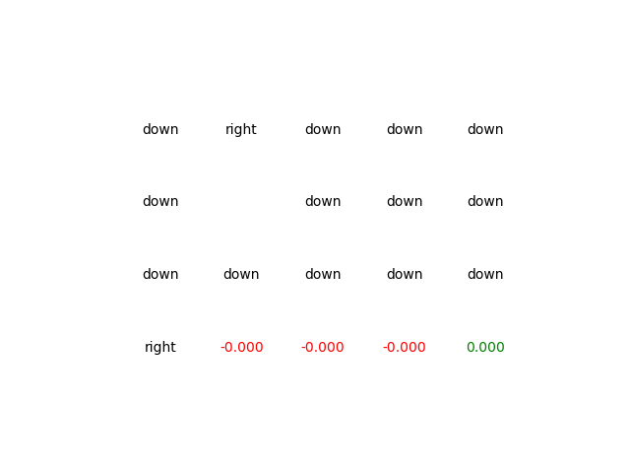
If the cliff has very high negative value, then the rewards will lead to a path away of the cliff else the path is the straight line between start and goal :

Slide 13
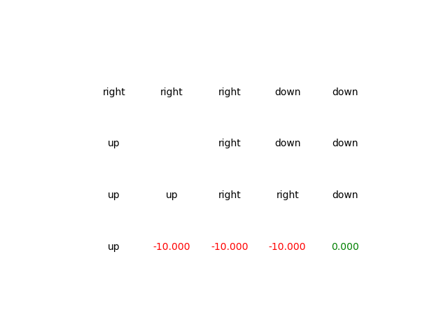
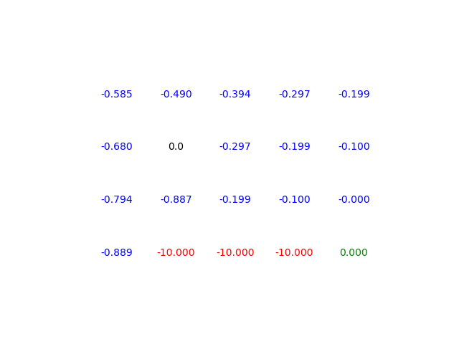
Reinforcement learning: Q-Learning
Path (P_move_action=0,99)
State policy for each state

Slide 14
Other start but still optimal path if P_move_action=1

Slide 15
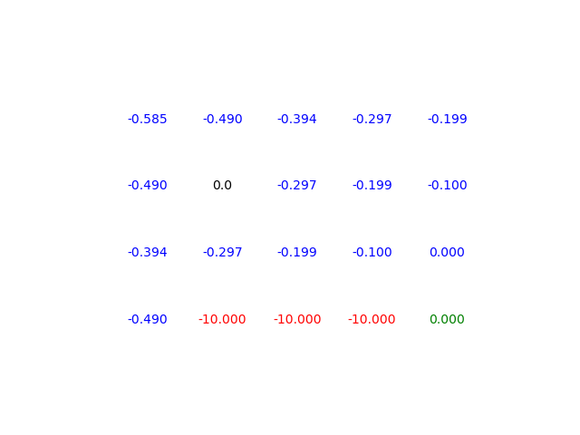
Q learning with epsilon greedy strategy
Optimal policy state

Slide 16
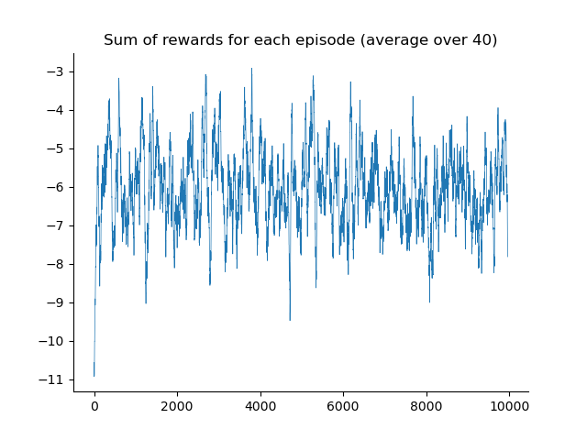
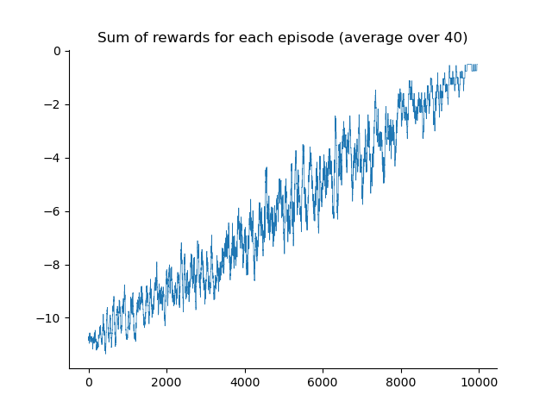
comparison
Epsilon constant strategy
Epsilon-greedy strategy

