Slide 1

Cyclistic Bike Rentals Marketing Strategy
The following three questions will form the basis for the upcoming marketing program:
I. How do Cyclistic members and casual riders use Cyclistic bikes differently?
II. Why would casual riders buy Cyclistic annual memberships?
III. Recommendations to convert Casual Riders to Cyclistic Members.

Slide 2
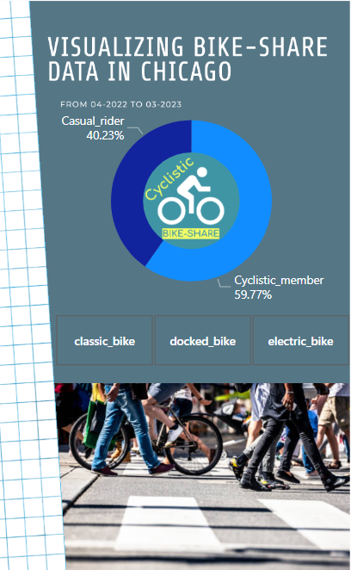
Cyslistic Members vs Casual Riders
Based on the Cyclistic’s historical trip data
from April 2022 to March 2023, the different points is:
Percentage of users.
Casual riders : 40.23%
Cyclistic members : 59.77%

Slide 3
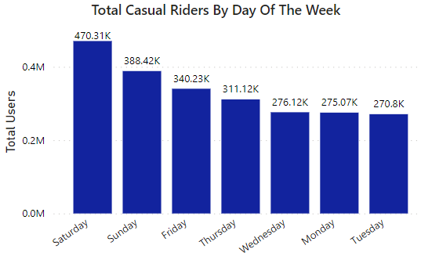
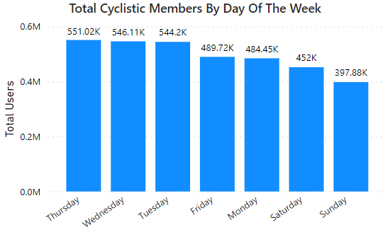
Cyslistic Members vs Casual Riders
Based on the Cyclistic’s historical trip data
from April 2022 to March 2023, the different points is:
Percentage of users.
Favorite day of the week.
Casual riders tend to rent bikes more frequently on weekends( Saturday, Sunday).
Cyclistic members rides are more balanced distributed across the week( Thursday, Wednesday, Tuesday).

Slide 4
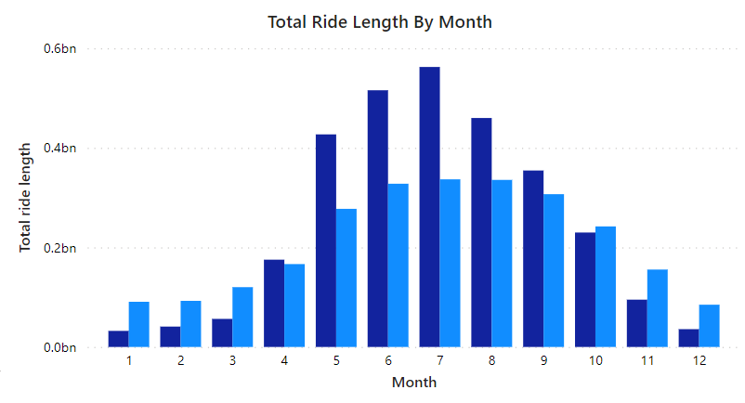
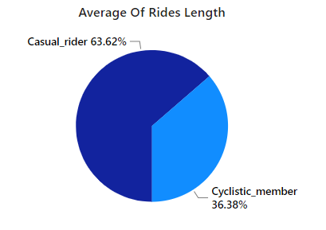
Cyslistic Members vs Casual Riders
Based on the Cyclistic’s historical trip data
from April 2022 to March 2023, the different points is:
Percentage of users.
Favorite day of the week.
Times “spent” on cycling.
Casual riders spent more time biking than Cyclistic members.
The average ride length for Casual riders is: 63.62%
And for Cyclistic members is: 36.38%

Slide 5
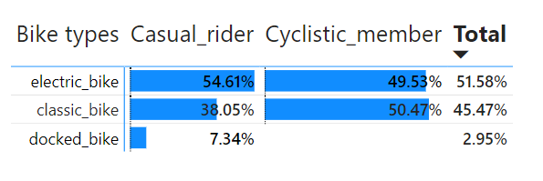
Cyslistic Members vs Casual Riders
Based on the Cyclistic’s historical trip data
from April 2022 to March 2023, the different points is:
Percentage of users.
Favorite day of the week.
Times “spent” on cycling.
Favorite types of bike.
Cyclistic members do not rent docked bikes. The percentage usage rates of electric bikes and classic bikes are approximately equal.
Casual riders rent electric bikes more than classic bikes by 16.56%. Some Casual riders also rent docked bikes, accounting for 7.34% of the total Casual riders.

Slide 6
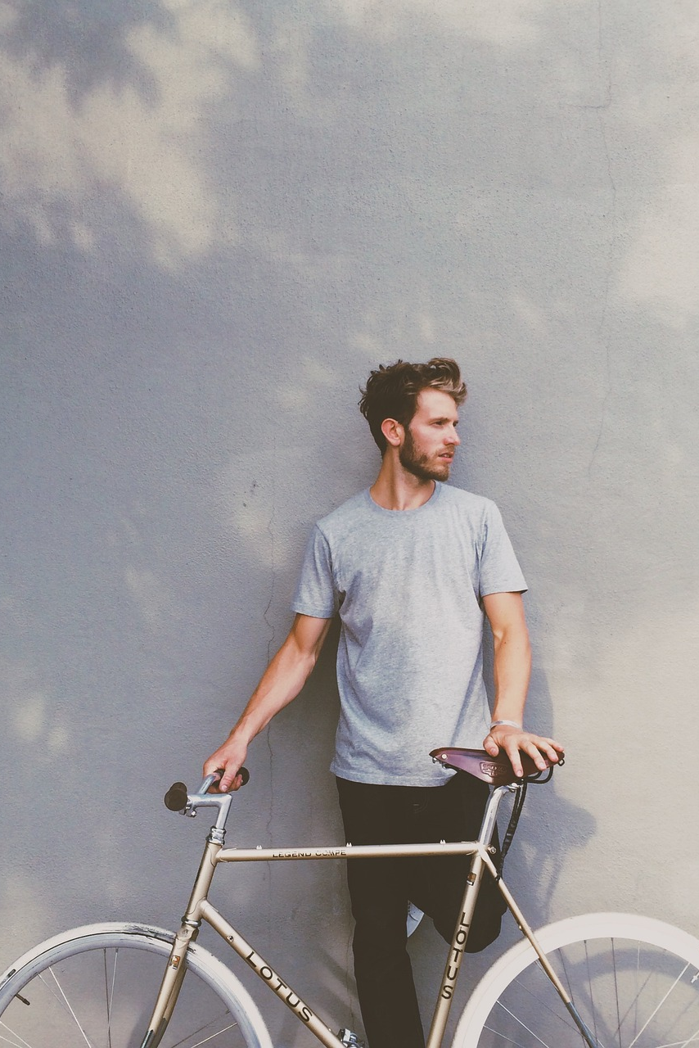
II. Why Casual Riders Would Buy a Membership
Cost savings: Depending on the frequency of bike rides, buying a membership may be more cost-effective than purchasing single-ride or day-pass options.
Convenience: With a membership, casual riders do not have to go through the process of renting a bike every time they want to ride. Instead, they can simply check out a bike using their membership card or app.
-> Overall, buying a membership is a good option for casual riders who use the bike-sharing system frequently and want to save money, enjoy convenience, and access additional benefits.

Slide 7
How Digital Media Affects Marketing Tactics
Social media is an effective way to target casual riders and promote membership options.
Email campaigns and digital ads can be used to remind casual riders of the benefits of membership.
Interactive maps and user-generated content can be used to showcase the bike rental experience.

Slide 8
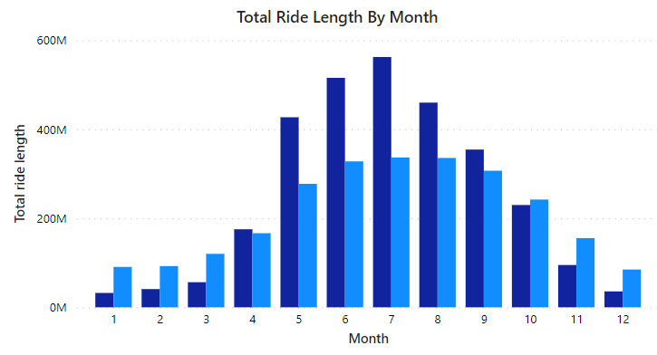
Some useful information.
Summer is the best season for business. Customers ride more then, particularly Casual riders.
The most popular bike rental station in Chicago is located at “Streeter Dr & Grand Ave” station.

Slide 9

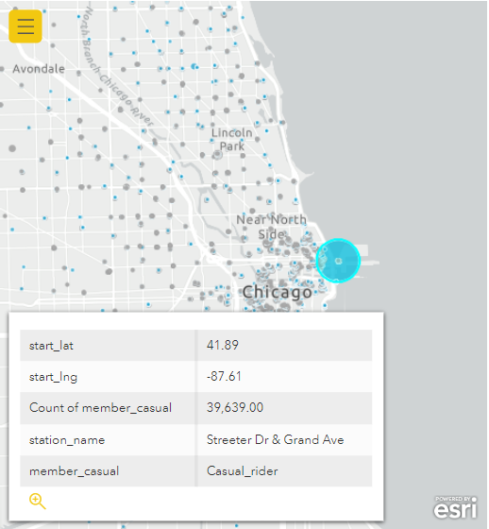
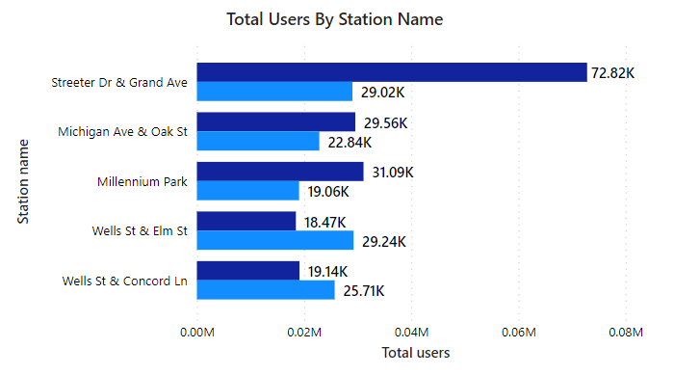
The most popular bike rental station in Chicago, particularly Casual riders:
The most popular station is “Streeter Dr & Grand Ave” station.
Total of riders for Casual riders is 72.82K and 29.02K for Cyclistic members.

Slide 10



III. Three recommendations: are valid strategies to convert casual riders into members and increase customer loyalty for Cyclistic's bike rental service:
Use social media and digital ads to target Casual riders with messaging that emphasizes the benefits of membership, such as cost savings and convenience. Especially during weekends and in summer.
Consider running marketing campaigns specifically targeting casual riders at the “Streeter Dr & Grand Ave” station. That is a great strategy to remind them of the benefits of membership and encourage them to make a longer-term commitment to the service.
Offering discounts or promotions for annual memberships can incentivize casual riders to commit to the service and become loyal customers. This approach can help increase revenue and improve customer retention. Provide incentives for longer biking sessions.

Slide 11
Thank you for your time 😊

