Slide 1
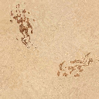
Icônes tuile de commandement

Slide 2


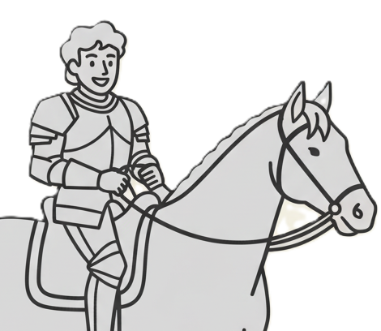


M3
Move Lord
M3
M2
Move Lord
M2
M1
Move Lord
M1
Move a Baron or Knight up to 3 tiles
Move a Baron or Knight up to 2 tiles
Move a Baron or Knight 1 tile
+1 tile if starting from a "Tile 2"
+1 tile if starting from a "Tile 2"
+1 tile if starting from a "Tile 2"
3
2
1

Slide 3




R3
Recruit Troops
R3
R2
Recruit Troops
R2
R1
Recruit Troops
R1
Recruit 3 troops to your Command Tile
Recruit 2 troops to your Command Tile
Recruit 1 troop to your Command Tile
+1 troop if it is a "Tile 1”
+1 troop if it is a "Tile 1”
+1 troop if it is a "Tile 1”
Resolve any battles
Resolve any battles
Resolve any battles
3
2
1

Slide 4
Build Keep
C
Concentrate Troops
C
D
Disperse Troops
D
Discard 3 troops from Command Tile to Cemetery to place a Keep
Concentrate troops in a straight line toward the Command Tile
Disperse troops in a straight line from the Command Tile
Resolve any battles
Resolve any battles
3
1
1

Slide 5
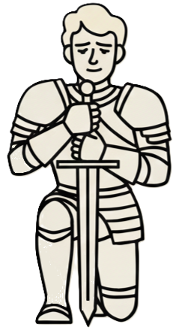
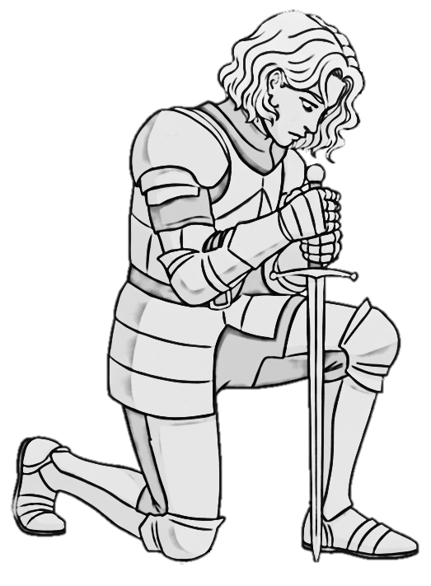
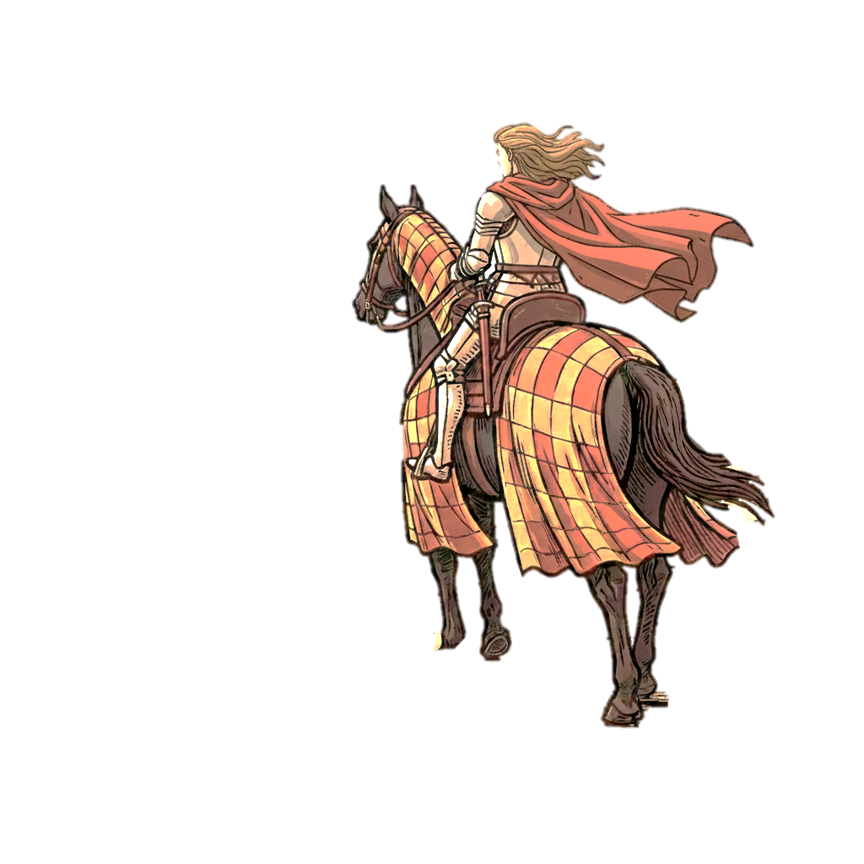
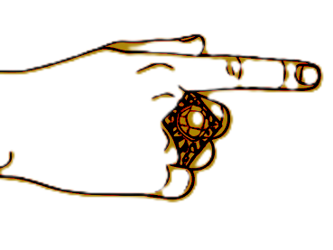
R
Recruit Knight
R
E
Exile Knight
E
L
Long Ride
L
Recruit a Knight to a tile with a Baron or Keep
Exile an opponent's Knight from the Baron’s tile to their supply
Move a Baron or Knight any number of tiles
3
3
3

Slide 6


Earth’s Wrath
The Black Curse
Wind of Sedition
Draw 3 Position cards
Draw 3 Position cards
Draw 3 Position cards
At these Positions, destroy all opponent and allied Keeps
At these Positions, send all opponent and allied troops to the cemetery
At these Positions, return all opponent and allied troops to the supply

Slide 7




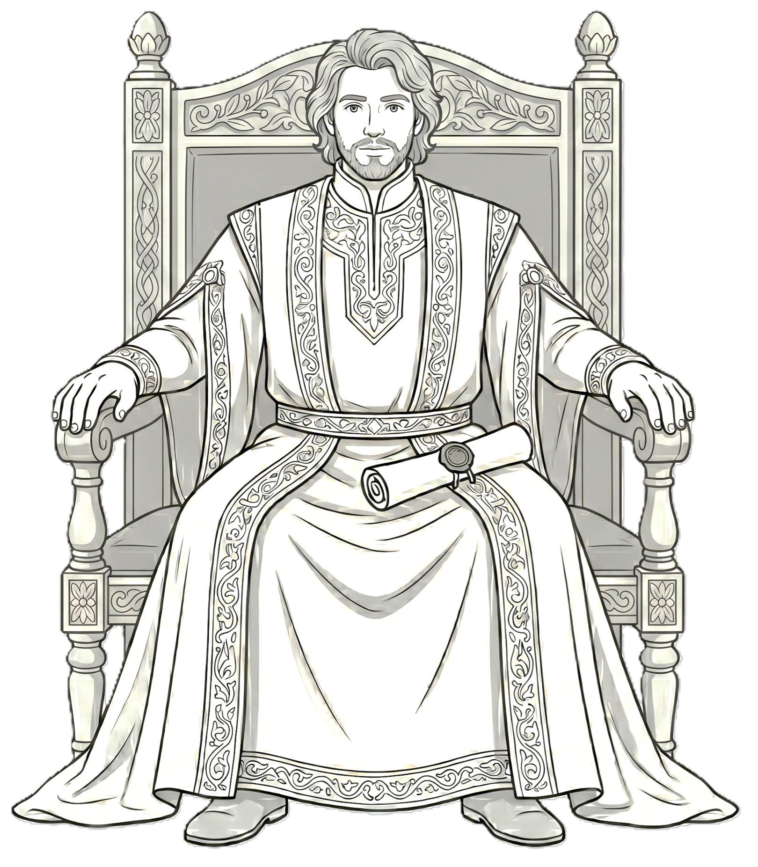
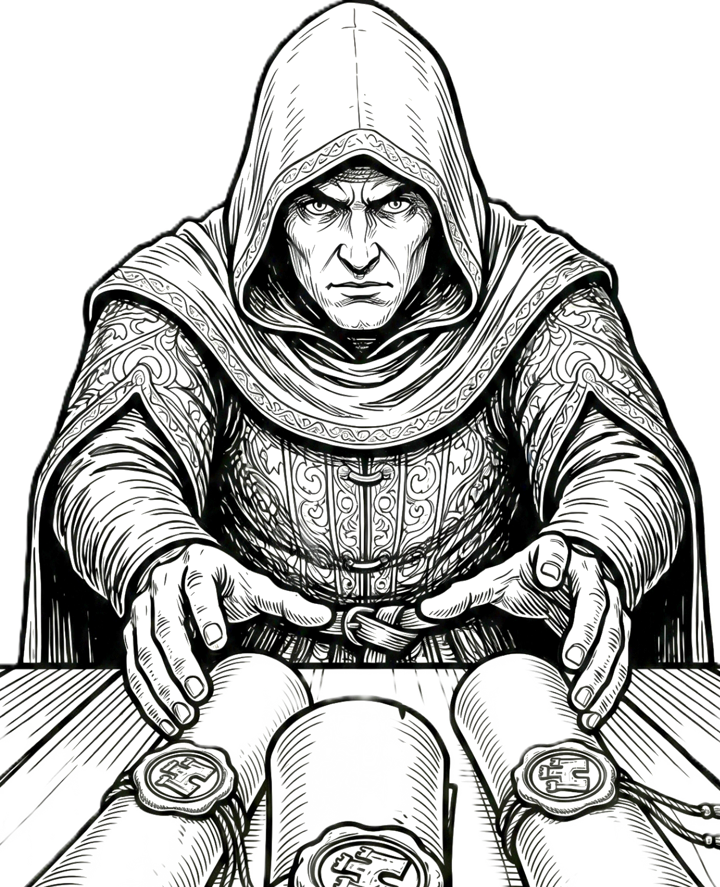
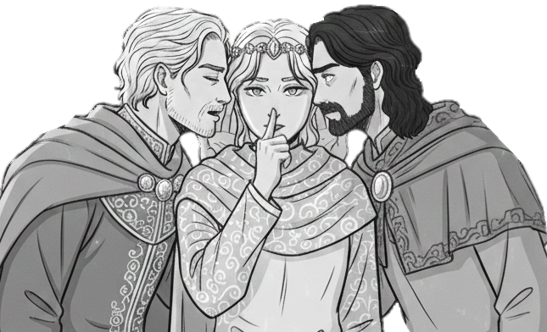


Parley Herald
S
Spy
S
C
Court Intrigue
C
Place this Herald in the Council zone
Draw 2 cards from an opponent's hand and discard them
Draw 6 cards, then discard down to 6 cards in hand
Full Council ➔ End of game
2
3

Slide 8

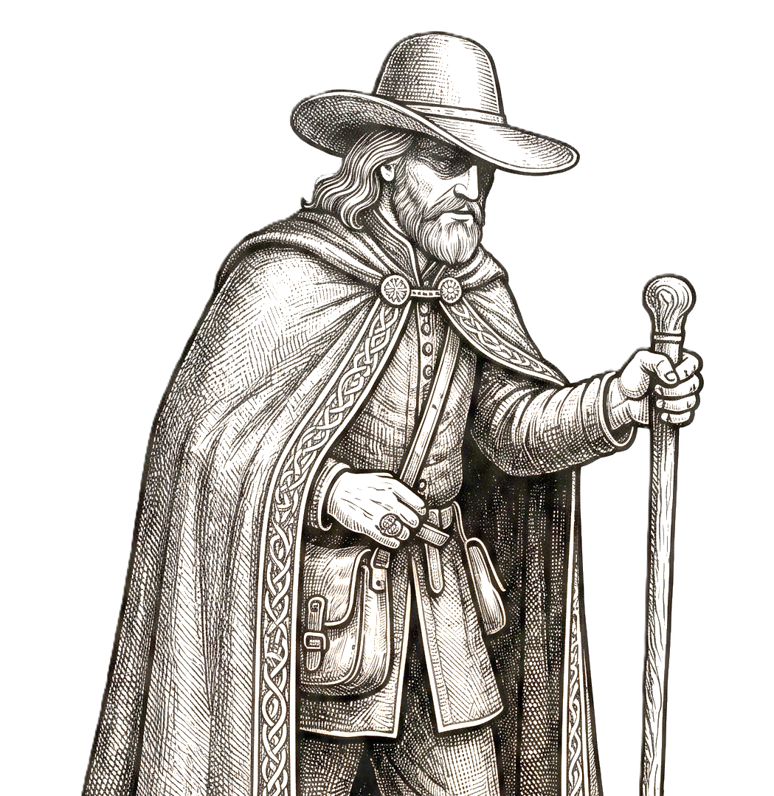
Bi
Baron incognito
Bi
M+
Move Lord
M+
R+
Recruit Troops
R+
+1
Credit
+1
Cross tiles with enemy baron or dungeon
Move from 1 more tile
Recruit 1 more troop
Spend 1 more credit
1

Slide 9

